Slide 1
Specialized Cluster and Institute of Apparel and Textile „Danube”
WP 7. Mapping and Clustering Entrepreneurial Skills in TCI
RESULTS OF TCI ENTREPRENEURIAL QUESTIONNAIRE

Slide 2
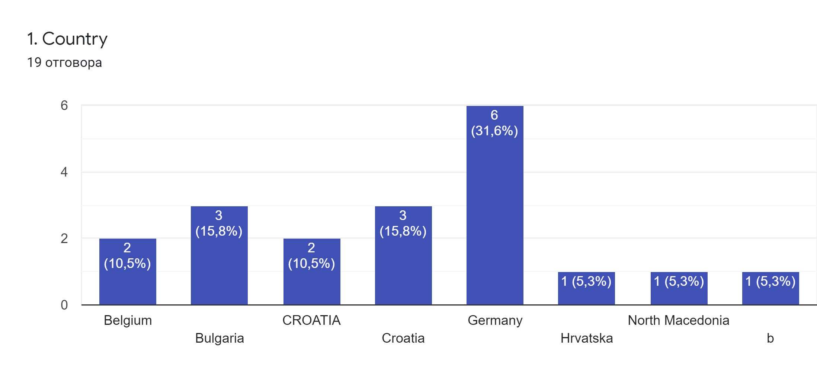

Slide 3
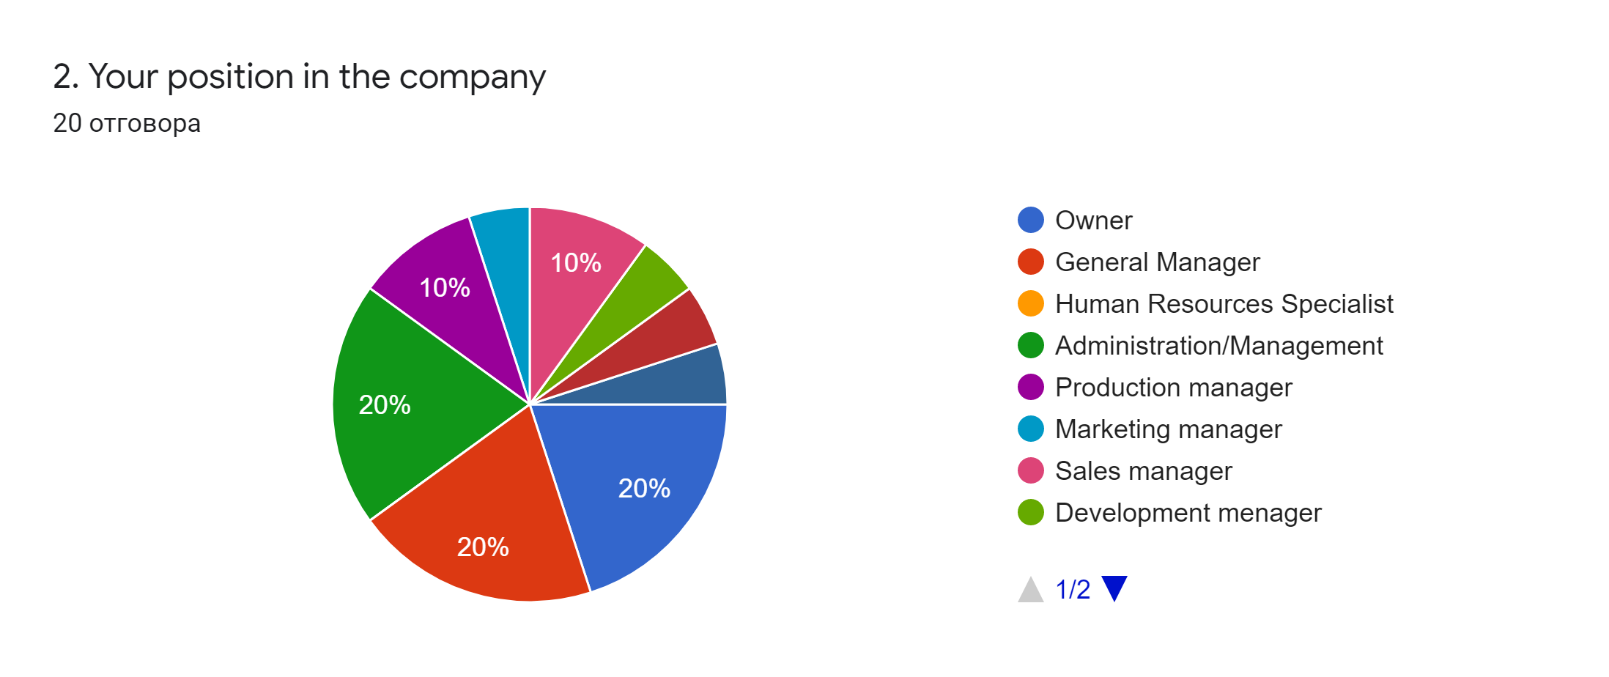

Slide 4
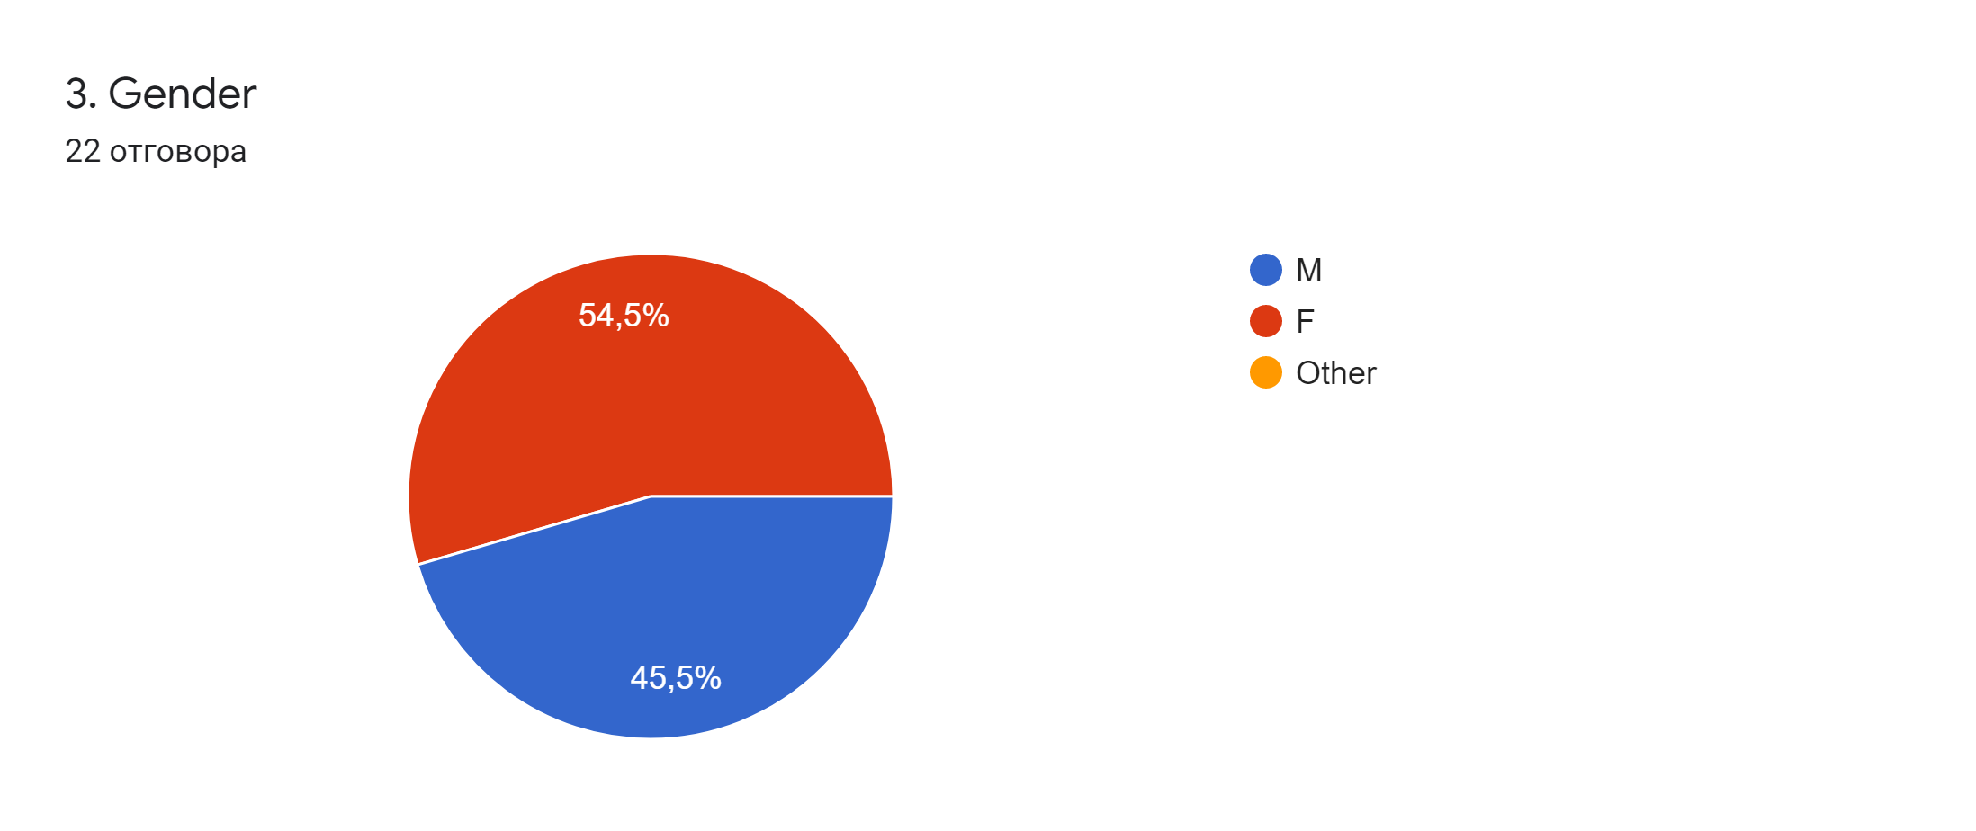

Slide 5
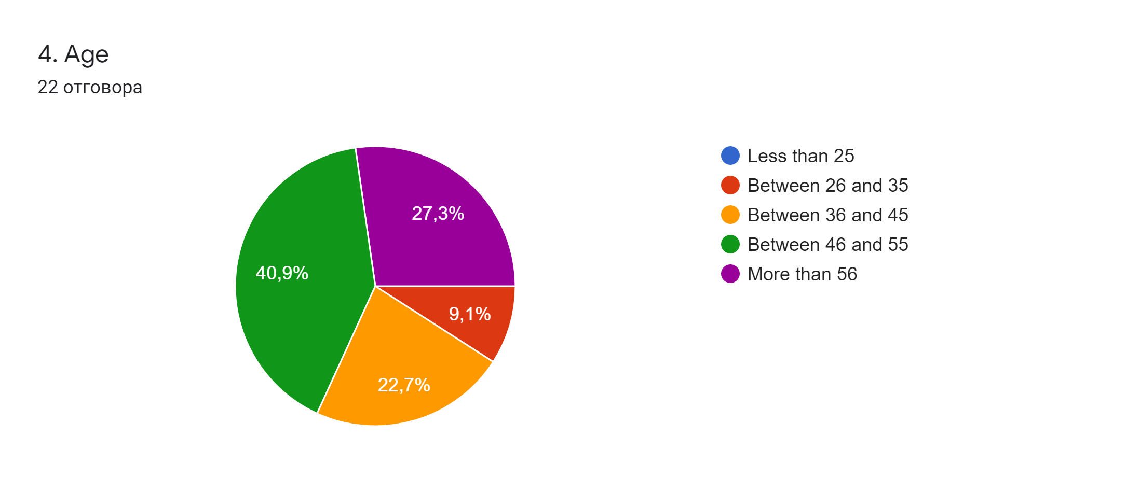

Slide 6
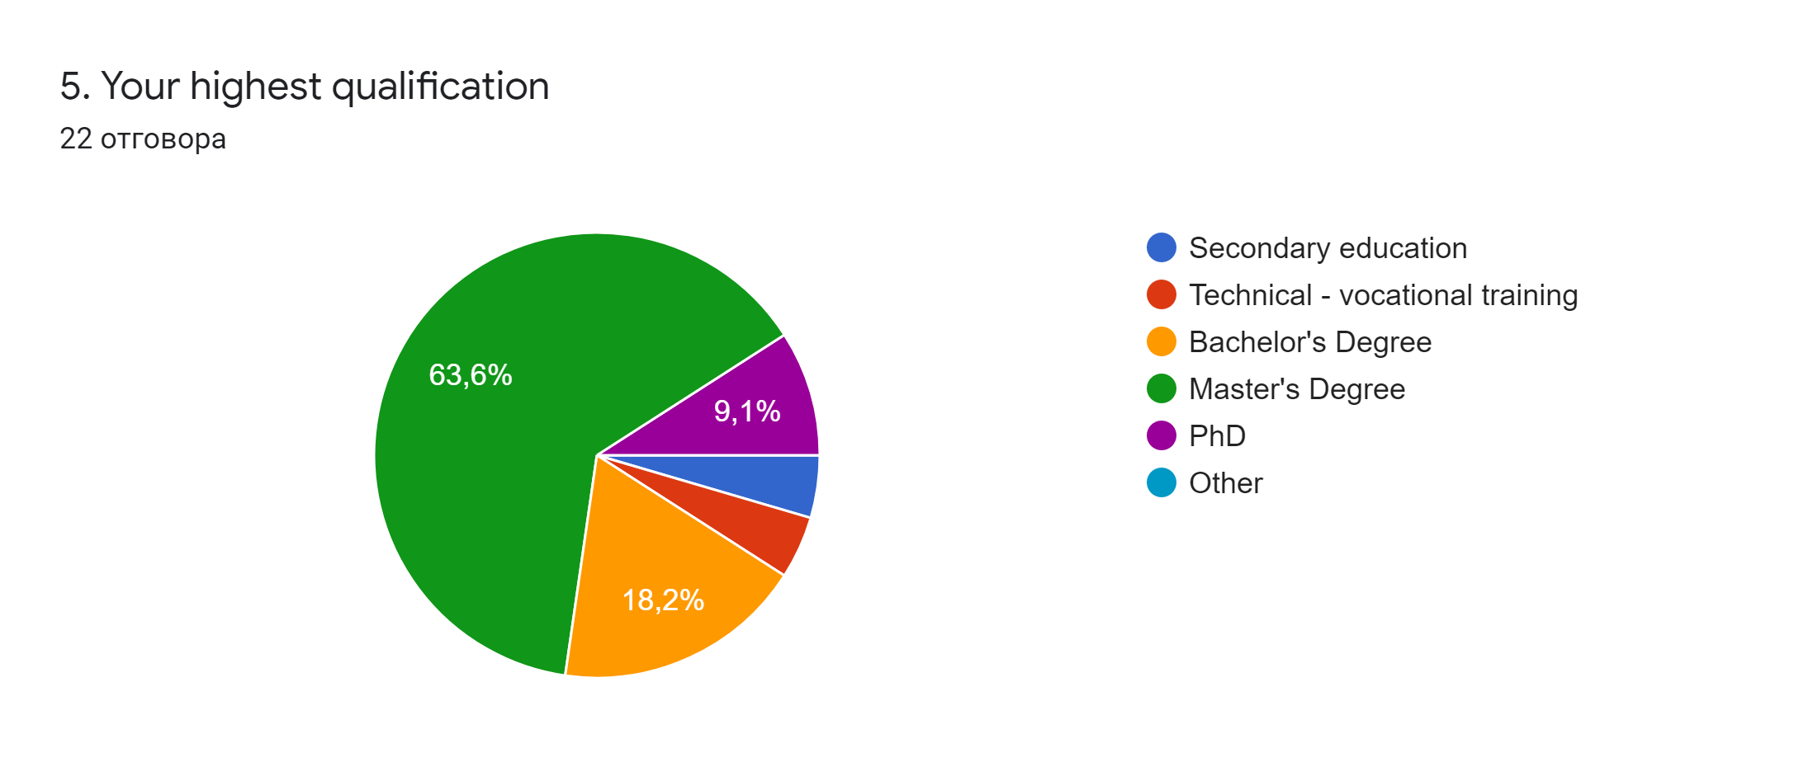

Slide 7
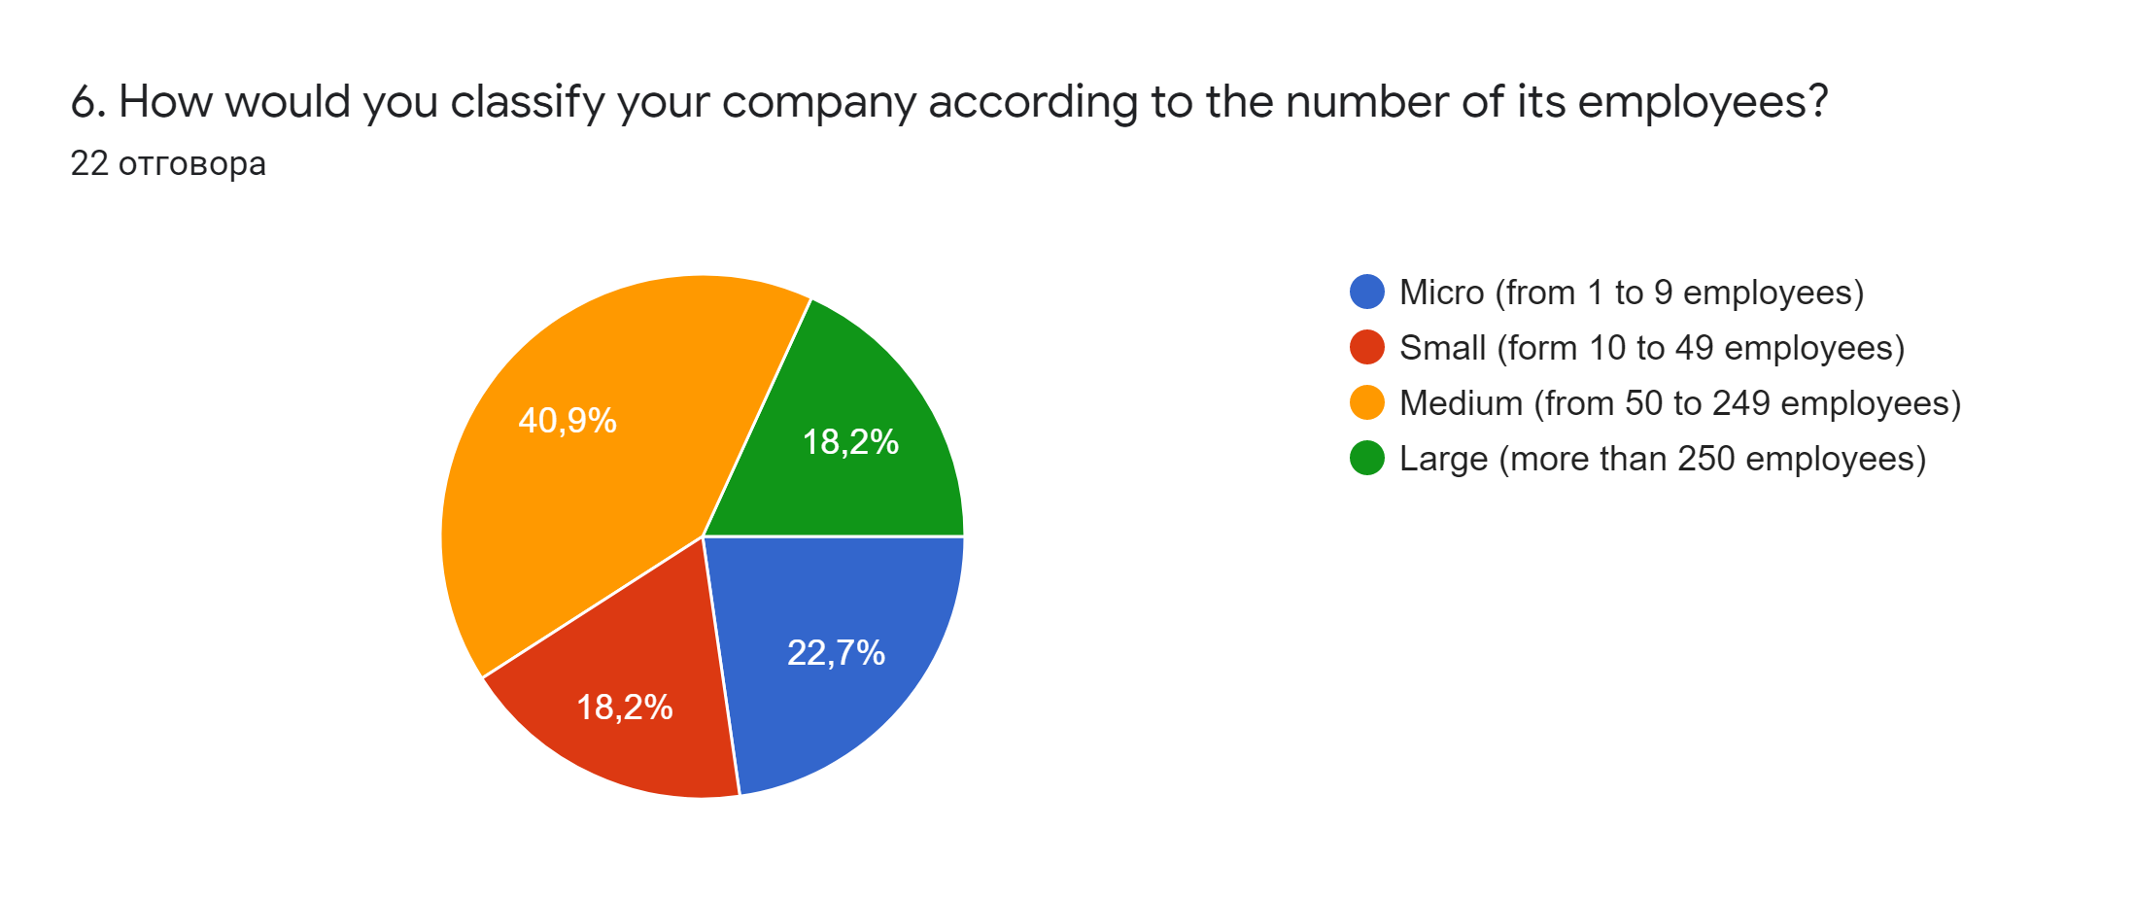

Slide 8
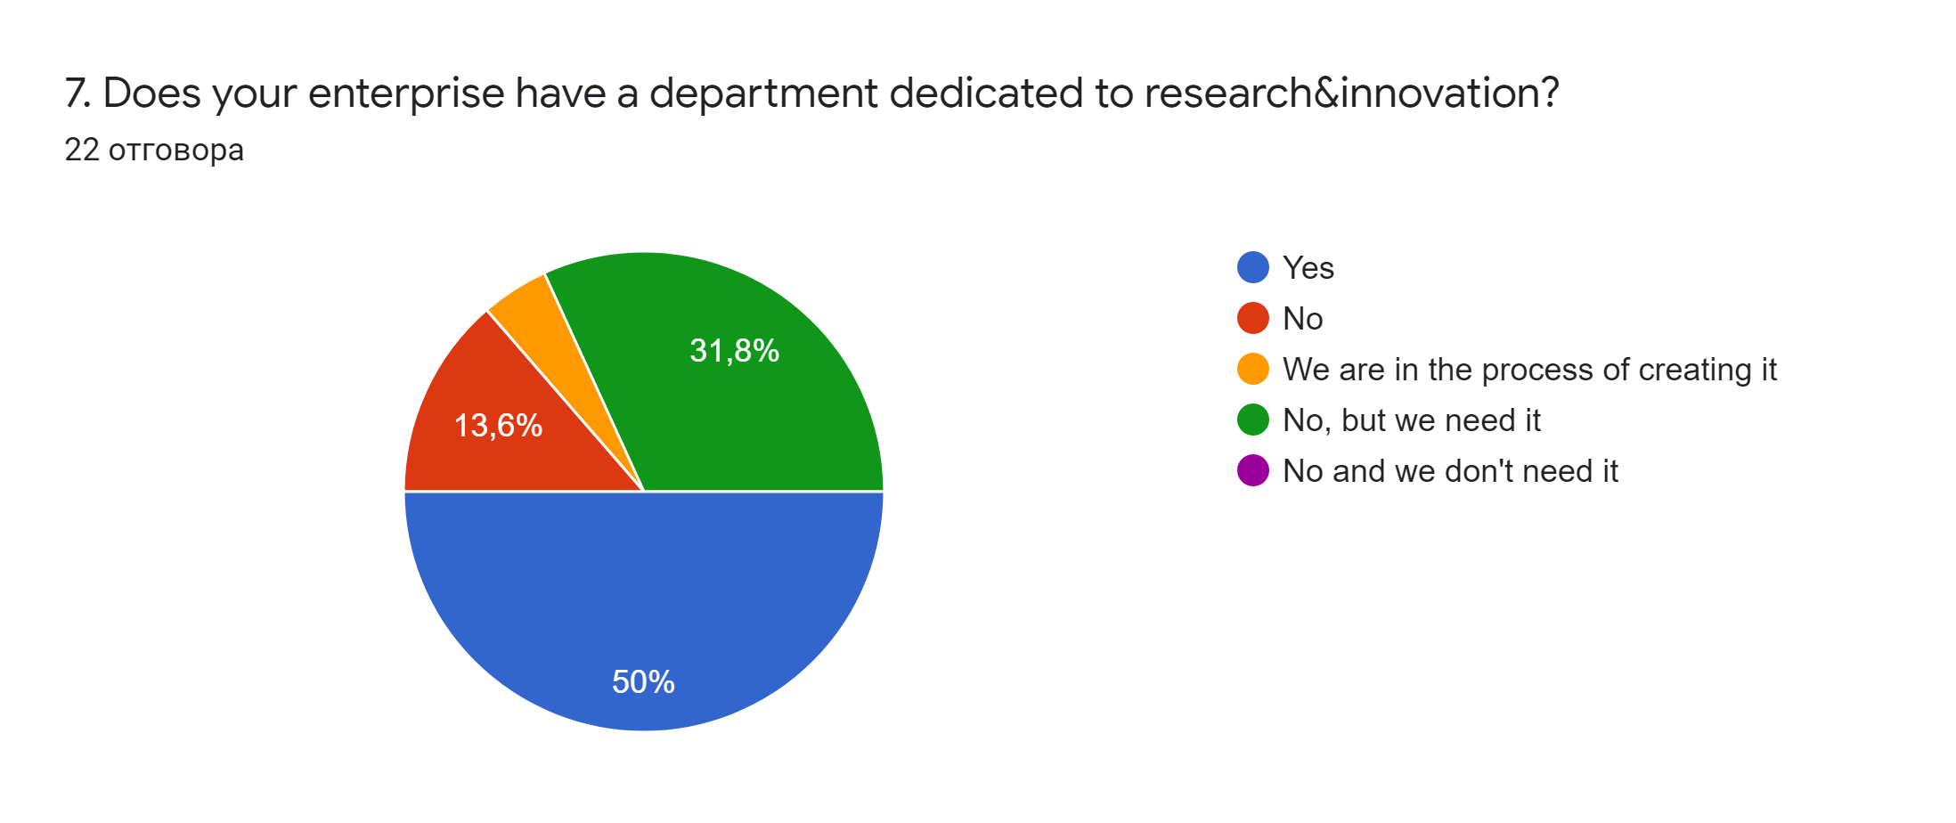

Slide 9
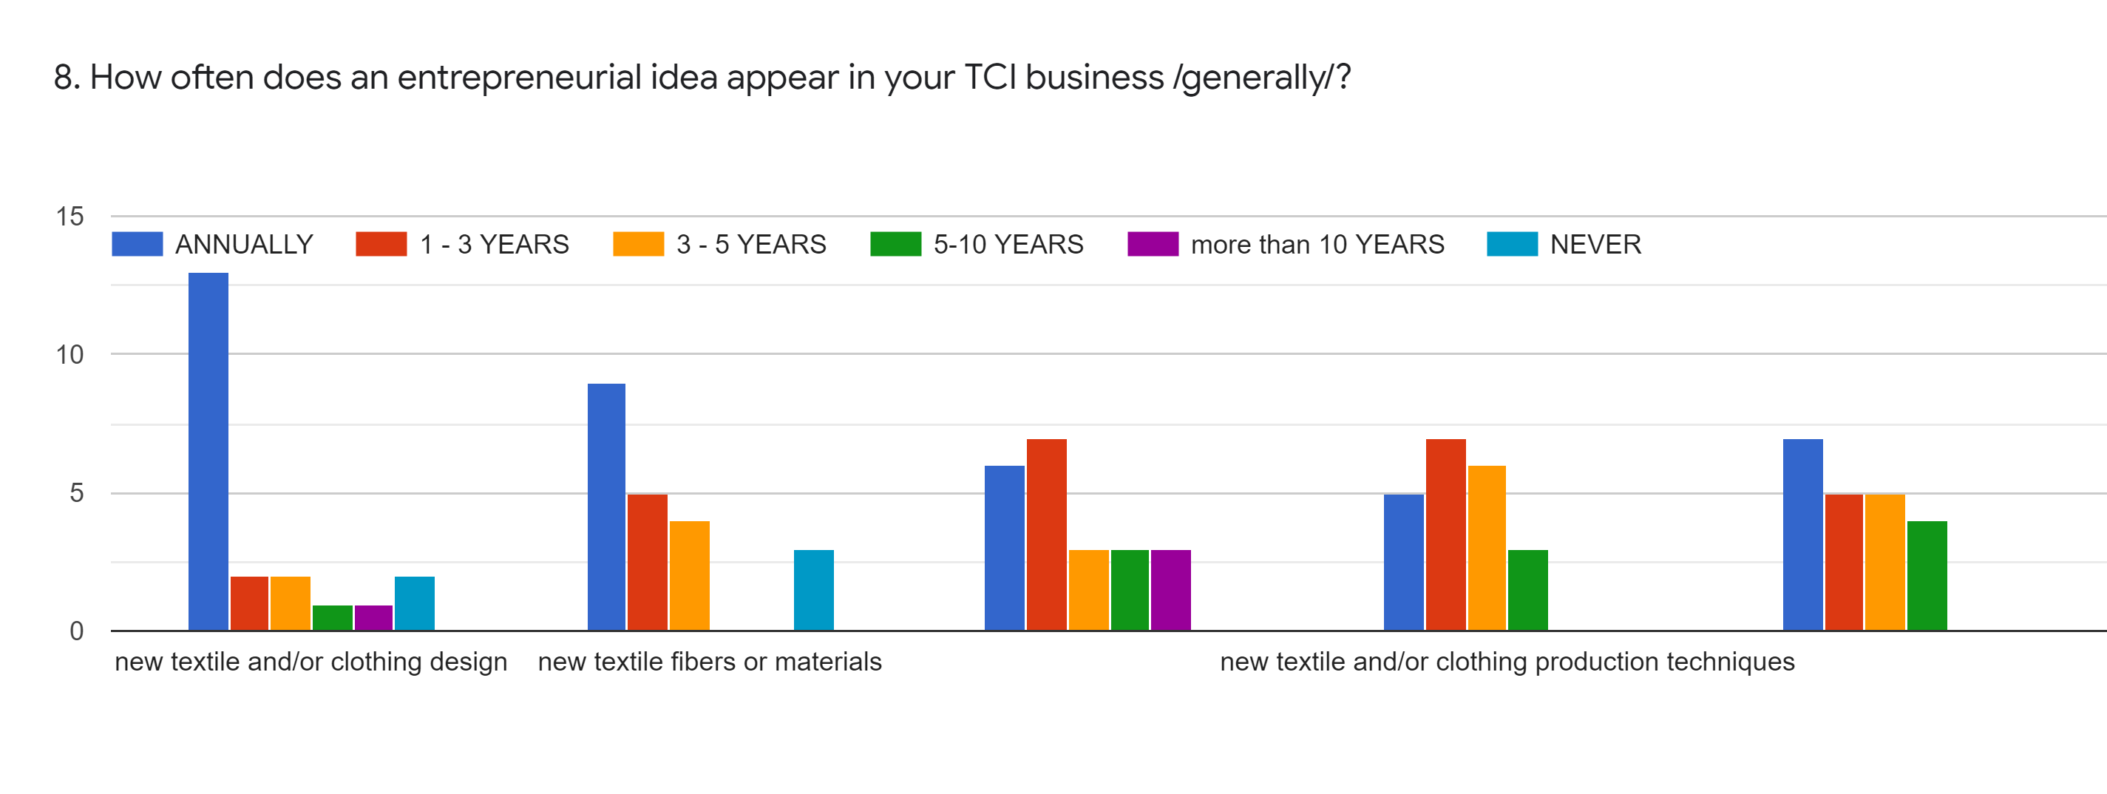

Slide 10
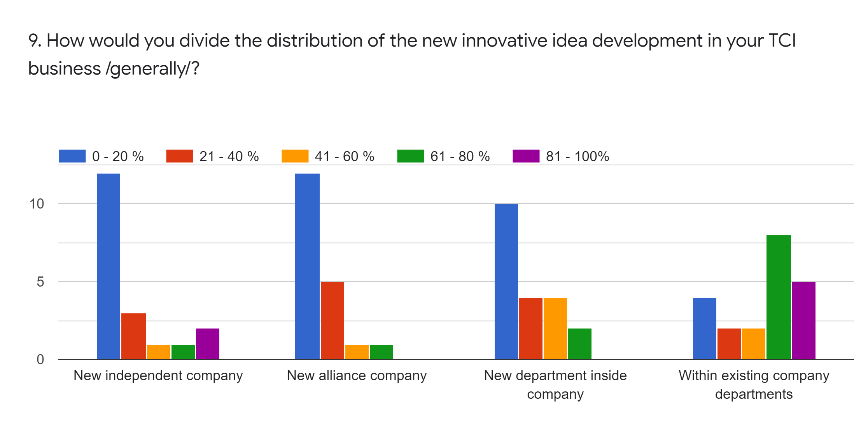

Slide 11
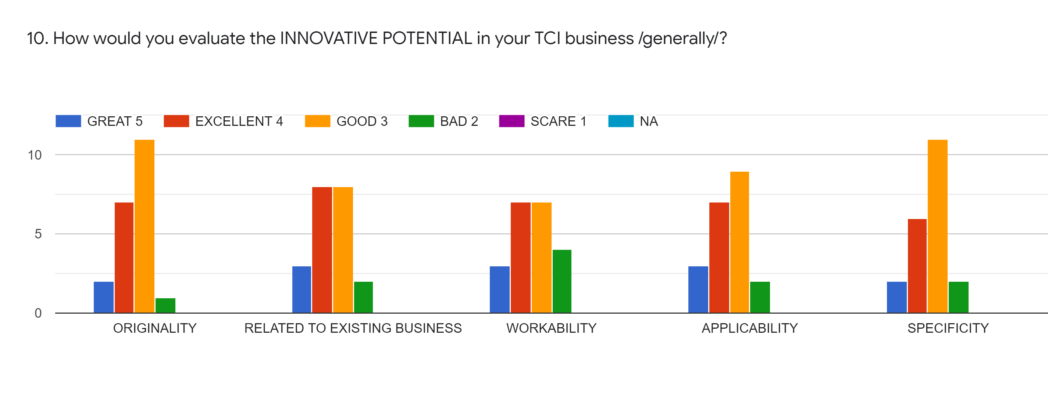

Slide 12
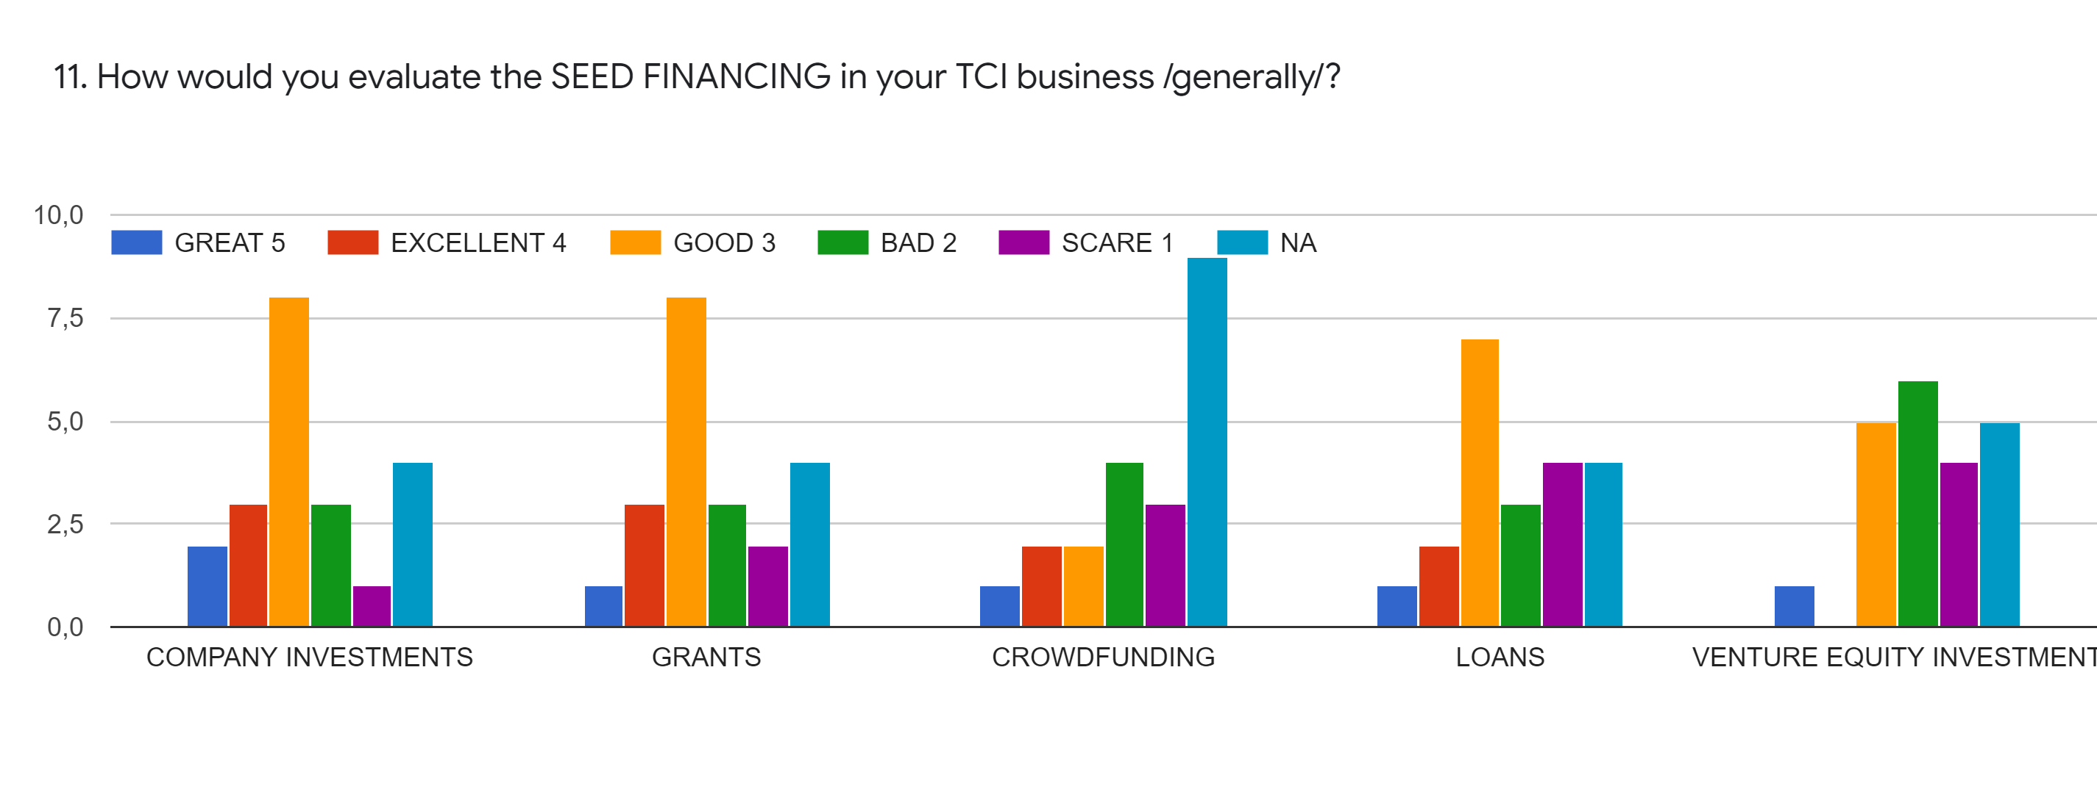

Slide 13
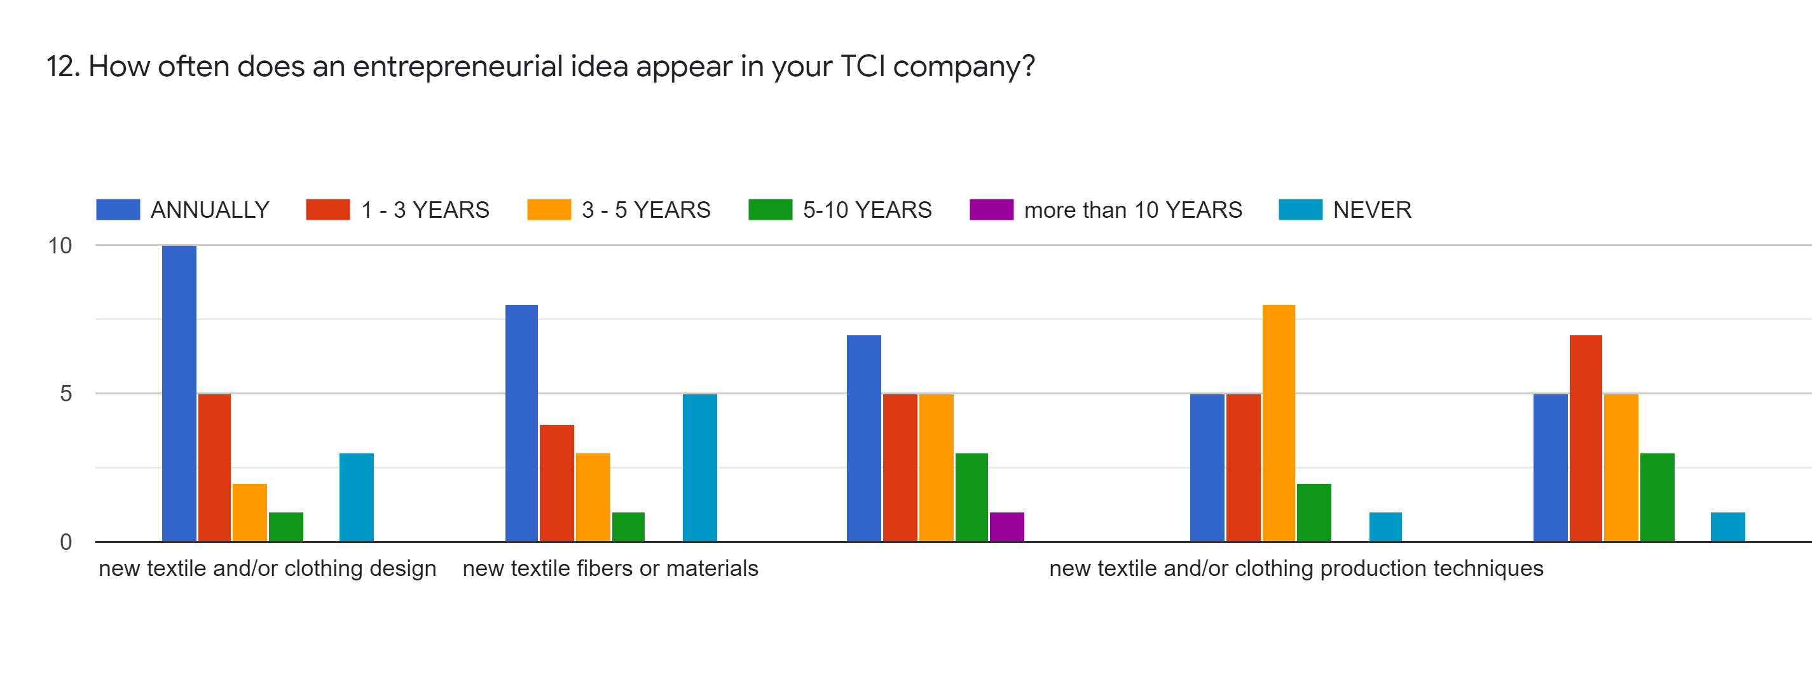

Slide 14
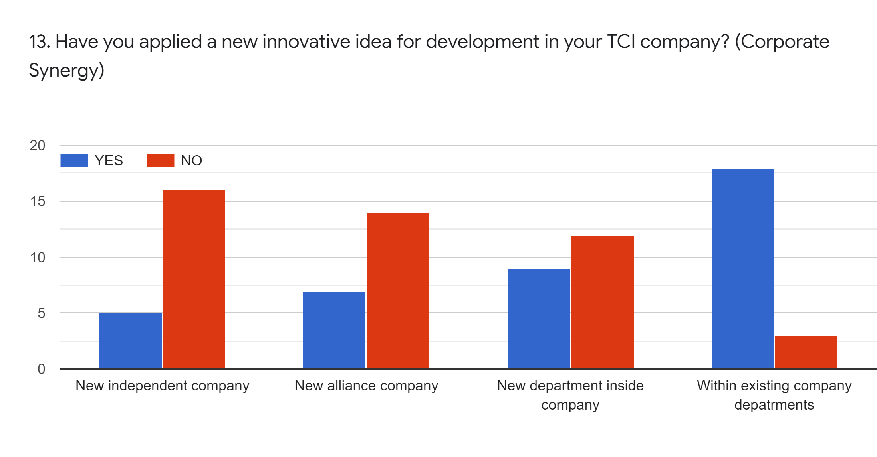

Slide 15
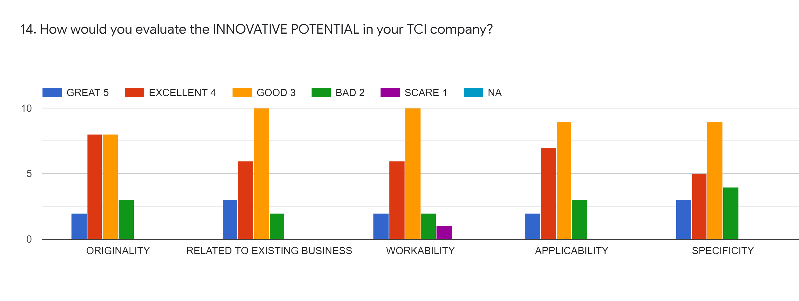

Slide 16
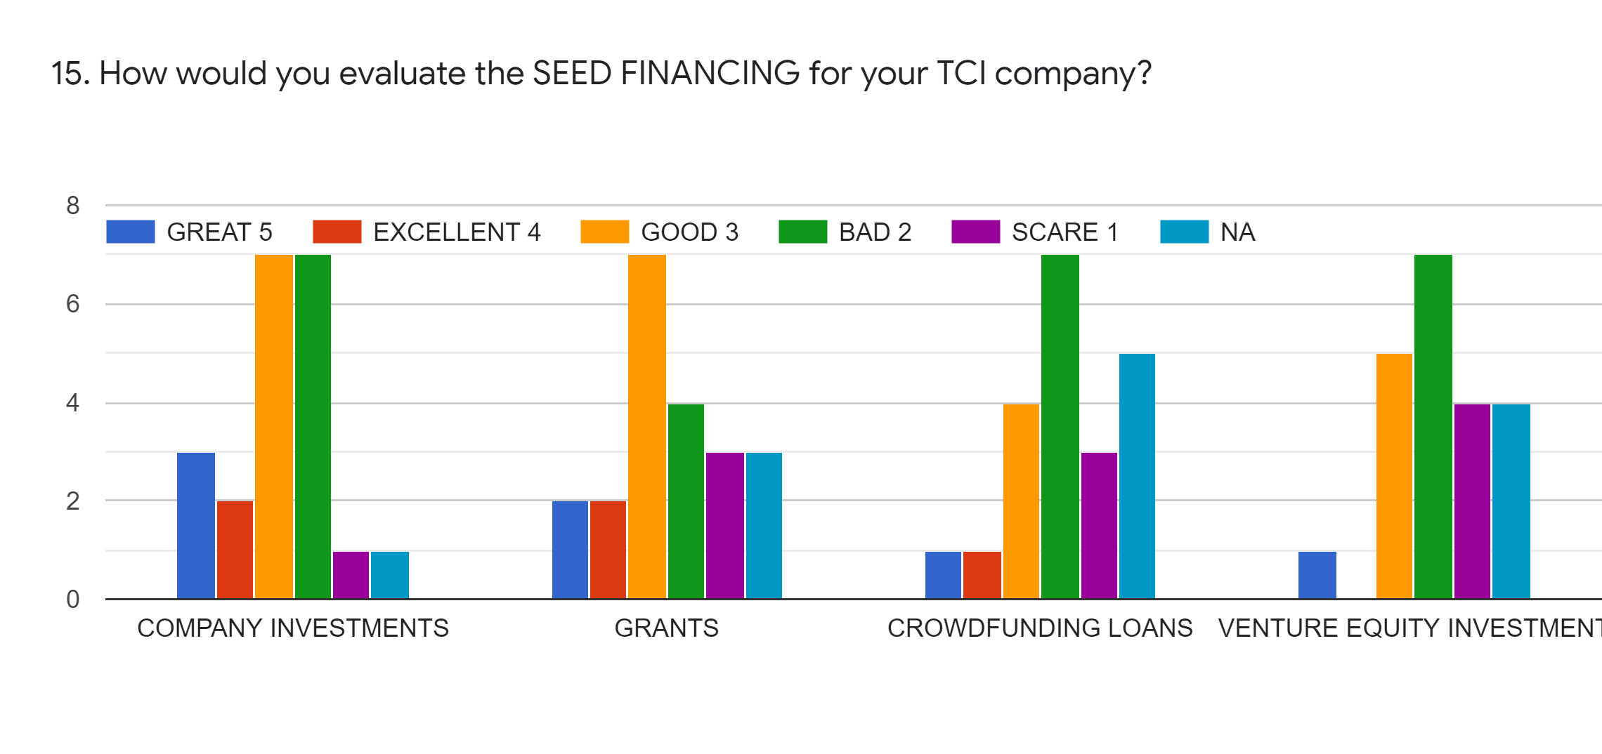

Slide 17
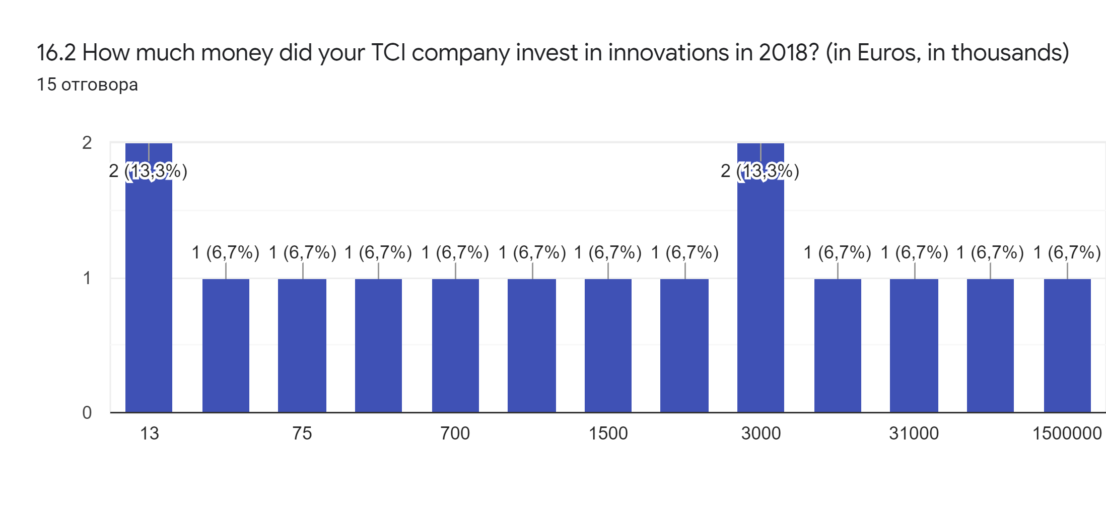

Slide 18
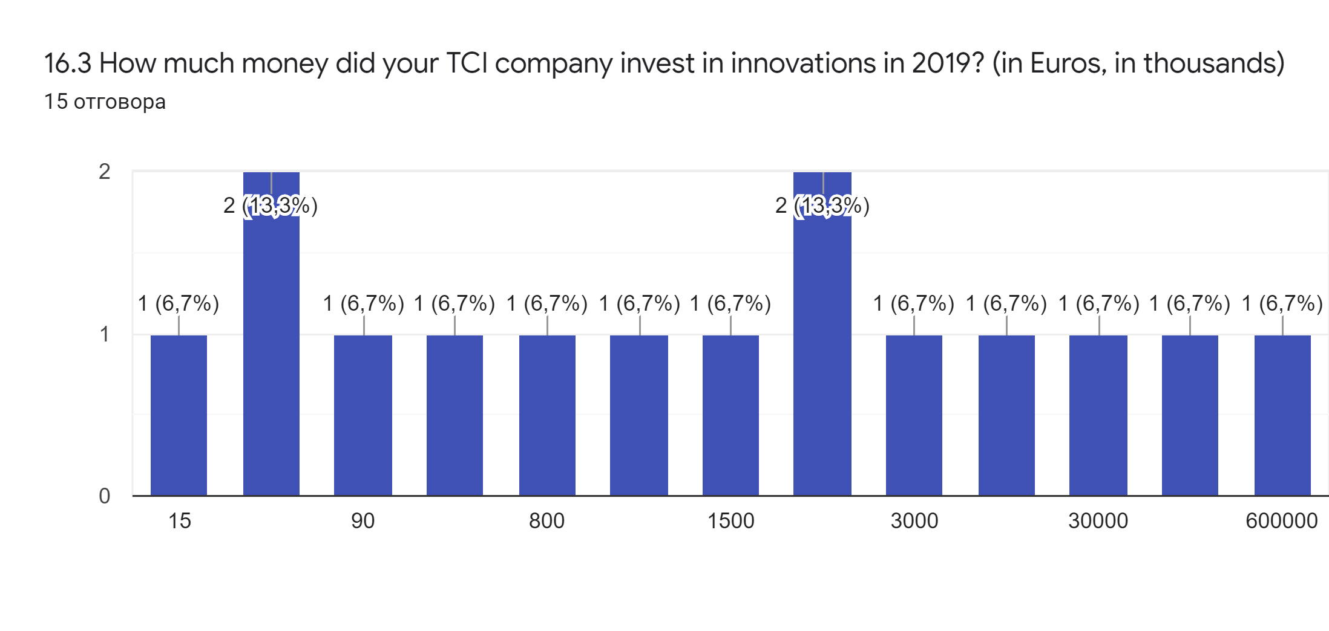

Slide 19
Thank you for your attention
Specialized Cluster and Institute of Apparel and Textile „Danube”
WP 7. Mapping and Clustering Entrepreneurial Skills in TCI

