Slide 1
Prof. Radostina A. ANGELOVA, PhD, DSc Technical University of Sofia, BULGARIA The course is developed under Erasmus+ Program Key Action 2: Cooperation for innovation and the exchange of good practices Knowledge Alliance
TRAINING COURSE
Design and production of woven fabrics
ICT IN TEXTILE AND CLOTHING HIGHER EDUCATION AND BUSINESS
Project Nr. 612248-EPP-1-2019-1-BG-EPPKA2-KA
The information and views set out in this publication are those of the authors and do not necessarily reflect the official opinion of the European Union. Neither the European Union institutions and bodies nor any person acting on their behalf may be held responsible for the use which may be made of the information contained therein.

Slide 2
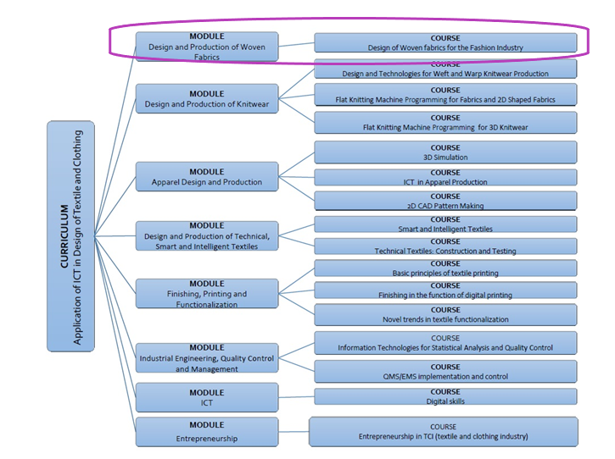
The information and views set out in this publication are those of the authors and do not necessarily reflect the official opinion of the European Union. Neither the European Union institutions and bodies nor any person acting on their behalf may be held responsible for the use which may be made of the information contained therein.

Slide 4
Course duration: 30 hours
Course description: The course deals with the production and design of weave patterns for fabrics, which could be used in the fashion industry or in the interior design. All themes would involve theoretical explanations and practical solutions with the application of a CAD/CAM software where possible (for the weave design). Depending on the needs of the company, some of the themes could be excluded or rearranged.

Slide 5
Course objectives:
The students to gain experience in the production of woven textiles, including preparatory processes, weaving machines and mechanisms
The students to acquire the necessary theoretical and practical knowledge in the design of weave patterns using CAD systems for two-dimensional design
The students to get a creative impulse for designing new weave patterns

Slide 6
Course content: 6 topics
Topic 1: Introduction to weaving and weaving preparatory processes (5 hours)
Topic 2: Weaving machines (5 hours)
Topic 3: Woven fabrics design and construction (2 hours)
Topic 4: Elementary weaves and their derivatives (3 hours)
Topic 5: Design of weave patterns for different fabric effects (10 hours)
Topic 6: Additional methods for design (5 hours)

Slide 7
Learning materials: As required in the project, three types of materials will be developed
For students: all participants, involved in the course to gain new knowledge
For trainers: the university teachers or researchers with experience in the field will have the possibility to use extra training materials, research articles, suggestions for online videos, books and correct answers of the quizzes.
For staff (practitioners): practical tips, step by step explanations of weave pattern creations, etc.

Slide 8
Topic 3. Woven fabrics design and construction (2 hours)

Slide 9
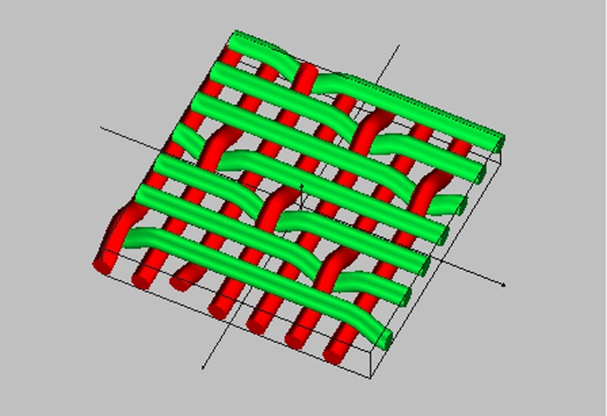
Topic 3. Woven fabrics design and construction
Lesson 11: Introduction to weaves
The lesson introduces the woven textiles and the principles for their formation
Lesson content:
Fabric construction
Weave patterns
Characteristics of the weave patterns

Slide 10
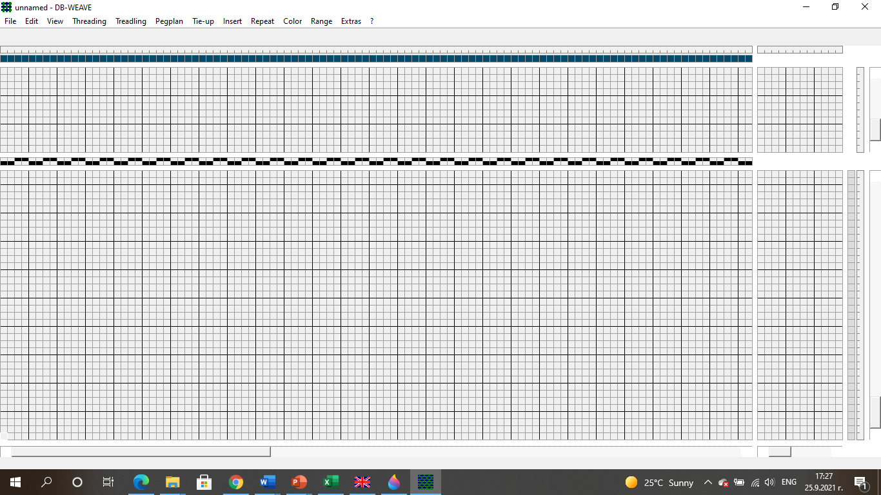
Topic 3. Woven fabrics design and construction
Lesson 12: Weave diagrams
The lesson introduces the woven textiles and the principles for their formation
Lesson content:
Weave diagrams parts
DB Weave software
Weave pattern
Reed threading
Threading
Treadling

Slide 11
Topic 3. Woven fabrics design and construction
Lesson 11: Introduction to weaves
The lesson introduces the woven textiles and the principles for their formation
Lesson content:
Fabric construction
Weave patterns
Characteristics of the weave patterns

Slide 12
Topic 4. Elementary weaves and their derivatives (3 hours)

Slide 13
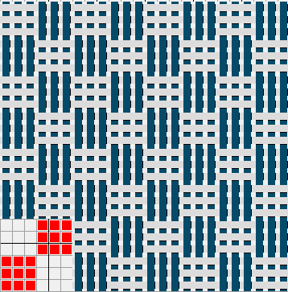
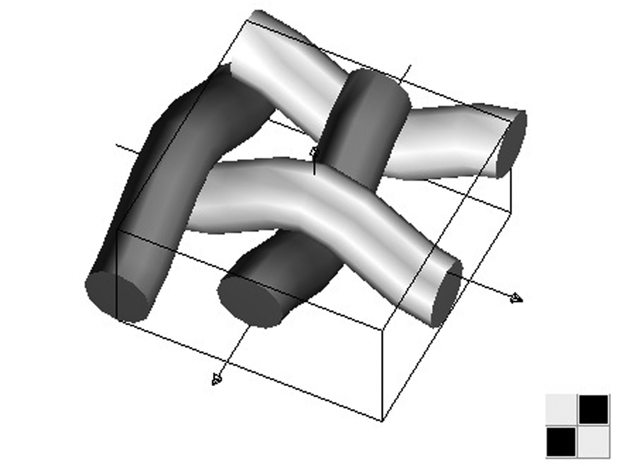
Topic 4. Elementary weaves and their derivatives
Lesson 13: The plain weave and its derivatives
Lesson content:
The plain weave
Rib weave
Warp rib weave
Weft rib weave
Complex rib weave
Hopsack weave

Slide 14
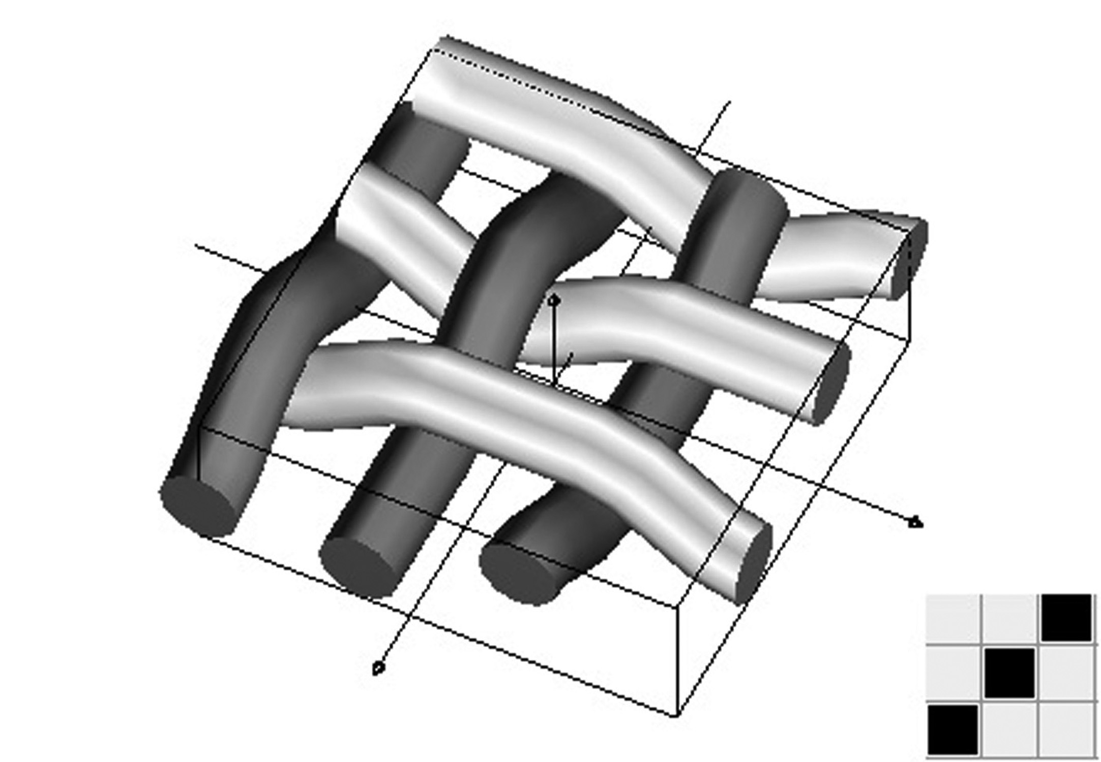
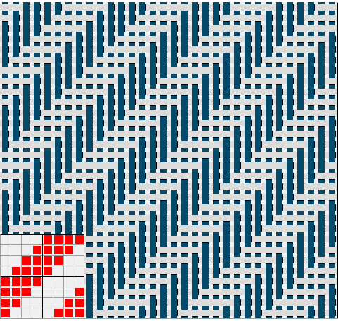
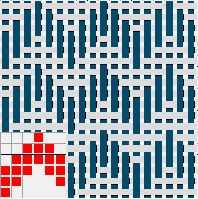
Topic 4. Elementary weaves and their derivatives
Lesson 14: The twill weave and its derivatives
Lesson content:
The twill weave
Right-handed twill
Left-handed twill
Strengthened twill weave
Complex twill weave
Zig-zag twill weave
Shadowed twill weave

Slide 15
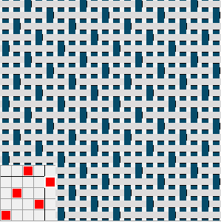
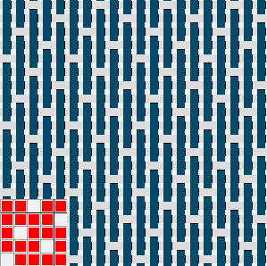
Topic 4. Elementary weaves and their derivatives
Lesson 15: Satin and Sateen weaves and their derivatives
Lesson content:
Satin weave
Sateen weave
Strengthened satin weave
Strengthened sateen weave
Shadowed satin weave
Shadowed sateen weave

Slide 16
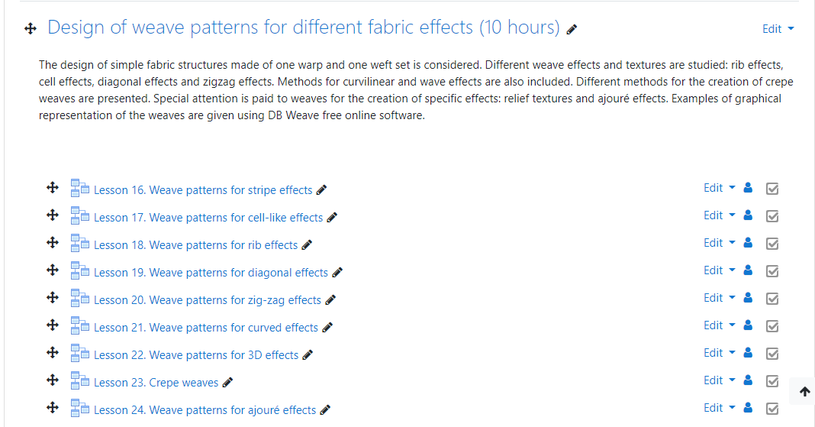
Topic 5. Design of weave patterns for different fabric effects (10 hours)

Slide 17
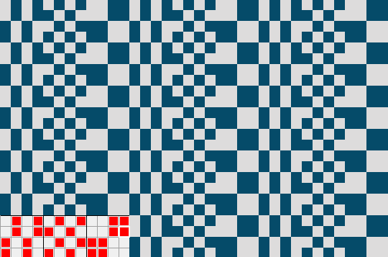
Topic 5. Design of weave patterns for different fabric effects
Lesson 16: Weave patterns for stripe effects
Lesson content:
Horizontal stripe effects
Vertical stripe effects
Calculation of the repeats

Slide 18
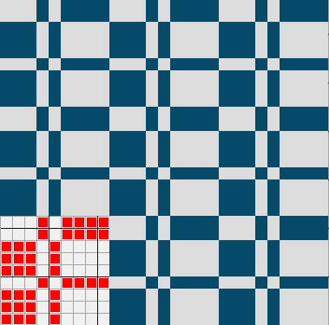
Topic 5. Design of weave patterns for different fabric effects
Lesson 17: Weave patterns for cell-like effects
Lesson content:
Square weaves
Fancy basket weave
Calculation of the repeats

Slide 19
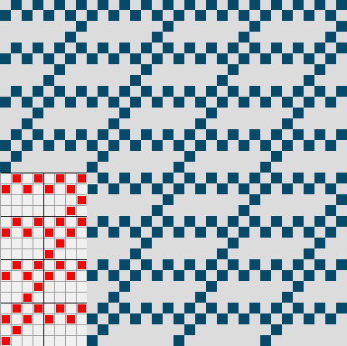
Topic 5. Design of weave patterns for different fabric effects
Lesson 18: Weave patterns for rib effects
Lesson content:
Tightened rib weave
Soleil weave
Tightened rib weave with additional threads
Tightened twill weave with additional weft threads
Tightened satin or sateen weave with additional weft threads
Calculation of the repeats

Slide 20
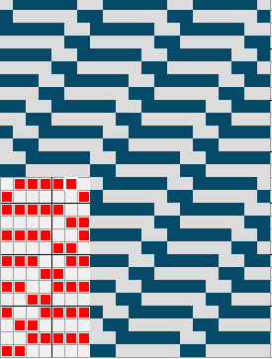
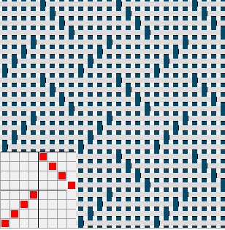
Topic 5. Design of weave patterns for different fabric effects
Lesson 19: Weave patterns for diagonal effects
Lesson content:
Elongated twill weave
Diagonal rib weave
Fancy diagonal twill weave
Broken twill weave
Calculation of the repeats

Slide 21
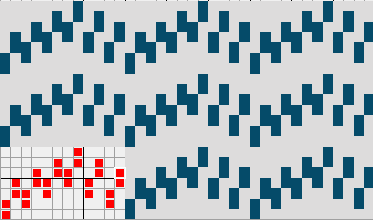
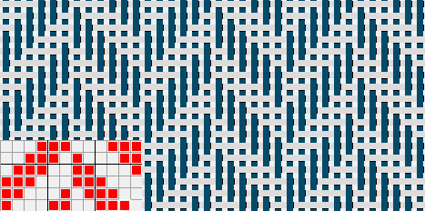
Topic 5. Design of weave patterns for different fabric effects
Lesson 20: Weave patterns for zig-zag effects
Lesson content:
Zig-zag rib weave
Herringbone twill weave
Calculation of the repeats

Slide 22
Topic 5. Design of weave patterns for different fabric effects
Lesson 21: Weave patterns for curved effects
Lesson content:
Curved twill weave
Curved zig-zag twill weave
Calculation of the repeats

Slide 23
Topic 5. Design of weave patterns for different fabric effects
Lesson 22: Weave patterns for 3D effects
Lesson content:
Waffle weaves
Calculation of the repeats

Slide 24
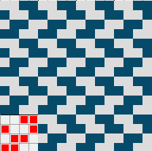
Topic 5. Design of weave patterns for different fabric effects
Lesson 23: Crepe weaves
Lesson content:
Basic consideration
Methods for creation
Calculation of the repeats

Slide 25
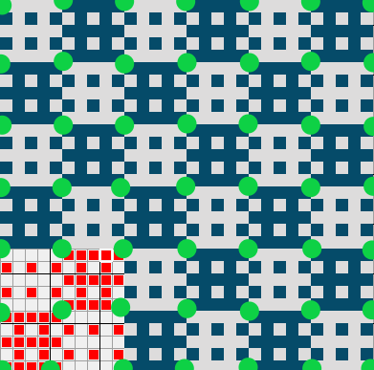
Topic 5. Design of weave patterns for different fabric effects
Lesson 24: Weave patterns for ajuré effects
Lesson content:
Basic consideration
Methods for creation
Calculation of the repeats

Slide 26
Topic 6. Additional methods for design (5 hours)

Slide 27
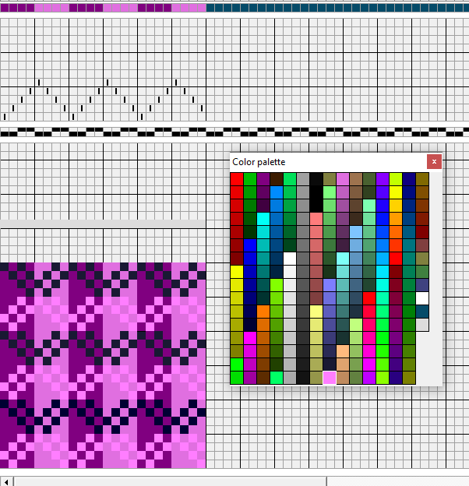
Topic 6. Additional methods for design
Lesson 25: Coloured weave patterns
Lesson content:
Principles for creation of coloured weave patterns
Repeat of the coloured pattern vs. repeat of the weave pattern
Design of weaves with coloured warp set
Design of weaves with coloured weft set
Design of weaves with coloured warp and weft set
The effect of the basic weave patterns view

Slide 28
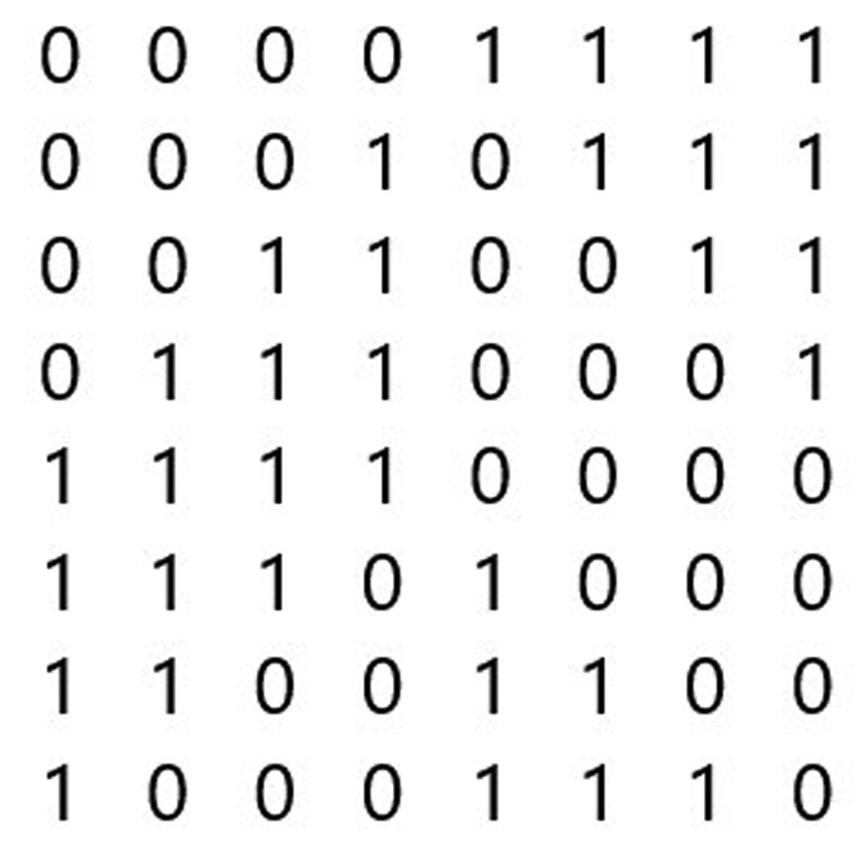
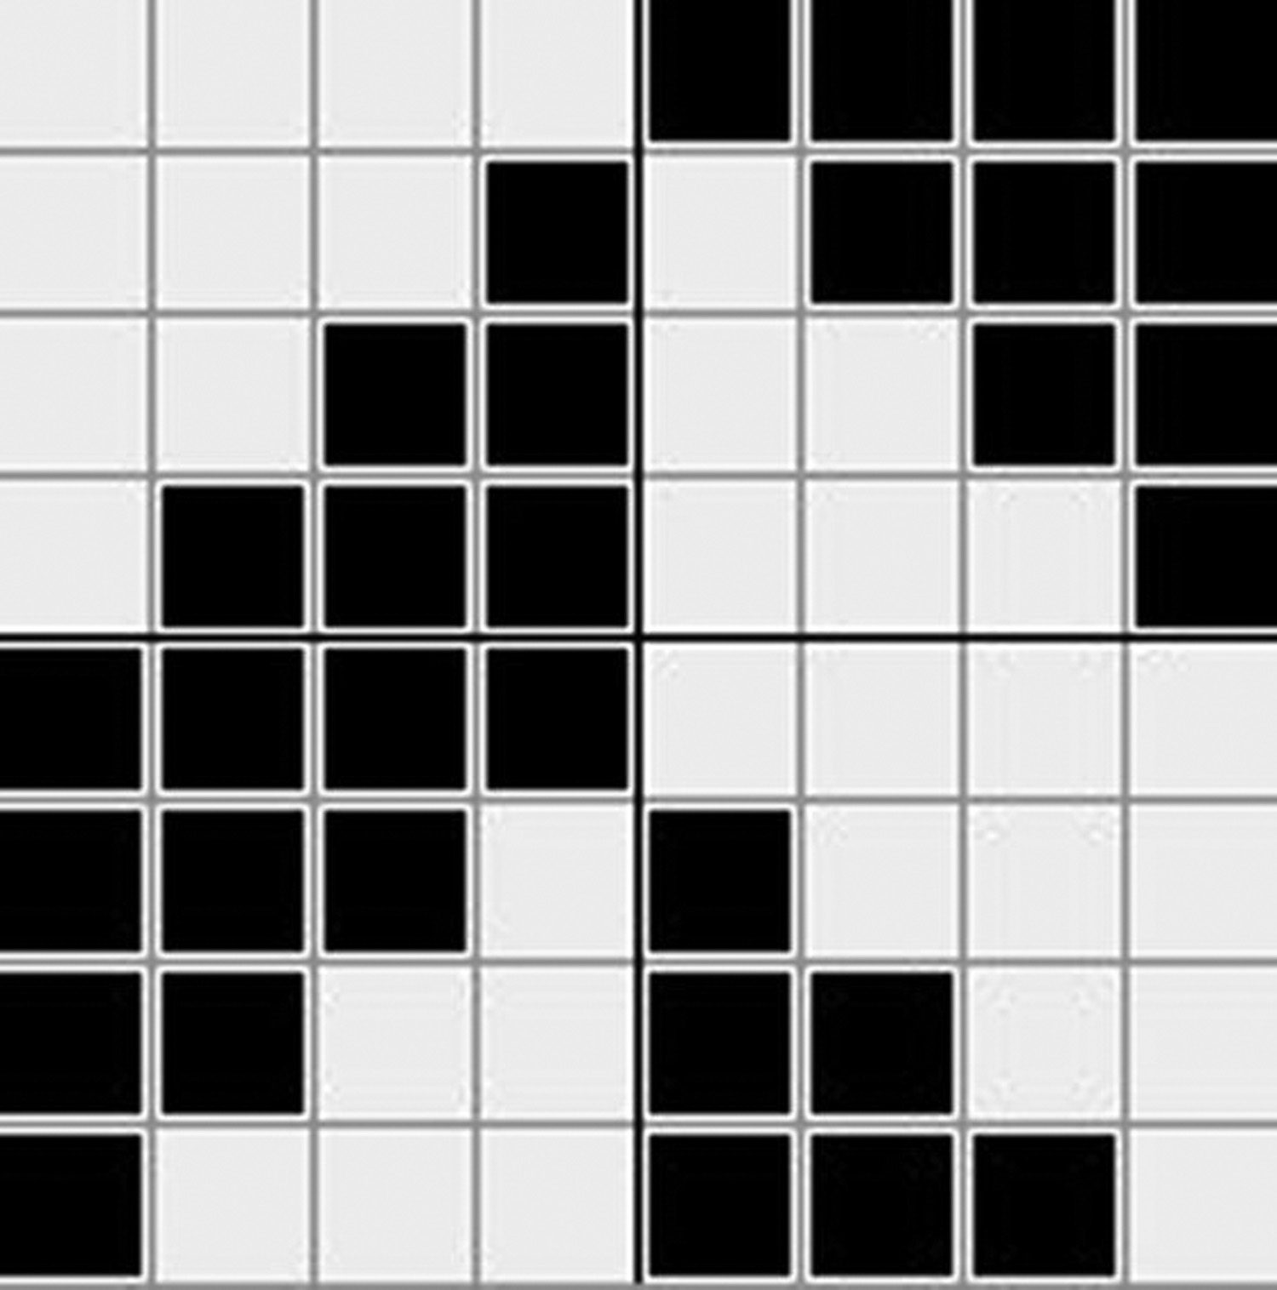
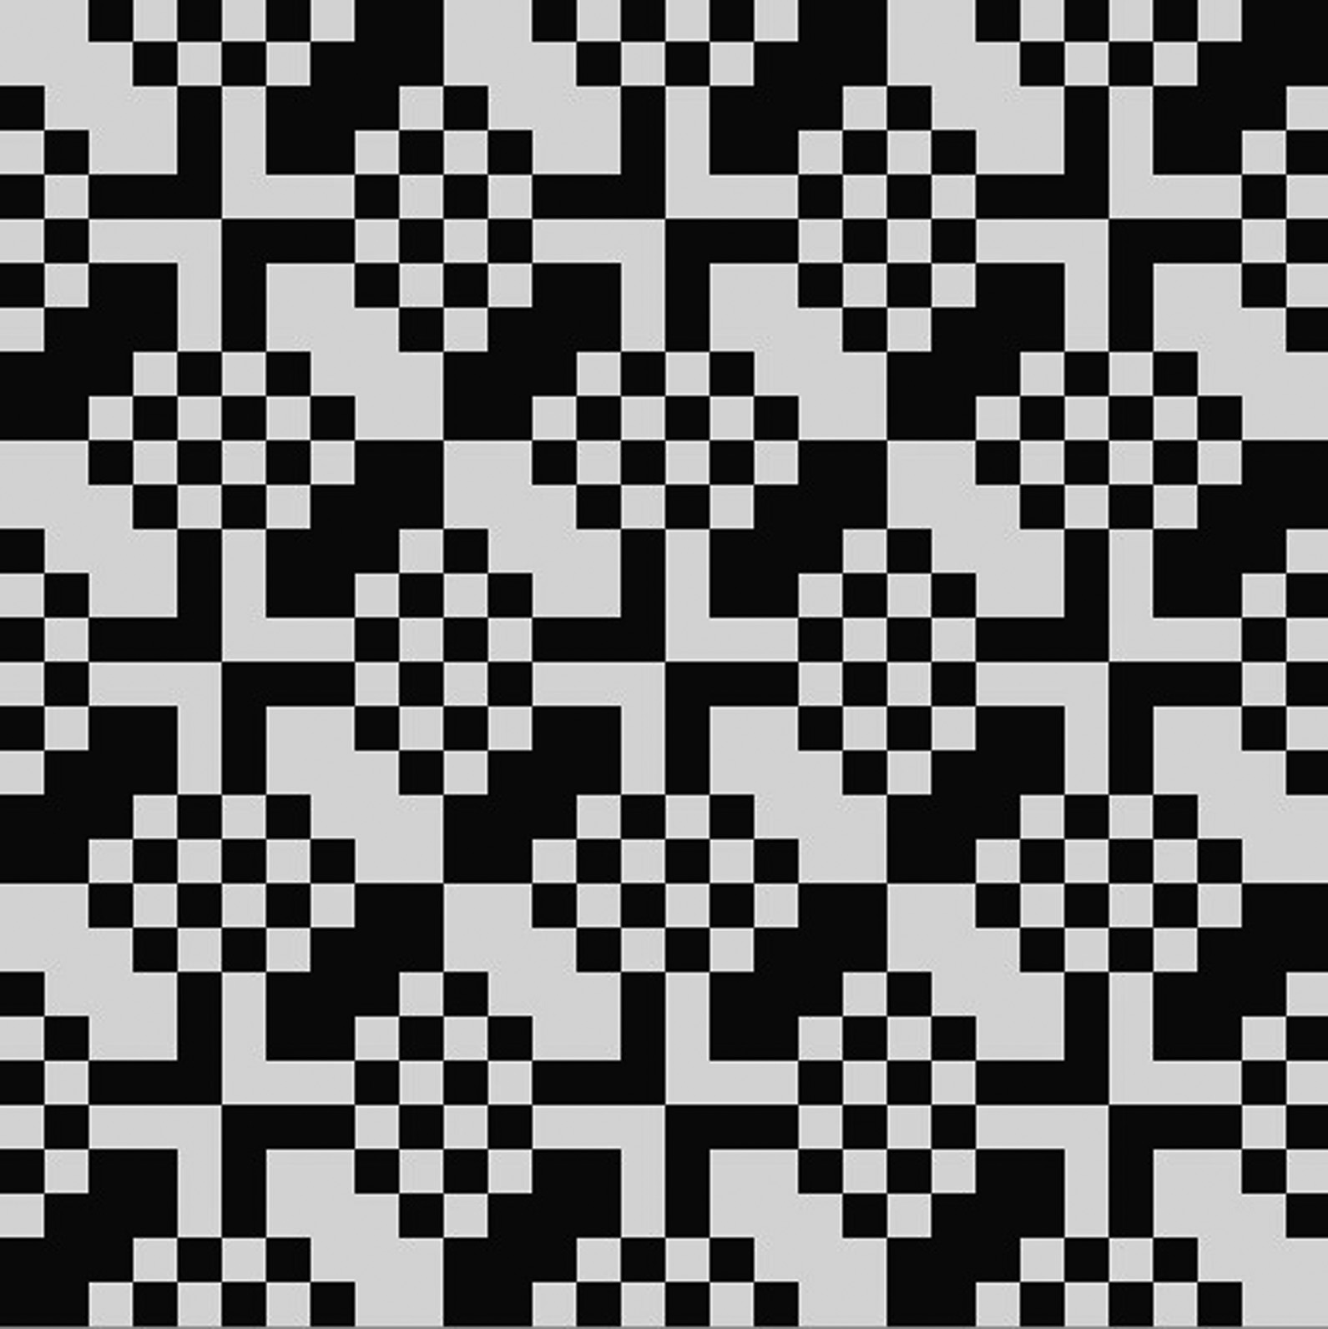
Topic 6. Additional methods for design
Lesson 26: New weave patterns based on Boolean operations
Lesson content:
The concept of the method
The Boolean operations in weave patterns’ design
Influencing parameters
Quality control: how to assess the new weave

Slide 29
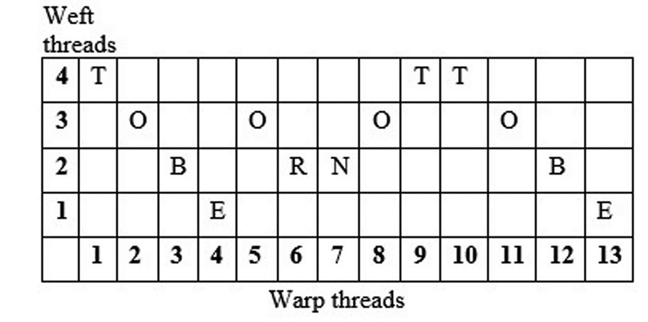
Topic 6. Additional methods for design
Lesson 27: New weave patterns based on texts
Lesson content:
The concept of the method
Transformation approach
Influencing parameters
Quality control: how to assess the new weave

Slide 30
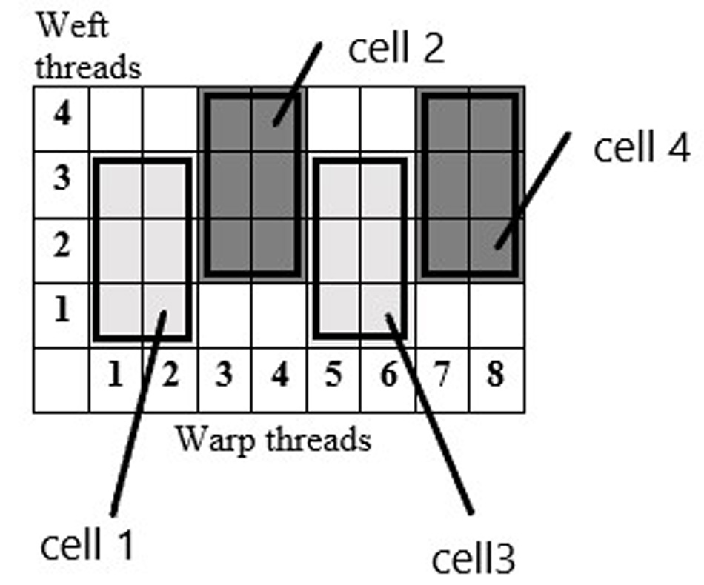
Topic 6. Additional methods for design
Lesson 28: New weave patterns based on texts
Lesson content:
The concept of the method
Transformation approach
Influencing parameters
Quality control: how to assess the new weave

Slide 31
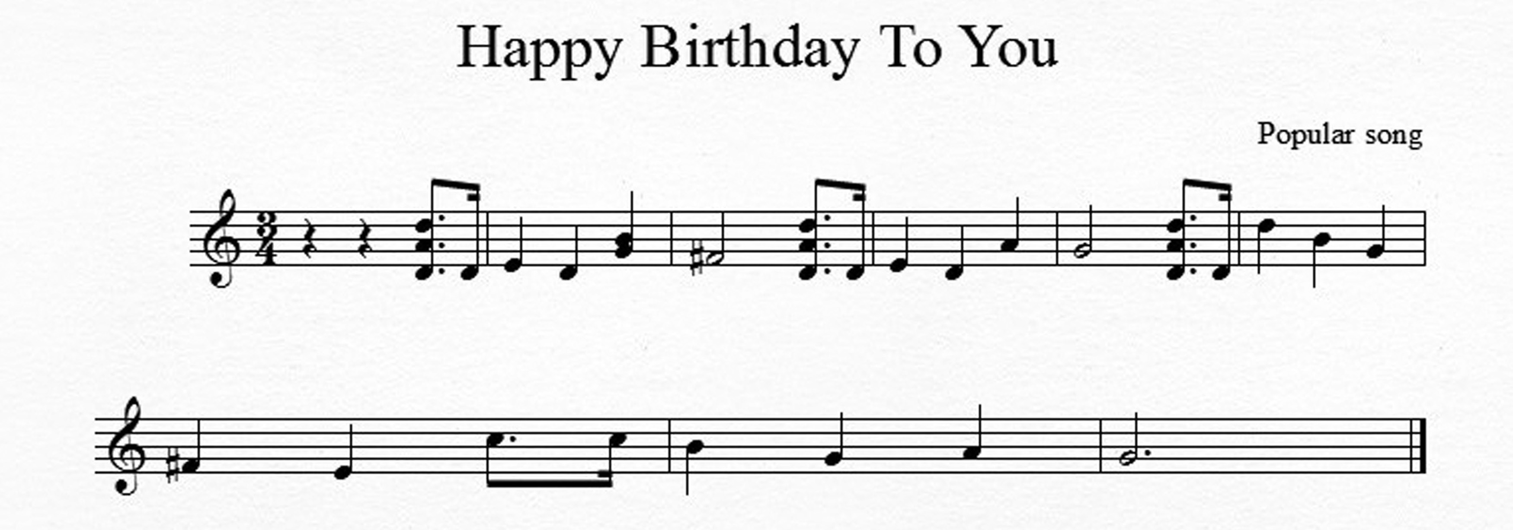
Topic 6. Additional methods for design
Lesson 29: New weave patterns based on musical scores
Lesson content:
The concept of the method
Transformation approach
Influencing parameters
Quality control: how to assess the new weave

Slide 32
THANK YOU FOR YOUR ATTENTION !

Slide 33
CONTACTS
Coordinator:
Technical University of Sofia
Faculty of Power Engineering and Power Machines
Project Manager of ICT-TEX:
Assoc. Prof. Dr. Angel Terziev
е-mail: aterziev@tu-sofia.bg
Web-site: ICT-TEX.eu
Contact: Prof. Radostina A. Angelova, PhD, DSc
radost@tu-sofia.bg, joy_angels@abv.bg
The information and views set out in this publication are those of the authors and do not necessarily reflect the official opinion of the European Union. Neither the European Union institutions and bodies nor any person acting on their behalf may be held responsible for the use which may be made of the information contained therein.

