Slide 1
TOPIC 9. FINANCING OF AN ENTREPRENEURIAL BUSINESS IN THE TEXTILE AND CLOTHING INDUSTRY

Slide 2
AGENDA
Capital and Finance
Commercial Loans
Venture Capital
Governmental Grants for TCI Entrepreneurial Activities

Slide 3
Entrepreneurial capital
Every business has different needs, and no financial solution is one size fits all.
Your personal financial situation and vision for your business will shape the financial future of your business
Once you know how much startup funding you’ll need, it’s time to figure out how you’ll get it.

Slide 4
Capital and finance
Capital is a broad term that can describe anything that confers value or benefit to its owner, such as a factory and its machinery, intellectual property like patents, or the financial assets of a business or an individual. While money itself may be construed as capital is, capital is more often associated with cash that is being put to work for productive or investment purposes. The capital is a critical component of running a business from day to day and financing its future growth.
Notes:
Every business has different needs, and no financial solution is one size fits all. Your personal financial situation and vision for your business will shape the financial future of your business. Once you know how much startup funding you will need, it is time to figure out how you will get it.
It is possible to start your business without a lot of capital. Assess your funding needs, including assets. Small businesses can get started without a lot of assets and inventory. You do not need to buy everything you want at the very beginning. Find a way to start as low cost as possible - think of using garage space to store inventory instead of paying for a warehouse or using social media to make the most of low-cost marketing - until you get some cash flowing. Consider working part-time when you launch your company. This will give time to build your business with less risk and provide you with a steady cash flow from another source. Once you have established a base, then transition to full time business ownership. It is also important for you to have fully developed and tested your product or service. Ensure your product or service is as complete and ready-for-market as it can be before marketing it or seeking financing.

Slide 5
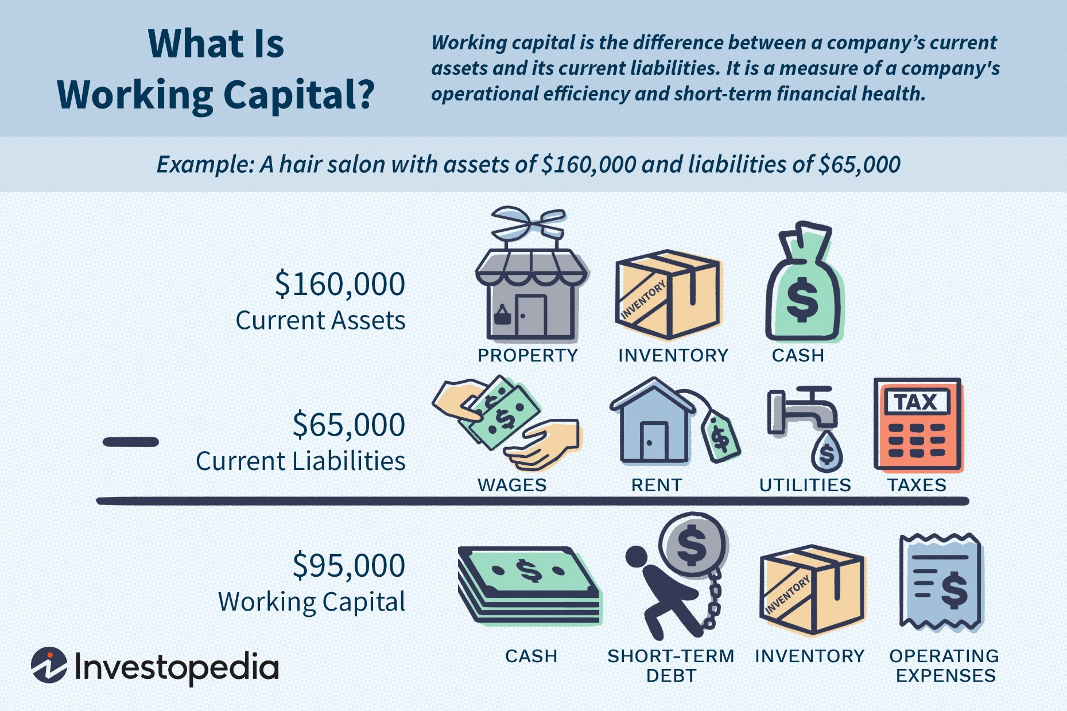
Source: www.investopedia.com
Notes:
The first thing you need to do is to assess your current financial situation thoroughly. You should not only know how much capital you need to get started or expand your business, but also know how your revenue stream will look in order to pay back any debt financing. Do you need more capital, or can you manage within the existing cash flow?

Slide 6
Sources of capital and finance
Self-funding;
Friends and relatives;
Life insurance policies;
Loans;
Commercial banks;
Investment companies;
Commercial finance companies;
Leasing companies;
Trade or supplier credit;
Customers.

Slide 7
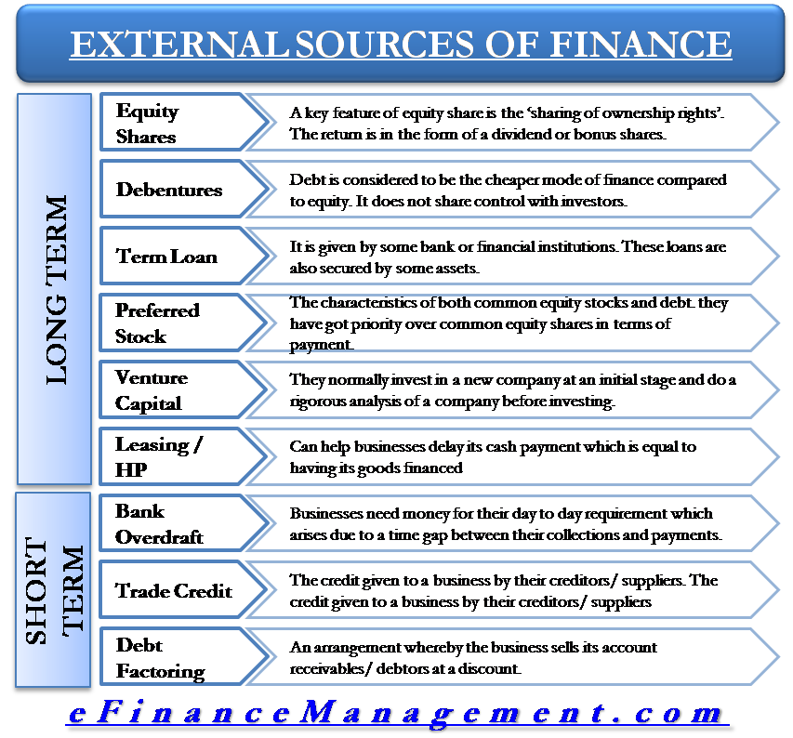
Source: www.efinancemanagement.com

Slide 8
The 5 Cs of credit
Character - to the potential lender, character means that you will make every possible effort to repay the loan. You must be a good manager, be honest, and have a good reputation as perceived by the lender.
Capacity - lenders not only look at the business’s financial projections, but also your ability to repay the loan if the business does not work out as planned.
Collateral - collecting from co-signers is becoming increasingly hard, and bankers then lose not one, but two customers. Before borrowing against these items, consider carefully the consequences of the worst possible situation in your business if you are forced to liquidate.

Slide 9
The 5 Cs of credit
Conditions - are those factors over which you have little or no control. The lender will look at the conditions, or trends, in the overall business economy, the trends in your community, the seasonal character of your business, and the nature of your product or service. Other factors entering the decision-making process are whether the lender may have already invested in a competing business and how much competition there is in your market. Be prepared to tell the lender how you plan to deal with these conditions, how you have assessed the market, and how your business will weather economic changes.
Capital - knowledgeable lenders will not put money into a new business unless they have concrete evidence that you have personally made a sizable financial commitment to the business. They know from experience that if the venture turns bad it will be easier for you to back out if you do not have your own money at risk.

Slide 10
Fund your business on your own
Source: www.fourweekmba.com

Slide 11
Fund your business on your own
How to self-finance
Self-funding (bootstrapping) lets you leverage your own financial resources to support your business. Self-funding can come in the form of turning to family and friends for capital, using your savings accounts.
With self-funding, you retain complete control over the business but you also take on all the risk yourself. Be careful not to spend more than you can afford, and be especially careful if you choose to use tap into retirement accounts early. You might face expensive fees or penalties, or damage your ability to retire on time - so you should check with your plan’s administrator and a personal financial advisor first.
Notes:
Your retirement account can be another source of financing for your startup business.
You may have built up considerable amount of money in your 401(k) at a job or in your IRA, and now you want to start a business or turn your sideline venture into a full-time activity. You can use the money in your retirement account as capital for your business. You can roll over the proceeds from your retirement account to own a business.
Rollovers as Business Startups (ROBS) are a way to optimize the use of money in your retirement account as a funding mechanism to start a business. It works if you have a 401(k) or other qualified retirement plan account with a balance that is sufficient for your funding needs and you adhere to the tax rules.
You have to incorporate your new business and have that corporation set up a qualified retirement plan (usually a profit-sharing plan permitted under the terms of the plan to invest in employer stock). Then, you have to roll over your 401(k) or other retirement account to the new retirement plan. Note that the rollover is tax-free. That plan then buys shares in your corporation, i.e., the plan becomes an owner of your business.
Pros and Cons
Financing your business with your retirement account has its own advantages and disadvantages.
The benefit is that by rolling over your retirement account into financing your business, you can avoid taxation on your retirement funds. Another benefit is that without bothering about your credit history, you can get access to necessary funds for your small business venture.
The main drawback of using your retirement account to finance your business is that you are putting your life savings at risk. If the business fails to perform at the expected level, then you will lose your livelihood as well as your savings.

Slide 12
6 Tips on How to Self-Finance Your Startup
Be an expert in your industry.
Overestimate how much starting capital you will need. A lot of people expect the revenues to be higher. They underestimate the costs and that always leads to some problems.
Become an expert problem solver willing to do any kind of work.
Invest in human capital.
Reinvest profits back into the company. Think of your business as a savings account.
Do not fear the unknown. Entrepreneurship by its nature involves taking risks. You just have to go all-in and obviously it's called 'calculated risk' for a reason because you have to measure the downside and the upside.

Slide 13
Fund your business by your family
Family and friends can be a viable and easy source of financing for your business. Entrepreneurs who lack a strong credit history or don’t want the hassle of dealing with banks or private lenders often turn to family and friends to finance their business. Through family and friends, you can possibly get quicker access to cash with fewer hoops to jump through. However, on the flip side, if your business fails or you are tardy in repaying the money, you may be headed for some conflict with your family and friends.
Notes:
You must carefully choose your financier. A financier with a bit of business knowledge will always help. Also, make sure to elaborate the risks and benefits of the investment to your financier. Even when securing financing from family and friends, you should have due diligence and passion for the business. It always helps. Instead of asking for the maximum, you should always be realistic and ask only for as much financing as you think is necessary. You must decide whether you want the financing from family and friends as a loan or as an investment in exchange for a share in your business. It’s always good to have an agreement and repayment plan, because, after all, it’s a business transaction.

Slide 14
Assignment 1
How to get own financial breakthrough?
Give an example of a textile innovation and start-up development. Evaluate with stickie its positive and negative arguments for self-financing .
Something positive
Something negative

Slide 15
Commercial loans
Short-term commercial loans - (30 to 90 days) are the most common loans made to a small business. They usually cover business operation expenses such as rent, insurance, advertising, inventory or salaries. Short-term loans are often unsecured and repayment is usually a lump sum, including interest when the loan matures.
Intermediate-term loans - are for one to five years to purchase business equipment, buy fixed assets or provide working capital. Intermediate-term loans are usually secured by the new equipment or business assets. They sometimes have low monthly payments, with a large balloon payment at the end of the term.
A long-term commercial loan - is for five years or more to purchase an existing business, buy real estate, or construct or improve a building or facility. The long-term loan is always secured by the assets for which the loan was made, usually requires constant monthly payments and often has a variable interest rate.
Notes:
Whenever possible, it's better to anticipate your needs rather than have to look for money under pressure. It is harder to gain approval for a loan when your company is already in trouble, so plan ahead and secure financing well in advance of a crisis.
There are two types of debt financing-short-term financing and long-term financing.
Short-term financing: Short-term financing can be in the form of an overdraft, a letter of credit, or a short-term loan.
Long-term financing: Long-term financing can be in the form of long-term loans or leasing.
Short-term Financing
Short-term financing can be in the form of:
Overdraft
Letter of credit
Short-term loan
The term period for short-term financing is generally less than one year. Such financing provides you with quick ways to get liquidity. It can help you fulfill small economic needs and also allows your business to capitalize on opportunities. However, short-term financing has higher interest rates and, in general, doesn’t fulfill long-term capital investment needs.
Long-term Financing
Long-term financing can be in the form of:
Long-term loan(s)
Leasing
The term period for long-term financing is more than one year. Periodic repayment is generally the mode of payback. Equipment that is costly can be taken on long-term lease which a business can eventually buy out. Long-term capital needs can be fulfilled through long-term debt. Long-term financing provides stability, but the total interest paid over a long time is higher.

Slide 16
Sources of commercial loans
Commercial banks - commercial banks are by far the most visible lenders and make the greatest number and variety of loans. However, banks are generally conservative lenders. Although they accept collateral for business loans, loan approval rests on your ability to repay the loan as shown by your profit projections, management skills and your personal record. Strive to establish and keep a good working relationship with your banker. It may help to involve the banker in the planning process for your new business. Avoiding the banker until you need money may make a loan harder to get because the banker is unfamiliar with the business and its history.
Notes:
Microloans are small, short-term loans for small businesses.
Pros: These may be available through your bank’s own loan programs loans are designed to help small businesses get started which reduces the risk involved in lending to new business owners.
Beyond credit history, another important thing that lenders consider while deciding whether to offer your business a loan is the amount of collateral that you have.
Collateral is an additional form of security which can be used to assure a lender that you have a second source of loan repayment. Assets such as equipment, buildings, accounts receivable, and inventory are considered possible sources of repayment if they can be sold by the bank for cash. Collateral can consist of assets that are usable in the business as well as personal assets that remain outside the business.
You can assume that all assets financed with borrowed funds will be used as collateral for the loan. Depending on how much equity was contributed by you toward the acquisition of these assets, the lender may require other business assets as collateral.
Your home or personal assets may be considered collateral, based on one of the following criteria:
The lender requires the residence as collateral. The equity in the residence is substantial, and other credit factors or sources of collateral are weak. You operate the business out of the residence or other buildings located on the same parcel of land

Slide 17
Sources of commercial loans
Leasing companies - leasing business equipment is another way to reduce capital needs. Everything from office furniture to food processing equipment can be obtained from leasing companies or commercial finance companies. Leasing is generally more expensive than bank financing and is limited to items that have a long serviceable life, widespread use, and are easily repossessed in the event of default. In many cases, you have the option to buy the equipment for an agreed upon amount at the end of the lease period.
Commercial finance companies - commercial finance companies are generally seen as the place to go when you are unable to secure financing from a bank. Commercial finance companies, like banks, are concerned with your ability to repay the loan; however, they are more willing to rely on the quality of the collateral rather than your track record or profit projections. If you do not have substantial personal assets or collateral, a commercial finance company may not be the best place to secure start-up capital for a business. Commercial finance company capital is usually several percentage points higher than bank financing.

Slide 18
7 Steps To Take When Getting a Business Loan From a Bank
Have a proper business plan.
State how you want to spend your finances.
State how you want to spend your finances.
Be keen on your credit score.
Clean up your credit report.
Assess all your lending options.
Keep proper financial records.

Slide 19
Assignment 2
Look at the requirements at the Bank loans for textiles listed?
Discuss on benefits and risks for taking financing by loans after the example - Loans For Clothing Stores | Small Business Funding.
External Pressures
Maintenance A Strong Cash Flow
Small Business Funding’s Value
benefits
risk

Slide 20
Venture capital definition
Venture capital is defined as providing seed, start-up and first stage finance to companies and also funding expansion of companies that have demonstrated business potential but do not have access to public securities market or other credit oriented funding institutions.
A Venture Capital Fund (VCF) strives to provide entrepreneurs with the support they need to create up-scalable business with sustainable growth, while providing their contributors with outstanding returns on investment, for the higher risks they assume. Investors can give you funding to start your business in the form of venture capital investments. Venture capital is normally offered in exchange for an ownership share and active role in the company.

Slide 21
Venture capital types. Early-stage financing
Seed Financing: Seed financing is provided for product development & research and to build a management team that primarily develops the business plan.
Startup Financing: After initial product development and research is through, startup financing is provided to companies to organize their business, before the commercial launch of their products.
First Stage Financing: Is provided to those companies that have exhausted their initial capital and require funds to commence large-scale manufacturing and sales.

Slide 22
Venture capital types. Business financing
Expansion financing:
Second stage financing: This type of financing is available to provide working capital for initial expansion of companies, that are experiencing growth in accounts receivable and inventories, and is on the path of profitability.
Bridge financing: Bridge financing is provided to companies that plan to go public within six to twelve months. Bridge financing is repaid from underwriting proceeds
Acquisition financing:
As the term denotes, this type of funding is provided to companies to acquire another company. This type of financing is also known as buyout financing.

Slide 23
Venture capital fund structure
Source: www.nvca.org

Slide 24
Primary characteristics of venture capital fund
Invests capital in return for equity, rather than debt (it is not a loan). That it is equity or quasi equity investment;
Has a longer investment horizon than traditional financing. It is long term investment;
It is an active form of investment;
Focuses high-growth companies;
Takes higher risks in exchange for potential higher returns.
Notes:
Going for venture capital investments in your business has its own pros and cons.
The good thing about it is that venture capital, which you can raise, is money that you can keep. You don’t need to repay or take account of interest rates. You don’t need to attach collateral for raising venture capital. It can help your business grow quickly. Venture capital funding is generally committed and long term.
The flip side is that in return for the capital investment, the venture capitalist would own a stake in your business and might at times, depending upon the amount of investment, make controlling decisions. So, raising venture capital amounts to giving up a share in your business. It can be a cumbersome and lengthy process for you to find a suitable venture capitalist that is willing to invest in your business.

Slide 25
Angel investors
Business “angels” are high-net-worth individual investors who seek high returns through private investments in startup companies. Private investors generally are a diverse and dispersed population who made their wealth through a variety of sources. But the typical business angels are often former entrepreneurs or executives who cashed out and retired early from ventures that they started and grew into successful businesses.
Notes:
Seeking angel investors to finance your business has its advantages and disadvantages.
One of the advantages is that angel investors may provide you the needed capital right at the startup stage of your business. They generally agree to flexible investment agreement terms compared to traditional sources of funding. Angel investors, often successful entrepreneurs themselves, add business acumen to your venture. They may agree to invest in your business, even if it is a risky venture, if they like your idea. Angel investors are often ready to look beyond mere financial return.
On the other hand, angel investors generally are not ready to make follow-up investments. They can be costly at times and want higher returns on their investment. An angel investor may often want to be involved in the decision-making process of your business and you may virtually lose control. It can be a difficult task to find out angel investors as they usually operate behind-the-scenes.

Slide 26
Angel investors
The capital they provide can be a one-time injection of seed money or ongoing support to carry the company through difficult times.
Advantages of business angel financing:
Free to make investment decisions quickly.
No need for collateral - i.e. personal assets.
Access to your investor's sector knowledge and contacts.
Better discipline due to outside scrutiny.
Access to mentoring or management skills.
No repayments or interest.
Notes:
Seeking angel investors to finance your business has its advantages and disadvantages.
One of the advantages is that angel investors may provide you the needed capital right at the startup stage of your business. They generally agree to flexible investment agreement terms compared to traditional sources of funding. Angel investors, often successful entrepreneurs themselves, add business acumen to your venture. They may agree to invest in your business, even if it is a risky venture, if they like your idea. Angel investors are often ready to look beyond mere financial return.
On the other hand, angel investors generally are not ready to make follow-up investments. They can be costly at times and want higher returns on their investment. An angel investor may often want to be involved in the decision-making process of your business and you may virtually lose control. It can be a difficult task to find out angel investors as they usually operate behind-the-scenes.

Slide 27
Angel investors - common characteristics:
They seek companies with high growth potentials, strong management teams, and solid business plans to aid the angels in assessing the company’s value.
They typically invest in ventures involved in industries or technologies with which they are personally familiar.
They often co-invest with trusted friends and business associates. In these situations, there is usually one influential lead investor (“archangel”) whose judgment is trusted by the rest of the group of angels.
Because of their business experience, many angels invest more than their money. They also seek active involvement in the business, such as consulting and mentoring the entrepreneurs.
They often take bigger risks or accept lower rewards when they are attracted to the non-financial characteristics of an entrepreneur’s proposal.

Slide 28
Get venture capital by investors
1) Find an investor - look for individual investors - sometimes called “angel investors” - or venture capital firms. Be sure to do enough background research to know if the investor is reputable and has experience working with startup companies.
2) Share your business plan - the investor will review your business plan to make sure it meets their investing criteria. Most investment funds concentrate on an industry, geographic area, or stage of business development.
3) Go through due diligence review - the investors will look at your company’s management team, market, products and services, corporate governance documents, and financial statements.

Slide 29
Get venture capital by investors
4) Work out the terms - if they want to invest, the next step is to agree on a term sheet that describes the terms and conditions for the fund to make an investment.
5) Investment - once you agree on a term sheet, you can get the investment! Once a venture fund has invested, it becomes actively involved in the company. Venture funds normally come in “rounds.” As the company meets milestones, further rounds of financing are made available, with adjustments in price as the company executes its plan.

Slide 30
Venture capital. Crowdfunding
Crowdfunding raises funds for a business from a large number of people, called crowdfunders. Crowdfunders are not technically investors, because they do not receive a share of ownership in the business and do not expect a financial return on their money. Crowdfunders expect to get a “gift” from your company as thanks for their contribution. Often, that gift is the product you plan to sell or other special perks, like meeting the business owner or getting their name in the credits. This makes crowdfunding a popular option for people who want to produce creative works or a physical product. Crowdfunding is also popular because it’s very low risk for business owners. Not only do you get to retain full control of your company, but if your plan fails, you’re typically under no obligation to repay your crowdfunders. Every crowdfunding platform is different, so make sure to read the fine print and understand your full financial and legal obligations.

Slide 31
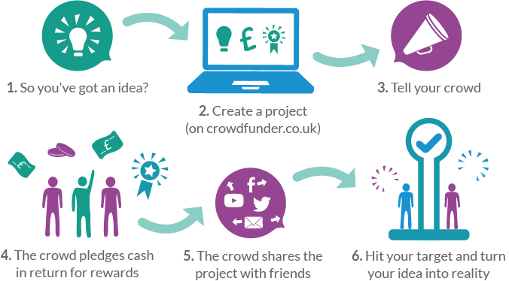
Crowdfunding process
Notes:
Collective funding platforms are websites that allow contact between fundraisers and the multitude of supporters. Through the platform for collective financing, financial commitments can be made and the provided financial resources can be collected.
Fundraisers usually have to pay a fee to the collective funding platforms if the fundraising campaign has been successful. In turn, collective funding platforms are expected to offer secure and easy-to-use services.
Many platforms operate on an all-or-nothing financial model. This means that if you achieve your goal, you get the money, and if you do not achieve it, everyone gets their money back - without feeling bad and without financial losses.

Slide 32
Crowdfunding process
Collective funding platforms are websites that allow contact between fundraisers and the multitude of supporters. Through the platform for collective financing, financial commitments can be made and the provided financial resources can be collected.
Fundraisers usually have to pay a fee to the collective funding platforms if the fundraising campaign has been successful. In turn, collective funding platforms are expected to offer secure and easy-to-use services.
Many platforms operate on an all-or-nothing financial model. This means that if you achieve your goal, you get the money, and if you do not achieve it, everyone gets their money back - without feeling bad and without financial losses

Slide 33
Crowdfunding types
Collective financing through the provision of compensation
Sponsors provide funds for a project or business, and in return for their contribution they expect to receive non-financial compensation at a later stage, such as goods or services.
Collective financing through donations
Sponsors provide small amounts to achieve the ultimate goal of a larger financial amount for a specific charity project, and in return do not receive financial or material benefits from it.
Collective financing with share capital
Sale of business shares to a number of investors for investment. The idea is similar to the way ordinary stocks are bought or sold on a stock exchange or venture capital.
Affiliate lending
The sponsors borrow money from the respective company with the stipulation that the money will be repaid with interest. This type is very similar to a traditional bank loan except that it is borrowed by many investors.

Slide 34
Crowdfunding benefits
Proof of concept and confirmation: Crowdfunding financing provides you with verification in real conditions; you can see if other people believe in your project or concept. If they want to contribute to it, this is a convincing confirmation that your market approves of the idea.
Help through other forms of financing: A successful campaign can not only be proof of your concept, but also emphasize that there is a market for your business that people trust. This is extremely useful when looking for additional funding from other types of financial sources, such as banks, venture capital, the so-called. “Business angels", as they may consider your idea less risky or get more favorable terms.

Slide 35
Crowdfunding benefits
Multi-person access: You reach a huge audience of individuals, some of whom may have valuable expertise and experience. Collective funding generally allows you to communicate with them in a new way that provides you with valuable feedback without incurring costs.
Strong marketing tool: Collective equity financing and collective financing through the provision of compensation can be an effective way to present a new product, a new company or the growth of an enterprise by directly targeting people who may be potential customers. You can generate expectation and interest even before the product is produced.

Slide 36
Assignment 3
Look at the requirements at the venture capital platforms listed in the crowdfunding types slide.
Discuss on benefits and risks for taking financing by crowdfunds.
benefits
risk

Slide 37
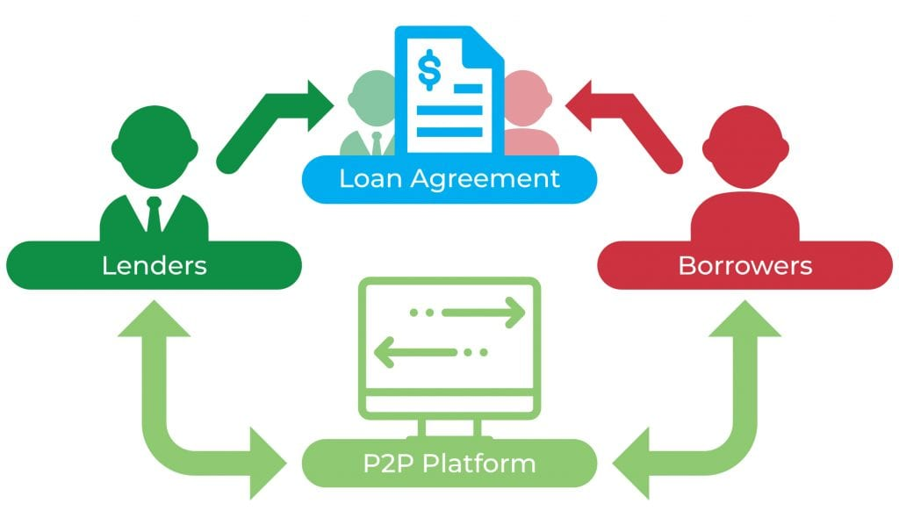
Peer-to-peer lending
Peer-to-peer lending can be another source of financing for your business. Peer-to-peer-lending essentially involves sharing your idea with other people in hopes that they will invest in your business.
https://jeangalea.com/p2p-lending-glossary/
Notes:
Financing your business through peer-to-peer lending gives you the advantage of choosing from a host of lenders and settling for repayment terms that you feel will suit you. It also makes it possible to avoid the lengthy process of taking a loan from a conventional source.
The disadvantage of this financing is that the terms of lending can often be vague, and the lender may have certain hidden terms of lending. You should check carefully before going ahead with this model of financing.

Slide 38
Government grants for TCI entrepreneurship
Operational programs
They are a key tool for implementing European policies in various fields.
The project cycle step-by-step:
Application;
Evaluation of project proposals;
Execution of the project;
Report for project fulfillment.

Slide 39
Governmental grants for TCI entrepreneurship
The benefits from governmental support
Training start-ups - different NGOs and training centers are financed to trained entrepreneurs. The expected output is increasing number of established new companies.
Marketing assistance - as the SMEs have lack of marketing competencies, the governmental programs allow SME companies to apply for marketing assistance programs. In addition, there are some programs financing participation at different Fairs and Exhibitions.
Concession of Excuse duties - some of the schemes allow the companies to use a public resource for cost coverage instead of paid taxes, e.g. the COVID-19 schemes.
Government Subsidies

Slide 40
Assignment 4
Look at the requirements at the EU project financing: ACCESS TO FINANCE.
Discuss on benefits and risks for taking EU-project financing for fashion start-up.
TEKES (Finland) – The Finnish Funding Agency for Innovation – grants and loans
A pilot programme on developing vouchers in health, care and the CCS – Tillvaxtverket (Sweden)
benefits
Catalan Institute for Cultural Companies (Spain) – repayable contributions (loan + subsidy
The Enterprise Investment Scheme and Seed Enterprise Investment Scheme (United Kingdom) – tax relief offered to venture capital investors
risk

Slide 41
Barriers in the T&C to internal financing
Misaligned Incentives. The fashion industry has engaged in a cost-driven race to the bottom, giving little attention to disruptive innovation and overlooking investment opportunities.
Limited Awareness of the Opportunity. Fashion has not traditionally been a technology- or innovation-driven industry.
Absence of a Structured Innovation Process. The fashion industry lacks clear stage gates, standardized processes, and commercialization paths. The absence of these structures causes greater uncertainty and misjudgment of risk, creating a barrier that impedes all stakeholders involved. The fashion industry is relatively new to working with outside innovators. For startups, that presents a challenge. Working with large fashion companies can be a slow and often unstructured process as teams attempt to navigate large corporations to get the right stakeholders or decision makers on board.

Slide 42
Barriers in the T&C to external financing
Lack of Experience and Technical Expertise. Engaging with innovative technologies in the fashion industry typically requires technical expertise. For example, having a background in materials science, chemistry, and fashion manufacturing techniques is often necessary to understand whether a given technology is viable.
Incorrect Perceptions Regarding Pricing and Externalities. High-risk investors such as VC funds especially benefit from fast growth and steep rises in company valuations. A common concern about technologies, especially in the field of new materials, involves the ability to reach competitive pricing compared with commodities such as cotton and polyester.
Inadequately Structured Exclusivity. Some exclusive contracts, especially from brands with smaller volumes, can impose unduly restrictive limitations that hinder broader scaling and rapid commercialization.

Slide 43
Assignment 5
Look at the requirements at the Barriers to internal financing of textile companies – Financing the Transformation Report.
Discuss on benefits and risks for taking different instruments of external financing for fashion start-up.
benefits
risk

Slide 44
Questions for discussion and tasks
Analyze the financial situation of your business. You have to do this to determine the financial needs of your business. You must arrive at the exact amount of financing that you need and the purpose for which you need it.
Create the financial plan of your business. It is the business plan and its viability that the investors are going to look at when you approach them for financing.
Evaluate the financing options that you have. Evaluate the pros and cons of each of the options and decide on the financing options that suit your business best.
Try to approach some investors. After you have decided on the financing option that best suits your business, you should approach the investors and negotiate with them to secure the investment.

Slide 45
Questions for discussion and tasks
Would you borrow money from friends or family members to start a business? Discuss why you answered the way you did.
Explore opportunities for growth. Once you have secured financing, you can concentrate on using it best to expand your business.
Under what conditions do you think adding a partner would be in the best interest of your business?

