Slide 1
TOPIC 5.1. PRICING

Slide 2
AGENDA
Price Definition
Pricing a Product
Factors influencing the pricing
Pricing Objectives
Pricing Strategies
Categories of pricing models

Slide 3
Price definition
Pricing is the method followed by a business to determine the selling price for its products or services. Pricing is influenced by the cost of production, promotion, and placement of the product being sold. Other pricing factors include competition, market conditions, brand, and quality of product. The price of a product, and of services like tuition, insurance premium, interest, rent, fare, toll, and salary, are some examples of price.
Notes:
Price is one of the four Ps of marketing. The other three are product, promotion, and placement. These are all costs incurred by a business during operation.

Slide 4
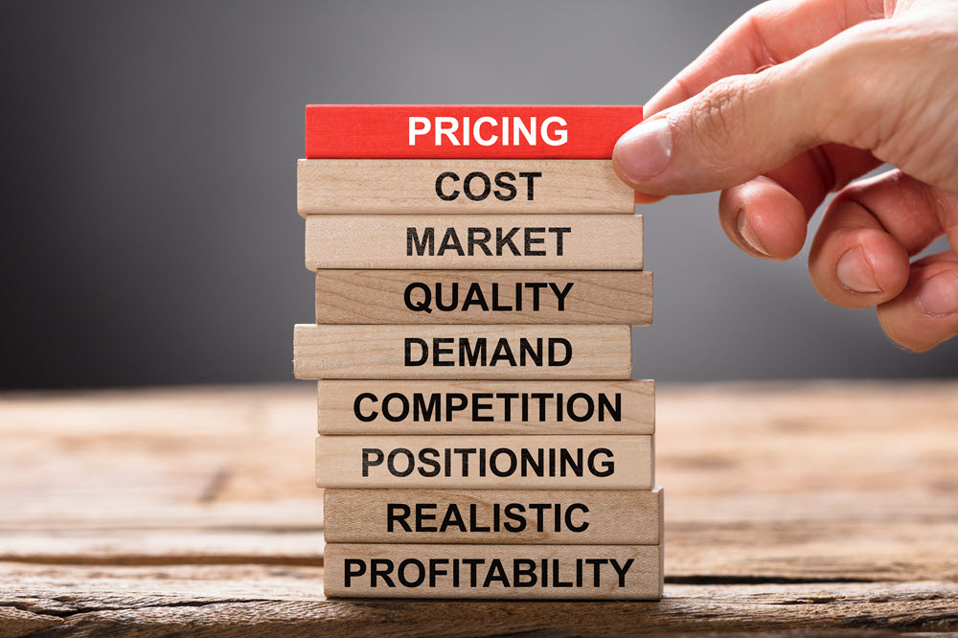
Pricing a product
Developing a marketing strategy;
Creating the "marketing mix," a technique used to develop plans for marketing a product;
Studying and estimating the demand for a product;
Calculating the fixed and variable costs related to a product;
Generating a price based on the market needs by predicting competitor strategies and understanding legal constraint’;
Setting the price of the product using the information collected through the previous steps.

Slide 5
Factors influencing the pricing:
Property and equipment leases;
Loan repayments;
Inventory;
Utilities;
Financing costs, such as interest on loans;
Salaries/wages/commissions;
Markdowns;
Shortages, such as not having an item in stock;
Damaged product;
Employee discounts;
Desired profit (profit should be included on the list of costs and treated as a fixed cost). Nobody runs a business just to break even.
Notes:
To determine the price for a product or service, business owners should understand the costs of running their business. If prices do not exceed costs in the long run, the business will fail.

Slide 6
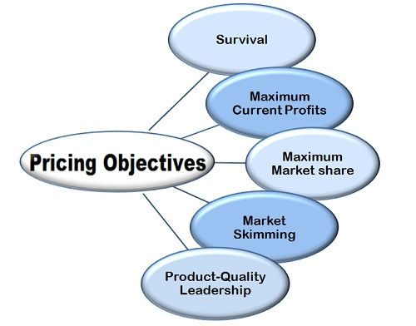
Pricing objectives
The pricing objectives depend on the organization’s goals:
Increasing sales: to sell the maximum number of product units or serve the maximum number of customers to decrease long-term costs and increase market share.
Increasing profit: to increase current profit by increasing revenue and decreasing costs.
Increasing revenue: to increase current revenue irrespective of profit margins. The company is trying to maximize long-term profits by increasing the market share and reducing costs.
Considering competitors’ price: Price of a product should be fixed considering the competitors’ prices.
Notes:
As a product is developed, a business needs to create a marketing strategy by identifying the target market and product placement. Ideally, the price of a product should match its quality.

Slide 7
Pricing objectives
Maintaining quality leadership: to use price to create a perception that the product is a quality leader.
Recovering partial cost: uses of other revenue sources to subsidize the price of a product or service. It may do this to increase market share, especially when selling a complementary product or while improving the business’s public image.
Surviving unmanageable situations: cover costs to remain in the market. Until the situation improves, profits may be ignored.
Maintaining stability: to avoid price wars and achieve price stabilization to maintain profit at a steady level.
Notes:
As a product is developed, a business needs to create a marketing strategy by identifying the target market and product placement. Ideally, the price of a product should match its quality.

Slide 8
Pricing strategies
Pricing strategies can also be used as sales promotion tactics:
Skim pricing.
Penetration pricing.
Premium pricing.
Differentiated pricing.
Psychological pricing.
Discounts and sales.

Slide 9
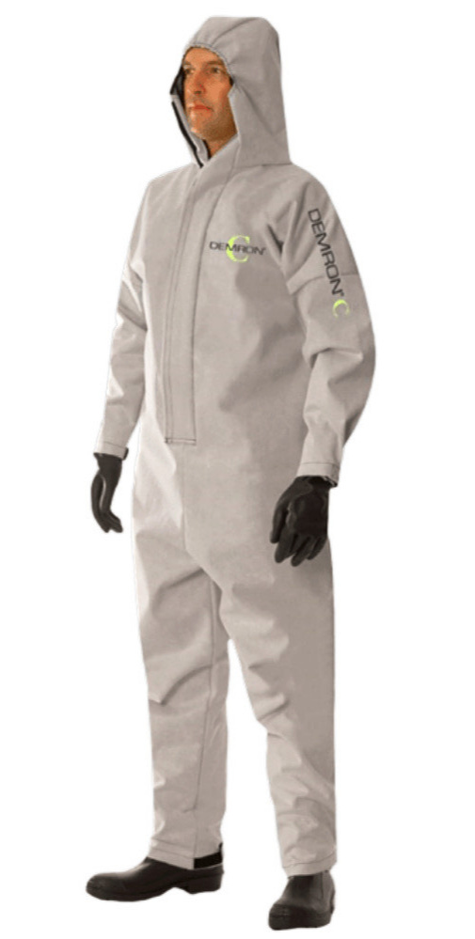
Skim pricing strategy
Using this strategy, the organisation attempts to sell a product at a high price.
This strategy can be used when:
The product is new to the market and there is little competition;
Demand is fixed and the customers are not too price-sensitive;
High volumes do not assure cost savings;
Companies are identifying investors to finance high-volume production with low profit margins during the initial phase.
Notes:
Using this strategy, the organisation attempts to sell a product at a high price. This is mainly aimed at customers who are not concerned about the price when the product is new to the market and there are fewer competitors. The price decreases when more competitors enter the segment.

Slide 10
Penetration pricing strategy
The business tries to maximize the quantity sold and increase the market share, by lowering the prices.
This strategy can be used when:
The customers are price-sensitive, and the sales will increase as the price declines;
Higher volumes guarantee cost savings;
The product or service is of a type that can gain mass appeal rapidly;
The competition is intense.

Slide 11
Premium pricing strategy
A product or service is priced at the high end of a possible price range to create a sense of perceived quality, which will attract status-conscious consumers.
This strategy may work if target consumers believe that:
High price guarantees good quality;
Buying a premium product or using a premium service signals their high worth to others and indicates that they are the members of an exclusive group.

Slide 12
Differentiated pricing strategy
The same product or service is priced differently for different customers and different markets. This strategy has three variations:
First-degree price differentiation: This is also called personalized pricing or one-to-one marketing. Here, the goal is to maximize the price that each customer is willing to pay. In this, the product or service is sold to each customer at a different price.
Second-degree price differentiation: In this case, price differs depending on the quantity. An example is selling large quantities at a lower unit price. This method allows businesses to set different prices for different market segments and capture a larger portion of the total market surplus.
Third-degree price differentiation: Also called group pricing; in this variation, the market is divided into different segments and the same price is charged to every consumer in the segment.

Slide 13
Psychological pricing strategy
The practice of displaying prices which are a few cents less than a price expressed in full amount. This is based on the assumption that the customers will not round the euros-and-cents prices up, and that, therefore, they will consider the euros-and-cents price to be significantly lower, when it is only marginally lower. Thus, this strategy is based on prices that appear as a bargain, to the consumer at first. Nowadays, many companies use psychological pricing to increase their sales.

Slide 14
Discounts and sales
Quantity discount: This type of discount is offered to bulk buyers.
Cumulative quantity discount: This is offered to buyers who purchase large quantities over a period of time, but do not place a large stand-alone order.
Seasonal discount: This is usually offered based on the time when the purchase is made or the service is used.
Cash discount: This is offered to customers who pay the bill before a specified date.
Trade discount: This is a discount offered to the members of the distribution channel for performing their roles. An example is a discount offered to a small retailer who may not be a bulk buyer.
Notes:
Most people buy in large quantities only if the product is available on sale. Most supermarkets have sales on all the time, or have very small interval between sales.

Slide 15
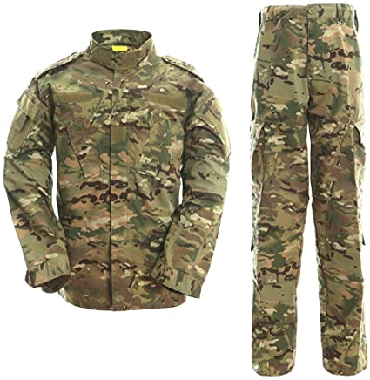
Categories of pricing models
Cost-based pricing - in this strategy, a business first determines the cost of developing a product and adds a markup for each unit based on factors such as expected profit, sales objectives, and customer expectations.
Cost-based pricing is commonly used for pricing large development contracts with the government.
Notes:
These three categories cover the majority of pricing models used by small businesses; however, there are others.

Slide 16
Advantages of cost-based pricing
It helps to find fair prices easily;
It involves calculating the full cost of the product. Pricing based on full cost looks factual and precise and may be more ethical;
It reduces the cost of decision making and lets a business set prices in an uncertain market where knowledge is incomplete as it does not involve much market research;
It is less risky than other methods;
It helps achieve competitive stability because Cost-based pricing helps set a price likely to yield returns acceptable to other members of the industry;
It is simple and readily available;
It helps justify price increase by relating to cost increase.

Slide 17
Disadvantages of cost-based pricing
It ignores the role of consumers in determining price - there is no guarantee that your consumers are willing to pay this price;
It ignores the role of competitors - the price may be much more or much less than what a competitor charges;
It creates little incentive for cutting costs;
It ignores opportunity cost.

Slide 18
Customer-based pricing
The customer-based pricing model is also sometimes called value-based pricing. In this model, the business first evaluates the customer to understand what he or she is willing to pay for the product or service, and then charges the price each customer is willing to pay. It gives little or no consideration to the cost of the product or service.

Slide 19
Customer-based pricing advantages
It gives the business the flexibility to charge different prices to different customers;
It can serve as a way to maximize profit margins;
It provides an incentive to offer a quality product and customer service and to keep costs down.

Slide 20
Customer-based pricing disadvantages
It can alienate customers who end up paying more than the successful bargainers;
Over time, customers can become aggressive bargainers;
It is harder to scale if the number of customers increases;
It may be difficult to implement in a market where buyers have a lot of options;
Businesses must still ensure that their costs are being covered by the revenue generated in the long run.

Slide 21
Competition-based pricing
In the competition-based pricing strategy, prices are fixed using the price of the competitors’ products. This strategy is applied in industries with one or two prominent companies. Thus, it’s also referred to as “follow the leader.”

Slide 22
Competition-based pricing advantages and disadvantages
The main advantage of competition-based pricing is that it’s easy to use, as extensive marketing research and statistical analysis are not required.
Some disadvantages of competition-based pricing are that:
It is difficult to know how the competitor is pricing the product; it may or may not be the best way;
The price can no longer be used as a variable in the marketing mix because the business no longer has control over it;
If the competitor’s product is not similar to your own, the price may not reflect the true value of the product. Additionally, it may not cover all of the costs to produce the product.

Slide 23
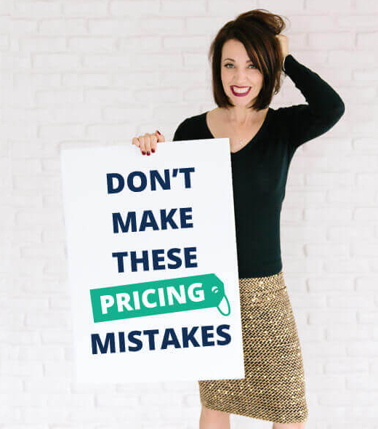
Common pricing mistakes small businesses make
Not having a strategy or not sticking to your strategy;
Underestimating costs;
Assuming that the only way to compete is via low price;
Setting your pricing strategy and forgetting to check if it works well or needs a modification;
Ignoring legal issues.

Slide 24
Questions for discussion and tasks
What is pricing?
How do costs affect pricing?
What are the objectives for pricing a product?
How do pricing strategies affect sales promotion?
What are the three general pricing models for small businesses? Choose one of them and explain what are the advantages and disadvantages of the model.
What are some common pricing mistakes?
Name three fashion brands that use the premium pricing strategy.

