Slide 1
The course is developed under Erasmus+ Program Key Action 2: Cooperation for innovation and the exchange of good practices Knowledge Alliance
TRAINING MODULE
FINISHING, PRINTNIG and FUNCTIONALIZATION
Course: Basic Principles of Textile Printing
Partner: P4 – University of Zagreb Faculty of Textile Technology
Prof. Martinia Glogar, Ph.D.
ICT IN TEXTILE AND CLOTHING HIGHER EDUCATION AND BUSINESS
Project Nr. 612248-EPP-1-2019-1-BG-EPPKA2-KA
The information and views set out in this publication are those of the authors and do not necessarily reflect the official opinion of the European Union. Neither the European Union institutions and bodies nor any person acting on their behalf may be held responsible for the use which may be made of the information contained therein.

Slide 2
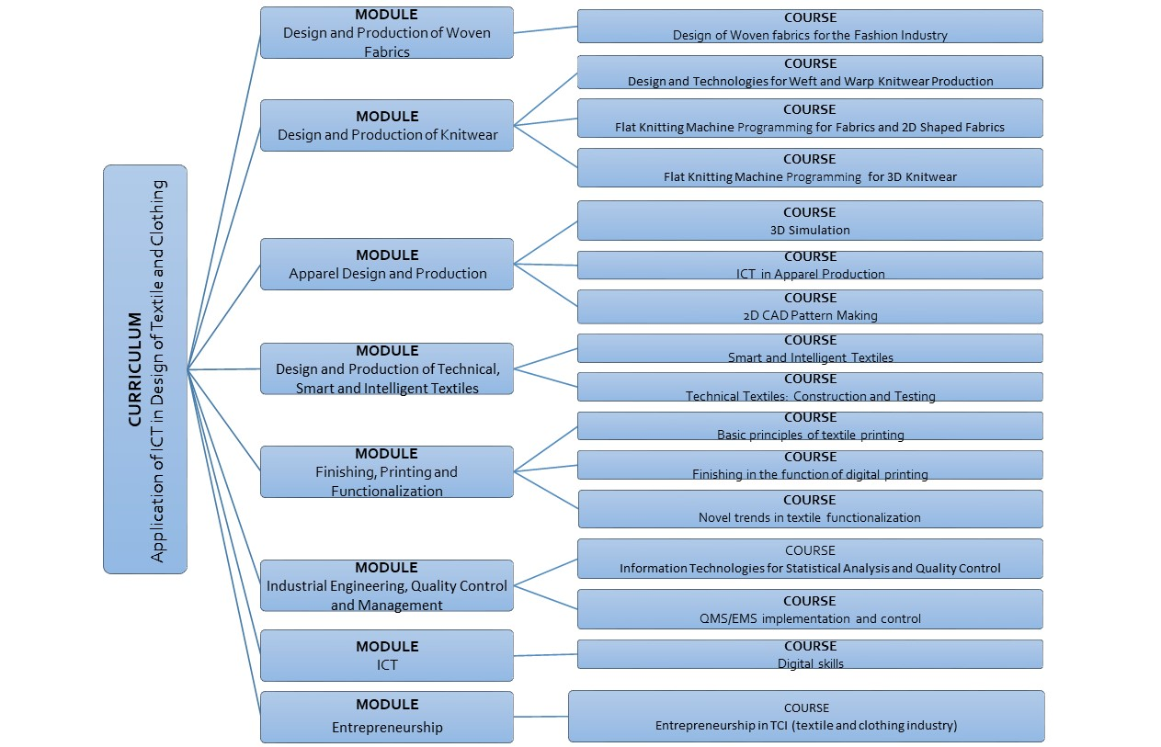
The information and views set out in this publication are those of the authors and do not necessarily reflect the official opinion of the European Union. Neither the European Union institutions and bodies nor any person acting on their behalf may be held responsible for the use which may be made of the information contained therein.

Slide 3
MODULE – FINISHING, PRINTING AND FUNCTIONALIZATION
Course: Basic Principles of Textile Printing
Duration: 20 hours
Course objectives
The entry of ICT into analogue, conventional textile printing technology, which involves the use of rotary or flat screens, has revolutionized its development. It is the most demanding stages of the process, such as sample design and sample-to-screen preparation, that become the points of the most significant implementation of information technology. With the introduction of the CAD system, the printing process itself is being digitized, enabling automation in the management of the printing machine and control of the handling of the printing paste. The aim of the course is to acquire the skills and knowledge of conventional screen printing, aiming in mastering the abilities of using the ICT tools in designing and overall printing process, and to point out the role of textile printing techniques in smart textile production.
Topics
- ICT in textile printing methods and techniques - CAD application in textile screen printing - Dye and pigment based textile printing
- Smart printing pastes - Dyes and pigments with special effects (thermochromic, photochromic, phosphorescent, fluorescent, biomimetic)
Learning outcomes
Knowledge | Skills | Responsibilities/autonomy
To consider all possibilities of ICT tools applications in technology of analog textile printing To select printing methods in response to market demands, with economy and environmental acceptability To know the basics of rheology as the foundation of the printing pastes preparing process To understand the creative aspect of textile printing technology and get acquainted with new printing methods for special and smart effects realization To understand the difference of bonding mechanism of dyes and pigments | To make a screen for performing printing using new techniques To select the thickener depending on the printing technique, dye and textile material used To select and apply the appropriate printing method for a certain type of material, a particular purpose and to achieve a certain effect To define the relevant parameters regarding the effect and the print quality desired To perform different textile printing techniques | To be responsible for the application of environmentally and economically sustainable printing paste as well as printing method To be able to optimize quantities of printing paste in order to avoid significant waste of chemicals To propose a short project of industrial design by using the textile printing techniques as the main creative tool To be responsible for developmental approach to the scope of exploring and applying new techniques and smart dyes and pigments

Slide 4
MODUL: Finishing, Printing and Functionalization
Course: Basic Principles of Textile Printing
Course duration: 20 hours
Content: 5 Units / 15 lessons
DESCRIPTION OF THE COURSE:
The course in Basic Principles of Textile Printing includes basic aspects of textile printing technology in the context of automation, modernization and implementation of ICT tools in the technological process of printing from the stage of design and pattern preparation to the final product.
it presents the basic features of the printing process, from the design phase and preparation of patterns and screens, to the selection and implementation of appropriate printing techniques with reference to the rheological and structural properties of printing pastes.
It provides an overview of the automation and digitization of the printing process and introduces participants to the important role of textile printing in the production of smart textiles.
It introduces to dyes and pigments of special propersties such as thermochromia, photochrmia, phosphorescence, fluorescence, biomimetic, nanoparticle printing pastes with effects for smart textile production (e.g. electrical conductivity).

Slide 5
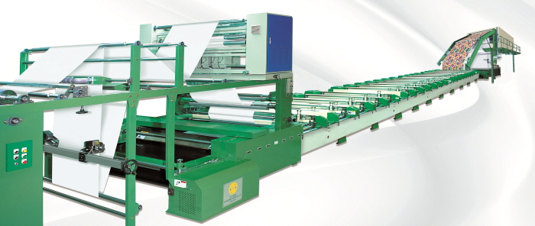
THE AIMS and OBJECTIVES OF THE COURSE:
The aim of the course is to acquire the skills and knowledge of conventional screen printing, aiming in mastering the abilities of using the ICT tools in designing and overall printing process, and to point out the role of textile printing techniques in smart textile production.

Slide 6
LESSON 1: Basics of Textile Printing
OVERWIE of:
Historical aspects, early from up to date development, current position, future aspects
Basic tools, machinery and CAD/CAM tools in textile printing
Pattern preparation, screen production with technical characteristics
Textile printing basic phases with aspects of fixing

Slide 7
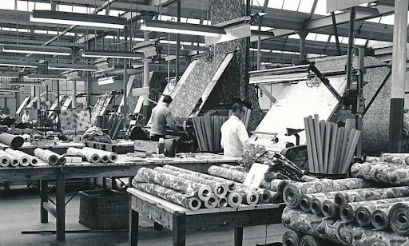
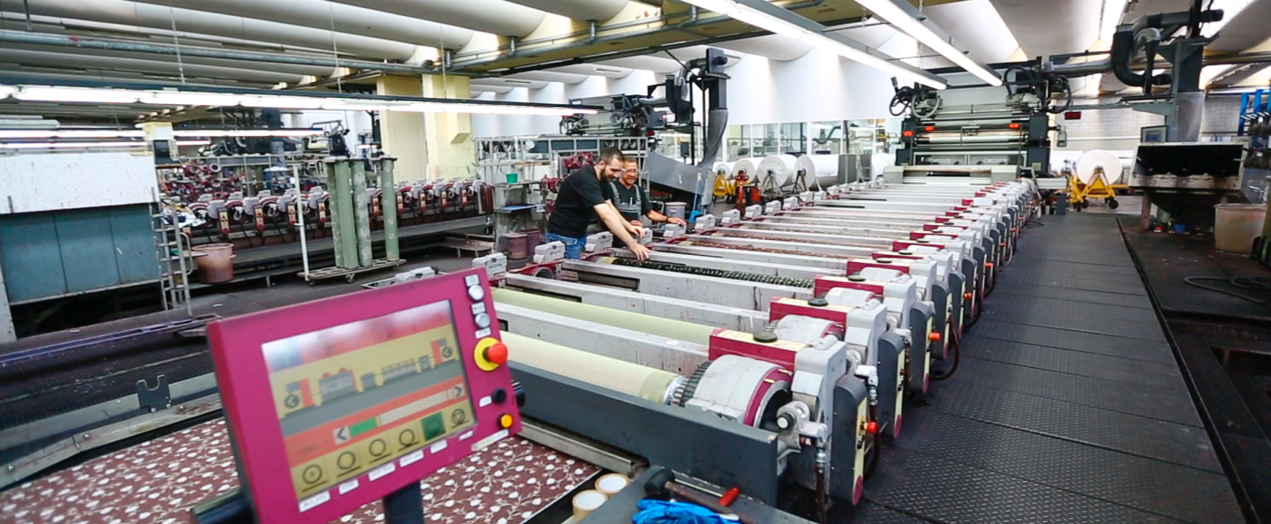
Short historical overview of mechanical textile printing machines
Early development of techniques that preceded rotary printing
Introduction of flat screen printing to industrial production
The most significant development milestones that were reflected in the development of textile printing (e.g. synthetic fiber development)
Historical aspects, early from up to date development, current position, future aspects
FROM / TO

Slide 8
Basic tools, machinery and CAD/CAM tools in textile printing
Historical overview (from 50-es till up to date development)
Industrial settings wit automation
Computer control settings

Slide 9
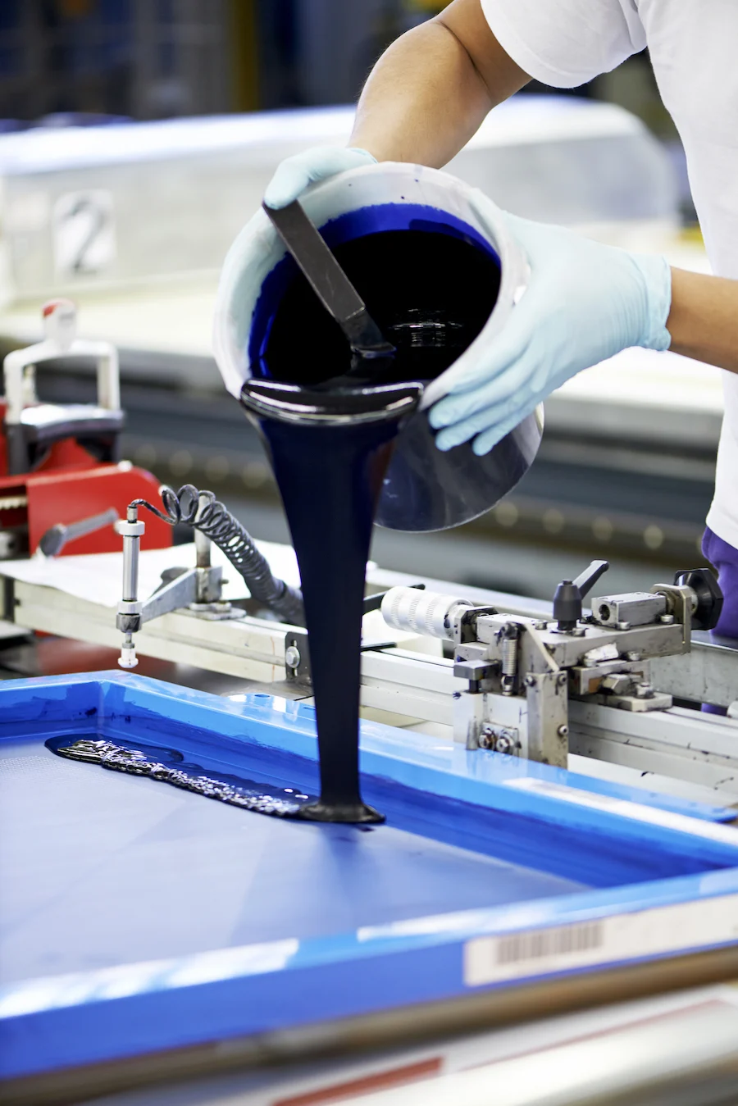
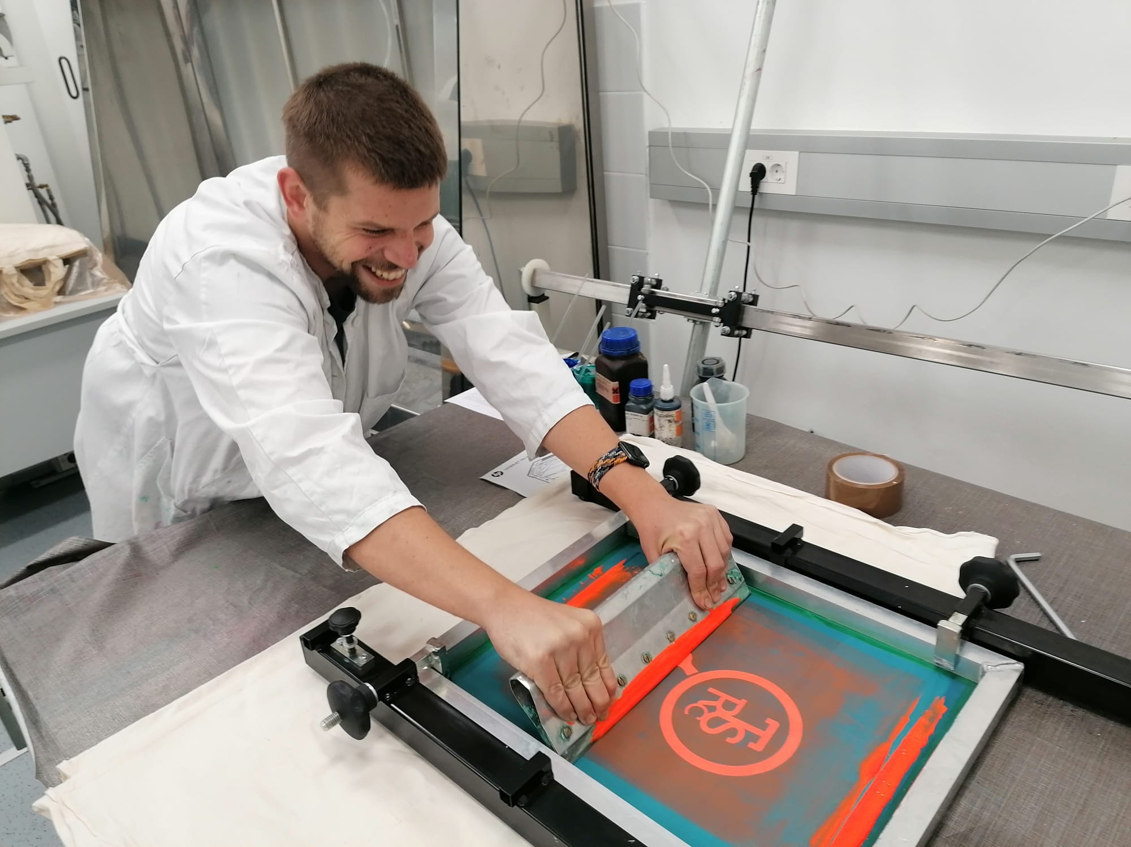
Pattern preparation, screen production with technical characteristics
Textile printing basic phases with aspects of fixing
The introduction to simple pattern and complex images preparation
Limitations due to technical requirements of printing machines
Basic tools for hand printing
Fixing methods
Steam fixing
Hot air fixing

Slide 10
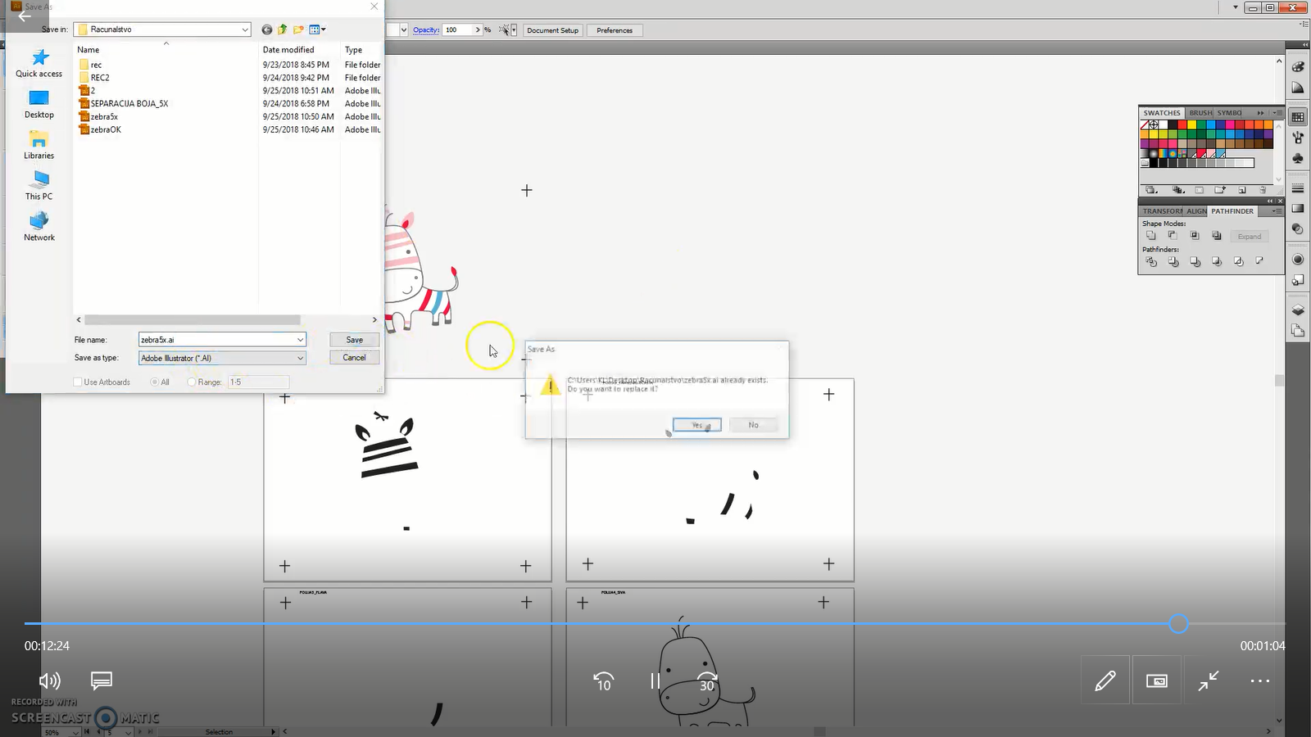
LESSON 2: Pattern and Screen Preparation
Digital tools in pattern-to-screen preparation (separation of the effects, size definition, methodology for complex images)
Selection and methodologies of screen preparation
Preparation of patterns with clearly defined boundaries between individual effects
Tutorial in Adobe Illustrator for separating the effects of a four-color, simple pattern – for students

Slide 11
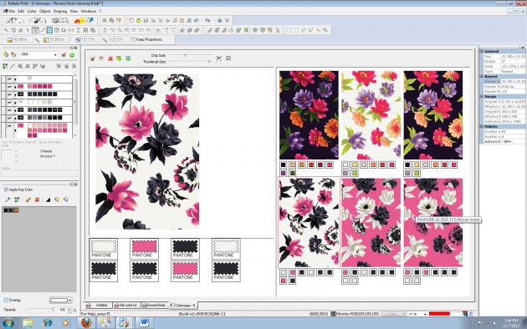
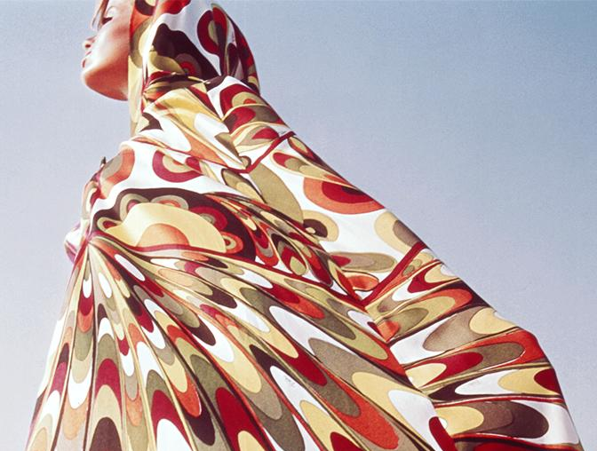
Preparation of patterns with defined color separation but raster effects -
Tutorial for simple color separation with usage of raster - for medium complex samples where there are shadowy transitions, but the defined colors can still be clearly separated

Slide 12
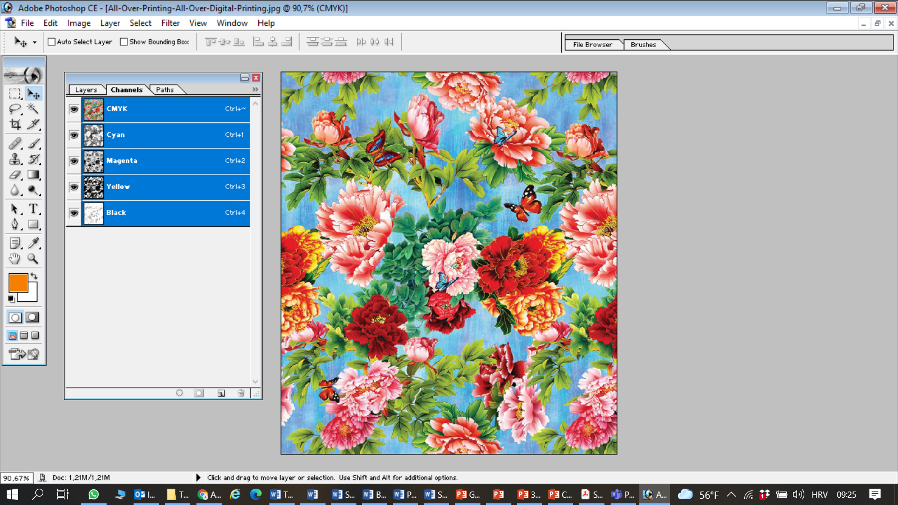
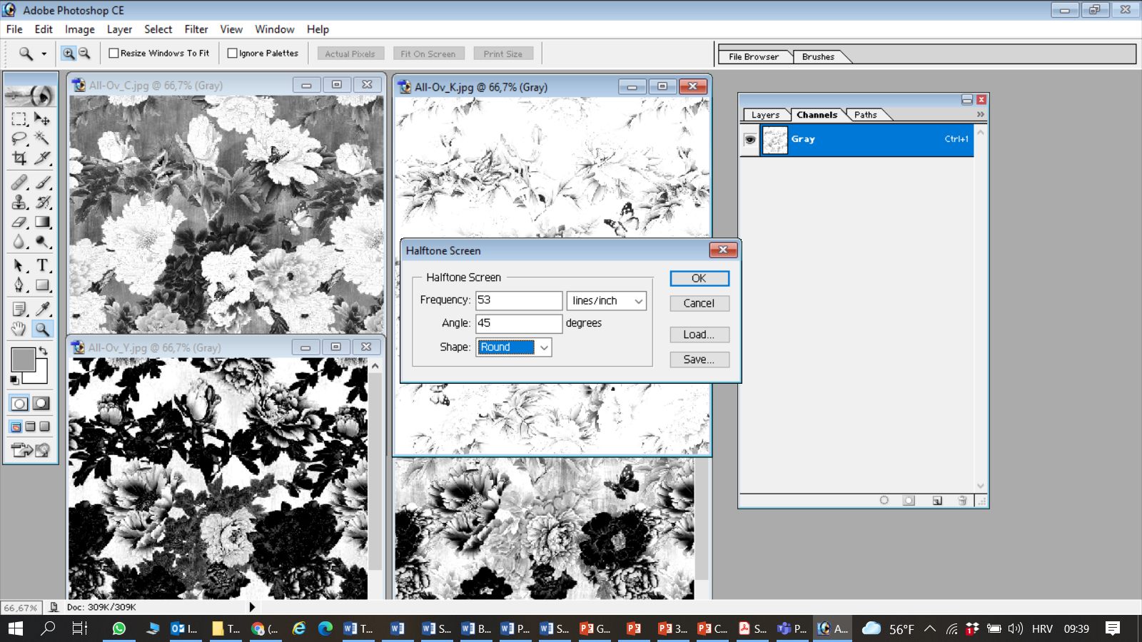
Preparation of complex patterns with undefined number of colors
Tutorial for preparing complex images, in which the number of colors and the boundaries between colored effects cannot be clearly defined. In such images, raster separation is performed in preparation for four-color screen printing in CMYK process inks.
Required skills and knowledge:
Understanding the relationship between raster fineness and screen mesh fineness
Calculation of raster fineness relative to screen mesh
Adjusting the frequency and shape of the raster dot depending on the characteristics of the sample, screen and textile material to be printed
Understanding the laws of subtractive color mixing

Slide 13
Digital tools in pattern-to-screen preparation (separation of the effects, size definition, methodology for complex images)
Selection and methodologies of screen preparation
Flat screens
Rotary screens
CAD systems for:
Light exposure
Laser exposure
Laser engraving

Slide 14
LESSON 3: Dyes and Pigments
Basic definition of dyes and pigments, structural and chemical difference between dyes and pigments, selection
Dyes and pigments with special effects (thermochromic, photochromic, fluorescent, phosphorescent, biomimetic)
Mechanisms of textile material and dyes/pigments interaction
Reactive dyes
Direct dyes
Vat dyes
Cellulose fibers (cotton, flax, hemp)
}
Dyes are coloured, mostly organic, water soluble chemical compounds which absorb light in visible spectrum. Dyes have certain affinity towards textile fibre and bond chemically with textile fiber over functional groups, giving a certain colour to textile.
Reactive dyes
Acid dyes
Protein fibers (wool, silk)
Basic dyes
Metal complex 1:1 and 1:2 dyes
Synthetic fibers (PES, PA, PAN)
Disperse dyes
Pigments are coloured, water insoluble chemical compounds that also have the property of absorbing light in visible spectrum giving a colour to a material, but they do not posses any natural affinity towards fibre and must be mechanically bonded to a textile material by usage of binders.

Slide 15
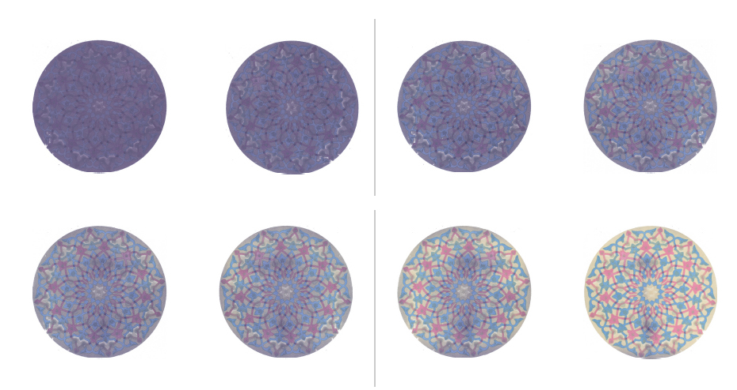
Basic definition of dyes and pigments, structural and chemical difference between dyes and pigments, selection
Dyes and pigments with special effects (thermochromic, photochromic, fluorescent, phosphorescent, biomimetic)
Mechanisms of textile material and dyes/pigments interaction
Smart textile production
THERMOCHROMIC DYES
Liquid crystals
Leuco dyes
Leuco dye can switch between two chemical forms and one of them is colorless.
Liquid crystal they provide a constantly changing spectrum of colors at a range of temperatures when observed

Slide 16
PHOTOCHROMIC PIGMENTS
Photochromism is the reversible change in color of a chemical structure between two different absorption spectrum. If a photochromic material is exposed to ultraviolet rays, its color will transform from its colored state to its colorless state.
FLUORESCENT and PHOSPHORESCENT PIGMENTS
Fluorescent dyes/pigments have the ability to simultaneously absorb and emit, provided they absorb shorter wavelengths (absorb in the UV region or VIS region bounded by UV) and emit longer wavelengths of the visible spectrum. They are characterized by the so-called Stokes shift.
Phosphorescence is similar to fluorescence, in that it implies a phenomenon that occurs when a substance absorbs radiation of a certain wavelength or group of wavelengths and re-emits photons of different wavelengths. The difference is in the show time. As a rule, if the emission stops after the excitation source is removed then the illumination is called fluorescence; if the emission continues (so-called "afterglow"), then it is called phosphorescence.

Slide 17
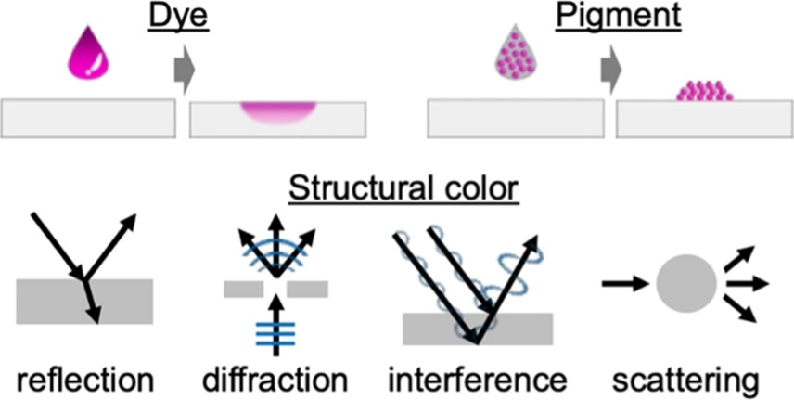
BIOMIMICRY – „Structural Colors”
Structural colours have iridescence or metallic appearance that cannot be obtained by mere chemical dyes or pigments, but needs to strategically design material composites with controlled variable nanostructures that can reproduce the biological structure itself These so-called ‘‘structural colours’’ usually have a distinctive appearance (shiny, metallic aspect often with an angle-dependent apparent colour) that contrasts with the dull and diffuse aspect of more common pigmentary colours.
Physically, structural colours are the result of the fundamental optical processes of diffraction, interference or scattering. In general terms, structural colours are produced by the microscopic patterns of a reflective material. The range of reflected wavelength usually varies with the polarisation of the incident light. But more strikingly, it often depends strongly on the refracting angle, meaning that apparent colours change when varying the viewing orientation. Hence, structural colours often appear ‘‘iridescent.’’

Slide 18
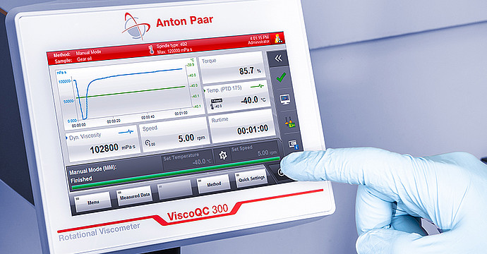
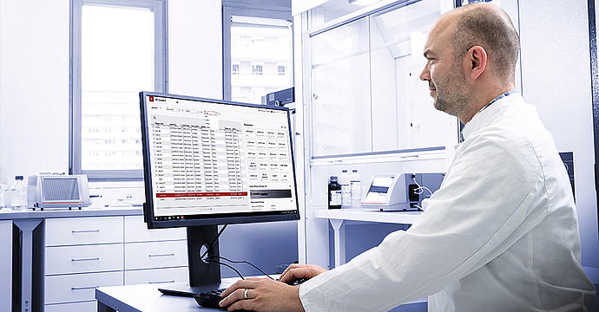
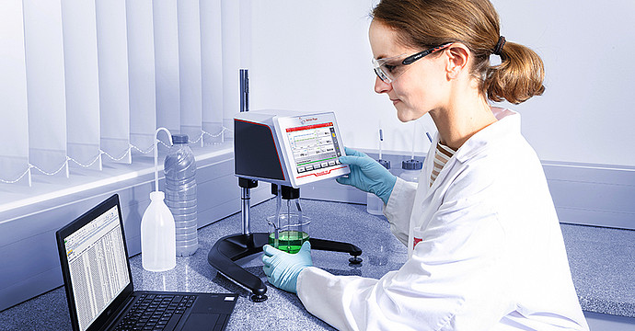
LESSON 4: Composition of the Printing Paste
Thickening agents play a paramount role in the formulation of printing pastes, ensuring through the modulation of the rheological properties, sharp and clean drawing patterns, by preventing dye migration, a homogenous distribution of the printing paste on the screen and its uniform flow through the screen openings. The selection of the thickening agent is determined by the fabric to be printed, the printing conditions, and, above all, the type of dye used.
Thickeners, chemical and physical characteristics, selection
Rheological properties of thickeners and printing pastes
ICT in RHEOLOGY
https://www.anton-paar.com/corp-en/products/details/software-solutions-for-viscoqc-software/?sku=219349
Stand-alone rotational viscometer with
software package
LIMS Bridge software which allows
for automatic method selection and
data export
The V-Collect data software - automatic data export in an xls file, ready for further analysis or graphical illustration.

Slide 19
LESSON 5: ICT in Textile Printing
ICT role in modern textile printing technology
ICT tools in textile printing (examples of specialized software)
Novel aspects of textile printing
Information transfer, digital texture visualization, colour objectification systems
Software for imaging, designing and color separation
CAD software solutions for textile printing industries are innovative packages, developed to achieve the highest quality in the shortest time.
They must be able to integrate into the entire production process.
Must be based on modular concept with all modules working “hand to hand“ to assure and simplify connection between designing (CAD) and screen production (engraving / light exposure - CAM).

Slide 20
Examples:
POINTCARE for printing
Designing module
Module for design preparation for digital or conventional rotary printing
Digital sampling
Matching digital sampling to rotary printing

Slide 21
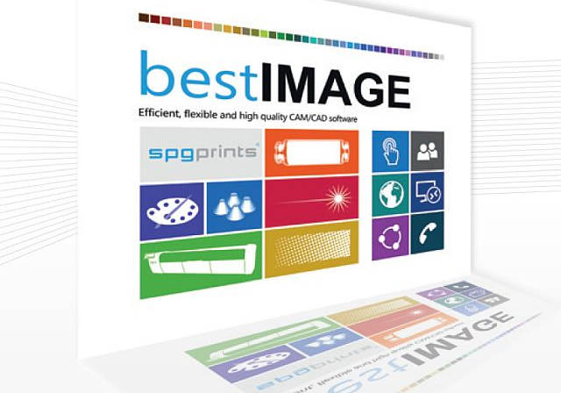
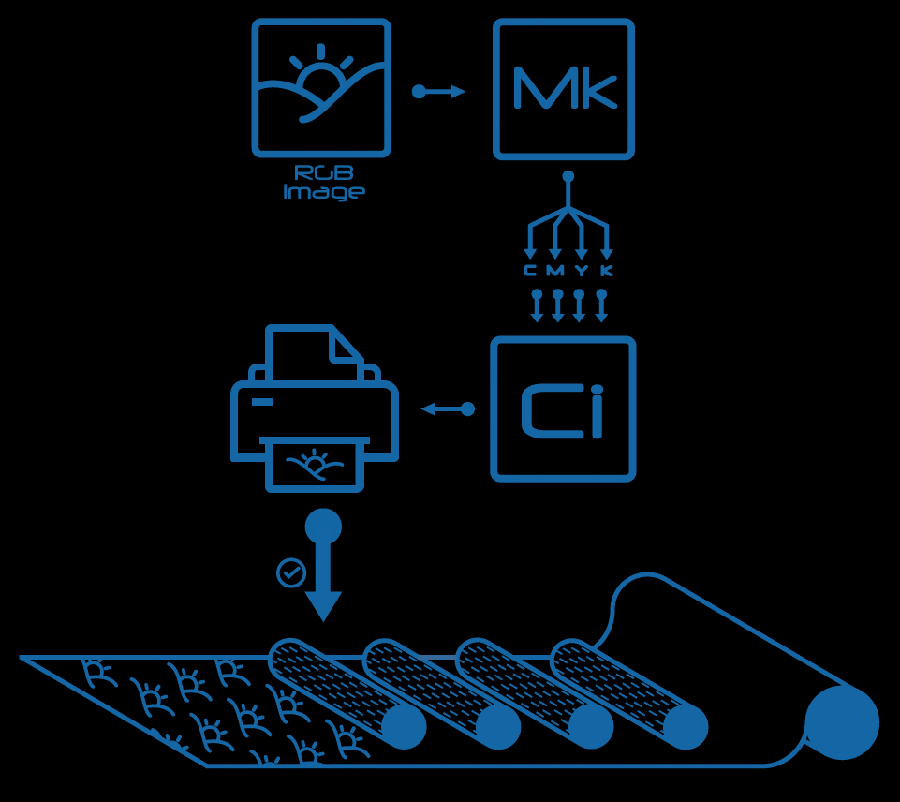
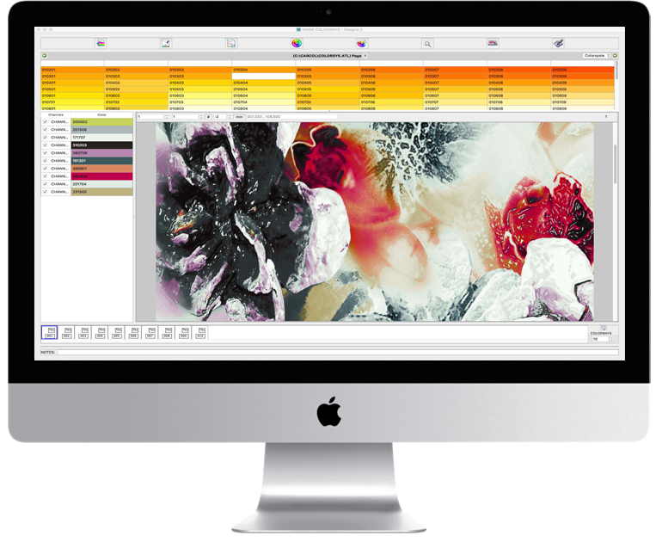
bestIMAGE - spgprint
Defining and editing designs.
Repeating, color separation, texture mapping, simulation, colors calibration
Modular settings – connecting the preparation phase with screen production by laser engraving or laser exposure method
Compatible with all commercial rotary printing machines
TREEPAINT
Solution engineered for 4-colour rotary printing
Module for design preparation, 3D simulation, color raster separation
Digital sampling
Rotary printing

Slide 22
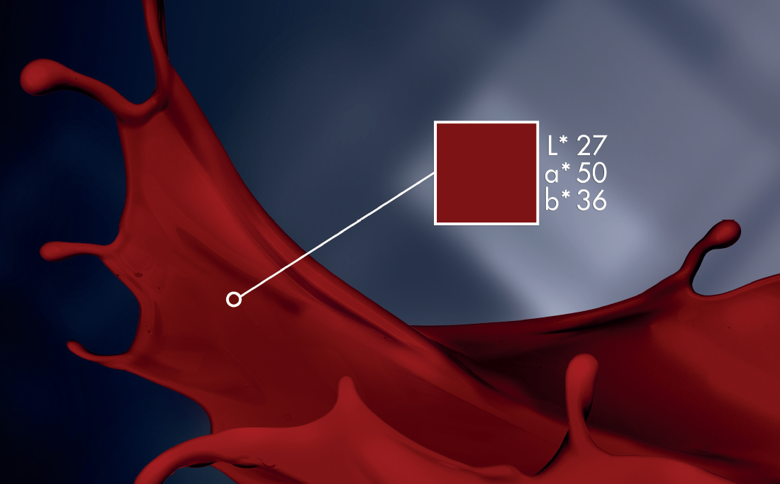
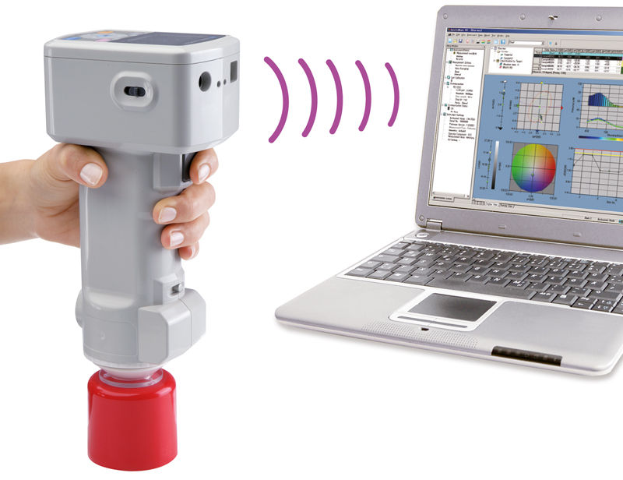
Color Objectification
Color metrics imply objective color measurement, based on the simulation of the visual experience of color, but in a much more precise system, which is performed by a spectrophotometer device. Color metrics involve objective, numerical evaluation of color, accurate color reproduction, and precise color differences.
In color metric, by color measurement, each color sensitive element associates the parameters required for its unambiguous (numeric) characterization. This implies accurate and precise evaluation of color, its accurate reproduction and accurate specification of color differences.

Slide 23
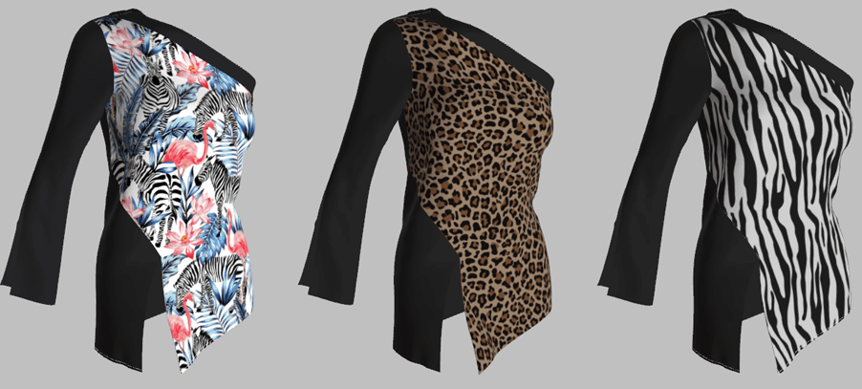
Color and Pattern Visualization
3D Collaboration – From Concept to Production
Draping and movement simulation
Pattern positioning
Pattern variation
Fabric and textures simulation
Visualizing garment in various materials, colors and patterns to get the visual properties of virtual sample.
Displaying styles in high quality rendering mode and viewing designs in an accurate, true to life virtual sample.

Slide 24
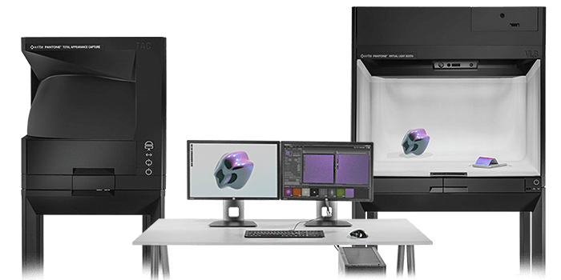
The BOOK of COLOUR
PANTORA Material Hub, part of X-Rite Total Appearance Capture ecosystem
Module for real materials migration into the digital form.
Setting for measuring and modelling the appearance characteristics of a physical material with high level of accuracy
Enabling unmatched realism and efficiency in virtual design.
Capturing physical appearance properties such as color, texture, gloss, translucency and transparency in a digital format.
Simplifying the maintenance and upkeep of samples by utilizing digital material libraries.
Eliminating ambiguities with precise accuracy to improve product quality and communication with stakeholders to reduce design approval cycles and accelerate time to market.
Reducing the amount of time spent manually adjusting and correcting scanned materials.
Experiencing more accurate renderings and improved product quality.

Slide 25
CONTACTS
Coordinator:
Technical University of Sofia
Department of Textile Engineering
Project Manager of ICT-TEX:
Prof. ANGEL TERZIEV, PhD
е-mail: aterziev@tu-sofia.bg
Web-site: ICT-TEX.eu
The information and views set out in this publication are those of the authors and do not necessarily reflect the official opinion of the European Union. Neither the European Union institutions and bodies nor any person acting on their behalf may be held responsible for the use which may be made of the information contained therein.

