Slide 1
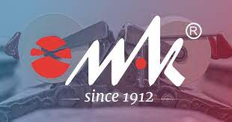
COMPANY MAK PLC PRESENTATION
ICT IN TEXTILE AND CLOTHING HIGHER EDUCATION AND BUSINESS (ICT-TEX)

Slide 2
LEADER OF Working package 9
DEVELOPMENT OF SYLLABUSES IN DESIGN AND PRODUCTION OF WOVEN FABRICS

Slide 3
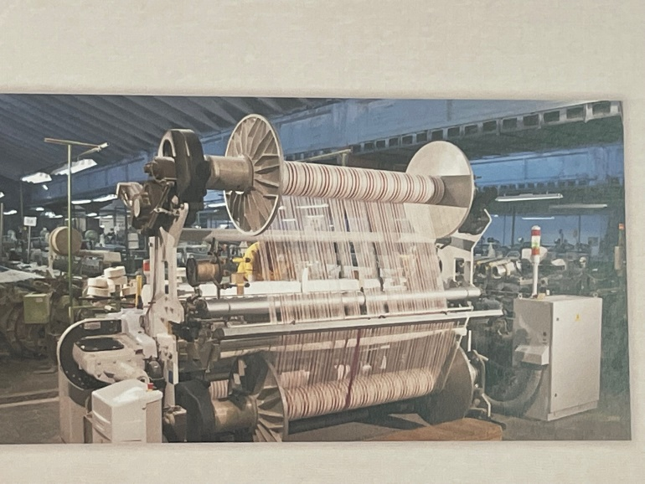
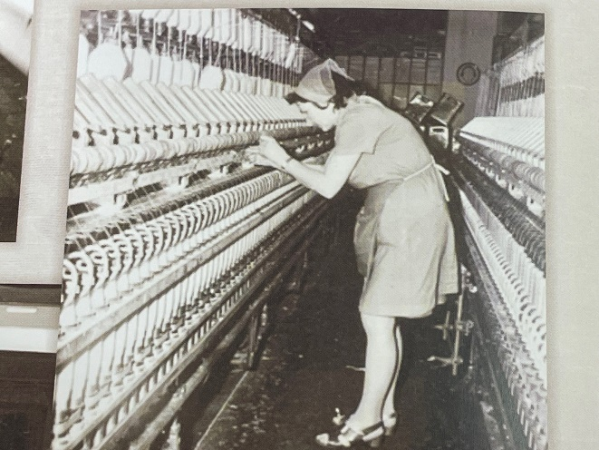
ABOUT THE COMPANY
HISTORY
Established in 1912
100 years later – monthly output between 250 000 and 300 000 meters
250 employees

Slide 4
OUR FABRICS
Company MAK has more than 500 different cotton and cotton type fabrics, developed in blends with polyester, polyamide, 100% polyamide or 100% polyester fabrics, in wide range of weights starting from 40 g/m² to 550 g/m², Dobby weaving
Medical fabrics
Special fabrics
Military fabrics
Workwear
Shirts

Slide 5
OUR MACHINES
WEAVING DEPARTMENT
Warping machines BENNINGER and HACOBA
Sizing machine – Sucker Müller
15 Twisting machines
2 assembly winding machines
21 PICANOL looms – Rapier and Air-jet
FINISHING DEPARTMENT
ZIMMER and STORK printing machines
BENNINGER PAD steamer
KUSTERS PAD steamer
KUSTERS Dyeing Foulard
HOT – MELTING LAMINATION LINE

Slide 6
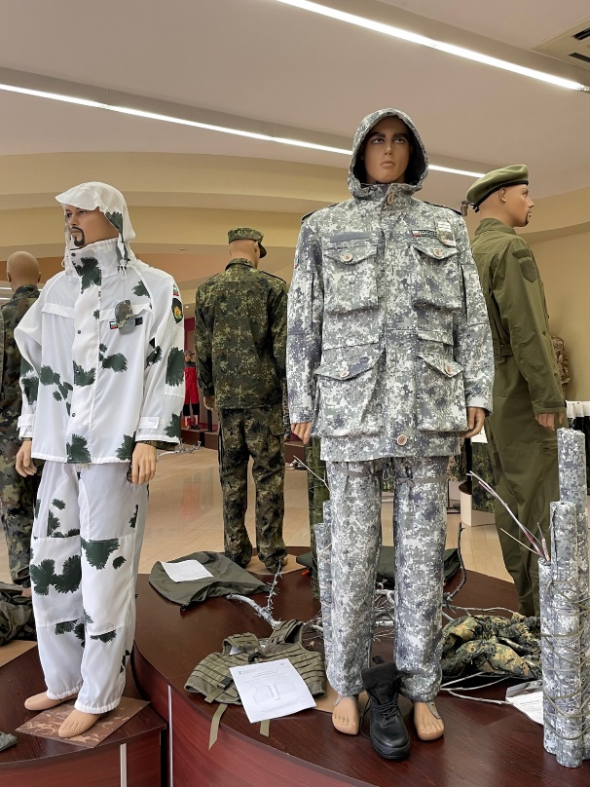
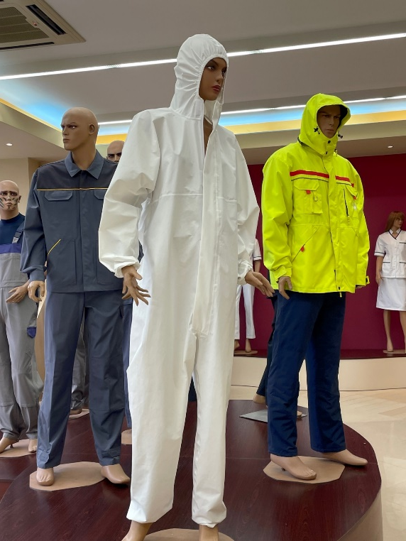
GARMENTS
Manufacturing of military, police, firefighter uniforms and equipment, ballistic vests, overalls, protective rain suits and raincoats, sleeping bags, rucksacks, tactical vests, protective coveralls against COVID and more.

Slide 7
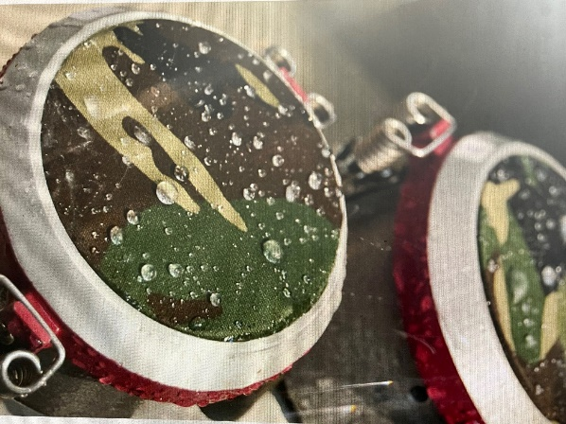
QUALITY CONTROL
ACREDITED LABOURATORY
MORE THAN 140 EUROPEAN STANDARDS

Slide 8
PROJECTS
Increasing the competitiveness of the company “MAK” AD through technological modernization of the production process“
"Safe and healthy work environment at “MAK” AD“
MAK AD with New Better and Safer Working Conditions", under contract BG05M9OP001-1.008-2400 of 09.06.2017, financed by procedure BG05M9OP001-1.008 "Good and Safe Working Conditions" of the Operational Human Resources Development Program 2014-2020.

Slide 9
ICT-TEX CHALLENGE
Overview the existing study programs, in the sphere of Design and production of woven fabrics – aims, competencies, knowledge
Identification of the good university practices
Development a study programs, collaborating with the partner universities (P1-P4)

Slide 10
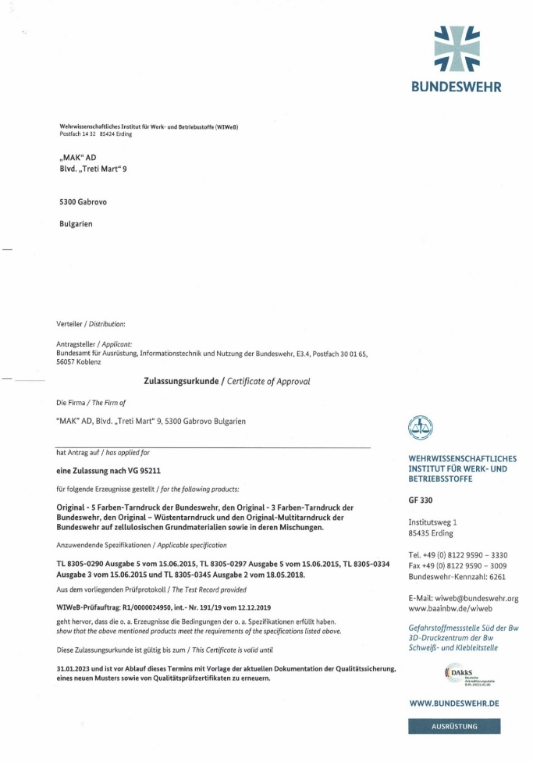
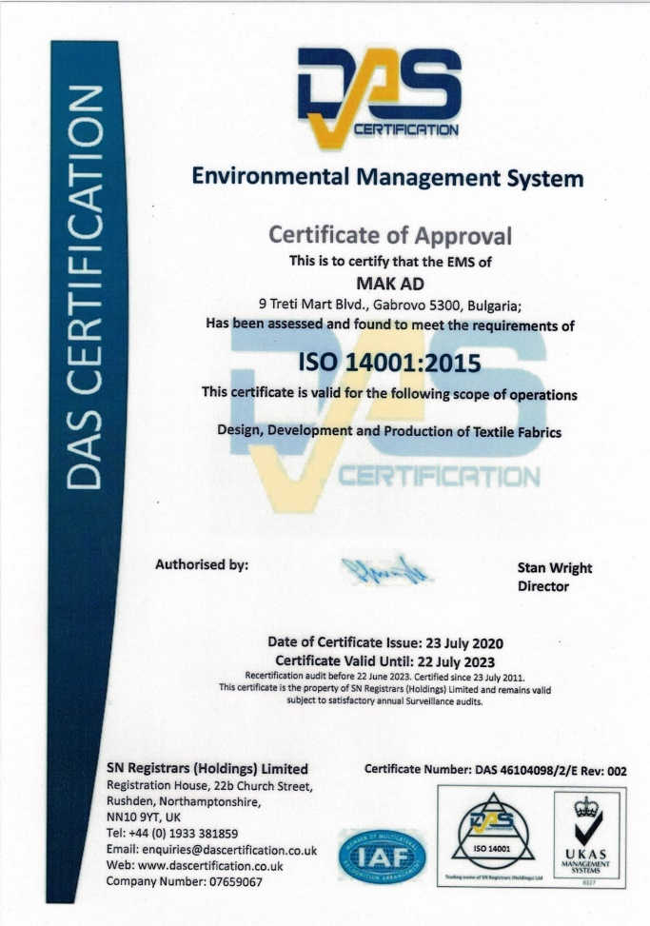
CERTIFICATES

Slide 11
POLICY
Reducing or limiting the use of hazardous substances in production processes
Rational use of materials and resources, including water and energy
Implementation of general and specific environmental objectives and environmental programs

Slide 12
CORPORATE GOVERNANCE
Balanced relationship between the Company's governing bodies, its shareholders and all interested parties
Transparency and fair cooperation between the company and stakeholders
The corporate governance of “MAK” AD is based on the rules and standards of the National Corporate Governance Code

Slide 13
Thank you for your attention!

