Slide 1
TOPIC 1. FUNDAMENTALS OF ENTREPRENEURSHIP
IN THE TEXTILE AND CLOTHING INDUSTRY

Slide 2
AGENDA
Fundamentals of Entrepreneurship
The Business Enterprise as a System
Invention and Innovation
Facts and Key Figures of the European Textile and Clothing Industry

Slide 3
Entrepreneurship definition
Entrepreneurship refers to the process of creating a new venture and bearing any of its risks, with the view of making the profit. It is an act of seeking investment and production opportunity, developing and managing a business enterprise, so as to undertake production function, arranging inputs like land, labour, material and capital, introducing new techniques and products, identifying new sources for the enterprise.
The entrepreneur can create a new business or develop a strategy to revitalize mature organisation in response to a perceived opportunity.

Slide 4
Entrepreneur definition
Entrepreneur is an individual who creates a new business, bearing most of the risks and enjoying most of the rewards. The entrepreneur is commonly seen as an innovator, a source of new ideas, goods, services, and a business model and procedures. The entrepreneur undertakes innovations, finance and business acumen in an effort to transform innovations into economic goods.
“Entrepreneur is someone who takes resources from a lower level of productivity and raise them to a higher level.” J. Schumpeter
The entrepreneurs impact and help the development and the growth of the economy.

Slide 5
Entrepreneur and economic development
The entrepreneur, who is a business leader, looks for ideas and puts them into effect in fostering economic growth and development.
The entrepreneur:
Promotes capital formation;
Creates large-scale employment opportunities;
Promotes balances regional development;
Creates and distributes wealth;
Increases Gross Domestic Product.

Slide 6
Advantages and challenges of being entrepreneur
Starting your own business can be an exciting and rewarding experience. It offers numerous advantages like being your own boss, setting your own schedule, and making a living doing something you enjoy.
Entrepreneurship brings with it a variety of challenges. Becoming a successful entrepreneur requires sound planning, creativity and hard work, and it also involves taking risks, because all businesses require some form of investment, usually time or money.

Slide 7
Entrepreneurs Vs intrapreneurs

Slide 8
Entrepreneurs Vs intrapreneurs
Entrepreneurs | Intrapreneurs
Provide the spark. | Keep the flame going.
Are found anywhere their vision takes them. | Work within the confines of an organisation.
Face many hurdles and they are sometimes ridiculed and riddled with setbacks. | May sometimes have to deal with conflict within the organisation.
May find it difficult to get resources. | Have their resources readily available to them.
May lose everything when they fail. | Still have a paycheck to look forward to if they fail.
Know the business on a macro scale. | Are highly skilled and specialized.

Slide 9
Characteristics of an entrepreneur
The successful entrepreneur possesses a combination of traits that show both innovation and leadership qualities:
Ambition;
Enthusiasm;
Creativity;
Problem-solving;
Decision-making;
Perseverance;
Discipline.

Slide 10
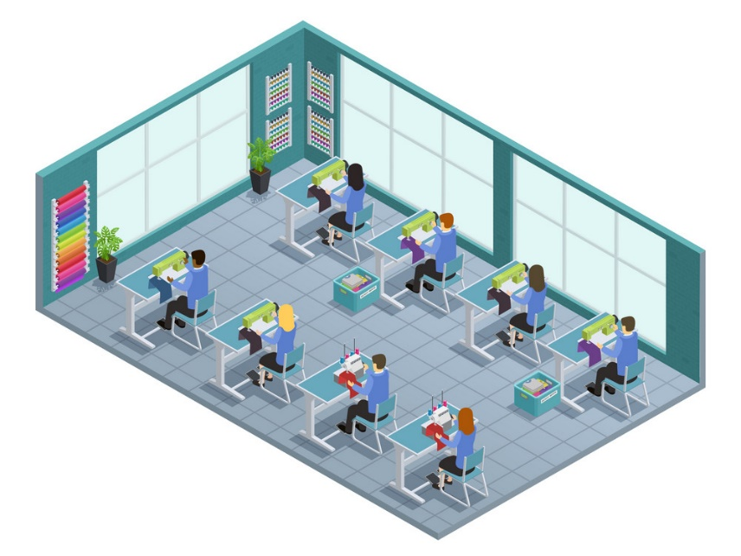
TCI enterprise as a system
Information
Managers
Information
Input
Output
Resources
Workers
Products
The TCI enterprise is an aggregation of processes and activities for production and distribution of goods and services in the textile and clothing industry. It is a way of organizing the economic activity of individuals with common goal.
Notes:
The input is transformed into products and
services through production process
Sells goods and services for profit
Hires employees
Operates under certain name

Slide 11
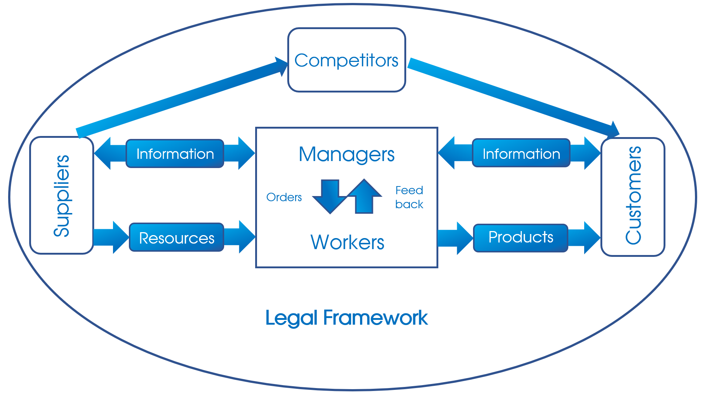
External environment of the TCI enterprise

Slide 12
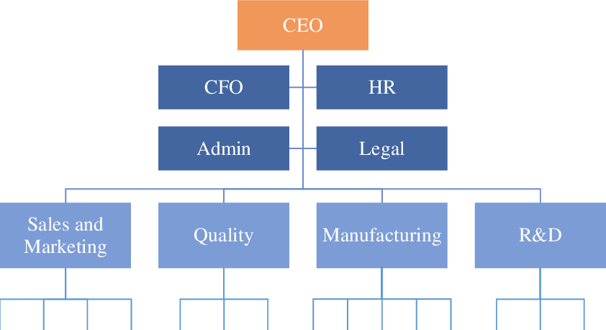
Inner factors of the TCI enterprise
Personnel
The main inner factors of the textile and clothing enterprise are:
Goals;
Tasks;
Personnel;
Structure;
Technology.
Technology
Personnel
Goals
Structure
Tasks

Slide 13
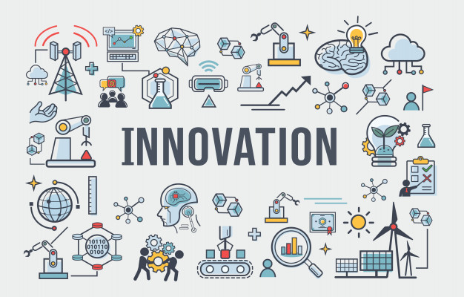
Innovation in TCI
Innovation refers to something new or to a change made to an existing product or field in the TCI. An innovation is a new or improved product or process (or combination thereof) that differs significantly from the unit’s previous products or processes and that has been made available to potential users (product) or brought into use by the unit (process). Oslo Manual, 2018

Slide 14
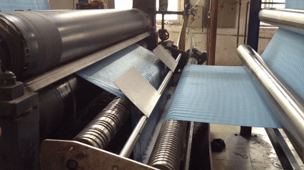
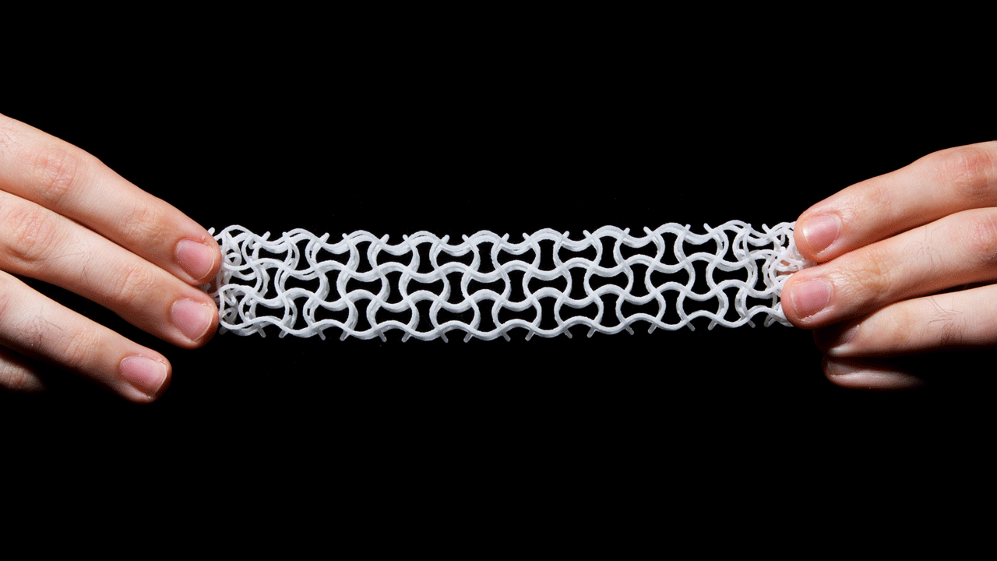
Invention in TCI
An invention is a unique or novel device, composition or method. It may be an improvement upon a machine or product or a new process for creating an object or a result. An invention is a result of a study or experiment. An invention that achieves a completely unique function or result may be a radical breakthrough. It is something that did not existed before.

Slide 15
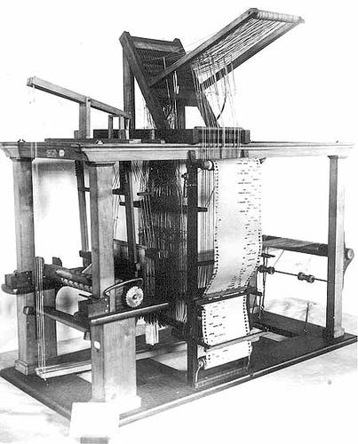
Invention vs innovation
Invention | Innovation
Refers to the occurrence of a new idea for a product or process that has never been made before. | Refers to the implementation of the idea for the product or process for the very first time.
Creation of a new thing. Technical solution. | Adding value and transforming the new thing into a product.
An original idea which strikes the inventor. Technical and scientific skills are required. | A need for the product or its improvement is felt. Marketing , technical and management skills are required.
Single solution or process. | A combination of various solutions and processes.
Limited to the R&D function. | Spreads through the whole organization.

Slide 16
Key figures of the European textile & clothing industry, 2019
The European Textiles and Clothing sector is a very globalized industry, with annual exports exceeding €61 bln and imports well over €109 bln.
Source: Euratex and Eurostat
Notes:
The textile and clothing (T&C) sector is an important part of the European manufacturing industry, playing a crucial role in the economy and social well-being in many regions of Europe. The sector includes ca. 160,000 companies (of which 99.8% are micro & small companies), employing 1.5 million people and generating a turnover of €162 billion. The textile and clothing industry covers a wide range of activities, from the transformation of natural or manmade fibres into yarns and fabrics, to the production of a wide variety of products such as hi-tech synthetic yarns, bed-linens, industrial filters, and clothing and fashion. The corona crisis has confirmed the strategic importance of the sector: the safety of healthcare workers and the population at large depend on textiles, but their importance goes far beyond. Without textile materials, no cars, airplanes or buildings can be built, nor can agrifood workers, defence and security forces or craftsmen, do their work in full.

Slide 17
The textile manufacturing process
A complex value chain and diversity of product
Source: Euratex

Slide 18
TCI share in total manufacturing activities, 2018
Nearly 1 out of 10 manufacturing companies in EU belongs to the T&C sector.
Source: Euratex

Slide 19
Size of companies (number of employees), share
Small and medium sized enterprises are at the core of the industry.
Source: Euratex

Slide 20
Evolution of labour force and productivity per employee
The EU T&C industry has achieved considerable gains in productivity per employee over the years.
Source: Euratex

Slide 21
Employment in the TCI by gender, 2018
Woman represent more than 70% of all employees in the sector.
Source: Euratex

Slide 22
Share of turnover by sector, 2019e
Source: Euratex

Slide 23
EU28 yearly evolution of exports to turnover ratio
The T&C industry becomes more competitive on global markets.

Slide 24
Product share by sub-sector
The clothing manufacturing is the main contributor to the total production
and technical textiles is growing importance.
Source: Euratex

Slide 25
Investments
The T&C industry
continues to invest in its future.
Source: Euratex

Slide 26
Household consumption
EU is a key market for fashion.
Source: Euratex

Slide 27
E-Commerce
Clothing and sports goods: most popular online purchases by E-shoppers in the EU.
Source: Euratex

Slide 28
World exports of textile
Europe is
the world’s 2nd exporter
in our industry.
38% of the industry’s turnover is sold on global markets, whereby SMEs are particularly active (covering more than 50% of those global sales).
Source: Euratex

Slide 29
World exports of clothing
Europe is
the world’s 2nd exporter
in our industry.
Source: Euratex

Slide 30
EU exports by product
EU trade exports’ growth in Europe has been driven by the clothing sub – segment.
Source: Euratex

Slide 31
Questions for discussion
What is entrepreneurship?
Who is an entrepreneur and how does he/she influence the business economics?
What are the differences between an intrapreneur and an entrepreneur?
What are the external factors of the TCI enterprise and how they influence its activities?
Name at least five personal characteristics that an entrepreneur needs. Think about some characteristics of an entrepreneur and determine if entrepreneurship is really right for you.
List several personal characteristics that might hinder someone from becoming an entrepreneur. In what ways could these characteristics also prevent someone from becoming a valued employee?
What is innovation and what is invention? Give examples for the TCI.
Which are the most developed sub-sectors of the textile and clothing industry in your country and town?

