Slide 1
Prof. Radostina A. ANGELOVA, PhD, DSc Technical University of Sofia, BULGARIA The course is developed under Erasmus+ Program Key Action 2: Cooperation for innovation and the exchange of good practices Knowledge Alliance
TRAINING COURSE
Design and production of woven fabrics
ICT IN TEXTILE AND CLOTHING HIGHER EDUCATION AND BUSINESS
Project Nr. 612248-EPP-1-2019-1-BG-EPPKA2-KA
The information and views set out in this publication are those of the authors and do not necessarily reflect the official opinion of the European Union. Neither the European Union institutions and bodies nor any person acting on their behalf may be held responsible for the use which may be made of the information contained therein.

Slide 2
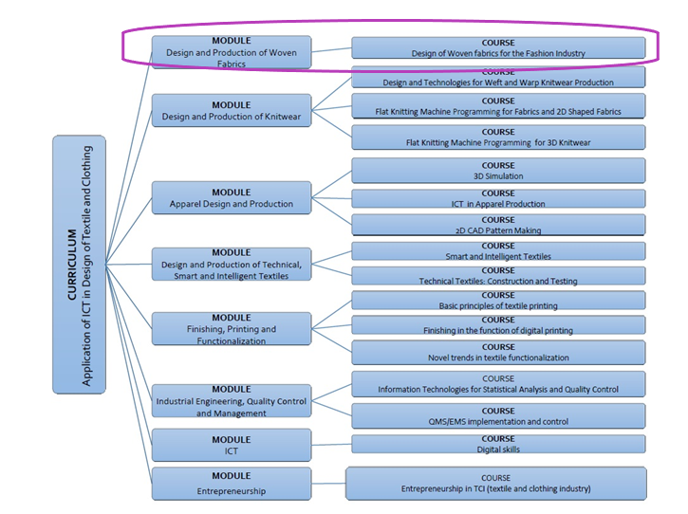
The information and views set out in this publication are those of the authors and do not necessarily reflect the official opinion of the European Union. Neither the European Union institutions and bodies nor any person acting on their behalf may be held responsible for the use which may be made of the information contained therein.

Slide 4
Course duration: 30 hours
Course description: The course deals with the production and design of weave patterns for fabrics, which could be used in the fashion industry or in the interior design. All themes would involve theoretical explanations and practical solutions with the application of a CAD/CAM software where possible (for the weave design). Depending on the needs of the company, some of the themes could be excluded or rearranged.

Slide 5
Course objectives:
The students to gain experience in the production of woven textiles, including preparatory processes, weaving machines and mechanisms
The students to acquire the necessary theoretical and practical knowledge in the design of weave patterns using CAD systems for two-dimensional design
The students to get a creative impulse for designing new weave patterns

Slide 6
Course content: 6 topics
Topic 1: Introduction to weaving and weaving preparatory processes (5 hours)
Topic 2: Weaving machines (5 hours)
Topic 3: Woven fabrics design and construction (3 hours)
Topic 4: Elementary weaves and their derivatives (3 hours)
Topic 5: Design of weave patterns for different fabric effects (10 hours)
Topic 6: Additional methods for design (4 hours)

Slide 7
Learning materials: As required in the project, three types of materials will be developed
For students: all participants, involved in the course to gain new knowledge
For trainers: the university teachers or researchers with experience in the field will have the possibility to use extra training materials, research articles, suggestions for online videos, books and correct answers of the quizzes.
For staff (practitioners): practical tips, step by step explanations of weave pattern creations, etc.

Slide 8
Topic 1. Introduction to weaving and weaving preparatory processes (5 hours)

Slide 9
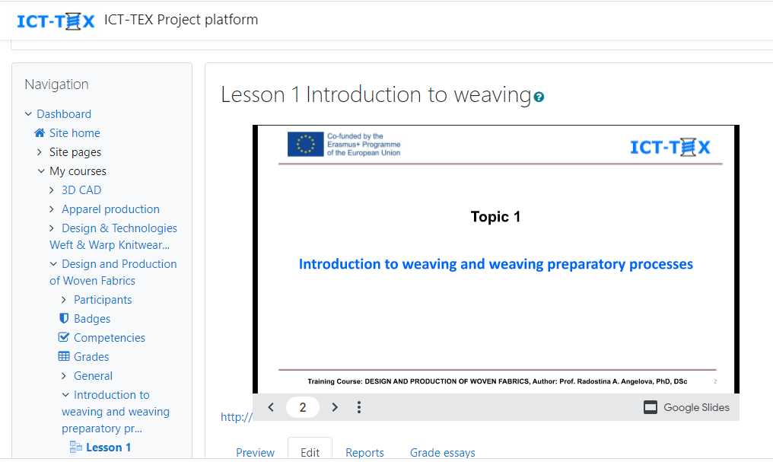
Topic 1. Introduction to weaving and weaving preparatory processes (5 hours)

Slide 10
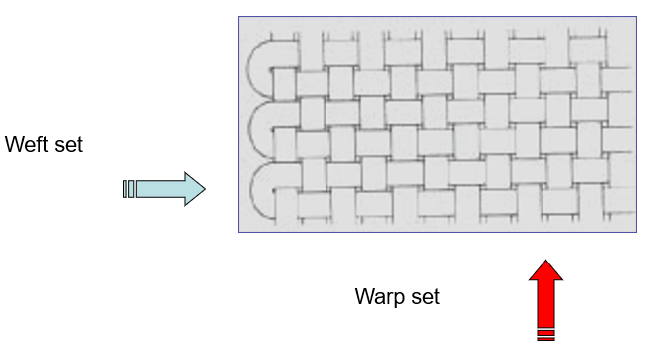
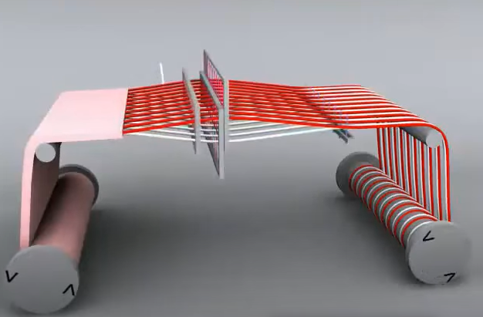
Topic 1. Introduction to weaving and weaving preparatory processes
Lesson 1: Introduction to weaving
The lesson introduces the woven textiles and the principles for their formation

Slide 11
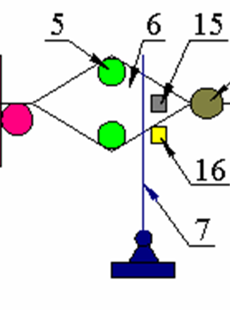
Topic 1. Introduction to weaving and weaving preparatory processes
Lesson 1: Introduction to weaving
It explains the basic mechanisms and elements in a weaving machine:
Warp set let-off
Shed formation
Filling (weft thread) insertion
Beating-up
Cloth take-up

Slide 12
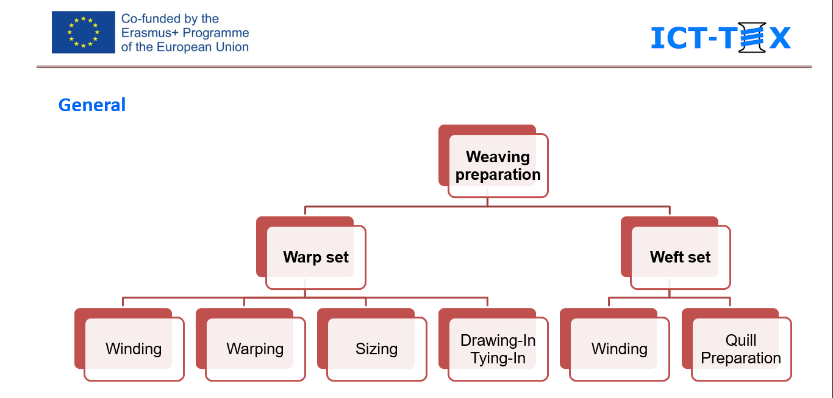
Topic 1. Introduction to weaving and weaving preparatory processes
Lesson 2: Weaving preparatory processes. Winding
The lesson introduces the weaving preparation processes, starting with the winding.

Slide 13
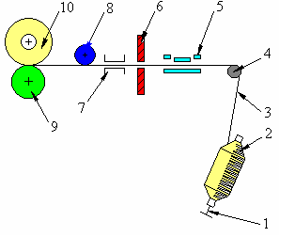
Topic 1. Introduction to weaving and weaving preparatory processes
Lesson 2: Weaving preparatory processes. Winding
Lesson content:
Essence and aims of the process
Working principle of the winding machine
The three zones of action of the winding machine:
Spool Unwinding
Drawing and Cleaning
Bobbin winding
Characteristics of the process
Quality control

Slide 14
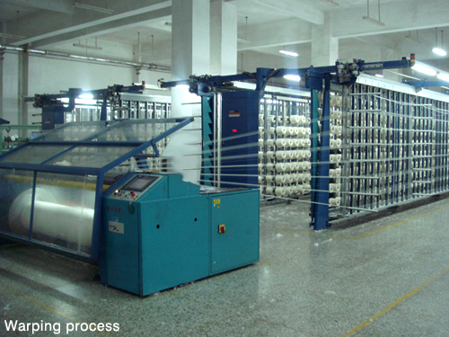
Topic 1. Introduction to weaving and weaving preparatory processes
Lesson 3: Weaving preparatory processes. Warping
Lesson content:
Essence and aims of the process
Types of warping machines
Direct warping
Indirect warping
Characteristics of the process
Warping frames
Quality control

Slide 15
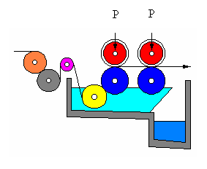
Topic 1. Introduction to weaving and weaving preparatory processes
Lesson 4: Weaving preparatory processes. Sizing
1.5-4.0 daN/cm²
Lesson content:
Essence and aims of the process
Basic terms
Sizing materials and additives
Sizing machines
Characteristics of the process
Quality control

Slide 16
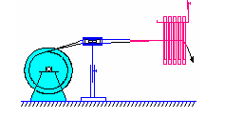
Topic 1. Introduction to weaving and weaving preparatory processes
Lesson 5: Weaving preparatory processes. Drawing-In and Tying-In
2
3
Lesson content:
Essence and aims of the processes
Characteristics of the process
Devices used
Quality control
1
4

Slide 17
Topic 2. Weaving machines (5 hours)

Slide 18
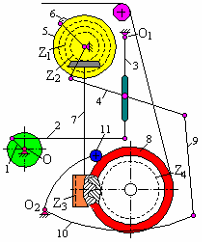
Topic 2. Weaving machines
Lesson 6: Warp let-off mechanism
Lesson content:
Aim of the mechanism
Types of mechanisms, working principles
Role of the back rest roller
Quality control

Slide 19
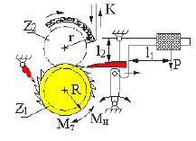
Topic 2. Weaving machines
Lesson 7: Take-up mechanism
Lesson content:
Aim of the mechanism
Working principles
Types of mechanisms
Calculations
Quality control

Slide 20
Topic 2. Weaving machines
Lesson 8: Shedding mechanisms
Types of shedding mechanisms
Cam shedding
Dobby shedding
Jacquard shedding
Lesson content:
Aim of the mechanism
Shed formation
Types of shed
Types of shedding mechanisms
Cam shedding
Dobby shedding
Jacquard shedding

Slide 21
Topic 2. Weaving machines
Lesson 9: Filling insertion mechanisms
Weaving machines
Shuttleless
Rapier
Projectile
Air-jet
Water-jet
Shuttle
Multiphase
Filling direction
Warp direction
Single phase
Lesson content:
Aim of the mechanism
Types of filling insertion mechanisms
Shuttle weaving
Projectile weaving
Rapier weaving
Air-jet weaving
Water-jet weaving
Multiphase weaving

Slide 22
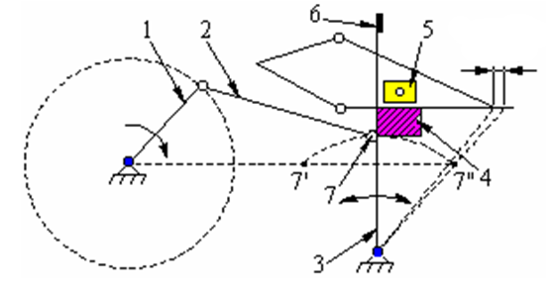
Topic 2. Weaving machines
Lesson 10: Beat-up mechanism
Lesson content:
Aim of the mechanism
Types beat-up mechanisms
Applications

Slide 23
THANK YOU FOR YOUR ATTENTION !

Slide 24
CONTACTS
Coordinator:
Technical University of Sofia
Faculty of Power Engineering and Power Machines
Project Manager of ICT-TEX:
Assoc. Prof. Dr. Angel Terziev
е-mail: aterziev@tu-sofia.bg
Web-site: ICT-TEX.eu
Contact: Prof. Radostina A. Angelova, PhD, DSc
radost@tu-sofia.bg, joy_angels@abv.bg
The information and views set out in this publication are those of the authors and do not necessarily reflect the official opinion of the European Union. Neither the European Union institutions and bodies nor any person acting on their behalf may be held responsible for the use which may be made of the information contained therein.

