Slide 1
TOPIC 4. TCI ENVIORNMENT FOR ENTREPRENEURS

Slide 2
AGENDA
Entrepreneurial Goals and Objectives. Goal Setting
Blue Ocean Strategy
Opportunities and Threats of the TCI Environment
Market Research and Analysis
Porter’s Five Forces of Competitive Position Analysis
Value Proposition Canvas

Slide 3
Learning goals and objectives
In this topic the students will learn how to set goals and objectives for their business and to use different entrepreneurial strategies. They should learn how to use specific instruments and tools to analyze the market and challenge their competitors. The students will learn how to put in practice the value proposition model.
Short summary of content
Entrepreneurial goals and objectives defined. Innovative goals and Blue Ocean Strategy. Opportunities and threats of the TCI. Market analysis. Porter’s Five Forces of Competitive Position Analysis. The Value Proposition Canvas.
Expected results
Students to set SMART goals for their business, taking into account the opportunities and threats from the external environment and on this basis to create an innovation that add value for the customers. Using different entrepreneurial tools, they can easily identify customers’ problems and find business opportunities to meet the customers’ needs.

Slide 4
Entrepreneurial goals and objectives
Goals and objectives are a critical component of management, both in terms of planning and in terms of the larger Planning-Organizing-Leading-Controlling framework that is used in entrepreneurship.
Goals are outcome statements that define what an organisation is trying to accomplish, both programmatically and organizationally. Goals are usually a collection of related programs, a reflection of major actions of the organization and provide rallying points for managers.
For example: the T&C company might state a financial goal of growing its revenues 20% per year or has a goal of growing its international markets.

Slide 5
Objectives in the TCI
Objectives are very precise, time-based, measurable actions that support the completion of a goal. Objectives typically must:
be related directly to the goal;
be clear, concise and understandable;
be stated in terms of results;
begin with an action verb;
specify a date for accomplishment;
be measurable.
Example: Going back to our textile company’s example and in support of the company’s 20% revenue growth goal, one objective might be to open three new stores in the next six months.

Slide 6
Innovative goals

Slide 7
Innovative goals
To promote an understanding of fashion and textile design in relation to the needs of fashion, contractual furnishings, home textiles, and B2B textile products.
To provide hands-on experience using a set of complex technologies found in industry today to build prototypical solutions to solve current needs.
To provide business experience in responding to fashion and textile market opportunities with creative and innovative products that integrate textile materials, design fundamentals, business fundamentals, sourcing, data mining of market information, and new developments in material science and engineering.

Slide 8
Innovative goals
4. To create an internal entrepreneurial environment that approximates the actual conditions in industry by building studios and workshops containing state-of-the-art systems, resources, technologies, and a community of creativity and innovation.
5. To develop strong multi-functional teamwork and communication skills using visual and verbal presentation assignments and interfaces with practitioners in the design community and the textile industry.

Slide 9
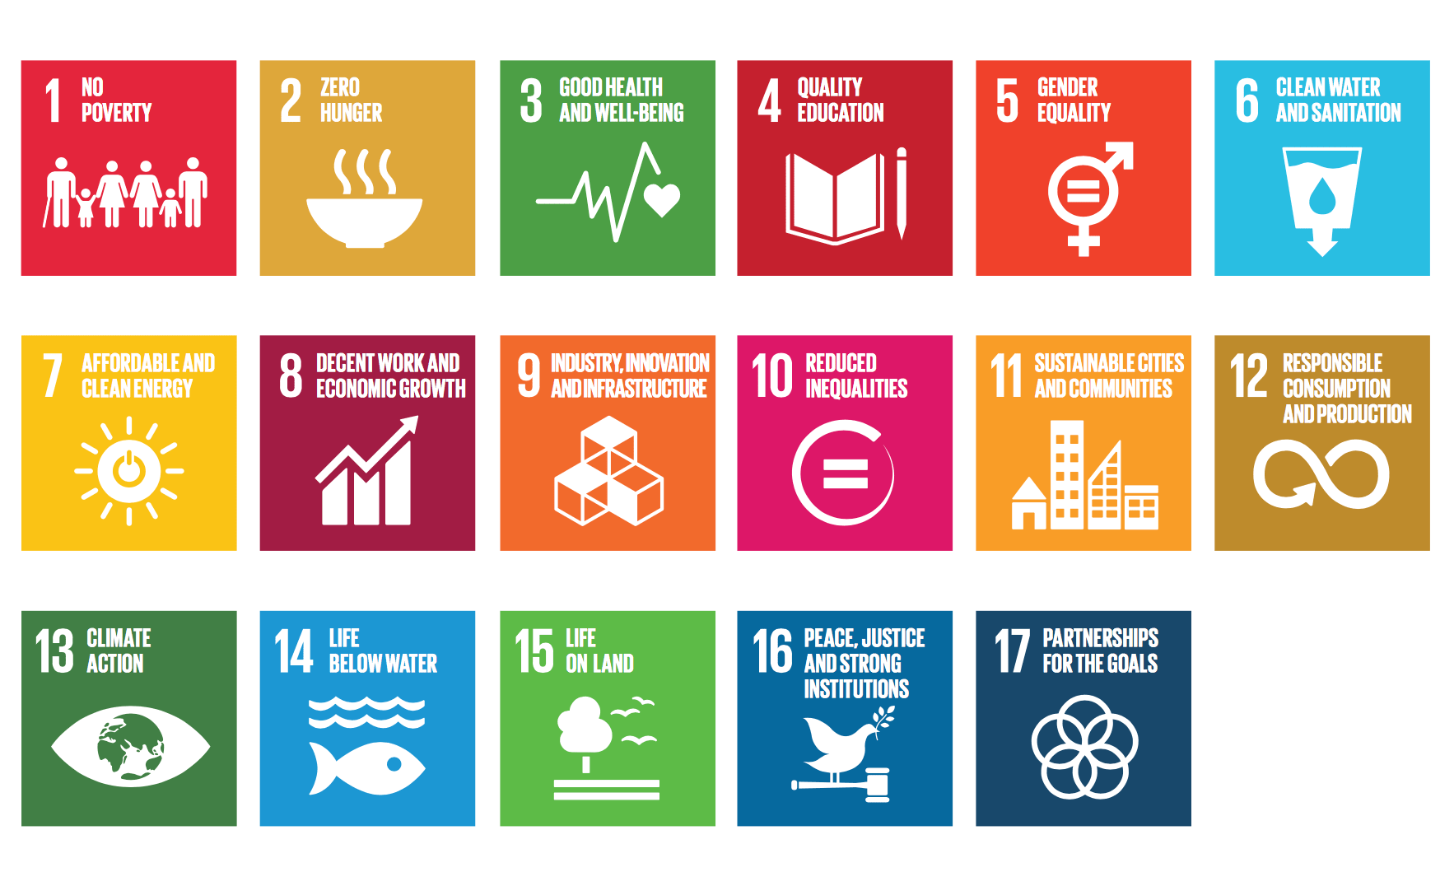
Innovative sustainable goals

Slide 10
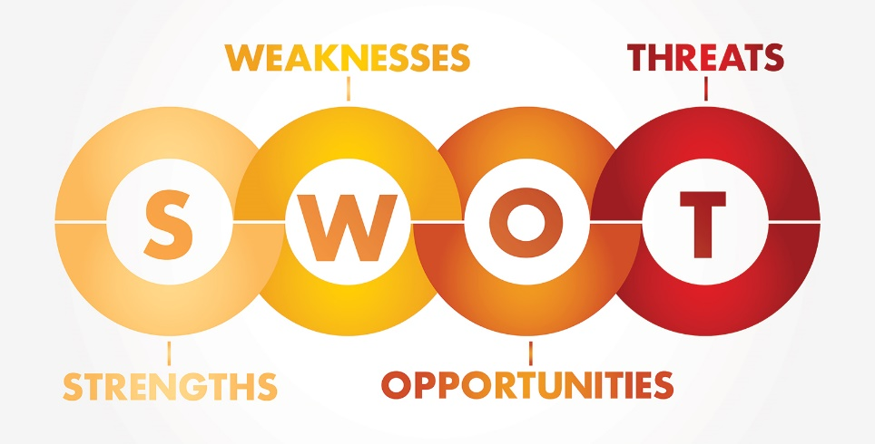
Opportunities and threats of the TCI environment
Opportunity is any favourable situation in the organisation's environment. It is usually a trend or change of some kind or an overlooked need that increases demand for a product or service and permits the firm to enhance its position by supplying it.
Threats are anything that could cause damage to your organization, venture, or product. This could include anything from other companies (who might intrude on your market), to supply shortages (which might prevent you from manufacturing a product).

Slide 11
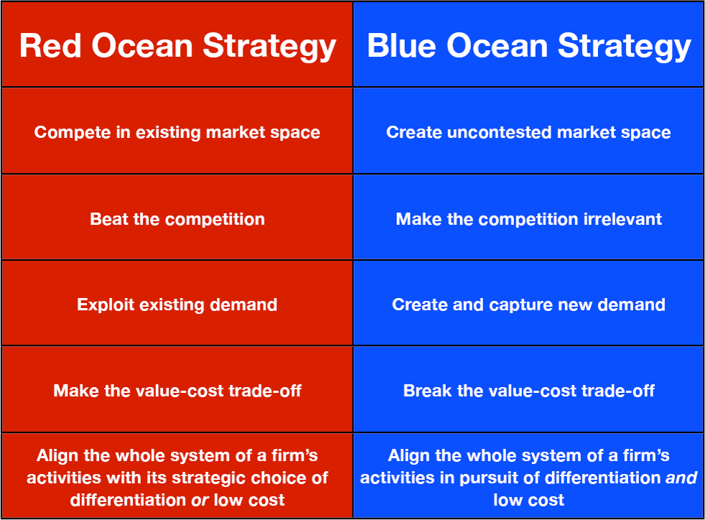
Blue Ocean Strategy
Source: www.business-to-you.com/blue-ocean-strategy/

Slide 12
Assignment 1
Give examples for some of the current TCI environmental trends:
The introduction of a better alternative for an impersonal apparel product, incl. fast fashion development and apparel and fabrics personalization.
Gender/Generation features of textile and clothing, incl. Generation X, Generation Y, Generation Z.
New laws for clean environment production of fabrics.
Growing digitalization of the economy and apparel online shopping.
Attention to sustainability and circular economy.
Use of artificial intelligence.
Importance of social media and influencers for the apparel design.

Slide 13
Assignment 2
Find out some of the TCI environmental trends in the Zara example: Process Innovation – Zara – 7innovation. Place the given trends onto the dashboard.
opportunities
strengths
threats
weakness

Slide 14
Assignment 3
Collect a set of key facts about a T&C enterprise from your country and its environment. This will include facts about the organisation's markets, competition, financial resources, facilities, employees, inventories, marketing and distribution system, R&D; management, environmental setting (e.g. technological, political, social, and economic trends), history and reputation. Evaluate the data to determine whether they constitute strengths, weaknesses, opportunities or threats for the enterprise.
Notes:
This may be done independently by the individuals in a group, results being compared afterwards.

Slide 15
Market research and analysis

Slide 16
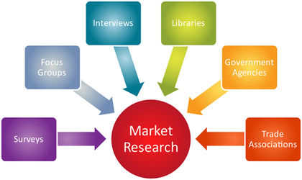
Market research and analysis
Market research is the process of determining the viability of a new service or product through research conducted directly with potential customers. Market research allows a company to discover the target market and get opinions and other feedback from consumers about their interest in the product or service. Investopedia

Slide 17
Research the T&C industry
You will need to know what others in T&C industry are doing, even if they are not your direct competitors.
Trade Associations and your local Chamber of Commerce as information sources.
Use Internet to find reports and analysis of your industry. This will help you see if experts are predicting a downward or upward trend, any new laws and regulations that you have to conform to and ascertain the general feelings toward the T&C industry.
You should never stop learning about your customers, competition, or industry; they are constantly changing.
Notes:
You will need to know what others in T&C industry are doing, even if they are not your direct competitors. Trade Associations and your local Chamber of Commerce are good places to start. Use the Internet to find reports and analysis of your industry. This will help you see if experts are predicting a downward or upward trend, any new laws and regulations that you have to conform to and ascertain the general feelings toward the T&C industry.
There is no one market research source that will answer all of your questions, so you’ll need to get information from multiple sources. Additionally, market research is essential to the ongoing success of your business even after you start. You should never stop learning about your customers, competition, or industry; they are constantly changing.

Slide 18
Define your customer
You need to know who your target customers are. Know your customers’ preferences, where they shop, what they like, what they do not like. You have to create a target customer profile.
The customer profiling has to be completely unique, based on your mission, values, and your business goals. These documents should be alive and change along the way, together with your business.

Slide 19
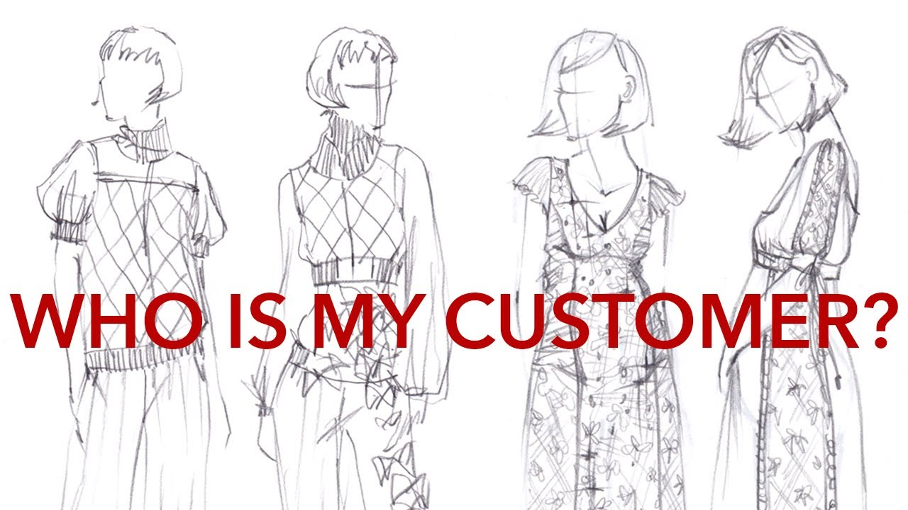
Define your customer profiling in segments
Demographical:
Gender; Age; Marital Status; Education; Job; Income; Religion; Country; Living environment.
Psychological:
Life style; Interests; Values; Style; Vacation and free time; Shopping behavior and motive; Online or offline shopping preferences; Goals and aspirations.
Customer info:
What social networks do they prefer?; Where do they consume their news?; What challenges do they face?; What are their problems?; How do they decide to spend their money?; What would make your customers recommend your brand to their friends?; Best ways to reach your customer.

Slide 20
Assignment 4. Determine your target market and define your customer
Think about who your potential customers are and make a list defining their demographics, including age, education level, geographic location, and income level. You need to know what potential customers want, what price they are willing to pay, how they decide what to buy, and where they buy it. A common mistake with new business owners is assuming that if the business owner would buy the product, everyone else will as well.
Use customer reviews on Amazon.com and take a look at the customer reviews posted about businesses or products similar to your idea.

Slide 21
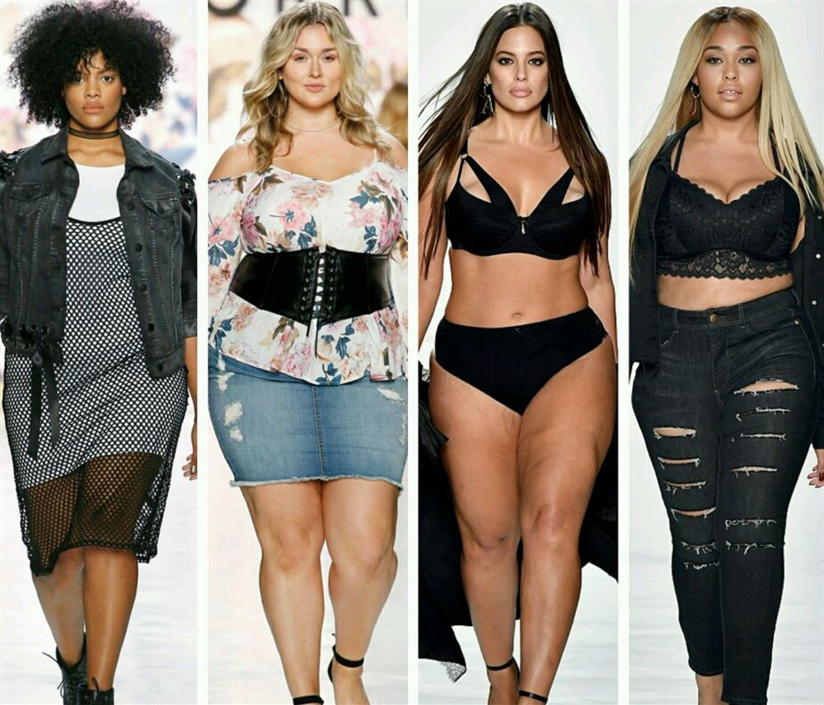
Define your niche in a three trillion dollar fashion industry
A niche market is a small subset of the market for a specific demographic, product type, a particular price point, and a certain quality. A place where there is high demand and low supply.
For startups to enter the market, they need to place themselves in a relatively small niche.
Notes:
The advantage of finding your own niche is less competition. They need to be where their target customers are, and where there is a healthy amount of competition. If there are a few competitors, it means that there is a market and a need for your type of product and concept. You can always tweak your concept, values, business strategies and products to differentiate yourself from the others. By doing this, startups will increase their chances of growing.

Slide 22
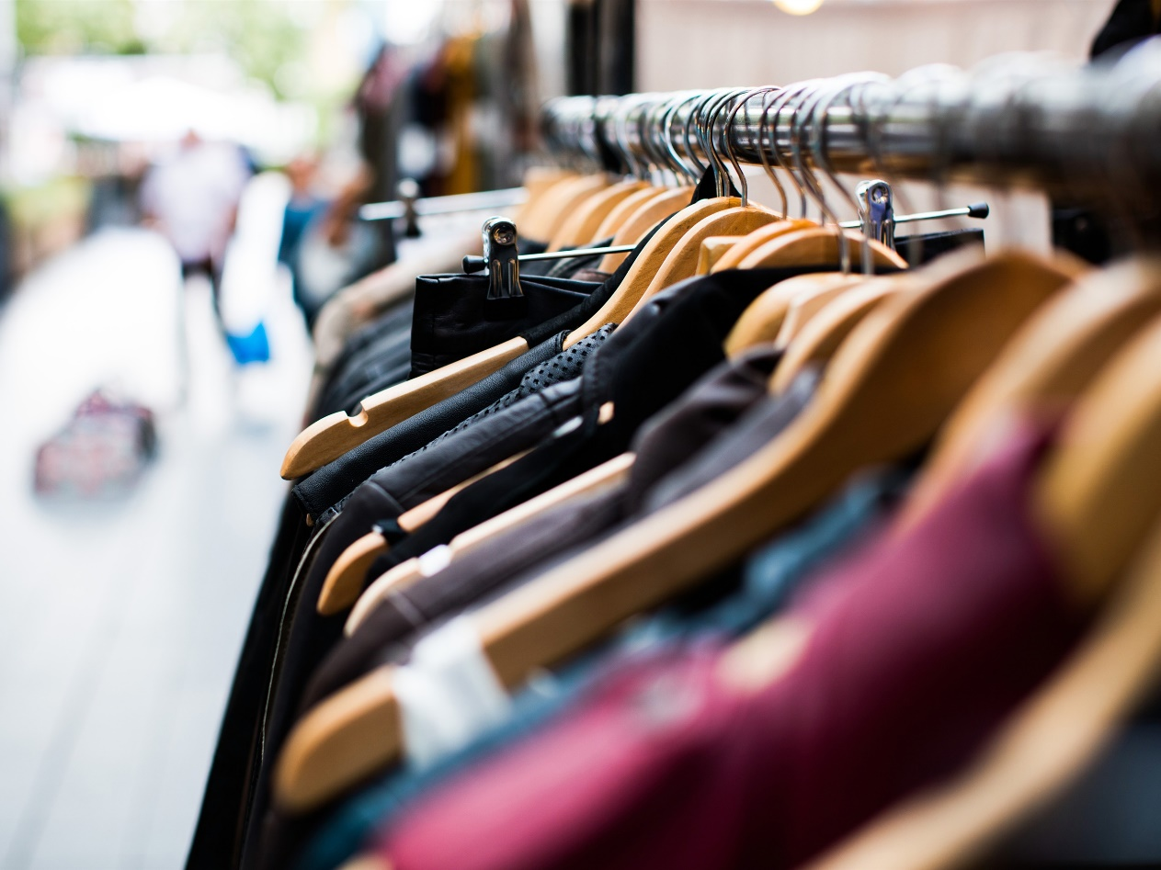
Get to now your competition
Who are your competitors?
What price ranges are there?
What quality do your competitors offer at what price?
Do you know the collections, the colors, the materials, the marketing, the stories, and the pitches of the competitors?
What do you offer that is unique?
With what your business will be better or different?
Is your competition only local or global?
Notes:
Use the web to conduct a search on popular business listings in the fashion market. Assess how your offerings compare to your competitors.
How can you work that into your marketing plan to set you apart from the competition?
Is your competition only local (for example, with a boutique shop) or is it global (any products that can be shipped or services that can be done remotely can get to your customers from anywhere in the world)?

Slide 23
Porter’s five forces of competitive analysis
Source: https://www.business-to-you.com/porters-five-forces/

Slide 24
What problems can you solve? Most of the successful apparel brands in the market, solve some sort of a problem for their target customer. What needs does your target customer have and how are you going to solve his problems?
Testing of your T&C business idea and products
When you test your idea, you will have lots of valuable information to tweak your product offering. You will also know how to talk your customer’s language, making it easier for you to connect, attract and keep your customers. Be aware of how small your niche is. If there are not that many customers that want your products, you will have a hard time to grow your business.

Slide 25
Value Proposition Canvas
Source: www.strategyzer.com

Slide 26
Assignment 5
Having in mind your T&C business idea answer these questions:
What segment do you want to start in? Menswear, bridalwear, sportswear, streetwear, childrenswear, etc.?
What gender should it be for? Men’s, women’s, kids, unisex?
Do you want to sell online, retail, a mix?
What is your geography?
Where is your customer?
What price segment will your products be in?
What quality do you want to have? (this is often related to the product price).

Slide 27
Assignment 6
Talk directly to potential customers. If you know people that fit your ideal customer profile, talk to them. Tell them about your concept and ideas and show them product ideas. Stay super focused on your true ideal customer. See how they react to your idea. Would they buy your product? Ask them what elements are important to them, whether it’s price, quality, reputation in the T&C industry, or something else.

Slide 28
Questions for discussion
Give an example for a long-term business goal.
Give an example for a short-term business goal.
What does the acronym SMART stand for?
What is the difference between the red and the blue ocean in the Blue Ocean Strategy?
What opportunities do you see around you to start your own business in the TCI?
What challenges can you anticipate starting your own business?
In the segment area that you have defined, what are the problems that you are going to solve for your customers? How are you going to do this through your products?

Slide 29
Questions for discussion and tasks
Define a niche for your product. Evaluate your product offering and the receiving in your market. Adjust your offer to serve your niche better.
Visit a trade fair for your type of products. Imagine your product being exhibited next to all other brands and products in this fair. How would you get noticed? What would set you apart?

