Slide 1
ICT - TEX WP 10 Non-wovens

Slide 2
// Non-wovens - Naturals

Slide 3
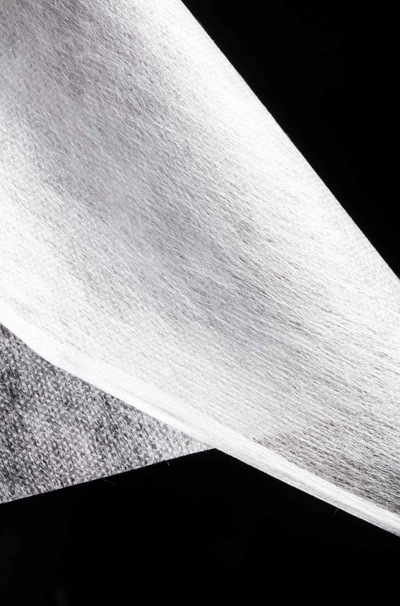
Ingeo Hydrophilic Nonwoven
Durable, hydrophilic PLA-based nonwoven for absorbent hygiene products with lower carbon footprint and longer shelf life. It consists of 15 gsm (0.44 osy) spunbond fabric from 100% Ingeo PLA, topically modified with 0.3 wt.% Lurol-15231-25%. Its surface energy can be tailored via the topical treatments designed specifically for PLA nonwovens, enhancing its fluid management with improved strike-through, re-wet resistance (2x higher), and run-off metrics compared to polypropylene (PP) for superior skin health. Improved permanence/durability reduces the amount of topical treatment needed for nonwovens, which decreases the potential for skin irritation and reduces surface finish wash-off, keeping the surface tension high. In diapers, using this nonwovens system for the topsheet can increase the efficacy of the absorbent core, enabling a reduction in super absorbent polymer (SAP) or pulp by up to 30% and resulting in thinner, more comfortable, and cost-effective products. In addition, it offers improved breathability due to its higher water vapor transmission rate, and is easy to manufacture via spunbond, meltblown, or staple fiber processes. The melt spinning and calendering optimization studies showed that a range of fabric improvements are also possible to improve its softness, tensile strength, and elongation. It can come in a range of weights from 15 gsm to 75 gsm (0.44 osy to 2.2 osy) from partner customers. Applications are for diapers, adult incontinence, and feminine hygiene products.
NatureWorks LLC 15305 Minnetonka Boulevard www.natureworksllc.com

Slide 4
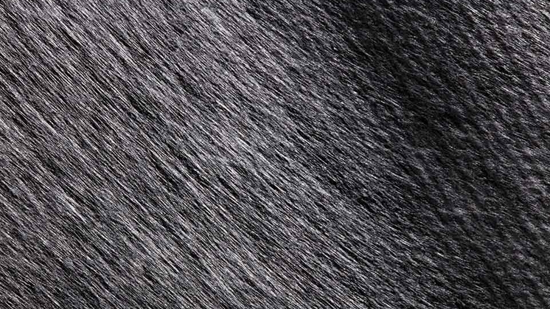

Slide 5
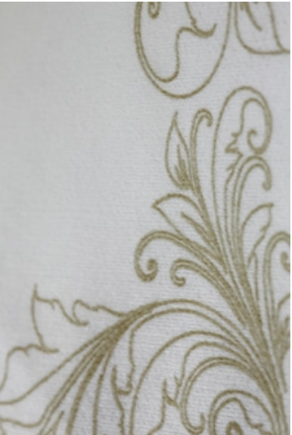
NOVOLINO™ Nonwoven
Disposable, nonwoven textile composed of 60% wood pulp, 25% polypropylene (PP) and 15% polyester (PES). The first nonwoven that bridges the gap between traditional airlaid nonwoven and linen for tabletop applications. It combines softness, quality and disposability. The synthetic layer protects diners’ dark clothing from fiber linting. It ensures consistency of color and hygiene and guarantees a clean, fresh napkin every time.It allows for many design variations, offering flexibility of color and design. The nonwoven is produced in a composite process and the material is then converted into consumer and food service items. The material is provided in reel format. Reel widths are based on customer’s requirements, from 200 - 3200 mm (7.87 - 126 in). It is only sold in white ready-to-print in 45 – 70 g/m2 (1.33– 2.06 oz/yd2) basis weight. FSC and FDA certification is underway on this product. Applications include napkins, tablecovers, runners (in both restaurant and residential environments) and airline (headrest covers and a disposable alternative for high-end sleeping products in First and Business class).
Suominen Corporation Finland www.suominen.fi

Slide 6
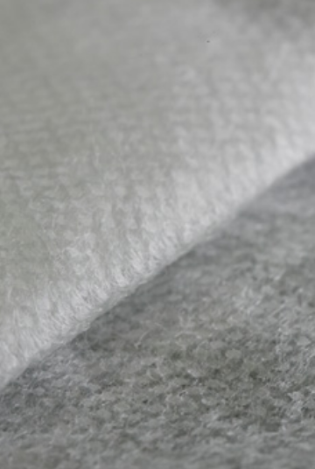
Green PE/PLA Biobased Nonwoven
Spunbond nonwoven textile from 100% rapidly renewable resources. The fibers are comprised of bio-based polyethylene (PE) and polylactic acid (PLA) in a sheath/core fiber structure. This textile utilizes complex fiber structure to provide the many technical specifications required of nonwovens, while using bio-based content. The combination of ecological composition with performance attributes offsets petrochemical usage in a market comprised largely of disposable goods. Pellets of PLA are made from ethanol, which is distilled form fermented corn. Bio based PE is created in a similar manner, using fermented sugarcane as its base. Solid PLA and PE pellets are melted and extruded though a spin pack, which orients the liquid polymers into a sheath/core construction. This results in a single fiber comprised of two polymer types, in which a PE sheath surrounds a PLA core. This bi-component fiber is continuously extruded onto a moving belt, as busts of air lengthen the fiber and randomize its orientation. The fibrous web is then run through a heated textured roller, which melts portions of the overlapping fibers to bond the fabric structure together. Basis weights of 13.5 to 85 gsm are offered, rolls can be slit to custom widths, the maximum width available is 126 in (3.2 m). The textile comes in a standard white color, with custom dying to match swatches or Pantone numbers available per customer request. Two bonding patterns are available: diamond and oval. Additionally, hydrophilic or hydrophobic chemistries can be added to the surface. Physical property test results vary with basis weight, but testing for breaking force and elongation, as well as air permeability can be provided for a specified textile grade. As a point of reference the 23 gsm product has the following typical properties in the machine direction and cross direction respectively: tensile strength (ASTM D5035-11) 24.8 N/2.54 cm and 13.0 N/2.54 cm and elongation at break (ASTM D5035-11) of 57% and 66.7%, the air permeability (ASTM D737-08) of 572 CFM. Applications include wipes, feminine hygiene, medical garments, diapers, filtration, and disposable textile goods.

Slide 7
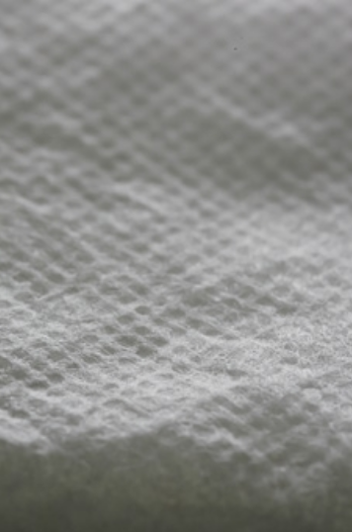
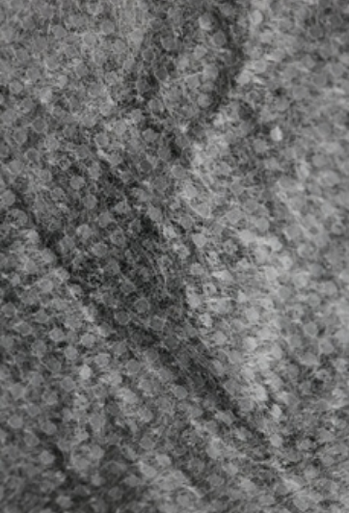
Fitesa United States
www.fitesa.com

Slide 8
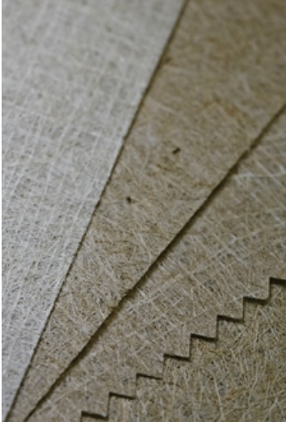
Jute Non-Woven
Range of nonwoven fabrics composed of jute fibers, a rapidly renewable bast fiber. The material is able to be produced in a 30 gsm (0.88 oz/yd2) weight, equivalent to a spunbond polypropylene (PP), is comparable in price as well as being biodegradable, which PP is not. In comparison to other jute materials, these nonwovens have a smoother surface and are lint-free. For applications in agricultural settings, the textile offers advantages over plastic films or textiles as it is breathable and permeable. The fabrics are produced in a patented process which bonds the fibers together into lightweight, paper-like sheets which can be washed and reused. Some of the fabrics contain a woven scrim for additional strength and dimensional stability. The weight ranges from 30 – 150 gsm (0.88 – 4.42 oz/yd2). The fabric is naturally tan in color but can be printed. Applications include shopping bags, agriculture mulch films, packaging and reinforcements for composites.
Hangzhou E.F. Green Technology Co. Ltd China www.hzgreen.cn

Slide 9
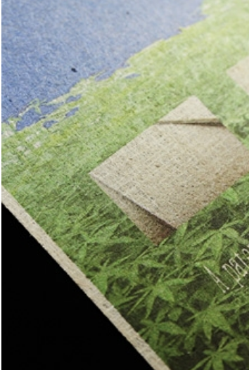
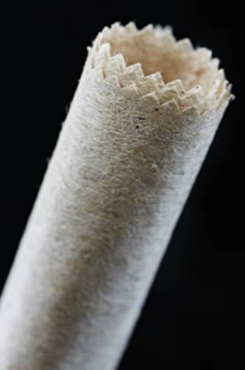

Slide 10
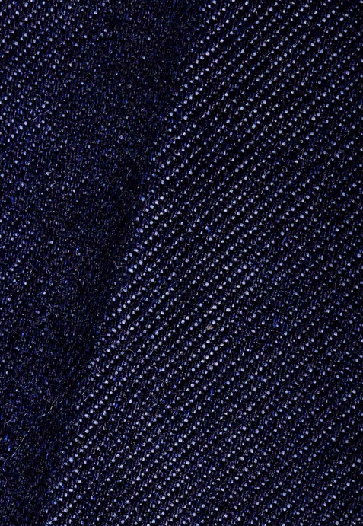
Infinited Fiber
A technology that produces cellulosic fiber textiles and non-woven fibers from paper waste (both pre and post-consumer). The process can turn textile and paper waste into new fibers for the textile industry – not just once, but infinitely, without any decrease in the quality of the fiber. The technology provides chemically regenerated fibers for the fashion and technical textile industries with the ability to replace 100% viscose fibers. The new fibers can also replace cotton in several applications. Today, there simply is not enough cotton available to meet the growing demand. Besides, viscose production uses carbon disulfide (CS2), one of the most environmentally and medically hazardous chemicals. The core of the technology consists of three key processes: activation, dissolving, and fractioning. The technology has major cost and ecological advantages and fits into any existing pulp and viscose fiber plant. The resulting high-performance fiber has a natural handfeel like cotton, 30-40% higher color uptake, and natural antibacterial properties. It also needs considerably less water for production than cotton, up to 5,300 gal (20K L) less water per lb (kg) than cotton, and 160K ha less forest needs to be harvested than viscose (30% of viscose comes from endangered and ancient forests). Key figures for a 1.3/40 fiber made from 100% textile waste includes a decitex (dtex) of 1.3, tenacity when dry of >22 cN/tex, tenacity when wet of >10 cN/tex, elongation when dry of 15-20%, and a length of 40 mm. The company’s pilot capacity will expand from 50 to 500 tons by 2020. The first licensed commercial plant is scheduled for 2020-2021 and the first high volume >100K ton plant is scheduled for 2022-2023. Their business model is to sell technology licenses to existing fiber producers in textile and non-woven industries. Applications include apparel, footwear, accessories, and automotive and furniture upholstery.
Infinited Fiber Company Oy Finland www.infinitedfiber.com

Slide 11
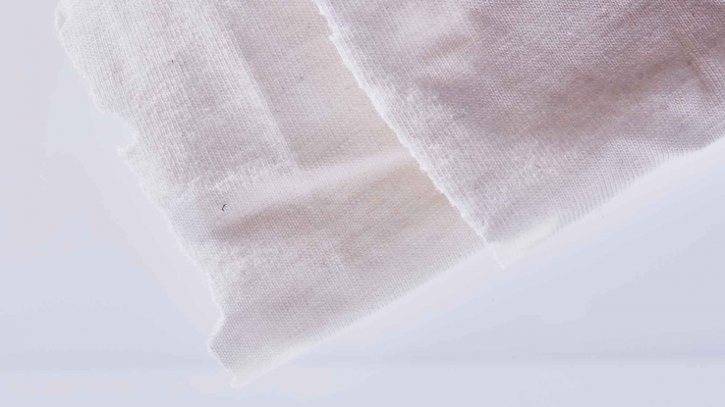

Slide 12
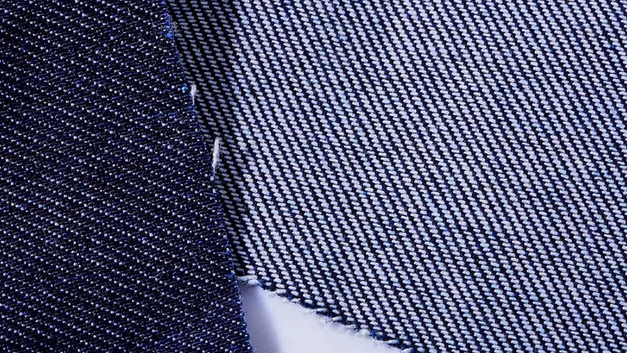

Slide 13
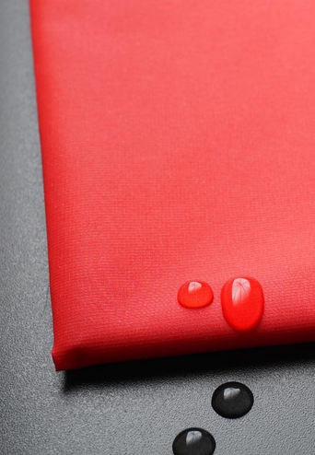
DYNTEX® Biological Origin
High performance fabric series that is made entirely from castor oil without any fossil resources, offering lightweight comfort and resource efficiency. The castor oil plant is a non-edible, renewable resource that grows in arid, nutrient-poor soil, and requires little water. It doesn’t compete with the cultivation of food crops and natural resources in the agricultural industry. This bio-polyamide is used to produce a particularly high-quality yarn, EVO® developed by Fulgar. In a special manufacturing process, the company uses this yarn to produce super light, high tech fabrics with one-of-a-kind tactile properties and bright colors. EVO® yarn has intrinsic thermal insulation properties due to its bio origin, providing superior comfort and its unique chemical structure can ensure excellent dyeing qualities even at low temperatures. The finished fabrics with PFC-free DWR treatment are downproof, breathable, water-repellent, extremely durable and odor resistant. Their monomaterial composition make it easy to recycle the material, offering a better end of life solution. The series consists of tear resistant woven fabrics in different constructions (Taffeta, Rip Stop, Twill) in the 45 to 88 gsm (1.33 to 2.6 osy) range that can meet the demanding (high strength, lightweight performance) requirements of the outdoor industry. The fabrics are available in standard 145-147 cm (57.1- 57.9 in) width in different colors and are sold by linear meter. MOC for samples is 100 m (328.1 yd) and for bulk is 500 m (1640.4 yd). Applications are for sports and active fashion.
DYNTEX GmbH Austria www.dyntex.eu/

Slide 14
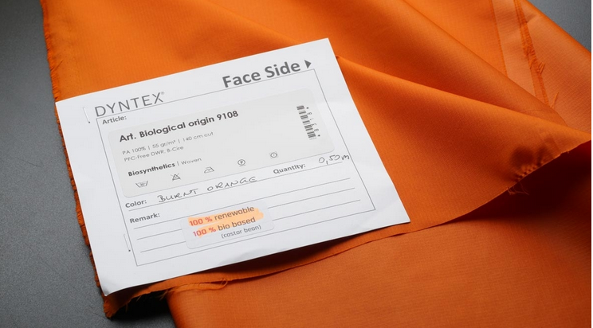

Slide 15
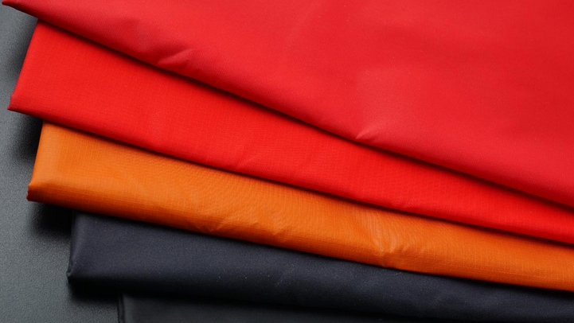

Slide 16
// Non-wovens - Biodegradable biobased nanofibres filtre

Slide 17
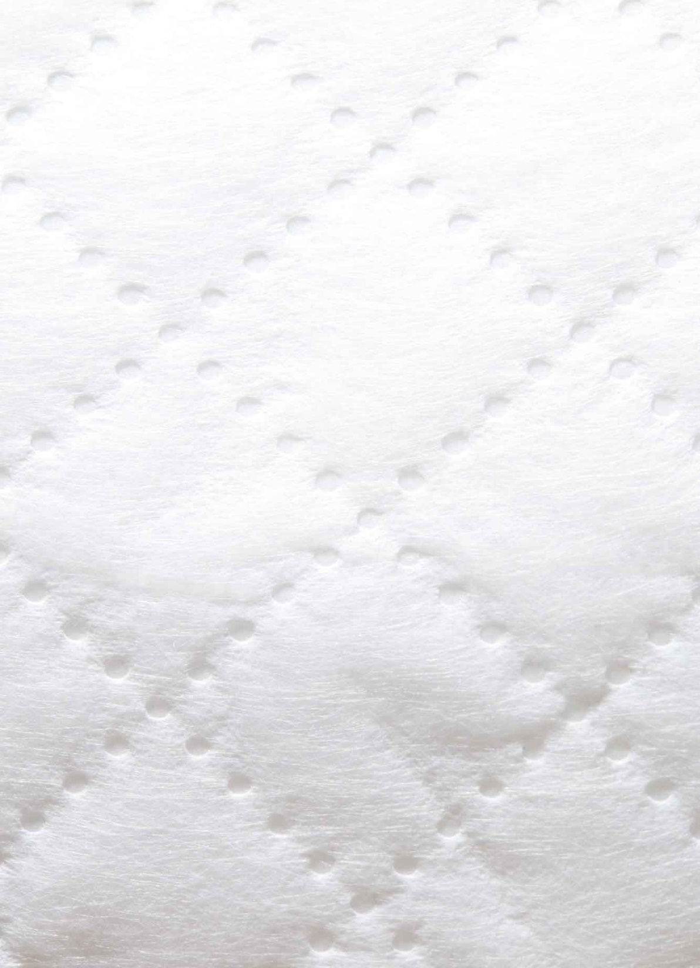
FilterLayr™
The world’s first, completely natural, biodegradable, secondary filter for ventilation systems that uses ultra-thin fibers to create a healthier indoor air environment. Nanofibers have huge benefits for air filtration — smaller fibers provide greater surface area and, thus, higher efficiency (rating F8 >90%). This diffuser filter uses a continuous electrostatic web of nanofibers (40 km, 0.6 mile long) to prevent triggers of asthma and respiratory allergies, such as microscopic bacteria, molds, and dust particles from the air. Similar to a spider web, Van der Waals forces help to pull in even the finest particles, trapping them in the dense nanofiber web and preventing them from escaping into the environment. These nanofibers are electrospun onto the surface of a 100% biodegradable ‘potatopak’ base made from potato starch; they are then infused with bio-based, antimicrobial additives. The natural antibacterial and antifungal activity of the Manuka plant (tea tree native to Australia and New Zealand) extrac takes over to neutralize the trapped particles. Applications are as durable filters for ventilation systems that are applicable to HVAC and personal protective equipment, as well as for the automotive industry.
NanoLayr Ltd. (Formerly Revolution Fibres) New Zealand www.revolutionfibres.com

Slide 18
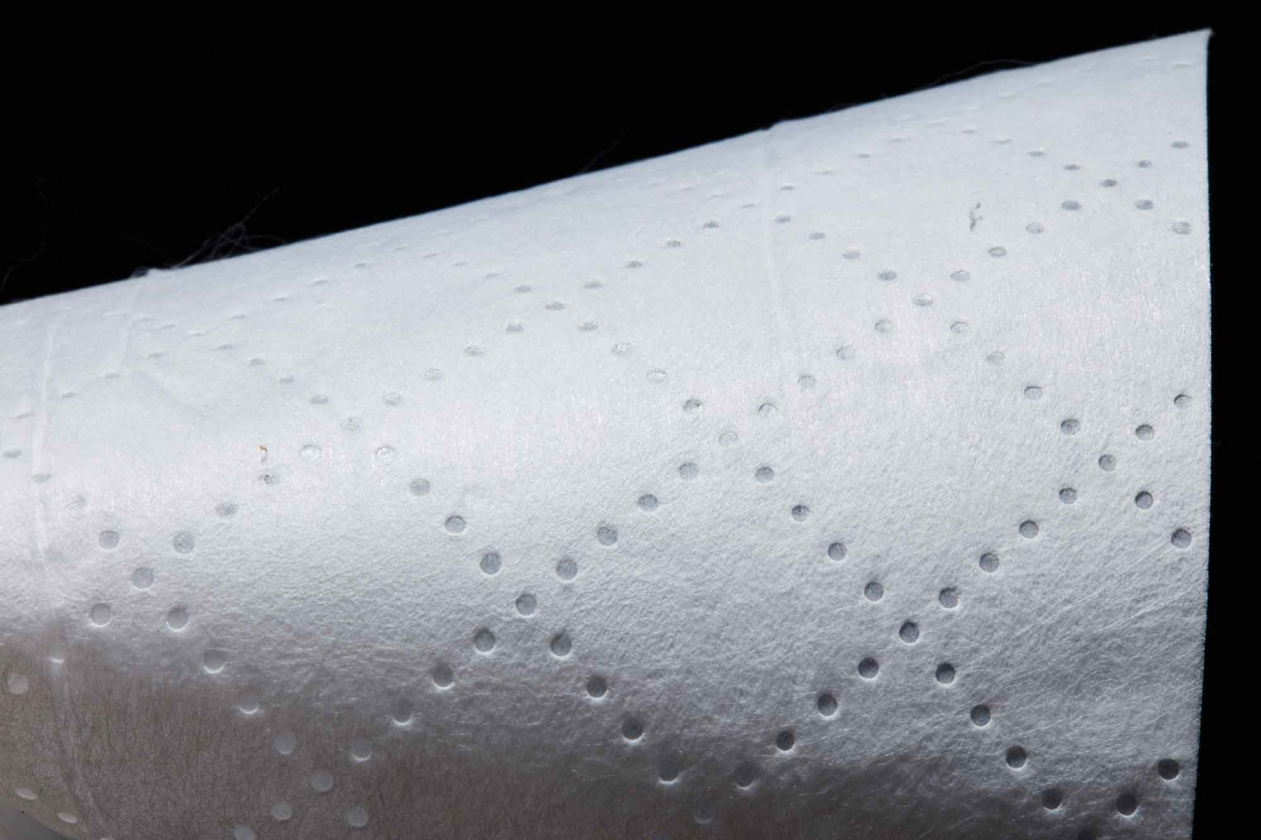

Slide 19
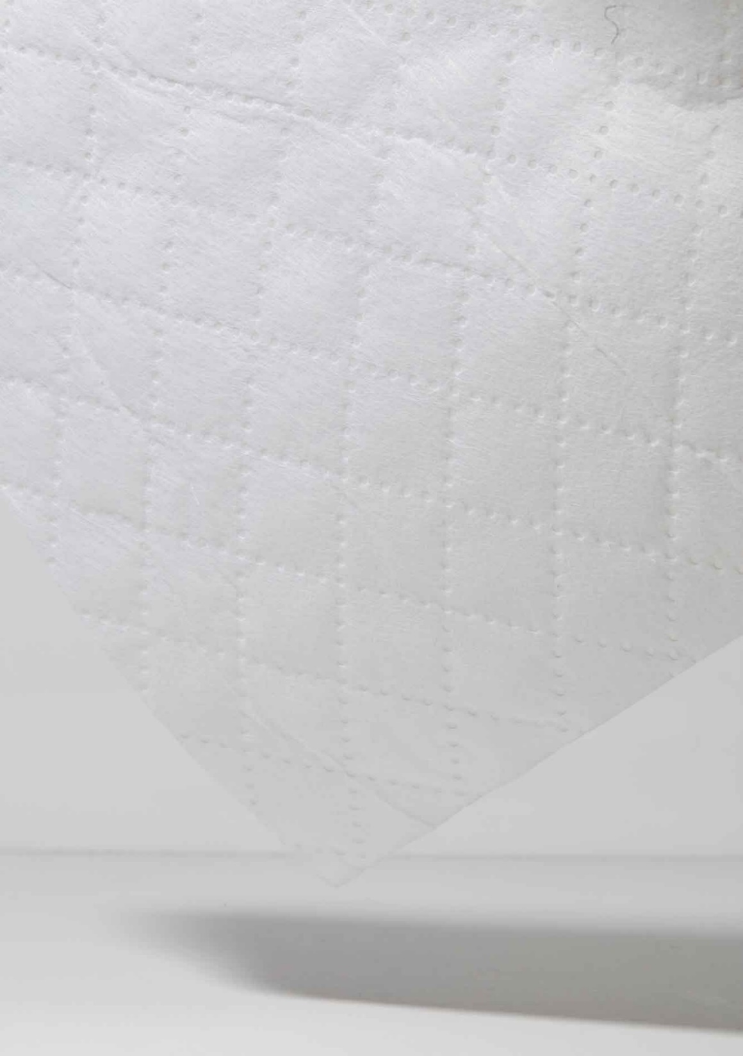
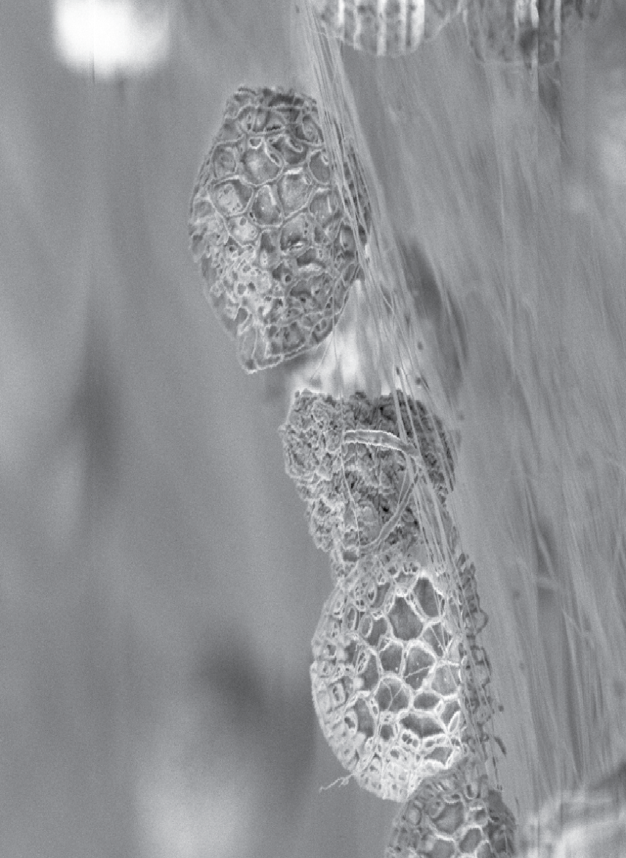

Slide 20
// Non-wovens - Hydrophilic abrasive wiping nonwovens

Slide 21
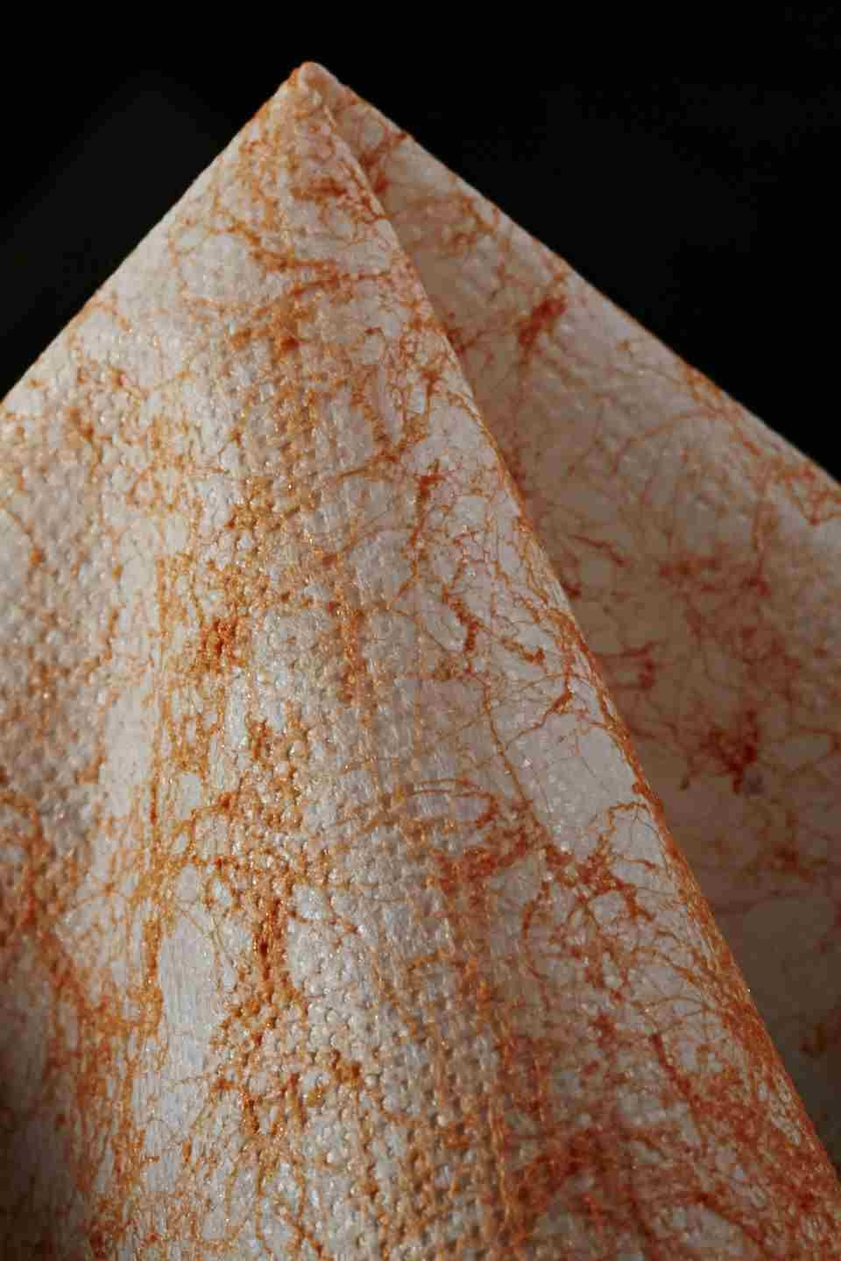
Duotex
Nonwoven textiles that incorporate a harder and more abrasive top layer to aid cleanup of tougher soiling. These meltblown polypropylene (PP) membranes are calendered with a meltblown fiber on one face to produce a 20 – 30 gsm weight wipe. They can be printed onto the reverse side, are easily cut and sewn as well as heat bonded, and are disposable. The wipes are hydrophilic. Five colorways are offered; blue, orange, black, green and red on an off-white backing. They are available in a maximum usable width 3200 mm (126 in) and trimmed range of 100-3200 mm (4 - 126 in). Applications are for cleaning wipes.
Mogul Tekstil Ltd. Turkey www.mogulsb.com

Slide 22
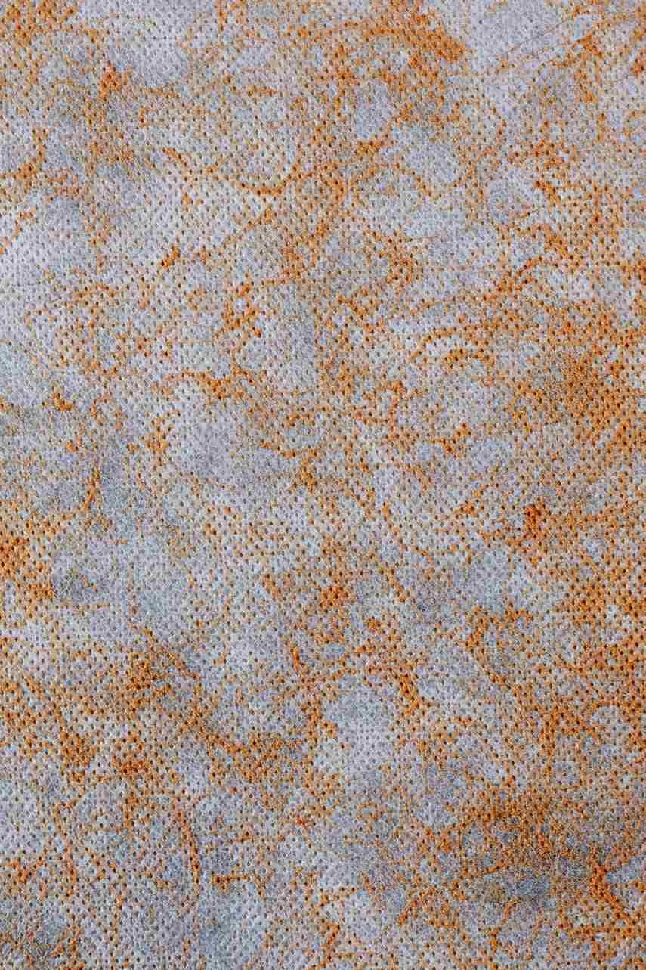
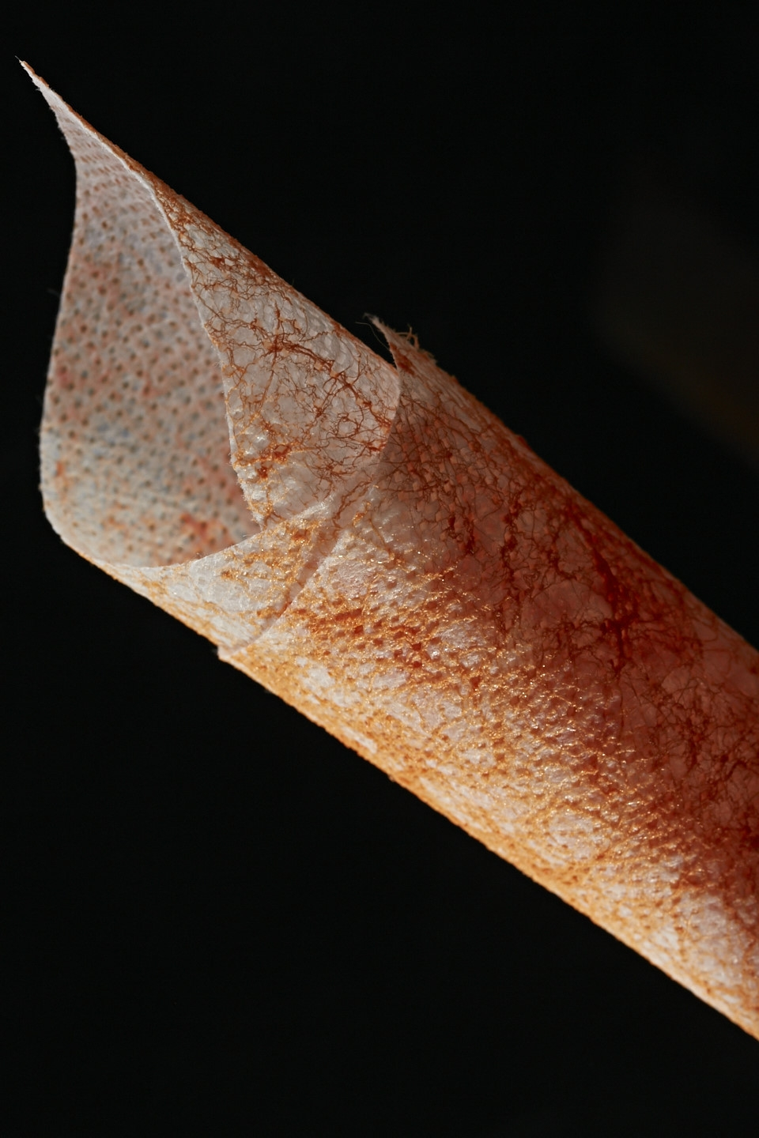

Slide 23
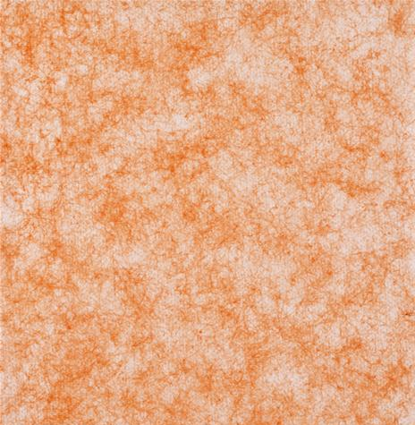
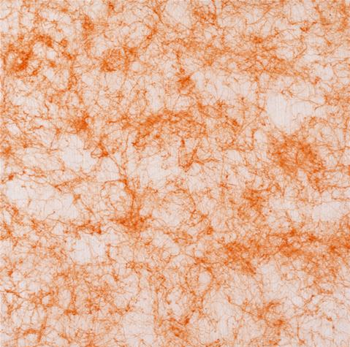
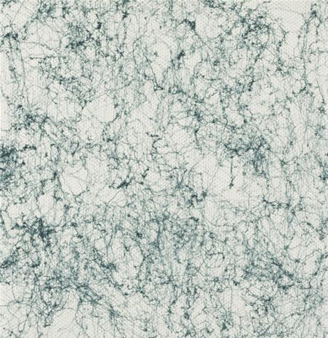

Slide 24
// Non-wovens - Translucent material made from bacterial cellulose

Slide 25
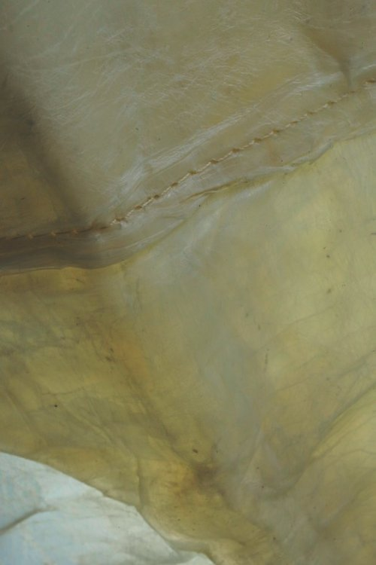
Bioleather
Tough, flexible, translucent sheets that are made of bacterial cellulose. Bacterial cellulose is produced as a secretion from bacteria fed a sugary solution (in this case pineapple juice) in a warm bath. These sheets are made from remnant cuts from the larger sheets, with the majority of the sheet used to produce beauty care products. The leftover parts are pressed together with a roller forming a single homogenous sheet and dried in a hot-air oven. Finally, they are rigidized with hard paraffin, much in the way that waxed cotton is treated, making it impervious to water. The resulting membrane is claimed to be equivalent in stiffness to aluminum for the same weight, has a leather-like hand, and good mechanical properties such as tear strength and stitchability. They are offered in 290 x 200 mm (11.4 x 7.9 in) and in a nominal thickness of 1.2 mm (0.05 in). It can be customized in color, texture, thickness (give the bacteria more time) and in size (use a larger bath), giving it advantages over leather. The sheets can be used in many of the places that leather is currently used, for example as a fabric for bags and upholstery, and for accessories.
Thainanocellulose Co. Ltd. Thailand thaitnc.com

Slide 26
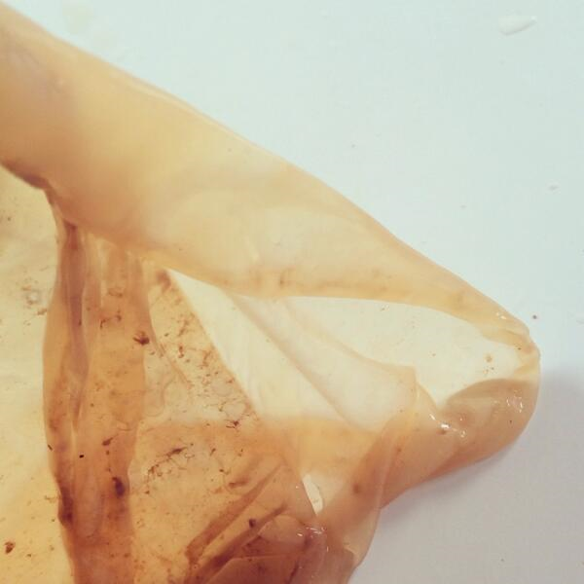
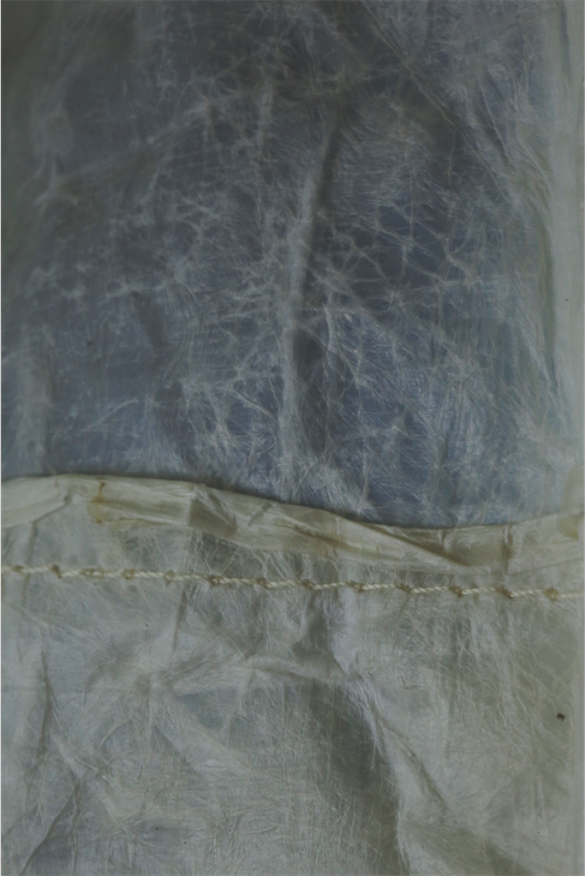

Slide 27
// Non-wovens - Advanced Fibers for skin and wound care

Slide 28
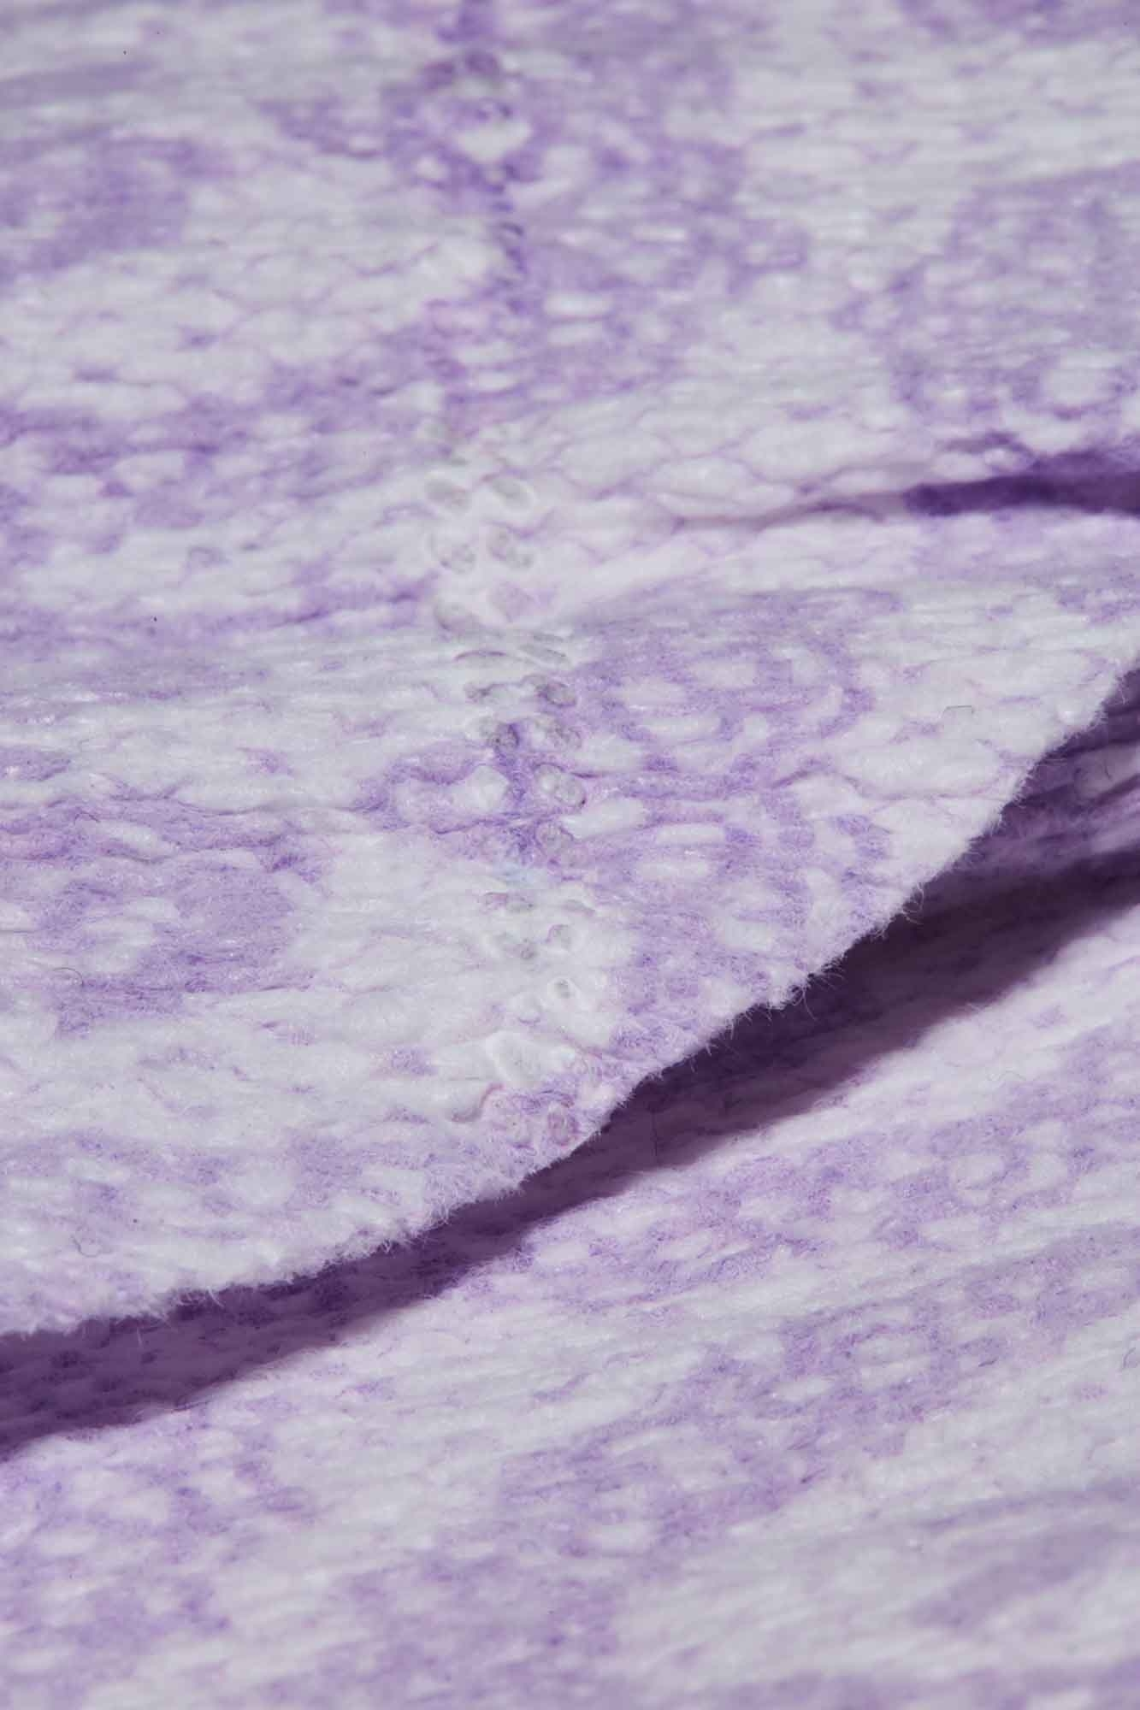
MICROFIN DRY™
A multilayer nonwoven that combines cellulose (35%) and polypropylene (PP) layers (50%) with elastic threads (15%) into a semi-durable fabric. The combination of the two materials balances their opposing liquid behavioral properties into a comfort-focused absorbent textile, which offers breathability and temperature regulation. Cellulosic materials tend to be highly absorbent while PP repels liquid — specifically water — and is non-absorbing. By positioning the porous PP nonwovens on the exterior faces, the surface remains dry while the core absorbs. Additionally, the water repellency of the PP layers supports retention of liquid in the core, preventing “re-wet.” The gathered structure increases surface area for absorbing, allowing a thin and lightweight textile to hold a large portion of fluid. Meltblown PP has a soft-touch effect against the skin. Thin layers of meltblown PP are positioned on the either side of the cellulose core layer. Elastic threads are incorporated into the sandwich structure under tension, which gathers the fabric into a fine gathered structure upon release, providing stretch and recovery as well as increased surface area for absorption. The material is offered as a roll good, 80 cm or 120 cm in width (31 in or 47 in). Dyeing and printing are both possible for visual customization and testing of cooling, wicking, and breathability performance resulted in the following: qmax rating of 65.5 W/m2 K, moisture transport after 60 min 96%, and vapor transpiration after 60 min of 538 g/m2 H respectively. These are comparable or slightly improved over on-market athletic apparel textiles and as a semi-durable textile, it can be washed 3-4 times. Applications include personal hygiene, baby diapers, athletic apparel, and hospital garments, and linens.
Haso Ltd. Japan www.hasoltd.com

Slide 29
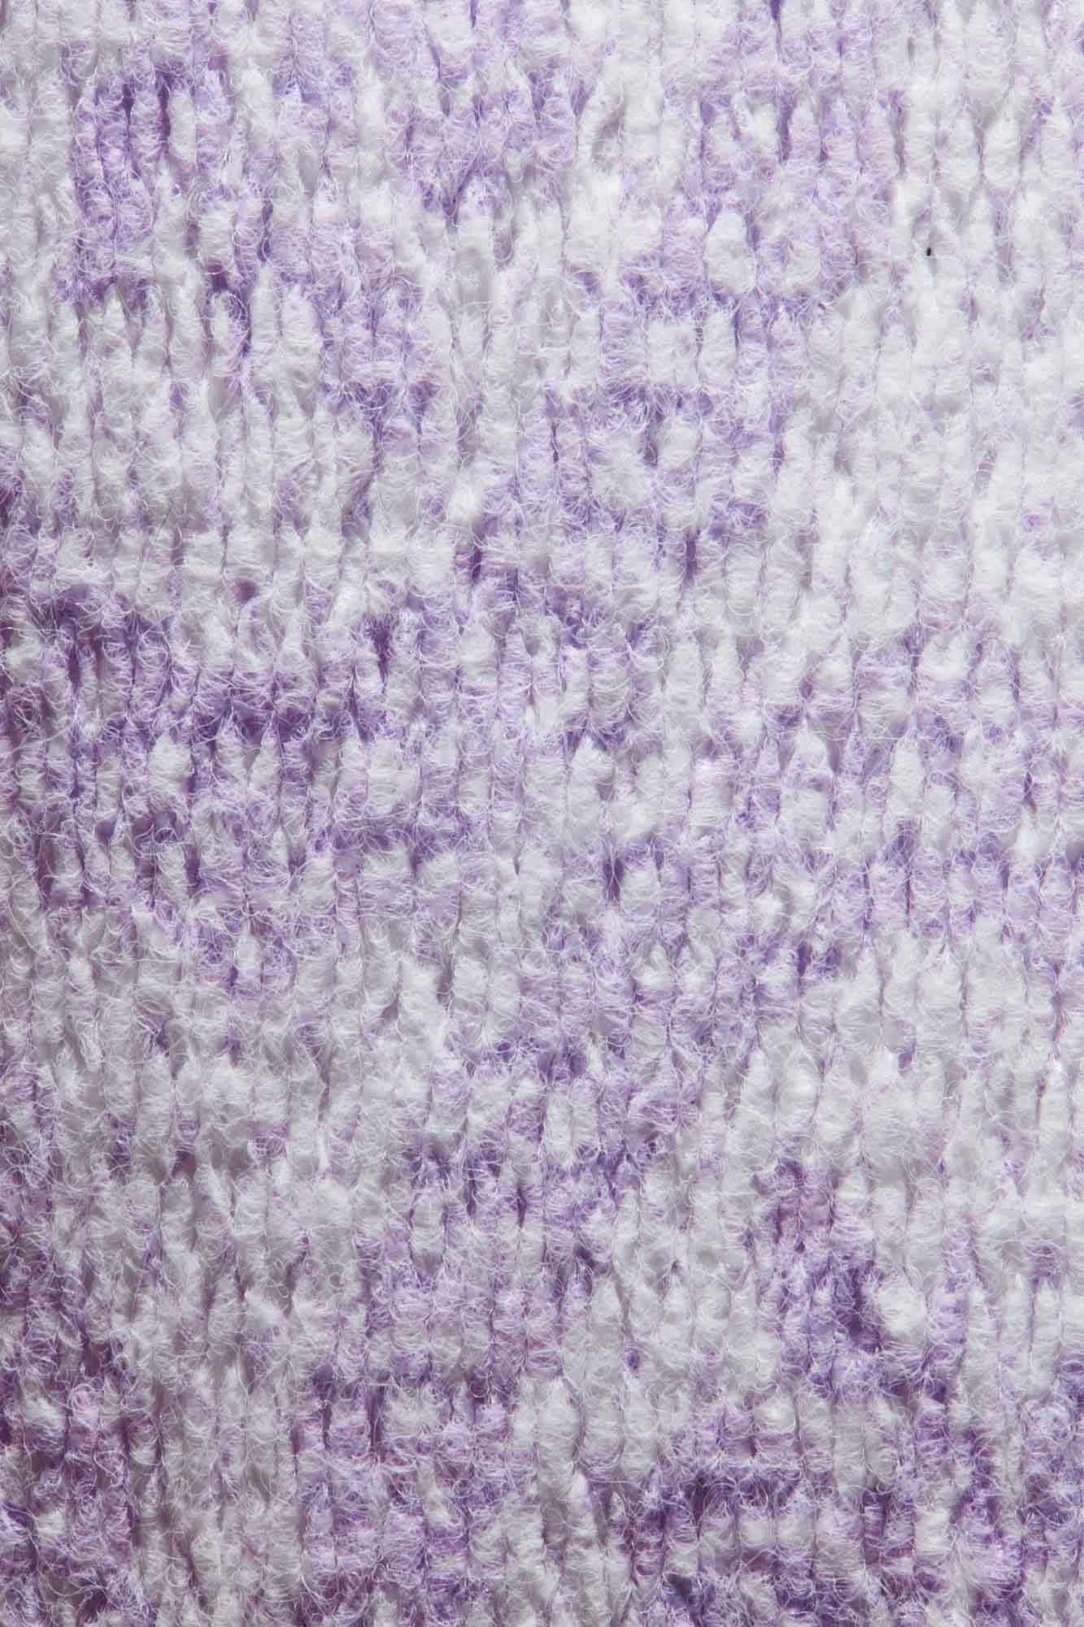
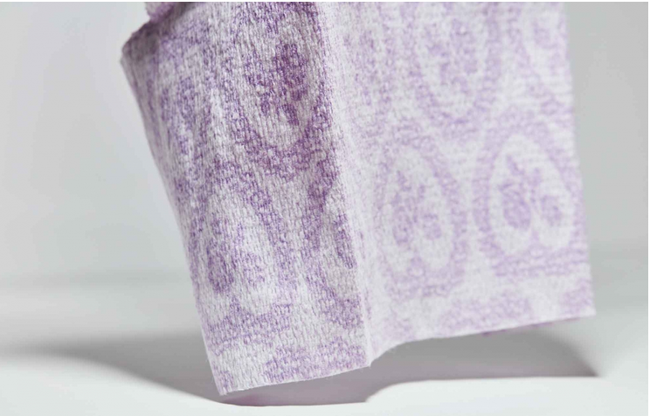

Slide 30
Regenerated Collagen Fiber
Textile fibers made from collagen. Collagen fibers have a very smooth surface and an inherent softness. They also readily absorb and release humidity, balancing moisture. This absorbent behavior aids in dye uptake and results in deep colors. Other properties include bacteria growth inhibition and a Limited Oxygen Index (LOI) of 36, which can be indicative of low combustibility. For comparison: wool, considered to be a naturally fire retardant fiber, has an LOI of 25 (higher scores are better). Untreated cow hides are solubilized, stabilized, and non-collagen components are removed. The solution is then concentrated and wet spun into filaments. After drying, the filaments are cut into staple fibers and crimped to add texture. The fibers are offered in bales of 100 kg (220 lb.). Multiple fiber cut lengths are available: 38 mm, 51 mm, 76 mm, 89 mm (1.5 in, 2 in, 3 in, 3.5 in); custom lengths are negotiable. The fiber is off-white in color. Dyeing and finishing must remain at temperatures under 60 ˚C (140 ˚F) to ensure stability of the fiber. Moisture behavior testing shows the fiber to have slightly higher absorbency volume than cotton and a slower moisture release rate, about double the time from peak moisture to dry. A bacteriostatic property is also demonstrated, with a reduction in the presence of staphylococcus aureus by 50% 18 hours after the initial culture on a blended collagen textile. Odor reduction is also seen, demonstrated by particle reductions in odor causing compounds. Reductions by a 100% polyester nonwoven and a 14% collagen nonwoven are, respectively: ammonia 7% and 95%, acetic acid 20% and 89%, insovaleric acid 24% and 56%. Applications include cosmetic facemasks, accessories, lingerie, base layers, sleepwear, and bedding.
Kaneka Corporation Japan www.kanecaron.com/cef/en/collagen.html

Slide 31
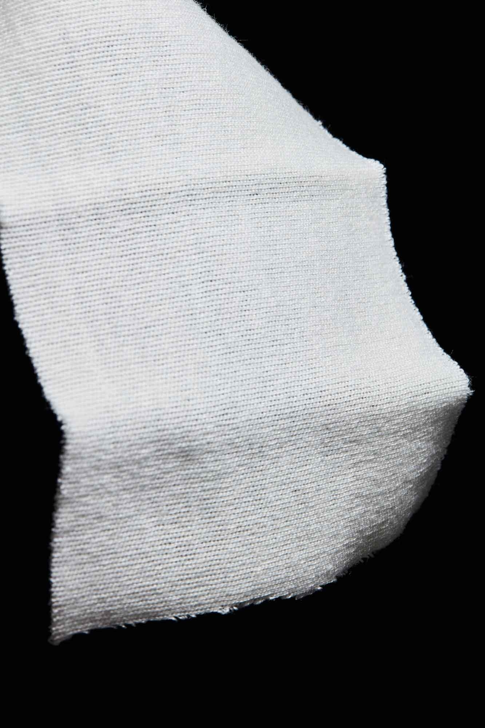
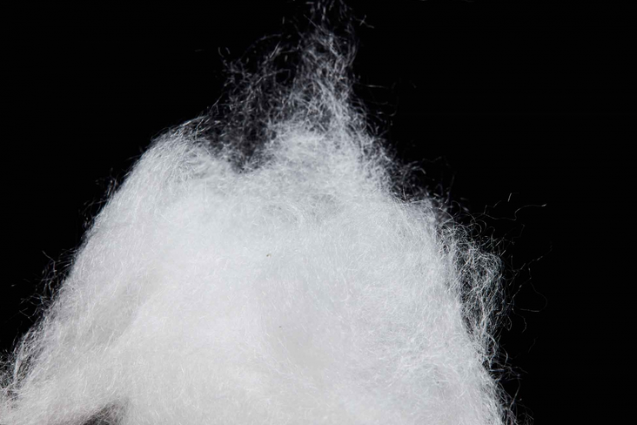

Slide 32
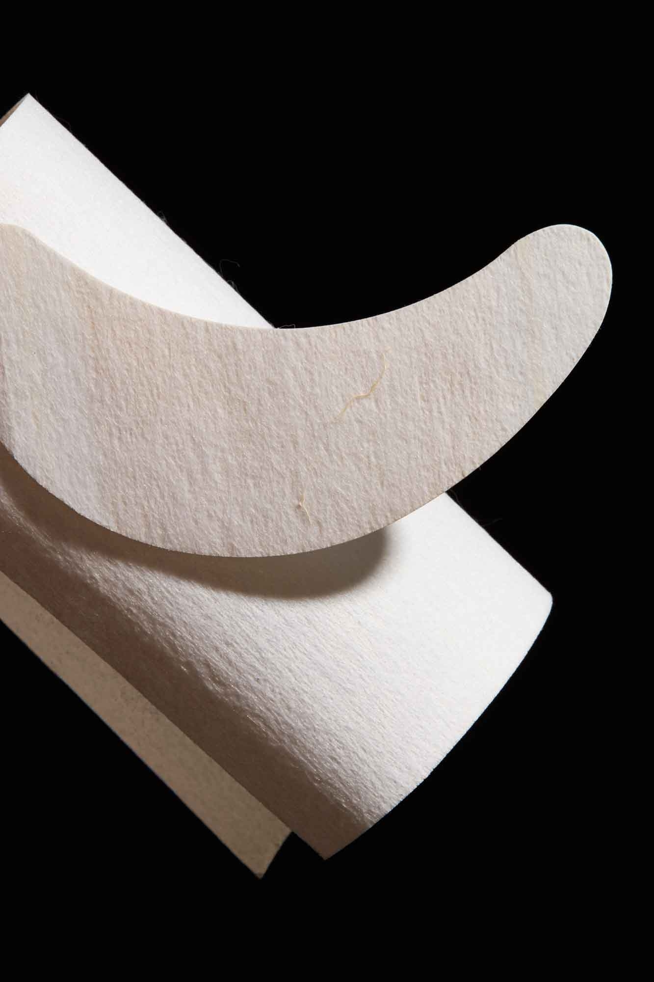
ACTIVLAYR
A new, clinically proven delivery platform for natural nutrients and treatments using nanofibers made from marine collagen, providing optimal skin care benefits. It is a patch on which a proprietary blend of fruit (kiwifruit, grape seeds) extracts and marine collagen has been immobilized in a dry, stable format with no additives, preservatives, or fragrances. Collagen is sourced from the skin by-product of deep water fish found in New Zealand, and is electrospun in the form of nanofibers (100 nm–150 nm, 0.004 mil–0.006 mil) on a wide range of substrates, including polycotton with a protective layer (typically LDPE film). The treatment area on this easy-to-use patch is fully dissolved in less than 15 secs in water at 20 ˚C (68 ˚F). During application onto moistened skin, the ingredients are rapidly transferred from the patch and activated on the skin for maximum effectiveness. Using collagen fibers as a delivery mechanism, a measured dose of specially formulated plant and fruit extracts, essential oils, and enzymes can be introduced into the skin for moisturizing, elasticity, whitening, anti-inflammation, and more.
The material is available in sheet, strip, and roll format in 0.5 m–2 m (19.7 in–78/7 in) widths with options to customize the substrate material, color, and protective layer. The use of bio-origin nanofibers act as a delivery platform for topical skin applications, as well as for wound dressings, drug delivery, and other healthcare applications, such as acne treatment and burn treatment.
REVOLUTION FIBRES LTD New Zealand www.revolutionfibers.com

Slide 33
Sugi® Cellulose Sponge Material
Multi-purpose, robust cellulose-based sponge material for effective use in various medical fields such as diagnostics, wound care, and micro-surgery. The sponge is made of 35% pure cotton and 65% regenerated cellulose and is stable in a variety of chemicals and solutions. It is hydrophilic with an absorptive capacity ranging from 1200%–2100% depending on the material specification due to its open pore structure, affinity to water, adhesion, cohesion, and van der Waals forces. In addition to absorbing liquids, it also holds the absorbed liquid over a period of time. Unlike other cellulose sponge materials, it offers high tear and tensile strength (> 50 N for a strip of 19 mm x 81 mm, 0.75 in x 3.2 in) due to its special manufacturing process. The material is biocompatible and can be custom designed by controlling its size, colors, patterns, and physical and chemical properties to meet specific client challenges. It comes in a standard wet thickness of 8 mm–10 mm (0.3 in–0.4 in). Applications are for packaging, personal care, home care, eye surgery, wound care, and hospital hygiene.
Benefit when used in band aids:
Naturally styptic through physical redirection of the pressure on the wound pad (soft compression)
Ideal for managing venepuncture/arterial puncture (dialysis shunts, central venous catheter)
Supports “Wet Wound Management” of exsudating wounds
Eudermic PSA-adhesive with a high adhesive force
Transparent, water-proof and semi-permeable polyurethane foil for better wound inspection
Up to 4 days changing interval

Slide 34
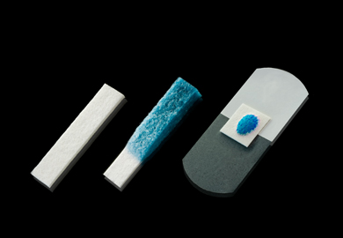
Kettenbach GmbH & Co. KG Germany

Slide 35
// Non-wovens - Upcycled gelatin-based leather-like material

Slide 36
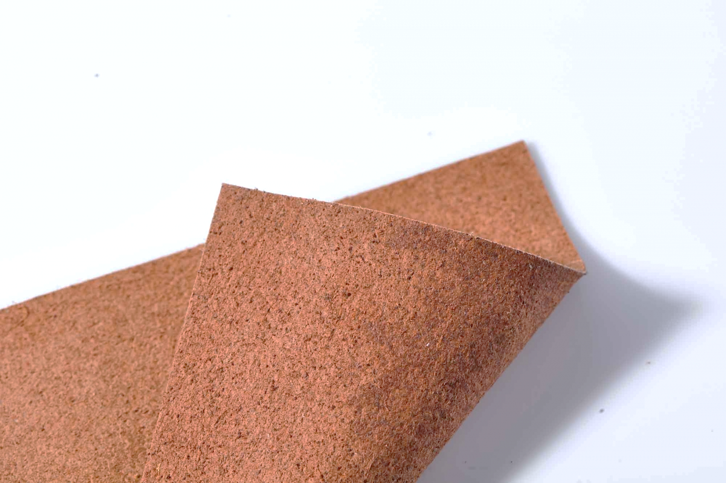
GELATEX
A leather-like textile that is chemically identical to and feels like leather, but is manufactured from waste rather than skinned from a cow. The nonwoven textile consists of nanofibers based on gelatin from low-value meat waste. In addition to skin, the material is also made from bones to enable up to 3-5 times more material from the same animal. While 95% of leather is produced using toxic chemicals like chromium, lead, or arsenic, and a lot of water, producing the nonwoven requires only organic non-toxic substances and almost no water. The characteristics of the material, such as texture, water resistance, and thickness, can be customized upon request. It is supplied in rolls with a width of approximately 20 in (50 cm) and natural colors (i.e. brown, tan, and olive). The material is easily scalable, sustainable, and cost-efficient, coming in at about half the price of leather. Applications include apparel, footwear, fashion accessories, and automotive and furniture upholstery.
GELATEX TECHNOLOGIES OÜ
Estonia
www.gela-tex.com

Slide 37
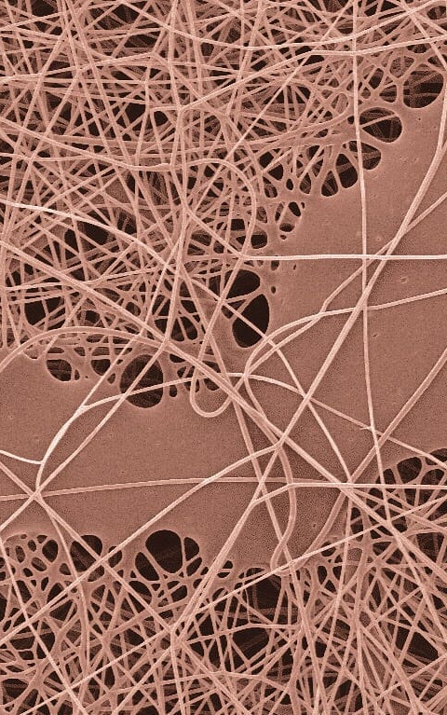
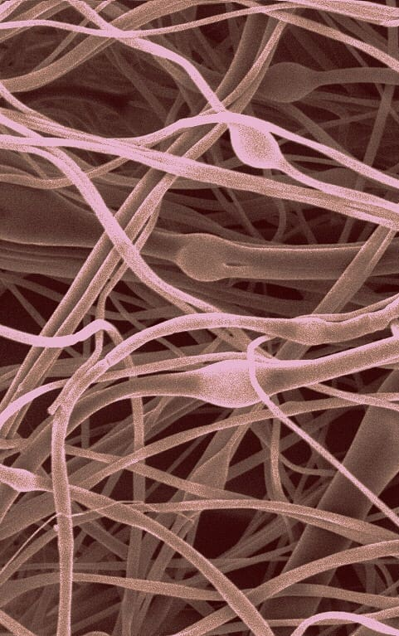

Slide 38
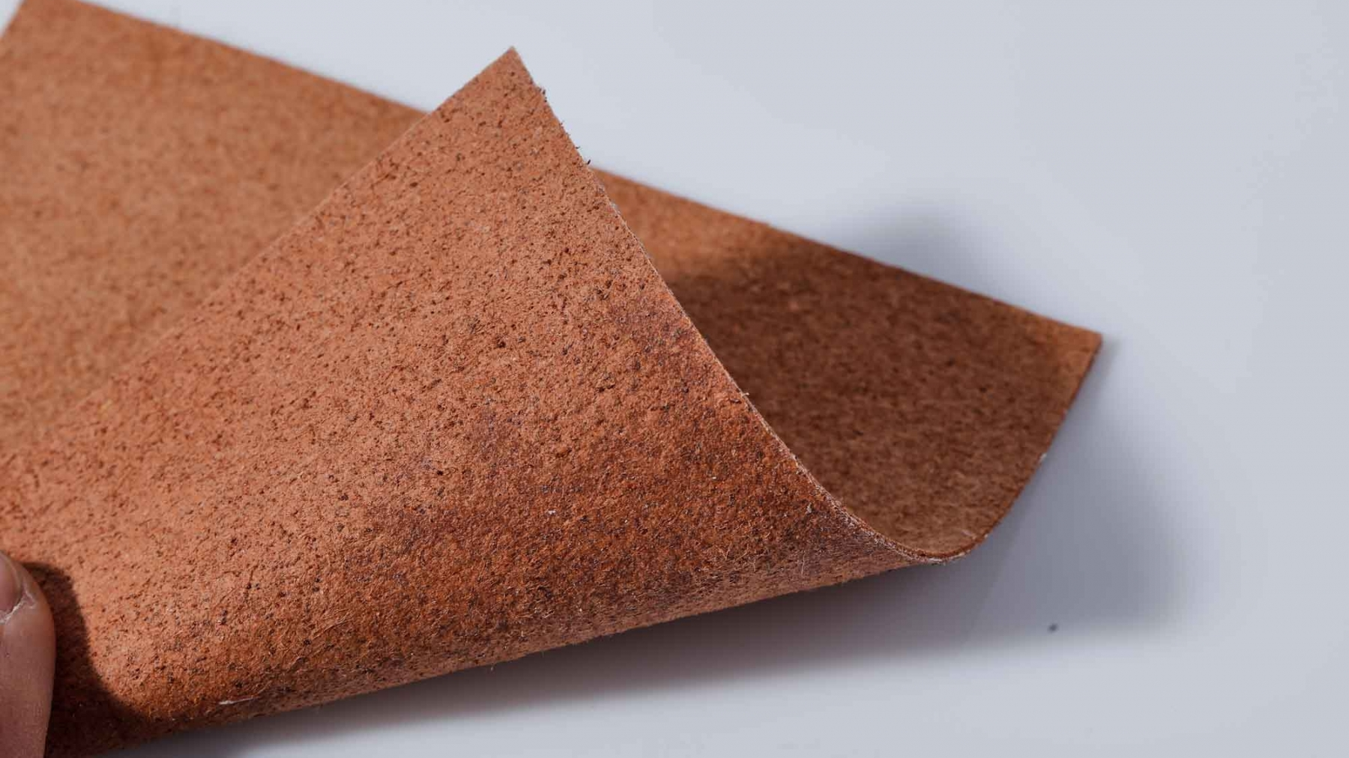

Slide 39
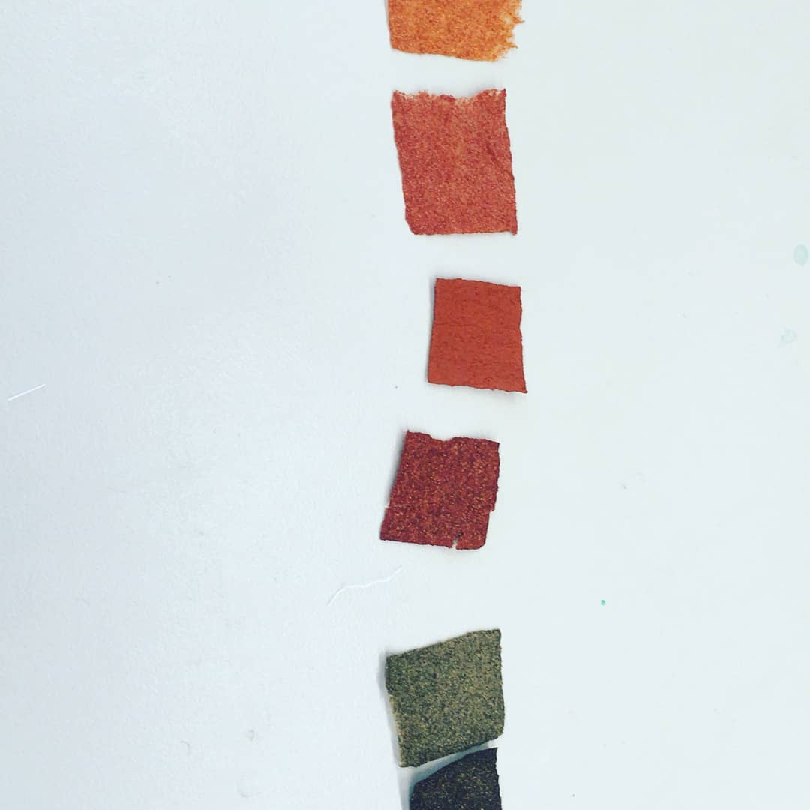

Slide 40
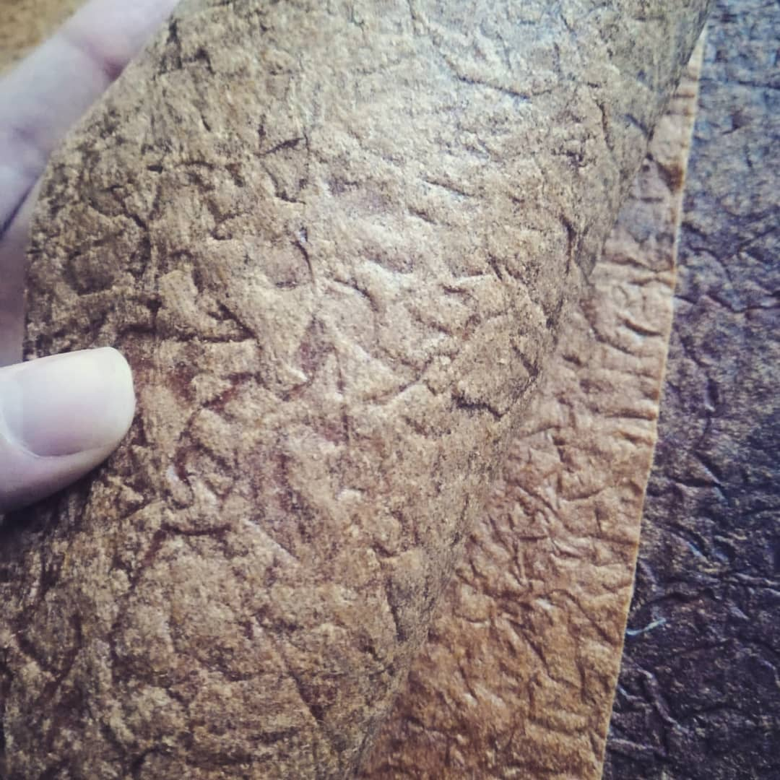
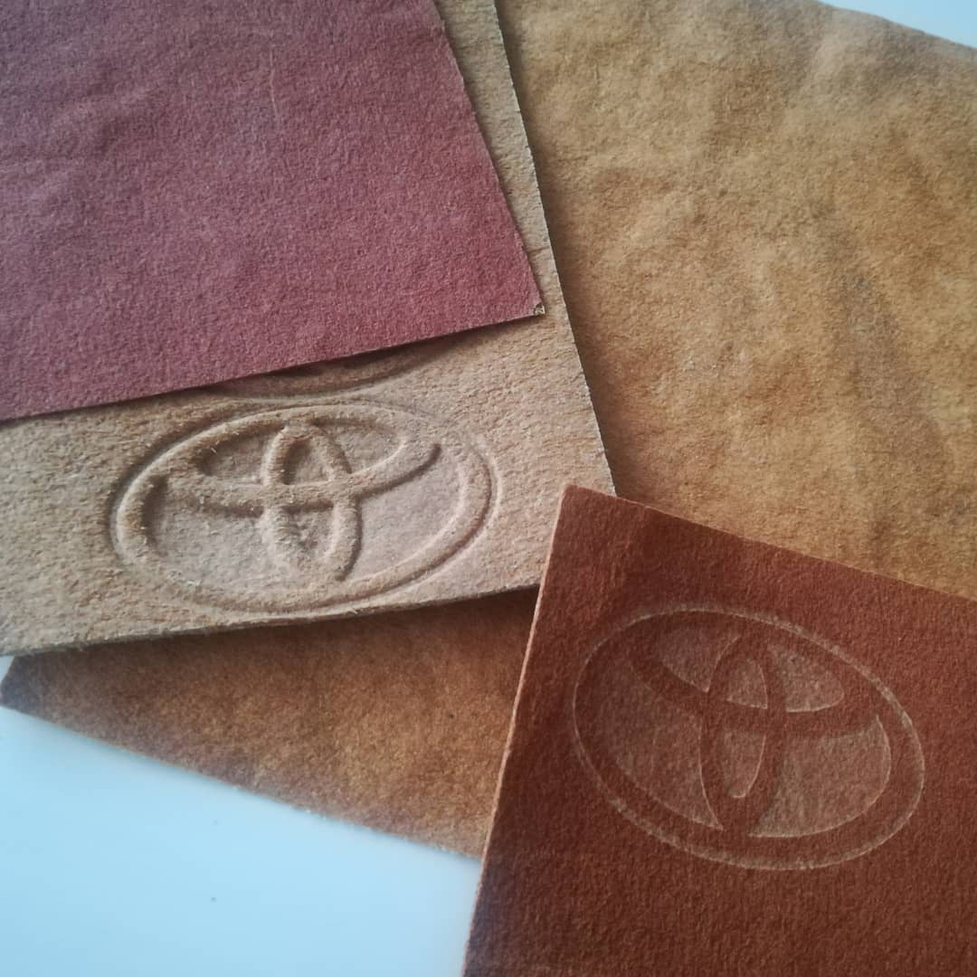

Slide 41
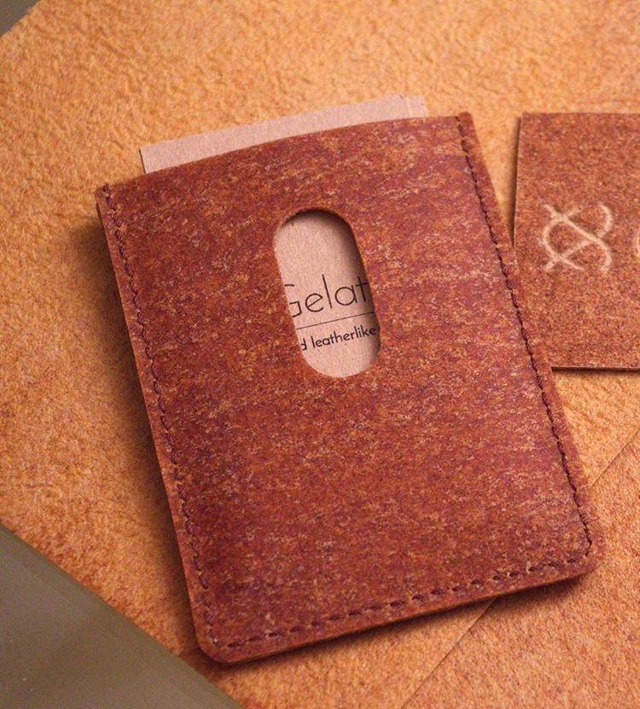
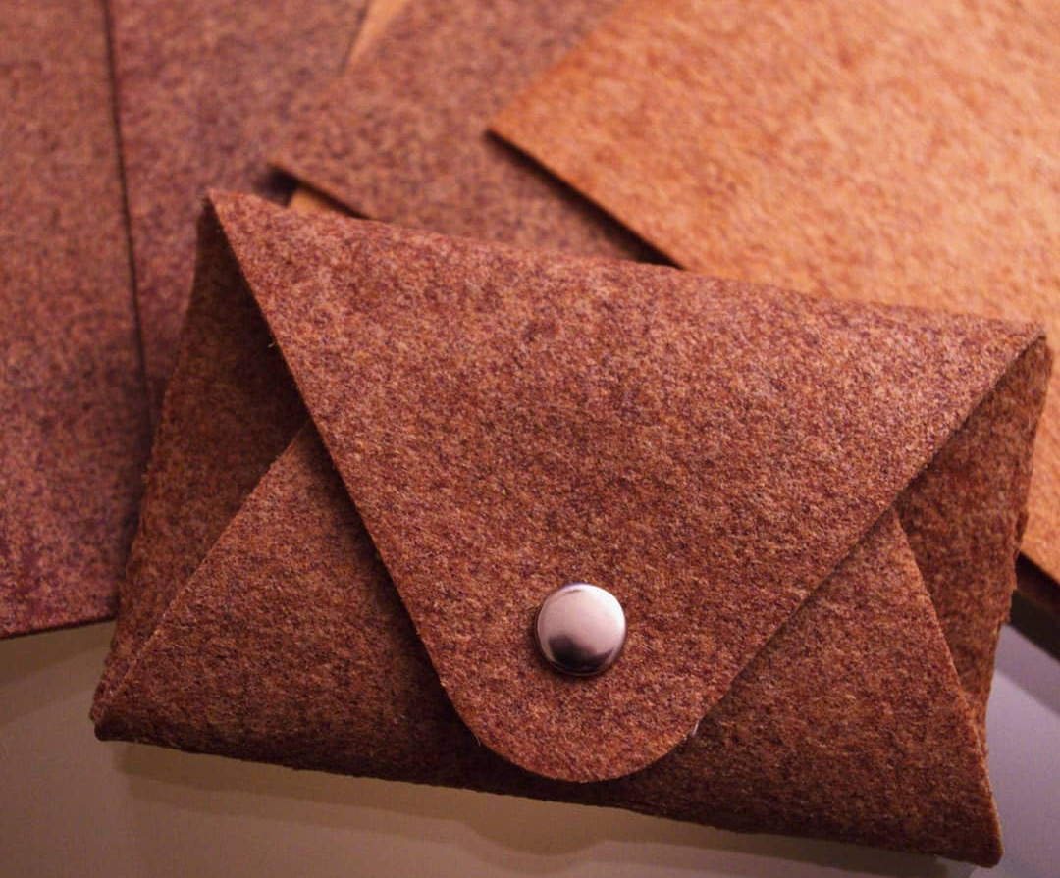

Slide 42
// Non-wovens - Antibacterial, antimicrobial

Slide 43
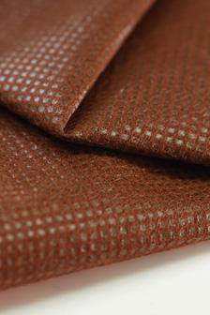
Clapure®
Polypropylene (PP) spunbond nonwoven textile that incorporates long-lasting anti-bacterial and anti-fungal properties as well as tick protection. The repellent function is highly durable, and incorporates the functional oil component into the body of the polymer itself. The oil is compounded into the polymer matrix, stabilizing the oil, promoting slow release and long lasting performance. After the oil is compounded into the polymer, the blended polymer is formed into a fiber web via the spunbond process. The polymer is extruded through a spinnerette, creating thin strands, which are drawn and randomized by gusts of air. The fibers are deposited onto a conveyor belt in random orientation and are bonded in place with a heated roller, which melts small areas of the fibers into solid points. Goods are offered on rolls in widths up to 84 in (2133 mm), and are available in thicknesses ranging from 0.2 to 1 mm (0.008 to 0.04 in). Color can be fully customized at the client’s request. Three types of the textile are offered anti-bacterial, anti-fungal, and anti-tick. The material has passed SEK standards (Japan Textile Evaluation Technology Council) test method JIS L 1902, showing a value of ≥ 2.2 for bacteriostatic activity. Applications include home goods, mattress covers, upholstery, apparel storage and outdoor sports equipment.
Kuraray Living Co., Ltd.
Japan
www.kurarayliving.jp/

Slide 44
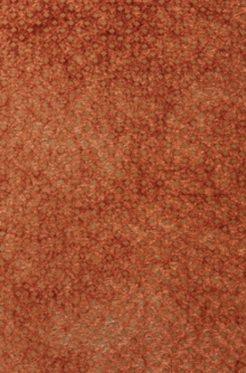
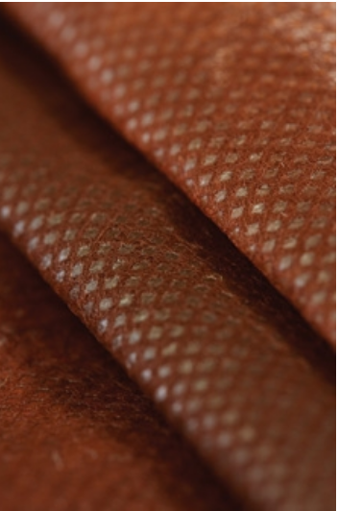

Slide 45
// Non-wovens - Conductivity

Slide 46
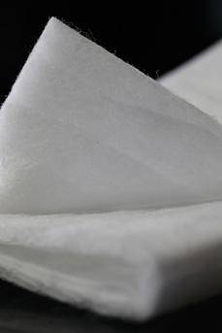
NanoWave®
Polypropylene (PP) nonwoven textile with a pleated interlayer for improved filtration properties. The various fiber sizes and internal pleating increase the surface area of the textile as compared to a flat textile of equivalent thickness, allowing for increased particulate retention and decreased force required to move air through the system. The efficiency achieved with this textile is a significant improvement on other synthetic fiber filters with double the dust holding capability. This construction provides improved filtration efficiency over glass fiber filters, which were previously the most efficient filtration textile available. The use of a synthetic fiber as opposed to glass fiber offers increased durability, eliminates fiber shedding, decreases cost, and increases processing options due to the thermoplastic nature of PP. Additionally the low pressure drop and increased efficiency of the material decreases energy demands on the filtration system, such and an HVAC unit, resulting in lower power usages and costs. Multiple nonwoven fabrication techniques melt blown, spun bond and air laid are combined in a proprietary layering process to created a multilayer structure in a continuous roll. The textile can then be heat or ultrasonic welded into final product shapes. The textile is offered as a continuous roll, which can be slit to customer specifications. Basis weights are available from 160 to 180 gsm. Only a standard white color is offered. Textile grades are available for a range of filtration classes, European standards F6, F7, and F8, as well as US standards MERV 11, MERV 14, and MERV 15. Flammability testing (DIN 53438) has resulted in a F1 rating. Applications include filtration of gas media, respirators, residential and commercial HVAC systems, vacuum cleaner bags, and exhaust filters.
Hollingsworth and Vose Company United States www.hovo.com

Slide 47
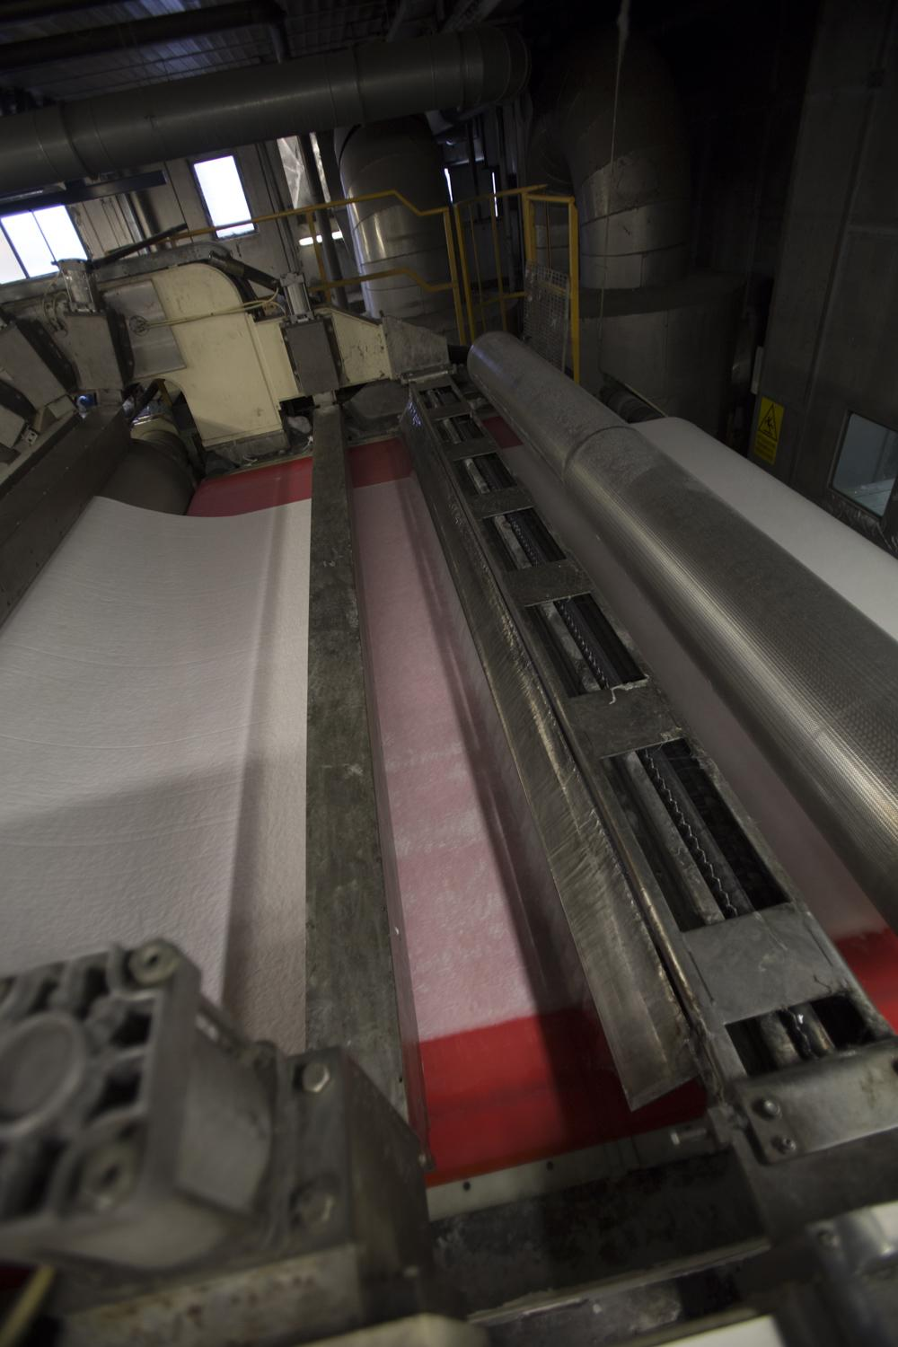
WaveK-TEX 50 e 70 – bamboo viscose nonwoven
Nonwoven spunlace made of 100% bamboo viscose, 50 and 70 gr / m2, super absorbent, soft, strong and resistant even when moist, with documented bacteriostatic characteristics, 100% natural. The product is anti-allergenic to help prevent odors and redness.
Various types of treatments can be applied for special applications (hydrophilic or hydrophobic treatments).
Applications include absorbent parts such as nonwovens for band aids, facial masks, feminine hygiene and adult incontinence.
Orsa Nonwovens produces, enhances and sells nonwovens for different applications. Amongst their manufacturing processes are mechanical needle punching and and hydroentanglement (spunlacing). Natural and man made fibers are used.
ORSA NW S.r.l. Italy www.orsa-nw.it/?page_id=286

Slide 48
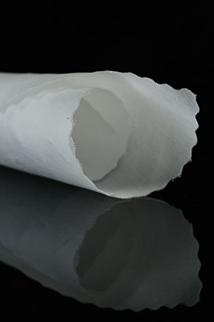
NnF MBRANE®
Nonwoven continuous nano fiber webs, comprised of PET (polyester), PA6 (nylon 6), PAN (polyacrylonitrile) or PVB (polyvinyl butyral). Nano fiber webs offer increased number of pores with decreased individual pore size, this creates significant improvements in filtration efficiency while minimizing impedance of media flow; minimizing pressure drop. Fibers are produced through force spinning. The polymer is dissolved in a solvent creating a fluid solution that is extruded through a fine spinerette. As the solution leaves the nozzle the solvent evaporates leaving a fine homopolymer fiber behind. Force spinning utilizes centrifugal force to propel the solution out of the spinneret tip, forming a cylindrical mass of nanofibers, with or without a substrate. Webs are offered in 2000 m rolls (2187 yards) from 0.5 to 1 m in width (1.6 to 3.2 ft). The nanofiberous layer is white, though the substrate component could be colored. Webs are fully customizable in porosity and grammage and are available with and without substrates. Post treatments are available on request, including lamination of nanofibrous membranes (double / triple sandwich material), post treatment with plasma spray (hydrophobic / hydrophilic surface treatment), doping with functionalized particles (e.g. antibacterial, thermal barrier, Ag, ZnO, TiO2).
Filtration efficacy (EN 779:2012) has been tested for the PA6 web at the University of Liberec receiving a F9 based on the European Efficiency guide; effective filtration of tobacco smoke, respirable dust and microbes. Applications include filtration of liquid and gaseous media, barrier systems, thermal and sound insulation.
Currently the following version are produced:
NnF MBRANE® - PUR
NnF MBRANE® - PA6 (Nylon 6)
NnF MBRANE® - PAN (Polyacrylonitrile)
NnF MBRANE® - PVB (Polyvinylbutyral)
NnF MBRANE® - PCL (Polycaprolactone)
NnF MBRANE® - PVDF

Slide 49
PARDAM NANO4FIBERS s.r.o.
Czech Republic www.nano4fibers.com/

Slide 50
SAF™ Nonwoven
Nonwoven fabrics that incorporate a super absorbent polymer (SAP) and can absorb up to 200 times its weight in water. This non-irritant, odorless needlefelted sheet uses staple fibers that contain a (SAP) - crosslinked acrylate copolymer - at compositions of between 10 and 60% with the remaining material either polypropylene, viscose, kraft pulp fiber, bicomponent polyolefin or polyester staple fiber. The fabrics are offered in a range of thicknesses from 1.5 mm to over 25 mm (0.06 to 1 in) and have absorbencies up to 60g/g of demineralized water (less in saline). They have weights from 75 – 620 gsm (2.21 to 18.3 osy). The fabrics are used in spill containment and for medical uses such as wound care, drug delivery, urine capture and as dental mats.
Technical Absorbents Ltd.
United Kingdom
www.techabsorbents.com

Slide 52
Imgne X3
A conductive coating made from graphene that can transform any material into a smart material. The proprietary graphene coating is tailored to minimize any impact on the existing physical properties while providing optimum electrical conductivity. It is also tailored to be compatible with the chemistry of the substrate and the specific application, which can be formulated for a range of industrial coating processes including spray, dip, and blade. The company has the capability of deploying this technology at low cost and large scale. In order for the finished material to become a smart material such as a sensor, it needs to be connected to an electrical source. There are no minimum or maximum size requirements and the coating can be applied to any size area. Current applications include coated conductive geotextiles that identify leaks in dams and containment systems before commissioning.
IMAGINE INTELLIGENT MATERIALS PTY LTD Australia www.imgne.com

Slide 53
BIOARMOUR™ -
ADVANCED WOUND CARE
A hybrid product which combines the performance and benefit features of foam, hydrogel, alginate, hydrocolloid and gauze.
Composed of a gel-cast biopolymer matrix, the BioArmour™ AWC dressing incorporates wound healing actives. Also contained within the gel-cast biopolymer matrix is a controlled and sustained release antimicrobial agent to protect and prevent infection of the wound bed. The biopolymer matrix allows for quick wicking and control of exudate while maintaining an adequate moisture level for rapid healing of the wound. The flexibility and non-adherent properties of the dressing provides patient comfort during dressing changes.
The dressing is indicated for use in light to moderate exuding partial and full thickness wounds including decubitus ulcers, diabetic ulcers, 1st and 2nd degree burns, and donor sites. It may also be used over debrided and partial thickness wounds. This gel-cast biopolymer matrix manufacturing method results in a new wound healing absorbent dressing composed of fibers and materials that have inherently low bioburden.
The gel-cast biopolymer dressing has the capability to deliver non-toxic antimicrobial agents for infection control properties, with full bio-compatibility. The dressing is non-adherent to body tissue. Other advantages are: high mechanical wet strength in the wound bed, easy conformability to the wound, and a pliable and flexible structure with no sharp edges that can cause pressure and stress in the wound. Even in the event the dressing is cut to shape, there are no sharp edges or material that can disassociate from the dressing and reside in the wound causing a secondary infection site.
IMAGINE INTELLIGENT MATERIALS PTY LTD Australia www.imgne.com

Slide 54
Biovation LLC
USA
http://biovation.com/products/bioarmour-advanced-wound-care/#tab-id-2

