Slide 1
TRAINING COURSE
Design and Technologies for Weft and Warp Knitwear Production
Assist. Prof. Daniela Sofronova, PhD Bachelor’s, Master’s & PhD Degree Program, Faculty of Power Engineering and Power Machines, Technical University of Sofia, BULGARIA
The course is developed under Erasmus+ Program Key Action 2: Cooperation for innovation and the exchange of good practices Knowledge Alliance
ICT IN TEXTILE AND CLOTHING HIGHER EDUCATION AND BUSINESS
Project Nr. 612248-EPP-1-2019-1-BG-EPPKA2-KA
The information and views set out in this publication are those of the authors and do not necessarily reflect the official opinion of the European Union. Neither the European Union institutions and bodies nor any person acting on their behalf may be held responsible for the use which may be made of the information contained therein.

Slide 2
CURRICULUM
Application of ICT in Design of Textile and Clothing
MODULE
Design and Production of Woven Fabrics
COURSE
Design of Weave Patterns for the Fashion Industry
MODULE
ICT
MODULE
Finishing, Printing and Functionalization
MODULE
Industrial Engineering, Quality Control and Management
MODULE
Design and Production of Knitwear
MODULE
Apparel Design and Production
MODULE
Design and Production of Technical, Smart and Intelligent Textiles
MODULE
Entrepreneurship
COURSE
Design and Technologies for Weft and Warp Knitwear Production
COURSE
Flat Knitting Machine programming for Fabrics and 2D Shaped Fabrics
COURSE
Flat Knitting Machine programming for 3D Knitwear
COURSE
3D Simulation
COURSE
ICT in Apparel Production
COURSE
Smart and Intelligent Textiles
COURSE
Technical Textiles: Construction and Testing
COURSE
Basic principles of textile printing
COURSE
Finishing in the function of digital printing
COURSE
Information technologies for quality control
COURSE
Introduction to ICT (Basic digital skills)
COURSE
ICT in textile and fashion industry
COURSE
Basic Entrepreneurial skills
COURSE
Entrepreneurship in TCI (textile and clothing industry)
COURSE
2D CAD Pattern Making
COURSE
Novel trends in textile functionalization
The information and views set out in this publication are those of the authors and do not necessarily reflect the official opinion of the European Union. Neither the European Union institutions and bodies nor any person acting on their behalf may be held responsible for the use which may be made of the information contained therein.

Slide 3
MODULE “DESIGN AND PRODUCTION OF KNITWEAR”
Duration: 20 hours
Course objectives
The knitting technology has been playing a very vital role in our life style. Knowledge developed in the past, particularly in the last 50 years in the field of knitting technology has contributed significantly to the developments of state-of-the-art machinery on one hand and highly sophisticated and specialized textile products on the other. Advanced knitting machines capable of producing high-value apparel require highly skilled programmers and designers with technical understanding. The course will provide an in depth overview about the operations and functionalities of the most spread knitting machines and the associated design structures.
Topics
Circular knitting machines - Rashel knitting machines
Flat knitting machines - Tricot knitting machines
Sock knitting machines
Learning outcomes
Knowledge | Skills | Responsibilities/autonomy
To understand the main functionalities, components, properties and control systems in circular / flat / sock / Rashel / tricot knitting machines To state the operations peculiarities and differences between the analysed type of machines To understand different manufacturing techniques and knitting design structures To explore changing tension, yarn thicknesses and colour | To operate and exploit the latest functionalities of the most spread knitting machines To apply different knitting techniques To use holding & short row knitting to develop three-dimensional knit structures, volume, shapes, and techniques | To develop original aesthetics through application of 2 and 3 dimensional techniques To develop creative design outcomes through the combination of materials and processes

Slide 4
Course duration: 20 hours
Content: 9 lessons, 6 topics
DESCRIPTION OF THE COURSE
The program contains topics focused on the weft and warp knitting fabric design and the construction and the main units used by various types of knitting machines such as flat knitting machines, circular knitting machines, socks knitting machines, Raschel and tricot knitting machines ;
The topics are illustrated with a lot of schemes, images and examples;
The course is available on the Moodle e-learning platform;
The interactivity of the course is realized with the help of the “Lesson” resource, flash animations, links for video animation in YouTube;
After each Lesson a Quiz for testing the knowledge is developed.

Slide 5
AIMS AND OBJECTIVES OF THE COURSE
The participants gain experience to understand the main functionalities, components, properties and control systems in various types of knitting machines
To understand different manufacturing techniques and knitted design structures
Students who successfully complete this course acquire the necessary professional and practical knowledge for the knitting machines and the fabric design

Slide 6
THREE TYPES OF LEARNING MATERIALS
Materials for Students;
Materials for Staff - extra training materials, which are scientific papers, focused on latest researches in the field, links to the world biggest manufacturers of knitting machines;
Materials for Teachers (University Teachers/Researchers) - extra training materials, which are scientific papers, focused on the material in the course, electronic books, quiz correct answers.

Slide 7
LESSON 1. Introduction to knitting process. Workflow of knitwear production. Basic concepts. Knitting methods
Introduction to knitting process
Workflow of knitwear production
Basic concepts. Methods of knitting
The made interactivities includes:
Buttons for forward and backward with one slide
Home button
Hyperlinks in the content of the lesson
Hyperlinks with other lessons
Hyperlinks to the Internet
Implementation of questions in the lesson
Copyright flash animations and images

Slide 8
QUIZ
Example for an question of the quiz, that students can do each time they read the lesson

Slide 9
QUIZ
By correct response the students go to the next question or to the next Lesson!
By wrong response the students go to the Lesson again!

Slide 10
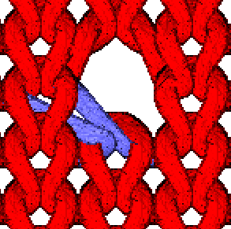
LESSON 2. Structure and properties of knitting fabric. Elements of the pattern in weft and warp knitting. Applications
Structure of knitting fabric. Stitch parameters
Properties of knitted fabric
Elements of the pattern in weft knitting
Elements of the pattern in warp knitting
Application and examples for weft and warp knitwear

Slide 11
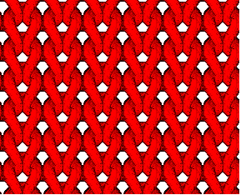
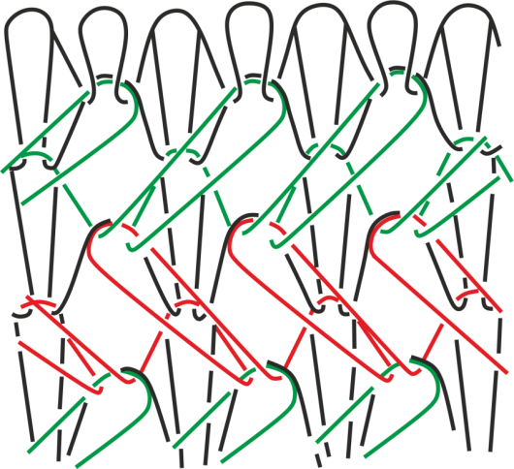
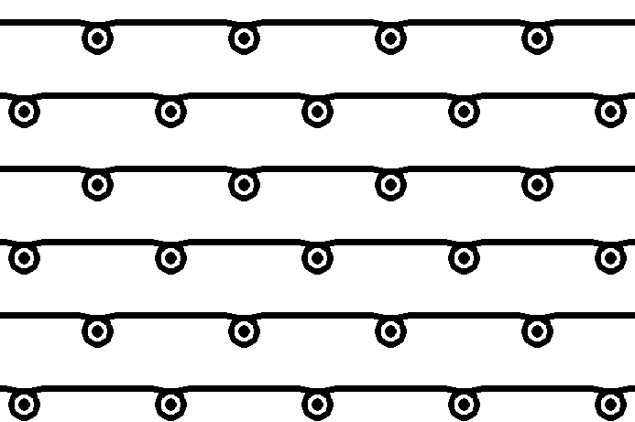
LESSON 3. Knitted fabric design – weft stitches
Classification of stitch types
Weft stitches
Plain
Derivate
Effects

Slide 12
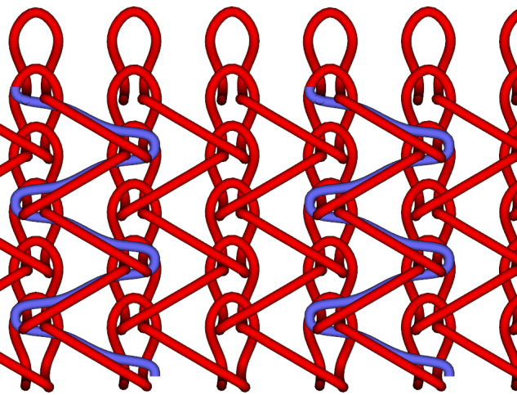
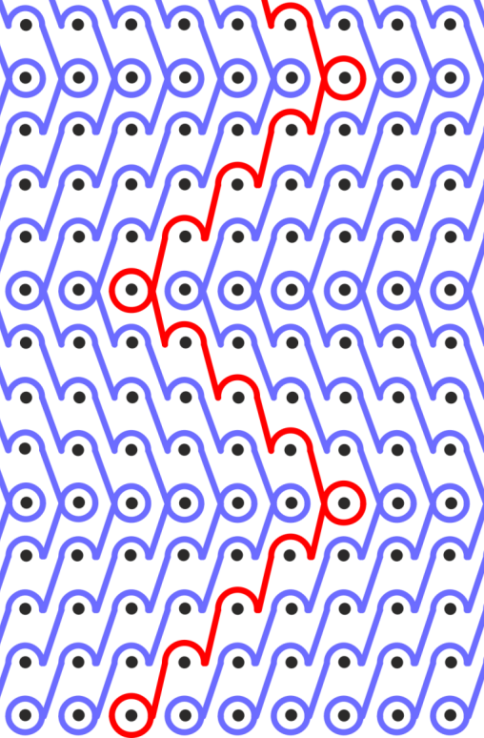
LESSON 4. Knitted fabric design – warp stitches
1. Types of warp stitches
Basic
Derivate
Stitches with two warps
Stitches with layd-in threads

Slide 13
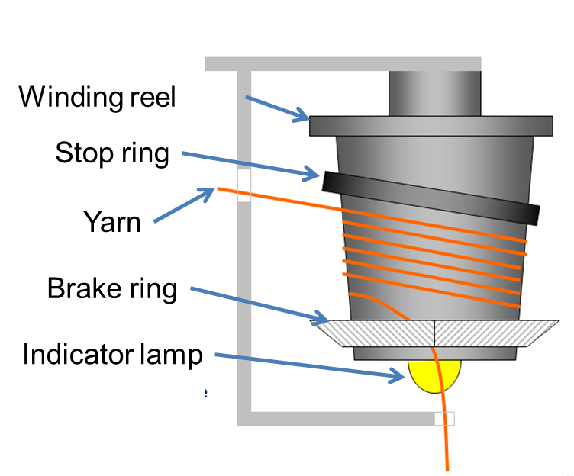
LESSON 5. Classification in knitting machines. Types of knitting units
Classification in knitting machines
Types of knitting machines units
Needle bed
Needles
Sinkers
Cams
Feeders
Winder

Slide 14
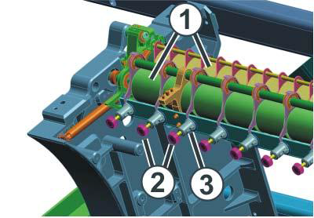
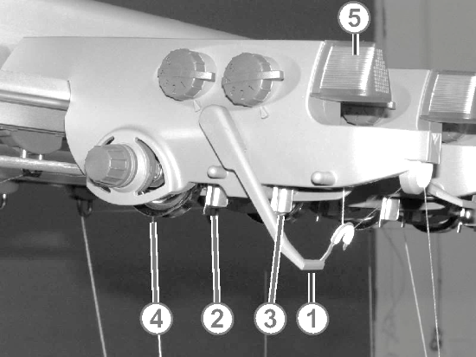
LESSON 6. Flat knitting machines
Introduction
Main characteristics
Layout
Animation of knitting process on flat knitting machine
Basic mechanisms
Carriage
Needle bed
Needle selection
Yarn feeder
Stitch pressing-down devices
Take-down system (winder)
Advantages of flat knitting machine
CAD system and electronic control

Slide 15
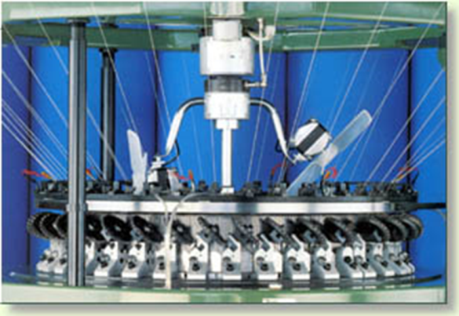
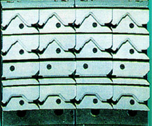
LESSON 7. Circular knitting machines
Introduction
Single circular machine
Main characteristics
Layout
Animation of knitting process on the machine
Knitting systems
Relanit knitting machine
Double circular machine
Main characteristics
Layout
Animation of knitting process on the machine
Basic mechanisms
4. Productivity of circular knitting machines

Slide 16
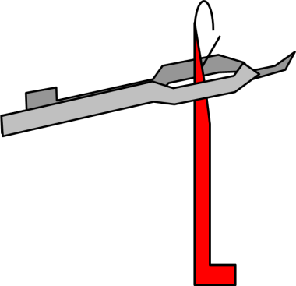
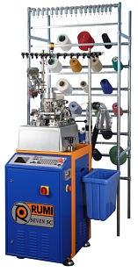
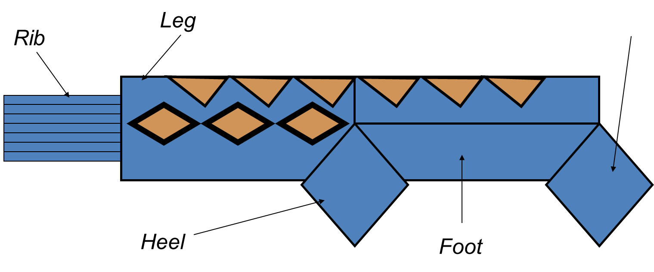
LESSON 8. Socks knitting machines
Introduction
Single sock knitting machine
Main characteristics
Layout of single socks knitting machine
Layout of double socks knitting machine with dial
Layout of double cylinder socks knitting machine
Animation of knitting process on the machine
Technology for men sock production
Toes

Slide 17
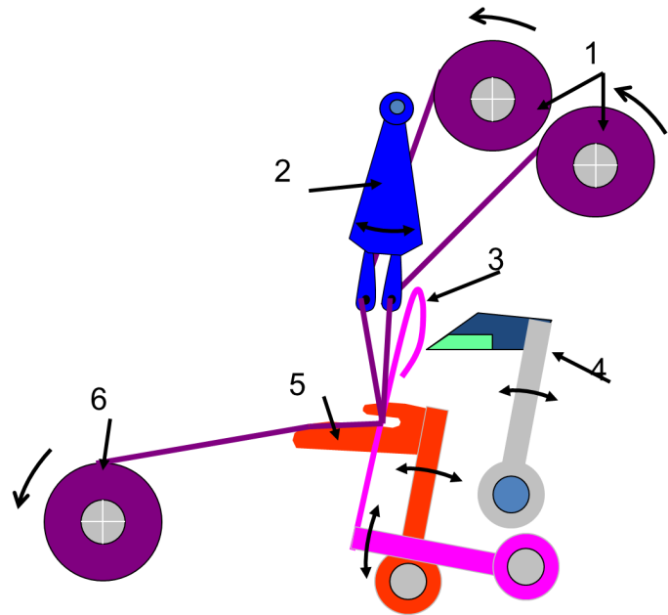
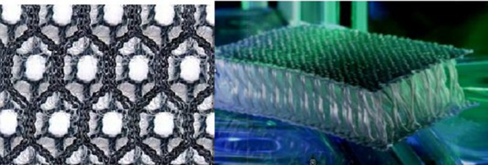
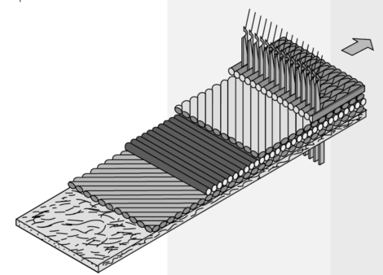
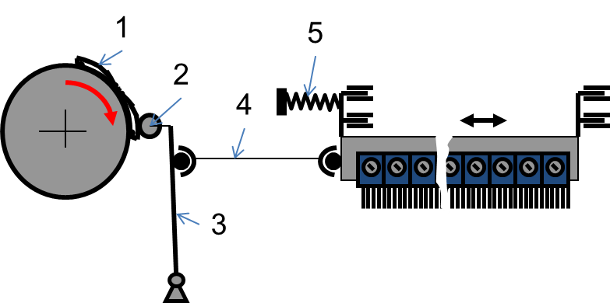
LESSON 9. Raschel and tricot knitting machines
Introduction
Main characteristics
Layout
Animation of knitting process on warp knitting machine
Guide bars
Yarn tension control
Take-down system
Technologies for fabric and 3D knitting products
Advantages of warp knitting machine

Slide 18
THANK YOU FOR YOUR ATTENTION !

Slide 19
CONTACTS
Coordinator:
Technical University of Sofia
Department of Textile Engineering
Project Manager of ICT-TEX:
Assoc. Prof. Angel Terziev, PhD
е-mail: aterziev@tu-sofia.bg
Web-site: ICT-TEX.eu
The information and views set out in this publication are those of the authors and do not necessarily reflect the official opinion of the European Union. Neither the European Union institutions and bodies nor any person acting on their behalf may be held responsible for the use which may be made of the information contained therein.

