Slide 1
Benny MALENGIER, PhD Ghent University, BELGIUM The course is developed under Erasmus+ Program Key Action 2: Cooperation for innovation and the exchange of good practices Knowledge Alliance
TRAINING COURSE
Design and Production of Technical,
Smart and Intelligent Textiles Software Installation
ICT IN TEXTILE AND CLOTHING HIGHER EDUCATION AND BUSINESS
Project Nr. 612248-EPP-1-2019-1-BG-EPPKA2-KA
The information and views set out in this publication are those of the authors and do not necessarily reflect the official opinion of the European Union. Neither the European Union institutions and bodies nor any person acting on their behalf may be held responsible for the use which may be made of the information contained therein.

Slide 2
WP10: Development of Syllabuses - SOFTWARE
Following software would be used. Students would be required to install this software
Texgen
Inkscape
Ink/Stitch
Arduino
Abaqus Student Edition
Google Chrome for online tools (python, arduino, DOE)

Slide 3
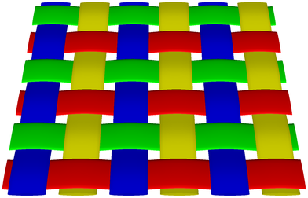
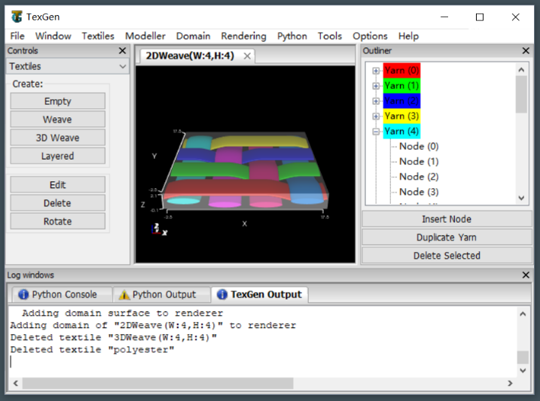
TexGen
TexGen is open source software licensed under the General Public License
Developed at the University of Nottingham
Modelling the geometry of textile structures
See http://texgen.sourceforge.net/index.php/Main_Page

Slide 4
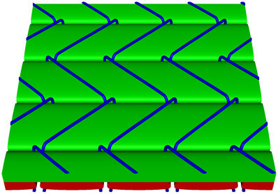
Texgen
Install it for windows with the instruction on the webpage:
http://texgen.sourceforge.net/index.php/Windows_Installation
https://sourceforge.net/projects/texgen/files/texgen/3.12.2/
file: texgen-bundle-64bit-Python27-3.12.2.exe
TexGen geometry can be exported in IGES and STEP format
Notes:
TexGen can be used to create the geometry of fabrics for meso-scale textile mechanics modelling, but also provides basic input to set up a weaving loom. Meshing can either be done directly within TexGen or geometry can be exported to the two most common CAD exchange file formats, IGES and STEP. Alternatively, Python scripts can be used to transfer geometry to specific third party applications such as Abaqus.

Slide 5
InkScape
Vector Drawing Program
Open Source (GPL)
Install from the website: https://inkscape.org/
2D-Drawing
Notes:
Inkscape
Adobe illustrator
CorelDraw
Macromedia Freehand
Affinity Designer
Microsoft Visio
Xara Extreme
Xfig

Slide 6
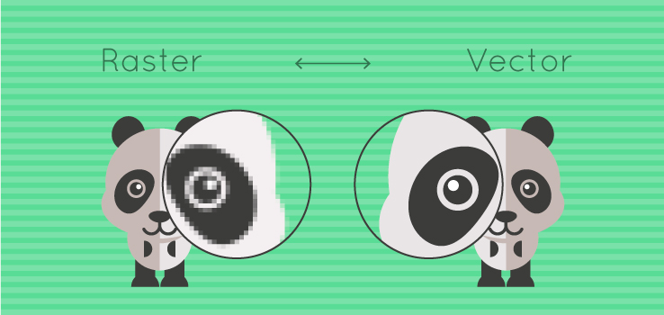
InkScape
Creates Vector Drawings

Slide 7
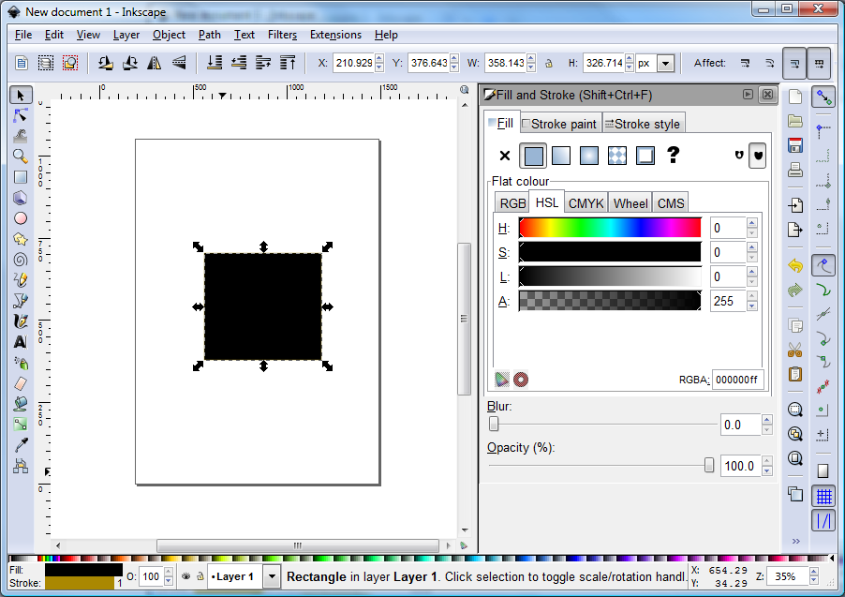
InkScape Interface
New page
Select Object selecteren, move, deform/scale
Change Lines
Standard figures
Drawing lines (free hand)
Straight & Bend Lines (smooth)
Text & Fonts

Slide 8
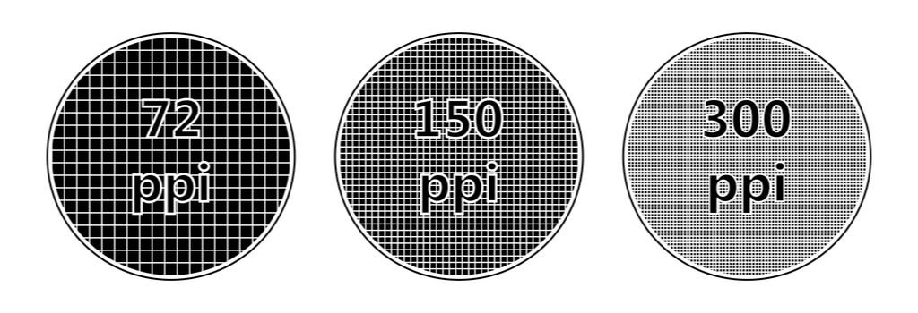
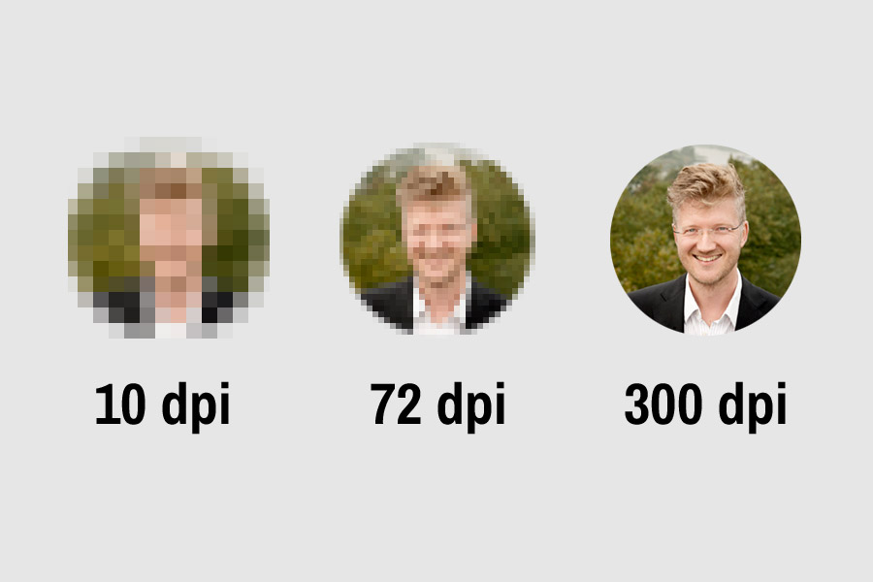
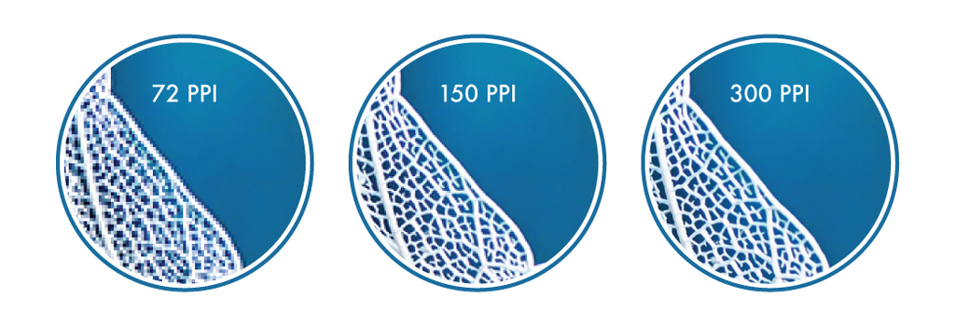
Inkscape: used for ...
Images/icons … export in the dpi you want

Slide 9
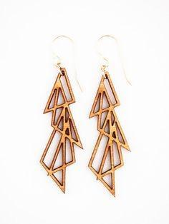
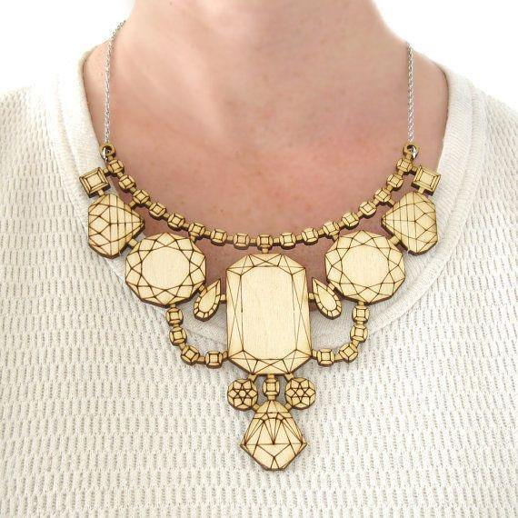
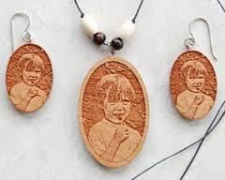
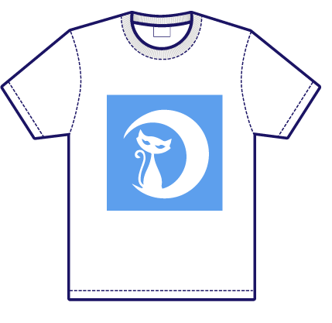
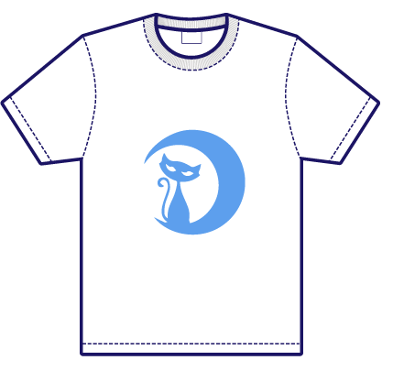
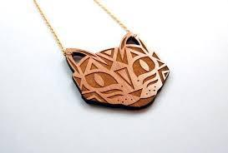
Inkscape: used for ...
fast
faster
slow
CNC tools
lasercutter
vinyl cutter
...
cut
engrave
raster

Slide 10
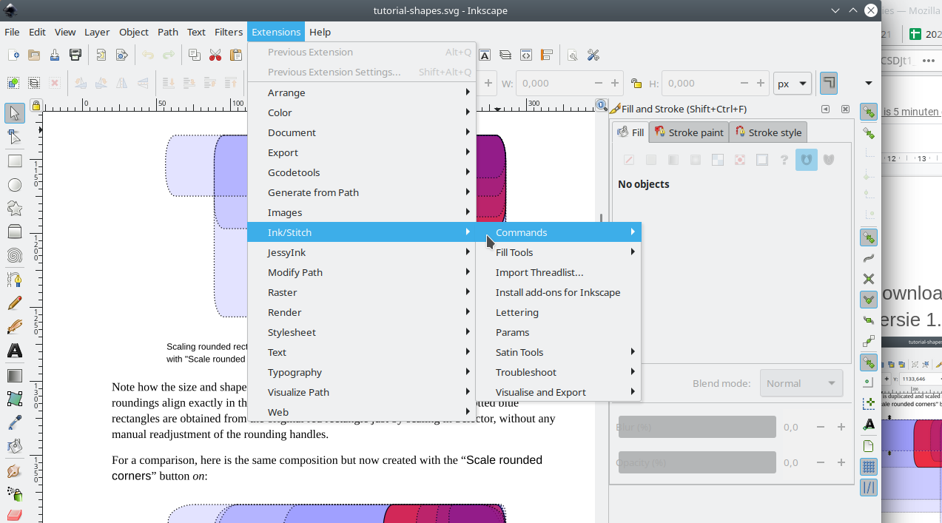
Ink/Stitch
Add on for Inkscape
Used for digital embroidery
Inkscape 1.x+ MUST be installed
Installeer with the manual after selecting your computer system https://inkstitch.org/docs/install/
Restart Inkscape and test if all was installed
See option in Extensions:

Slide 11
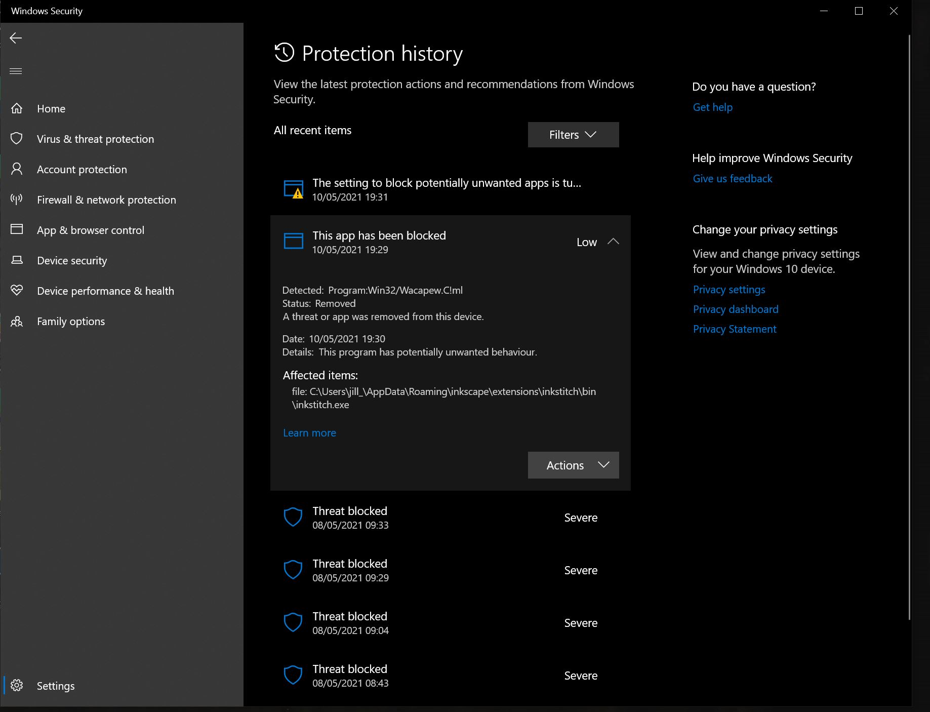
Ink/Stitch installation problems
Problem recent Mac: https://codewithhugo.com/catalina-permission-command-line-fix/ so do: xattr -d com.apple.quarantine /Applications/<app-name>.app
xattr -r -d com.apple.quarantine ~/Library/Application\ Support/org.inkscape.Inkscape/config/inkscape/extensions/
Problem Windows antivirus: ink/stitch uses same packaging methods as some malware, creating false positive hits as malware. See https://github.com/inkstitch/inkstitch/issues/710 or https://github.com/pyinstaller/pyinstaller/issues/4633
You must take inkstitch.exe then out of quarantaine so it would work (via Protection History). Then restart inkscape, if needed, copy inkstitch.exe to the correctlocation

Slide 12
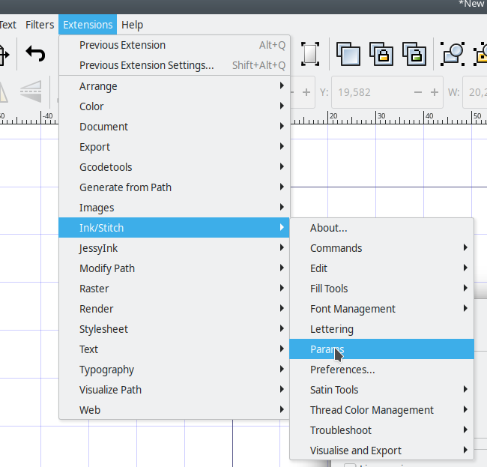
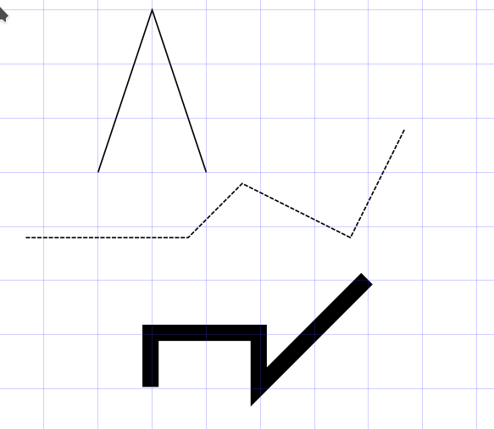
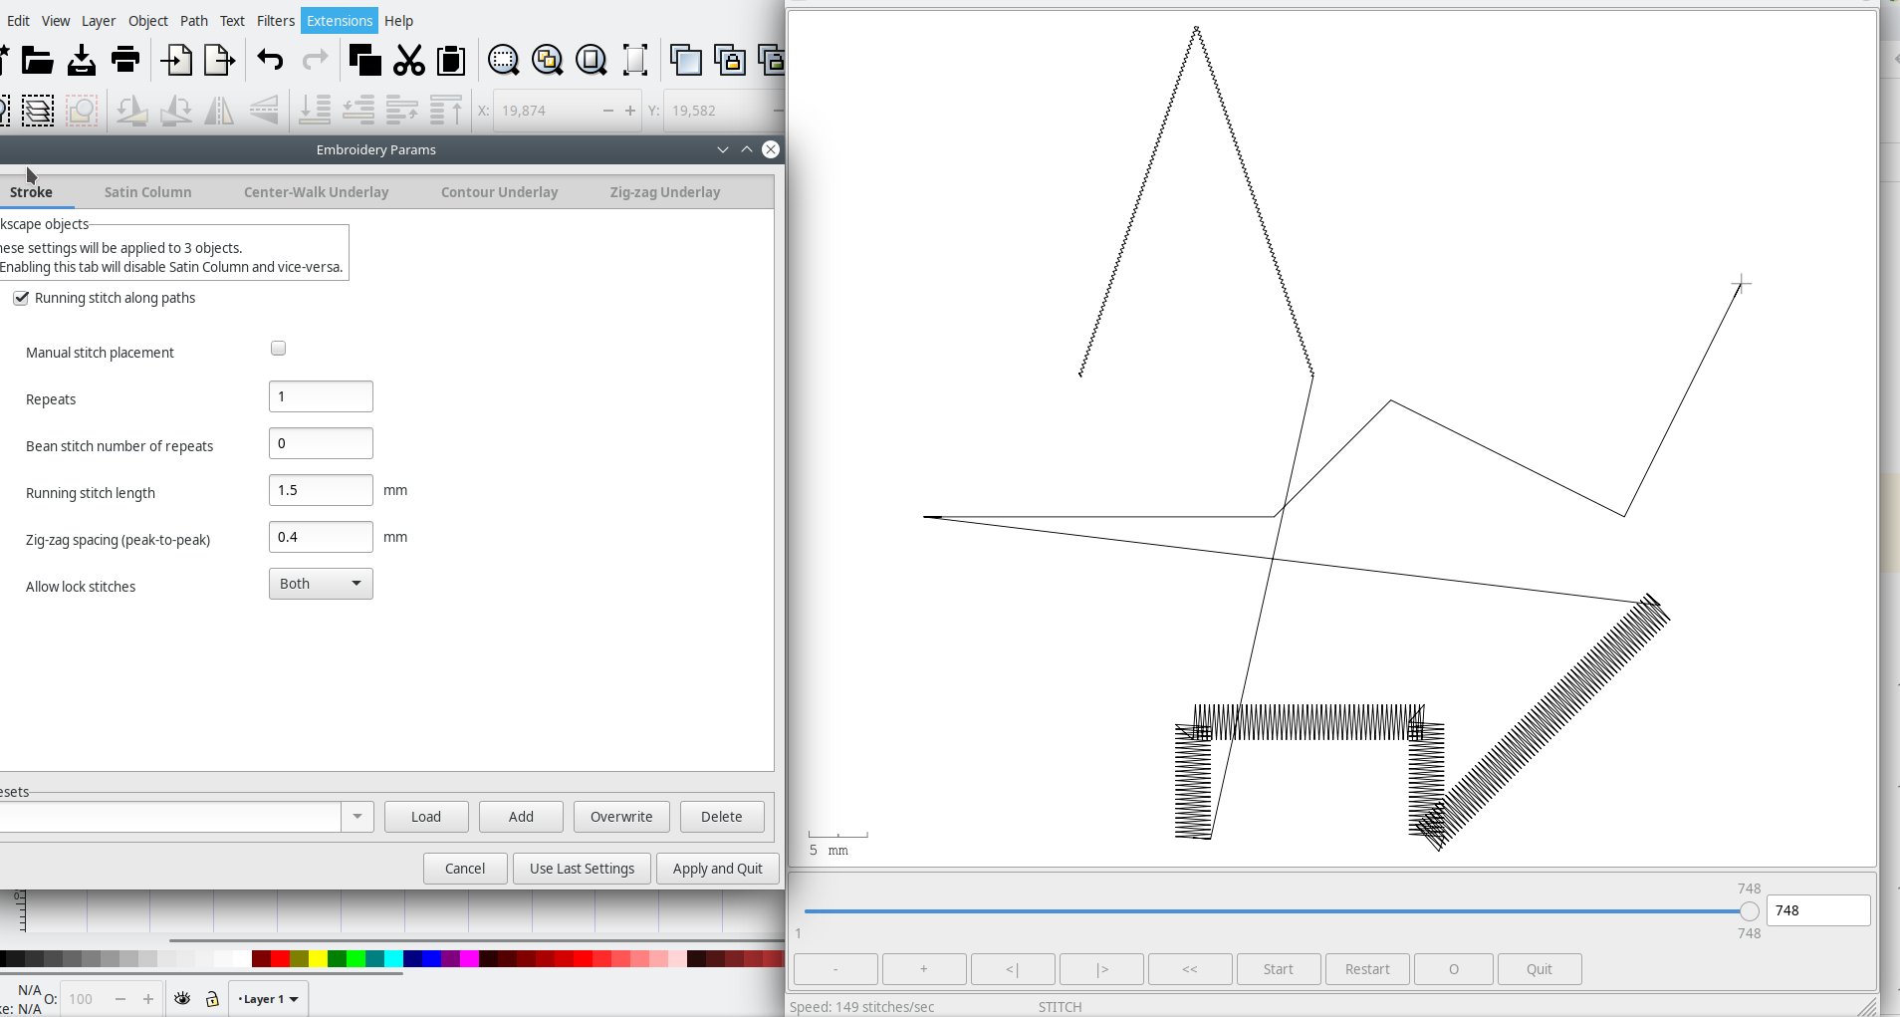
Ink/Stitch workflow
Generate Embroidery parameters
Draw
Verify the results - Improve

Slide 13
Arduino
For intelligent textile projects, microcontrollers must be programmed
Do this through the Arduino IDE
Download from the site https://www.arduino.cc/en/software
Current version 1.8.15
Install via the option Windows Win 7 and newer , not via Win App.

Slide 14
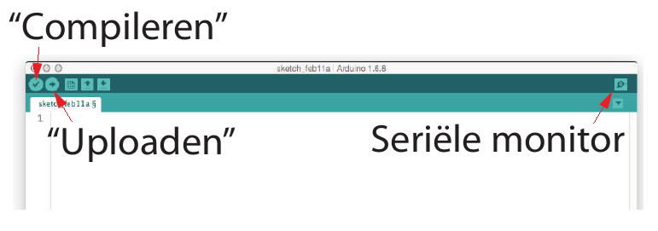
Arduino IDE
Integrated Development Environment
Texteditor
Compiler/Debugger
Linker/Locater
Bootloader
Serial monitor

Slide 15
Google Chrome
Modern browser, allows for:
python programming through https://colab.research.google.com/
Basic electronics through 3dcircuits on https://www.tinkercad.com/
Visual Arduino programming

Slide 16
Abaqus
Students can use the student edition, which can be downloaded from
https://edu.3ds.com/en/software/abaqus-student-edition

Slide 17
THANK YOU FOR YOUR ATTENTION !

Slide 18
WP10: Development of Syllabuses - TexGen hands on for Technical Textiles
Following software would be used. Students would be required to install this software
Texgen
Inkscape
Ink/Stitch
Arduino
Abaqus Student Edition
Google Chrome for online tools (python, arduino, DOE)

Slide 19
TexGen: Technical Textile construction
Benny Malengier

Slide 20
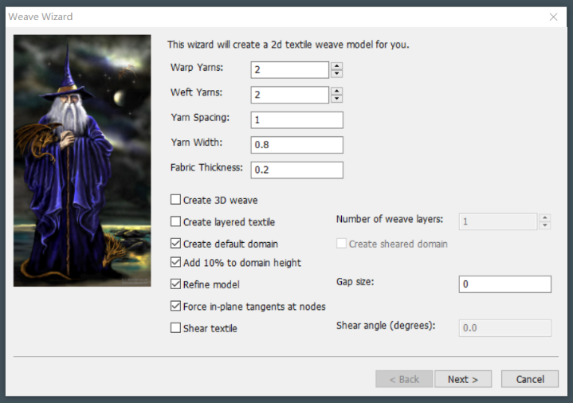
TexGen for standard woven Structures
Create a standard woven structure via the weave wizard

Slide 21
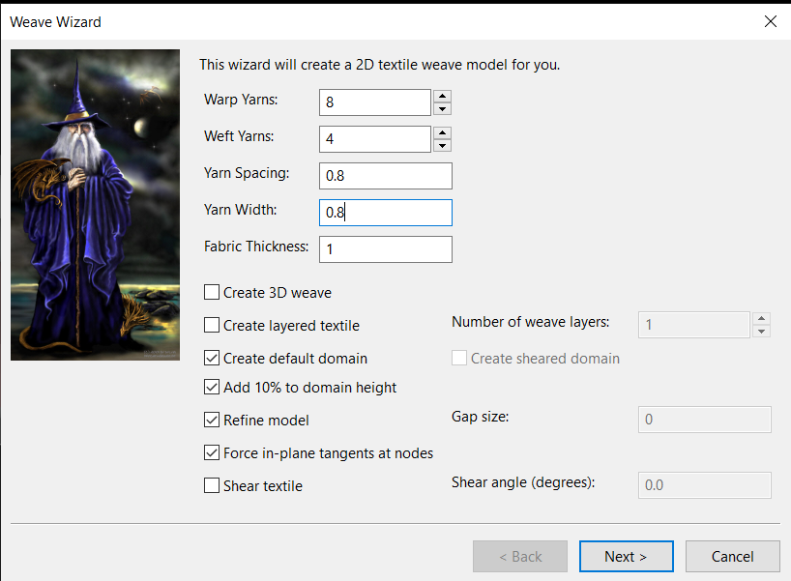
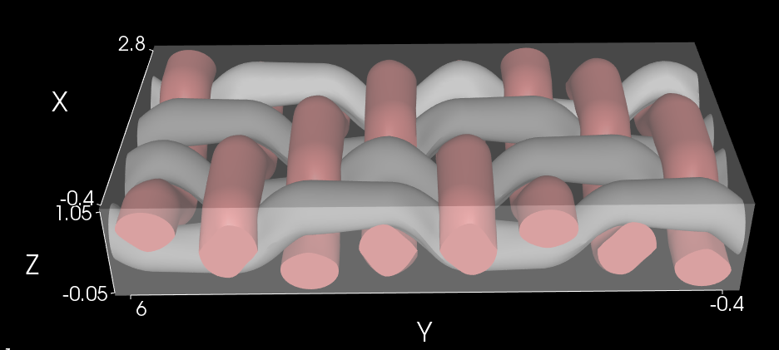
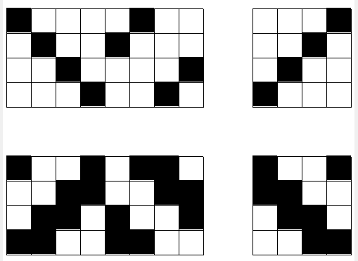
2. Create herringbone twill, cotton yarn 0.8 mm, yarns 0.8mm apart, 1mm thick

Slide 22
Assignment students
Assign each student (group) a known weave type
set different sizes/types of yarns
have them submit their texgen result to create a representation

Slide 23
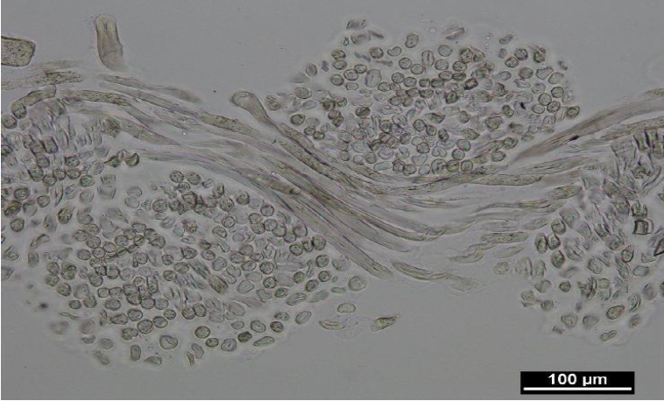
Specialty yarn shape

Slide 24
Tape yarns
Tape yarns are used for many technical structures. In TexGen it is the default yarn: when starting the Weave Wizard, the default yarn width is 0.8, while the default fabric thickness is 0.2, so yarns of 0.1 thick and 0.8 wide are used. The default yarn spacing is 1, indicating there is a gap of 0.2 between the yarns, leaving sufficient space for the tape to interleave each other.

Slide 25
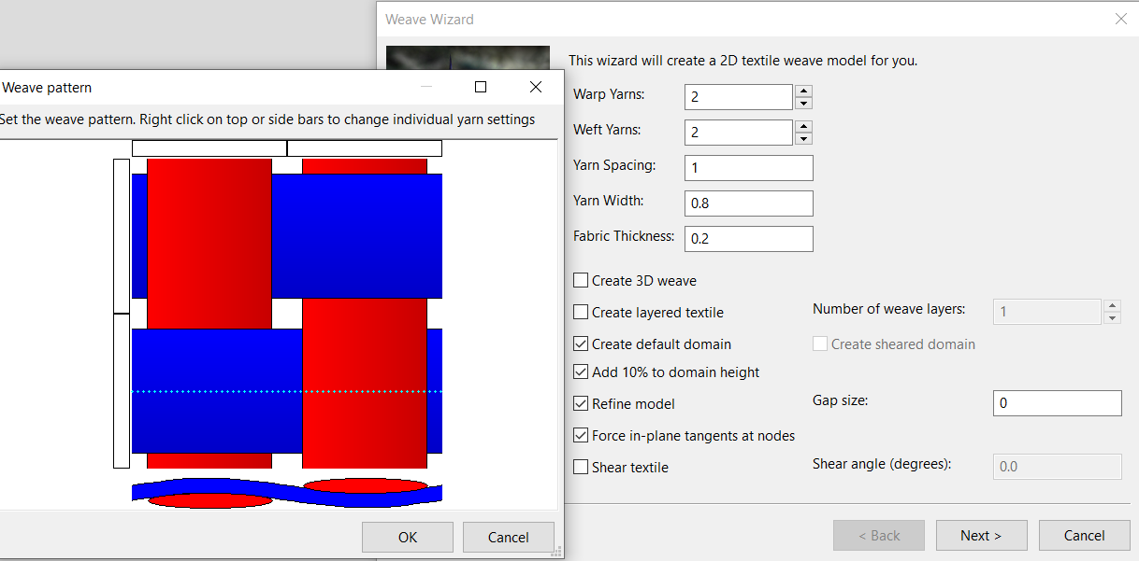

Slide 26
Combining different cross-section yarns
Eg: Metal monofilament in weft and warp combined with standard yarn.
Create a 5x5 plain woven structure, adding the metal yarn in the center. The yarn itself takes on a lenticular shape of 0.3mm wide and 0.1mm thickness, while the copper wire has a diameter of 0.15 mm.

Slide 27
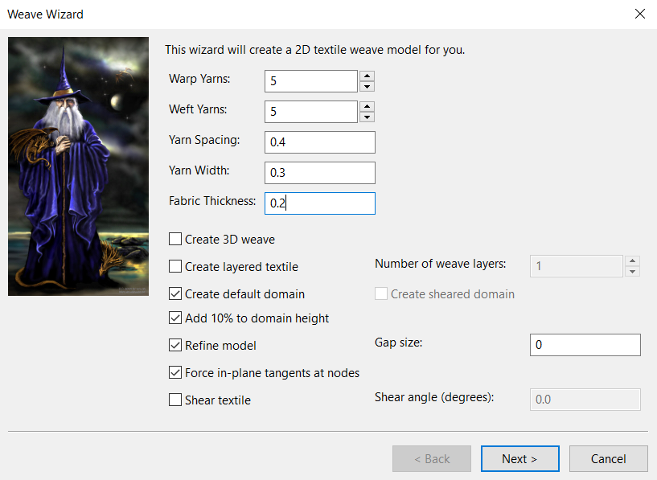
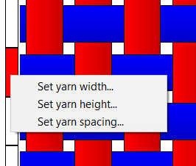
Select the copper wire, and change yarn width via the context menu

Slide 28
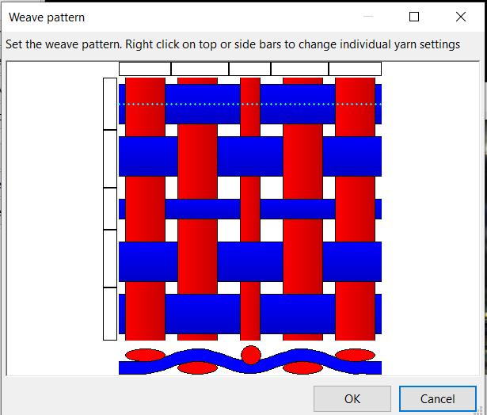
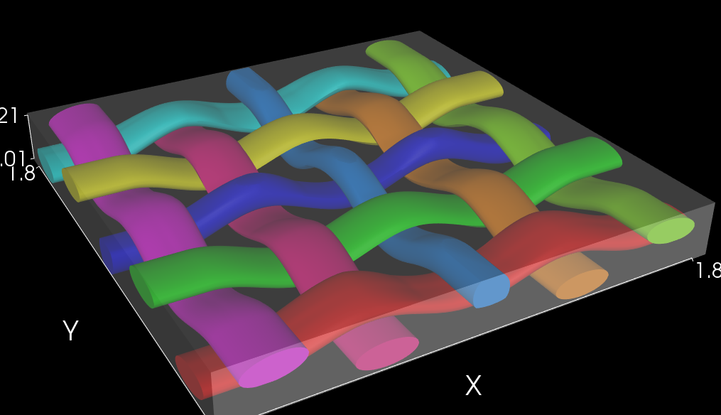
Set yarn width and height of the central yarns to 0.15 as this is the thin round copper wire. You should end up with:

Slide 29
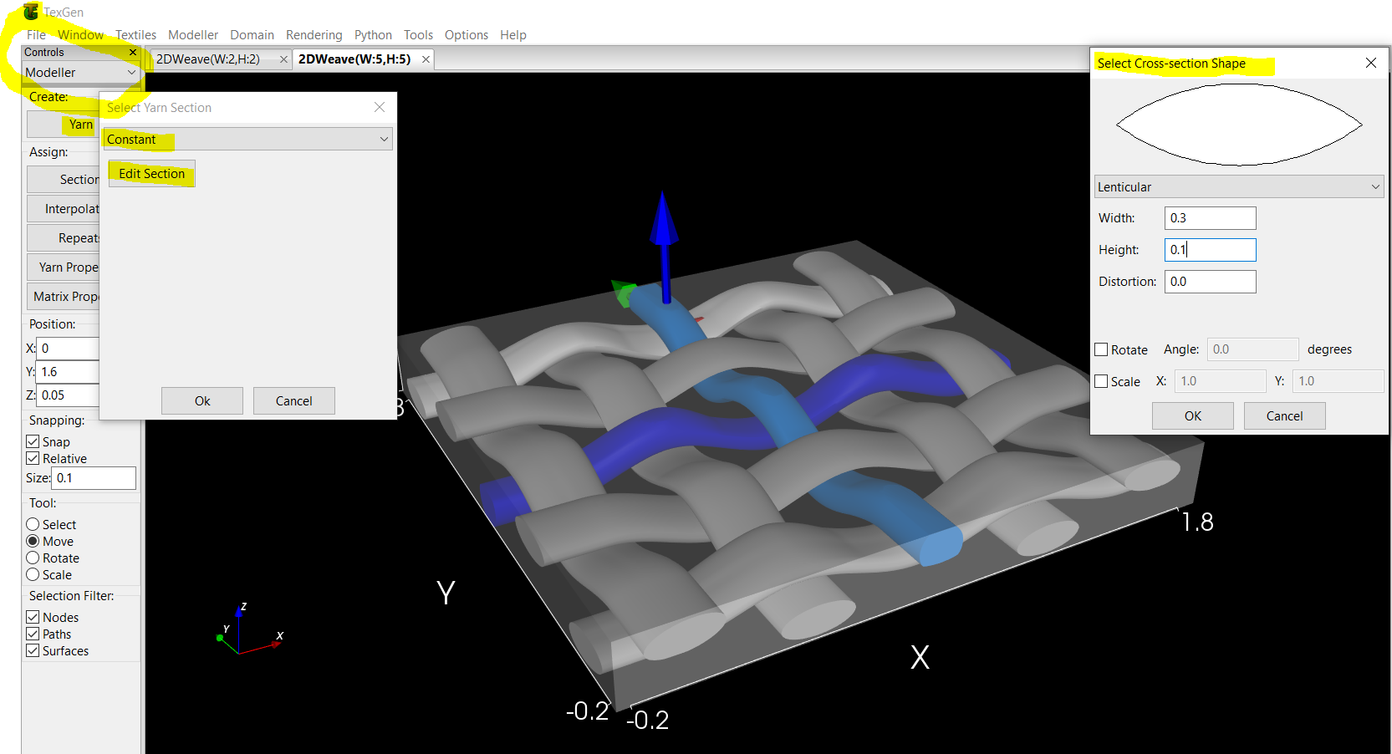
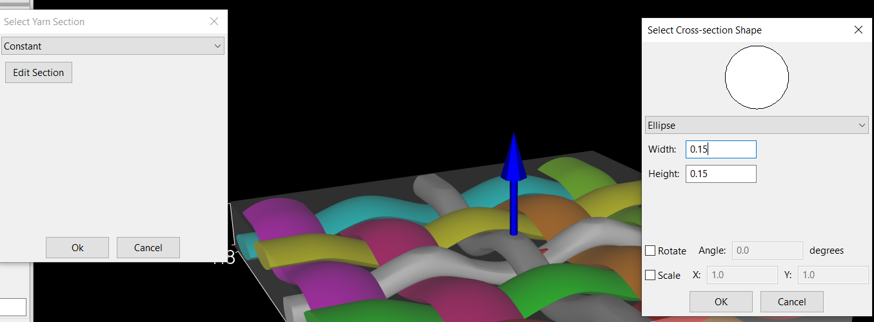
Fix the cross-section. Go to Modeller view, select yarns to change, set yarn section to lenticular width 0.3, height 0.1.
The copper wires should
be made round instead

Slide 30
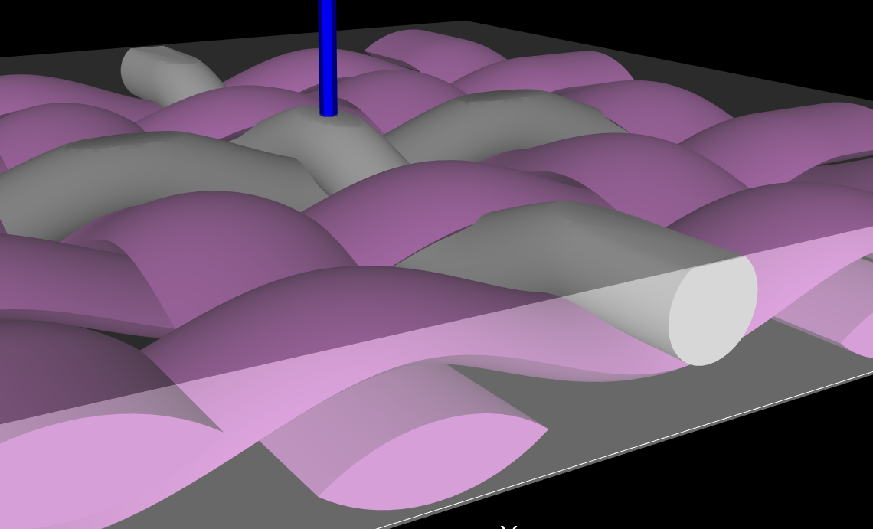
The result

Slide 31
Assignment
We can see the two metal wires have good contact.
A nice assignement for students is: can you make sure there is NO contact (so as to be able to make a circuit through weaving that does not intersect at the crossing)

Slide 32
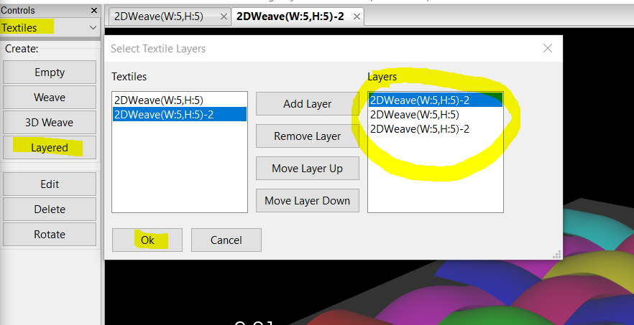
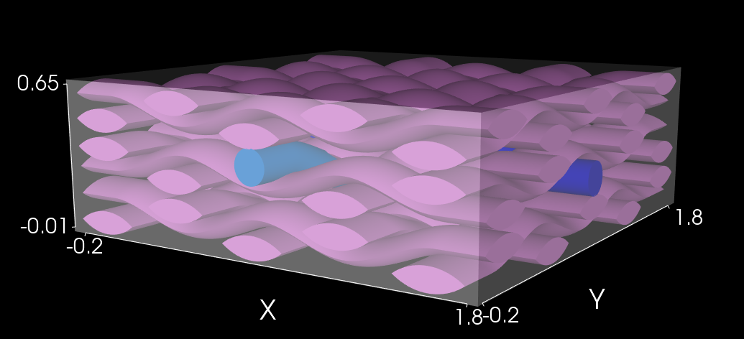
Multilayer
Select Layered. Combine previously created weaves to make a layered structure.
This is example of laminating structures.

Slide 33
Free woven fabric design
More advanced: You can create free structures by designing node by node.
Like this knits can be made also.

Slide 34
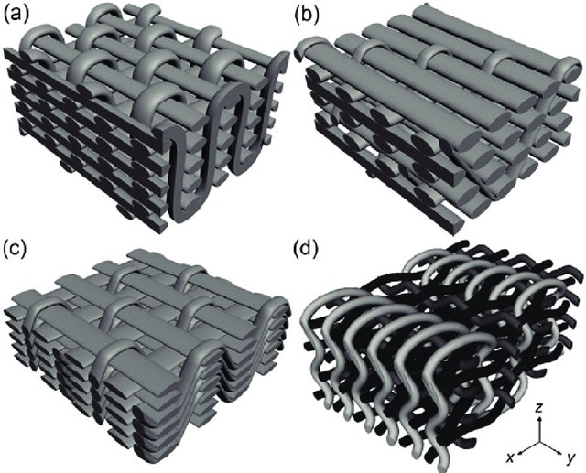
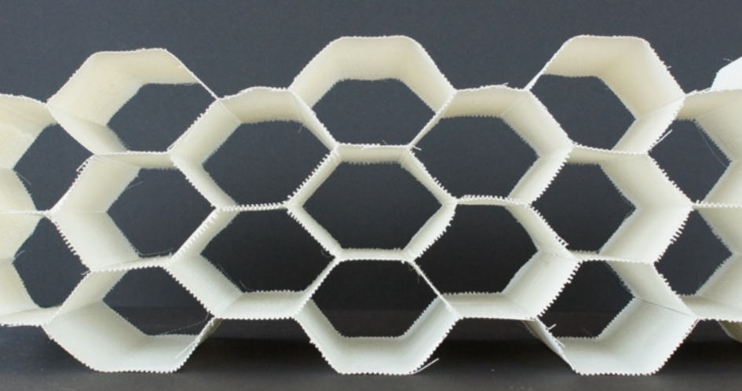
3D woven structures
3D woven structures:
(a) orthogonal,
(b) through-the-thickness angle interlock,
(c) layer-to-layer angle interlock,
(d) fully interlaced from:
Stig F, Hallström S. Spatial modelling of 3D-woven textiles. Composite Structures 2012;94:1495-1502. DOI: 10.1016/j.compstruct.2011.12.003 CC-BY-3.0
hollow 3D woven fabric from 3D Weaving

Slide 35
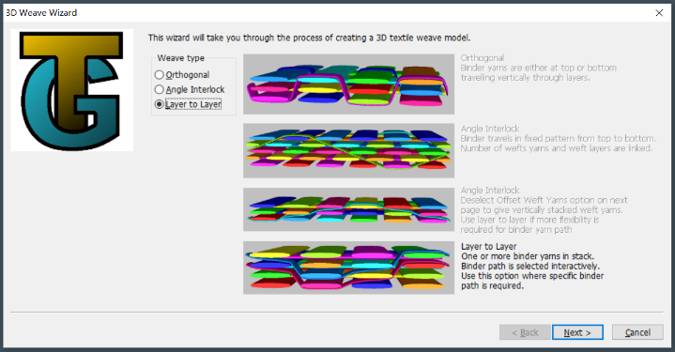
TexGen 3D Weave Wizard
3 standard types available

Slide 36
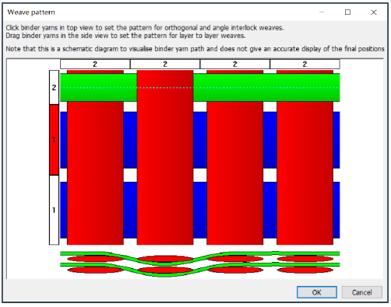
Example: Layer to layer 3D woven fabric

Slide 37
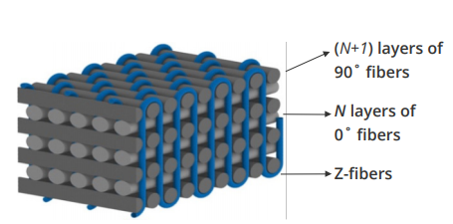
Example: No-Crimp 3D woven structure

Slide 38
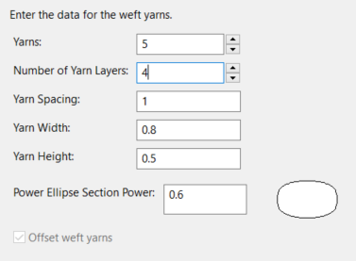
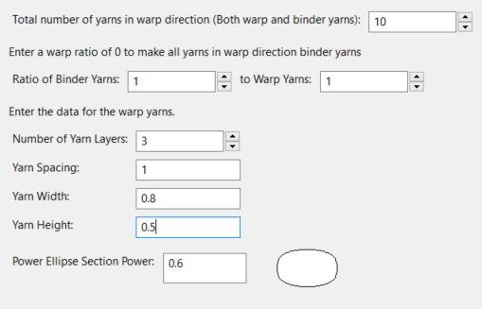
3D Weave Wizard, and select weave type Orthogonal
Then: set weft, set type of weft, set warp and binder, set type of warp and binder

Slide 39
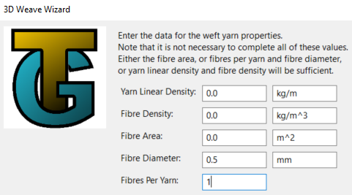
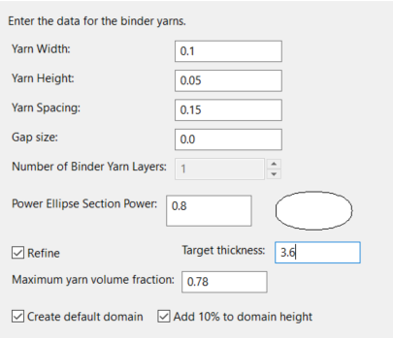
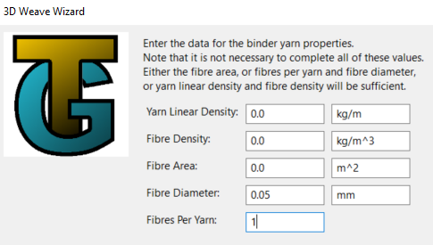

Slide 40
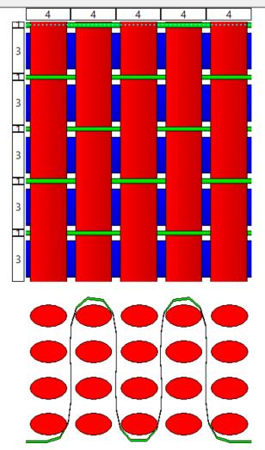
Next, indicate how the binder yarns run

Slide 41
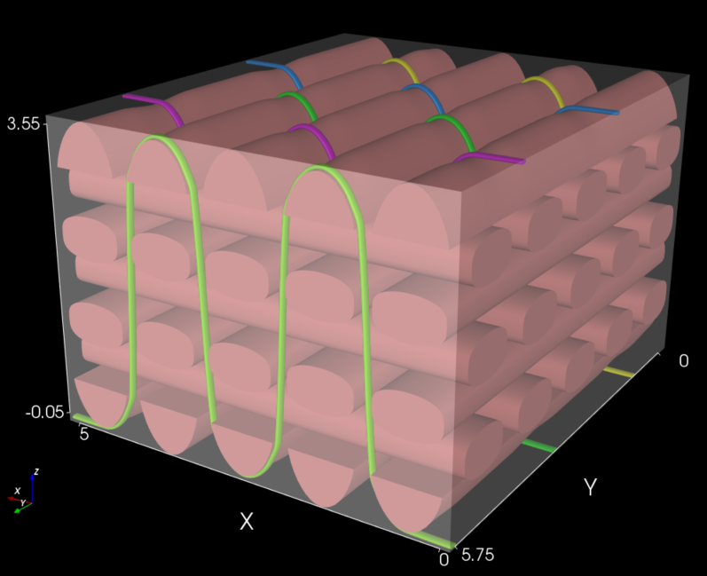
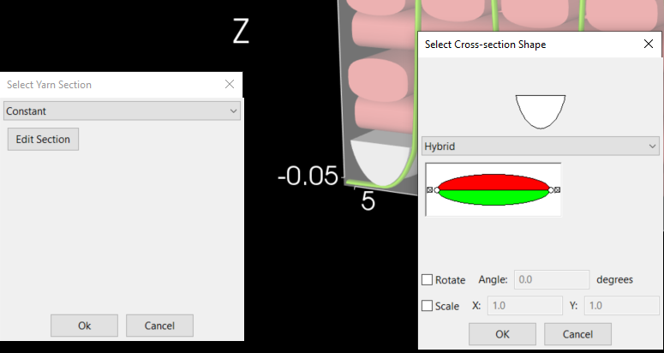
Intermediate result:
Error clear in Modeller → Section

Slide 42
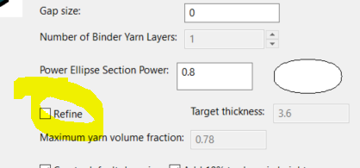
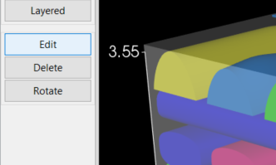
Fix Error with Textiles→ Edit, reenter data of the original screens, but tick off Refine model
Recompute the structure

Slide 43
Result

Slide 44
Assignment
Good assignment for students: Give them a textile 3D woven structure. Have them create it in TexGen

Slide 45
Advanced use
Python interaction with TexGen
Export for use in Abaqus.

Slide 46
Ink/Stitch: Smart Textile construction
Benny Malengier
Images from UWB, Czech Republic (OptimTex project cases)

Slide 47
Ink/Stitch
Design patterns for use on embroidery machines

Slide 48
Embroidery Stitch File Format | Embroidery Machine Brand
.ART | Bernina
.PES / .PEC | Brother / Baby Lock / Deco
.DST | Tajima / Barudan
.EXP | Melco / Bravo
.SEW / .JEF | Janome
.VP3 / .HUS / .VIP | Husqvarna /Viking
A list of machine embroidery file formats and machine brands

Slide 49
Connections and pads with Ink/Stitch

Slide 50
Embroider pads for electronic components
A possible design (in mm) is the following:
We require a way to embroider these pads. Step 1 is drawing them in the correct size with Inkscape

Slide 51
Open Inkscape, and draw the rectangles, give then correct size

Slide 52
With Ink/Stitch generate the embroidery pattern: Extension Ink/Stitch→ Params
Visualize, and embroider: Extensions → Ink / Stitch → Visualize and Export → Embroider…

Slide 53
Assignment
A good assignment is to have students create the optimal pad for a component you give them.
Eg, for an SMD LED 1206 (mm dimension) it could be:

Slide 54
Always use rectangular patch ?
If the accuracy of the gap is very important, then use manual hatching!
Remove the rectangle before embroidery

Slide 55
Testing a good distance
Have students test with best distance, by embroidering different ones and see what works.

Slide 56
Snap buttons
Consider larger pads for eg snap buttons or magnets.
Example: 10x10mm

Slide 57
Arduino - Programming for Smart Textiles - Hands On
Benny Malengier

Slide 58
What is Arduino ?
Arduino is an open source computer platform, meant to make the use of a microcontroller easy.
Arduino is for students, hobbyists, artists, and everybody interested in the making of “smart” and “creative” objects.

Slide 59
2005: the first!
2009: USB !
2017: Arduino UNO (Rev. 03)

Slide 60
What can you do with Arduino?
Measurement/input → Think (software) → Output: sound, light, action, display, ...

Slide 61
What is inside an Arduino UNO ?

Slide 63
Arduino IDE
Integrated Development Environment
Texteditor
Compiler/Debugger
Linker/Locater
Bootloader
Serial monitor
Download from: https://www.arduino.cc/en/Main/Software
Free software (Linux, OSX, Windows) - Current version 1.8.15

Slide 64
IDE - Settings
To compile an Arduino sketch (= program) correctly, the IDE must know which type of Arduino (= board) is being used,
To be able to upload a sketch to the Arduino, the IDE must know via which port the Arduino is connected with the PC.

Slide 65
What is a sketch ?
A sketch is an Arduino programm,
A sketch is saved in a folder with the same name as the sketch,
A sketch can be made/edited with the Arduino IDE.
Not used to programming? You can use several block based environments to create code. We use: blokkencode.ingegno.be/index_en.html

Slide 66
What is in a sketch ?
a sketch contains at least always the following 2 unique functions:
void setup()
Takes care of the initialisation,
Is begin executed one single time,
after power-up,
after reset,
after starting a serial monitor (introspection of the code),
void loop()
Contains the main program that executes again and again.

Slide 67
A first program with Blocks
To start, we use an interactive programming environment: blokkencode.ingegno.be/index_en.html
Use index_en.html for the English version

Slide 68
Minimum Sketch content
Load following minimum sketch to the Arduino

Slide 69
Working with a LED
The Arduino has an internal LED on the board
This is connected with pin 13 on Arduino. On WEMOS use pin D4 instead
Make a LED blink:

Slide 70
CONTACTS
Coordinator:
Technical University of Sofia
Faculty of Power Engineering and Power Machines
Project Manager of ICT-TEX:
Assoc. Prof. Dr. Angel Terziev
е-mail: aterziev@tu-sofia.bg
Web-site: ICT-TEX.eu
Contact: Benny Malengier, PhD, DSc
benny.malengier@ugent.be
The information and views set out in this publication are those of the authors and do not necessarily reflect the official opinion of the European Union. Neither the European Union institutions and bodies nor any person acting on their behalf may be held responsible for the use which may be made of the information contained therein.

