Slide 1
Technical Textiles - Construction and Testing: Software

Slide 2
Technical Textiles: Construction and Testing - SOFTWARE
Following software will be used.
Texgen
Abaqus Student Edition
Google Chrome for online tools (python, arduino, DOE)

Slide 3
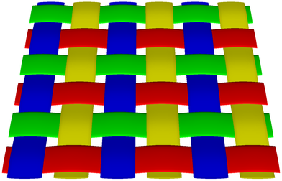
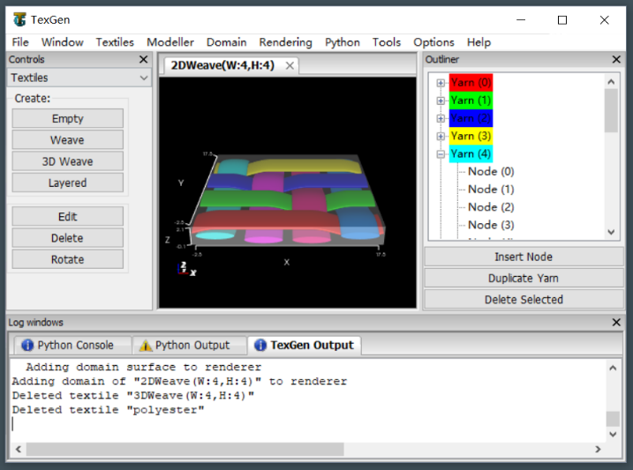
TexGen
TexGen is open source software licensed under the General Public License
Developed at the University of Nottingham
Modelling the geometry of textile structures
See http://texgen.sourceforge.net/index.php/Main_Page

Slide 4
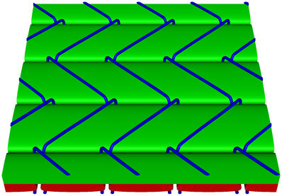
Texgen
Install it for windows with the instruction on the webpage:
http://texgen.sourceforge.net/index.php/Windows_Installation
https://sourceforge.net/projects/texgen/files/texgen/3.12.2/
file: texgen-bundle-64bit-Python27-3.12.2.exe
TexGen geometry can be exported in IGES and STEP format
Notes:
TexGen can be used to create the geometry of fabrics for meso-scale textile mechanics modelling, but also provides basic input to set up a weaving loom. Meshing can either be done directly within TexGen or geometry can be exported to the two most common CAD exchange file formats, IGES and STEP. Alternatively, Python scripts can be used to transfer geometry to specific third party applications such as Abaqus.

Slide 5
Google Chrome
Modern browser, allows for:
python programming through https://colab.research.google.com/
Basic electronics through 3dcircuits on https://www.tinkercad.com/
Visual Arduino programming

Slide 6
Abaqus
Students can use the student edition, which can be downloaded from
https://edu.3ds.com/en/software/abaqus-student-edition

Slide 7
TexGen: Technical Textile construction
Benny Malengier

Slide 8
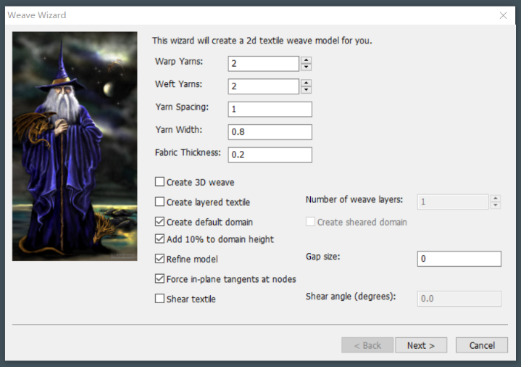
TexGen for standard woven Structures
Create a standard woven structure via the weave wizard

Slide 9
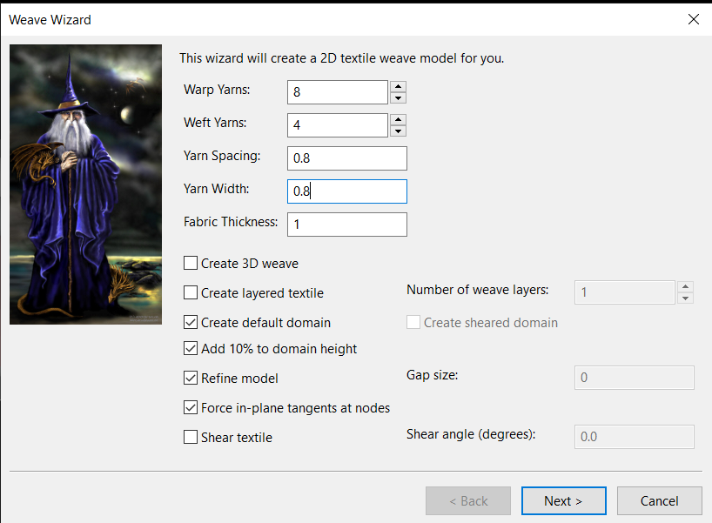
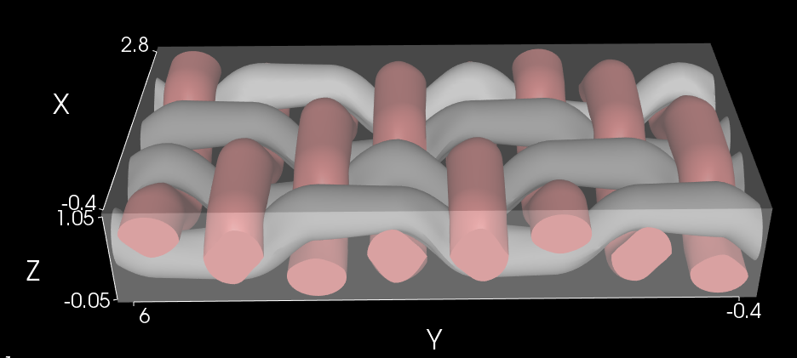
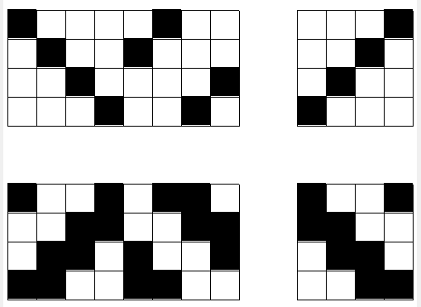
2. Create herringbone twill, cotton yarn 0.8 mm, yarns 0.8mm apart, 1mm thick

Slide 10
Assignment students
Assign each student (group) a known weave type
set different sizes/types of yarns
have them submit their texgen result to create a representation

Slide 11
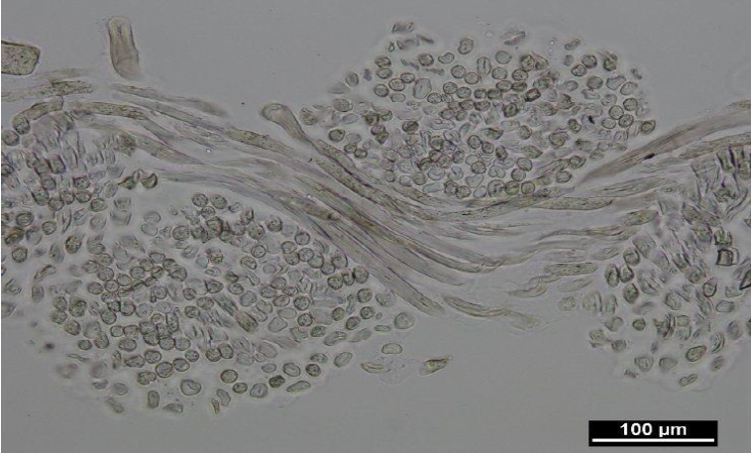
Specialty yarn shape

Slide 12
Tape yarns
Tape yarns are used for many technical structures. In TexGen it is the default yarn: when starting the Weave Wizard, the default yarn width is 0.8, while the default fabric thickness is 0.2, so yarns of 0.1 thick and 0.8 wide are used. The default yarn spacing is 1, indicating there is a gap of 0.2 between the yarns, leaving sufficient space for the tape to interleave each other.

Slide 13
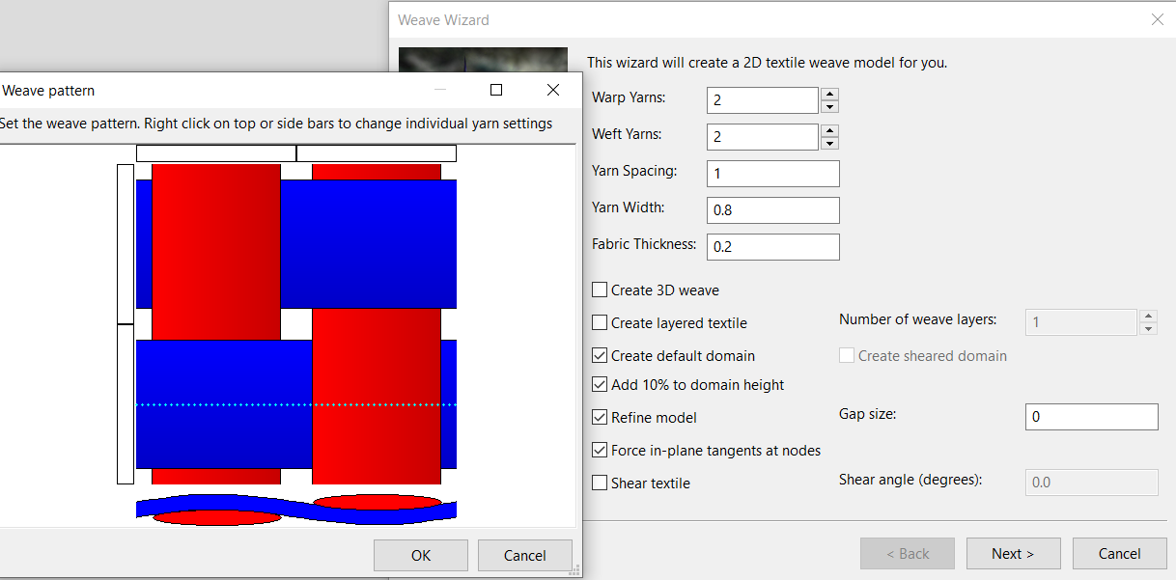

Slide 14
Combining different cross-section yarns
Eg: Metal monofilament in weft and warp combined with standard yarn.
Create a 5x5 plain woven structure, adding the metal yarn in the center. The yarn itself takes on a lenticular shape of 0.3mm wide and 0.1mm thickness, while the copper wire has a diameter of 0.15 mm.

Slide 15
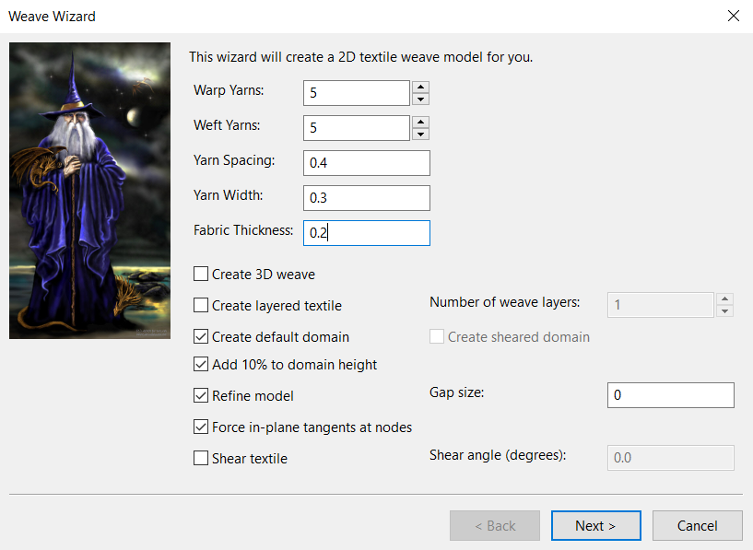
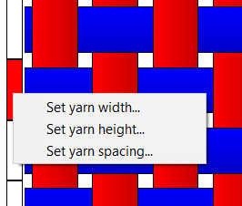
Select the copper wire, and change yarn width via the context menu

Slide 16
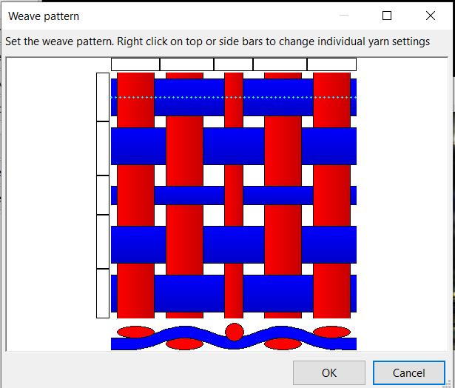
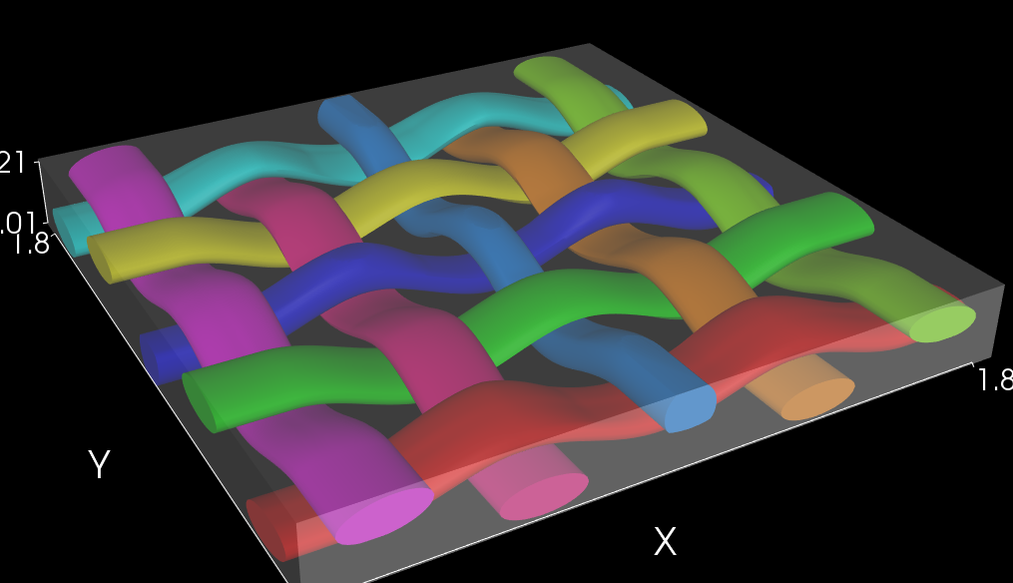
Set yarn width and height of the central yarns to 0.15 as this is the thin round copper wire. You should end up with:

Slide 17
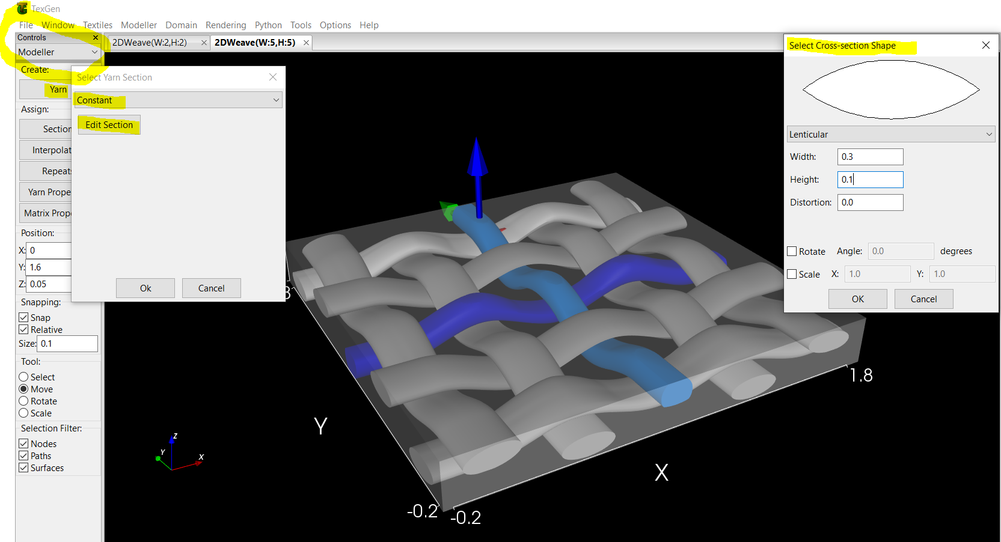
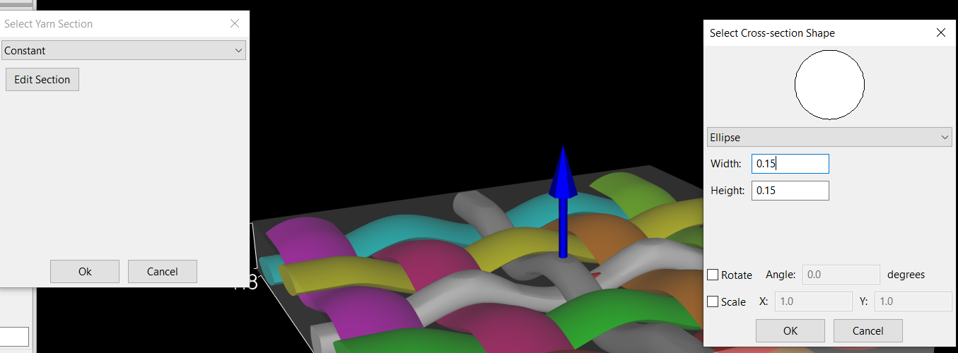
Fix the cross-section. Go to Modeller view, select yarns to change, set yarn section to lenticular width 0.3, height 0.1.
The copper wires should
be made round instead

Slide 18
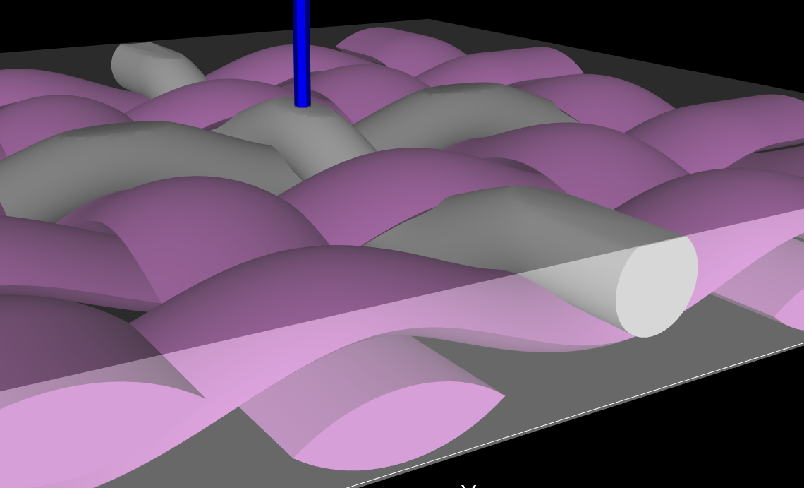
The result

Slide 19
Assignment
We can see the two metal wires have good contact.
A nice assignement for students is: can you make sure there is NO contact (so as to be able to make a circuit through weaving that does not intersect at the crossing)

Slide 20
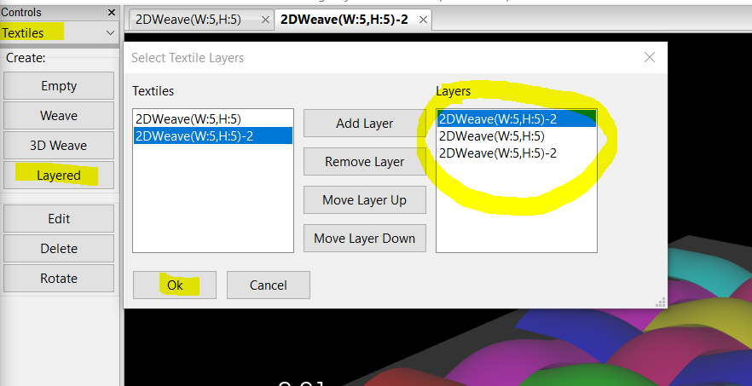
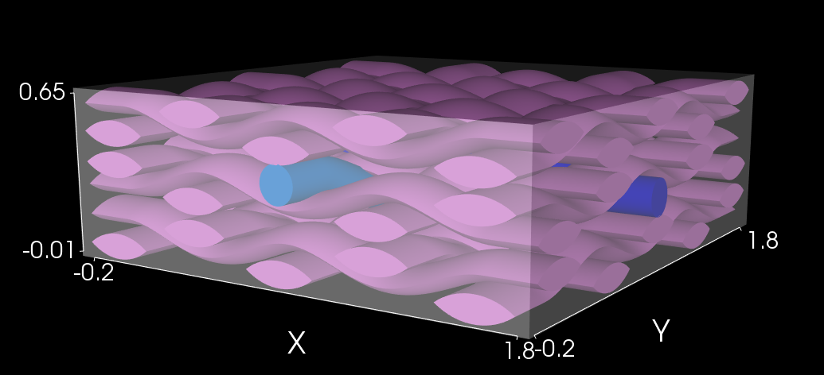
Multilayer
Select Layered. Combine previously created weaves to make a layered structure.
This is example of laminating structures.

Slide 21
Free woven fabric design
More advanced: You can create free structures by designing node by node.
Like this knits can be made also.

Slide 22
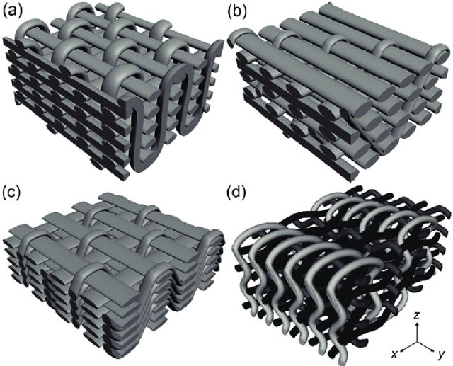
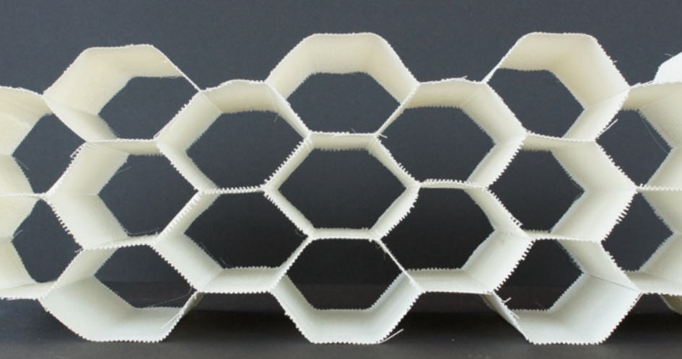
3D woven structures
3D woven structures:
(a) orthogonal,
(b) through-the-thickness angle interlock,
(c) layer-to-layer angle interlock,
(d) fully interlaced from:
Stig F, Hallström S. Spatial modelling of 3D-woven textiles. Composite Structures 2012;94:1495-1502. DOI: 10.1016/j.compstruct.2011.12.003 CC-BY-3.0
hollow 3D woven fabric from 3D Weaving

Slide 23
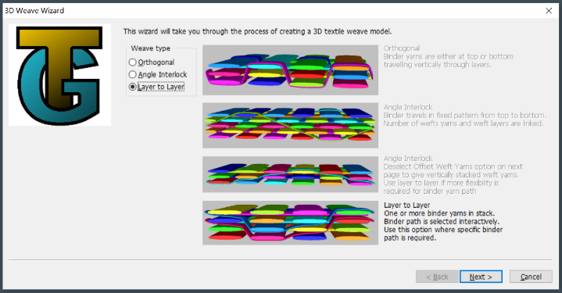
TexGen 3D Weave Wizard
3 standard types available

Slide 24
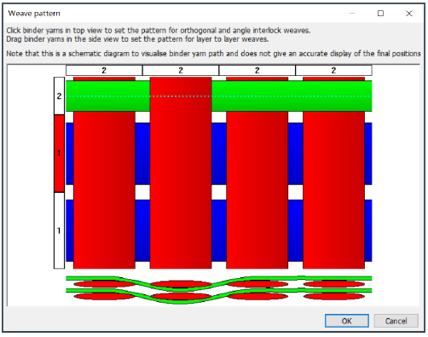
Example: Layer to layer 3D woven fabric

Slide 25
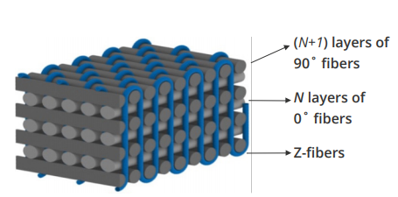
Example: No-Crimp 3D woven structure

Slide 26
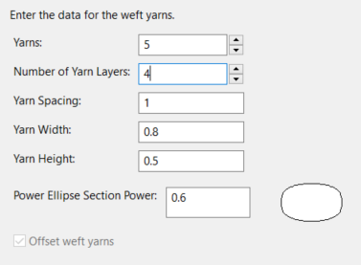
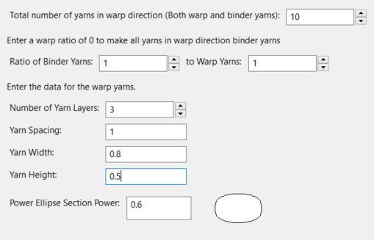
3D Weave Wizard, and select weave type Orthogonal
Then: set weft, set type of weft, set warp and binder, set type of warp and binder

Slide 27
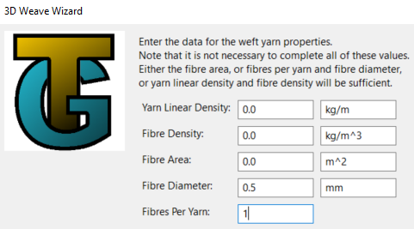
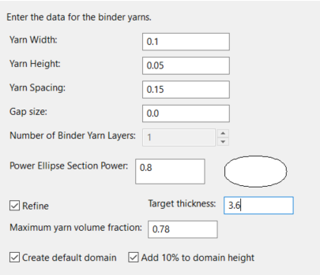
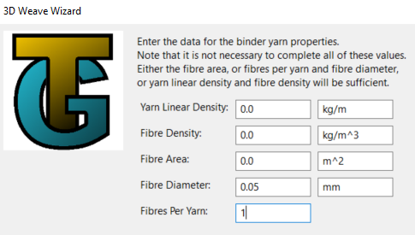

Slide 28
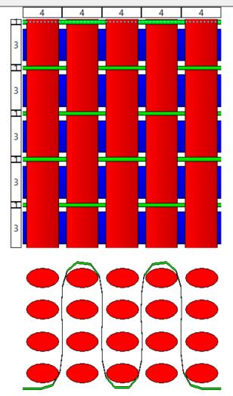
Next, indicate how the binder yarns run

Slide 29
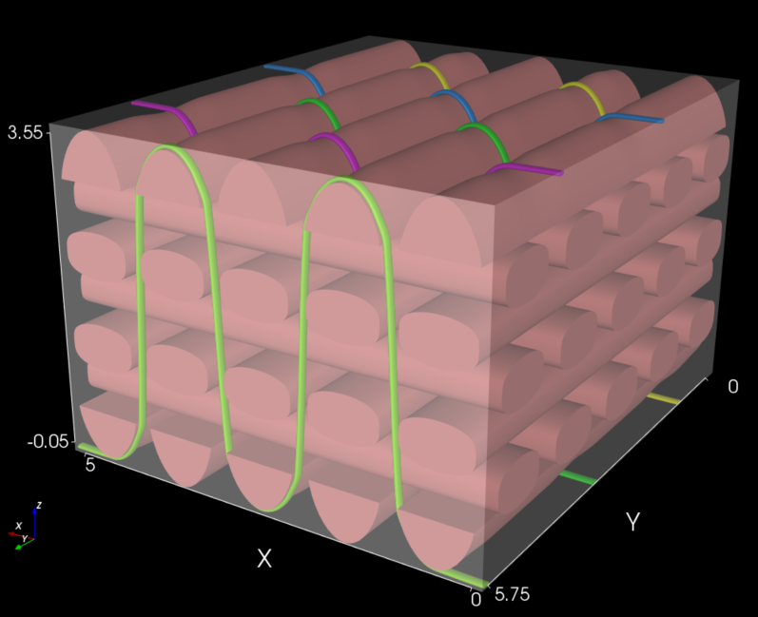
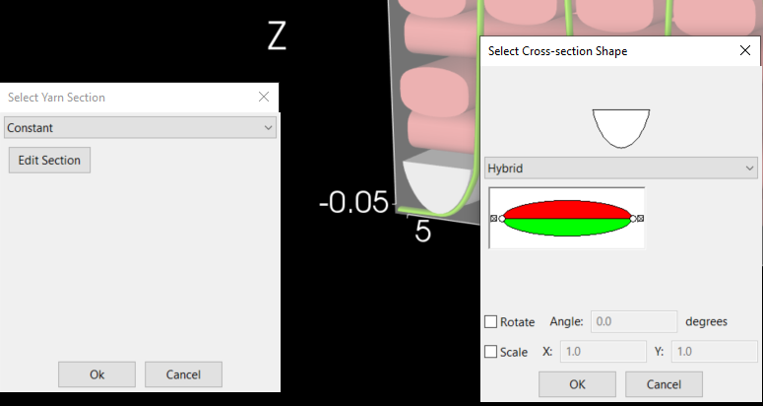
Intermediate result:
Error clear in Modeller → Section

Slide 30
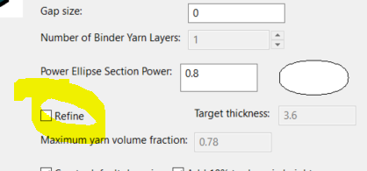
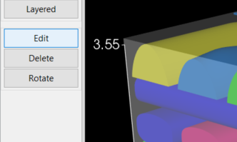
Fix Error with Textiles→ Edit, reenter data of the original screens, but tick off Refine model
Recompute the structure

Slide 31
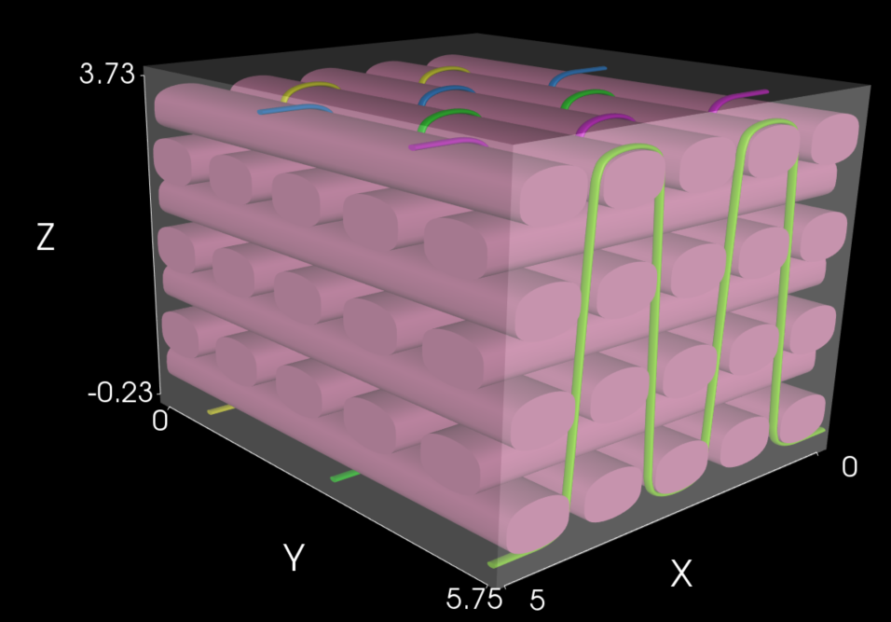
Result

Slide 32
Assignment
Good assignment for students: Give them a textile 3D woven structure. Have them create it in TexGen

Slide 33
Advanced use
Python interaction with TexGen
Export for use in Abaqus.

Slide 34
CONTACTS
Coordinator:
Technical University of Sofia
Faculty of Power Engineering and Power Machines
Project Manager of ICT-TEX:
Assoc. Prof. Dr. Angel Terziev
е-mail: aterziev@tu-sofia.bg
Web-site: ICT-TEX.eu
Contact: Benny Malengier, PhD, DSc
benny.malengier@ugent.be
The information and views set out in this publication are those of the authors and do not necessarily reflect the official opinion of the European Union. Neither the European Union institutions and bodies nor any person acting on their behalf may be held responsible for the use which may be made of the information contained therein.

