Slide 1
TOPIC 5. MARKETING PLANNING
OF THE TEXTILE AND CLOTHING BUSINESS

Slide 2
AGENDA
Basic Marketing Concepts
Marketing Mix
Marketing Process
Fashion Branding
Digital Marketing of the T&C Business

Slide 3
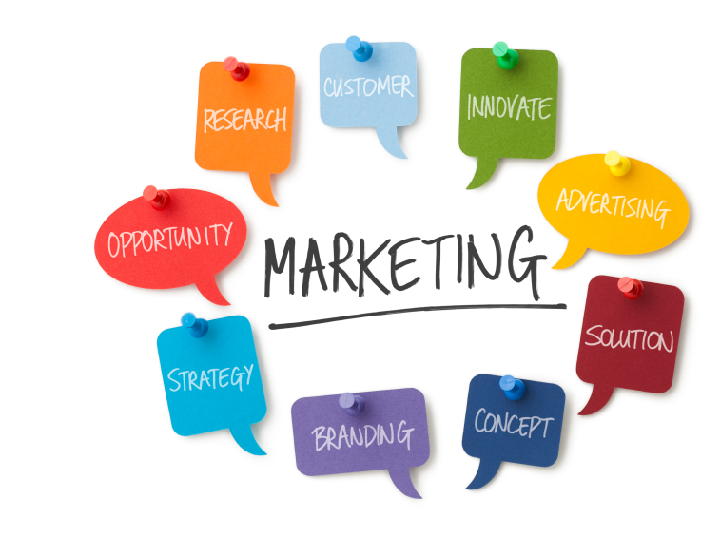
Marketing definition
Marketing is a societal process by which individuals and groups obtain what they need and want through creating, offering, and freely exchanging products and services of value with others. Philip Kotler
Marketing is the process of planning and executing the conception, pricing, promotion, and distribution of ideas, goods, and services to create exchanges that satisfy individual and organizational goals. American Marketing Association

Slide 4
Basic concepts
Market: a group of potential customers for a particular product or service
Product: anything that can be offered to a market to satisfy a desire or a need.
Products include: goods, services and ideas.
Goods: physical goods constitute the bulk of most countries' production and marketing effort.
Services: any activity done by professionals as: fashion designers and beauticians. Many market offerings consist of a variable mix of goods and services.
Ideas: every market offering includes a basic idea. Goods and services are platforms for delivering some idea or benefit.

Slide 5
Basic concepts
Marketing plan includes marketing goals and strategies.
Marketing goals require a time frame:
Short-Range Goals. What do you want to accomplish in the next year? You may find it helpful to break one-year goals into smaller periods, such as quarters (three months).
Mid-Range Goals. What do you want to achieve in the next two to five years?
Long-Range Goals. Where do you see your business ten or twenty years from now?
Motive. Why do you want to reach each objective? What rewards do you hope to obtain? Consider the opportunity.
Consistency. Be careful that your goals do not conflict with one another.
Cost. Work out a budget for your marketing plan, to check the feasibility of your goals.

Slide 6
Basic concepts
Customer value: a combination of quality, service, and price (QSP).
Value increases with quality and service and decreases with price.
Value is a ratio between what the customer gets and what he gives.
$$Value=\frac{Benefits}{Costs}=\frac{Functional benefits+Emotional benefits}{Monetary costs+Time costs+Energy costs+Phychic costs}$$
Satisfaction: a person's feelings of pleasure or disappointment resulting from comparing a product's perceived performance (or outcome) in relation to his or her expectations. If the performance falls short of expectations, the customer is dissatisfied.

Slide 7
Marketing mix
Main marketing strategy areas: product, place, price and promotion.
The combination of these elements defines the marketing mix.
Quality
Features
Brand
Packaging
Size
Warranty
After sales
Tariff
Sale
Discount
Sales terms
Credit terms
Distribution channel
Distribution area
Point of sale
Warehouses
Means of transport
Advertising
Sales force
Sales promotion
Public relations

Slide 8
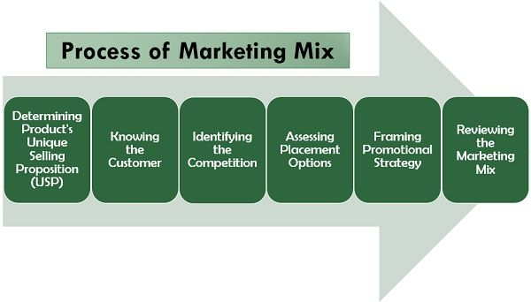
Process of marketing mix
Source: www.theinvestorsbook.com

Slide 9
Marketing process
CUSTOMERS
BUSINESS
ENVIRONMENT
Information about needs
Information about competitors
NEEDS, WANTS and DESIRES
Environment CONDITIONS
Marketing strategies
Competition Strategies
Consumer VALUE and SATISFACTION
Competitive ADVANTAGE
Consumer behavior
Competitor behaviour
Consumer ATTITUDES
Competitors REACTIONS

Slide 10
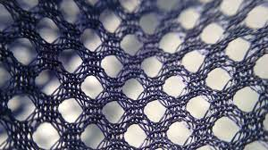
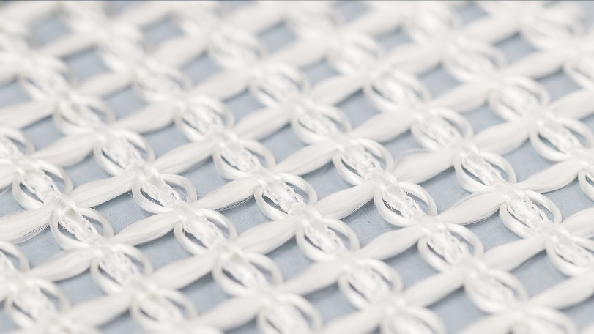
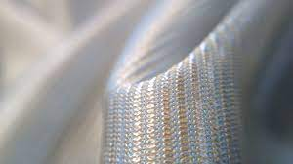
TCI products
13.10 Preparation and spinning of textile fibres
13.20 Weaving of textiles
13.30 Finishing of textiles
13.91 Manufacture of knitted and crocheted fabrics
13.92 Manufacture of made-up textile articles, except apparel
13.93 Manufacture of carpets and rugs
13.94 Manufacture of cordage, rope, twine and netting
13.95 Manufacture of non-wovens and articles made from non-wovens, except apparel
13.96 Manufacture of other technical and industrial textiles
13.99 Manufacture of other textiles n.e.c.
14.11 Manufacture of leather clothes
14.12 Manufacture of workwear
14.13 Manufacture of other outerwear
14.14 Manufacture of underwear
14.19 Manufacture of other wearing apparel and accessories
14.20 Manufacture of articles of fur
14.31 Manufacture of knitted and crocheted hosiery
14.39 Manufacture of other knitted and crocheted apparel
15.11 Tanning and dressing of leather; dressing and dyeing of fur
15.12 Manufacture of luggage, handbags and the like, saddlery and harness
15.20 Manufacture of footwear

Slide 11
Product life cycle
Notes:
Introduction
This stage is generally the most expensive stage of a product’s life span. Sales are generally low at this stage while initial expenses such as R&D and promotion may be very high. The business’s main purpose during this stage of the product life cycle is creating product awareness and generating demand.
Inform potential customers how your product will benefit them (e.g., save money or time, ease of use, convenience, increase productivity, adding prestige, etc.). Promotion efforts should target specific audiences or consumers most likely to accept your high-tech product or service.
Some examples of high-tech products in this stage include wearable tech and 3D printers.
Growth
The product moves from the Introduction stage to the Growth state as customer demand for the product increases while production costs decrease. Businesses experience the majority of their sales and realize their highest profit margin during this stage.
Marketing efforts are shifted toward a broader audience to increase market share and create customer loyalty. A business may also alter its marketing strategy as it faces increased competition from other businesses entering the market with their version of the high-tech product.
Tablets and smart phones are examples of products at the Growth stage of the product life cycle.
Maturity
The Maturity stage is characterized by a peak in sales volumes and declining profits. This stage is considered the most challenging as businesses aim to maintain their market share in a market which has become saturated while customer demand has decreased.
Marketing efforts at this stage focus on product differentiation among the competition. Businesses may also consider other means of gaining a competitive advantage such as by improving business processes.
PCs, laptop computers and digital phones may be considered examples of products in the Maturity stage.
Decline
The end of the product life cycle is marked by steadily declining sales and profits. The product may become obsolete at this point as new, improved products assume their positions and takeover market share. Companies at this stage may decide to discontinue the product or seek ways to reduce other costs.
Fax machines, and land line telephones may be considered by some to be examples of products in the decline stage. Can you think of some other examples?

Slide 12
Product diffusion cycle
Notes:
The Product Diffusion Curve model reflects the adoption rates of new products and discontinuous innovations, respectively, by demographic groups. Innovators are your first customers, followed closely by the early adopters and early majority. More cautious buyers make up the late majority, with your last potential customers being laggards who resist change.
The Product Diffusion Curve was developed in 1957 and originally applied to agriculture. It was a result of research conducted to study farmers' adoption of hybrid corn seed. Its application has been extended to various product categories including continuous innovations.
Note that the adoption rate among the groups forms a bell curve. Those first and last to adopt innovation are at the extreme ends of the bell curve while the majority of customers fall in the middle of the curve. Understanding how these groups respond to new products will help you develop your marketing strategies.
Innovators
Innovators make up the smallest group of consumers of new products. They are the first to readily adopt new technology. They keep up-to-date on the latest technology in a particular industry. They are eager to try the latest innovation and are willing to take risks when it comes to purchasing untested products. Their adoption of a new product is likely to influence the Early Adopters.
An example of this is an online technology blogger who reviews new products. A great review by a prominent reviewer will have a huge influence on early adopters.
Early Adopters
Early Adopters, like Innovators, also readily adopt new products. Early Adopters regard themselves as trendsetters and respond to promotions appealing to their sense of prestige. Early Adopters also seek new products to gain a competitive advantage. They are well-informed and willing to learn new technologies. They are willing to take a risk and pay for it, too, although they prefer to wait until the Innovators have weighed in.
Early Majority
The Early Majority comprises approximately one-third of all potential consumers; therefore, it's essential to gain their adoption. They are not as willing to rush toward purchasing a new product. They're open to innovation, but cautious. They want proof that the product works, meets their requirements, and is easy to use, requiring little or no time to learn how to operate. Price plays a significant role in the decision-making process whether to adopt the innovation.
There is often a wide gap between the Early Adopters and the Early Majority - this is referred to as a Chasm. The Chasm occurs as a result of declining or stagnant sales in the early market and a simultaneous lag or delay in adoption by the Early Majority. Whereas Innovators and Early Adopters are eager to adopt and spend their money on high-technology, saturating the Early Market, the Early Adopters prefer to take a wait and see approach to ensure the product works and costs decline before adopting the innovation.
To overcome or cross the chasm and enter into the Mainstream Market, you must readjust your marketing strategy to address the needs of a select segment of the entry group.
Late Majority
The Late Majority also makes up approximately one-third of all potential customers. The Late Majority is characterized as somewhat conservative. They prefer to wait to adopt an innovation until it has become widespread and standard. They also tend to wait until the price is lower.
Laggards
Laggards dislike change and, generally speaking, will only adopt a new product when there is no other option available to meet their requirements.

Slide 13
Determining product strategies
Building a product image involves attracting new customers and keeping current ones loyal.
Product strategies for doing this include branding and communicating product features and benefits.
To attract people in your target market, you need to choose a product that matches well with their needs or wants. When given a choice, consumers buy the product with the features and benefits that best meet their requirements.

Slide 14
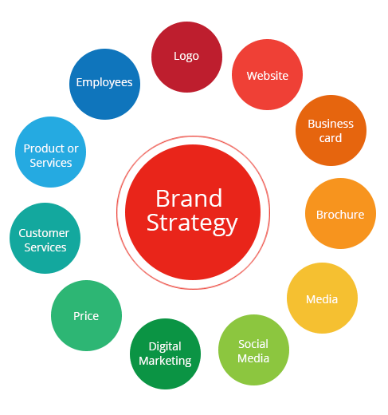
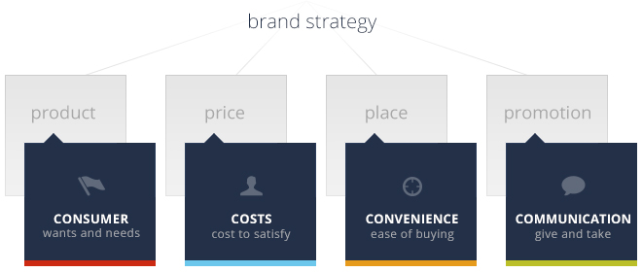
Fashion branding
Brand is a marketing strategy that can create an emotional attachment to your product in the mind of the consumer.

Slide 15
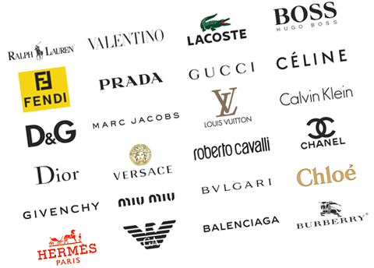
Fashion branding. Successful models
Category-wise: For shoes it is 2 per cent, sports brands have 5 per cent occupancy, jewelry and accessories take up 1 per cent, apparel has 53 per cent, lingerie covers 1 per cent.
Format-wise.
Gender-wise: women’s wear – 40 per cent, men’s wear – 30 per cent, kidswear 20 per cent and generic/mixed/unisex – 10 per cent.
Local retailers.
Franchised versus company owned: franchised outlets having 20-22 per cent occupancy as against company owned outlets having 78-80 per cent occupancy.

Slide 16
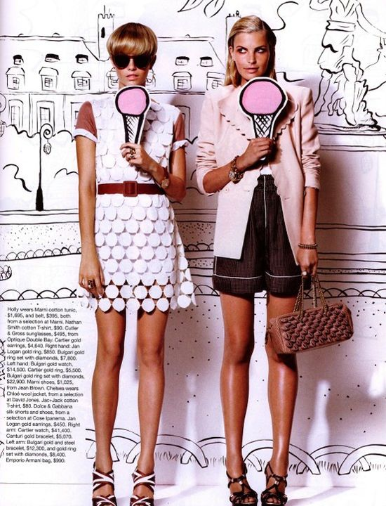
Fashion branding. Visual merchandising model
Visual merchandising can help create that positive customer image that leads to successful sales.
Visual merchandising is a major factor often overlooked in the success or failure of a retail store.
Visual merchandising can be defined as everything the customer sees, both exterior and interior, that creates a positive image of a business and results in attention, interest, desire and action on the part of the customer.
The basic objective for visual merchandising is a desire to attract customers to a place of business in order to sell the merchandise.

Slide 17
Strategies for successful fashion branding
Use emotional storytelling in your marketing plan for long-lasting brand awareness.
Throw referral marketing into your marketing mix to let your customers do the heavy lifting for you.
Solve a problem in the fashion market and your marketing plan will build itself.
Center your fashion business on the community it supports and you will build brand loyalty for years to come.
Develop brand loyalty by giving back to the community that supports you.
Let your customers stand behind you (and your fashion products) by standing up for something that matters.
Provide a way for your customers to show off the fashion products you’re selling to build both community and loyalty.

Slide 18
Strategies for successful fashion branding
The exclusivity makes customers buy faster — as well as make their products more desirable and coveted.
Explore content marketing as a powerful marketing channel that works even when you’re not.
Make your social media campaign fun and people will participate.
Sell a fashion product that solves a global problem and everyone will notice.
Make a challenge to communicate an idea with as little as possible.
Built an entire company popularity by spending money to charity
Focus solely on a specific niche and targeted specific influencers to reach them.
Sponsor prominent athletes to help break into new markets.
Fashion Marketing : 25 Strategies From The Fashion Industry (referralcandy.com)

Slide 19
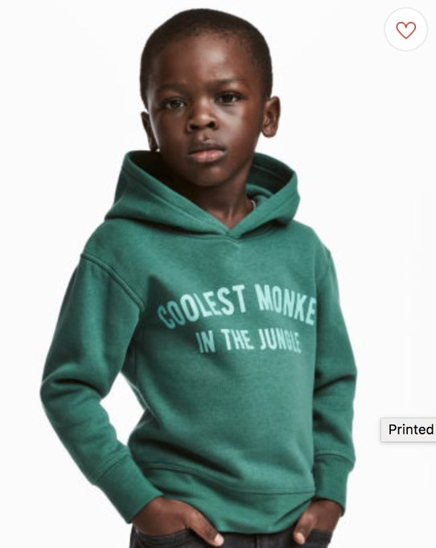
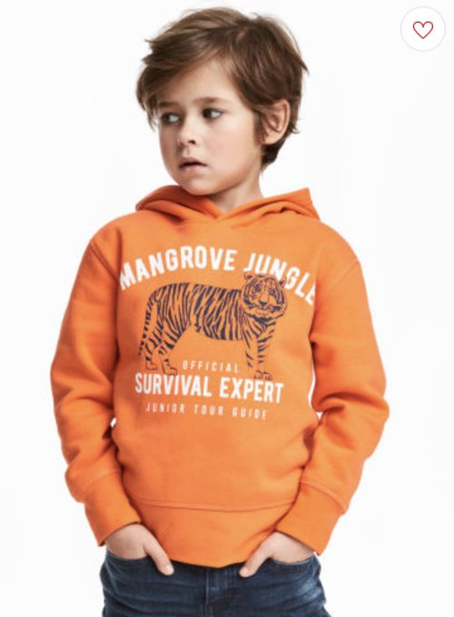
Assignment 1
Look at the example: The fashion commercials failure: The 7 Most Embarrassing Branding Mistakes of 2018 | Inc.com
Discuss on what the fashion companies have missed according to successful marketing examples.
Something positive
Something negative

Slide 20
E-marketing of T&C. Step by step guide
Visitors: Social Media, Influencer Marketing & Search Engines:
Step 1: Set Profitable Goals from the Jump.
Step 2: Consolidate Your Ad Account.
Step 3: Let the Facebook Pixel Do Its Thing.
Step 4: Retarget Your Audience.
Step 5: Connect with Impactful Creative.
Conversion Rate: Optimize Your Fashion Funnels & Pages:
Step 6: Build Funnels Around the Almighty Offer.
Step 7: Improve Speed & Usability, Especially on Mobile.
Step 8: Digital Fashion Merchandising: Product Descriptions & Product Recommendations.
Step 9: Improve Site Browsing, Discovery & Checkout Experiences.
Fashion Marketing in Ecommerce: Guide, Strategies & 50+ Examples (commonthreadco.com)

Slide 21
E-marketing of T&C. Step by step guide
Lifetime Value: Retention, Email Marketing & SMS:
Step 10: Find Your Cash Multiplier.
Step 11: Leverage Email Marketing.
Step 12: Engage in SMS Marketing.
Variable Costs: Shipping & Returns (the ‘Unfashionable’ Part):
Step 13: Negotiate Better Deals.
Step 14: Optimized Returns.
Step 15: Inventory Management.
Profit: Find the Right Partner to Bring Everything Together:
Step 16: Has your fashion ecommerce store arrived at the corner of poppin’ and profitable, yet?

Slide 22
Fashion branding. Merchandising problems
Too much quantity on display;
Inadequate display;
Confusing display;
One product category overshadowing the other;
Colour distortion in the store leading to consumer grievances;
Lack of brand congruence of the visual look and feel created.

Slide 23
Assignment 2
Look at the example: Marketing Case Study - How we Built an Audience for Launch of a Streetwear Label around KPOP?
Discuss on risks and benefits of brand exposure.
benefits
risk

Slide 24
Pricing strategies
Premium pricing
Bundle pricing
Economy pricing
Types of pricing strategies
Value pricing
Psychology pricing
Promotional pricing
Penetration pricing
Price skimming
Cost-based pricing

Slide 25
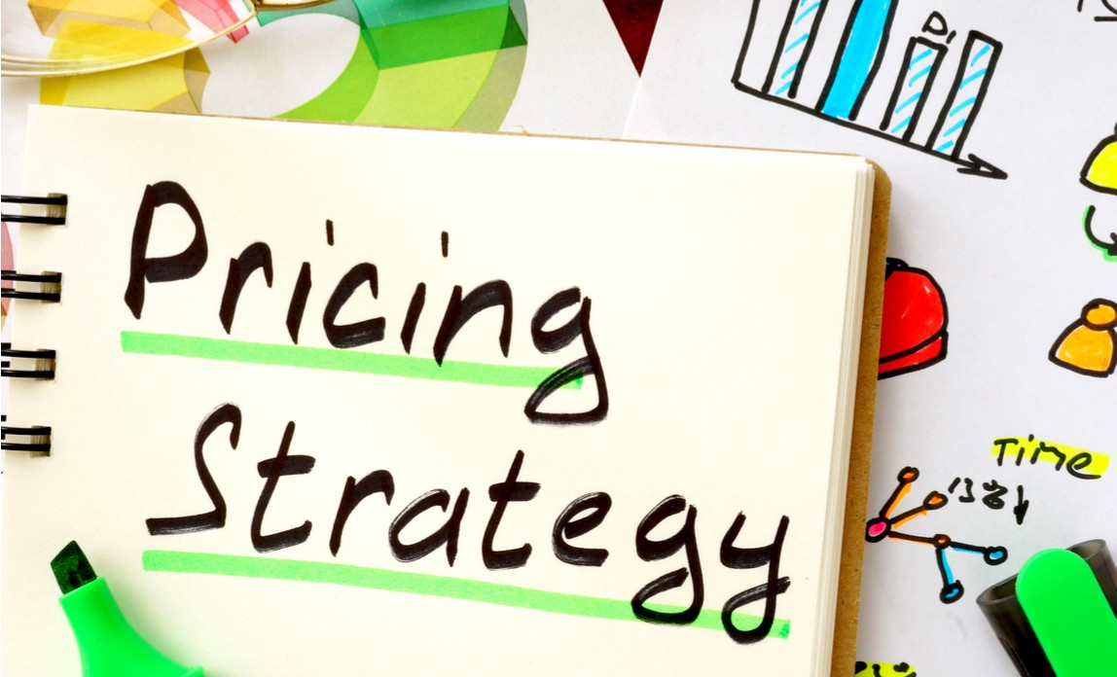
Developing price strategies
Developing price strategies involves:
Identifying price objectives:
Build or maintain an image.
Increase sales volume (quantity).
Obtain or expand a market share.
Maximize profits.
Selecting a basic price strategy:
Demand-based.
Competition-based.
Cost-based.
Making price adjustments.

Slide 26
Place strategies. Distribution. Where and when will you sell?
To determine place strategies you should decide:
What distribution channels to use.
Where and when you will sell your products.
How you will transport and store them.
Examples:
Choosing an excellent location for a physical store.
Determining the days and hours when customers are most likely to shop.
Providing an easy-to-use Website that customers can access any time, from any location.
Taking orders via a toll-free telephone number, with operators standing by 24 hours a day.

Slide 27
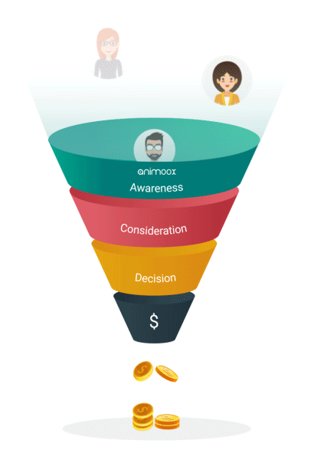
Promotion
AIDA is a popular communication model used by companies to plan, create, and manage their promotions.
Attention, making customer aware of the product.
Interest, providing information about the advantages and benefits.
Desire, generate desire by convincing that product will meet customer's need.
Action, making it as easy as possible for customer to make the purchase.

Slide 28
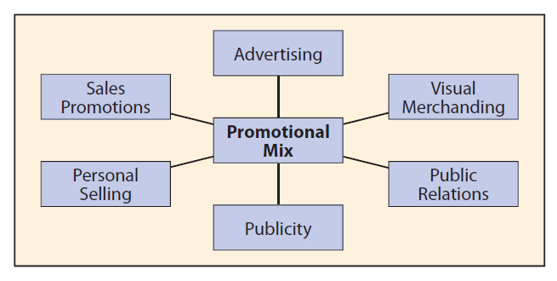
Promotional mix
We use promotion to build a favorable awareness about our product and influence people to buy it.
Elements of a promotional mix:
Advertising;
Visual merchandising;
Public relations (PR);
Publicity;
Personal selling;
Sales promotion.

Slide 29
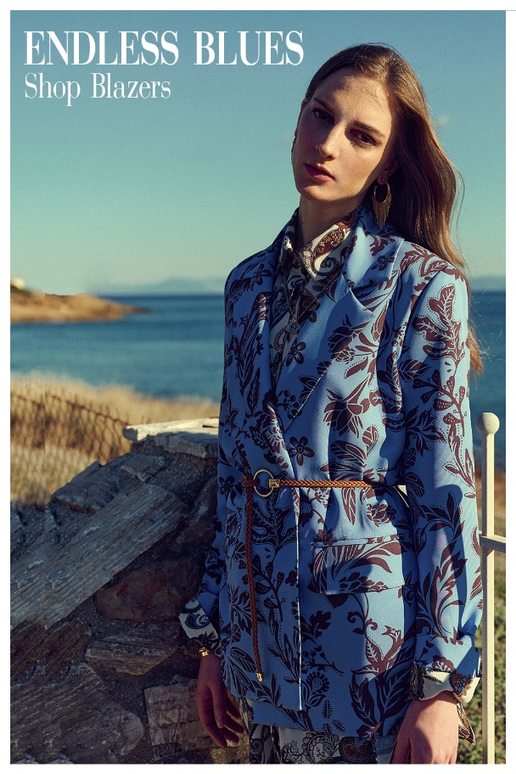
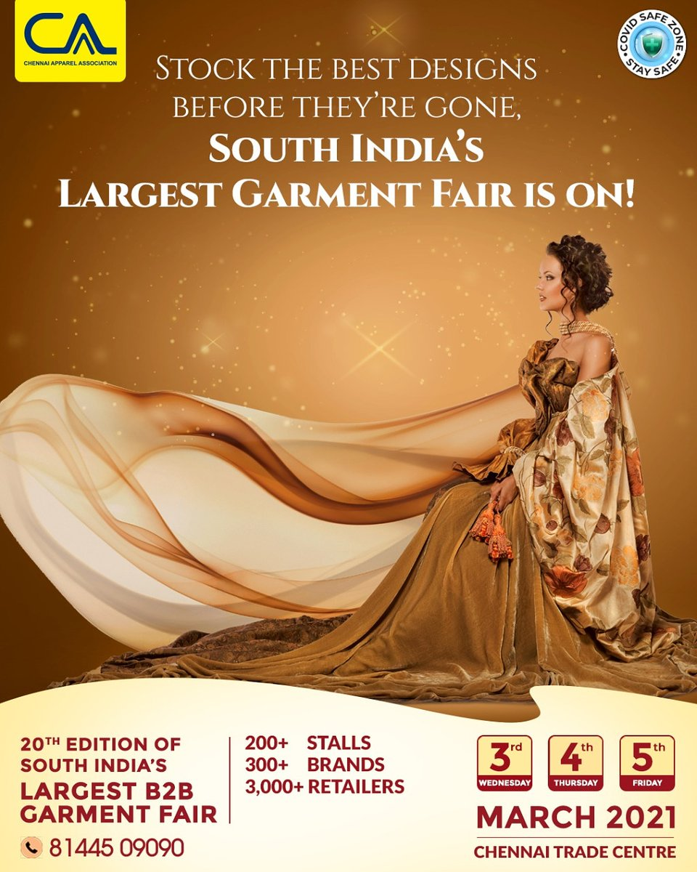
T&C communications
Advertising/ commercials.
B2C and B2B sales.
Direct marketing.
https://youtu.be/UIwTZDJMwyY

Slide 30
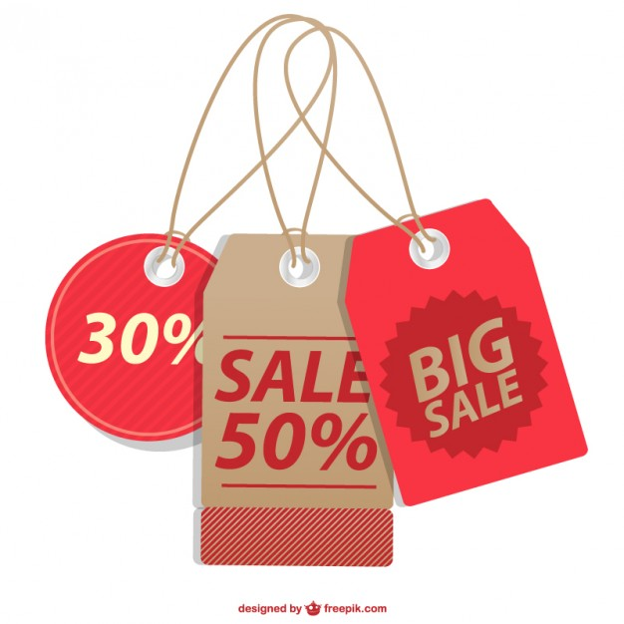
Promotion. Developing a promotional plan
A promotional plan for a new T&C business must take into consideration three stages of a business startup:
What promotions are needed before the business is opened?
Examples:
Establishing a favorable business image.
Educating your target market about the features and benefits of coming products.
Creating an awareness of where and when you will be opening.
What promotional adjustments will need to be made when the new business is launched?
Promotions to get people to try a product or service.
What ongoing promotional strategies are needed?
Promotions for keeping current customers loyal. Include methods for measuring promotion effectiveness in your plan.

Slide 31
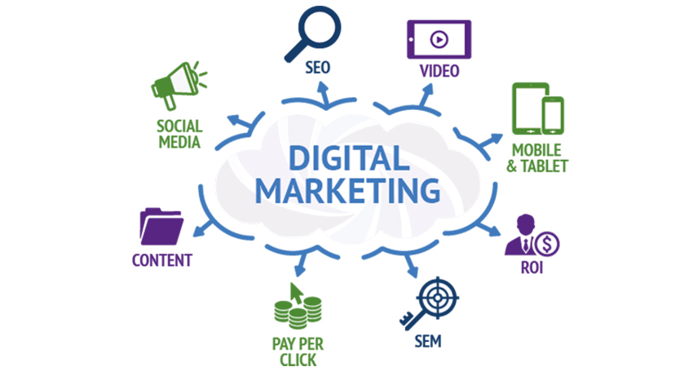
Digital marketing of T&C business
E-marketing, Internet marketing, Web marketing, Online marketing
Digital marketing is the process of marketing a product or service using the Internet. It does not only include marketing on the Internet, but also includes marketing done via e-mail and wireless media. It uses a range of technologies to help connect businesses to their customers.

Slide 32
Digital marketing of T&C business
E-mail marketing - is probably the cheapest way to tell about your brand and products, but also one of the hardest, if you don’t know what you are doing. It requires people to subscribe to your mailing list
Blog - since marketing tactics have changed from ‘trying-to-sell’ to ‘giving useful information’ (inbound marketing), blogs have become a part of marketing practices.
Online marketing - the main information people seek for is address, phone number, opening hours and products. Consumers like to compare the findings and then make their purchasing decision based on the facts found online. It is crucial to have a website up and running.

Slide 33
Digital marketing of T&C business
Mobile marketing - brands are competing with hottest trends. Currently, most innovative labels offer apps and game-like experiences. Other stick to the basics and send simple text messages with offers.
Word-of-mouth - making people talk about your brand and share experience is very important for the brand image, engagement and most of all, trust. Word-of-mouth - it is considered as the most valuable marketing method.
Social media marketing - building online identity and gaining popularity takes years, but can be easily achieved with the help of social media. Do not expect to get hundreds of followers quickly, as only 49 a celebrity can gather thousands of followers when entering a new social media channel.

Slide 34
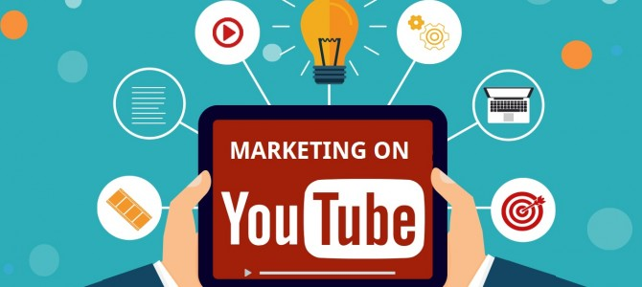
Digital marketing of T&C business
YouTube and Live stream Video - making videos is not something new, but nowadays, it can be done almost by anyone and with a very little budget. There are many (even free) apps and software available that can be used to create a video, and some of the software have pre-made templates/layouts for making the video look a bit more interesting and professional.
Events and expeditions.

Slide 35
E-marketing of T&C. Step by step guide
Visitors: Social Media, Influencer Marketing & Search Engines:
Step 1: Set Profitable Goals from the Jump.
Step 2: Consolidate Your Ad Account.
Step 3: Let the Facebook Pixel Do Its Thing.
Step 4: Retarget Your Audience.
Step 5: Connect with Impactful Creative.
Conversion Rate: Optimize Your Fashion Funnels & Pages:
Step 6: Build Funnels Around the Almighty Offer.
Step 7: Improve Speed & Usability, Especially on Mobile.
Step 8: Digital Fashion Merchandising: Product Descriptions & Product Recommendations.
Step 9: Improve Site Browsing, Discovery & Checkout Experiences.
Fashion Marketing in Ecommerce: Guide, Strategies & 50+ Examples (commonthreadco.com)

Slide 36
E-marketing of T&C. Step by step guide
Lifetime Value: Retention, Email Marketing & SMS:
Step 10: Find Your Cash Multiplier.
Step 11: Leverage Email Marketing.
Step 12: Engage in SMS Marketing.
Variable Costs: Shipping & Returns (the ‘Unfashionable’ Part):
Step 13: Negotiate Better Deals.
Step 14: Optimized Returns.
Step 15: Inventory Management.
Profit: Find the Right Partner to Bring Everything Together:
Step 16: Has your fashion ecommerce store arrived at the corner of poppin’ and profitable, yet?

Slide 37
Assignment 3
Look at the THE EFFECTS OF SOCIAL MEDIA ON FASHION CONSUMPTION? Discuss on benefits and risks for taking social media decision: Be effective; Be “Pinnable”; Set up a business account; Be clear; Appeal to the audience; and Represent the brand.
benefits
risk

Slide 38
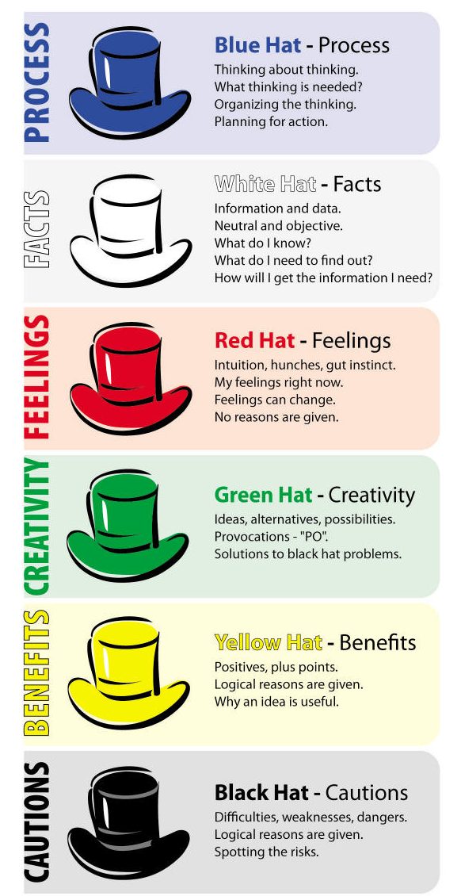
Assignment 4.1
See the given examples of clothing advertisement ideas:
https://www.youtube.com/watch?v=nrz2I_tcS5A
Choose one of the given roles and comment how effective they are:
The blue hat: This is the hat of control, used for management and organization;
The white hat: This is the objective hat, which focuses on facts and logic;
The red hat: This is the intuitive hat, focusing on emotion and instinct;
The green hat: This is the creative hat, where ideas are abundant and criticism spare;
The yellow hat: This is the optimistic hat, used to look for positive outcomes;
The black hat: This is the cautious hat, used to predict negative outcomes.
Source: www.educatorstechnology.com

Slide 39
Assignment 4.2
See the given examples of clothing advertisement ideas:
How to Start an Online Clothing Store in 7 Easy Steps (bigcommerce.com)
Choose one of the given roles and comment how effective they are:
The blue hat: This is the hat of control, used for management and organization;
The white hat: This is the objective hat, which focuses on facts and logic;
The red hat: This is the intuitive hat, focusing on emotion and instinct;
The green hat: This is the creative hat, where ideas are abundant and criticism spare;
The yellow hat: This is the optimistic hat, used to look for positive outcomes;
The black hat: This is the cautious hat, used to predict negative outcomes.
Source: www.educatorstechnology.com

Slide 40
Questions for discussion and tasks
What are the main elements of the marketing mix?
Where is the most appropriate place to advertise your T&C business?
What does the acronym AIDA stay for?
List the six elements of a promotional mix.
Describe an example of visual merchandising that recently attracted your attention of garment product. Did you buy the product? Why or why not?
Imagine you were writing promotional material for a new jeans brand. Try to define in one sentence the concepts you think would help persuade customers to buy or will grab their attention.
Thinking about your own buying experiences, what characteristics do you most appreciate in a salesperson? What selling behaviors have you witnessed that decreased your desire to buy? Why?

Slide 41
Questions for discussion and tasks
What are the stages that you must take into consideration in the promotional plan for a new business?
Create a magazine advertisement - write the text for the ad, create art or take photos for it and research media prices for different and sizes and placements.
Advertising agencies can help you create, plan and manage advertising and other promotional activities. If you intend to hire such an agency, you will also need to include its fees in your budget. Research advertising companies and compare their prices.
What forms of digital marketing are the best for you T&C business idea?
What do you think happens to the price of a garment as it goes through a large number of intermediaries?

Slide 42
Questions for discussion and tasks
Design and draw a brand mark for your real or imaginary T&C product, service, or company.
Work in a group. Each member should research the advantages and disadvantages of a different type of advertisement for a T&C business idea.
Why is branding important?
What elements are included in branding? Why is brand repetition important?
Interview someone who works at a local advertising agency, or an individual who designs advertisements for a living. Find out what’s involved in running their businesses and how they got started in advertising. Also, ask about the creative processes they use to produce actual advertisements.
What could happen if you fail to follow up with a customer after a sale is made? What advantages might you gain from asking the customer for feedback?

