Slide 1
Assoc. Prof. Dr. Radka ATANASOVA Vice-Dean for learning activity, Faculty of Power Engineering and Power Machines Bachelor’s and Master’s Degree Program: DESIGN AND TECHNOLOGIES FOR CLOTHING AND TEXTILES Technical University of Sofia, BULGARIA The course is developed under Erasmus+ Program Key Action 2: Cooperation for innovation and the exchange of good practices Knowledge Alliance
TRAINING COURSE
APPAREL DESIGN AND PRODUCTION
Course: 2D CAD Pattern Making
ICT IN TEXTILE AND CLOTHING HIGHER EDUCATION AND BUSINESS
Project Nr. 612248-EPP-1-2019-1-BG-EPPKA2-KA
The information and views set out in this publication are those of the authors and do not necessarily reflect the official opinion of the European Union. Neither the European Union institutions and bodies nor any person acting on their behalf may be held responsible for the use which may be made of the information contained therein.

Slide 2
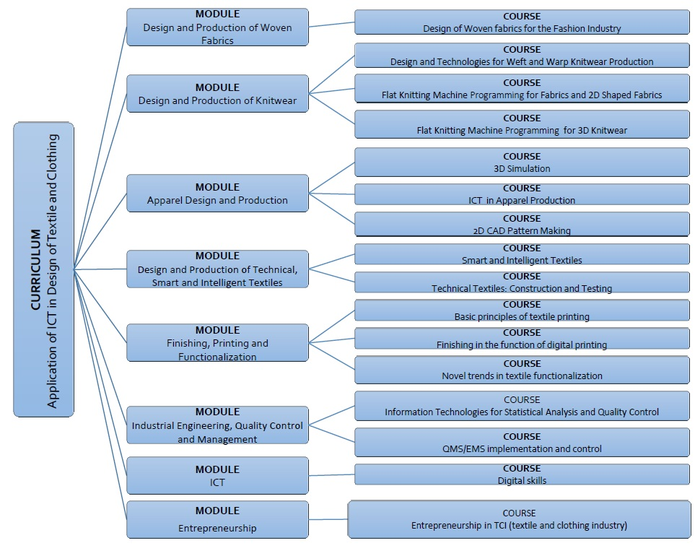
The information and views set out in this publication are those of the authors and do not necessarily reflect the official opinion of the European Union. Neither the European Union institutions and bodies nor any person acting on their behalf may be held responsible for the use which may be made of the information contained therein.

Slide 3
MODULE – APPAREL DESIGN AND PRODUCTION
Course: 2D CAD Pattern Making
Duration: 30 hours
Course objectives
Today’s clothing industry is moving toward using advanced technology in designing and pattern-drafting. Clothing companies continuously seek new solutions for saving time in product development and generally increasing efficacy in activities raging form, the design process through the manufacturing process. Such programs can enhance communication, ease flow, an produce cost effectiveness at all stages. 2D CAD Pattern Making is a knowledge-intensive and creative course that will lead learners across different pattern making techniques taking into consideration materials, colours and styles combination. Lessons are taught using specialized CAD software (e.g. AccuMark by Gerber Technology, Modaris by Lectra).
Topics
Introduction to CAD functionalities - Modeling techniques for different garments - Computer grading of details
Algorithms for pattern making of basic apparel constructions - Darts manipulations - Development of production patterns
Algorithms for pattern making of specific garment elements - Design of gathered elements - Modelling of knitwear clothing
Learning outcomes
Knowledge | Skills | Responsibilities/autonomy
To be aware of pros and cons of CAD clothing systems To understand the software main features and functionalities To know and understand different textile material properties and related design techniques principles To understand body anatomy, measurements and grading To appraise symmetry and asymmetry in the construction of clothing To acquire a sense of the volume, proportions and aesthetics criteria To know different grading methodologies | To apply modelling techniques (splitting/combining, flipping, rotation, symmetry and asymmetry principles) To calculate structural dimension of the drawing parts applying proportionality principles To apply different pattern making methods according to style and functional requirements To apply different techniques for the design of gathered elements (folds, pleats, draperies) To practice specific pattern making algorithms for specific garment elements and details (sleeves, collars, lapels, pockets, facings) To grade details using different functions, making measurements and adjustments | To entirely manage the different phases for a garment modelling and prototype To recognize and take into account the connections between design, material properties and production requirements To translate design elements into new products paying attention to aesthetic and formal qualities and performance (comfort, safety, durability, etc.)

Slide 4
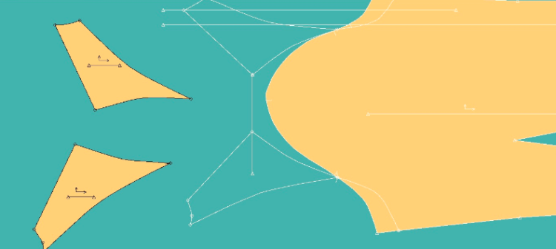
Course duration: 30 hours
Content: 12 lessons
DESCRIPTION OF THE COURSE
The program contains topics referring computer aided development of basic constructions and various styles of ladies’ and men’s garment
The topics are illustrated with many examples
The course is available on the Moodle e-learning platform
The interactivity of the course is realized with the help of the “wiki” resource, animations, videos with audio instructions
After each topic there is a Quiz to test the knowledge

Slide 5
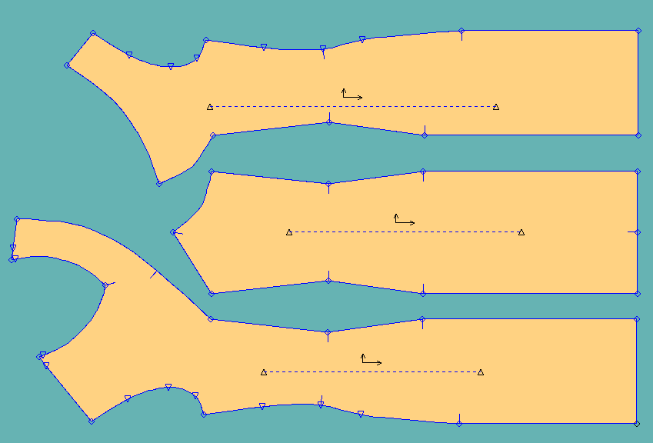
AIMS AND OBJECTIVES OF THE COURS
The participants gain experience to use the functions of a specialized graphic system for clothing and to develop algorithms for design of the pieces
Students who successfully complete this course acquire the necessary professional and practical knowledge for the use of CAD systems for two-dimensional design

Slide 6
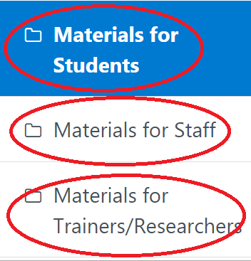
TYPES OF LEARNING MATERIALS
Materials for students
The staff course contains additional training materials, which are drawings of details at a scale of 1:1 directly for import into CAD system
The trainers’ course contains additional training materials, which are algorithmically sequential steps and used functions in pictures

Slide 7
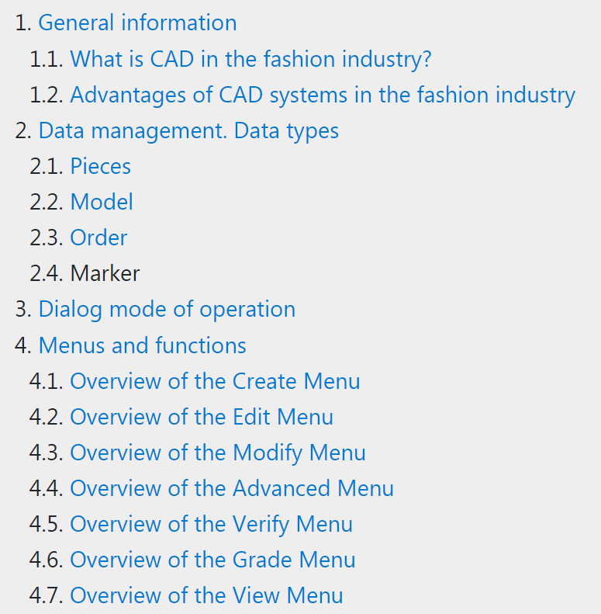
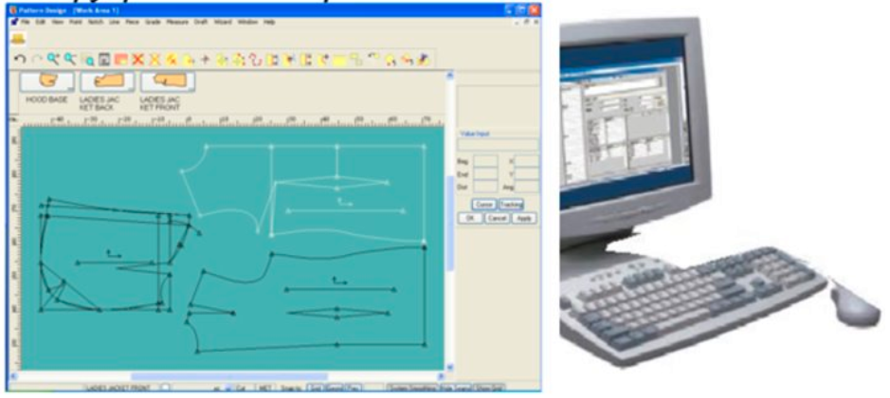
LESSON 1. INTRODUCTION

Slide 8
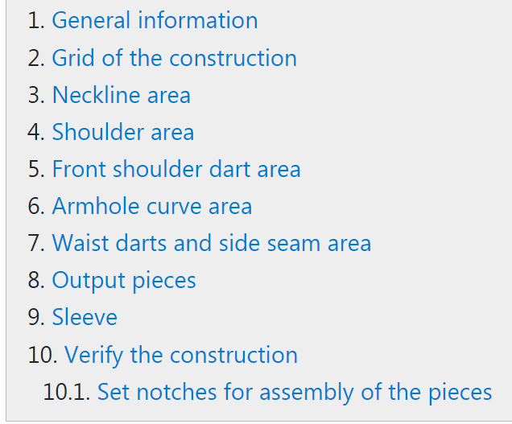
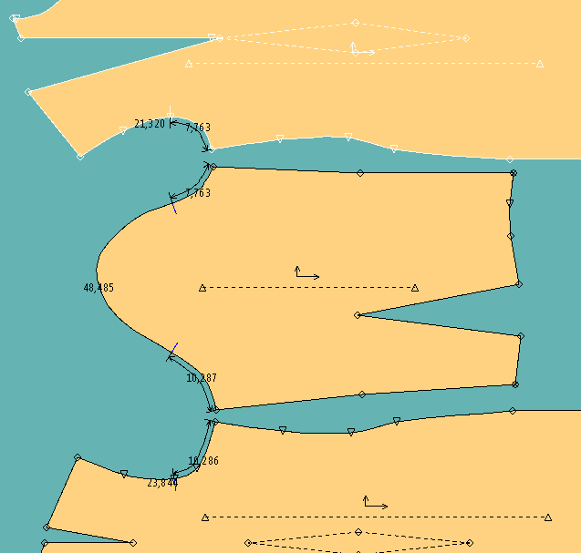
LESSON 2. BASIC APPAREL CONSTRUCTIONS

Slide 9
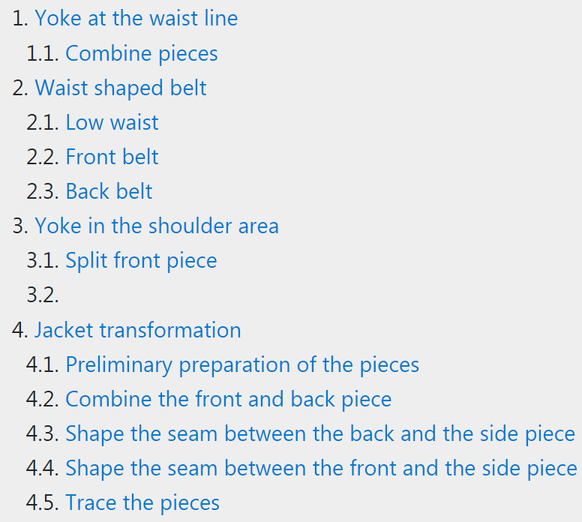
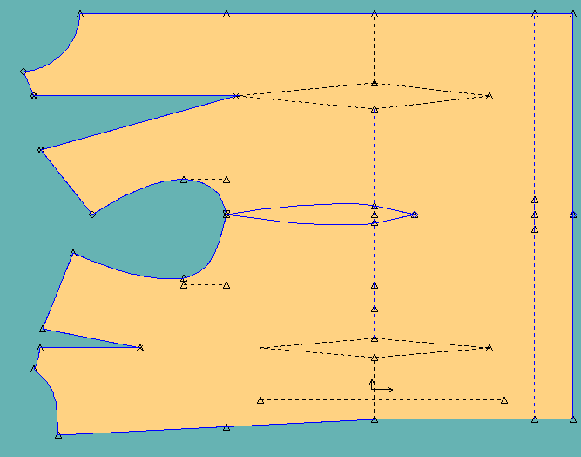
LESSON 3. MANIPULATION OF PIECES

Slide 10
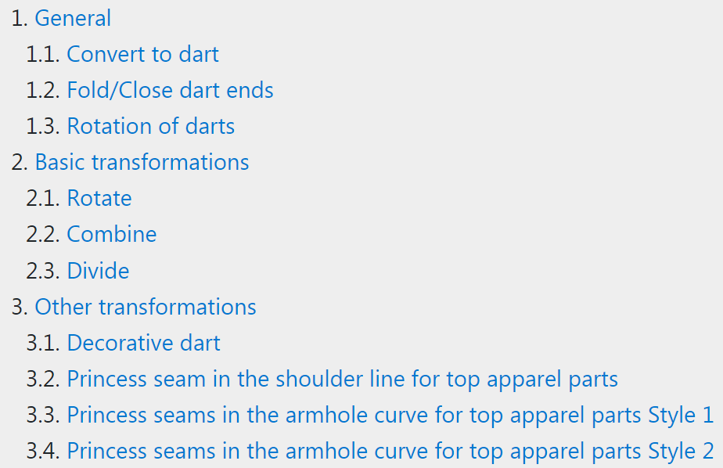
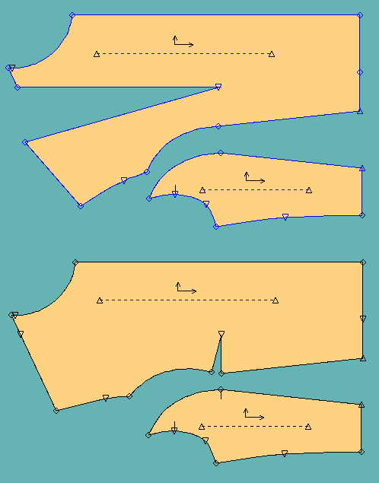
LESSON 4. DARTS MANIPULATIONS

Slide 11
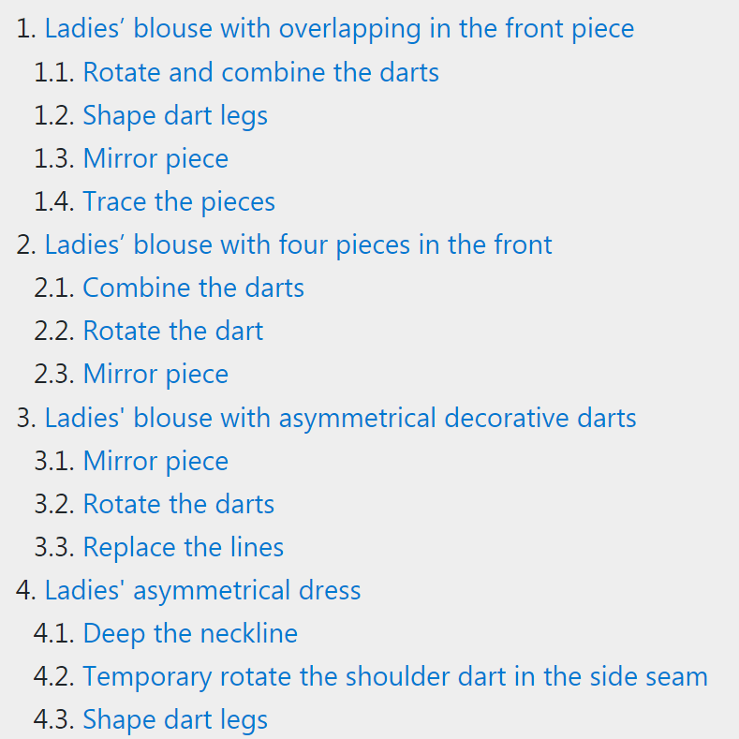
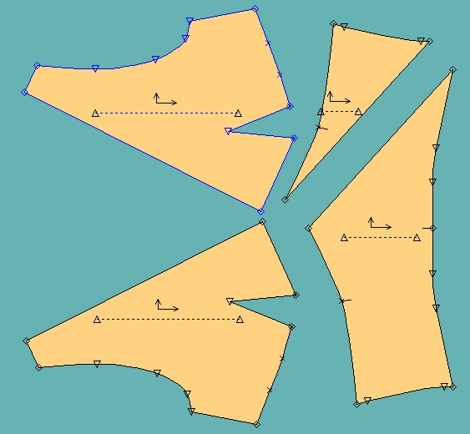
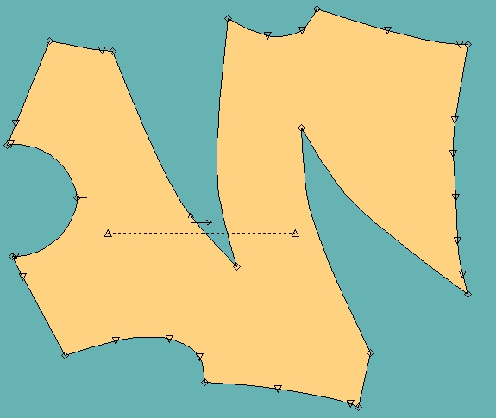
LESSON 5. SYMMETRY AND ASYMMETRY OF THE PIECES

Slide 12
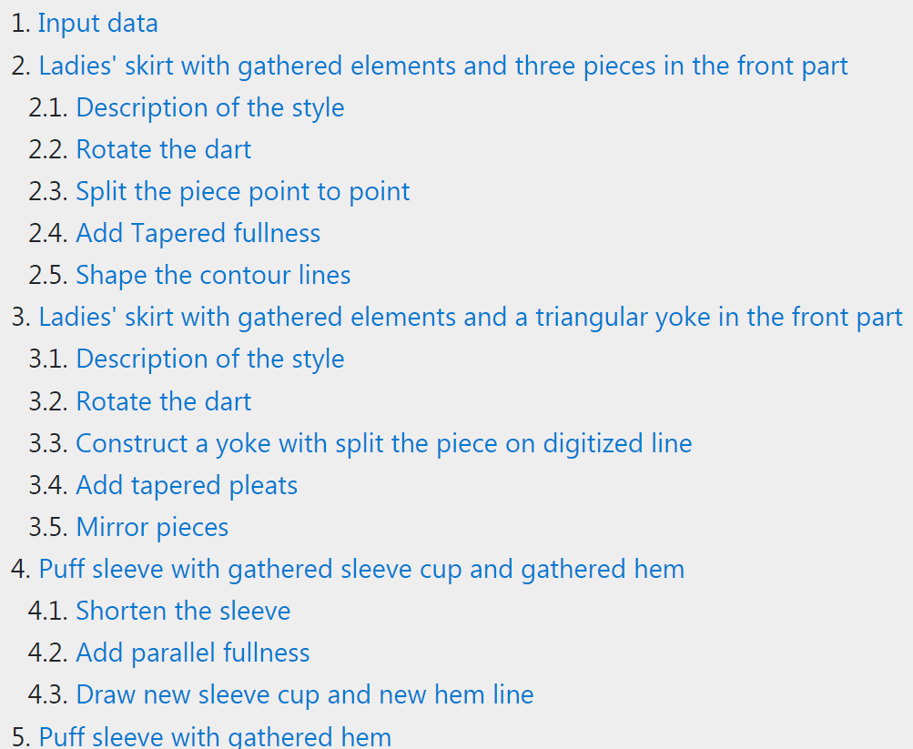
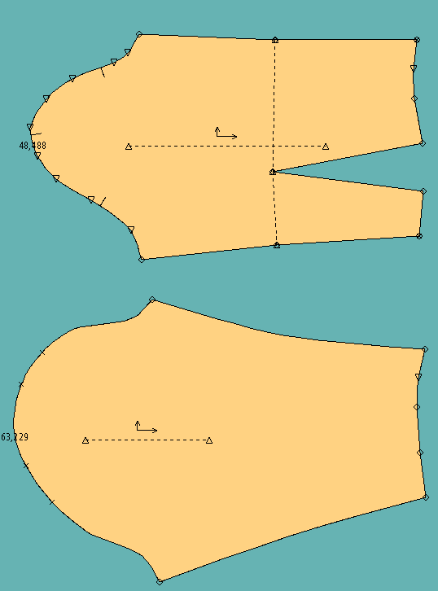
LESSON 6. GATHERED ELEMENTS

Slide 13
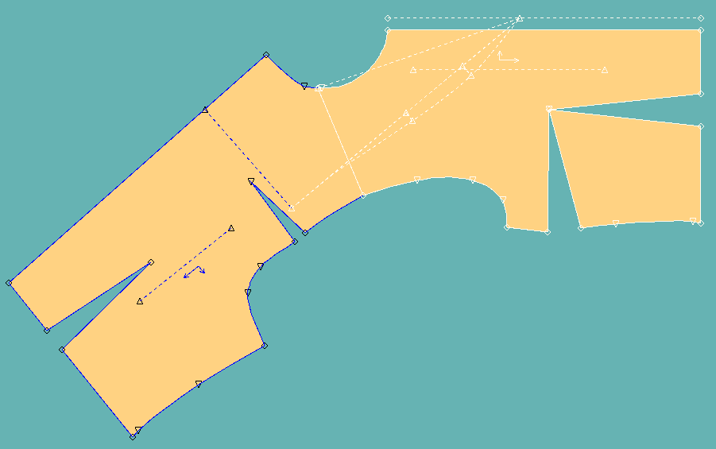
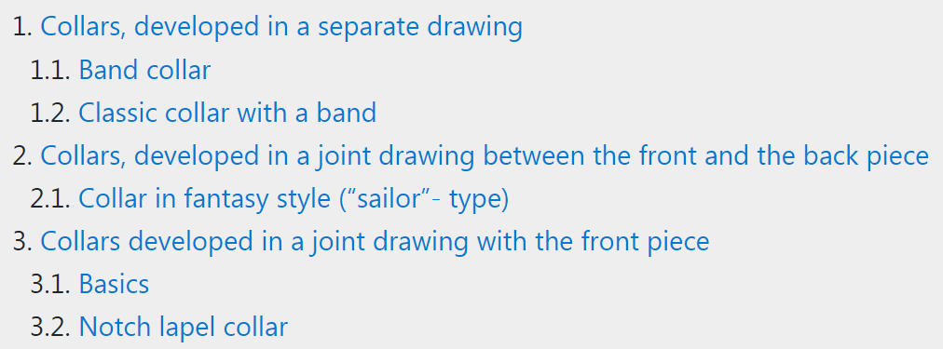
LESSON 7. COLLARS AND LAPELS

Slide 14
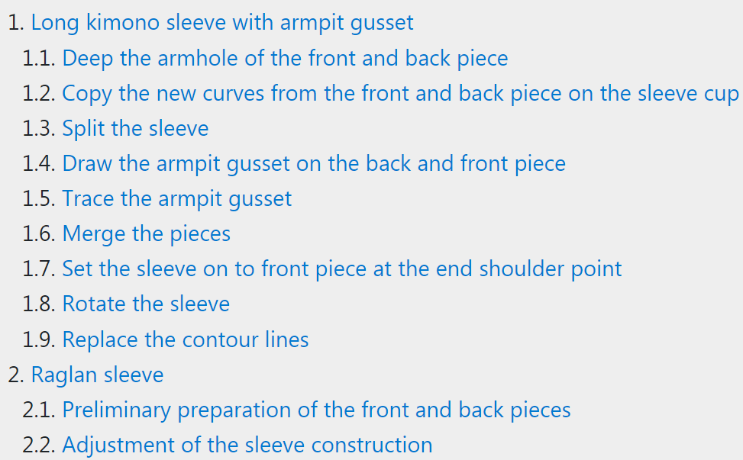
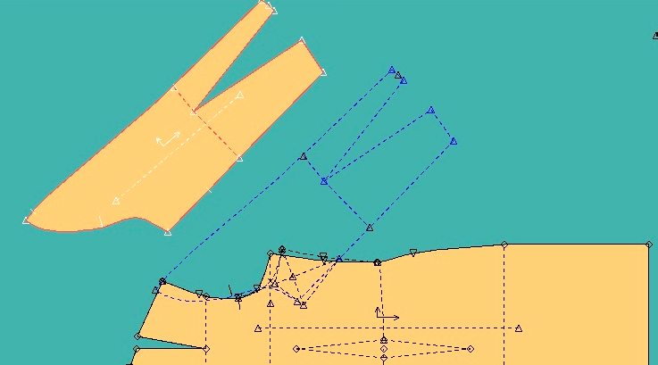
LESSON 8. TYPICAL TYPES OF SLEEVES

Slide 15
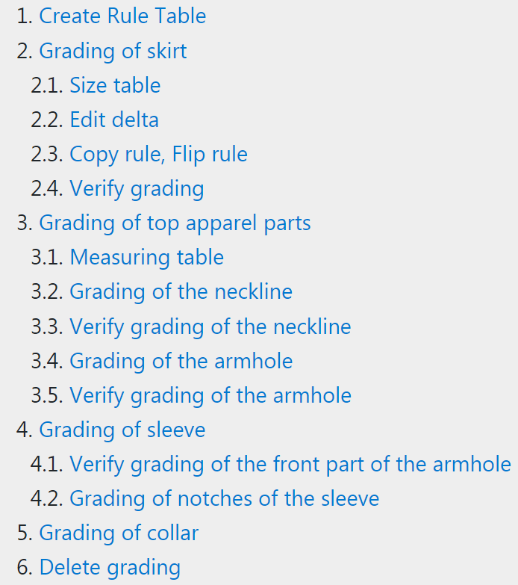
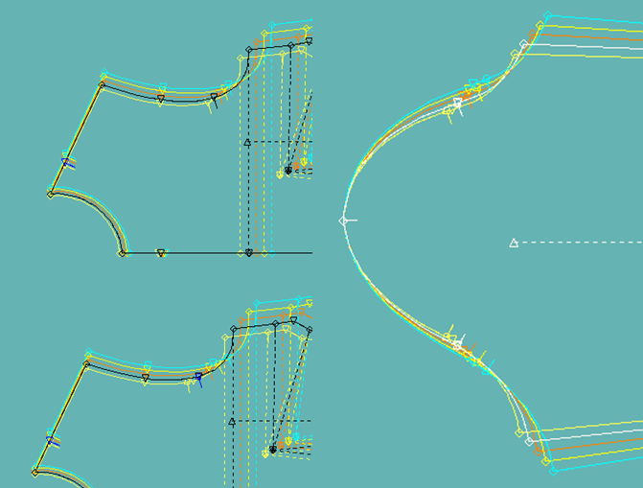
LESSON 9. GRADING OF PIECES

Slide 16
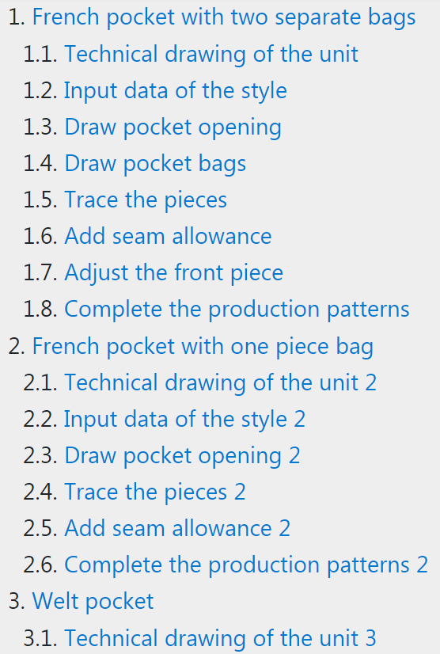
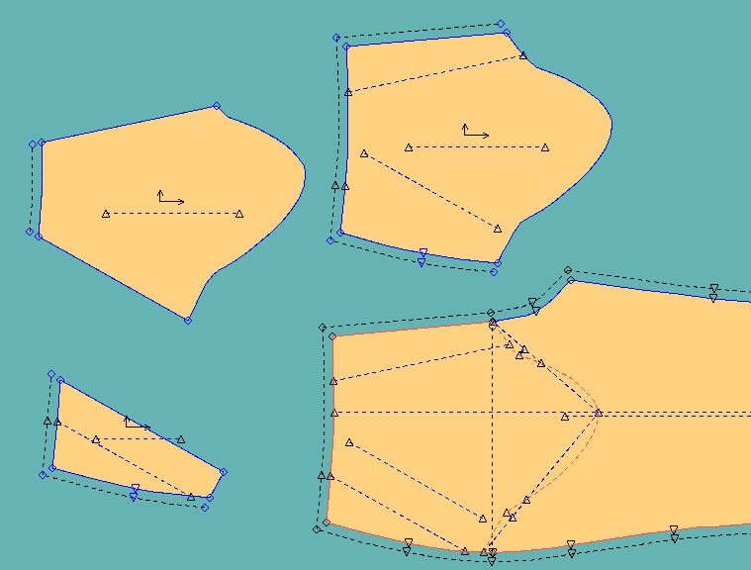
LESSON 10. AUXILIARY PIECES FOR POCKETS

Slide 17
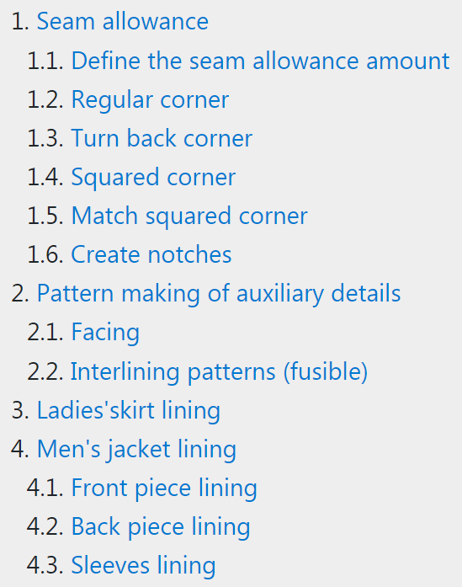
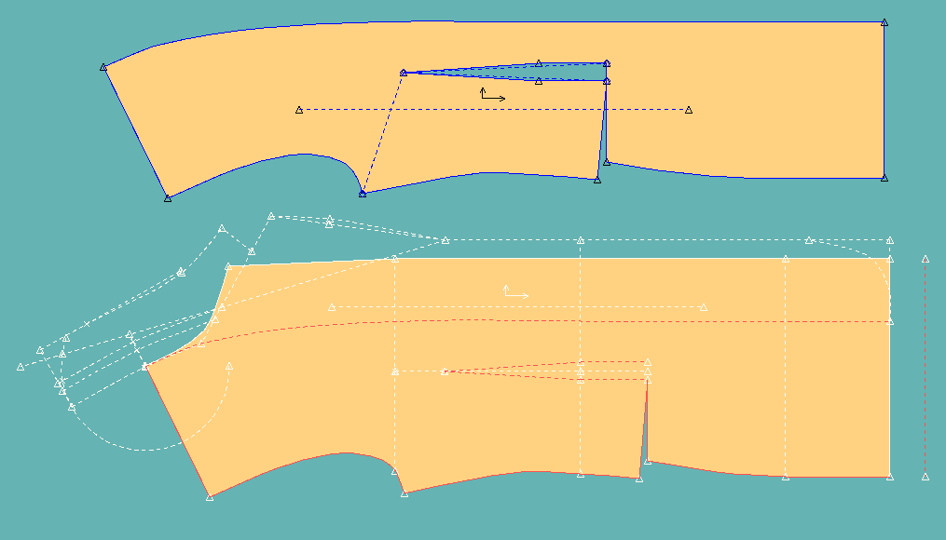
LESSON 11. PRODUCTION PATTERNS

Slide 18
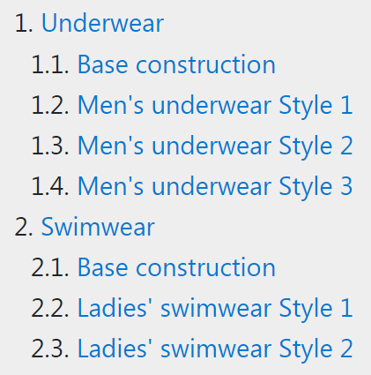
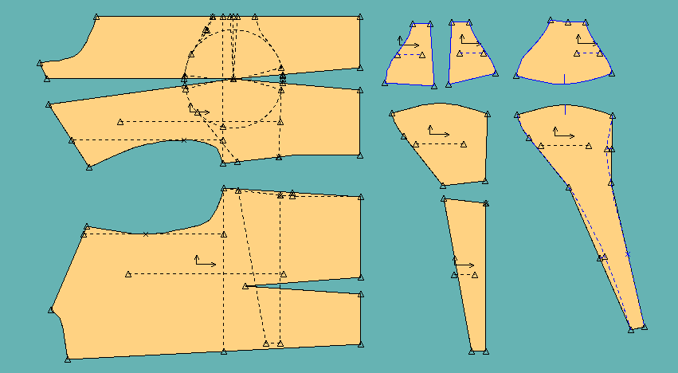
LESSON 12. KNITWEAR CLOTHING

Slide 19
QUIZ

Slide 20
THANK YOU FOR YOUR ATTENTION !

Slide 21
CONTACTS
Coordinator:
Technical University of Sofia
Faculty of Power Engineering and Power Machines
Project Manager of ICT-TEX:
Assoc. Prof. Dr. Angel Terziev
е-mail: aterziev@tu-sofia.bg
Web-site: ICT-TEX.eu
Contact: Assoc. Prof. Dr. Radka Atanasova
ratanasova@tu-sofia.bg
The information and views set out in this publication are those of the authors and do not necessarily reflect the official opinion of the European Union. Neither the European Union institutions and bodies nor any person acting on their behalf may be held responsible for the use which may be made of the information contained therein.

