Slide 1
Benny MALENGIER, PhD Ghent University, BELGIUM The course is developed under Erasmus+ Program Key Action 2: Cooperation for innovation and the exchange of good practices Knowledge Alliance
TRAINING COURSE
Design and Production of Technical,
Smart and Intelligent Textiles
ICT IN TEXTILE AND CLOTHING HIGHER EDUCATION AND BUSINESS
Project Nr. 612248-EPP-1-2019-1-BG-EPPKA2-KA
The information and views set out in this publication are those of the authors and do not necessarily reflect the official opinion of the European Union. Neither the European Union institutions and bodies nor any person acting on their behalf may be held responsible for the use which may be made of the information contained therein.

Slide 2
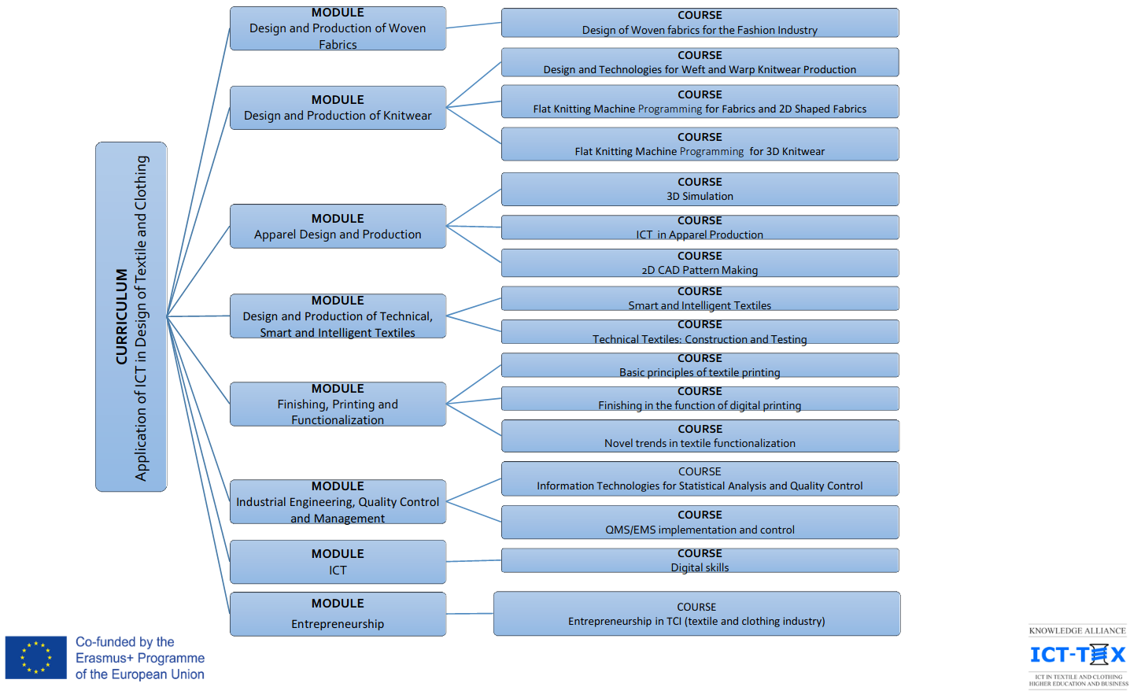

Slide 3
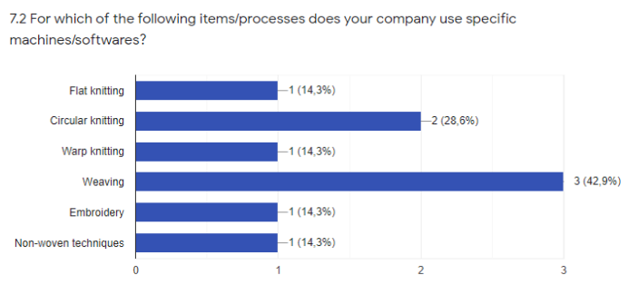
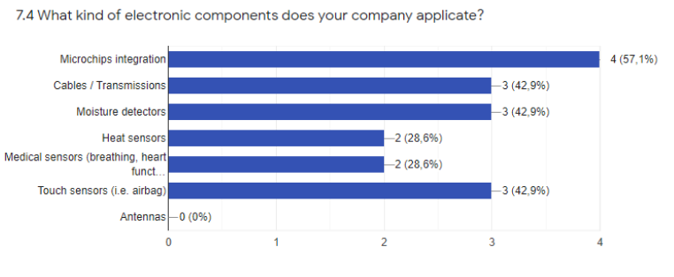
WP10: Development of Syllabuses

Slide 4
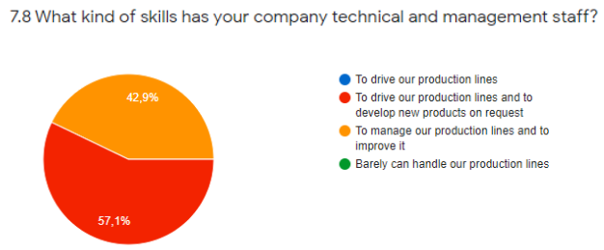
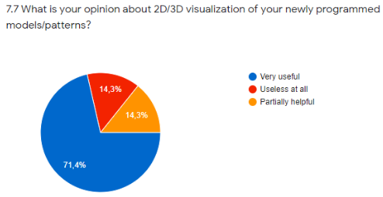
Software used mentioned:
Stoll (M1+, Microdor)
PE Design
Eurolaser
Picanol software
Mayer&Cie software
Excel
Inkscape/Inkstitch
OptiTex
DOE
Own software
Interest in others.

Slide 5
Smart and Intelligent Textiles
Course duration: 20 hours

Slide 6
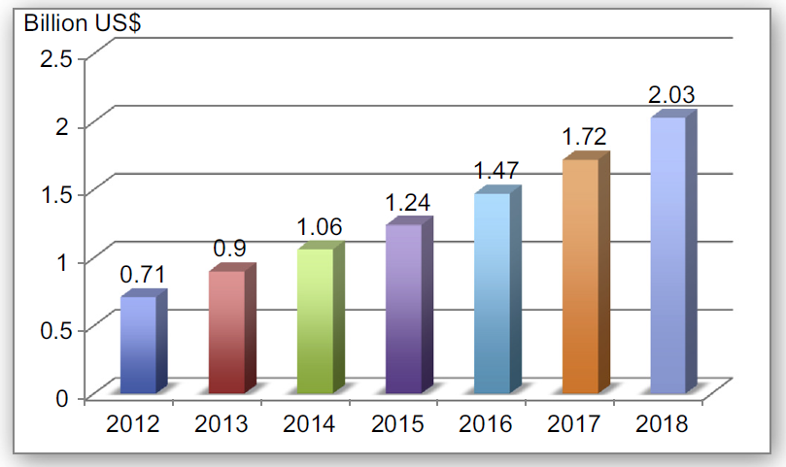
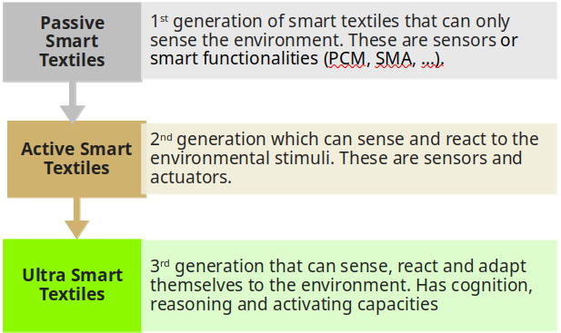
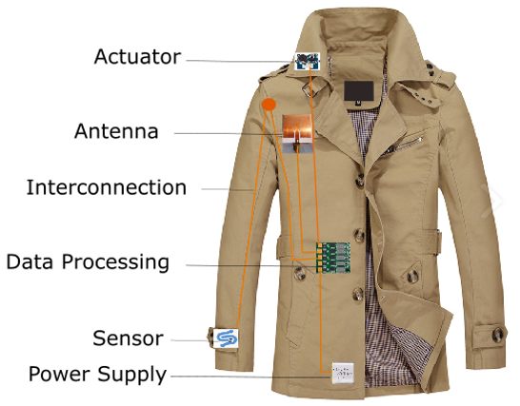
Topic 1. Introduction to Smart and Intelligent Textiles (1 hour)
History
Classification
Markets
Notes:
Source (image): Building blocks of smart textile system; https://encyclopedia.pub/4251

Slide 7
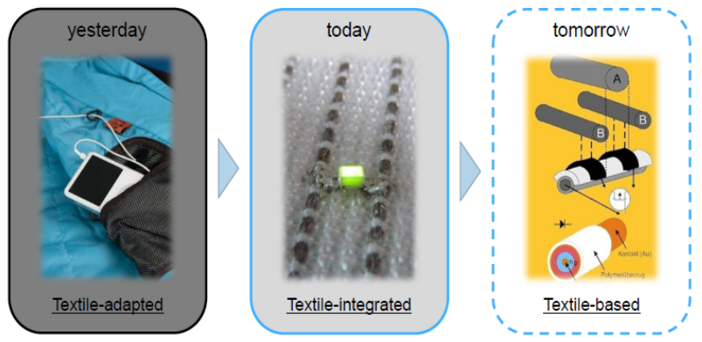
Topic 1. Introduction to Smart and Intelligent Textiles
Different classifications!

Slide 8
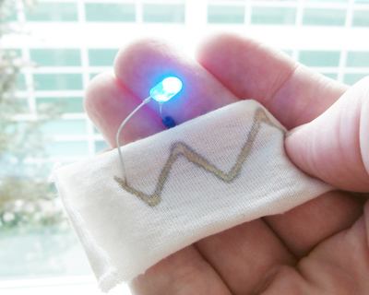
Topic 2. Electroconductive textile materials (2 hour)
Theory of electrical conduction
Intrinsic conductive materials (metals, carbon, polymer)
Composite conductive materials
Conductive coatings and inks

Slide 9
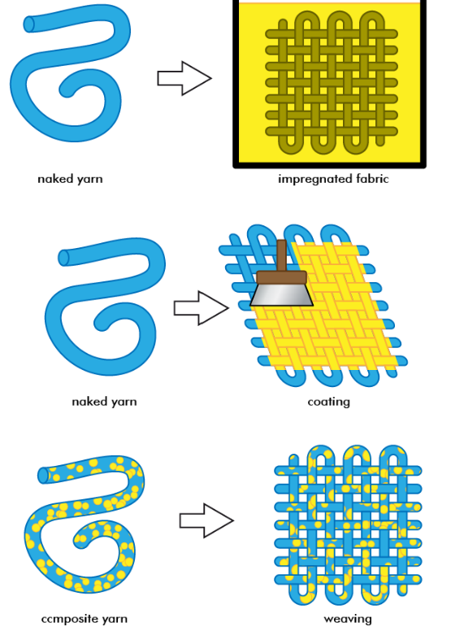
Topic 2. Electroconductive textile materials
ICT:
4-point resistivity measurement in practice
area resistivity
Python/Excel: computing out total resistivity, power consumption

Slide 10
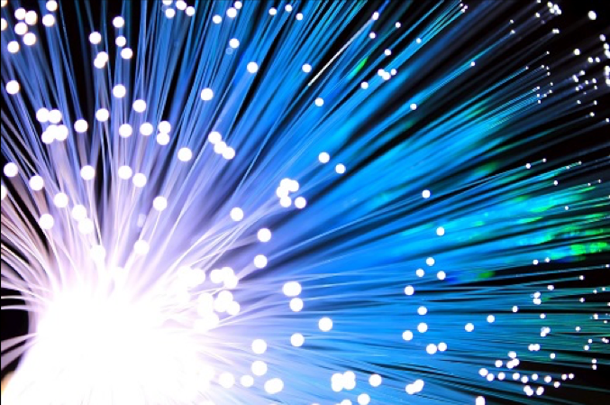
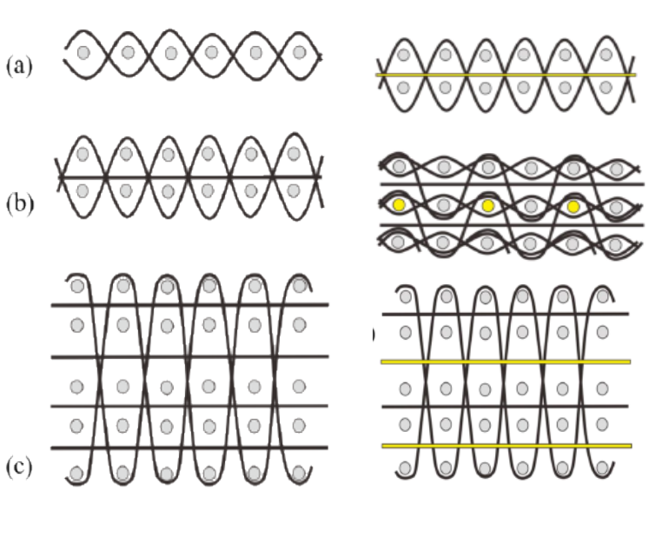
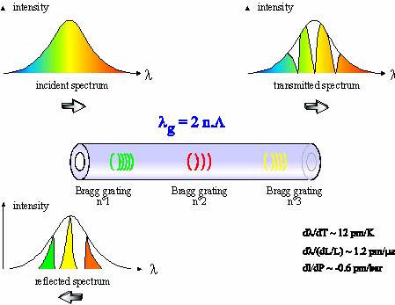
Topic 3. Optical fibres (1 hour)
Properties of optical fibres
Sensing methods with optical fibres
ICT:
Computing out properties
Notes:
Selm, B.; Gurel, E.A.; Rothmaier, M.; Rossi, R.M.; Scherer, L.J. Polymeric Optical Fiber Fabrics for Illumination and Sensorial Applications in Textiles. Int. Mater. Syst. Struct. 2010, 21, 1061–1071.
Koncar, V. Optical fiber fabric displays. Opt. Photon. News 2005, 16, 40–44.

Slide 11
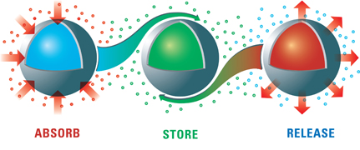
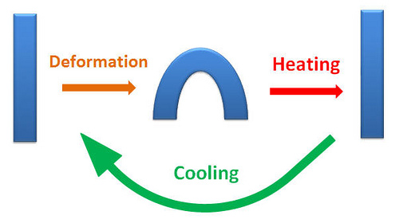
Topic 4. Specialty Constructions (2 hours)
Microencapsulation
Phase Change Materials
Chromic materials
Shape memory materials
Hydrogels and super absorbents
Biomimetic materials
ICT:
Properties in simulation software (eg Abaqus)

Slide 12
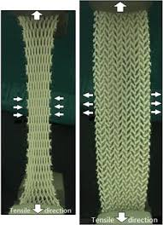
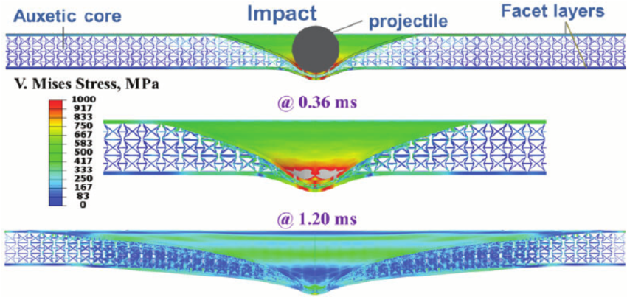
Topic 5. Specialty Constructions (1 hours)
Auxetic textiles
Shock absorbing textiles

Slide 13
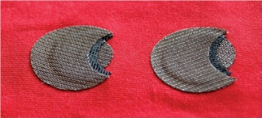
Topic 6. Sensors (3 hours)
Textile strain sensors
Pressure sensor and piezoelectric materials
Chromic materials

Slide 14
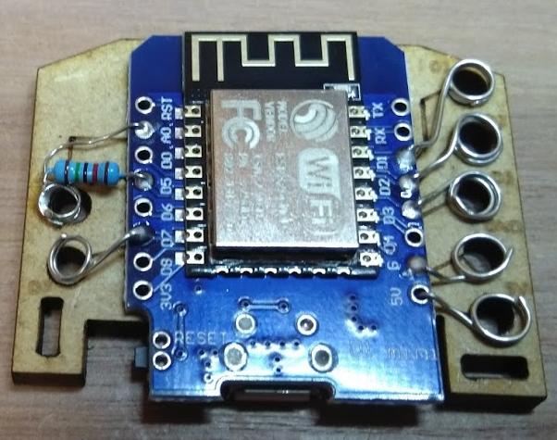
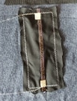
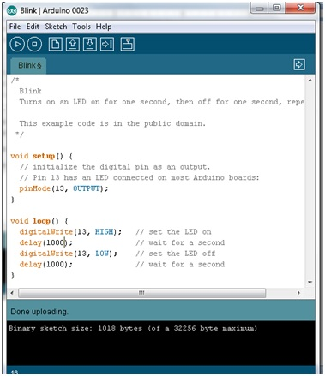
Topic 6. Sensors
ICT:
Data Acquisition
IoT
Arduino (C coding)

Slide 15
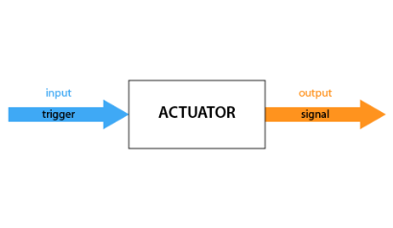
Topic 7. Actuators (2 hours)
Mechanical actuators
Chemical actuators
Thermal actuators
Optical Actuators
Electrostimulation
ICT:
Arduino (C coding)

Slide 16
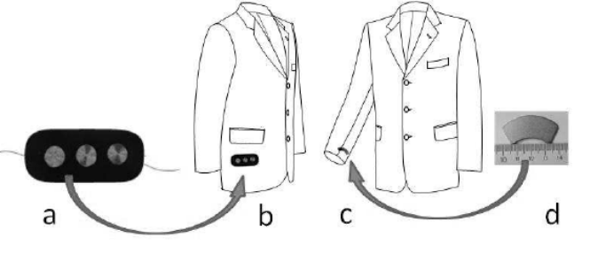
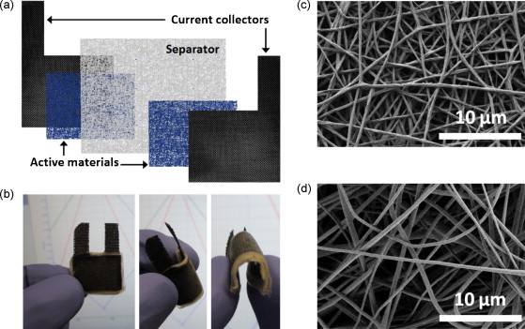
Topic 8. Energy for smart textiles (2 hour)
Energy storage
Energy harvesting: thermo electric, triboelectric, photovoltaic, piezoelectric
ICT:
Power needs computation
Notes:
Image: Paradiso JA, Starner T: Energy scavenging for mobile and wireless electronics. IEEE Pervasive Computing 2005, 4:18-27
Image: Supercapacitor battery - active materials: PEDOT nanowebs, separator: PAN nanoweb (Alexis Laforgue)

Slide 17
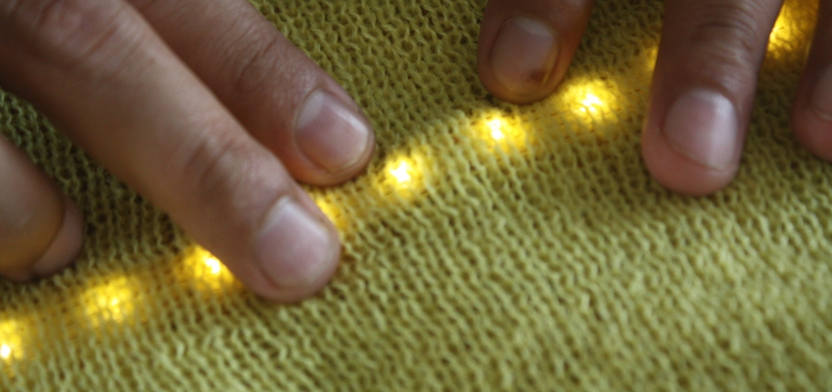
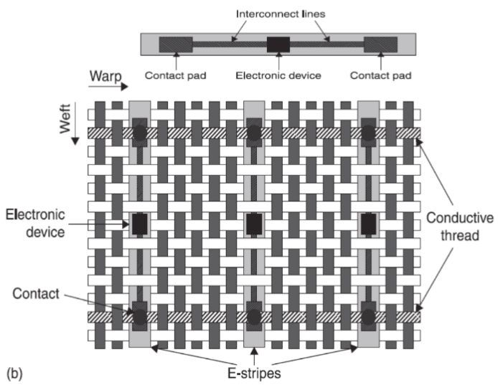
Topic 9. Textile Integration (2 hour)
Integration methods: weaving/knitting, embroidery, printing, lamination
Antenna (RFID, Bluetooth, patch)
Smart Suit: Examples
Smart textile design
ICT:
Design of smart garments (Clo3d/Inkscape)
Design in weaving
Design in knitting
Design in embroidery
As assignments with material other courses!

Slide 18
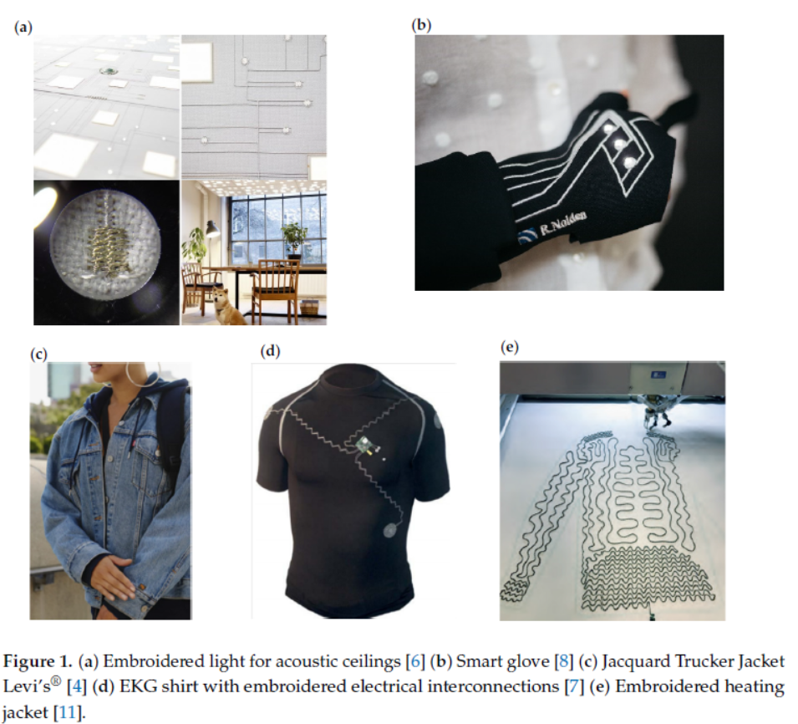
Topic 10. Micro-electronic integration in a garment (3 hour)
Integration technology
Adding intelligence: using the Arduino Microprocessor to drive a prototype.
Programming basics for smart textiles
pushbutton
analog sensor
I2C communication
Wifi logging with IoT
Practical hands-on

Slide 19
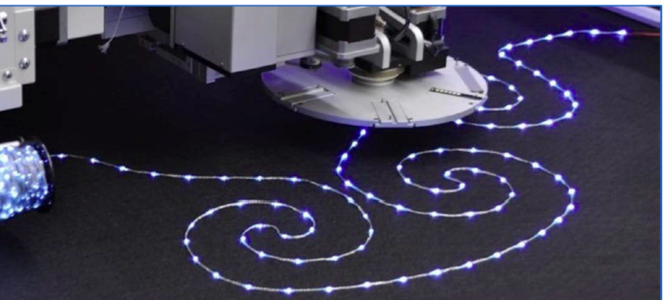
Topic 10. Micro-electronic integration in a garment
ICT:
Full smart garment creation start to finish
Design software
Arduino

Slide 20
Topic 11. Future Outlook (1 hour)
Future Trends in Smart Textiles applications
End of life
Standardization

Slide 21
Technical Textiles: Construction and Testing
Course duration: 20 hours

Slide 22
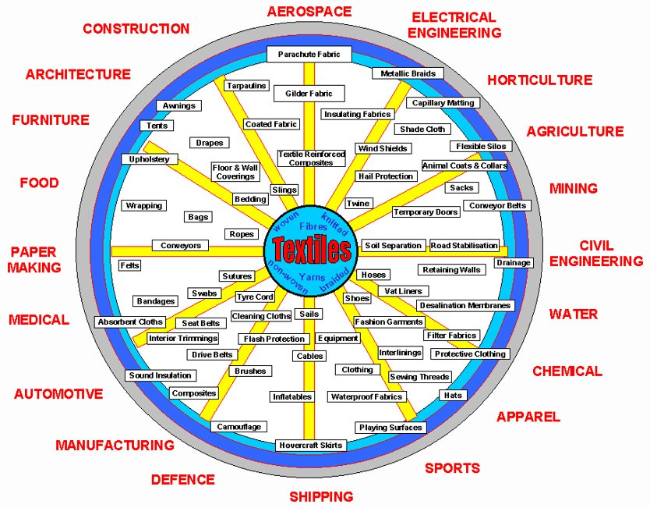
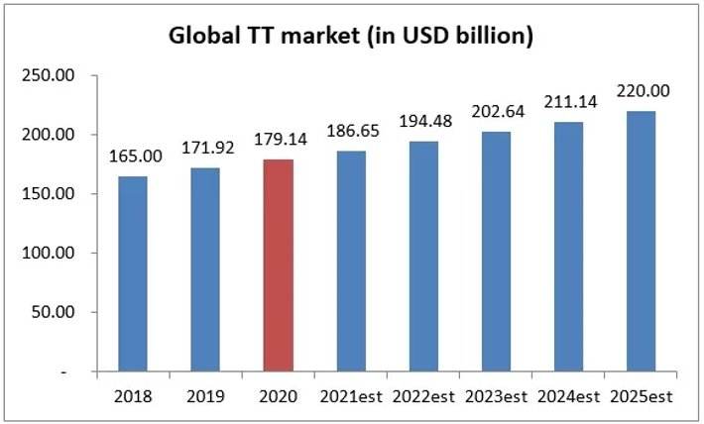
Topic 1. Introduction to Technical Textiles (2 hours)
Definition and history
Subdomains and examples: Buildtech, Agrotech, Clothtech, Geotech, Hometech, Indutech, Medtech, Oekotech, Packtech, Protech and Sportech
Future trends

Slide 23
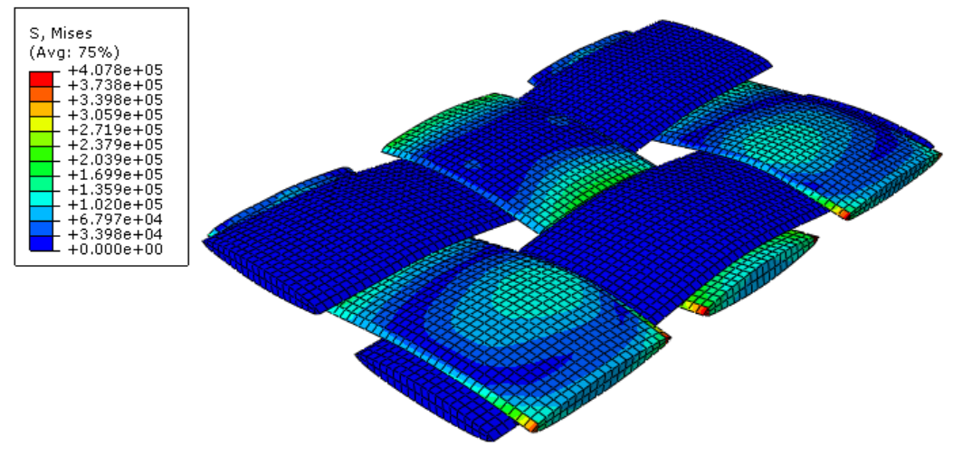
Topic 2. Functionalities: Mechanics of Textile Materials (2 hour)
Properties of textile materials: density, modulus (stress-strain), creep
Mechanical models: continuum, mass-spring
Compression exerted by a fabric

Slide 24
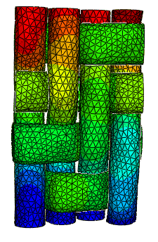
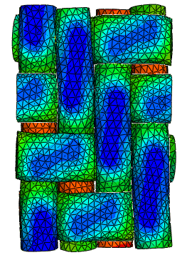
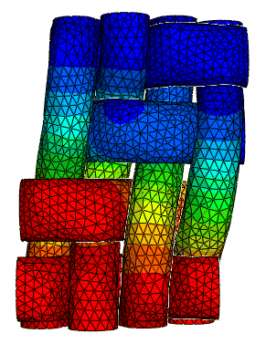
Topic 2. Functionalities: Mechanics of Textile Materials
ICT:
Abaqus modelling
Blender modelling
Tensorflow modelling

Slide 25
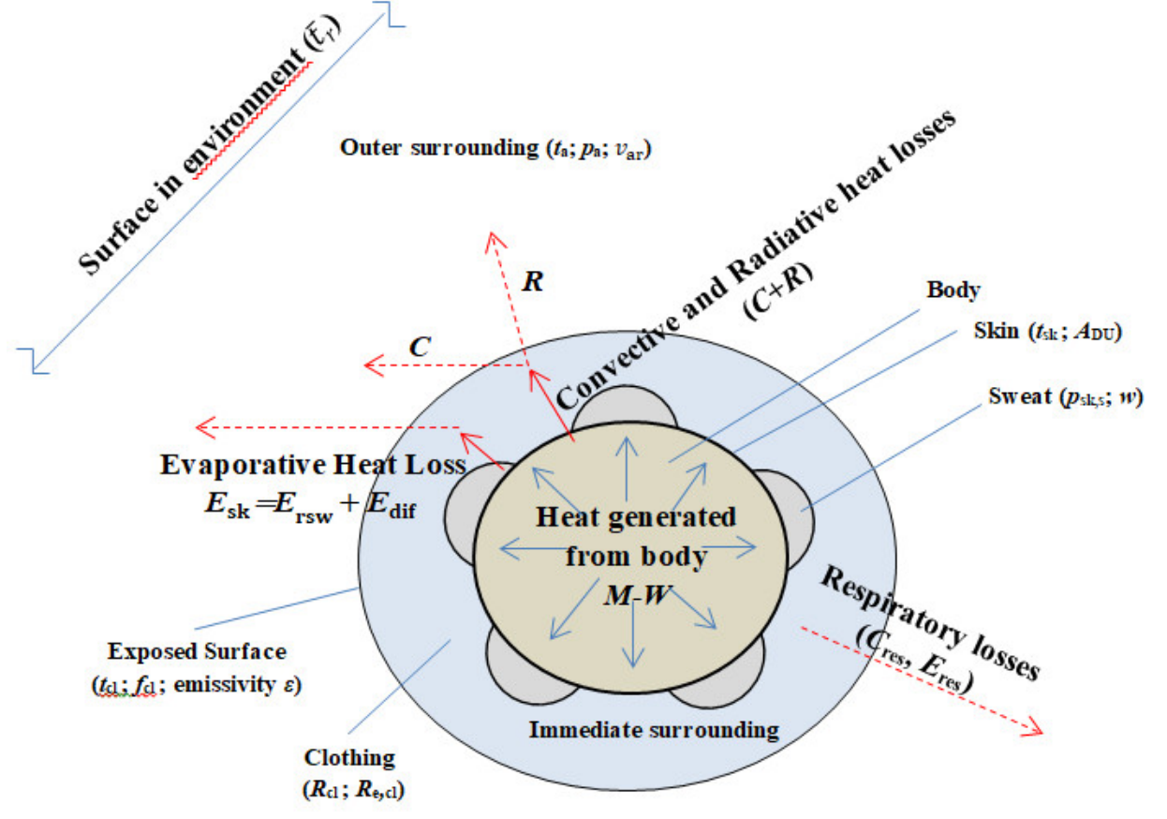
Topic 3. Functionalities: Heat and Mass Transfer in Textile Materials (2 hour)
Properties of heat transfer: conductivity, radiance, transmittance, …
Properties of mass transfer: permeability, filtration, sorption, wetting, wicking
ICT:
Comfort models
Abaqus

Slide 26
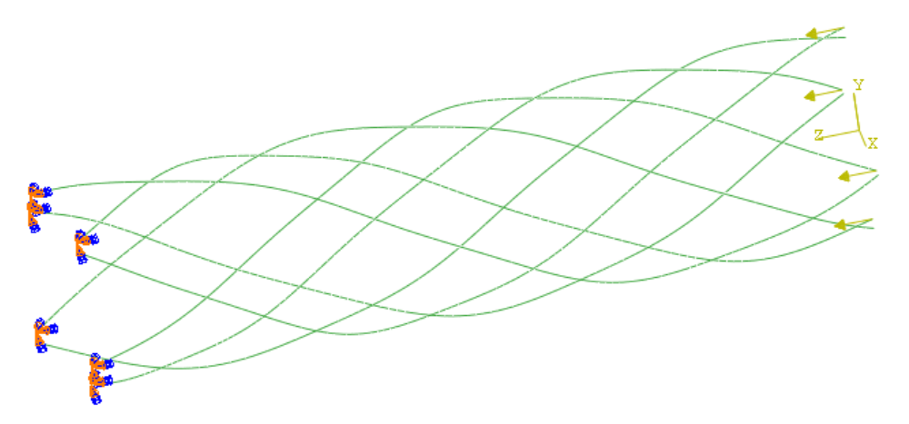
Topic 4. Construction: Braided Structures (3 hour)
( contribution Y. Kyosev TU Dresden)
Regular braided structures
Complex 3D braided structures
Carrier motion
Software for braided structures
ICT:
Configurator
Braider

Slide 27
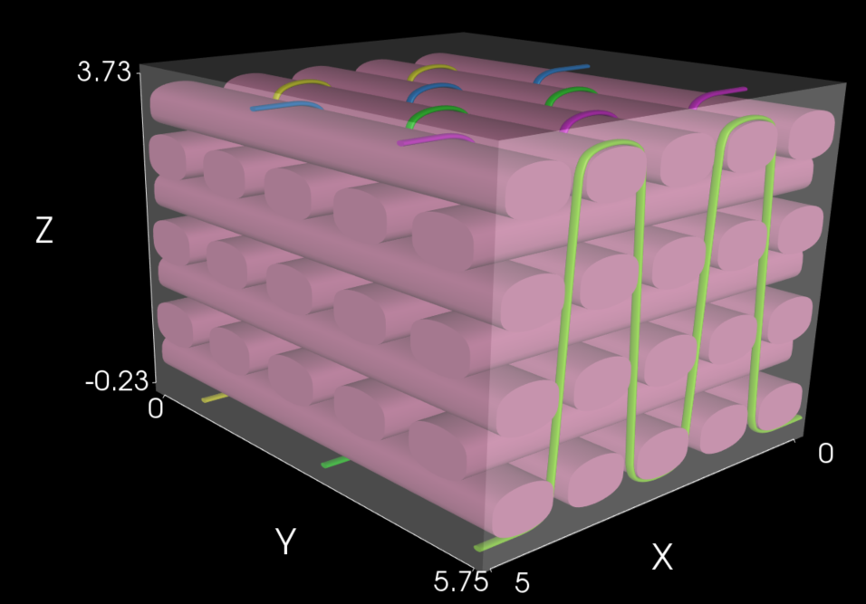
Topic 5. Construction: Complex Woven Structures (2 hour)
3D Weaving
Software for 3D Weaving (Texgen)
Industrial weaving (weaving combined with rods, profiles, …)
Applications: Composites, geotextiles, Concrete pouring, pulling mats
ICT:
Texgen
Commercial software ?

Slide 28
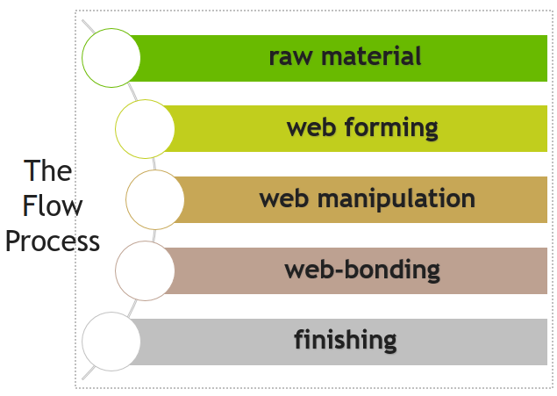
Topic 6. Construction: Nonwovens (2 hour)
Production methods for nonwovens
Applications
ICT:
Testing: homogenization of fabric layer

Slide 29
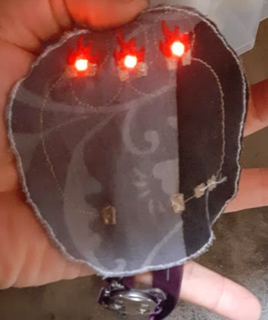
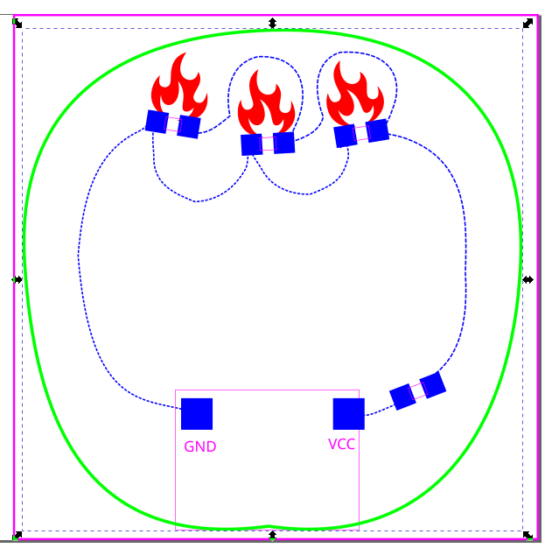
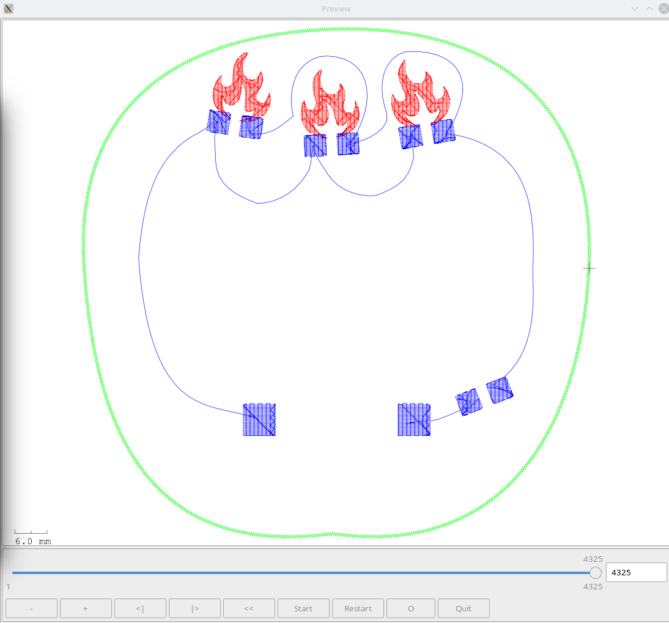
Topic 7. Construction: Technical Embroidery (4 hour)
Specialized embroidery: W-Head, K-Head, Functional Sequin
E-textile embroidery
Design of e-textile embroidery (PE Design, Ink/Stitch)
ICT:
Inkscape
Ink/Stitch
PE Design (Brother)

Slide 30
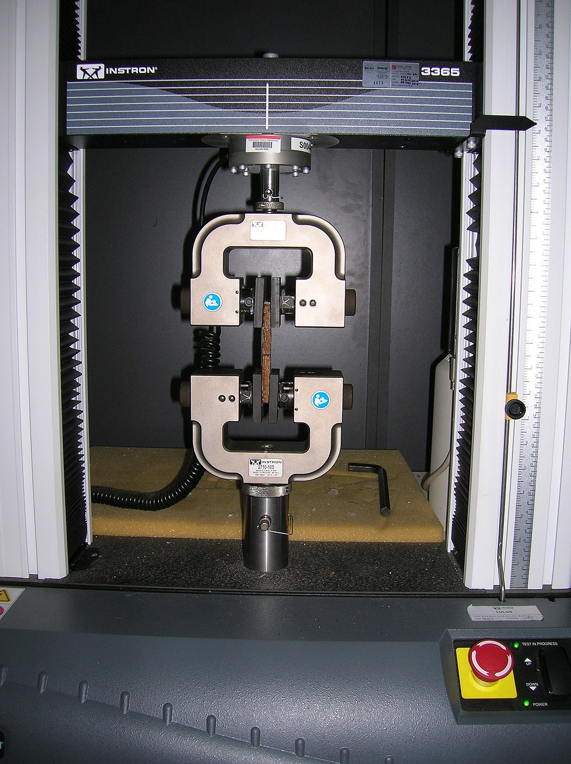
Topic 8. Testing Technical Textiles (3 hour)
Most common tests for technical textiles
DOE
Statistical techniques: Annova, PCA
Performance Evaluation of Technical Textiles
ICT:
Spreadsheet,
Python,
Statistical Software

Slide 31
THANK YOU FOR YOUR ATTENTION !

Slide 32
CONTACTS
Coordinator:
Technical University of Sofia
Faculty of Power Engineering and Power Machines
Project Manager of ICT-TEX:
Assoc. Prof. Dr. Angel Terziev
е-mail: aterziev@tu-sofia.bg
Web-site: ICT-TEX.eu
Contact: Benny Malengier, PhD, DSc
benny.malengier@ugent.be
The information and views set out in this publication are those of the authors and do not necessarily reflect the official opinion of the European Union. Neither the European Union institutions and bodies nor any person acting on their behalf may be held responsible for the use which may be made of the information contained therein.

