Slide 1
TOPIC 11. PRACTICAL STEPS FOR STARTING YOUR OWN TEXTILE AND CLOTHING BUSINESS

Slide 2
AGENDA
Select Your Product Category
Know Your Textile and Clothing Market
Estimate Production Requirements
Estimate Raw Materials Requirements
Factory Space Requirement. Find a Location
Manpower Requirement
Internal Process Flow
Suppliers and Vendors
Establish Your Brand
Reach Your Customers. Distribution
Time Management
Find a Mentor
Notes:
1. Know who you are. State your target consumer, the retailers that will sell your product, your breakeven point, and how you’ll do your sales.
2. How will you develop the line? Find factories? Go into production?
3. Why should anyone buy your line?
4. Who your target market is?
5. What are your price points? Who will you “hang with”?
6. What retailers fit your market?
7. What is your niche?

Slide 3
Practical questions before starting your own textile business
1. Know who you are. State your target consumer, the retailers that will sell your product, your breakeven point, and how you’ll do your sales.
2. How will you develop the line? Find factories? Go into production?
3. Why should anyone buy your line?
4. Who your target market is?
5. What are your price points? Who will you “hang with”?
6. What retailers fit your market?
7. What is your niche?

Slide 4
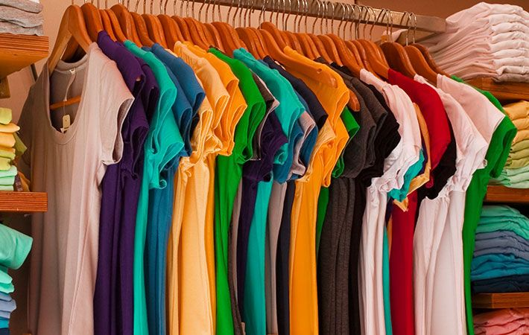
Select your product category
What type of garments are you going to make?
Narrow your product profile as much as possible. There is a wide range of product categories.
Notes:
For example: if you plan to make knits garment (T-Shirts, Polo ), you would not try to make woven products (Shirts, Trousers) at the same time.

Slide 5
Know your textile and clothing market
You need to understand your customers and what they seek.
Study your competition. What are your competitors doing
Define the capital you would need to start your textile business, your funding options.
What are the steps you need to take to promote your business?
What type of licensing does your business need?

Slide 6
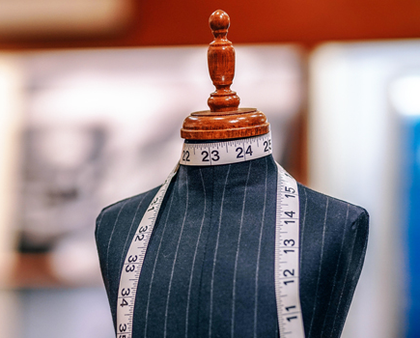
Know your textile and clothing market
Product Demand - it is important to understand the nature of demand for the particular type of product you are planning to sell. Demand may not be same everywhere, so you should carry out an area-wise survey to determine it.
Competition - if there are other competitors in the same locality, selling similar products that you intend to sell, then try to discover what you can do to outplay them.
Pricing - it is an important factor in all kind of businesses. Try to price your products as competitively as possible.

Slide 7
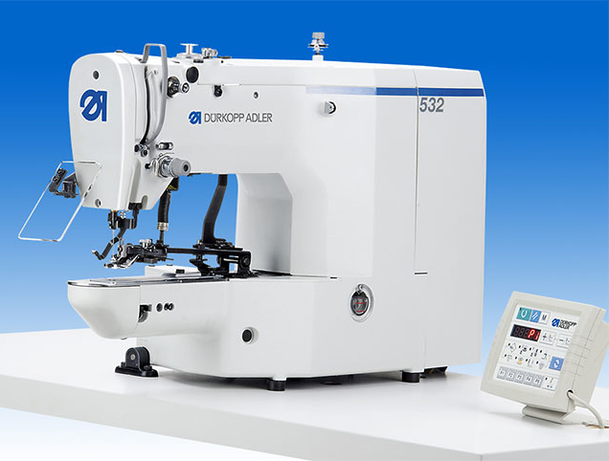
Estimate production requirements
Decide about the production capacity - how many pieces are you planning to make daily?
Calculate the number of sewing machines and other equipment.
What types of machines are required to make garments that you have selected from the wide range of product categories. Find the number of machines to be purchased in each machine type. This step would help you to calculate capital investment in machines. For example: sewing machines, pressing tables, cutting room machines, steam generator for pressing table, diesel generator for power back-up, finishing room equipment, furnishings etc.
Notes:
In apparel Manufacturing, “Production capacity” is one of the most important criteria used for vendor selection by the buyers. It is because; the production time of an order is directly proportional to the vendor’s production capacity.
The capacity of a factory is primarily expressed in terms of total machines factory have. Secondly, how much pieces the factory produces on daily for the specific products? In general, total numbers of machines in a factory mostly remains the same for a period. But factory may produce various types of the product during the season. According to the product (style) category, machine requirement may change and daily average production in each style may vary. So to be specific during booking orders, a planner should know exactly how much capacity he or she needed to procure the order in a given time period.

Slide 8
Estimate raw materials requirements
Make a list of raw materials, required to make the garment with average consumption. This would help you to prepare your budget on material sourcing.

Slide 9
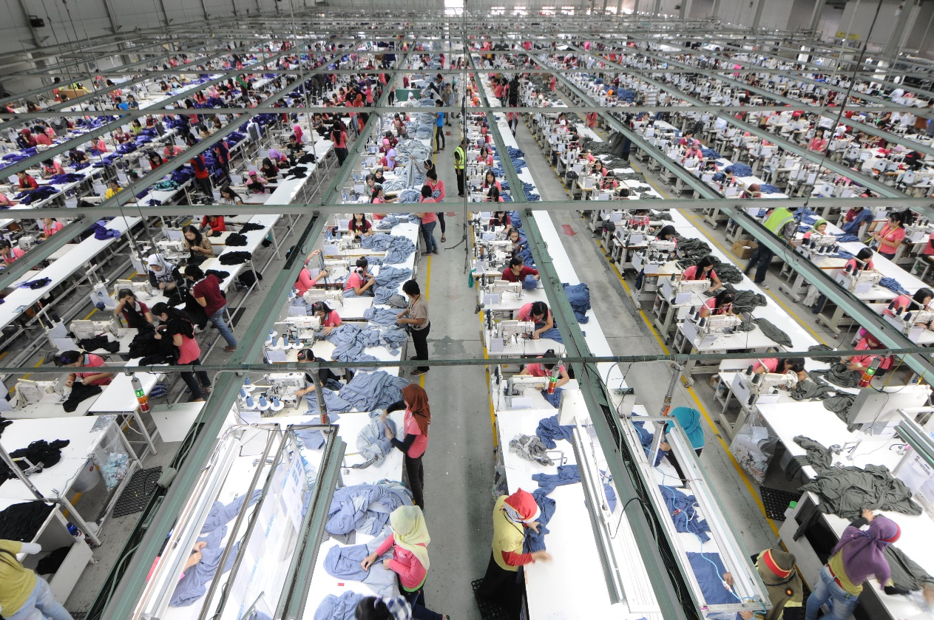
Factory space requirement
How much space is required for installing machines and office for staff? To set up factory you need space for installing machines, office space and setting up departments for production and associated processes. Calculate space requirement.
According to what you have planned for a factory building you can rent a space. Estimate rent amount for the project budget.

Slide 10
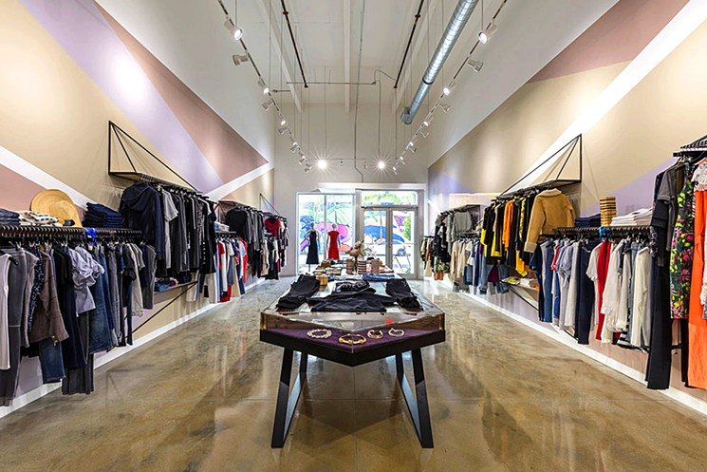
Find a location
Whether it is a shop for selling textile products or a factory that produces textiles, location is a major factor that influences the success and growth of your business. If it is a factory, make sure it is well connected. At the same time it should also have an abundant supply of water and electricity. For shops, it should be located in an area frequented mostly by your target buyers.

Slide 11
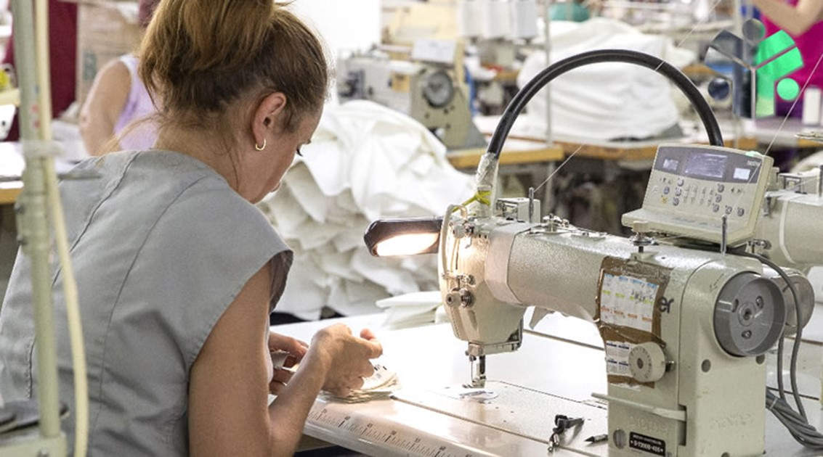
Manpower requirement
Manpower is one of the primary resources for a business. In manpower planning, include number of staffs, supervisors and workers (operators and helpers) you need to hire to make projected garments and to run business smoothly.
Estimate salaries for each employee and add to your budget to running cost. Get an idea from the market how much salary you need to pay to managers and workers.

Slide 12
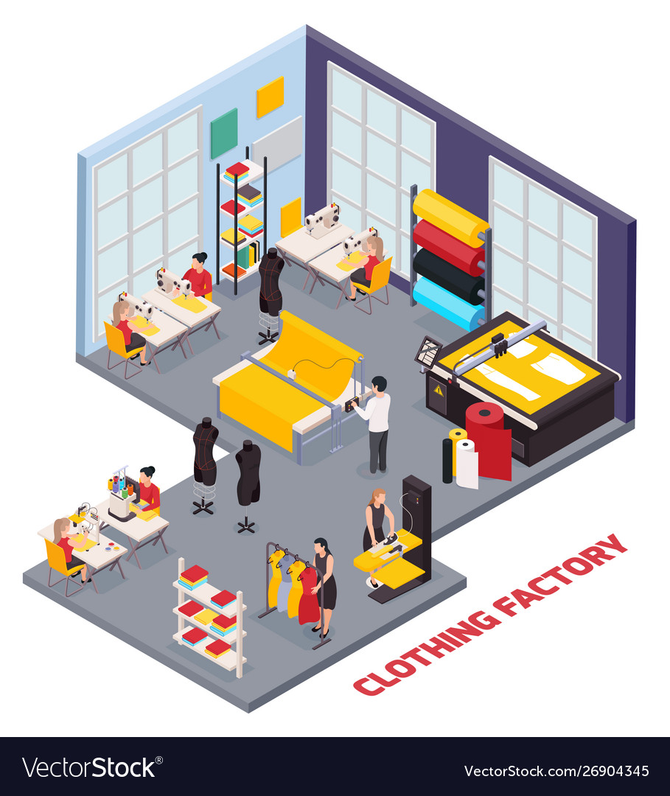
Internal process flow
Make a detailed process flow of an order. This will help you to decide what all departments you need to set up and you can plan hiring people accordingly. You can cross check about your equipment requirement process by process.

Slide 13
Project costs
To know the estimated budget you have to prepare cost of the project. You need to calculate total capital investment, rent, workers wages and running costs. Also include finance required for sourcing raw materials for initial months and other expense etc.
Prepare a monthly cash flow requirement for at least one year to run you business without financial problem.

Slide 14
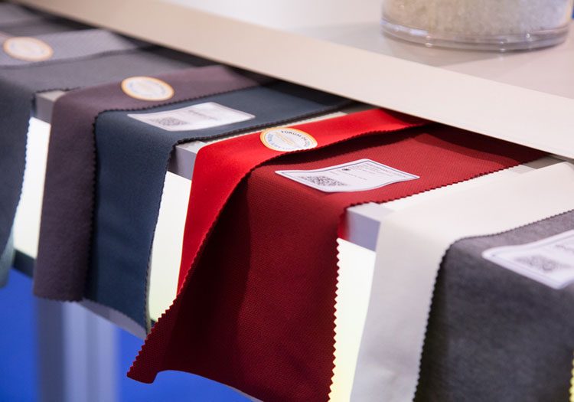
Suppliers and vendors
Start working on finding good and reliable suppliers for fabrics, trims and other necessary items required to manufacture your garments.
Start establishing suppliers with your region, then go to another country and even you can source from the international market for the quality and cost-effective materials.
Notes:
If you are planning to start a business in textile printing or production, you should begin to look for the vendors supplying the raw materials needed for that purpose. You should start contacting manufacturers and vendors to decide the type of fabric you would like to carry. You need to maintain caution when purchasing high-quality fabrics or a wide variety of them. If you want you can also check up on some unique fabrics outlets or local artisans specializing in hand dying fabrics or weaving textiles. Such types of fabrics will add value to your regular offerings.

Slide 15
Establish your brand
Establish your brand name. Every creation of you should carry the name of your brand. Whenever you host an exhibition or fashion show, highlight your brand name.
Use your brand name for sponsorship. The brand name will give you recognition and with time, people will remember and prefer your brand.

Slide 16
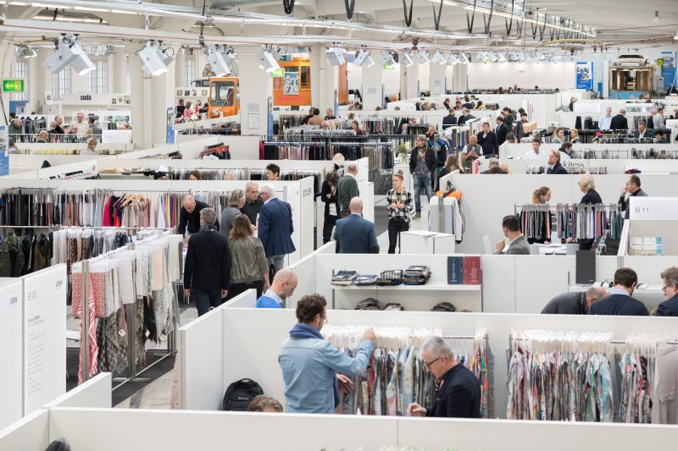
Reach your customers
Make a list of potential customers and start contacting them for business leads.
Visit textile and apparel fairs and exhibitions.
Use the social media channels for advertising and selling your products.
Notes:
You need to let people know about the new business you are going to start or have already started. Spread the word to as many prospective buyers as possible. You can expect a good start to your business if more people are already aware of it beforehand. Social media marketing and online marketing are some of the most powerful tools these days. You can effectively reach out to a large number of target buyers by using these tools. Signing up for Twitter or creating a new page on Facebook can get you started along these lines.

Slide 17
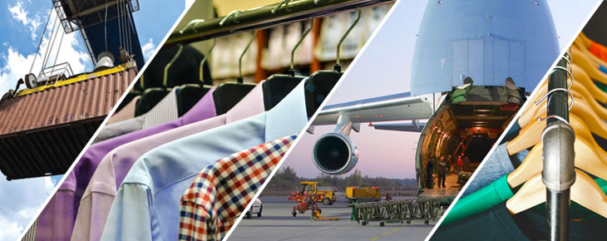
Distribution
An important consideration in your textile business will be transportation.
You must include the cost of transportation in your budget before starting any business venture.
Notes:
You need to let people know about the new business you are going to start or have already started. Spread the word to as many prospective buyers as possible. You can expect a good start to your business if more people are already aware of it beforehand. Social media marketing and online marketing are some of the most powerful tools these days. You can effectively reach out to a large number of target buyers by using these tools. Signing up for Twitter or creating a new page on Facebook can get you started along these lines.

Slide 18
Time management
Mastering the art of managing time is crucial to the success of any business. If you are constantly running short of time and in the process missing out on important tasks, it is time for you to learn effective time management.

Slide 19
Find a mentor
Seek help from an expert. An expert's guidance will help you to save your time, money, and efforts. You can also learn many things about business insights from an expert.
Finding a mentor for advising and helping through your business’ life, using online resources, and finding in-person assistance.
Notes:
A mentor is someone who has been there before. They are experienced, successful, and can provide critical guidance to help you make an informed decision with your business.

Slide 20
Tips for success
Deliver “today” in fashion.
Respond flexibility to apparel distribution needs.
Innovate in high quality production facility.
Innovate in functional innerwear technology.
Develop products according Aging society.
Do environment friendly production.
Notes:
A mentor is someone who has been there before. They are experienced, successful, and can provide critical guidance to help you make an informed decision with your business.

Slide 21
Assignment
Using the Your Textile and Clothing Business Ideas Document define what are the barriers to entering each business? (Such as high initial capital costs, unique technology, or customer need for brand recognition).
Which business would you like to do according to the skills and competencies you have?
Which type of textile and clothing business, presented in the document, do you find the most possible and practically applicable, when you do not have a lot of financial resources?
Try to describe a brief profile of the main customer segment for each business.
What will be the initial cost for starting each business?

