Slide 1
QMS/EMS Implementation and Control

Slide 2
Quality Control in Technological Finishing Process of Men’s Jacket
Example of quality control
Partner: P4 – University of Zagreb Faculty of Textile Technology
Assoc. Prof. Anica Hursa Šajatović, Ph.D.

Slide 3
The technological process of garment finishing is the final and very important part of the garment manufacturing process in which garments get their final appearance.
The final appearance of clothing, its fit to the human body and the presentation to the buyers all have a significant effect on sales.
The technological finishing process requires the use of high quality machines and equipment to correct any minor defects that appear during the process of clothing manufacturing to ensure the garment fits the 3D body shape and to prepare the final product for packaging.

Slide 4
Quality control and quality assurance are complex areas in the apparel industry
Quality control in the apparel industry includes:
preproduction quality control (each component of a garment should be tested – fabric, closures, interlinings, sewing threads, elastic waistband, other design elements),
quality control during production (spreading and cutting defects, defects in assembling, defects during pressing and finishing) and
final inspection (testing of performance requirements, overall appearance, sizing and fit)

Slide 5
Control planning is a part of quality management system which determines the purpose of the garment, along with other relevant parameters for the garment in question (design, attractive appearance, production quality, comfort, etc.).
To ensure quality control, different control points need to be defined through the whole production process via input, interphase and final inspection.
The quality control system should:
ensure adequate education and staff training,
raise awareness of individual responsibility (self-control) - only responsible behaviour and work ethics can ensure the right quality level.

Slide 6
A major defect is a flaw that often leads to product failure or lack of its functionality (for example broken zipper or stitches, tears in the fabric, etc.).
A minor defect is a flaw that does not reduce the functionality of a product, but still deviates from standards and specifications (for example unclipped thread, untrimmed seam allowance, slubbed yarns in the fabric, etc.).

Slide 7
Final inspection
final inspection, the correctness or defects on garments are determined by measuring, counting and visual inspection
h - length of jacket
h1 - sleeve length
h2 - chest length
b - half width of the back part
b1- half of sleeve circumference
Examples of individual measures during final control - men's jacket

Slide 8
Examples of individual measures during final control - men's trousers
h - length of trousers (without waistband)
h1 - inseam length
b - half of waist circumference
b1 - half of hem circumference

Slide 9
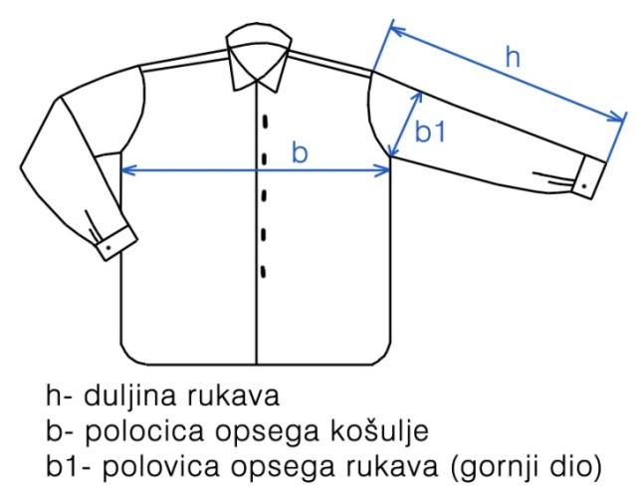
Examples of individual measures during final control - men's shirt
h - sleeve length
b - half of chest circumference
b1 - half of sleeve circumference (upper part)

Slide 10
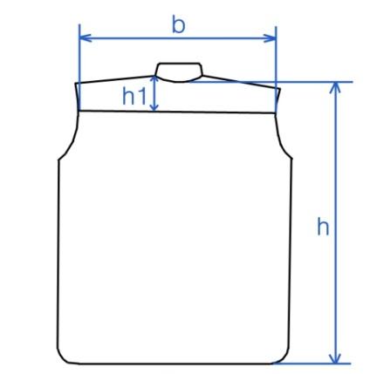
Examples of individual measures during final control - men's shirt
h - length of men's shirt
h1 - width of yoke
b - width of the back part

Slide 11
Examples of individual measures during final control - men's shirt
h - cuff length
h – collar length

Slide 12
Types of Quality Control
In order to achieve required standards and requests, the company has to implement the TQM system (Total Quality Management) and the QAS system (Quality Assurance System) into its quality management system.
TQM management refers to complete quality management; nonconformity or defects are removed as soon as they appear in the production.

Slide 13
Basic principles of the TQM system are the following:
quality can and has to be managed,
all employees are responsible for the quality,
problems have to be prevented not just fixed,
quality has to be controlled,
improvement of the quality has to be a continuous process,
objectives are based on customer requirements,
management has to be involved,
improving the quality requires planning and organization.

Slide 14
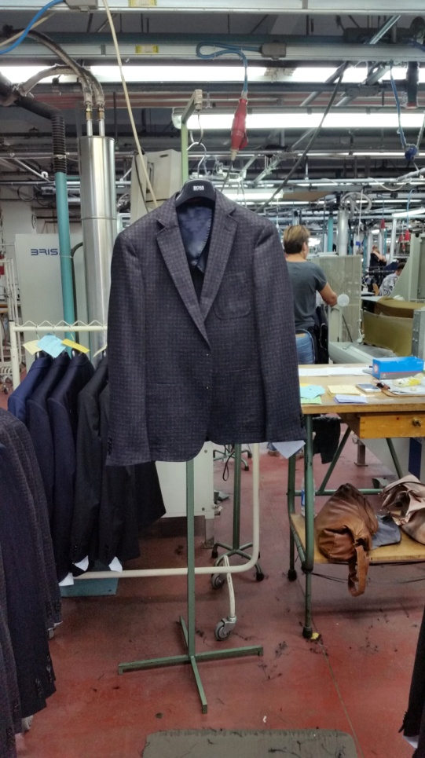
Quality control during production
The workplace of quality control during production process is located between the technological process of sewing and finishing
The goal of this type of control is to find possible defects on garments occurring in the technological process of sewing

Slide 15
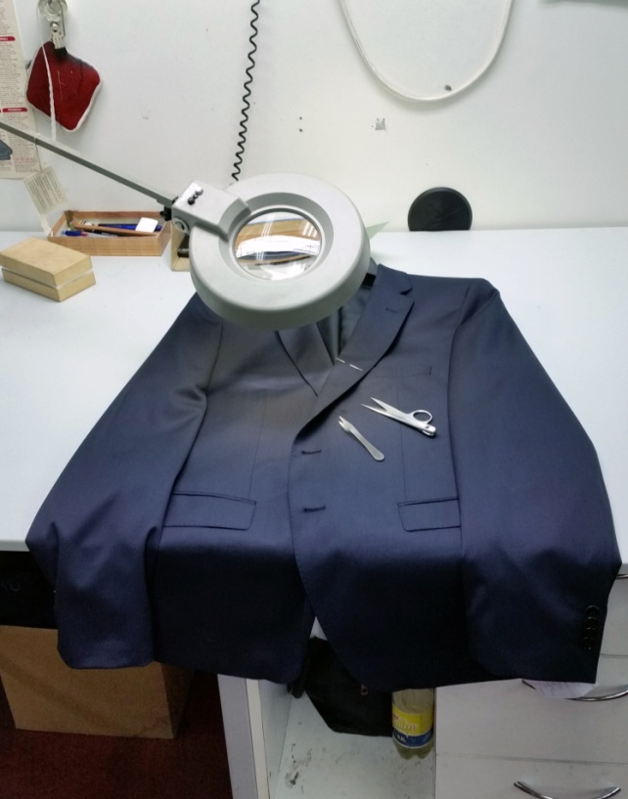
Piece control
the workplace of piece control is elimination of defects that are caused by poor-quality material
The workplace should be equipped with required technical auxiliary tools (nippers, scissors, needle with rounded point)
The worker has to be educated about the types of fabric, types of weaves (plain, satin and twill weave) as well as the characteristics of warp and weft yarns

Slide 16
In case of a broken, inserted or drawn out weft or warp, or holes on material on larger cutting parts (front, back and side part of clothing, upper and lower part of sleeves, front and back parts of trousers), workers should be trained how to correct the damage by inserting the warp and weft yarn with regard to the rule of a particular weave, using a needle with a rounded point.

Slide 17
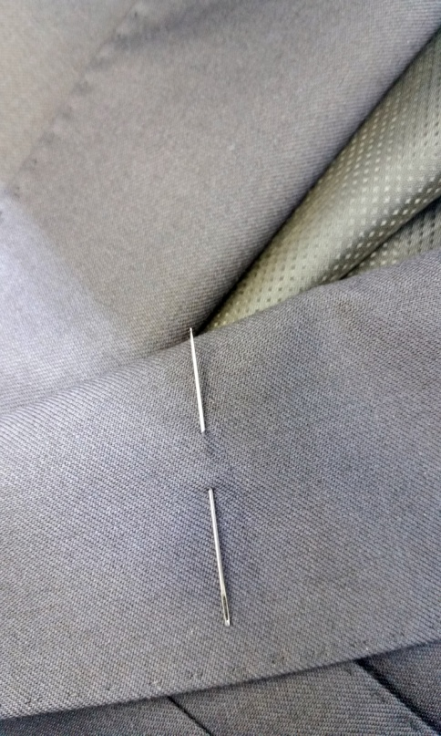
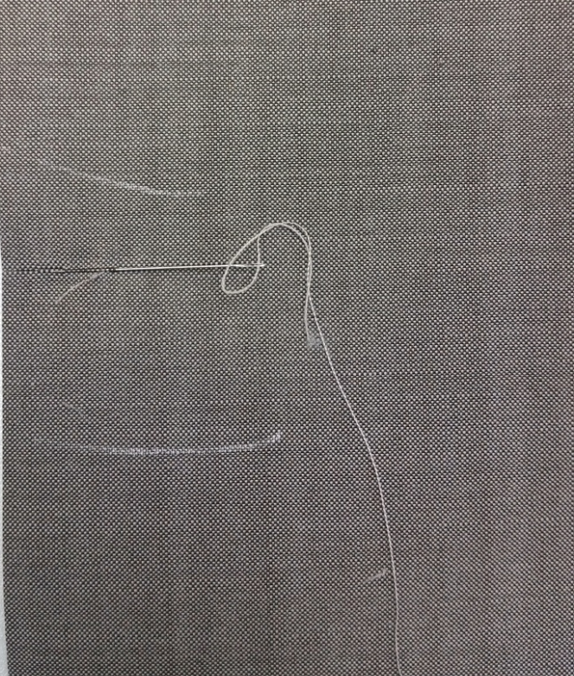
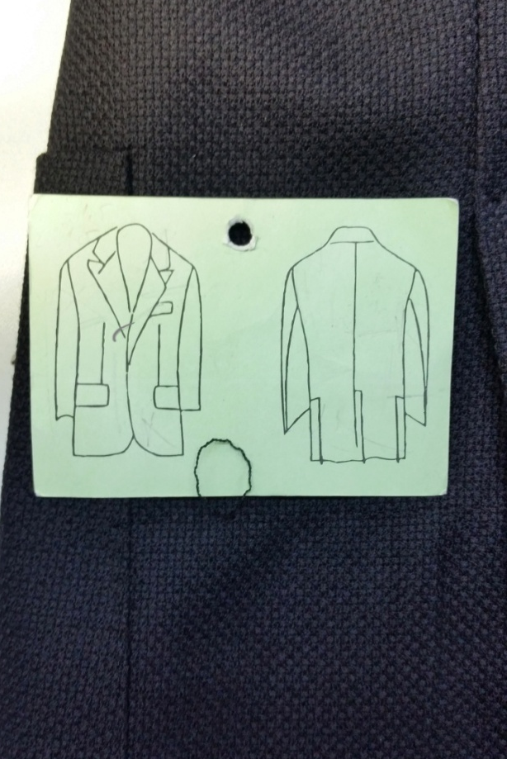
Correction of defects caused by poor-quality material
needle with a rounded point | inserting of drawn out yarn | marking defects caused by poor-quality material (drawn out yarn)

Slide 18
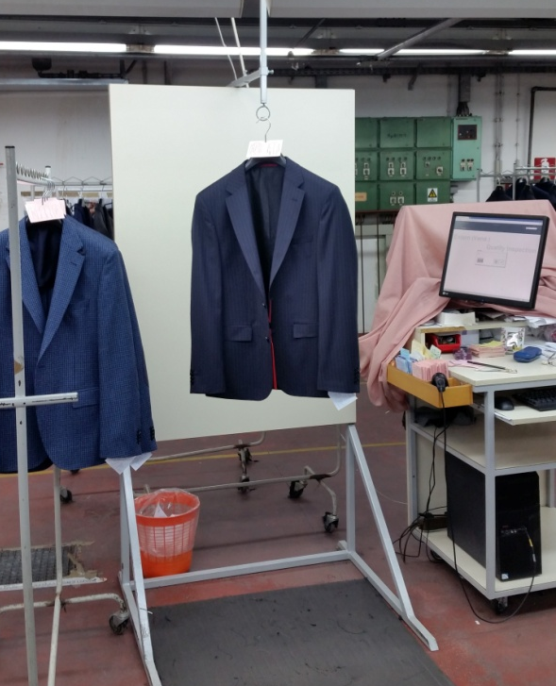
Final inspection
The workplace of final inspection is located at the end of the technological process of finishing
The workplace has to be equipped with two transport stands, one for clothing items which satisfy quality requirements, and the second one for clothing items which will be sent back to production process for repairing
Workplace has to be equipped with a desk and PC for printing and preparing the technical documentation

Slide 19
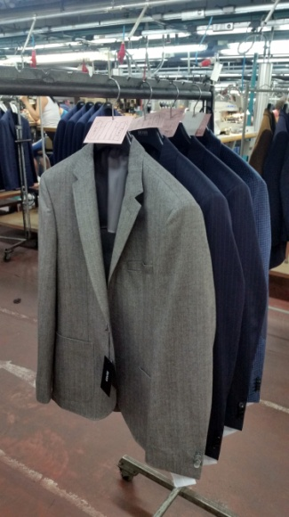
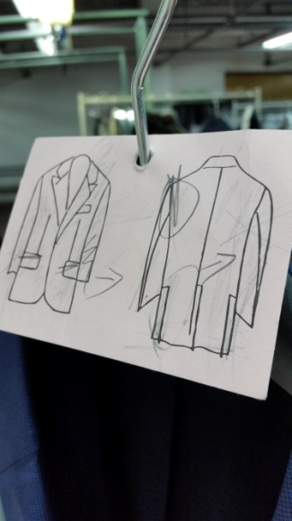
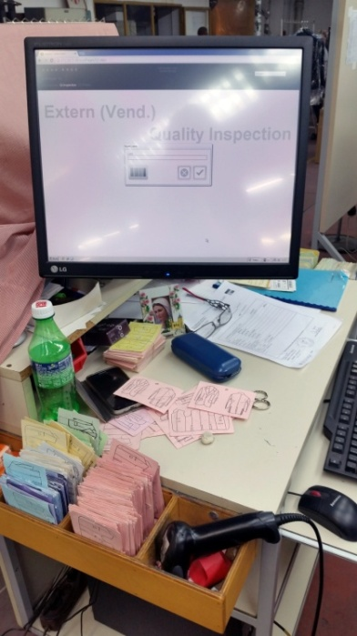
The workplace of final inspection
transport stands for male's jackets with defects | control card with marked defects | PC (working station) for data entry

Slide 20
The bar code on manufacturer label sewn inside the pocket of men’s jacket is scanned and first class quality is confirmed on clothing items without defects.
Classified clothing items are sent to packaging and transported to storage.
When classifying the types of defects on man’s jacket, the worker in final inspection can put one or more coloured control cards.

Slide 21
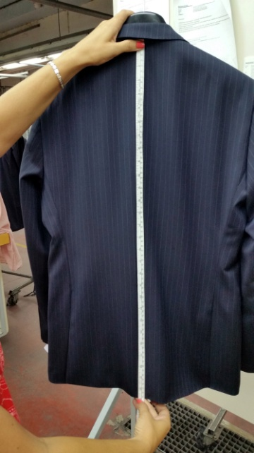
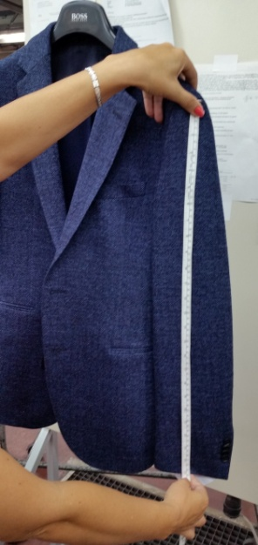
Audit control - random selection method
On men’s jacket, audit control is performed on clothing size 48
Worker in the final inspection periodically select a certain amount of men’s jackets using random sampling method and perform a detailed control of length and circumference of clothing on these samples
Measurement of length Measurement of sleeve length

Slide 22
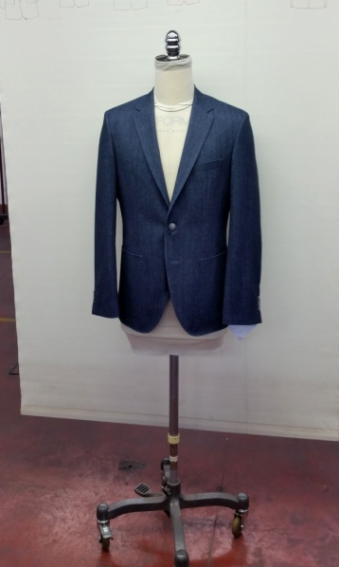
Fitting quality control
men's jacket is put on a dress form (dummy) and the fit of jacket is evaluated in all segments
Men's jacket segments for fitting quality control

Slide 23
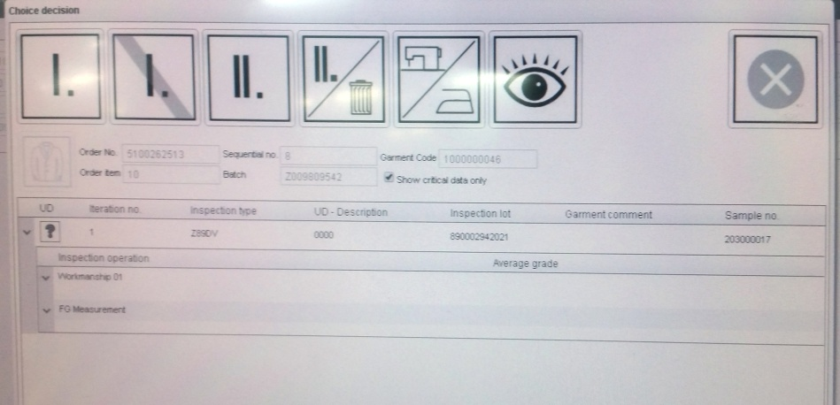
The interface of a computer program for monitoring, collecting and processing data of fitting quality control. Processed and analysed data of quality are forwarded to the buyer or client.
PC software for monitoring of quality control

Slide 24
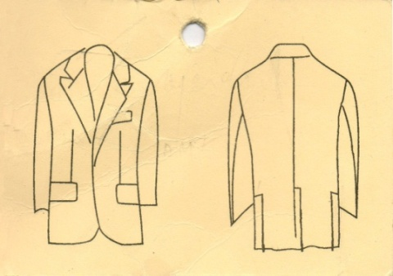
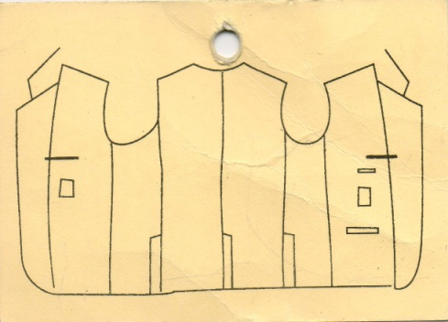
Control cards
Workplaces in quality control during production and final inspection have the obligation to mark defects using different colour control cards depending on the type of defects.

Slide 25
The cards and types of defects are classified as follows:
WHITE – defects made in sewing room (front parts, pocket edges, pockets, front darts)
ORANGE - defects made in sewing room (inner part – lining and inset labels)
YELLOW - defects made in sewing room (decorative hand stitching, decorative stitching, seams, vent, pattern, piped seam, bottom part of the collar, length of the jacket, length hem of the jacket)
BLUE - defects made in sewing room (sewing of sleeves – inner part)
VIOLET - defects made in sewing room (sewing of sleeves – outer part, buttons, applications on jacket, vent, length and fit of sleeves, side seams, ironing the length of the jacket, back part of the jacket and collar).
RED - defects made in garment finishing process (ironing and sewing on buttons)
GREEN – fabric defects.

Slide 26
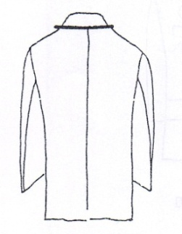
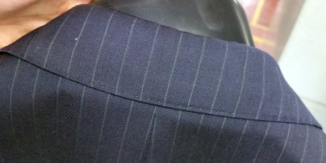
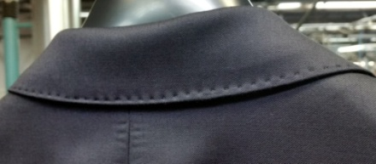
Example: defects on men's jacket
Description of the defect | Mark on the control card | Defect on men's jacket
Unequal width of seams or non-matching pattern on the collar

Slide 27
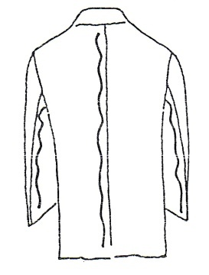
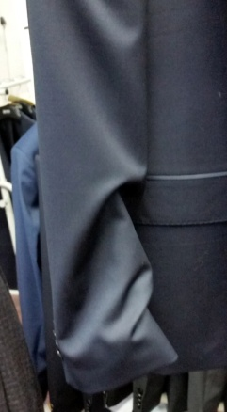
Example: defects on men's jacket
Description of the defect | Mark on the control card | Defect on men's jacket
Improperly sewn sleeve linings

Slide 28
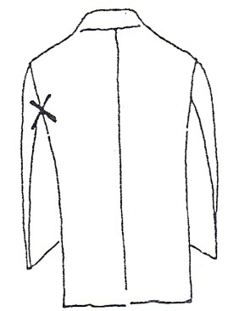
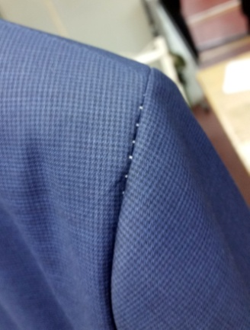
Example: defects on men's jacket
Description of the defect | Mark on the control card | Defect on men's jacket
Insufficient seam resistance

Slide 29
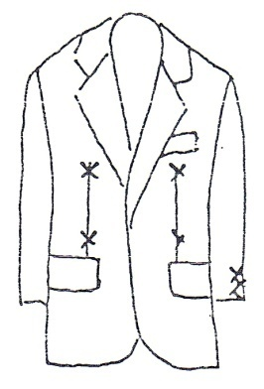
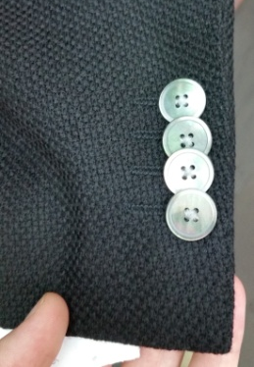
Example: defects on men's jacket
Description of the defect | Mark on the control card | Defect on men's jacket
The buttons are not sewn in line with the edge of the vent Position and length of darts

Slide 30
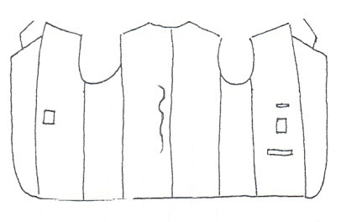
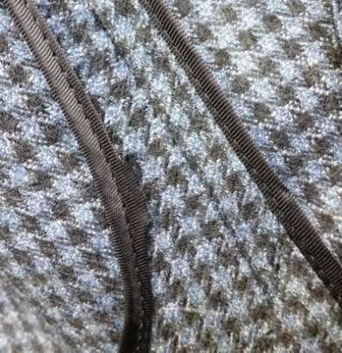
Example: defects on men's jacket
Description of the defect | Mark on the control card | Defect on men's jacket
Unequal edging with lacing

Slide 31
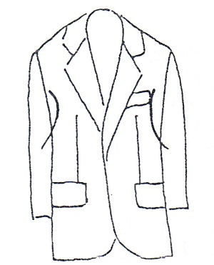
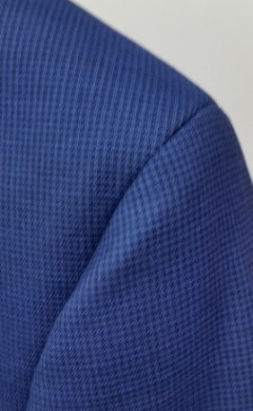
Example: defects on men's jacket
Description of the defect | Mark on the control card | Defect on men's jacket
Unequal ironing of armholes

Slide 32
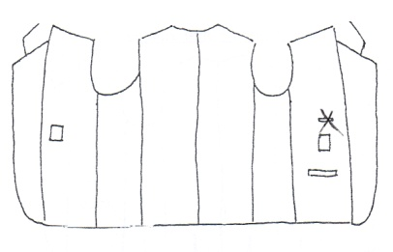
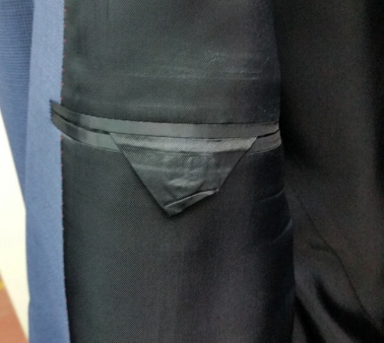
Example: defects on men's jacket
Description of the defect | Mark on the control card | Defect on men's jacket
Irregularly ironed lining

Slide 33
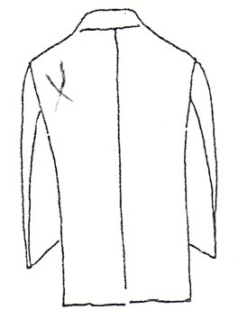
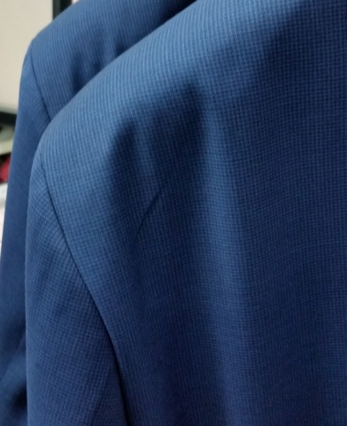
Example: defects on men's jacket
Description of the defect | Mark on the control card | Defect on men's jacket
Ironing defect (fold on the back part of the men's jacket)

Slide 34
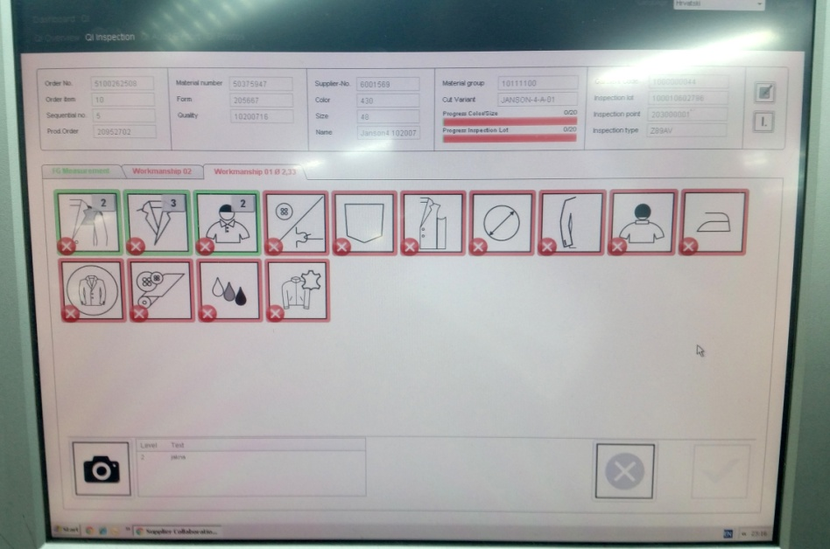
Computer Quality Monitoring
In the most clothing company quality control is monitored by computer programs.
After reading a line code for one men's jacket, a sketch of the model with list of measurements of all segments and tolerances are displayed on a monitor screen.

Slide 35
The following grades are entered at the end of each quality control:
1 - very good, great,
2 - good,
3 - satisfying, minor defects that can be recognized by an expert,
4 - sufficient, the defects have to be eliminated as soon as possible,
5 - wrong, the possibility of complaint and
6 - insufficient, the jacket is not for sale
The average grade is calculated from the individual grades of the jacket segments, and the results of quality control are sent weekly to the quality assurance department.

Slide 36
Interval [cm] | Class
Front part of men's jacket
0 - ± 1.00 cm | I. Class
± 1.1 – 2.0 cm | I. Class (marginally)
± 2.1 – 3.0 cm | II. Class
± > 3.0 cm | II. Class, not for sale
Back part of men's jacket
0 - ± 0.5 cm | I. Class
± 0.6 - ± 1.0 cm | I. Class (marginally)
± 1.1- 2.0 cm | II. Class
± > 2.0 cm | II. Class, not for sale
Sleeves
0 - ± 1.00 cm | I. Class
± 1.1 - ± 2.0 cm | I. Class (marginally)
± 2.1 - ± 3.0 cm | II. Class
± > 3.0 cm | II. Class, not for sale
The grade of fit depends on the visual impression and deviations from the established boundary values, and their intervals are given in Table

Slide 37
CONTACTS
Coordinator of project:
Technical University of Sofia
Department of Textile Engineering
Project Manager of ICT-TEX:
Prof. Dr. Angel Terziev
е-mail: aterziev@tu-sofia.bg
Web-site: ICT-TEX.eu
The information and views set out in this publication are those of the authors and do not necessarily reflect the official opinion of the European Union. Neither the European Union institutions and bodies nor any person acting on their behalf may be held responsible for the use which may be made of the information contained therein.

