Slide 1
Smart and Intelligent Textiles

Slide 2
Smart Textile Material Overview
Benny Malengier

Slide 3
Rational
Materials to obtain for use by students
Allow for a range of projects, leaving freedom
Add extra options as needed
Ideally companies sponsor materials for students to experiment with

Slide 4
What are E-Textiles and wearables
E-textile: An electronic textile (E-textile) is a type of fabric that contains electronic elements. In general, the development of electronic textiles supports the idea of wearable computing, or electronic devices worked into garment designs. (also known as smart textile)
Wearable computing: the mash-up of digital circuitry with clothing
Wearable: Wearable technology consists of things that can be worn, such as clothing or glasses, that contain computer technology or can connect to the internet.

Slide 5
What are smart textiles?
Smart textiles can be described as textiles that are able to sense stimuli from the environment, to react to them and adapt to them by integration of functionalities in the textile structure.
Three subgroups
passive smart textiles can only sense the environment, they are sensors;
active smart textiles can sense the stimuli from the environment and also react to them, they also have an actuator function;
very smart textiles go a step further, having the gift to adapt their behaviour to the circumstances.

Slide 6
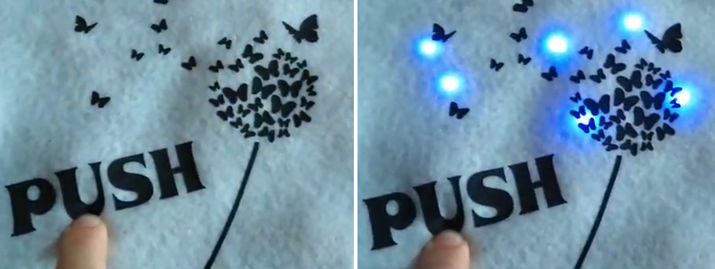
Functions in smart textiles
5 functions can be distinguished in a smart suit, namely:
Sensors: measure the environment
Data processing: use output sensor to determine what to do
Actuators: react to the input
Energy supply
Communication

Slide 7
Smart Textiles: A primer
Why?

Slide 8
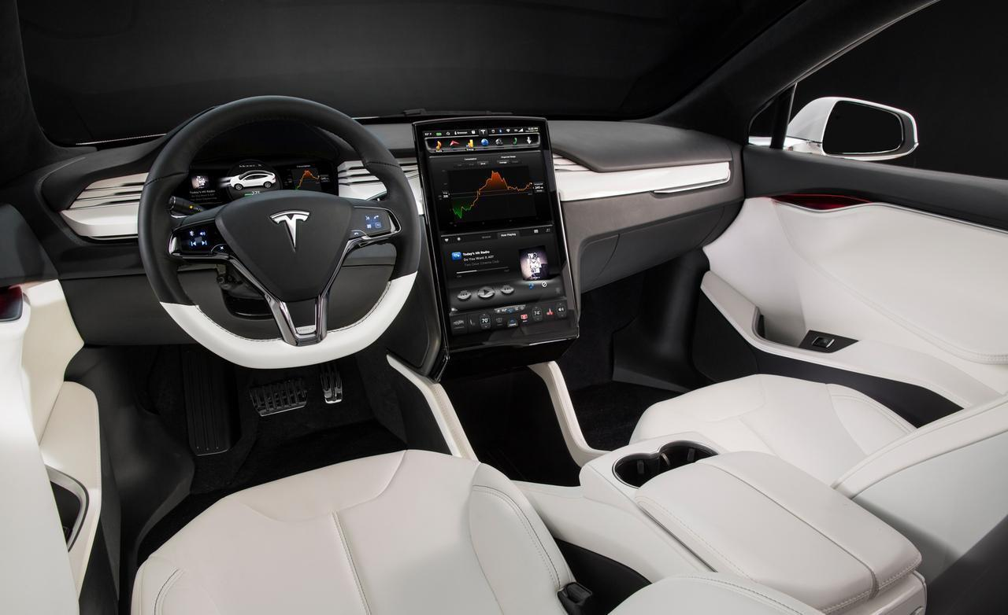
Notes:
Textiles are everywhere. Making them smart, adds smartness everywhere we go!

Slide 9
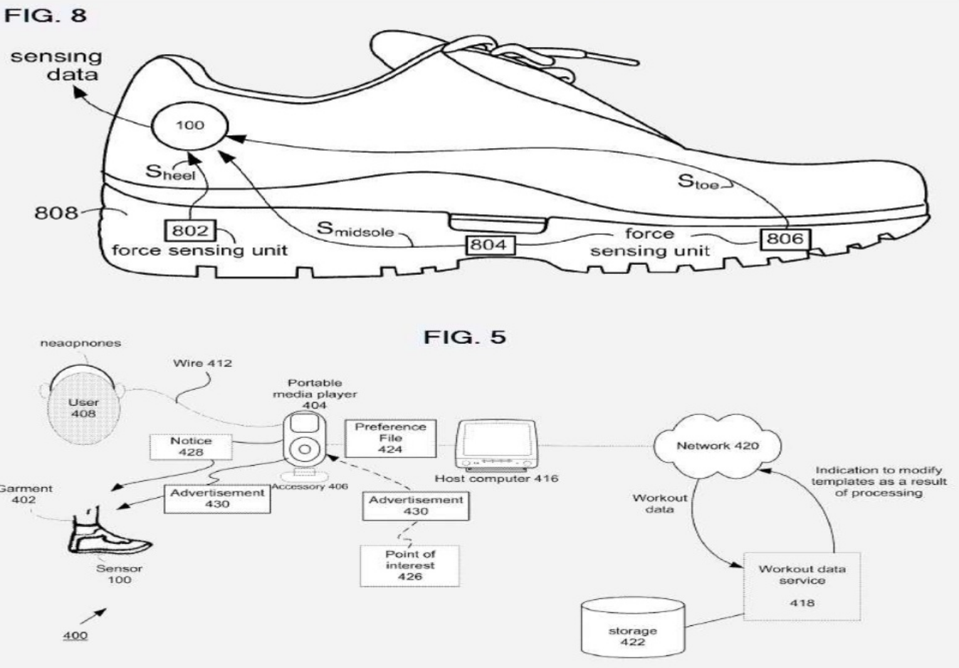
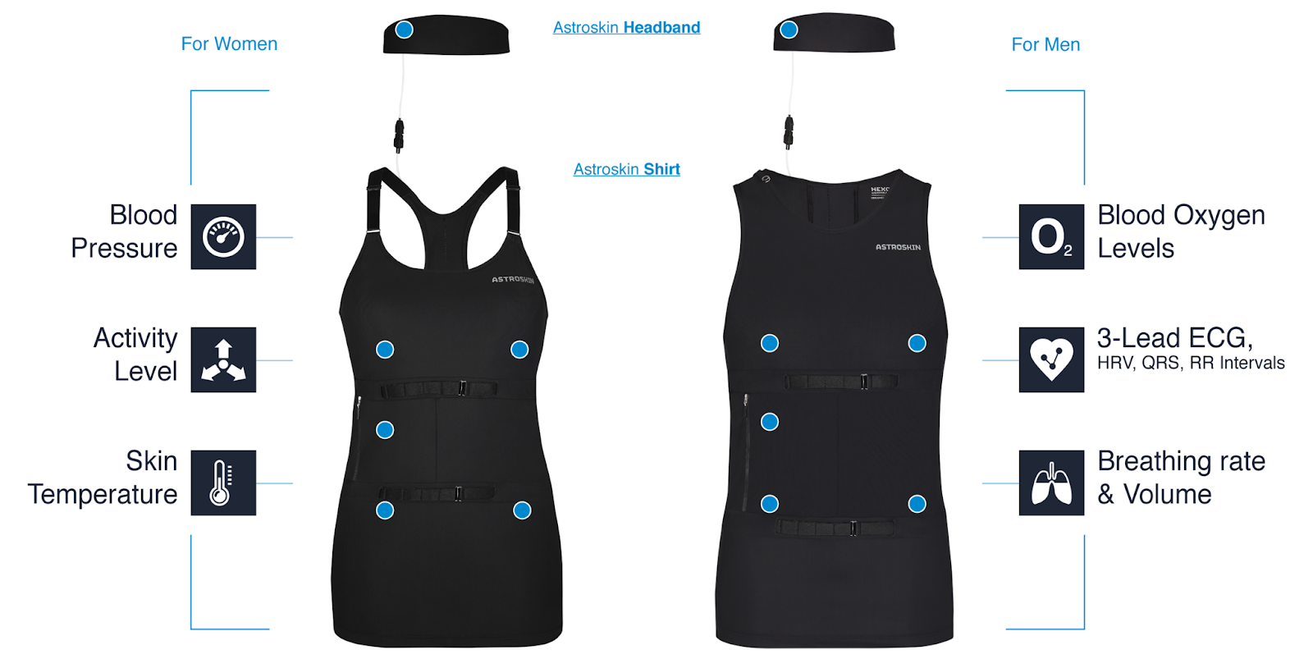
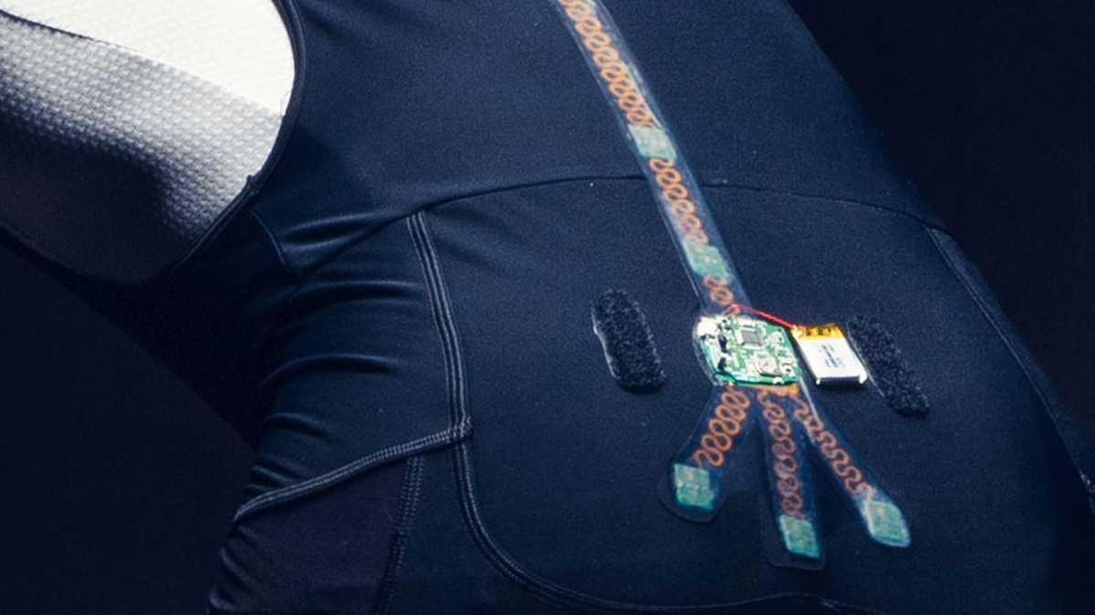
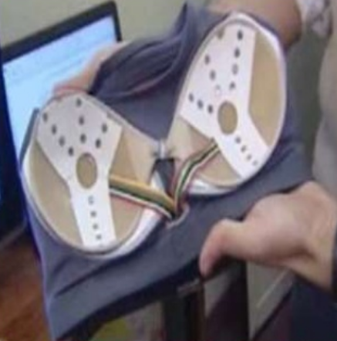
Sport
Non invasive, invisible, measure heart rate, muscle activity, blood oxygen level
Indication of presence when dark
Correct position, or support

Slide 10
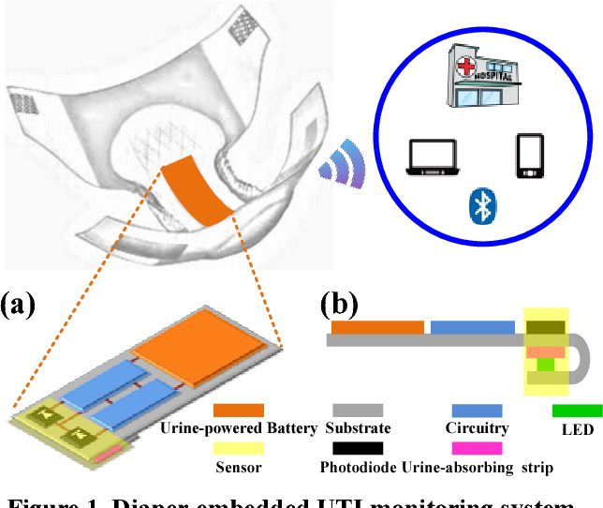
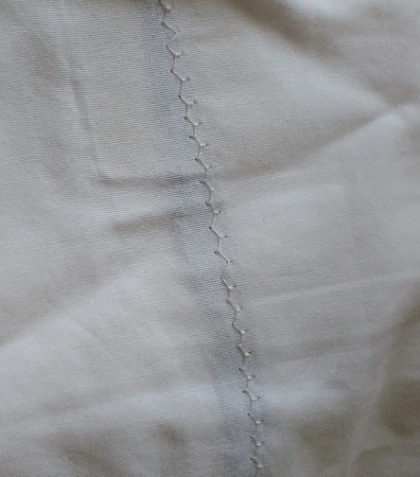
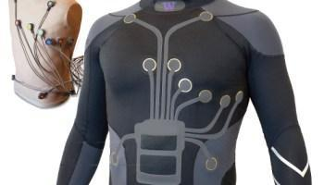
Healthcare
Monitoring: heart, movement, temp, oxygen, incontinence, baby breathing, snoring, ...
Phone aid workers
Continual measurements for doctor
Integration in bedding, pillows, ...
Intel.letto in bed detection,
Team Scheire

Slide 11
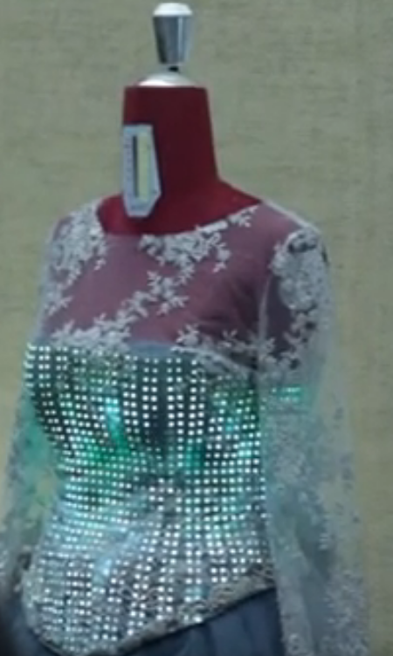
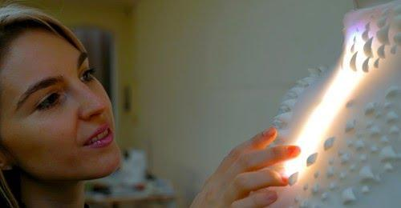
Fashion
https://www.youtube.com/watch?v=lPpnGxgWtyU

Slide 12
Components
How to make interconnections between components
At what moment to place them?
How to wash the system?
How to recycle?
Notes:
Questions we need to ask when making smart textiles

Slide 13
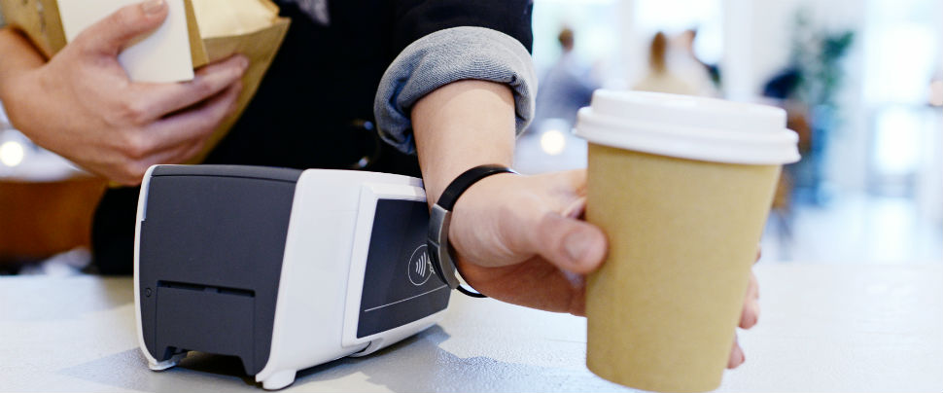
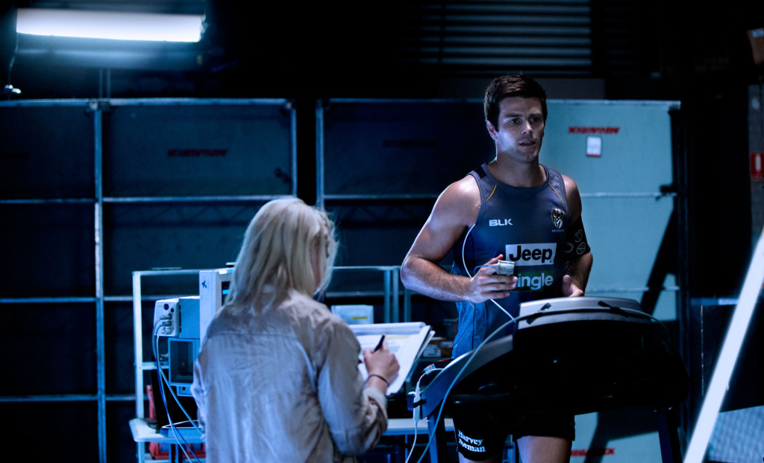
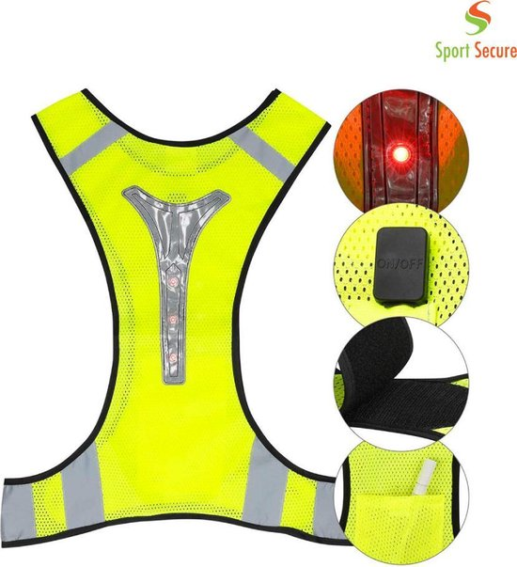
Wearables in daily life
Notes:
Current wearables are now often rigid devices we add to our body

Slide 14
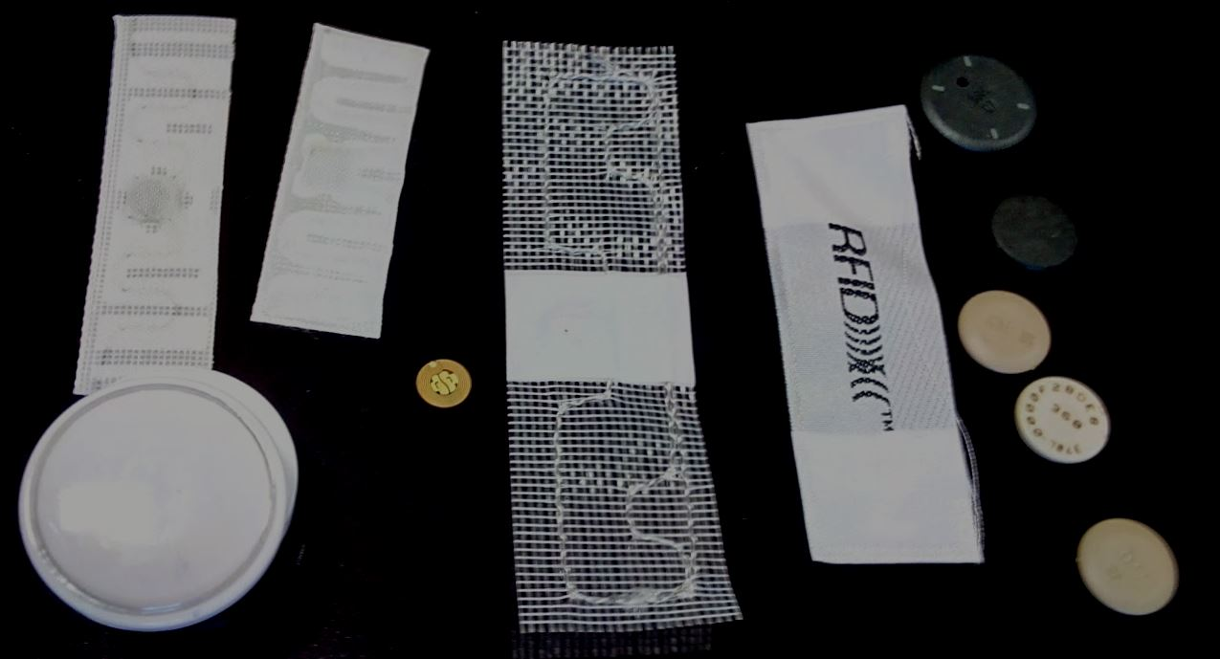
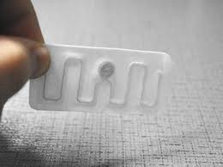
RFID
Another common antenna integrated in textile is the one needed for RFID chips. These chips are added to textile to aid in identification and logistics. For example, in a hotel the towel will contain an RFID chip.
If you buy clothes, they will often have an RFID label you should cut before wearing the clothes.

Slide 15
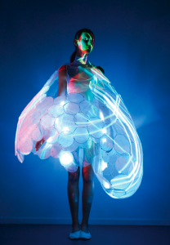
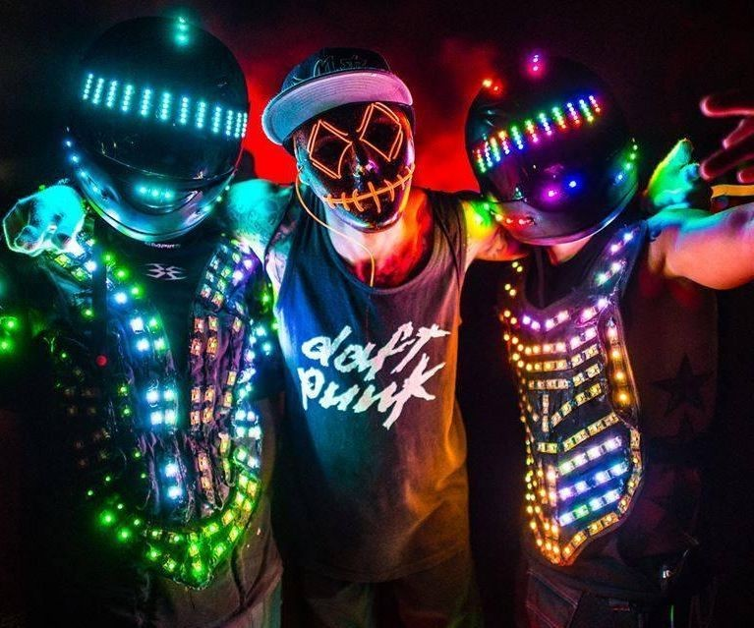
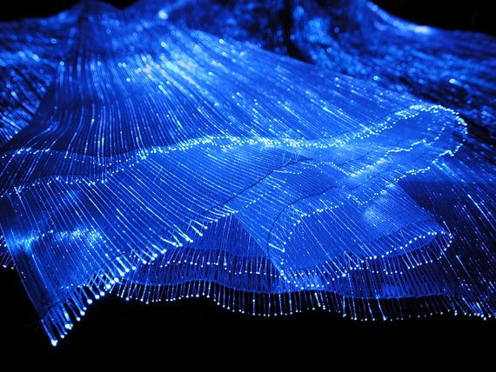
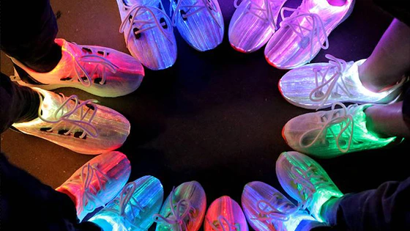
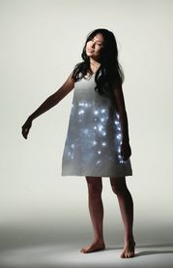
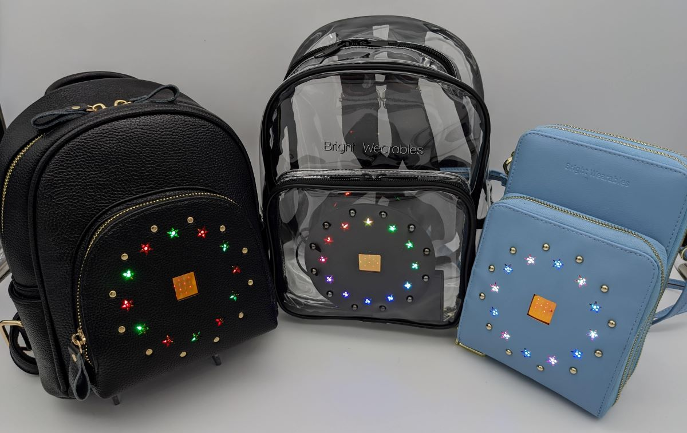
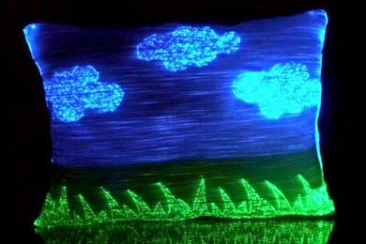
E-Textiles and art
Notes:
In art, e-textiles can lead to a huge transformation!

Slide 16
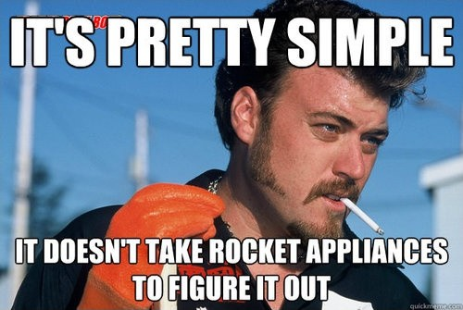

Slide 17
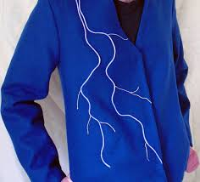
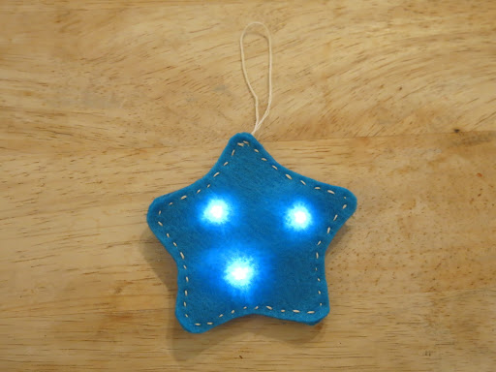
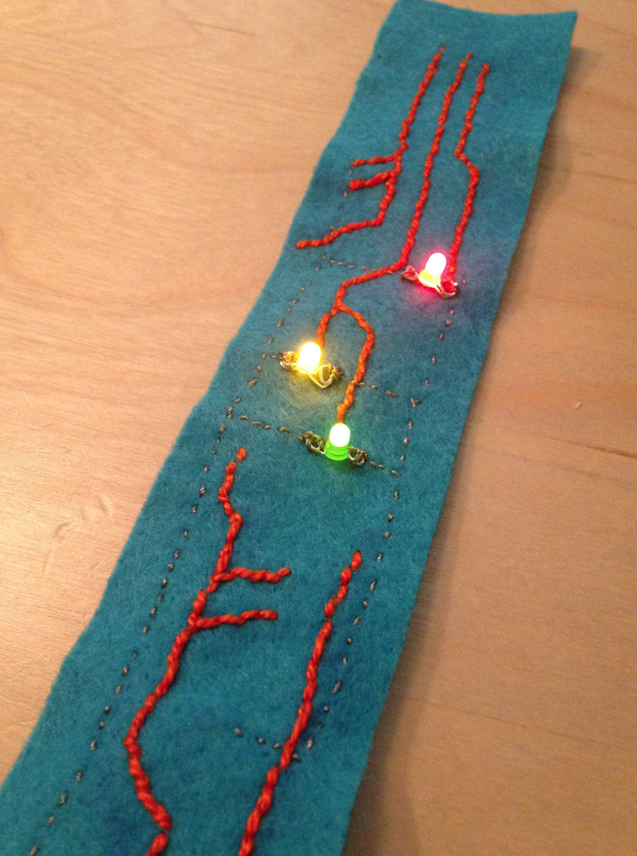
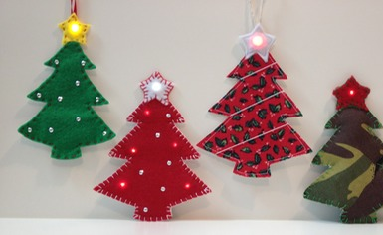
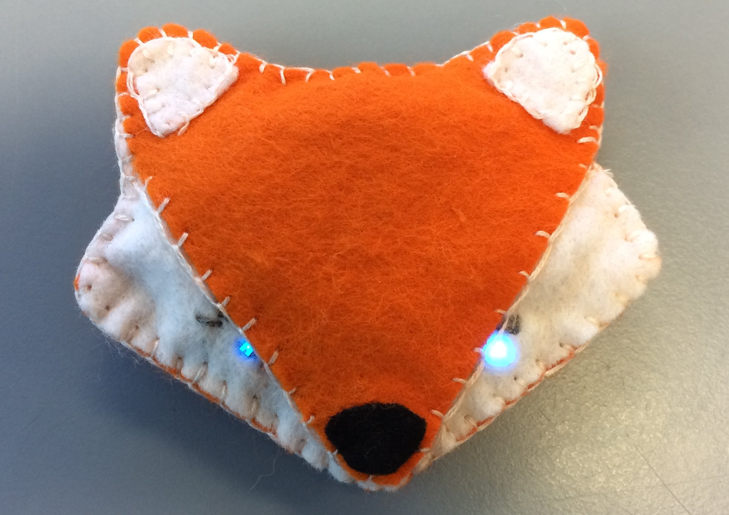
Your first try: It doesn’t have to be complex !

Slide 18
Basic components
Textile-based

Slide 19
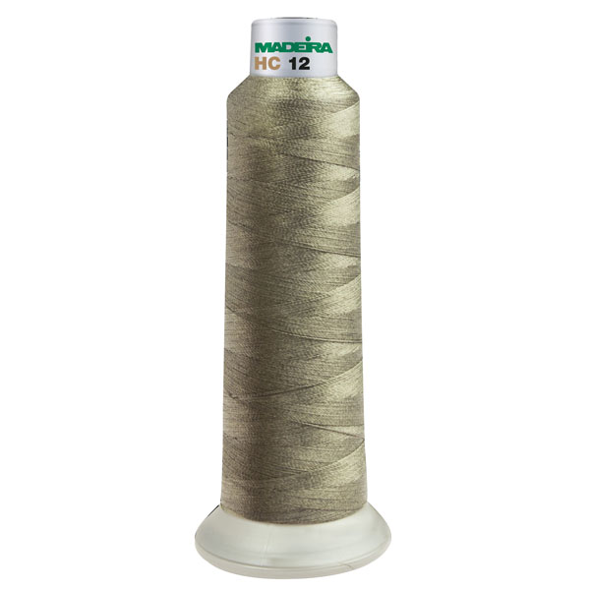
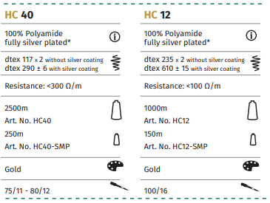
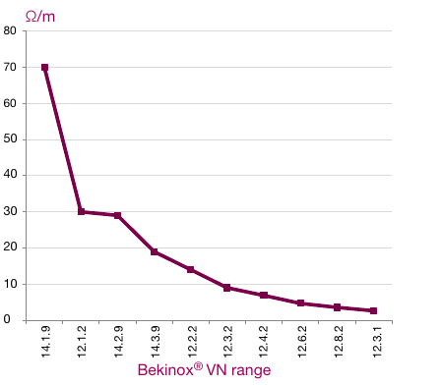
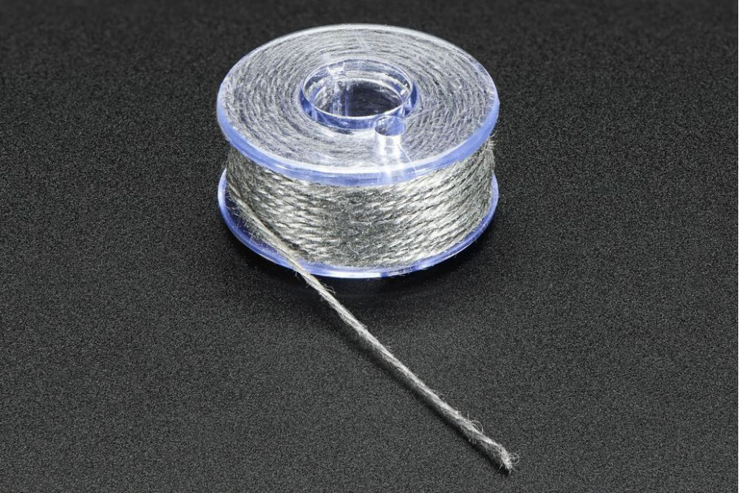
Basic components: conductive wire
Madeira yarn
Bekaert Bekinox VN yarn
Carbon fibre: Hexel IM7-C 12K
Ni coated CF
https://www.youtube.com/watch?v=eawHJ9gpYIM

Slide 20
Madeira HC12
Thicker ⇒ Not suited for filled regions. Easy to have short circuit, paths need to be further apart
Thicker needle needed (100 / 16)

Slide 21
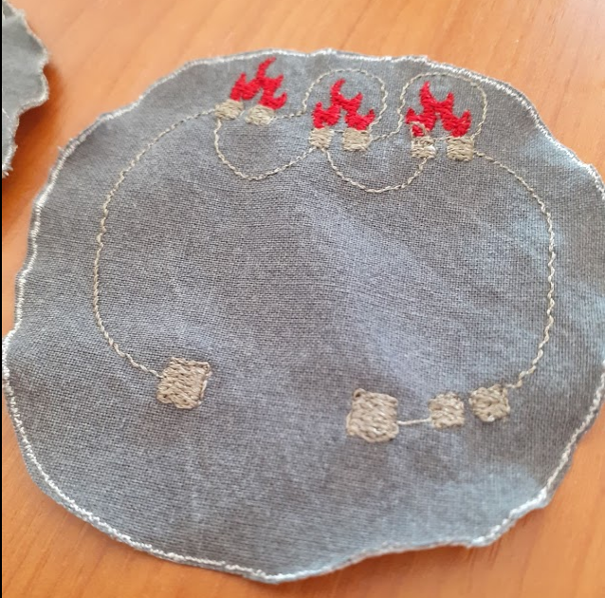
Madeira HC40
Easy in use … but 300 Ohm/m ⇒ 200 Ohm loss in a simple design.
…. to compute how much extra resistance is still needed

Slide 22
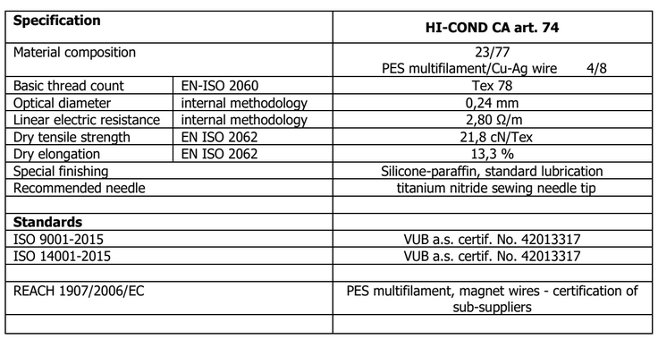
Clevertex Hi-Cond 74

Slide 23
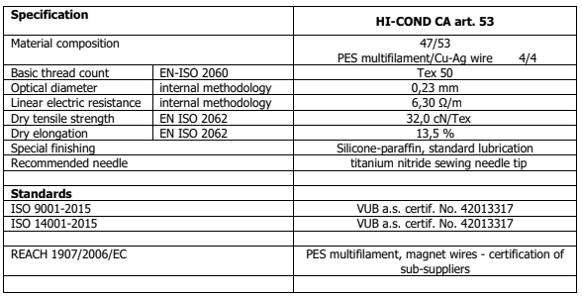
Hand correction: Clevertex Hi-Cond 53
100m bobbins not suited for embroidery ⇒ use for hand sewing

Slide 24
Other Conductive wires
Conductive wire
Stainless steel: Bekinox (VN12.4), no brand,
Carbon fibre: Hexel IM7-C 12K
Silver based : eg Madeira HC40, polyamide silver plated (Madeira 420SMP)
Ni based (eg Ni coated Carbon fiber is good for capacitive touch detection)
Use Multimeter to test the fabric you want to use. How does it work?

Slide 25
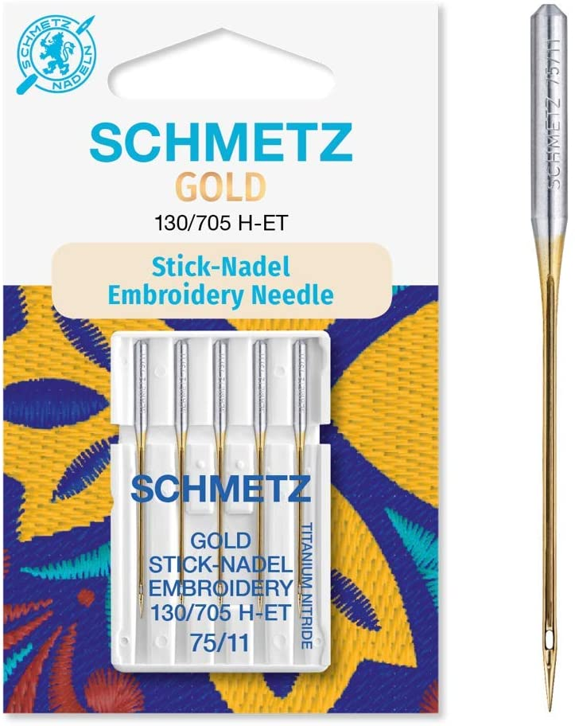
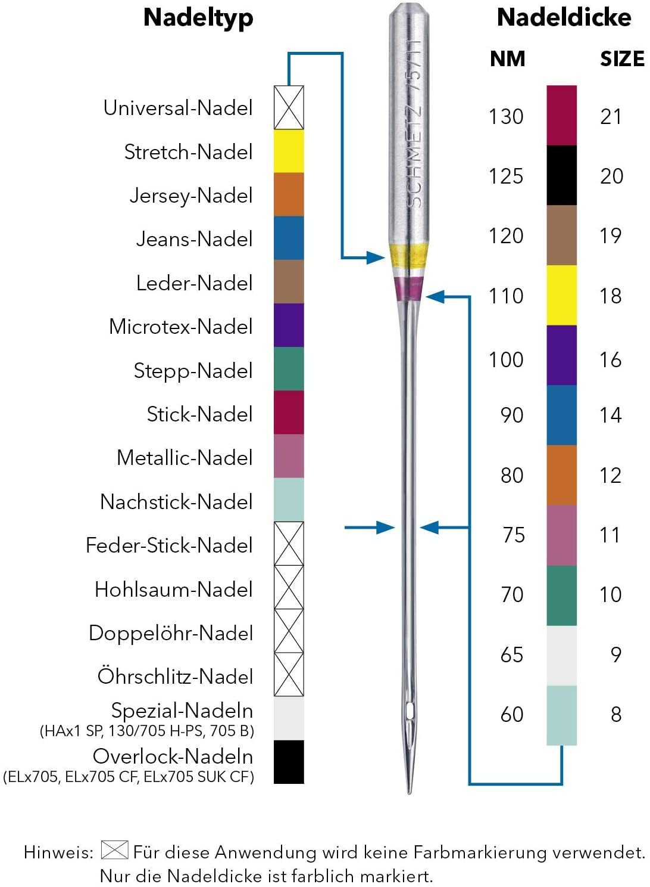
Embroidery/sewing needles ...
Metalic yarn: Titanium-nitride needles !
Other yarn: select correct needle

Slide 26
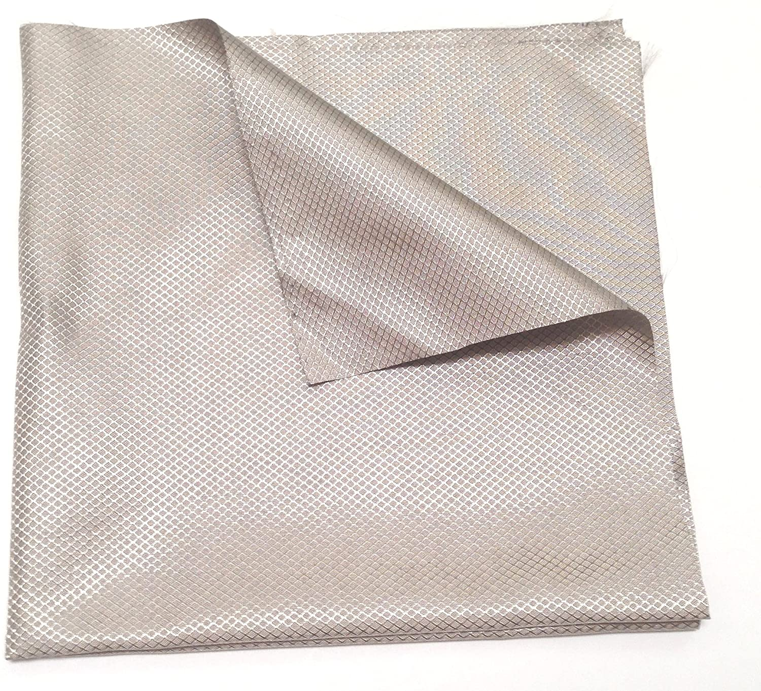
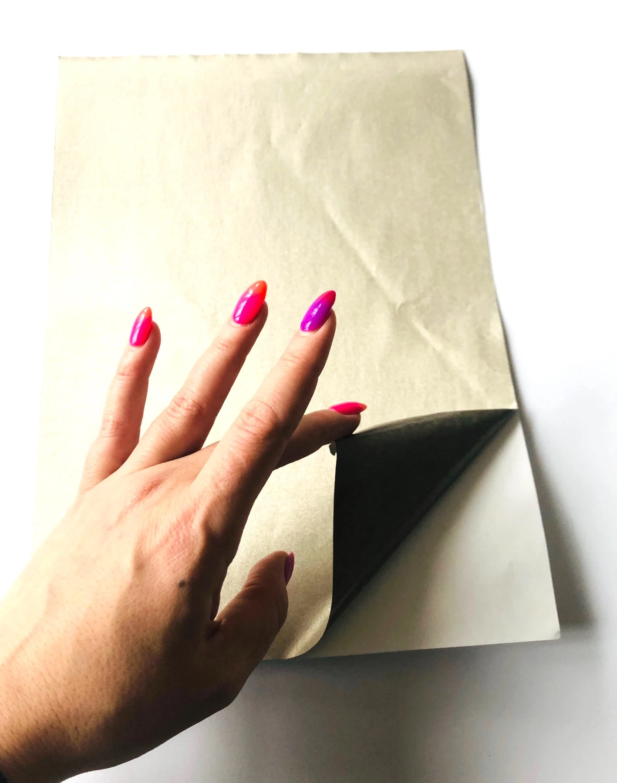
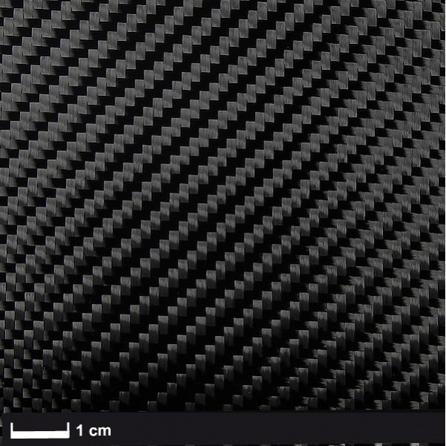
Basic components: Conductive fabrics
Space tape: 6 Eur voor 10x10cm … use little!
You can WASH, SOLDER, CUT, LASER, VINYL/PLOTTER CUT, and SEW !

Slide 27
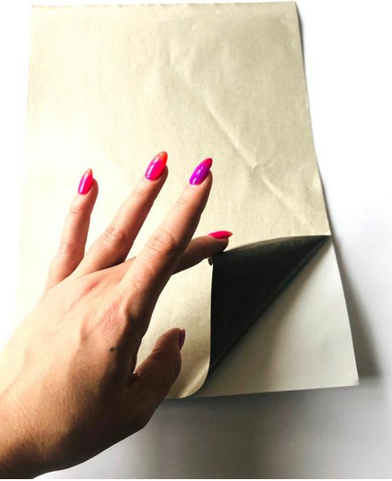
Conductive adhesive fabric
https://missioncontrollab.com/collections/technologist-and-teacher-supply/products/space-fabric : 5€ 10x10cm, Dutch company
Nylon infused with silver, adhesive backing also conductive, woven
You can WASH, SOLDER, CUT, LASER, VINYL/PLOTTER CUT, and SEW !
Silver → discoloration possible after touching with fatty finger
Notes:
kopertape toevoegen

Slide 28
Conductive Velcro
Silver based velcro?
Resistivity: Hook: 1.8 Ohm per sq, Loop: 1.4 Ohm per sq, 0.8 Ohm through mated closure
6€ per 5 cm !!
mission control lab
https://www.adafruit.com/product/1324

Slide 29
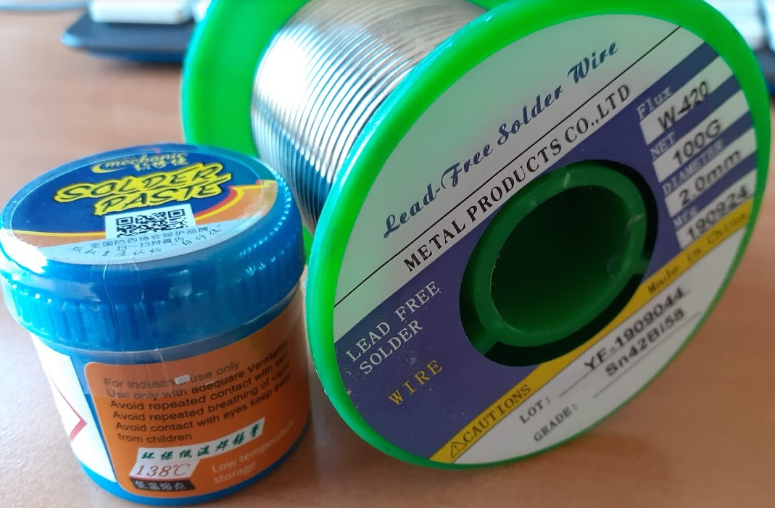
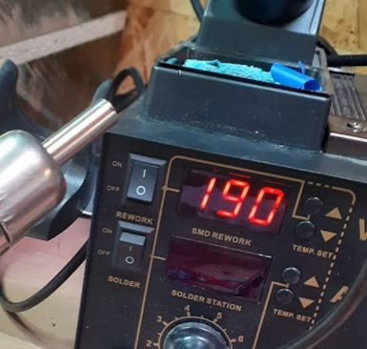
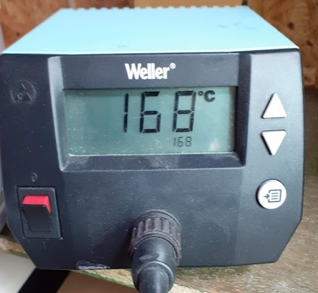
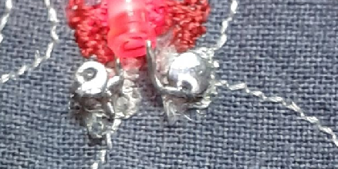
Soldering … avoid damage on fabric !
Provide low Temp Solder eg SN42Bi58 (wire of paste, melt at 138℃)
Use soldering iron or hot air soldering.

Slide 30
Basic components
Textile-integrated

Slide 31
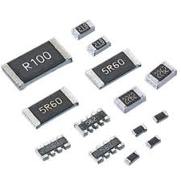
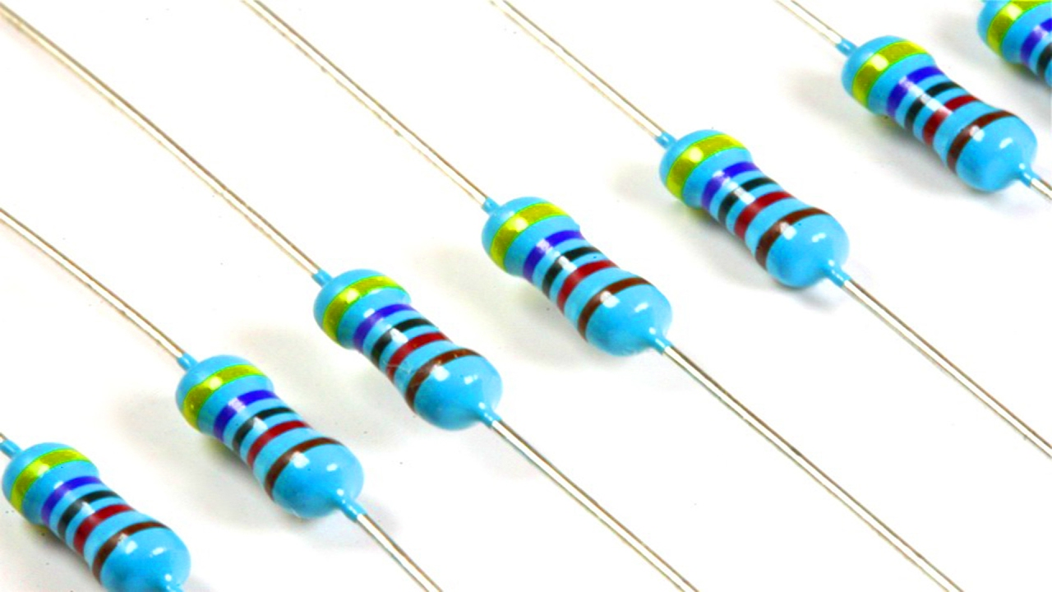
Basic components: resistors

Slide 32
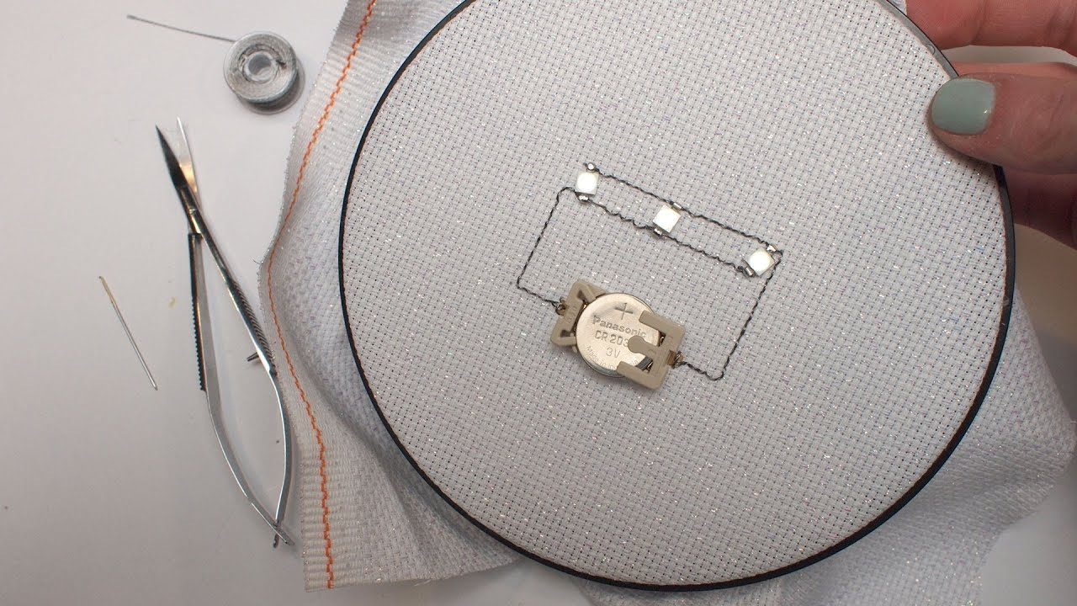
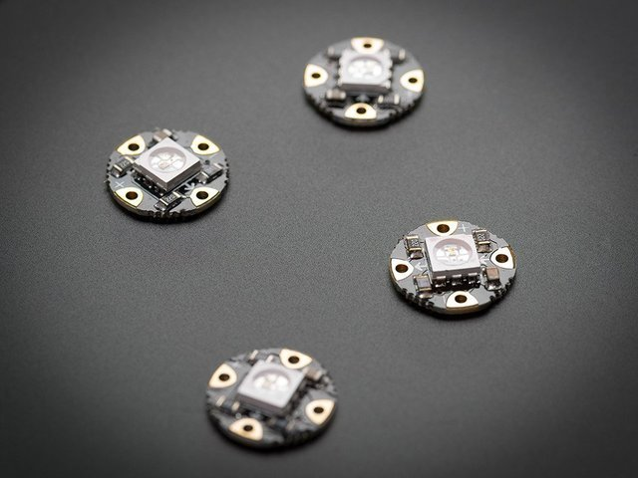
Basic components: LED
Or make it yourself:
For your project NEOPIXEL LED are available

Slide 33
Light: a common actuator in smart textiles
When selecting the light to use to embed in textiles, we need to consider the power use and the light intensity.
Light output is expressed in Lumens, brightness is expressed in mcd and current draw in mA. What are these?
Lumen (lm) is the unit of luminous flux (Фv). This is the perceived power of a light source, so not the total power of the light, but weighted to represent the human eye’s response to the different colors (wavelengths of light)

Slide 34
Basic components: Tilt sensor

Slide 35
Basic components: LDR sensor (light sensor)

Slide 36
Basic components: NTC sensor (temp sensor)

Slide 37
Basic components: Motors

Slide 38
Microcontrollers
Requires Textile-adapted approach

Slide 39
Microcontrollers
Lilypad
Arduino mini

Slide 40
Microcontrollers
Wemos ESP
Arduino (uno)

Slide 41
Programming Concepts
To control your smart textile prototype, we use a microprocessor. This is an electronic circuit containing thousands of transistors, that can do numerical and logical calculations.
For development, we use a prototyping board, e.g. the Arduino UNO (left). For integration in textiles, small boards exist, like for example the WeMos Mini (right),
New board now (2021) used more and more: ESP32!

Slide 42
Battery
Keep it simple: students provide their own powerbank
5V, USB, powers all microcontrollers. Microcontroller powers LED, ...
BUT … danger of short-circuit? Avoid high power battery, and use coincells instead!
BUT … all brand powerbanks have short-circuit protection and are hence “safe” to use by non-electrical engineers.
Has to textile-adapted: special pocket/construction for the powerbank

Slide 43
Sensor: GY-BME280
Barometric Sensor
Pressure
Temperature
RH
Datasheet: https://lastminuteengineers.com/bme280-arduino-tutorial/ In setup() :

Slide 44
Sensor: MAX30102
Blood sensor
pulse-oximetry
heart-rate monitor
Example code: https://create.arduino.cc/projecthub/SurtrTech/measure-heart-rate-and-spo2-with-max30102-c2b4d8

Slide 45
Sensor HC-SR04
Distance sensor
Echo location
up to +/- 4m, limited to the speed of sound (343 m/s)

Slide 46
Sensor: vl53l0 X v2
Distance sensor
Small, enclosed lidar system
Time of flight sensor
Works at speed of light!
Shorter distance normally

Slide 47
Sensor MPU-6050
Movement sensor
3-axis gyroscope
3-axis accelerometer
Code: #include <TinyMPU6050.h> //adapted version from https://github.com/ingegno/TinyMPU6050
// Constructing MPU-6050
MPU6050 mpu (Wire);
// in setup() :
mpu.initialize(sdaPin, sclPin);

Slide 48
Sensor MPR121
Capacitive Touch Sensor
12 touch inputs
No contact needed
Code: use mpr121.h
See: https://github.com/bmcage/skills4smartex/tree/master/level03/capacitiveTouch/testcode/MPR121_captouch_neopix_testreadlevels

Slide 49
What will you make ?

Slide 50
Fashion

Slide 51
E-Textiles and art

Slide 53
Good Luck!

Slide 54
Some entry level examples

Slide 55
The basics: electronic circuit
Select a fabric substrate and make this!
Use Conductive wire
Add LED
Add correct Resistor!
Arduino: red wire to pin 13, black wire to GND
Write the code to make the LED blink
Add more LED’s

Slide 56
Textile Switches
Metallic snap buttons integrated in the textile can be used
Hook-and-loop fasteners (eg. velcro) with a silver infused or coated polyester (PES) to make it conductive

Slide 57
Switches

Slide 58
Pushbutton using a sandwich structure with hole
Thicker textiles are always compressible. Create sandwich structure, with a conductive yarn or fabric at the top and bottom, and non-conductive middle layer with a hole.
By pressing on the material, the two conductive parts can touch each other through the hole, closing the circuit

Slide 59
Switches

Slide 60
Textile Pressure Sensor
Mix cotton with metallic fiber! As you push in the fabric, there is more contact between different low conductive fibers.
Using Ohm’s law, I= V/R, for parallel circuit under constant voltage V, we calculate that if there are two contacts instead of 1, we have double the current!
1/R_{total} =1/R+1/R = 2/R, so I_{new}= V/R_{total} = 2 V / R
This can be verified by measurements.
Textile is elastic, so, without pressure, it goes back to the original form.

Slide 61
Other Sensors
Stretch sensor can be based on the same principle of changing the number of contact points.
For a tilt sensor, one might create
different contact zones

Slide 62
Power
Battery
USB charger
LiPo battery via battery-shield

Slide 63
Microcontroller: Add a brain

Slide 64
Microcontroller: Wemos D1 Mini
Wifi via ESP8266 Chip
⇒ ideal for IOT

Slide 65
AZ Delivery Wemos

Slide 66
The Skills4Smartex Prototypes

Slide 67
Construction Guide
Guide: https://github.com/bmcage/skills4smartex
Level 01 A:

Slide 68
Level 01 B:

Slide 69
Level 02 A:

Slide 70
Level 02 B:

Slide 71
Level 03 A:

Slide 72
Level 03 B:

Slide 73
CONTACTS
Coordinator:
Technical University of Sofia
Department of Textile Engineering
Project Manager of ICT-TEX:
Prof. Angel Terziev
е-mail: aterziev@tu-sofia.bg
Web-site: ICT-TEX.eu
The information and views set out in this publication are those of the authors and do not necessarily reflect the official opinion of the European Union. Neither the European Union institutions and bodies nor any person acting on their behalf may be held responsible for the use which may be made of the information contained therein.

