Slide 1
Smart and Intelligent Textiles: Software

Slide 2
Smart and Intelligent Textiles- SOFTWARE
Following software will be used.
Inkscape
Ink/Stitch
Arduino
Google Chrome for online tools (python, arduino, DOE)

Slide 3
InkScape
Vector Drawing Program
Open Source (GPL)
Install from the website: https://inkscape.org/
2D-Drawing
Notes:
Inkscape
Adobe illustrator
CorelDraw
Macromedia Freehand
Affinity Designer
Microsoft Visio
Xara Extreme
Xfig

Slide 4
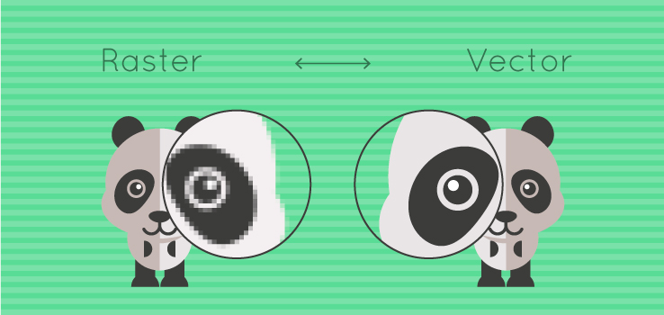
InkScape
Creates Vector Drawings

Slide 5
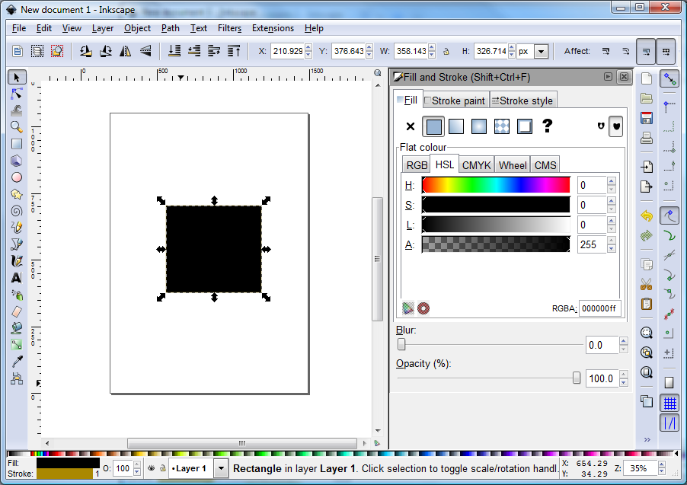
InkScape Interface
New page
Select Object selecteren, move, deform/scale
Change Lines
Standard figures
Drawing lines (free hand)
Straight & Bend Lines (smooth)
Text & Fonts

Slide 6
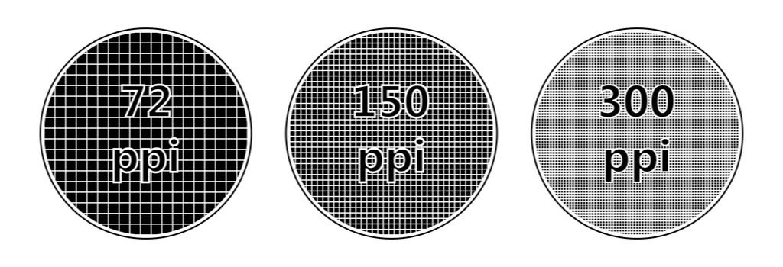
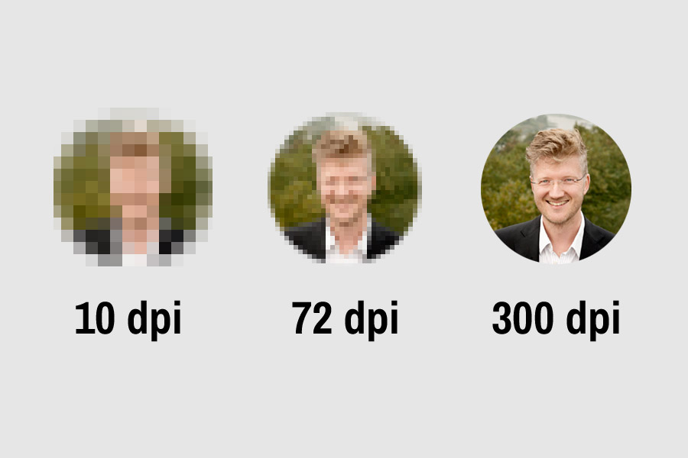
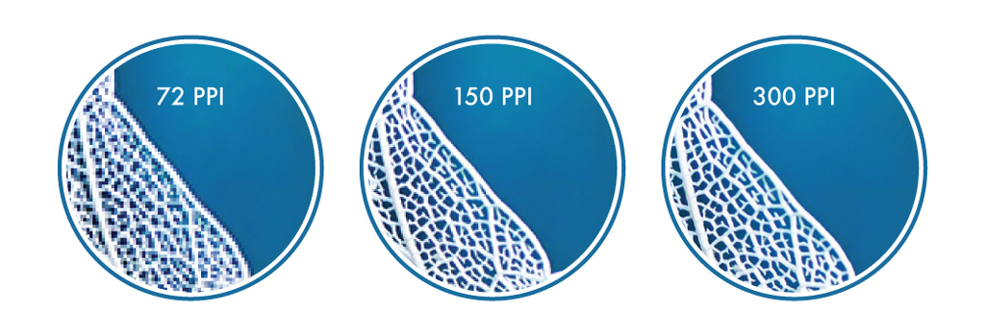
Inkscape: used for ...
Images/icons … export in the dpi you want

Slide 7
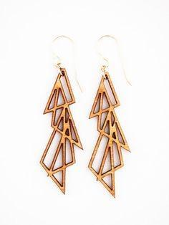
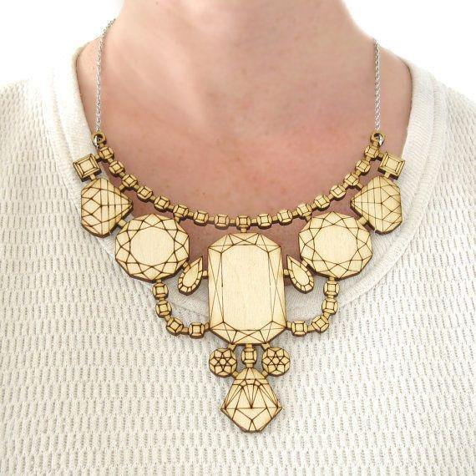
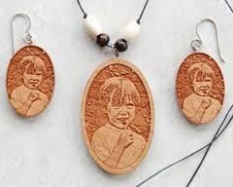
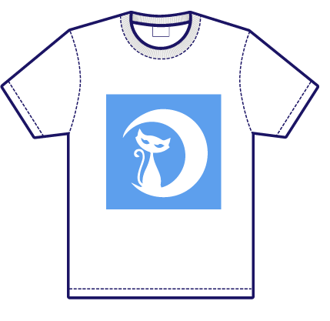
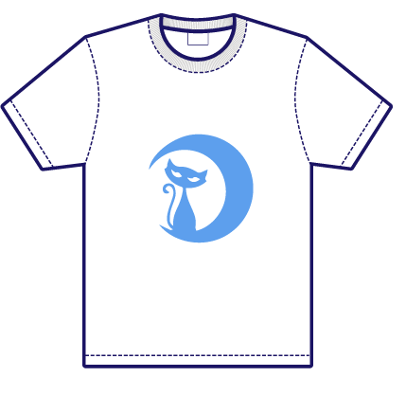
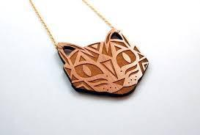
Inkscape: used for ...
fast
faster
slow
CNC tools
lasercutter
vinyl cutter
...
cut
engrave
raster

Slide 8
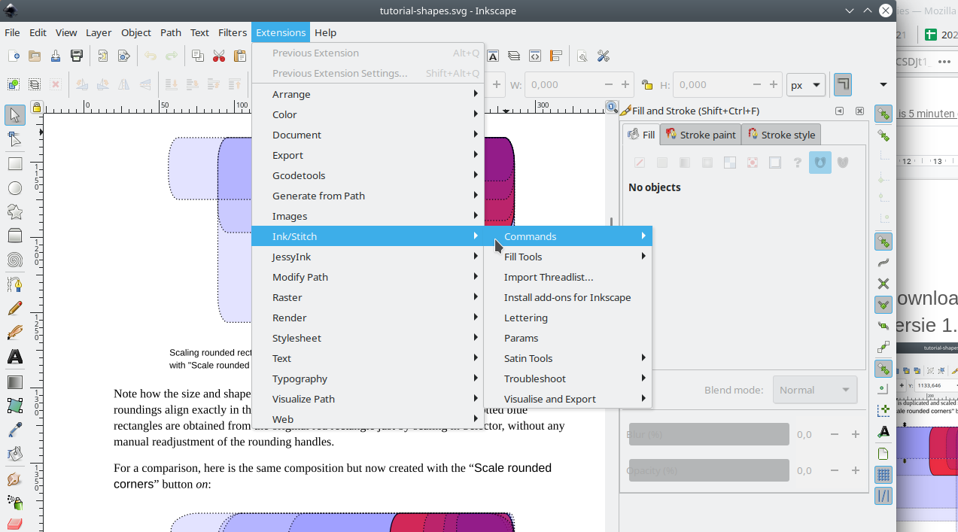
Ink/Stitch
Add on for Inkscape
Used for digital embroidery
Inkscape 1.x+ MUST be installed
Installeer with the manual after selecting your computer system https://inkstitch.org/docs/install/
Restart Inkscape and test if all was installed
See option in Extensions:

Slide 9
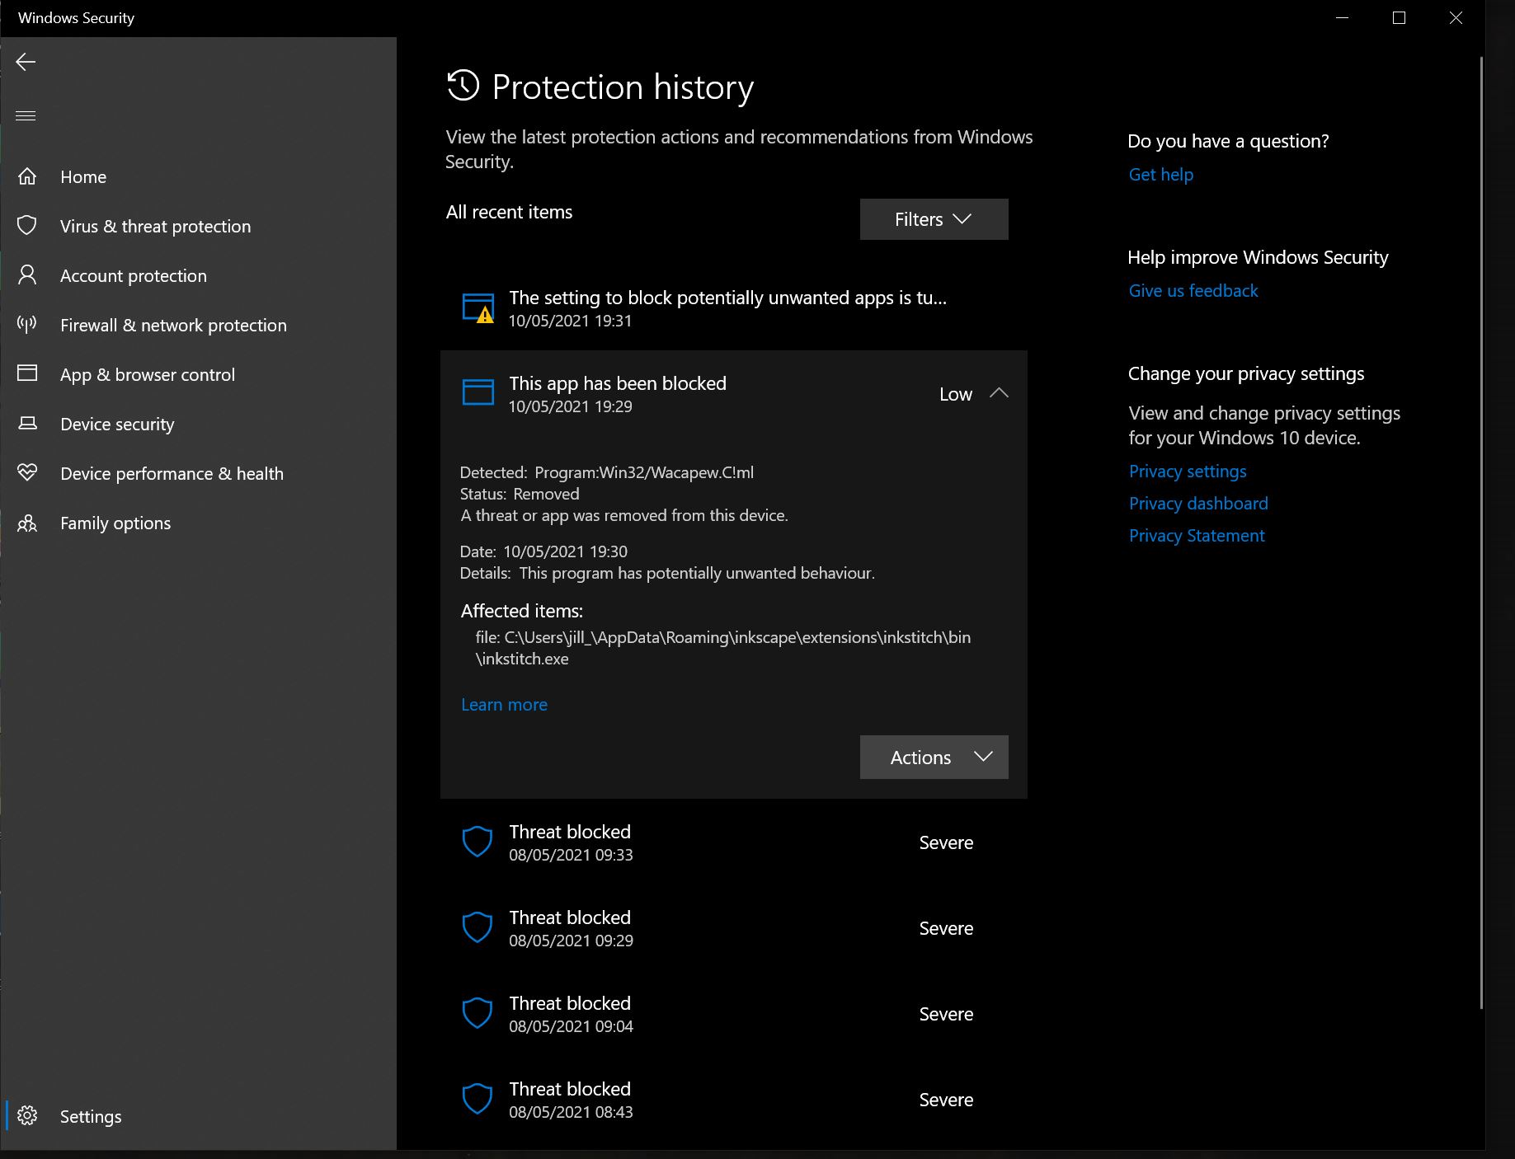
Ink/Stitch installation problems
Problem recent Mac: https://codewithhugo.com/catalina-permission-command-line-fix/ so do: xattr -d com.apple.quarantine /Applications/<app-name>.app
xattr -r -d com.apple.quarantine ~/Library/Application\ Support/org.inkscape.Inkscape/config/inkscape/extensions/
Problem Windows antivirus: ink/stitch uses same packaging methods as some malware, creating false positive hits as malware. See https://github.com/inkstitch/inkstitch/issues/710 or https://github.com/pyinstaller/pyinstaller/issues/4633
You must take inkstitch.exe then out of quarantaine so it would work (via Protection History). Then restart inkscape, if needed, copy inkstitch.exe to the correctlocation

Slide 10
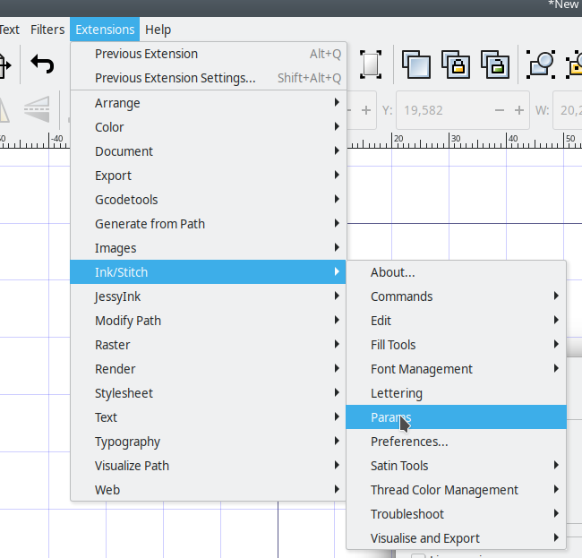
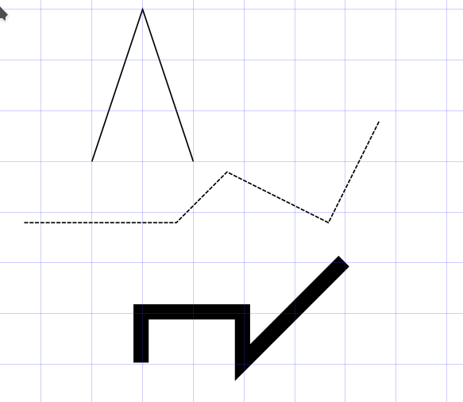
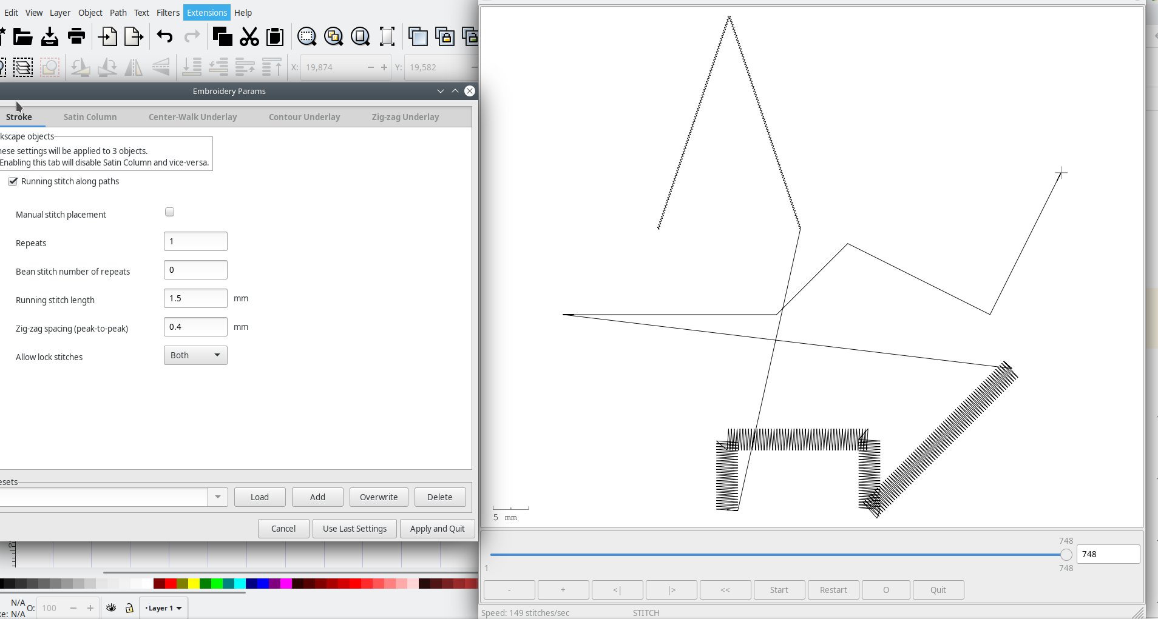
Ink/Stitch workflow
Generate Embroidery parameters
Draw
Verify the results - Improve

Slide 11
Arduino
For intelligent textile projects, microcontrollers must be programmed
Do this through the Arduino IDE
Download from the site https://www.arduino.cc/en/software
Current version 1.8.15
Install via the option Windows Win 7 and newer , not via Win App.

Slide 12
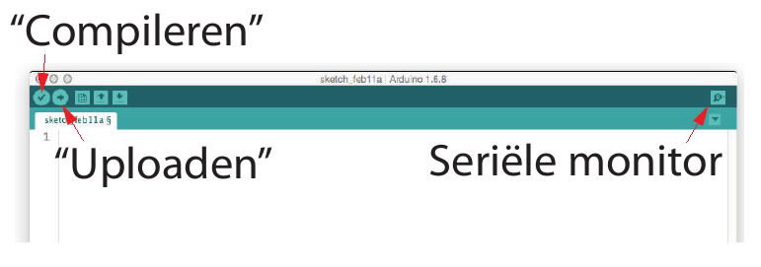
Arduino IDE
Integrated Development Environment
Texteditor
Compiler/Debugger
Linker/Locater
Bootloader
Serial monitor

Slide 13
Google Chrome
Modern browser, allows for:
python programming through https://colab.research.google.com/
Basic electronics through 3dcircuits on https://www.tinkercad.com/
Visual Arduino programming

Slide 14
Ink/Stitch: Smart Textile construction
Benny Malengier
Images from UWB, Czech Republic (OptimTex project cases)

Slide 15
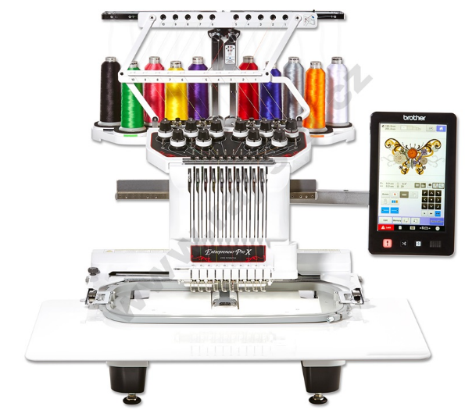
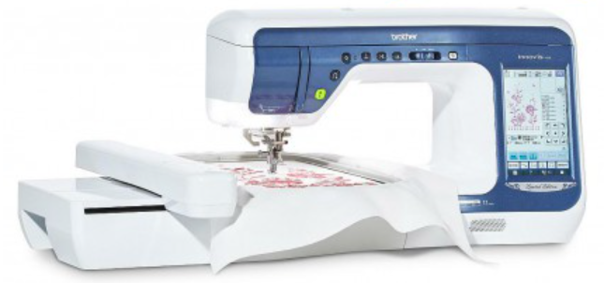
Ink/Stitch
Design patterns for use on embroidery machines

Slide 16
Embroidery Stitch File Format | Embroidery Machine Brand
.ART | Bernina
.PES / .PEC | Brother / Baby Lock / Deco
.DST | Tajima / Barudan
.EXP | Melco / Bravo
.SEW / .JEF | Janome
.VP3 / .HUS / .VIP | Husqvarna /Viking
A list of machine embroidery file formats and machine brands

Slide 17
Connections and pads with Ink/Stitch

Slide 18
Embroider pads for electronic components
A possible design (in mm) is the following:
We require a way to embroider these pads. Step 1 is drawing them in the correct size with Inkscape

Slide 19
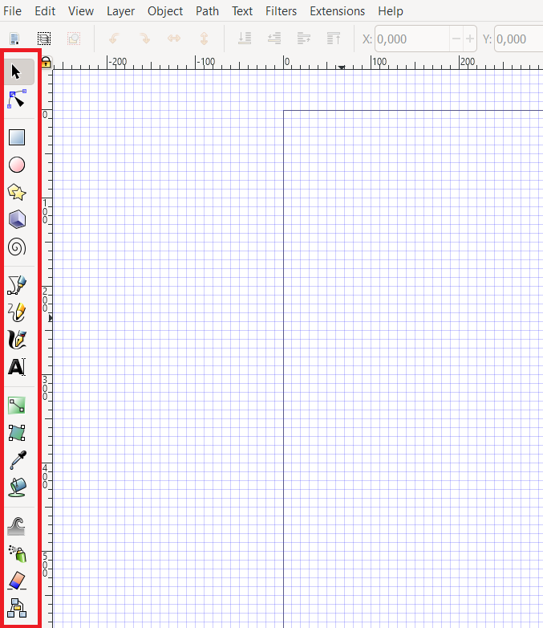
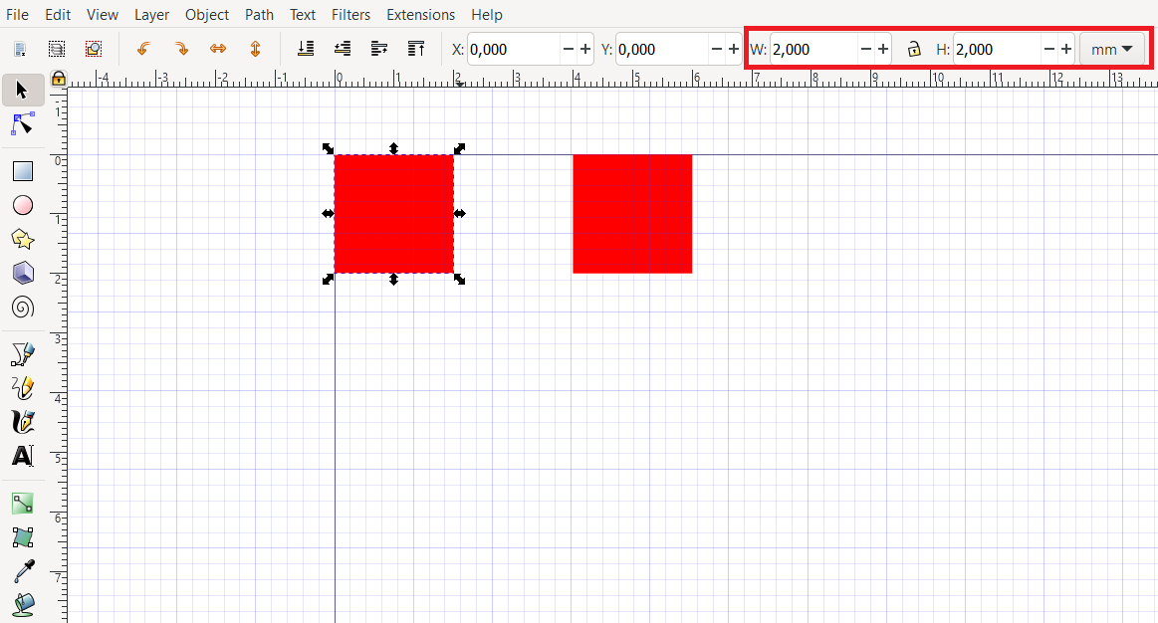
Open Inkscape, and draw the rectangles, give then correct size

Slide 20
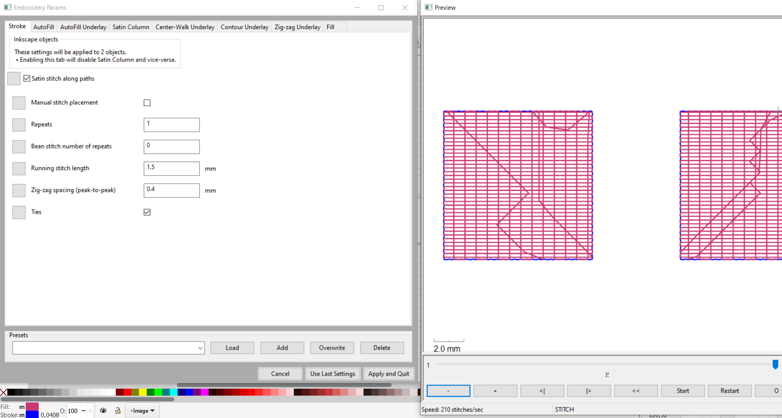
With Ink/Stitch generate the embroidery pattern: Extension Ink/Stitch→ Params
Visualize, and embroider: Extensions → Ink / Stitch → Visualize and Export → Embroider…

Slide 21
Assignment
A good assignment is to have students create the optimal pad for a component you give them.
Eg, for an SMD LED 1206 (mm dimension) it could be:

Slide 22
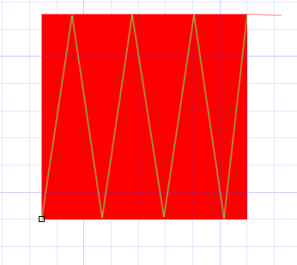
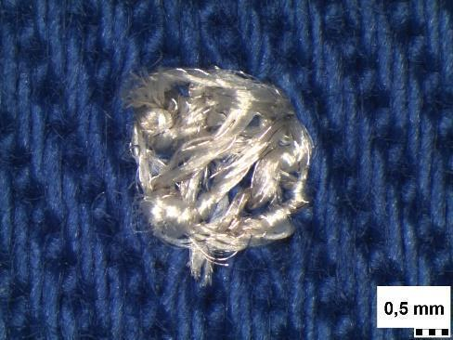
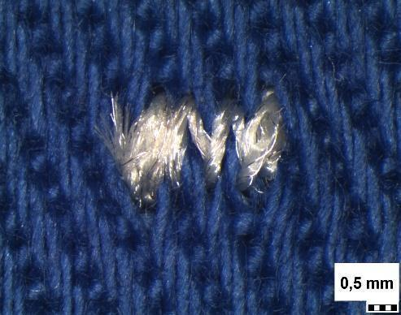
Always use rectangular patch ?
If the accuracy of the gap is very important, then use manual hatching!
Remove the rectangle before embroidery

Slide 23
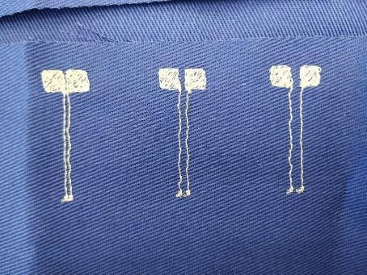
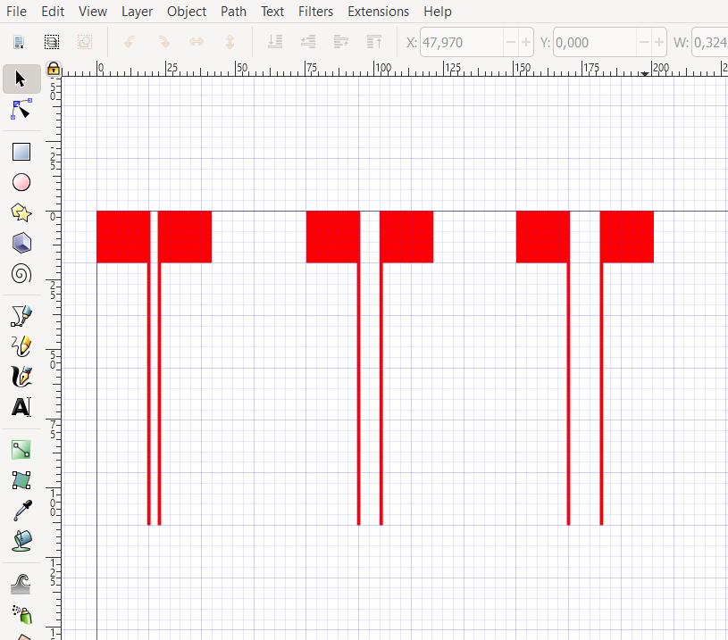
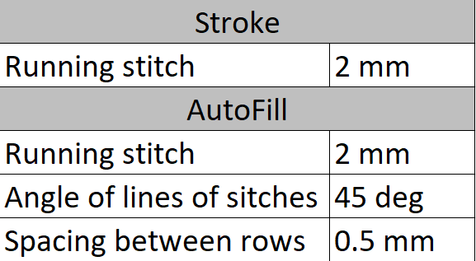
Testing a good distance
Have students test with best distance, by embroidering different ones and see what works.

Slide 24
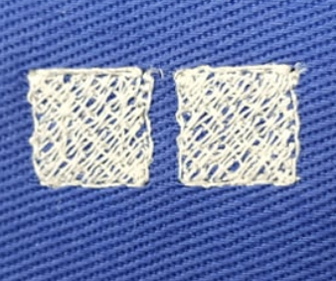
Snap buttons
Consider larger pads for eg snap buttons or magnets.
Example: 10x10mm

Slide 25
Arduino - Programming for Smart Textiles - Hands On
Benny Malengier

Slide 26
What is Arduino ?
Arduino is an open source computer platform, meant to make the use of a microcontroller easy.
Arduino is for students, hobbyists, artists, and everybody interested in the making of “smart” and “creative” objects.

Slide 27
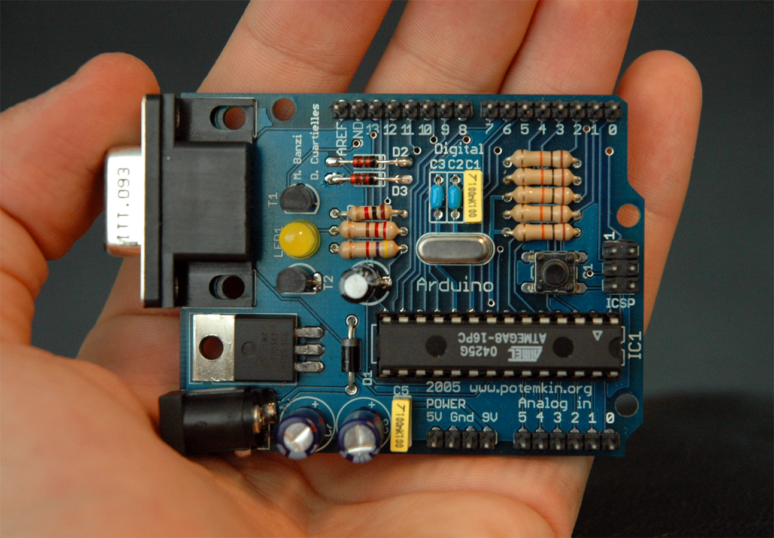
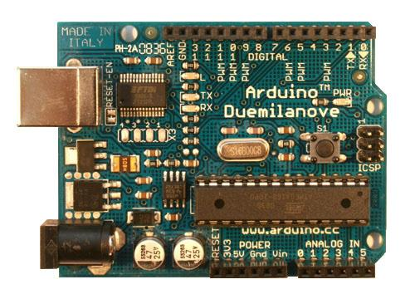
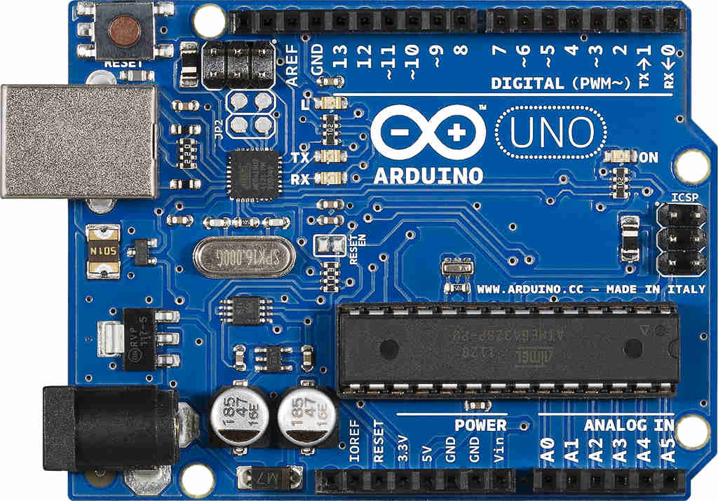
2005: the first!
2009: USB !
2017: Arduino UNO (Rev. 03)

Slide 28
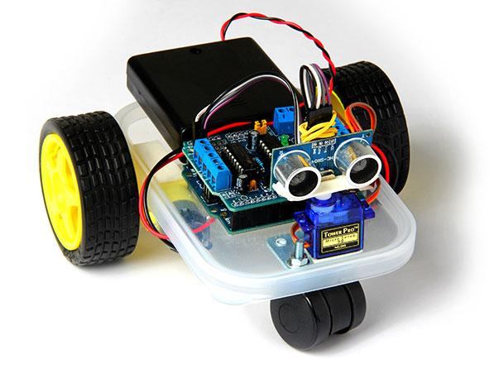
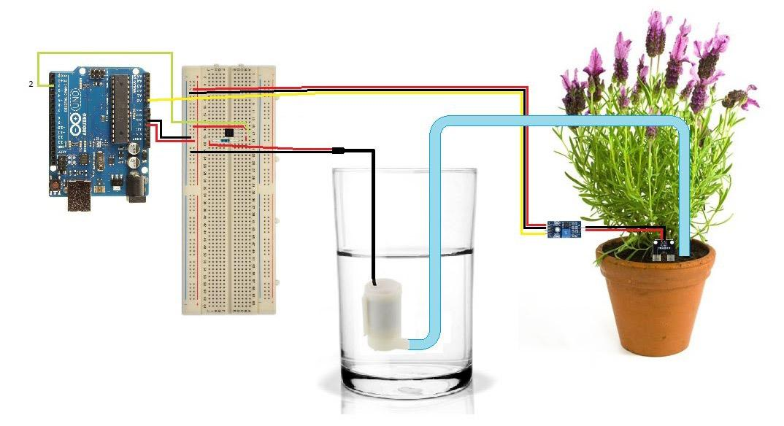
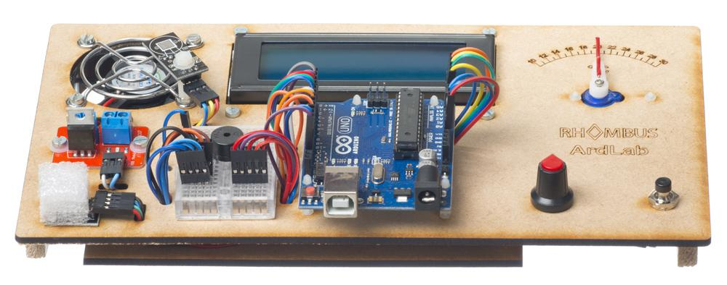
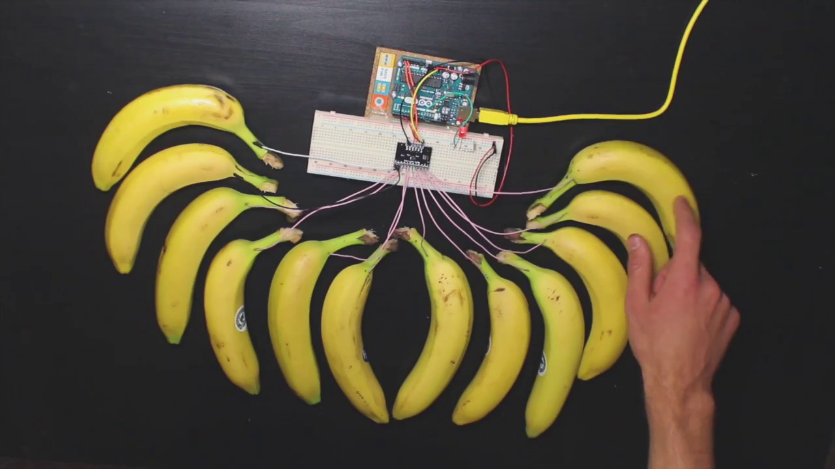
What can you do with Arduino?
Measurement/input → Think (software) → Output: sound, light, action, display, ...

Slide 29
What is inside an Arduino UNO ?

Slide 30
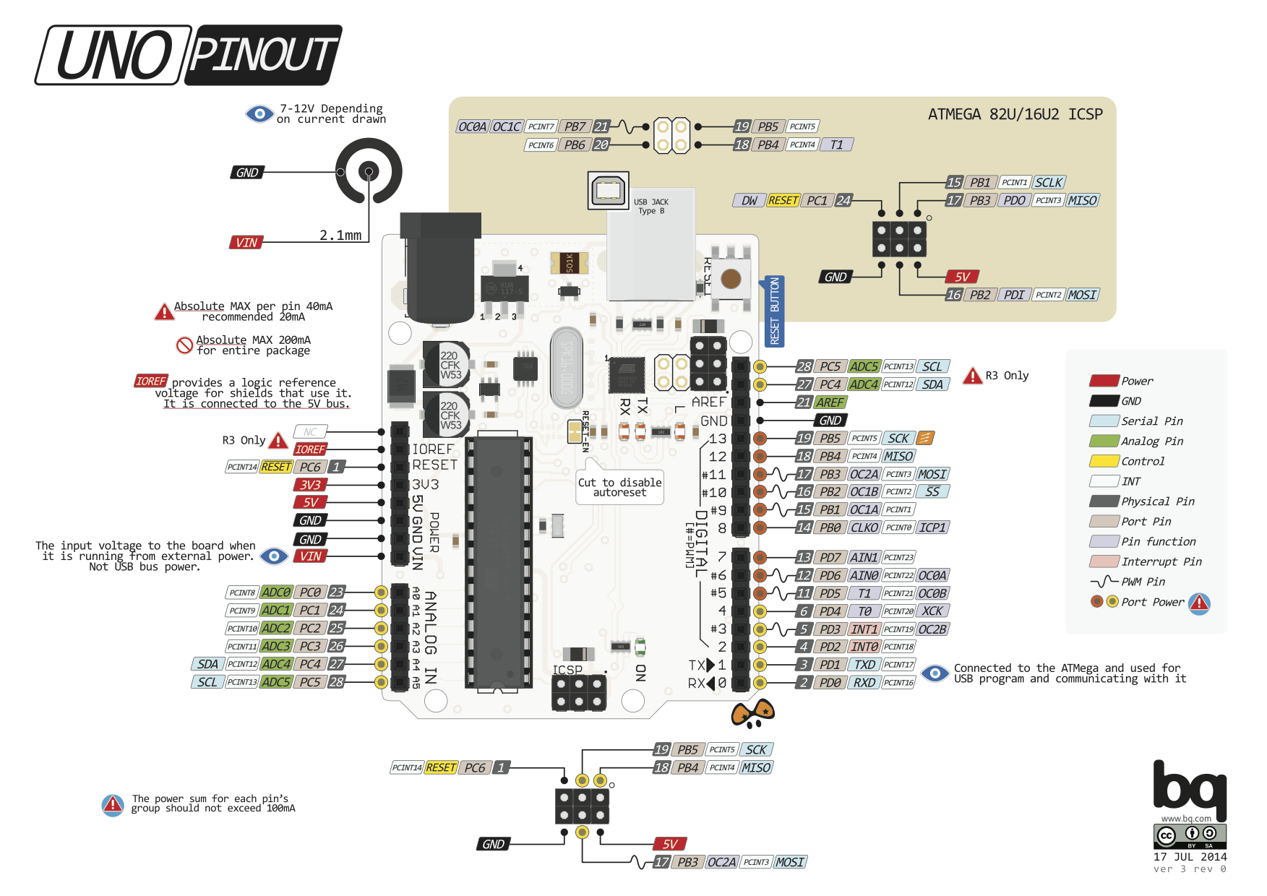

Slide 31
Arduino IDE
Integrated Development Environment
Texteditor
Compiler/Debugger
Linker/Locater
Bootloader
Serial monitor
Download from: https://www.arduino.cc/en/Main/Software
Free software (Linux, OSX, Windows) - Current version 1.8.15

Slide 32
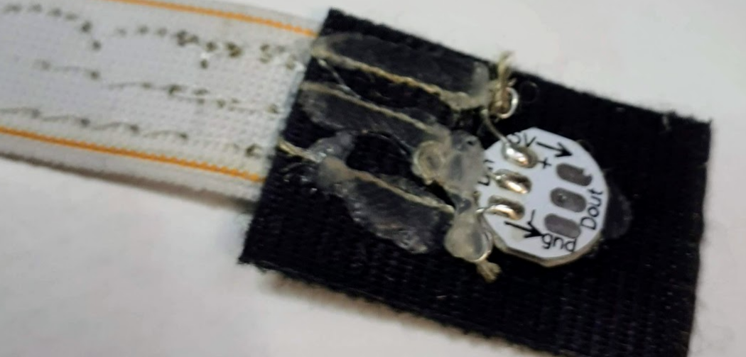
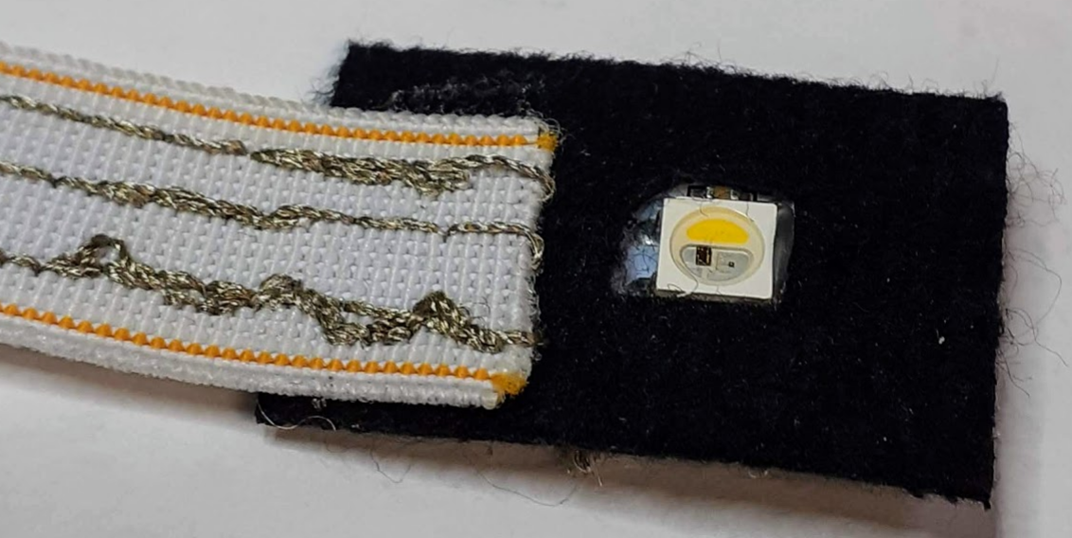
IDE - Settings
To compile an Arduino sketch (= program) correctly, the IDE must know which type of Arduino (= board) is being used,
To be able to upload a sketch to the Arduino, the IDE must know via which port the Arduino is connected with the PC.

Slide 33
What is a sketch ?
A sketch is an Arduino programm,
A sketch is saved in a folder with the same name as the sketch,
A sketch can be made/edited with the Arduino IDE.
Not used to programming? You can use several block based environments to create code. We use: blokkencode.ingegno.be/index_en.html

Slide 34
What is in a sketch ?
a sketch contains at least always the following 2 unique functions:
void setup()
Takes care of the initialisation,
Is begin executed one single time,
after power-up,
after reset,
after starting a serial monitor (introspection of the code),
void loop()
Contains the main program that executes again and again.

Slide 35
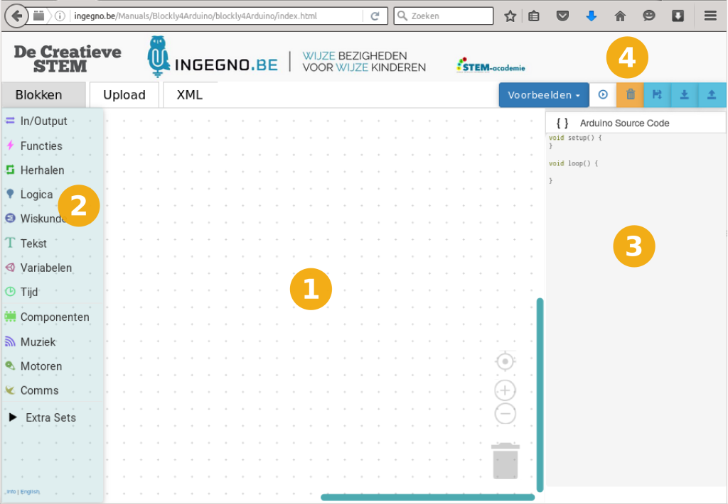
A first program with Blocks
To start, we use an interactive programming environment: blokkencode.ingegno.be/index_en.html
Use index_en.html for the English version

Slide 36
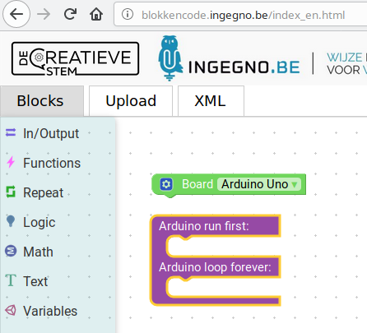
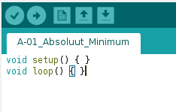
Minimum Sketch content
Load following minimum sketch to the Arduino

Slide 37
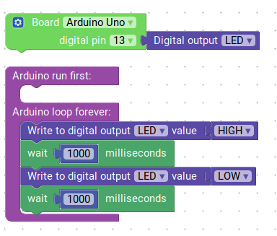
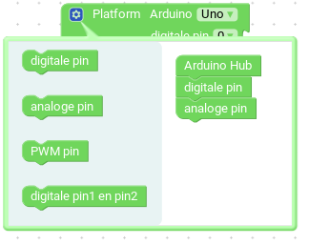
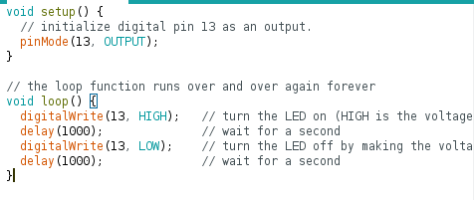
Working with a LED
The Arduino has an internal LED on the board
This is connected with pin 13 on Arduino. On WEMOS use pin D4 instead
Make a LED blink:

Slide 38
CONTACTS
Coordinator:
Technical University of Sofia
Faculty of Power Engineering and Power Machines
Project Manager of ICT-TEX:
Assoc. Prof. Dr. Angel Terziev
е-mail: aterziev@tu-sofia.bg
Web-site: ICT-TEX.eu
Contact: Benny Malengier, PhD, DSc
benny.malengier@ugent.be
The information and views set out in this publication are those of the authors and do not necessarily reflect the official opinion of the European Union. Neither the European Union institutions and bodies nor any person acting on their behalf may be held responsible for the use which may be made of the information contained therein.

