Slide 1
INDUSTRIAL ENGINEERING, QUALITY CONTROL AND MANAGEMENT Course: Information Technologies for Quality Control

Slide 2
Introduction
Education
2014 Methods, Transducers and Devices for Measurement and Control of Physical-Mechanical and Geometric Quantities
2010 Technical Legislation and Quality Control
2008 Industrial Management
Projects
BG051PO001-3.1.07-0018 Cooperation with the industry for improving the training at the Technical University - Sofia in measuring instruments and quality management
BG051PO001-3.1.08-0023 Improvement of the management of the Technical University - Sofia (TU)
Joint scientific and technical research and development in the field of metrological control of the Booster elements of the NICA project
Velizar Vassilev
Associate Professor
Technical University of Sofia
Mechanical Engineering Faculty
Department of Precise Engineering and Measuring Instruments
Experience
2020 Associate Professor
2015 Assistant Professor
Membership
CLUB 9000
UMB
BIS: TC 28 General Metrology

Slide 3
Introduction
CURRICULUM
Application of ICT in Design of Textile and Clothing
MODULE
Information technologies for quality control
COURSE
QMS/EMS implementation and control
COURSE Information technologies for quality control

Slide 4
Introduction
Course duration: 30 hours
Content: 12 lessons
DESCRIPTION OF THE COURSE
The includes basic issues of quality control tools and statistics and its application for the needs of the textile and clothing industry.
The topics are illustrated with many examples;
The course is available on the Moodle e-learning platform;
The interactivity of the course is realized with the help of the animations, videos with audio instructions;
After each topic there is a Quiz to test the knowledge.

Slide 5
Introduction
TYPES OF LEARNING MATERIALS
Students
Staff
Trainers/Researchers

Slide 6
Lesson 1. The Seven QC Tools
The Seven QC Tools
Cause-and-effect diagram | Check Sheet | Control chart | Histogram
Pareto chart | Scatter diagram | Stratification

Slide 7
Lesson 2. The Seven MP Tools
The Seven MP Tools
Affinity diagram | Relations diagram | Tree diagram | Matrix diagram
Prioritization matrix | Arrow diagram | Process decision program chart

Slide 8
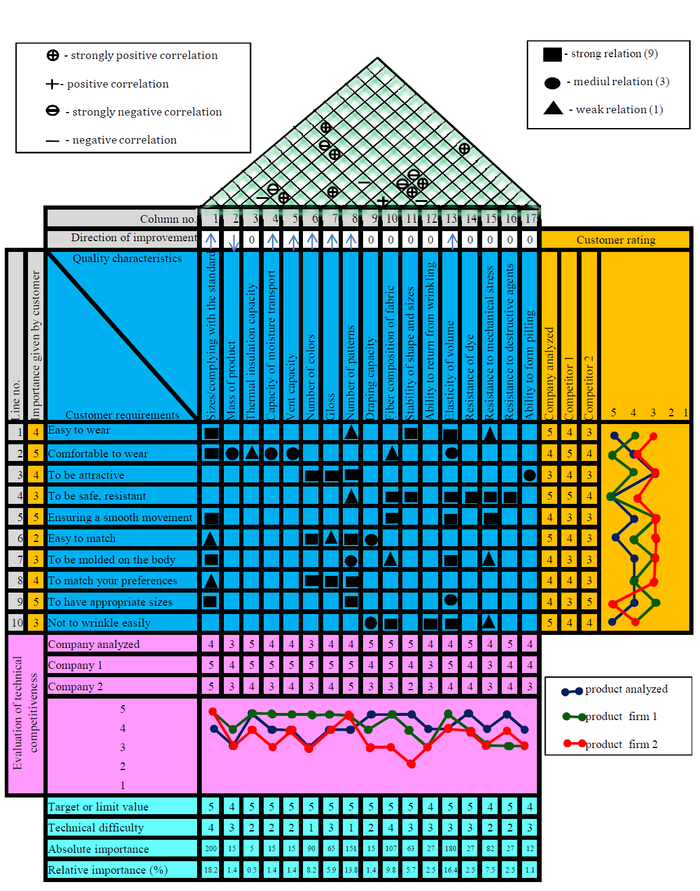
Lesson 3. The house of quality
QFD translates customer requirements (or VOC) into measurable design targets and drive them from the assembly level down through the sub-assembly, component and production process levels.

Slide 9
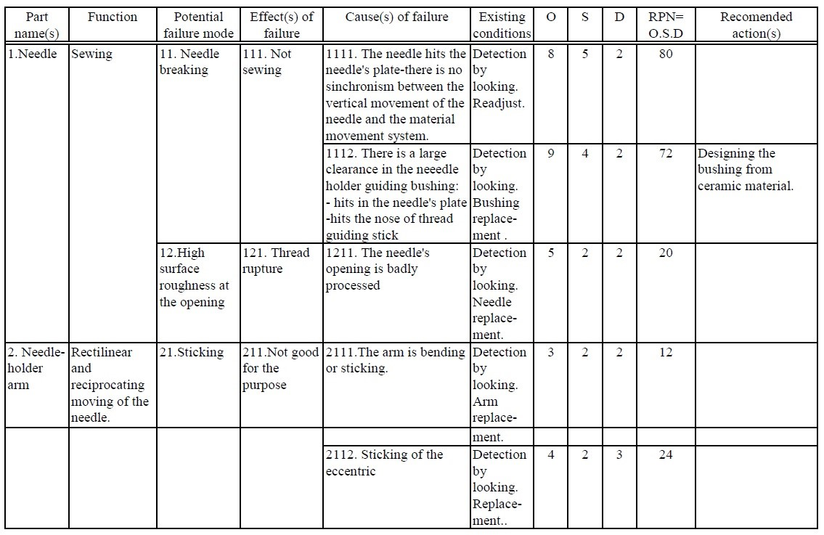
Lesson 4. FMEA
Failure modes and effects analysis is a step-by-step approach for identifying all possible failures in a design, a manufacturing or assembly process, or a product or service

Slide 10
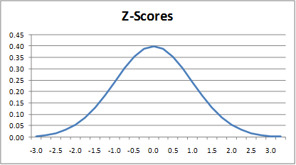
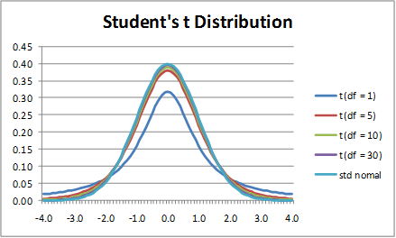
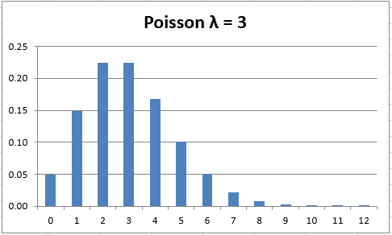
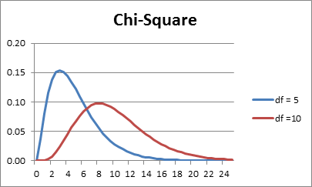
Lesson 5. Probability distributions with application in textile practice

Slide 11
Lesson 6. Statistical estimates of random variables
Arithmetic mean
Mode
Median
Range
Variance
Coefficient of variation

Slide 12
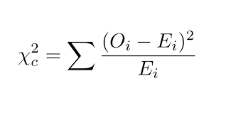
Lesson 7. Testing of non-parametric statistical hypothesis
Test for independence (whether two sets of data are independent of each other)
Comparing observed results with expected ones (Chi Square Test)

Slide 13
Lesson 8. Testing of parametric statistical hypothesis
Test for the equality (homogeneity) of variance across groups (F-test)
Test for test for equality of the population means (t-test)

Slide 14
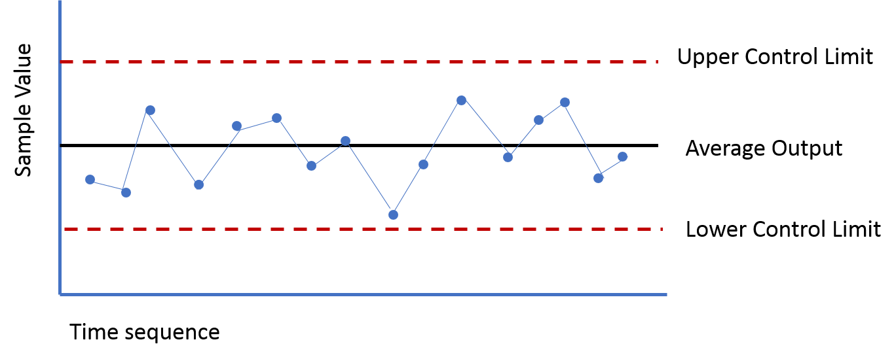
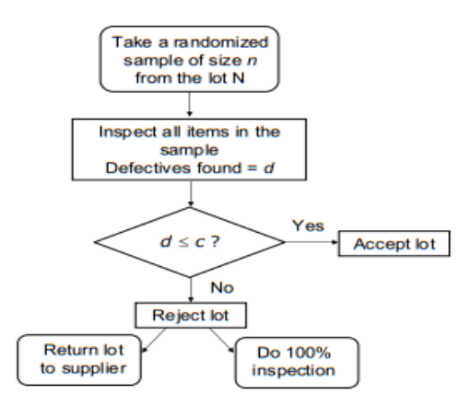
Lesson 9. Application of statistical hypothesis tests in Statistical Process Control (SPC) and Acceptance Sampling (AS)
Control charts, types of control charts and design of control charts for variables and attributes
Sampling Plans: Single, double, multiple and sequential sampling, sampling of variables and attributes

Slide 15
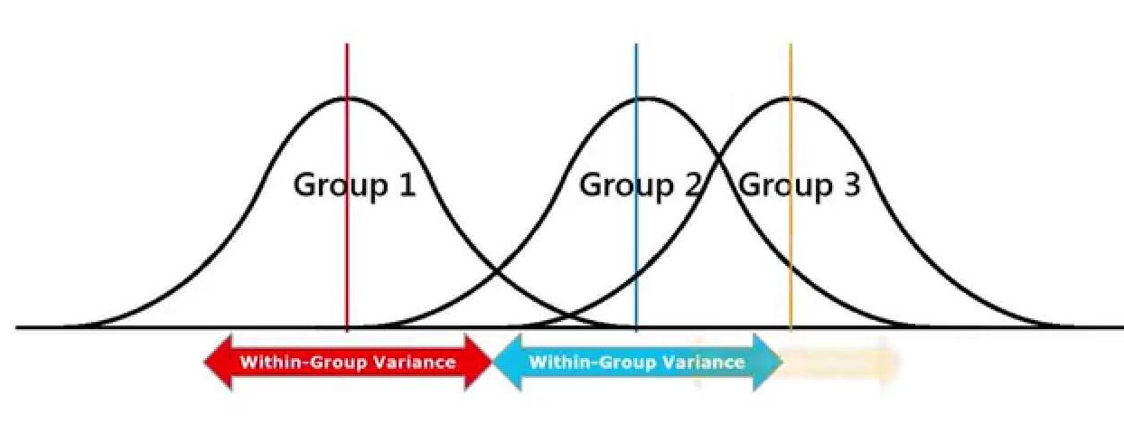
Lesson 10. Analysis of variance (ANOVA)
Single factor ANOVA
‎Two-factor with and without replication ANOVA

Slide 16
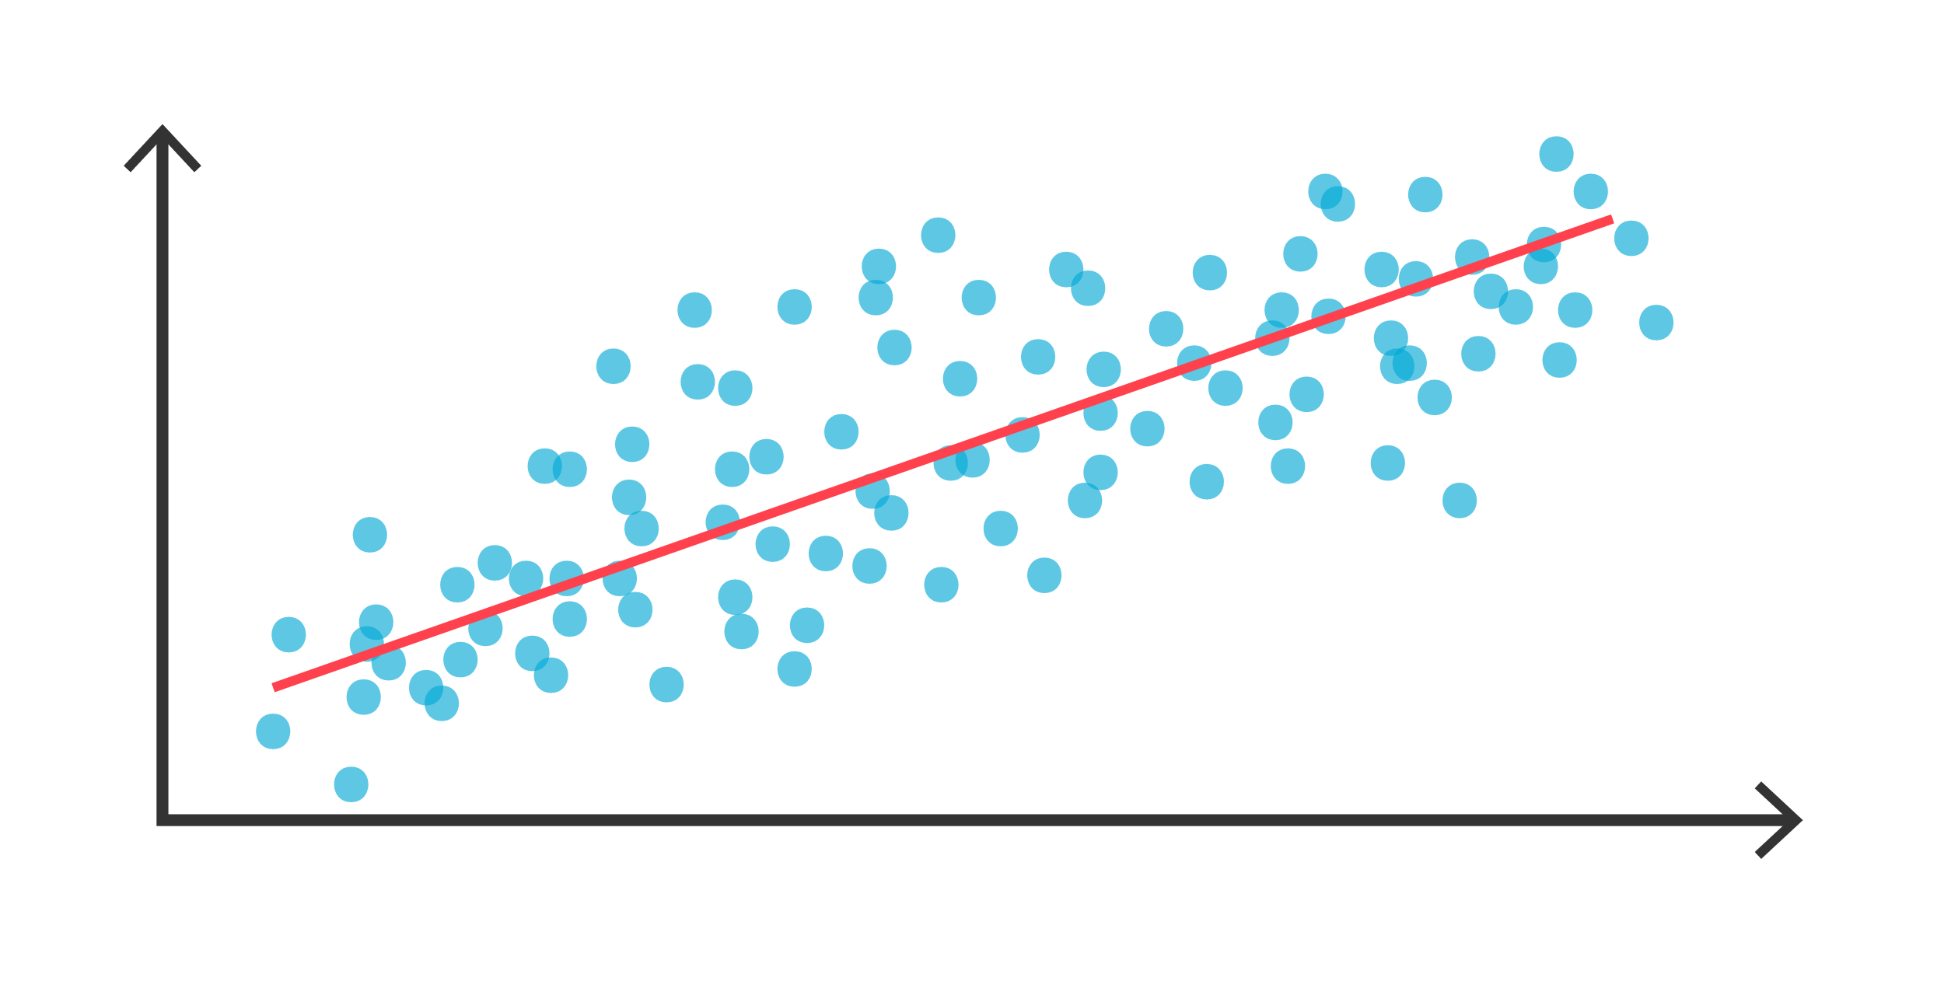
Lesson 11. Regression analysis
Regression analysis is a statistical method that shows the relationship between two or more variables.
Calculation of linear correlation coefficient between two variables
Graphical presentation / plotting the results
Finding regression equations / trendlines of different type with one variable
Calculation and displaying the equations and R-square values on chart
Forecasting by extrapolation
Linear regression analysis (more than one input variable)

Slide 17
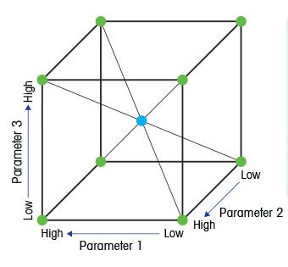
Lesson 12. Design of experiments
(DoE) is a statistical approach to reaction and process optimization that permits the variation of different factors simultaneously with the goal to screen the reaction space for optimum values

Slide 18
Thank you for your attention!
Address:
Technical University
of Sofia
8 Kliment Ohridski blvd.
Sofia, Bulgaria
Number:
+359 888 533 544
Email:
vassilev_v@tu-sofia.bg

Slide 19
Coordinator:
Technical University of Sofia
Project coordinator: assoc. prof. Angel Terziev, PhD
aterziev@tu-sofia.bg
Web-site: ICT-TEX.eu

