Slide 1
TOPIC 10. BUSINESS PLANNING FOR A TEXTILE AND CLOTHING ENTERPRISE

Slide 2
AGENDA
Business planning for T&C entrepreneurs
Marketing plan
Operations and production plan
Management plan
Financial plan

Slide 3
Business plan definition
A business plan is a written document, prepared by the entrepreneur that describes all the relevant external and internal elements, involved in starting a new venture. It addresses both short- and long-term decision making.
The business plan is like a road map for the business’ development. The Internet also provides outlines for business planning. Entrepreneurs can also hire or offer equity to another person to provide expertise in preparing the business plan.
In developing the business plan the entrepreneur can determine how much money will be needed from new or existing sources.
Notes:
Your business plan should be a living document, constantly revised to match changing markets and business needs.

Slide 4
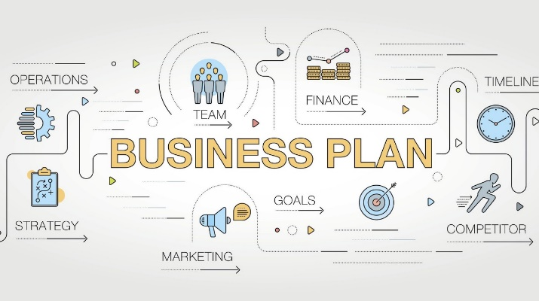
Business plan definition
A business plan is a blueprint for the business, which provides an outline to the business framework, declares visions, and showcases the necessary steps to fulfill the vision of the entrepreneur.
It shows the business’s history and background and models the entrepreneurial core values and mission.
As a roadmap, a good business plan helps navigating the entrepreneur towards his/her strategic direction.
The more thorough the business plan is, the better chances the business has to be successful.
Notes:
The business plan generally projects 3-5 years ahead and outlines the route a company intends to take to reach its yearly milestones, including revenue projections. A well thought out plan also helps you to step-back and think objectively about the key elements of your business venture and influences your decision-making on a regular basis.

Slide 5
Business plan audience
Business plans are designed to communicate to a specific target audience: internal or external stakeholders. Stakeholders include anyone with a potential vested interest in your business.
Even if you are not looking for outside funding, a business plan is useful for persons internal to the business: you, employees, management, sales, etc. to know your mission and vision as well as your target market and customer.
However, business plans are often the first thing an outside funder will request; therefore, much of what is in the plan will be directed at an external audience such as potential investors or lenders (government). Business plans are essential for investors, banks, and loan advisors.
Notes:
Tailor your plan to your intended audience. As your business expands, so will your plan.
When writing for internal stakeholders, focus on the detailed operation of the business. For example, include comprehensive data on the operating budget, market research, competitor analysis, sales lists, product design specifications, etc.
When writing for external stakeholders, focus on the financial aspect of the business. For example, if you’re looking for a traditional loan - you should include the amount you’re looking for, how the funds will be used, what those funds will accomplish, how you plan to repay, and any collateral you have to offer.
If you’re looking for investors, talk about growth; For example, what funds you will need in the short term as well as the long term (up to five years) and how you will use those funds to grow.
Calculate Return on Investment (ROI) estimations and how financial reporting will work. Tell them what percent ownership you’re willing to give to investors, what milestones or conditions you will accept, how you expect them to be involved (board membership, management, etc.), and any proposed investor exit strategy (such as buyback or sale options).

Slide 6
Business planning for T&C entrepreneurs Who should write the business plan
The business plan should be prepared by the entrepreneur.
The entrepreneur may consult many sources: lawyers, accountants, marketing consultants and engineers.
To help determine whether to hire a consultant, the entrepreneur needs to make a goal/objective assessment of his or her own skills.

Slide 7
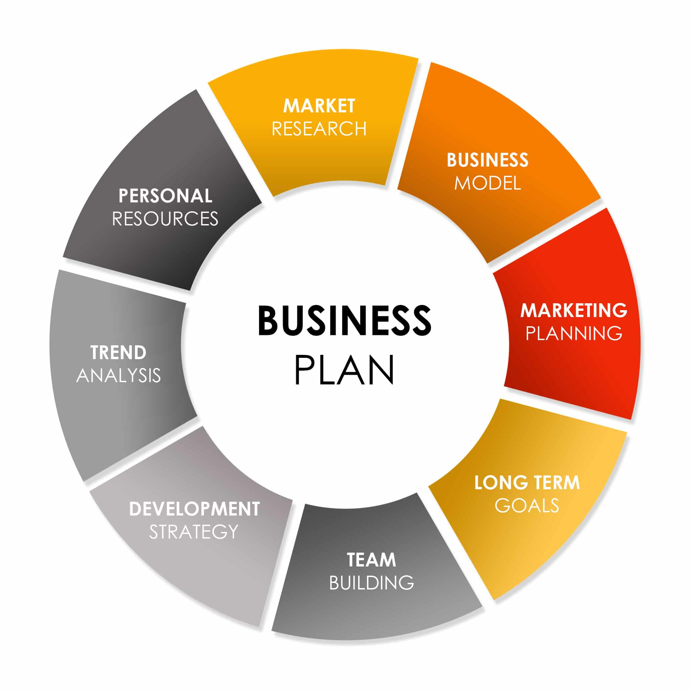
The business plan should:
Provide a strategy to accomplish the company mission.
Be based on facts and valid assumptions.
Provide for the use of existing resources.
Describe an organization to implement the plan.
Provide for continuity.
Be simple and short.
Be flexible.

Slide 8
Business plan content
A business plan contains mini-plans to address the different aspects of the business:
New idea for a product or a service. Innovative approaches that emphasize speed, flexibility, and the ability to change direction and adapt. Key business concepts such as marketing and finances, and/or be used as a tool to effectively operate the business by organizing company goals and objectives.
Sales and marketing analysis provides specific information regarding the textile and apparel industry in which the business operates.
Ownership and management structure of the business is also a key element of the business plan, detailing the qualifications and duties of the individuals in charge.
Financial information such as accounts payable and receivable, break even projections, and the current financial picture of the business give an accurate depiction of the business’ finances.

Slide 9
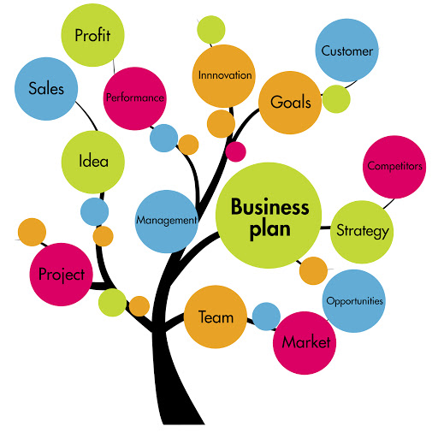
Business plan structure
Introductory page.
Executive summary.
Environmental and industry analysis.
Industry.
Description of the company.
Products or services.
Target market.
Financial and technical evaluation of the business.
Notes:
Business plan explains:
Who you are;
Why you are in business;
What you do;
How you do it;
Where you operate;
How you will generate profits;
Who your customers are;
Why your business is important.

Slide 10
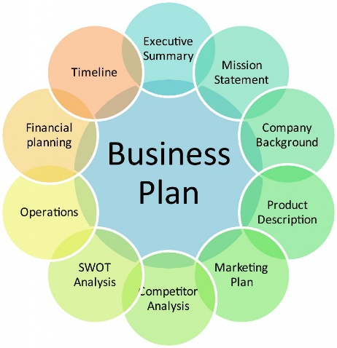
Business plan structure
Introductory page - the title page provides a brief summary of the business plan's contents, and should include: The name and address of the company; The name of the entrepreneur and a telephone number; A paragraph describing the company and the nature of the business; The amount of financing needed; A statement of the confidentiality of the report.
Executive summary - it should be three to four pages in length and should highlight the key points in the business plan. The summary should highlight in a concise manner the key points in the business plan. Issues that should be addressed include: 1) Brief description of the business concept; 2) Any data that support the opportunity for the venture; 3) Statement of you this opportunity will be pursued; 4) Highlight some key financial results that can be achieved.
Notes:
The Executive summary is the first section of a business plan, but it is the last section you will write. And, while it’s the last section you will write, it’s the first section your audience will read. Therefore, the Executive summary must be engaging, while simultaneously giving solid evidence that your business will succeed.
The Executive Summary should include short descriptive summaries of each section of your business plan:
Your company
Products or services you sell or plan to sell
Mission statement
Management and organizational structure
Target market and ideal customer
Competition
Future of your business and your industry
Banking relationships and information regarding current investors
Financial data and projections

Slide 11
Business plan structure
Environmental and industry analysis - environmental analysis is used to identify trends and change occurring on a national and international level that may impact the new venture. Examples of environmental factors are: Economy; Culture; Technology; Legal concerns. Industry analysis is focused on specific industry trends. Some examples of industry factors include: Industry demand; Competition.
Industry: Here briefly describe your industry; you will go into more detail later. What is your industry? Is your industry growing? What changes do you foresee and how does your company plan to take advantage of these changes? How does your company compare to competitors in your industry?

Slide 12
Business plan structure
Description of the company - begin with the mission statement or company mission, which describes the nature of the business and what the entrepreneur hopes to accomplish. The new company should be described in detail, including the product, location, personnel, background of entrepreneur. The emphasis placed on location is a function of the type of business.
Products or Services: How is your product or service new and exciting? How are products developed or services provided? Give a brief yet enticing overview of your product or service to include descriptions, pricing explanation, and competitive edge.
Target Market: This section should briefly describe to whom you will market your products. Give a short description of who you think will buy your product and why. To give a frame of reference, include your company’s location and whether you anticipate moving in the future.

Slide 13
Business plan structure
Financial and technical evaluation of the business - it is used to evaluate how long the company could be survival, and its ability to have sustainable profits over a period of time. If a business is viable, it is able to survive for many years, because it continues to make a profit year after year. The longer a company can stay profitable, the better its viability of the business. The financial plan for the business will have at its heart standard features: profit forecast; cash flow forecast; projected balance sheet.

Slide 14
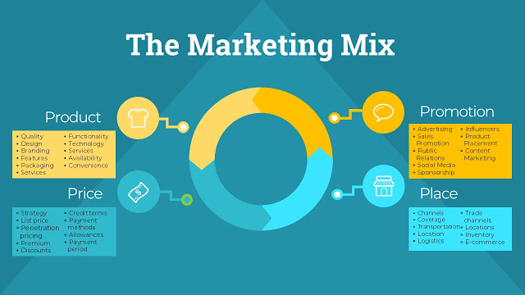
Marketing plan
Marketing plan will include details about:
your products and /or services;
the place in which you sell them and the way that you distribute them;
the price you charge for them;
the promotion you undertake.
Notes:
Your market is an important part of the business plan. Before you can sell something, you have to know who might buy it and what price they’re willing to pay for it. Research is the foundation to marketing. To conduct market research, you must gather facts and opinions in an orderly, objective way about your target: the industry and your potential customers.
If you don’t know who your customers are, you can’t develop a strategy to reach them. And, if you can’t reach them, you will likely not be effective in selling your products and services.

Slide 15
Industry and competition
Describe the industry you operate in, as well as the potential or prospects for your business within that industry. When identifying characteristics of your target market you should also determine the size of your potential market. You can determine the size of your market by examining the number of potential customers in a particular area; reviewing the geographic area they live in; analyzing prior annualized sales and considering market growth.
Who are your competitors in your industry?
Are there any regulations that apply to your industry?
What are the trends in your industry, growth, consumer preferences, product development?
What advantages or disadvantages do you have over you competitors?

Slide 16
Customers
Identify your target market and profile your customers. Your goal is to find out what people want to buy, not just what you want to sell them.
You should describe your customers’ needs, including information about the degree to which those needs are (or are not) currently being met. Specify what needs are you satisfying with your business.
Who are your current or prospective customers? Describe demographic information like age, gender, income level, etc.
What do they buy and why? Can they, and will they, buy my product? What price will they pay? Why might your customers prefer your product over the alternatives? Try to describe how each of your major products or services gives value to the customer.
What market segments or groups are more likely to buy your products?

Slide 17
Market segment
A market segment or targeted group of customers is a grouping of people sharing one or more characteristics that cause them to have similar product needs. Market segmentation or target marketing is the process of dividing a market into distinct segments that behave the same way or have similar needs. Because each segment is somewhat similar in their needs and attitudes, they will likely respond similarly to a specific marketing strategy.

Slide 18
Product/service line
Identify and describe all of the products and services your business sells or provides. Explain how the items you sell are priced. Explain how your products and services are competitive. Emphasize your competitiveness.
If you have pictures or brochures describing your products, reference them in this section and include them in an appendix to the business plan.
What is unique about your product? What are its important features?
What will it do for the customer? How does it benefit them? Why is it better for the customer when compared to the competition?
Who are your suppliers?
In which lifecycle stage is your product or service?
What research and development activities are you performing or planning?
What intellectual property rights do you have for your product or service?

Slide 19
Marketing strategy
After you’ve conducted your market research, you can create your marketing and sales strategy to reach your customers.
How will you communicate with your customers?
What is your plan to grow your company?
How will you sell your product or service?
Marketing strategy activities:
Advertising;
Community involvement;
Customer support;
Distribution;
Market research;
Media planning;
Product pricing;
Public relations;
Sales strategy.
Notes:
Marketing activities and strategies result in making products available that satisfy customers while making profits for the companies that offer those products. Creating a marketing strategy can be difficult. It deals with people and their constantly changing feelings and behaviors, which are influenced by countless subjective factors. Central to any successful marketing strategy is an understanding of your customers and their needs. The ability to satisfy your customers' needs better than your competitors can help you build customer loyalty and increase sales. Remember, trying to convince people to buy something they don’t want is extremely expensive and seldom successful.

Slide 20
A good marketing strategy
Identifies market segments in which a business can better serve than its competitors.
Determines what customers want and what they will pay for.
Tailors product offerings, prices, distribution, promotional efforts, and services toward those identified segments.
Addresses unmet customer needs that offer adequate profitability for the business and focus on the target markets it can serve best.
Needs to consider what changes are taking place, and emerging opportunities and threats.
Helps you assess how successful you are at meeting your customers' needs, as well as how successful your competitors are.

Slide 21
Marketing mix
Place refers to how the product gets to the customer. Specifically, it refers to the channel by which a product or service is sold or distributed. This is an important piece of information. Are you selling online, in a store, or through sales agents? In your own store or in someone else’s? Is that consistent with what your customers want? Is it convenient, comfortable, or ideal for them? How does your distribution channel compare to your competitors? If you have a physical location, how far are you from your competitors?
Pricing refers to the process of setting a price for a product, including discounts. You’ll want to discuss how you set prices. How does your price compare with your competition? How sensitive to price are your potential customers? How much of your product do you think you will sell at various price points? Are you going to change your prices often?

Slide 22
Marketing mix
The product aspects of marketing deal with the specifications of the actual goods or services, and how it relates to the end-user's needs and wants. In this section of your business plan, you can talk briefly about where your product fits in the market.
Promotion includes advertising, sales promotion, and publicity, and refers to the various methods of promoting the product, brand, or company. How do you plan on communicating with customers? What message will you communicate? You’ll want to discuss your promotional plans, the budget for this promotion, and how that budget will change through your business’s life cycle.

Slide 23
Sales forecast
Prepare a month by month projection based on historical sales (if available), industry and market research. You may create more than one projection based on multiple scenarios, particularly if this is a new business or new product. Align forecast assumptions with your market research or historical sales.
Notes:
Don’t pull numbers out of thin air. Finally, discuss how these sales will lead to company growth.

Slide 24
Operations and production plan
Lack of planning is certain to result in shortages or delays of necessary materials.
Without an analysis of how often resources need to be replenished, these necessities will not be found where and when needed.
The necessary resource might be something as small as staples for the stapler, or as essential as running out of the raw material needed to manufacture the product that is sold. In all cases, a business a cannot flourish if the management of its resources is not being monitored and planned for.
Production process management deals with converting raw materials into finished goods or products. It brings together the 6M's i.e. men, money, machines, materials, methods and markets to satisfy the wants of the people.

Slide 25
Operations and production plan
Technique adopted will depend on a number of factors, including:
the product or service quality of the product or service;
quantity of the product or service;
size of the organization;
the type of organization;
the organization’s resources;
legislation applicable to the organization.

Slide 26
Garment Manufacturing Process
Garment Design
Print + Color Design
Source and order fabric and trim
Tech Packs
Preliminary Costing
Pattern Development
Development Sampling
Pre-Production Process
Grade Patterns
Production Samples
Quality Control Check
Packing
Shipping and Logistics

Slide 27
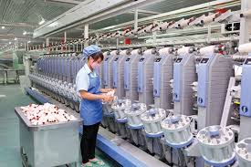
Operations and production plan
Methods of production process include:
Line production - just as the name suggests line production is producing goods along a line of production. The goods will be passed along a line containing different stages. At each stage in the line the goods will be altered. Often a person/group of people will be responsible for just one stage in the process. For example, in garment production, until garment components are gathered into a finished garment, they are assembled through a sub-assembly process.

Slide 28
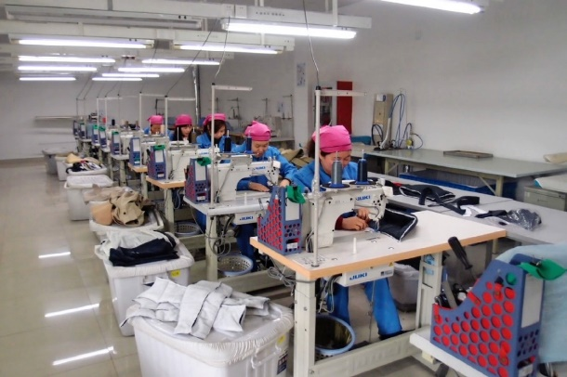
Operations and production plan
Methods of production process include:
Batch production - this is the method employed when the organization needs to produce a fixed amount of each of the type of goods it produces. In this instance production technique and resources will be adapted, to produce the product required and to produce just the amount required.

Slide 29
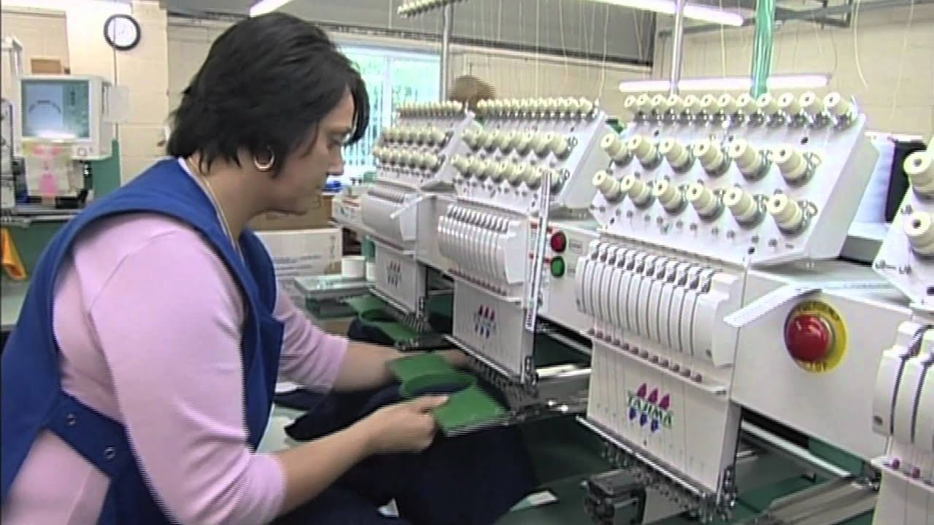
Operations and production plan
Methods of production process include:
Continuous flow production (CFP) - this is simply adopting line production 24 hours day/seven days a week, using automatic equipment. The automatic equipment will operate in the same manner day in day out. The ability to work in this manner is another advantage robots/machinery have over humans. CFP does not involve humans so it is not used in the service industry unlike line production.

Slide 30
Operations and production plan
Methods of production process include:
Just In Time Production (JIT) - this method of production generates goods/services “just in time” for them to be sold rather than preparing them months or weeks in advance. To save storage costs, the parts needed to make the end product will arrive just before they are used to manufacture the product. This means that the production process is carefully planned and organised. Production must be efficient and speedy otherwise the goods will not be manufactured “in time” for the customer. Conversely if there are no/few orders then production will slow down or stop altogether.

Slide 31
Operations and production plan. Assignment 1
Read the article: What is “Just In Time” Manufacturing?
What are the advantages of the method in theT&C business? List other applications of the method that you know in the textile business.

Slide 32
Seven basic quality tools in process management
Cause-and-effect diagram (also called Ishikawa or fishbone chart): Identifies many possible causes for an effect or problem and sorts ideas into useful categories.
Check sheet: A structured, prepared form for collecting and analyzing data; a generic tool that can be adapted for a wide variety of purposes.
Control charts: Graphs used to study how a process changes over time.
Histogram: The most commonly used graph for showing frequency distributions, or how often each different value in a set of data occurs.
Pareto chart: Shows on a bar graph which factors are more significant.
Scatter diagram: Graphs pairs of numerical data, one variable on each axis, to look for a relationship.
Stratification: A technique that separates data gathered from a variety of sources so that patterns can be seen (some lists replace “stratification” with “flowchart” or “run chart”).

Slide 33
Management plan
Mission statement: The mission statement is a brief statement about who the company is and what it stands for. Some companies use the mission statement as a marketing slogan. However, the true intent of a mission statement should be to describe the purpose of the business - a futuristic expression of hope inspiration.
Business Goals and Objectives: Your business goals and objectives should be specific and attainable. Remember, goals that are not specific will probably not be achieved. An example could be that your business meets a specific level of customer satisfaction or reaches an annual sales target.
Notes:
The first section provides a general background and description of your company. You should include things like a mission statement, company goals and objectives, and a general overview of your product or service, target market, and industry. You will also go into detail about your company’s management, organizational, and legal structures.

Slide 34
Management plan
Legal structure: What is the legal structure of your business? Here describe what legal requirements your business faces, such as licenses and/or permits your company operates with or needs. It is also an opportunity to highlight special operating achievements or certifications your company has. For instance, your business may have specific security clearances, hold patents, or be quality certified as an ISO 9000 firm. This section should also describe how the company is organized. Specifically, it should explain the legal form of ownership such as the business model. That is, are you organized as a proprietorship, partnership, or corporation and why.

Slide 35
Management plan
Management structure: This section should describe the processes that support what your company does. For instance, how is your company’s management organized? Who makes decisions? What are the values that drive your company? How many employees do you have, what do they do, and how are they paid? Do you anticipate this changing?
Notes:
Organizational structure: This section should describe the leadership of your company and include an organization chart, if you have one. Who are the principal members of your company and what are their roles? This section of the plan should include a brief resume on each key manager within the company to show that they are qualified to complete this work. If you have a board of directors or outside advisors (such as an attorney or accountant), list them here and describe the relationship. In this section, you should also explain how things get done in the company. Talk about your company’s core competencies.

Slide 36
Management plan
People in the company. Having the right people with the right skills is vital to every business. A successful business will recognize that, to be competitive in the 21st Century, it must be proactive in training and developing its employees and it must have in place a strategy for achieving this. People planning can be crucial in achieving longer term objectives by equipping employees with the right skills - and it is on those skills that the business will be competitive in its marketplaces. The plan will also cover broad statements on recruitment, employment, induction, training and a range of other related business functions.

Slide 37
Recruitment
The process of finding and hiring the best-qualified candidate (from within or outside of an organization) for a job opening, in a timely and cost effective manner. The recruitment process includes analyzing the requirements of a job, attracting employees to that job, screening and selecting applicants, hiring, and integrating the new employee to the organization.
The recruitment and selection is the major function of the human resource department and recruitment process is the first step towards creating the competitive strength and the strategic advantage for the organizations. Recruitment process involves a systematic procedure from sourcing the candidates to arranging and conducting the interviews and requires many resources and time.

Slide 38
Recruitment process
Identify Vacancy and Evaluate Need.
Develop Position Description.
Develop Recruitment Plan
Select Search Committee
Post Position and Implement Recruitment Plan
Review Applicants and Develop Short List
Conduct Interview
Select Hire
Finalize Recruitment

Slide 39
Employees motivational process

Slide 40
How to be a successful team manager
Provide purpose.
Build a star team, not a team of stars.
Establish shared ownership for the results.
Monitor, but do not micromanage.
Develop team members to fullest potential.
Make the work interesting and engaging.
Develop a self-managing team.
Motivate and inspire team members.
Lead and facilitate constructive communication.

Slide 41
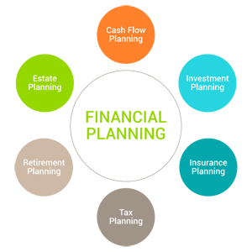
Financial plan
Finance is one of the important prerequisite to start an enterprise or capital is work as lubricant in a production process. The success of new venture is very much depending on availability of finance or capital.
Not having enough capital is the cause of many small business failures. Adequate capital is needed to start up the business, operate through hard times, and provide a good chance to become a profitable enterprise.
How much capital will I need?
How much of my own capital can I put in the business?
How much capital can I get from someone else?
How can I convince someone to provide me with capital?
Notes:
This important section explains your revenue forecasts, how much money you have and need, and when and how the business expects to make a profit. It also details what your marketing and operational processes and plans will cost.
This section of your business plan is considered the most important as it outlines the complete financial situation of your business.

Slide 42
Assignment 2
Identify exact amounts of funding you will need to start your business and make sure it ties specifically to your financial projections.
What are your current and future (3-5 years) funding requirement. Include time period that each request will cover, type of funding you would like to have (e.g., equity, debt), and the terms that you would like to have applied.
How you intend to use the funds you receive: Is the funding request for capital expenditures? Working capital? Debt retirement? Acquisitions? Whatever it is, be sure to list it in this section.
Any strategic financial situational plans for the future, such as: a buyout, being acquired, debt repayment plan, or selling your business. These areas are extremely important to a future creditor, since they will directly impact your ability to repay your loan(s).

Slide 43
Financial plan
Sources of capital:
Trade or supplier credit;
Life insurance policies;
Friends and relatives;
Customers;
Leasing companies;
Commercial finance companies;
Commercial banks;
Investment companies.

Slide 44
Financial elements
The Projected Balance Sheet represents the basic accounting equation: assets minus liabilities, equals net worth. It is made up of assets (items of value), liabilities (debts) and net worth (equity or the difference between a company’s assets and liabilities). It provides a measure of a business’s value at a particular point in time.
The Cash Flow Projection is a valuable tool that monitors and projects the amount of incoming and outgoing cash during a given period (usually monthly) to gauge financial performance. It helps you determine how much cash your business has on hand at any point in time. If your business has a negative cash position, it means that you have more money going out than coming in and may find paying your bills somewhat challenging. It shows you if your working capital is adequate and helps you determine how much and when you may need to borrow money. Don’t forget to account for things like selling or buying on credit or irregular expenses.

Slide 45
Financial elements
The Profit and Loss Projection is a measure of how a business’s income has performed over a specific period of time, usually six months or one year. It measures all income less all expenses to arrive at the amount of profit or loss generated by the business for the period. It is also called an income statement or an income and expense statement.
Notes:
If you’re adding proposed loans into your business plan, include the sources, amounts, and terms in the Financial Projections section of your business plan.
If you have (or plan to get) investors, include how much will be contributed by each investor and what percent ownership they will have.
If you are submitting your business plan to a bank because you are applying for a loan, you should also include a current personal financial statement on each company principal and a copy of your business or individual Federal Tax return for the last three years.

Slide 46
Important assumptions for financial plan
Plan Month | 1 | 2 | 3
Current Interest Rate | 10.00% | 10.00% | 10.00%
Long-term Interest Rate | 10.00% | 10.00% | 10.00%
Tax Rate | 30.00% | 30.00% | 30.00%
Other | 0 | 0 | 0

Slide 47
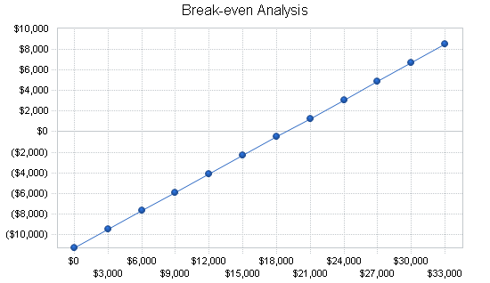
Financial results. Break-Even Analysis
Monthly Revenue Break-even | $18,844
Average Percent Variable Cost | 40%
Estimated Monthly Fixed Cost | $11,307
Notes:
If you are a new business, all of your financial statements should be projected one, two, and three years forward and include accompanying narratives to explain any assumptions. It should also include a Break-Even Analysis. Do your sales projections from the previous section indicate that you will reach your Break-Even Point? Do your research to accurately determine all of the potential costs and projections. Explain when you expect to become profitable and how you arrived at that conclusion.

Slide 48
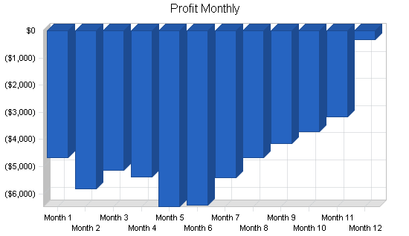
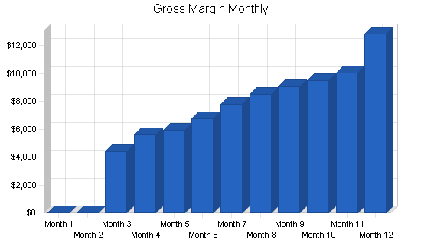
Financial results. Projected Profit and Lost

Slide 49
Pro forma profit and loss
Sales | $133,893 | $322,005 | $470,831
Direct Cost of Sales | $53,557 | $128,802 | $188,332
Other Costs of Goods | $0 | $0 | $0
Total Cost of Sales | $53,557 | $128,802 | $188,332
Gross Margin | $80,336 | $193,203 | $282,498
Gross Margin % | 60.00% | 60.00% | 60.00%
Expenses
Payroll | $93,200 | $116,000 | $130,000
Sales and Marketing and Other Expenses | $6,000 | $6,000 | $6,000
Depreciation | $1,800 | $1,800 | $1,800
Rent | $10,800 | $11,000 | $11,000
Utilities | $3,600 | $3,600 | $3,600
Insurance | $3,900 | $4,500 | $4,500
Payroll Taxes | $13,980 | $17,400 | $19,500
Other | $2,400 | $2,400 | $2,400
Total Operating Expenses | $135,680 | $162,700 | $178,800
Profit Before Interest and Taxes | ($55,344) | $30,503 | $103,698
EBITDA | ($53,544) | $32,303 | $105,498
Interest Expense | $0 | $0 | $0
Taxes Incurred | $0 | $9,151 | $31,110
Net Profit | ($55,344) | $21,352 | $72,589
Net Profit/Sales | -41.33% | 6.63% | 15.42%

Slide 50
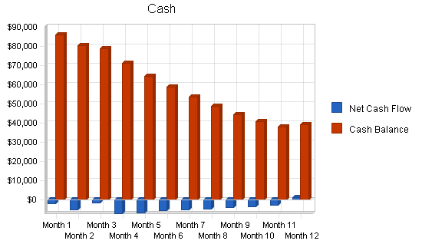
Financial results. Projected Cash Flow
Cash flows refer to the movements of money into and out of a business, typically categorized as cash flows from operations, investing, and financing.
Operating cash flow includes all cash generated by a company's main business activities.
Investing cash flow includes all purchases of capital assets and investments in other business ventures.
Financing cash flow includes all proceeds gained from issuing debt and equity as well as payments made by the company.
Notes:
You should also include a current twelve-month Cash Flow Projection statement that predicts the flow of cash several months’ forward.
Include your business tax documents for the last three years as well, if applicable. If you plan to introduce a new product line or if you will require a large influx of capital up front to grow your business, consider adding a Break-Even Analysis.
Remember to include accompanying narratives to explain any issues or assumptions in your plan.

Slide 51
Projected balance sheet
Assets
Current Assets
Cash | $38,932 | $51,165 | $121,724
Inventory | $9,422 | $22,660 | $33,133
Other Current Assets | $0 | $0 | $0
Total Current Assets | $48,354 | $73,825 | $154,857
Long-term Assets
Long-term Assets | $9,000 | $9,000 | $9,000
Accumulated Depreciation | $1,800 | $3,600 | $5,400
Total Long-term Assets | $7,200 | $5,400 | $3,600
Total Assets | $55,554 | $79,225 | $158,457
Liabilities and Capital | Year 1 | Year 2 | Year 3
Current Liabilities
Accounts Payable | $13,798 | $16,117 | $22,760
Current Borrowing | $0 | $0 | $0
Other Current Liabilities | $0 | $0 | $0
Subtotal Current Liabilities | $13,798 | $16,117 | $22,760
Long-term Liabilities | $0 | $0 | $0
Total Liabilities | $13,798 | $16,117 | $22,760
Paid-in Capital | $115,000 | $115,000 | $115,000
Retained Earnings | ($17,900) | ($73,244) | ($51,892)
Earnings | ($55,344) | $21,352 | $72,589
Total Capital | $41,756 | $63,108 | $135,697
Total Liabilities and Capital | $55,554 | $79,225 | $158,457

Slide 52
Business ratios
Ratios | Year 1 | Year 2 | Year 3 | Average
Current | 3.50 | 4.58 | 6.80 | 2.10
Quick | 2.82 | 3.17 | 5.35 | 0.86
Total Debt to Total Assets | 24.84% | 20.34% | 14.36% | 57.27%
Pre-tax Return on Net Worth | -132.54% | 48.33% | 76.42% | 4.00%
Pre-tax Return on Assets | -99.62% | 38.50% | 65.44% | 9.36%
Net Profit Margin | -41.33% | 6.63% | 15.42% | n.a
Return on Equity | -132.54% | 33.83% | 53.49% | n.a
Activity Ratios | Year 1 | Year 2 | Year 3 | Average
Inventory Turnover | 10.91 | 8.03 | 6.75 | n.a
Accounts Payable Turnover | 7.51 | 12.17 | 12.17 | n.a
Payment Days | 27 | 28 | 26 | n.a
Total Asset Turnover | 2.41 | 4.06 | 2.97 | n.a
Debt Ratios | Year 1 | Year 2 | Year 3 | Average
Debt to Net Worth | 0.33 | 0.26 | 0.17 | n.a
Current Liab. to Liab. | 1.00 | 1.00 | 1.00 | n.a
Liquidity Ratios | Year 1 | Year 2 | Year 3 | Average
Net Working Capital | $34,556 | $57,708 | $132,097 | n.a

Slide 53
Financial plan recommendations
Organize your financial records.
Calculate your net worth.
Establish a spending plan.
Build an emergency fund.
Reduce or minimize consumer debt.
Obtain adequate insurance.

Slide 54
Assignment 3
Choose one of the businesses in the Your Textile and Clothing Business Ideas Document and describe what will be the estimated expenses that you will have.
What will be the expected initial costs of your own T&C business idea?

Slide 55
Optional appendix of the business plan
Brochures and advertising materials;
Blueprints or plans;
Maps;
Copies of leases or contracts;
Any press coverage of business;
Industry or marketing studies;
Any other materials needed to support what you claim in the business plan.
Notes:
Don’t pull numbers out of thin air. Finally, discuss how these sales will lead to company growth.

Slide 56
How to write a business plan in fashion design
Analyze Your Niche. For example, are you passionate about designing affordable and stylish clothing from organic textiles? Is your clothing inspired by a journey you took or a specific era you’ve always loved? Really get to the heart of why you started your clothing brand – it’s this story that should resonate throughout your business plan.
Start with Market Analysis. Once you’ve introduced yourself and your clothing brand, your plan should immediately launch into a brief examination of your market, including the competitive landscape your business may be facing.
Demonstrate Customer Knowledge. It’s always worth outlining customer demographics, but consider taking this plan section to the next level by providing customer testimonials. The business plan should include more than just how to make a single sale, but how to create a community around the brand.

Slide 57
How to write a business plan in fashion design
Highlight Key Pieces. Got a few designs that really speak to the heart of your collection?
Name Your Brand Partners. Whether you’re working with a business owner who’s providing you with materials or teaming up with a shipping service, call out your brand’s partners in your business plan.
Share Your Marketing Strategy. Make sure you mention all the acquisition channels you’ll use to bring customers through your doors, like email, social media, digital ads, websites, search engine optimization and blog posts.
Do a Financial Projection. Your financial forecast should include a sales forecast, an expenses budget, income projections and a timeline of when you’ll break even with your business.

Slide 58
Questions for discussion and tasks
What is a business plan?
What are the sections of a business plan?
What questions do you need to consider early in the process of developing a business plan?
How would the alteration service business plan for a one-person service operation run from a home differ from that of a sewing manufacturing business requiring 100 employees, equipment and a building?
Use the business plan templates after the topic and compere what are the differences and similarities between them.

Slide 59
Questions for discussion and tasks
What product or service does your business provide and what need does it fill?
Who are the potential customers for your product or service and why will they purchase it from you?
How will you reach your potential customers?
Where will you get the financial resources to start or grow your business?
What do you need to operate your business?
What do you think is the best way to present your business plan?
Do a competitive analysis to show how you stack up against your direct competitors on things like price, your products, service, etc.

