Slide 1
OVERVIEW OF THE EUROPEAN TEXTILE INDUSTRY
MAK JSC
ICT IN TEXTILE AND CLOTHING HIGHER EDUCATION AND BUSINESS (ICT-TEX)

Slide 2
LEADER OF Working package 9
DEVELOPMENT OF SYLLABUSES IN DESIGN AND PRODUCTION OF WOVEN FABRICS

Slide 3
The EU region - one of the world’s leading producers of textile and apparel
Southern and Western EU, where most developed EU members are located such as Germany, France, and Italy, accounted for nearly 73.7% of EU’s textile manufacturing
Apparel manufacturing
medium-priced products for consumption in the mass market,
the high-end luxury apparel
EU fashion imports
59 % of clothes imported by EU countries came from outside the EU
41 % came from other EU countries.

Slide 4
Globalization and the fashion industry
Globalization of markets
International outsourcing
Unlimited flexibility between countries and factories

Slide 5
INNOVATIONS AND TEXTILE MANUFACTURE
The technical textiles industry in the EU today represents, roughly 30% of the total turnover in textile
Advanced materials, high-tech processes and manufacturing technologies as well as new business models, management and marketing concepts become an increasingly important factor of the competitiveness of the textile and clothing industry on the global market.
New applications for textiles

Slide 6
TEXTILE MANUFACTURING PROCESS
FIBERS
YARNS
FABRICS
FINISHED TEXTILES & CLOTHING

Slide 7
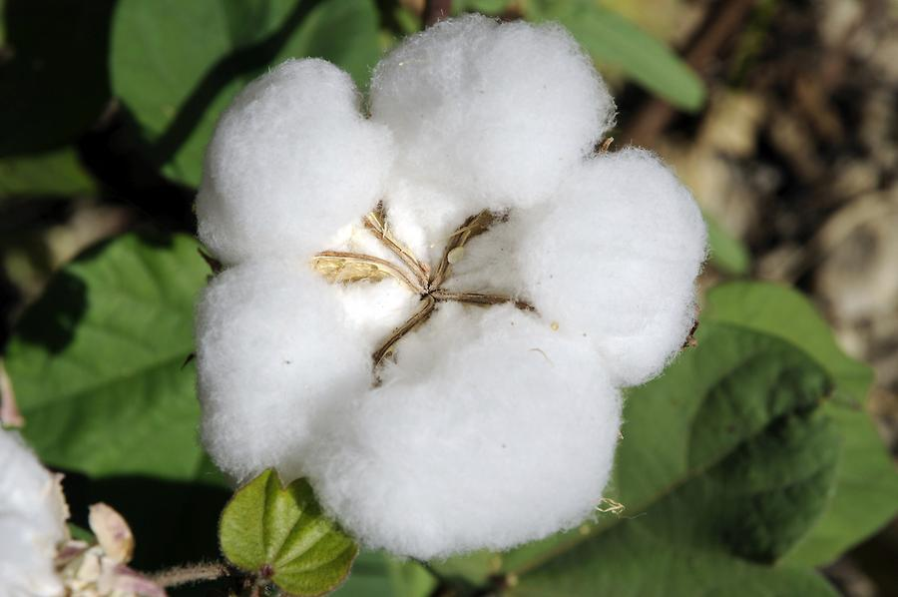
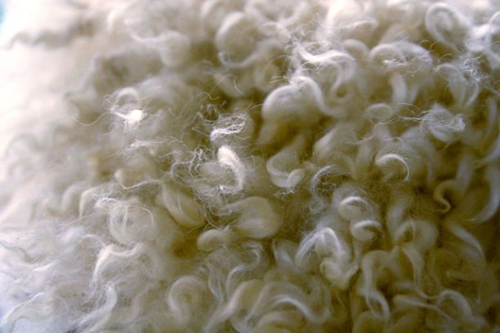
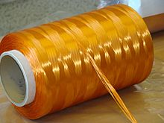
RAW MATERIAL INSIGHTS

Slide 8
COMPANY PROFILE IN THE TEXTILE INDUSTRY
Small and medium sized enterprises are the core of the Industry

Slide 9
EMPLOYMENT
1,5 million people employed in Textile and clothing, in Europe

Slide 10
HOUSEHOLD CONSUMPTION

Slide 11
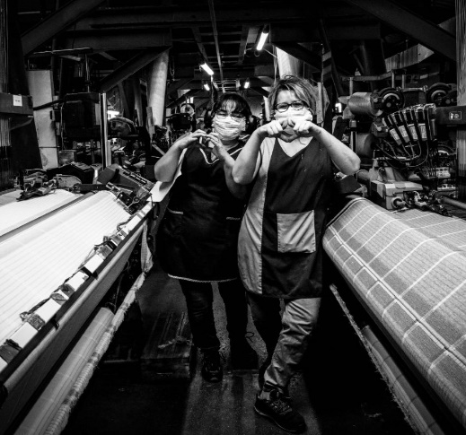
COVID-19 IMPACT
The EU textile and apparel industry is not immune to COVID-19.
50% drop in sales and production for the EU textile and apparel sector in 2020
9 out of 10 respondents reported facing serious constraints on their financial situation
80% of companies had temporarily laid-off workers.
Expectations are turnover to bounce back by about + 15% in 2021 and return to pre-crises levels only in 2023

Slide 12
EU’s sustainable textile strategy
The EU strategy for sustainable textile will be adopted by the end of 2021
Economic recovery can’t come at the expense of the environment
Establishing eco-design for textiles
Enabling better recycling of materials
Better management of production and post-consumer textile waste
Focus on understanding and promoting sustainable consumption behaviour

Slide 13
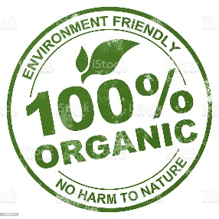
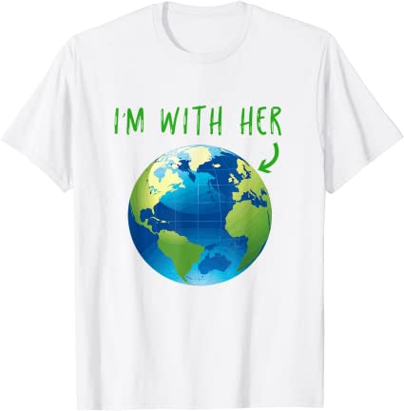
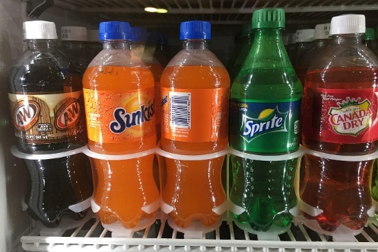
ORGANIC AND RECYCLED TEXTILES
More sustainable fabrics, more commitment
Organic cotton
Recycled PES

Slide 14
Thank you for your attention!

