Slide 1
QMS/EMS Implementation and Control

Slide 2
TRAINING COURSE
INDUSTRIAL ENGINEERING, QUALITY CONTROL AND MANAGEMENT
Course: QMS/EMS Implementation and Control
Partner: P4 – University of Zagreb Faculty of Textile Technology
Assoc. Prof. Sanja Ercegović Ražić, Ph.D.

Slide 3
Lecture plan:
Quality management system according to ISO standards
Quality management includes management methods and analysis techniques whose subject is quality management.
Quality concepts in organizations are based in principle either on norms and standards (international, national or internal to the company) or on the concept of TQM (Total Quality Management).
The basic standard is ISO 9001 and it is not a management method, but a standard or norm that serves as a reference model for setting the basic management processes in an organization that continuously contributes to improving the quality of the products or services delivered and customer satisfaction (hence quality management system). It is a process-oriented standard.
Basic principles, system elements and structure of the standard ISO 9001:2015 in the latest revised version, which is more oriented towards strategic management, requires active identification and management of risks, emphasizes customer orientation and overall practicality with less formal documentation.

Slide 4
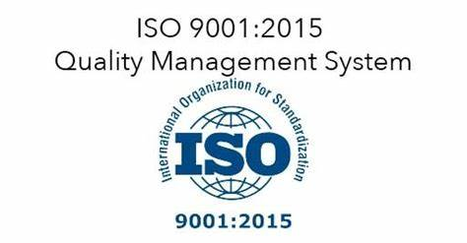
Lecture plan:
ISO 9001 The International Organization for Standardization (ISO) is a non-governmental international organization, which promulgates international standards, which are adapted to the current market needs and which drive innovation and support when challenges arise, or change is wished.
Its creation was demanded by engineers in 1946 in London and it started to operate in 1947 (ISO, 2020).
In 1987, ISO published the ISO 9000 family, which is a set of quality management system (QMS) standards.
The most common standard of the ISO 9000 family is ISO 9001, which is the only standard of this family that can be certified.
The last (newest) version of ISO 9001 has been released in 2015.
Source: MT-Hauber-Denise-Christin

Slide 5
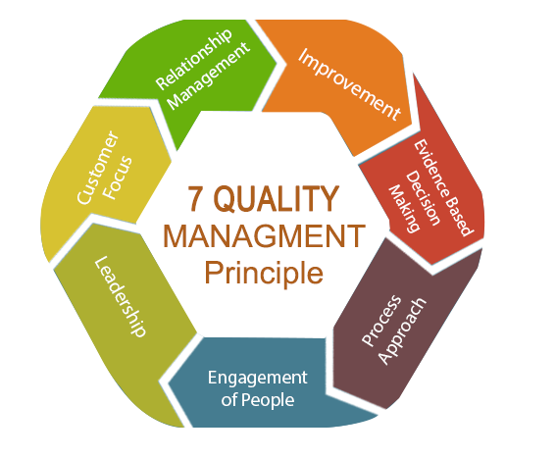
Lecture plan:
ISO 9001 establishes the requirements to implement, document, maintain and improve a QMS and it is based on the quality management principles (7), which are implied in ISO 9000 and therefore also in ISO 9001 (2015):
“Customer focus”,
“Leadership”,
“Engagement of people”,
“Process approach”,
“Improvement”,
“Evidence based decision making”
“Relationship management”.
Quality management principles
ISO 9001:2015 Quality Management System Certification in UK| dubai| oman| qatar| bahrain (traibcert.org.uk)

Slide 6
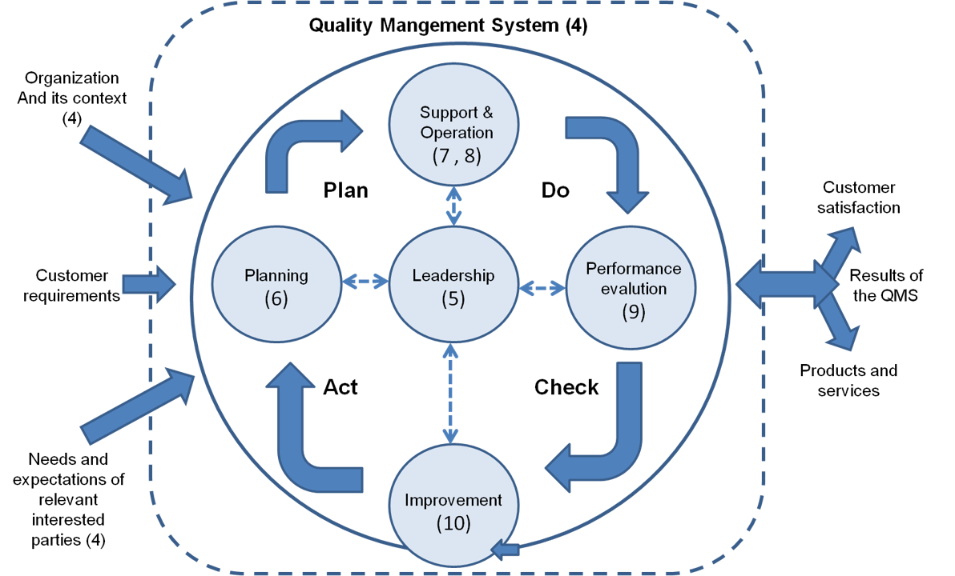
Lecture plan:
Companies implement ISO 9001 and can decide to certify it.
Certification is a process in which a third-party, namely a certification body, audits if the QMS implemented in the organization meets the requirements of the ISO 9001.
The audit process is done in accordance to the company who supports the auditors during the on-site audit.
If the evaluation is positive, the company receives the certificate which is valid for 3 years.
The ISO 9001 certification supports “knowledge management, customer satisfaction and organizational image”
Figure: High level structure
Process approach ISO
Source: ISO (2015)
Source: MT-Hauber-Denise-Christin

Slide 7
Lecture plan:
How do I get started with ISO 9001:2015?
Key tips
Tip 1 – Define your objectives. Why do you want to implement the standard?
Tip 2 – Ensure senior management is on board - it is crucial that everyone is supportive of the initiative and its objectives.
Tip 3 – Identify your organization’s key processes for meeting your objectives and customers’ needs (within each of these processes, ensure you understand your customers’ requirements and can guarantee that these are met).
ISO 9001:2015 Quality Management System Certification in UK| dubai| oman| qatar| bahrain (traibcert.org.uk)

Slide 8
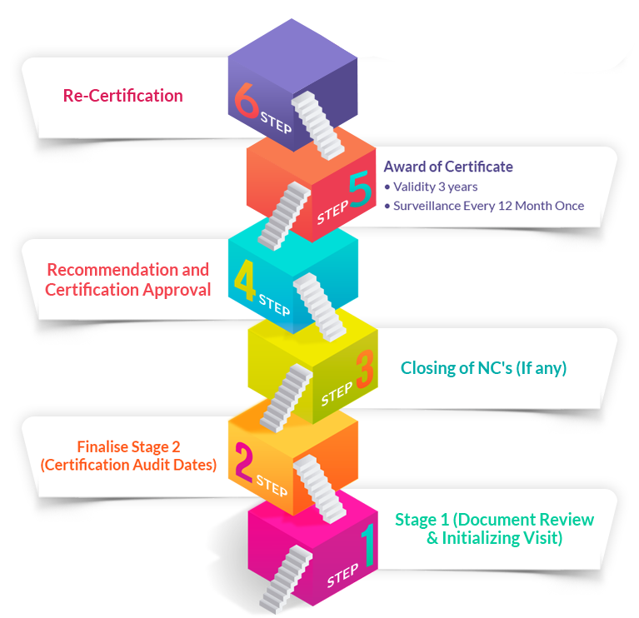
Lecture plan:
Certification Process
Preliminary audit (optional) – stage 1 and 2
Certification audit – stage 3 to 4
Issue Certificate - 4 to 5
Surveillance audits – stage 5
Re-certification – stage 6

Slide 9
CONTACTS
Coordinator of project:
Technical University of Sofia
Department of Textile Engineering
Project Manager of ICT-TEX:
Prof. Dr. Angel Terziev
е-mail: aterziev@tu-sofia.bg
Web-site: ICT-TEX.eu
The information and views set out in this publication are those of the authors and do not necessarily reflect the official opinion of the European Union. Neither the European Union institutions and bodies nor any person acting on their behalf may be held responsible for the use which may be made of the information contained therein.

