Slide 1
Specialized Cluster and Institute of Apparel and Textile „Danube”
WP 7. Mapping and Clustering Entrepreneurial Skills in TCI
TCI ENTREPRENEURIAL LEARNING

Slide 2
Entrepreneurial Syllabus
ENTREPRENEURSHIP IN TCI (total: 30 hours – 5 days * 6 hours)
I BASIC ENTREPRENEURIAL KNOWLEDGE
II ENTREPRENEURSHIP IN TCI

Slide 3
Entrepreneurial Syllabus
ENTREPRENEURSHIP IN TCI (total: 30 hours – 5 days * 6 hours)
I BASIC ENTREPRENEURIAL KNOWLEDGE - 10 hours
Entrepreneurial self-assessment
Basics of business entrepreneurship
Regulation and support of entrepreneurial activity and entrepreneurs
Main stages in the entrepreneurial process: from the idea to the growth

Slide 4
Entrepreneurial Syllabus
ENTREPRENEURSHIP IN TCI (total: 30 hours – 5 days * 6 hours)
I BASIC ENTREPRENEURIAL KNOWLEDGE - 10 hours
Entrepreneurial self-assessment

Slide 5
Entrepreneurial Syllabus
ENTREPRENEURSHIP IN TCI (total: 30 hours – 5 days * 6 hours)
I BASIC ENTREPRENEURIAL KNOWLEDGE - 10 hours
Basics of business entrepreneurship
Basics of Business economy and enterprise
Entrepreneurship and entrepreneur
Innovations and inventions

Slide 6
Entrepreneurial Syllabus
ENTREPRENEURSHIP IN TCI (total: 30 hours – 5 days * 6 hours)
I BASIC ENTREPRENEURIAL KNOWLEDGE - 10 hours
Regulation and support of entrepreneurial activity and entrepreneurs
Institutional support and technical infrastructure
Support programmes by regions and production

Slide 7
Entrepreneurial Syllabus
ENTREPRENEURSHIP IN TCI (total: 30 hours – 5 days * 6 hours)
I BASIC ENTREPRENEURIAL KNOWLEDGE - 10 hours
Main stages in the entrepreneurial process: from the idea to the growth
Entrepreneurial ideas
Assessment of environmental treats
Assessment of entrepreneurial advantages
Starting a new business / enterprise

Slide 8
Entrepreneurial Syllabus
ENTREPRENEURSHIP IN TCI (total: 30 hours – 5 days * 6 hours)
II ENTREPRENEURSHIP IN TCI - 20 hours
Innovations in TCI
TCI environment for entrepreneurs
Business planning for TCI entrepreneurs
Financing of TCI entrepreneurial business
Subcontracting chains and entrepreneurial networks
TCI entrepreneurial roadmap

Slide 9
Entrepreneurial Syllabus
ENTREPRENEURSHIP IN TCI (total: 30 hours – 5 days * 6 hours)
II ENTREPRENEURSHIP IN TCI - 20 hours
Innovations in TCI
Classification of innovations in TCI
Self-assessment of entrepreneurial potential
Self-assessment of innovative ideas
Development programs for TCI innovations

Slide 10
Entrepreneurial Syllabus
ENTREPRENEURSHIP IN TCI (total: 30 hours – 5 days * 6 hours)
II ENTREPRENEURSHIP IN TCI - 20 hours
TCI environment for entrepreneurs
Goals setting and effective TCI business management
Treats and opportunities of TCI environment
TCI entrepreneurial mapping

Slide 11
Entrepreneurial Syllabus
ENTREPRENEURSHIP IN TCI (total: 30 hours – 5 days * 6 hours)
II ENTREPRENEURSHIP IN TCI - 20 hours
Business planning for TCI entrepreneurs
Resources and resource management of TCI business
Production process and human resources of TCI innovative model
Financial results and TCI business sustaining

Slide 12
Entrepreneurial Syllabus
ENTREPRENEURSHIP IN TCI (total: 30 hours – 5 days * 6 hours)
II ENTREPRENEURSHIP IN TCI - 20 hours
Financing of TCI entrepreneurial business
Entrepreneurial capital and its management
Banking financing and industrial leasing schemes
Venture capital, business angels and crowdfunding
Governmental grants for TCI entrepreneurial schemes

Slide 13
Entrepreneurial Syllabus
ENTREPRENEURSHIP IN TCI (total: 30 hours – 5 days * 6 hours)
II ENTREPRENEURSHIP IN TCI - 20 hours
Subcontracting chains and entrepreneurial networks
Subcontracting and industrial networks
Entrepreneurial networks and short supply chains
Technology transfer

Slide 14
Entrepreneurial Syllabus
ENTREPRENEURSHIP IN TCI (total: 30 hours – 5 days * 6 hours)
II ENTREPRENEURSHIP IN TCI - 20 hours
TCI entrepreneurial roadmap

Slide 15
Entrepreneurial Syllabus
3 TYPES of Education ENTREPRENEURSHIP IN TCI
for University students /University entrepreneurship/
for TCI staff /in-business entrepreneurship/
for trainers (teachers/researchers)

Slide 16
Entrepreneurial Syllabus
ENTREPRENEURSHIP IN TCI (total: 30 hours – 5 days * 6 hours)
Main stages in the entrepreneurial process: from the idea to the growth
Motivation
What are your personal strengths and
weaknesses
What are the strengths of your endeavor
Which learning style is best for you
What is your level of knowledge and skills
What else is needed to realize your idea

Slide 17
Entrepreneurial Syllabus
ENTREPRENEURSHIP IN TCI (total: 30 hours – 5 days * 6 hours)
Main stages in the entrepreneurial process: from the idea to the growth
Self assessment test
Self-assessment, test your entrepreneurial potential | BDC.ca
Entrepreneur Quiz: what business suits your personality? (humanmetrics.com)

Slide 18
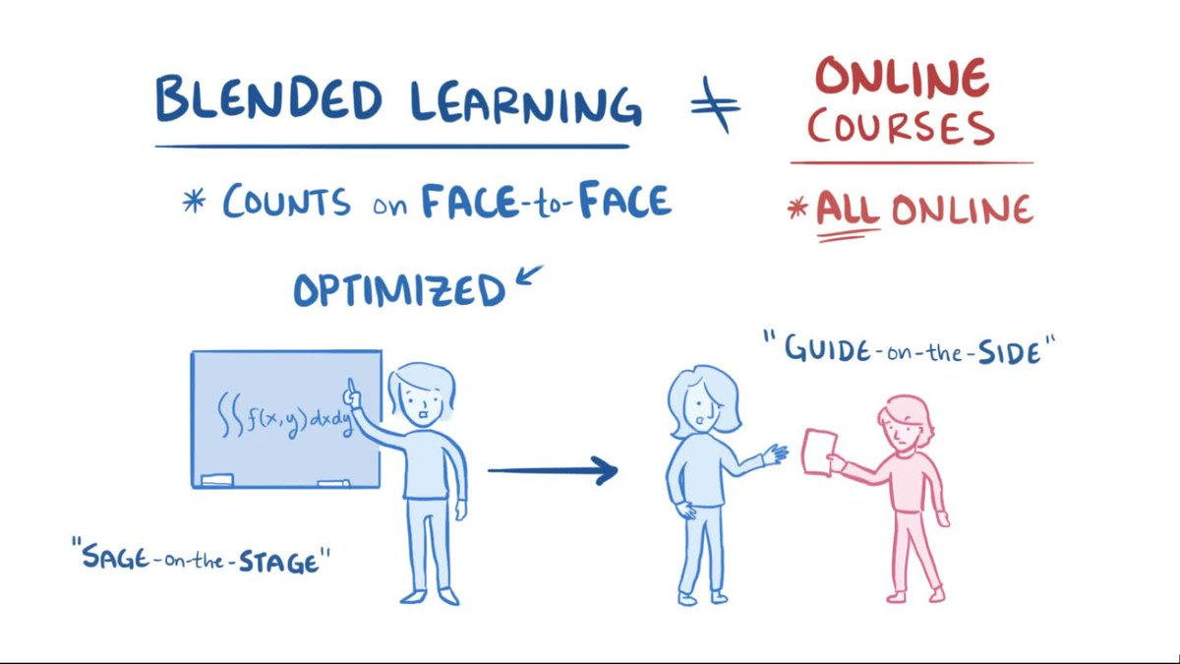
Entrepreneurial Syllabus
ENTREPRENEURSHIP IN TCI (total: 30 hours – 5 days * 6 hours)
Main stages in the entrepreneurial process: from the idea to the growth
Studding to be entrepreneur
Some of us are visual - imagine the things we read. For such people, learning is easier with pictures, diagrams, demonstrations than with textbooks
The auditory type learners say in their mind the things they read and write about. Such people prefer the new information they receive to reach them orally
Others learn through action - they prefer to learn about things by getting to them themselves. In other words, these people learn from their own experience

Slide 19
Specialized Cluster and Institute of Apparel and Textile „Danube”
WP 7. Mapping and Clustering Entrepreneurial Skills in TCI
DISCUSSION

Slide 20
Thank you for your attention
Specialized Cluster and Institute of Apparel and Textile „Danube”
WP 7. Mapping and Clustering Entrepreneurial Skills in TCI

