Slide 1
Specialized Cluster and Institute of Apparel and Textile „Danube”
WP 7. Mapping and Clustering Entrepreneurial Skills in TCI

Slide 2
Agenda
WP 7. Description
Entrepreneurs in Textile and Clothing Industry
The ROAD from business idea to real business
Clustering TCI entrepreneurs
Examples of TCI Entrepreneurial Success
Entrepreneurial Syllabus
Next steps ….

Slide 3
WP 7. Description
1. Preliminary conditions
Introduction of INNOVATIONS needs additional entrepreneurial skills
The technological changes means more FREELANCERS WORK
2. Knowledge of TCI Entrepreneurial practice
Identifying the INNOVATION MODELS and entrepreneurial practices in TCI
Analysing practices of innovations and ENTREPRENEURSHIP inside the TCI businesses
3. Final result
Foundation of the next steps in TCI ENTREPRENEURIAL TOOLS

Slide 4
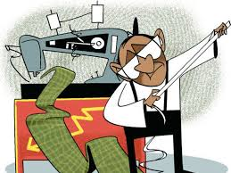
The ROAD from business idea to real business
How the TCI Entrepreneur look like ???

Slide 5
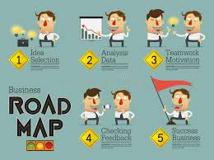
The ROAD from business idea to real business
What is the ROAD map?

Slide 6
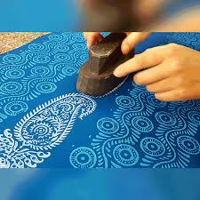
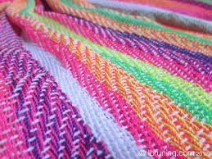
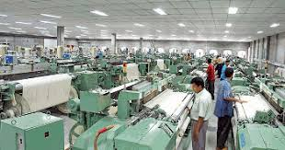
The ROAD from business idea to real business
STOP 1: INNOVATION IDEA
New textile and/or clothing design
New textile fibers or materials
New textile and/or clothing production instruments, techniques or technologies.

Slide 7
The ROAD from business idea to real business
STOP 1: INNOVATION IDEA
IDEA to be a description of a need or problem of some constituency coupled with a concept of a possible solution. (A characterization of this phase is still work in process on this site.)

Slide 8
The ROAD from business idea to real business
STOP 1: INNOVATION IDEA
INCREMENTAL INNOVATION defines improvement within a given frame of solution “doing better than what we already do”.
RADICAL INNOVATION consists of a larger change or “doing what we did not do before”.

Slide 9
The ROAD from business idea to real business
STOP 2: INNOVATION EVALUATION
Evaluation is to ask the question of whether there is an opportunity worth investing in.

Slide 10
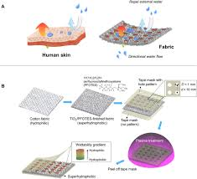
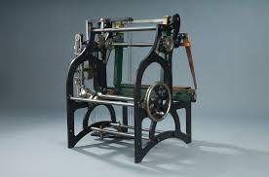
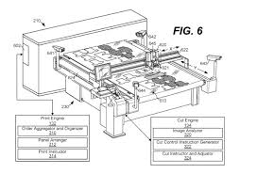
The ROAD from business idea to real business
STOP 2: INNOVATION EVALUATION
4 Elements of Successful innovation idea:
ORIGINALITY
WORKABILITY
RELEVANCE
SPECIFITY

Slide 11
The ROAD from business idea to real business
STOP 3: PLANNING
A plan begins as a fairly simple set of ideas, and then becomes more complex as the business takes shape.

Slide 12
The ROAD from business idea to real business
STOP 3: PLANNING
Financial plans and SEED FUNDING
Angel Investors
State Governments Funds

Slide 13
The ROAD from business idea to real business
STOP 4: BUSINESS LAUNCH
The process of choosing the right form of corporate entity and actually creating the venture as a legal entity.

Slide 14
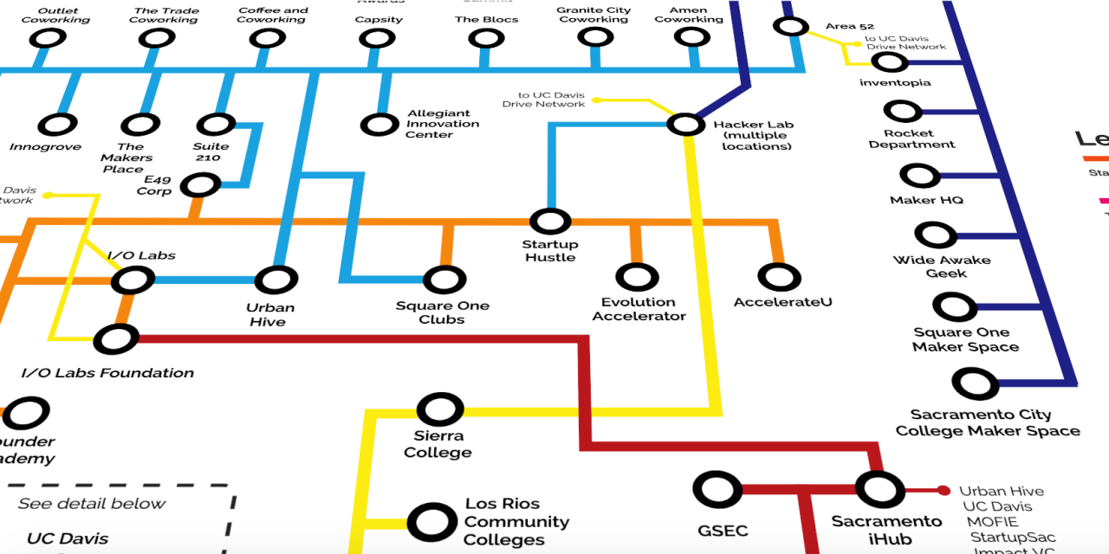
Clustering TCI entrepreneurs
Process of becoming TCI Entrepreneur

Slide 15
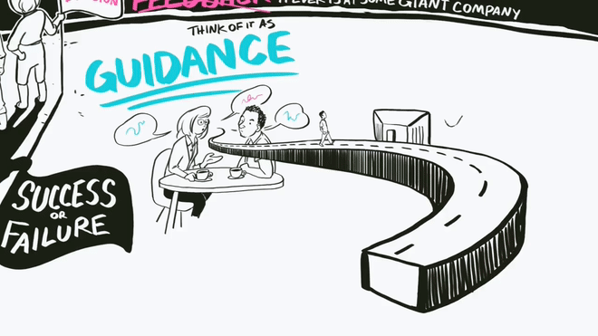
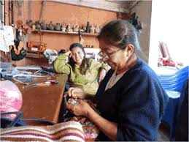
Clustering TCI entrepreneurs
Process of becoming TCI Entrepreneur
University entrepreneur
Business /internal or external/ entrepreneur
Social entrepreneur

Slide 16
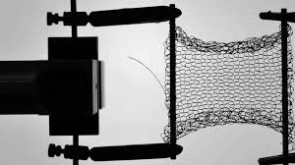
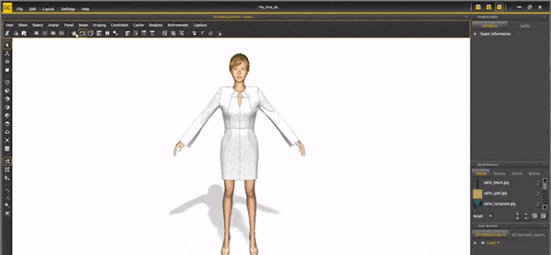
Clustering TCI entrepreneurs
Process of innovation idea support
NEW MATERIAL RESEARCH CENTRES
Textile Research Institute
Universities Textile Research Centres (TRC)
Journals of the Textile industry
Textile and apparel associations

Slide 17
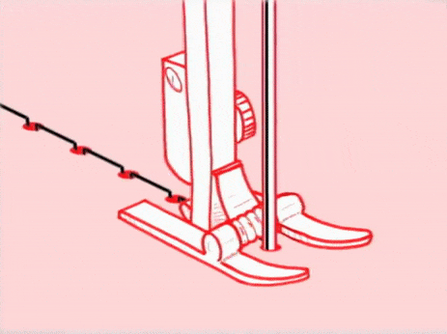
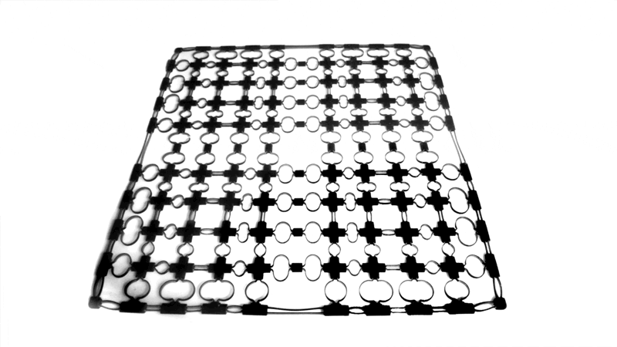
Clustering TCI entrepreneurs
Process of innovation idea support
ENTREPRENEURIAL LEARNING
University Centres for Entrepreneurship
(in)-Business Innovation Centres
TCI START-UP CENTRES
Apparel Incubation Centres
Textile Start-ups platforms (angel.co/textiles)
Start-up Textile Grand Challenge Programs support

Slide 18
Specialized Cluster and Institute of Apparel and Textile „Danube”
WP 7. Mapping and Clustering Entrepreneurial Skills in TCI
DISCUSSION

Slide 19
Next steps ….
Case studies on Successful TCI entrepreneurs in EU
Finalizing the Report on Mapping and Clustering TCI Entrepreneurship
Publishing booklet with the report, incl. case studies

Slide 20
Thank you for your attention
Specialized Cluster and Institute of Apparel and Textile „Danube”
WP 7. Mapping and Clustering Entrepreneurial Skills in TCI

