Slide 1
TOPIC 2. ENTREPRENEURIAL SELF-ASSESSMENT

Slide 2
AGENDA
Studying How to Become an Entrepreneur
Entrepreneurial Competencies
Entrepreneurial Personality
Entrepreneurial Motivation
Entrepreneurial SWOT Analysis
Entrepreneurial Self-Assessment Tests

Slide 3
Why study entrepreneurship
Owning a business is not for everyone. But that is okay because both employees and entrepreneurs are needed in the world of work. Whether or not you choose to become an entrepreneur, the things you will learn in studying entrepreneurship can benefit you in many ways. There are two primary reasons why studying entrepreneurship makes sense, even if you do not plan to be an entrepreneur:
you learn to think like an entrepreneur;
you develop a vision for your life.

Slide 4
Think like an entrepreneur
Thinking like an entrepreneur and being conscious of how to make a business run more successfully can help you be a better employee. You can treat someone else’s business as if it were yours. Employers often promote these kinds of employees, the ones who think entrepreneurially. Here are three ways to think like an entrepreneur when you are working as an employee:
Observe. Keep on the lookout for chances to learn new skills and accept new responsibilities. Staying aware of what goes on around you can help generate new ideas for business growth. This includes ideas for new products or services that customers may need or want.
Listen. Pay attention to what others have to say. Challenges that other employees are facing may give you ideas for making business improvements.
⦁ Think. Instead of complaining about a problem, analyze it. Then suggest possible solutions.

Slide 5
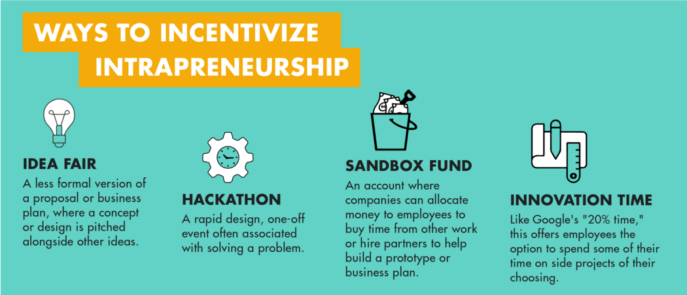
Intrapreneurship
More and more businesses today encourage the practice of intrapreneurship.
That is, they give employees opportunities to be creative and try out new ideas, almost like being an entrepreneur within the company.
Source: https://mitsloan.mit.edu/

Slide 6
Develop a vision for your life
Learning about entrepreneurship often inspires people to develop a vision for their life. A vision is a “picture” of what you want the future to be.
What kind of life do you want?
What things are most important to you?

Slide 7
Learning styles of entrepreneurs in the TCI
The visual type learners imagine the things they read. For such people learning is easier with pictures, diagrams, demonstrations than with textbooks.
The auditory type learners say in their mind the things they read and write about. Such people prefer the new information, which they receive, to reach them orally.
Others learn through action - they prefer to learn from their own experience.

Slide 8
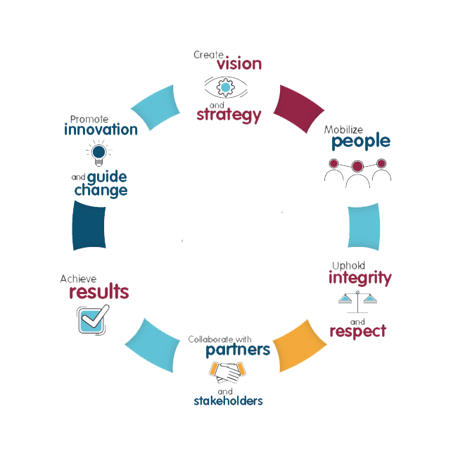
Entrepreneurial competency profile
Becoming a successful entrepreneur requires planning, creativity and hard work, and it also involves taking risks. The main entrepreneurial competencies can be divided into three main groups:
Technical competencies;
Business competencies;
Entrepreneurial competencies.

Slide 9
Entrepreneurial skills
A skill is an ability that is learned through training and practice. Some of the basic skills, the entrepreneurs need, are:
Business Skill: Understanding how to create and manage a business.
Communication Skill: The ability to listen well, write well, and speak well.
Computer Skill: The ability to use technological tools effectively.
Decision-Making and Problem-Solving Skills: Knowing how to apply logic, information, and past experiences to new decisions and problems.
Organizational Skill: The knack of keeping tasks and information in order; the ability to plan well and manage your time.
Teamwork Skills: The ability to persuade and motivate people; knowing both how to be a leader and work in a team.

Slide 10
Entrepreneur’s qualities
Innovation and creativity;
Persistence and resiliency;
Flexibility;
Openness to experience;
Agreeableness;
Tolerance towards ambiguity;
Risk-taking propensity;
Locus of control;
Self-sufficiency;
Freedom;
Networking ability;
Passionate;
Resilient;
Self-possessed;
Decisive;
Fearless;
Financially prepared;
Flexible;
Zoom lens-equipped;
Able to sell;
Balanced;
Other.

Slide 11
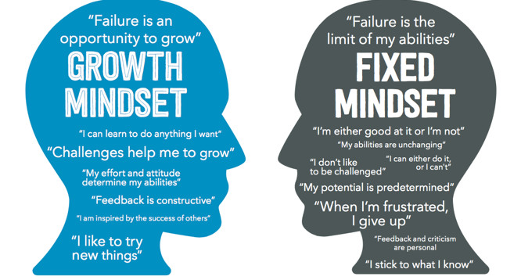
The entrepreneurial mindset

Slide 12
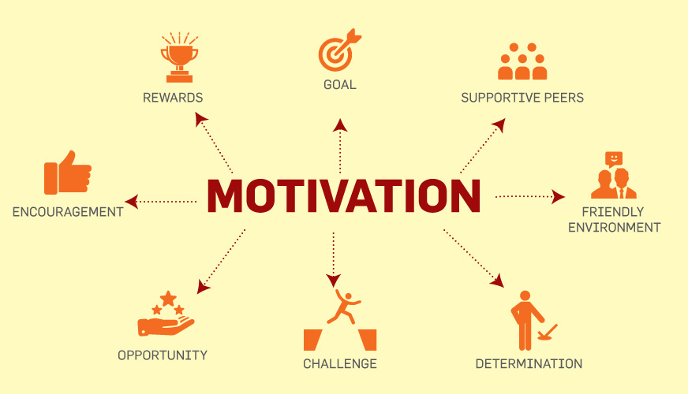
Entrepreneurial motivation
Set new goals;
Generate new ideas;
Focus on your dream;
Stay positive.

Slide 13
Entrepreneurial SWOT analysis
SWOT analysis is an extremely useful technique that allows you to focus on the potential you have for business development, identification and problem solving. You can also use it later to deal with all kinds of situations. The abbreviation SWOT comes from the English words Strengths, Weaknesses, Opportunities and Threats.

Slide 14
Entrepreneurial strengths
Communication skills;
Abilities;
Handling time;
Using resources;
Experience;
Knowledge;
Networking;
Personal motivation;
Always with new ideas;
Geographical location;
Qualifications;
Working with IT;
Do you finish everything you do;
Support from family and friends;
Own savings;
Other.

Slide 15
Entrepreneurial weaknesses
Personal circumstances;
Lack of qualities;
Reputation;
Vulnerability;
Can't work with deadline and under pressure;
Lack of finances;
Lack of qualifications;
Moral qualities, leadership qualities;
No support;
Find it difficult to work with documentation;
Lack of self-confidence
Other.

Slide 16
Entrepreneurial opportunities
Often asked to work for other people;
Your children have already grown up and will soon leave your home;
Technological innovation and development;
New markets, including the Internet;
Could you move to a new location;
Do you have friends abroad;
New training courses and programmes;
More entertainment;
Are your friends inviting you to do something new;
Influence of seasons, weather;
Need more money to invest;
Other.

Slide 17
Entrepreneurial threats
Politically - losses from state aid;
Legislative provisions;
Impact on the environment;
IT development - lack of skills;
Family responsibilities;
Debts;
Obstacles - health problems;
The weather, the seasons;
Obstacles of a family nature;
Lack of security;
Other.

Slide 18
Assignment
In the following questionnaires are present questions that will help you understand how confident you are, how you would manage your business and what you need to learn to become better.
There are no right or wrong answers, because all people are different! It is important to say exactly what you think so that what you say corresponds exactly to the way you feel.
Answer all questions!
Self-assessment, test your entrepreneurial potential | BDC.ca
Entrepreneur Quiz: what business suits your personality? (humanmetrics.com)
Understand Yourself - Personality Test (personalitylab.org)
The 300-Question Personality Test (truity.com)

Slide 19
Questions for discussion
What entrepreneurial skills do you think would be necessary to start a business in the T&C industry?
No one is born with all the characteristics needed to be a successful entrepreneur. Make a list of personality traits you already possess. Then focus on the ones you think you need to develop for starting a fashion business. Think about how can you develop them and become a successful entrepreneur?
Do you think you have the qualities of the successful entrepreneur?
How can learning about entrepreneurship help you to be a better employee?
Develop a vision and mission for your life now, as a student. Then develop a vision and mission for your future life.

Slide 20
Questions for discussion and tasks
Form a discussion panel to debate whether the rewards of entrepreneurship outweigh the risks. Half of the panel should focus on the rewards of entrepreneurship and the other half on the risks.
Do you have the knowledge and the right information for establishment a micro or small business?
Why do you think an entrepreneur might choose to keep a business small rather than expand it?
Try to arrange an interview with an entrepreneur from your country (if possible in the T&C business) and discuss with him/her the risks and rewards involved in starting his or her business. Ask this individual to share stories of successes and failures. Ask which personal characteristics or skills have contributed most to business success. Then ask what the owner would do differently if starting the business today.

