Slide 1
TOPIC 3. MAIN STAGES IN THE ENTREPRENEURIAL PROCESS IN THE TEXTILE AND CLOTHING INDUSTRY

Slide 2
AGENDA
Entrepreneurial Process in the TCI
Entrepreneurship Business Idea Generation for the TCI
Business Idea Evaluation and Selection

Slide 3
Entrepreneurial process: from the idea to its growth
Stages of the entrepreneurial process
Idea generation: every new venture begins with an idea. In our context, we take an idea to be a description of a need or problem of some constituency coupled with a concept of a possible solution.
Opportunity evaluation: this is the step where you ask the question of whether there is an opportunity worth investing in. Investment is principally capital, whether from individuals in the company or from outside investors, and the time and energy of a set of people. But you should also consider other assets such as intellectual property, personal relationships, physical property, etc.

Slide 4
Stages of the entrepreneurial process
Planning: You need a plan for how to capitalize on that opportunity. A plan begins as a fairly simple set of ideas and then becomes more complex as the business takes shape. In the planning phase you will need to create two things: strategy and operating plan.
Company formation/launch: Once there is a sufficiently compelling opportunity and a plan, the entrepreneurial team will go through the process of choosing the right form of corporate entity and actually creating the venture as a legal entity.
Growth: After launch, the company works toward creating its product or service, generating revenue and moving toward sustainable performance. The emphasis shifts from planning to execution. At this point, you continue to ask questions but spend more of your time carrying out your plans.

Slide 5
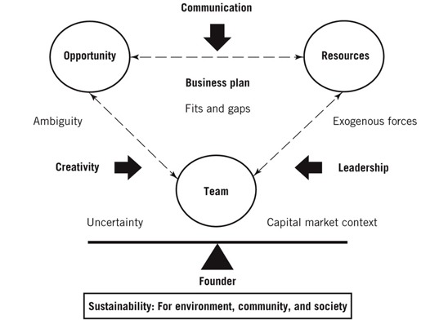
Timmons’ model of the entrepreneurial process
Source: www.venturefounders.com

Slide 6
Stanford d.school’s design thinking process
Source: www.researchgate.net/figure/Stanford-dschool-Design-Thinking-Process-Schmarzo-2017_fig2_338741533

Slide 7
Your business idea
What are your passions and skills?
You will be the engine behind your idea. If this is your first business, you will soon realize that there are ups and downs, and you’ll realize how hard you have to work to succeed. Your passion will make your work easier. It will make you endure the downs, and it will help you push through the tough periods. What passions do you have that can be related to the apparel industry? Are you a skier? Do you love sportswear? Are you streetwear obsessed? You will work 24/7 on your business, and if your passion doesn’t lie here, you should then not start with the idea.
Trust your gut feeling. You know deep down inside what you want to do. Trust your intuition!

Slide 8
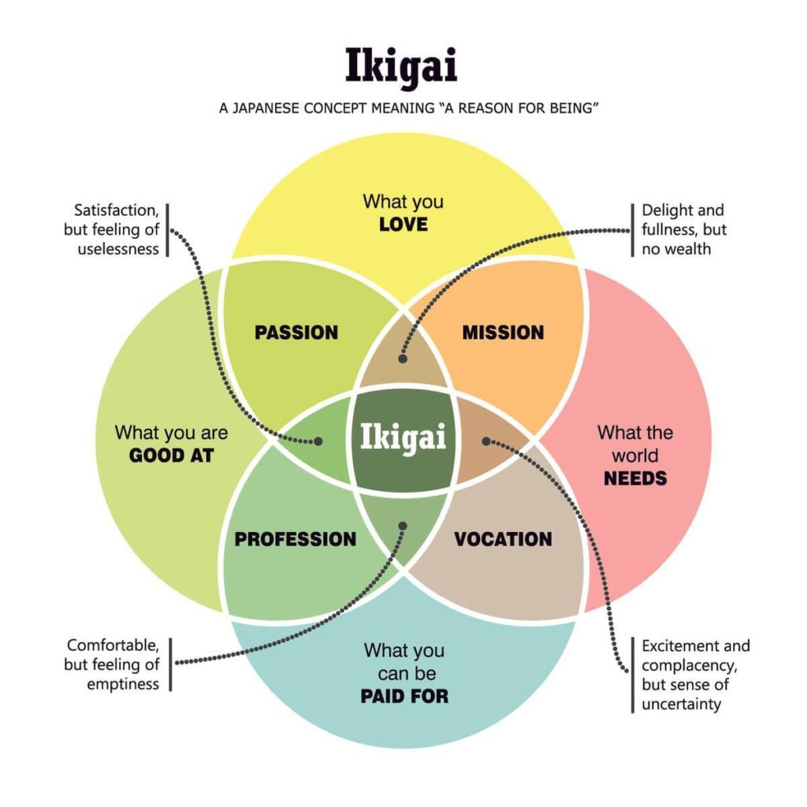
Your business idea
What are you interested in?
Often times the best ideas come from doing what you enjoy most - which is why personal passions or hobbies often lead to rewarding businesses. Do you have a special talent or skill that could be an idea generator? Even minor interests can lead to innovation.
What do you have to offer?
In addition to doing what you enjoy, ask yourself what aspects of your work do you do well and what you do not do so well. Knowing what you can offer and in which areas you excel are essential to building a business.
Source: www.reddit.com

Slide 9
Your business idea
What values do you want to run your business by?
The apparel market is extremely saturated. Today’s customers buy brands based on values and what they stand for.
What do you want?
One of the most important considerations when planning a business is pinpointing what you want to get out of it. Whether it is making money, working with and creating something you’re passionate about, or just being your own boss - it’s important to know whether your business idea will give you the life you want.
What are current market and consumer trends?
Successful entrepreneurs are always on the lookout for new opportunities in the market. While these ideas don't always have to stem from what you already do, it certainly helps if you can combine what's hot with your existing know-how, expertise, or passion in life.

Slide 10
Business idea generation methods
Brainstorming;
Method of association and analogies;
Trial and error method;
Method of control questions;
Synectic method;
Morphological analysis;
Delphi method
Focus groups
Problem inventory analysis
Analogous business

Slide 11
Business idea generation methods
Brainstorming - it is a group method for obtaining new ideas and solutions. It is based on the fact that people can be stimulated to greater creativity by meeting with others and participating in organized group experiences. The characteristics of this method are keeping criticism away; freewheeling of idea, high quantity of ideas, combinations and improvements of ideas. Such type of session should be fun with no scope for domination and inhibition.
Focus groups - these are the groups of individuals providing information in a structural format. A moderator leads a group of people through an open, in-depth discussion rather than simply asking questions to solicit participant response. Such groups form comments in open-end in-depth discussions for a new product area that can result in market success.

Slide 12
Brainstorming ideas
Source: www.collaboard.app/brainstorming-session-more-effective-with-online-whiteboard

Slide 13
Business idea generation methods
Problem inventory analysis - it is a method for obtaining new ideas and solutions by focusing on problems. This analysis uses individuals in a manner that is analogous to focus groups to generate new product areas. However, instead of generating new ideas, the consumers are provided with list of problems and then they are asked to have discussion over it and it ultimately results in an entirely new product idea.
Analogous business - in the textile industry, but operating in other geographic markets or outside of the textile industry and which are recognized for their innovation. What kinds of innovation drove them to success? How those innovations are applicable to your industry and company? What could you replicate in your business to create a market opportunity?

Slide 14
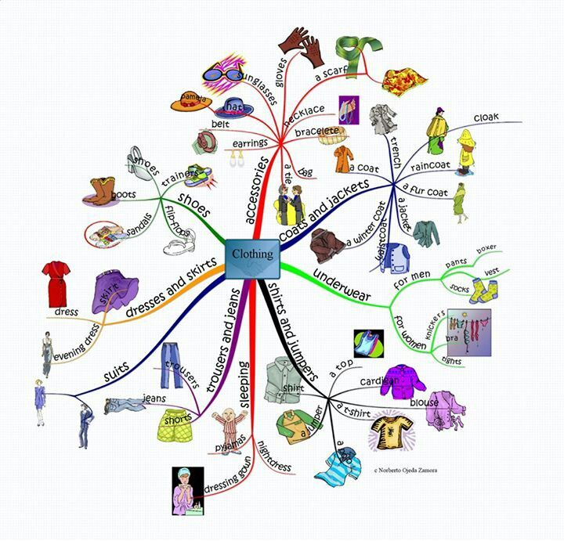
Business idea generation techniques
Storyboarding;
Mind mapping;
Sketching as a group;
Creating word banks;
Thinking hats technique;
Role playing;
Reverse thinking.

Slide 15
Assignment 1
Do you already have a T&C business idea?
Your idea, your values, your way of “seeing” things is a superpower that can launch something remarkable.
Using one of the above methods, generate three T&C business ideas that best suit your personality.
Generate an idea for a new fashion brand, depending on your interest, competency and experience, working in a team of two or three persons and present your idea to the other teams.

Slide 16
Business idea evaluation and selection
Considering the viability of the idea
01
Selecting one of the best business ideas
02
03
04
SWOT - analysis of the best business idea
Final decision

Slide 17
Checklist for selecting ideas
How familiar are you with this area?
Will you have to spend extra time and money to learn how to do business?
Will you get a partner?
Have you worked or owned such a business?
To what extent is personal experience crucial for business?

Slide 18
Checklist for selecting ideas
Assess the costs of starting a business and the barriers to competition that may exist.
Does the idea require relatively little investment, but if there are already others who perform it?
You need to differentiate your product or service from others that are already in business.

Slide 19
Entrepreneurial idea selection canvas
How many ideas can you choose?
If the answer is "zero," use the list to determine where you need to develop a strategy for the existing ideas
1
If the answer is "more than one," you are faced with a pleasant dilemma: to choose which of all the businesses to start.
2
If the answer is "one", you've probably found the business that's right for you.
3

Slide 20
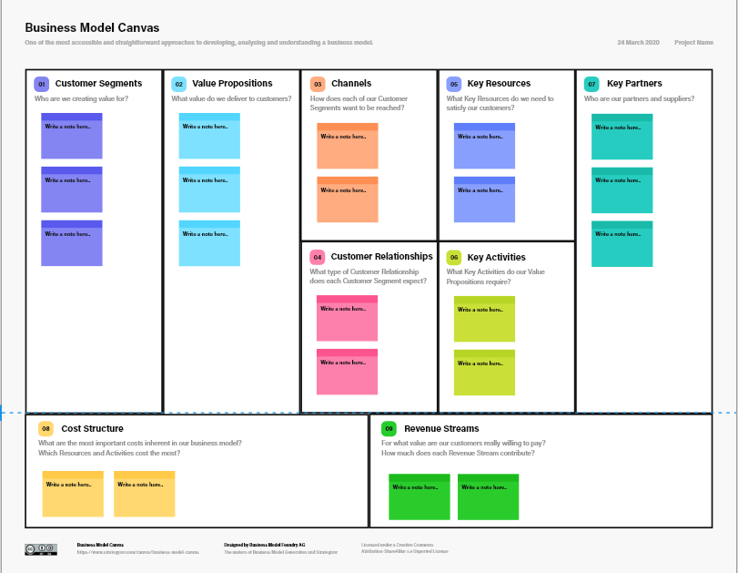
Business model canvas
Source: www.strategyzer.com

Slide 21
Business mandala canvas
Source: www.thebusinessinstitute.eu

Slide 22
Assignment 2. SWOT - analysis
Make a SWOT analysis of your TCI business idea. List the strengths, the weaknesses, the opportunities and the threats and assess them. Evaluate your idea as a business opportunity.
Source: www.en.wikipedia.org/

Slide 23
Questions for discussion and tasks
What is the entrepreneurial pathway from the idea to its growth?
What are the main elements of the Timmons’ model?
How to generate more business ideas?
What techniques for generating business ideas do you know?
How to select appropriate ideas?
Make a list of at least 5 interests. What do you enjoy doing? What industry do you know a lot about? Which of those interests can you benefit from in your new T&C business?
Make a list of at least 5 things you’re good at. What are you great at doing? What comes easily to you? Which of those skills can you apply in your new T&C business?

