Slide 1

TOPIC 7. VALUE AND SUBCONTRACTING CHAINS IN THE TEXTILE AND CLOTHING INDUSTRY

Slide 2
AGENDA
Value Chain in TCI
Subcontracting Chain in TCI
Supply Chain in TCI

Slide 3
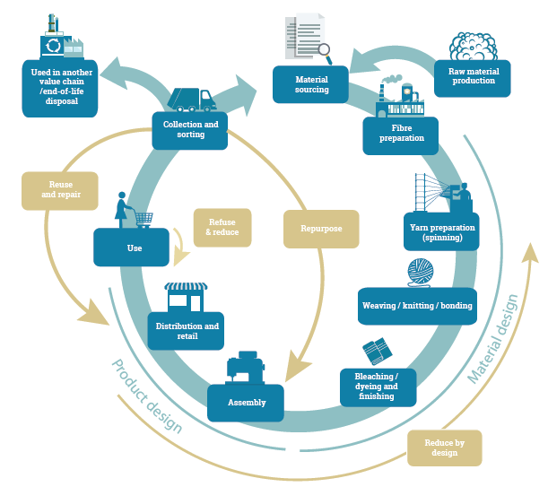
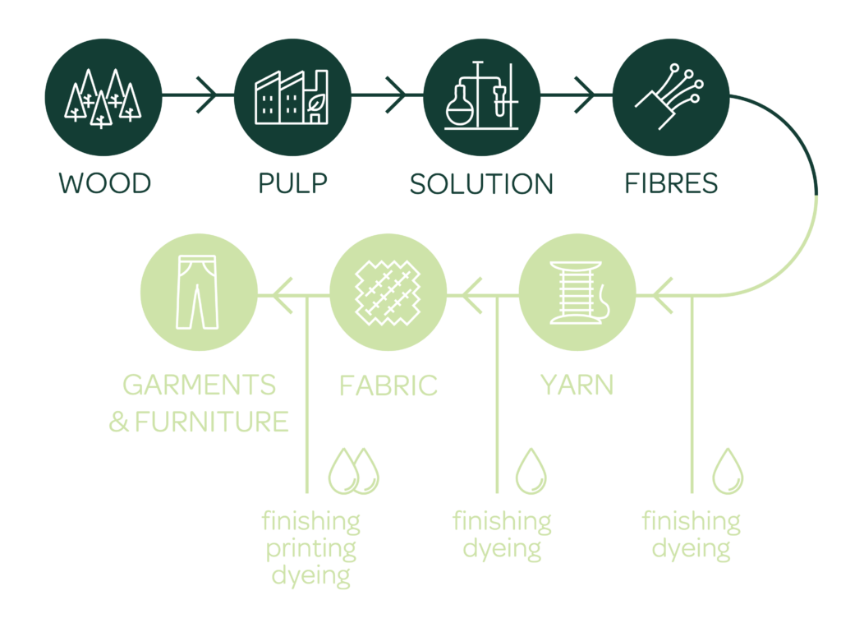
Value chain definition
Value chain: All activities and organisations, associated with the flow and transformation of goods from the raw materials stage through to the end user, as well as the associated information flows.
Source: www.oneplanetnetwork.org

Slide 4
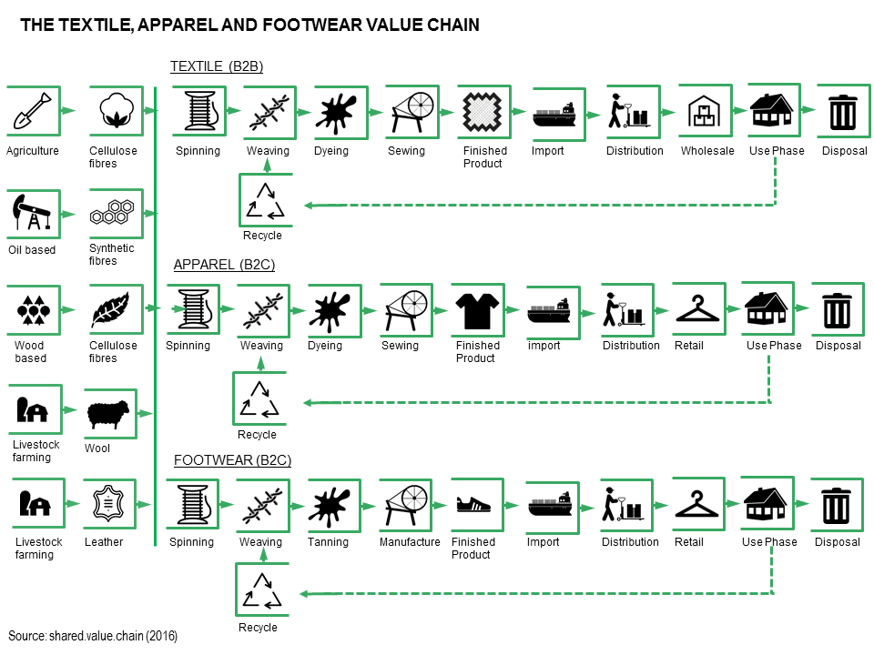
Textile, apparel and footwear value chain
Source: www.sharedvaluechain.com

Slide 5
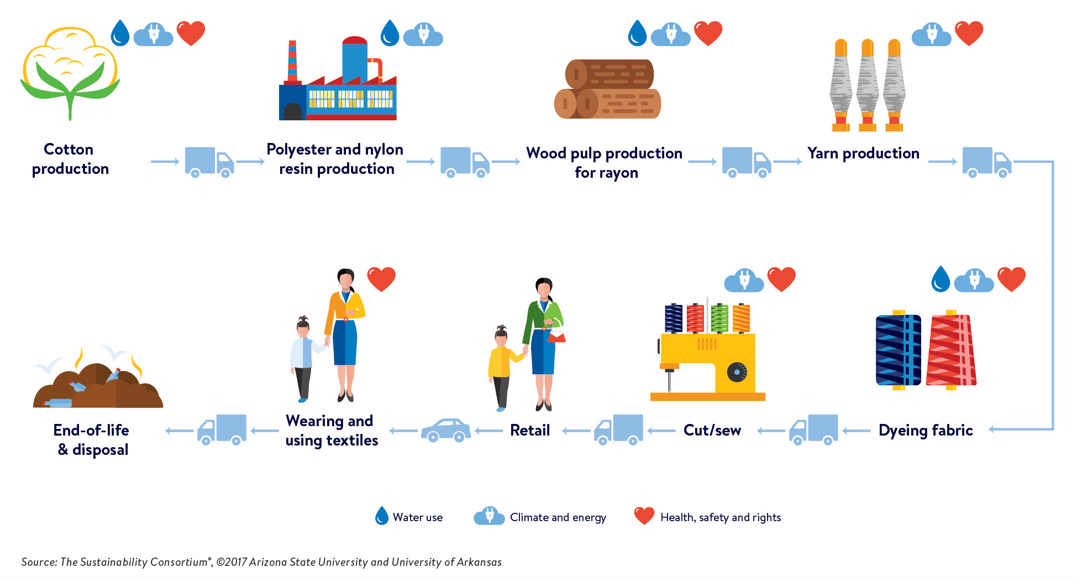
Source: Euratex
Source: www.cdn.corporate.walmart.com

Slide 6
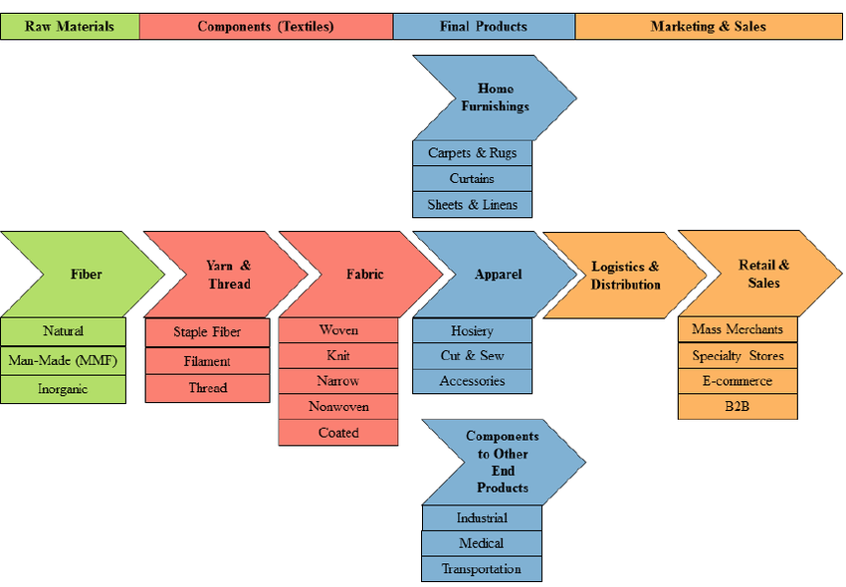
Source: www.researchgate.net/figure/Textile-Apparel-Value-Chain_fig1_290435588

Slide 7
Subcontracting definition
Subcontracting: Business arrangement by which one firm (the contractor or "principal"), contracts with another firm (the "subcontractor"), for a given production cycle, one or more aspects of production design, processing, manufacture, construction or maintenance work.
Subcontract manufacturing: is the process by which a subcontractor performs all or part of the manufacture of the principal’s product, to customized specification (of varying detail) provided by the principal.
A subcontracting chain: is a part of total supply chain from raw materials to finished products including subcontractors. The subcontracting chain is responsible for manufacturing activities on a long-term basis.

Slide 8
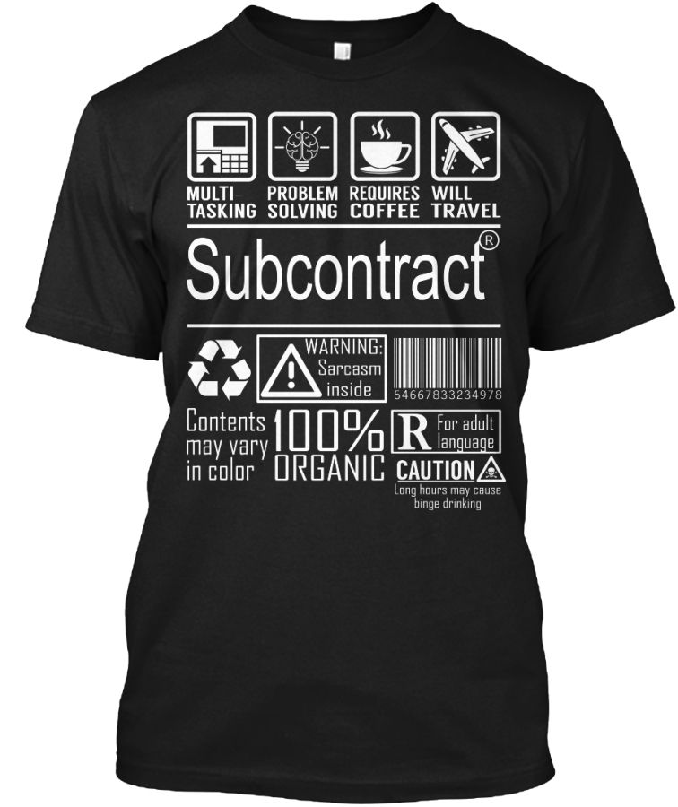
Definitions
Subcontractor: The enterprise that is contracted by a contractor for the production design, processing, manufacture, construction or maintenance work.
Contractual agreement to manufacture textile products usually states the quantity, type, quality, deadline, and price for which the subcontractor must deliver.

Slide 9
Reasons for existing subcontracting business in the T&C industry. Buyers’ demands:
Very short lead times as the time factor is increasingly important in the fashion industry.
Uncertainty of order volume round the year;
Getting control over manufacturing cost;
Keep away labour issues;
Last-minute changes as buyers may change designs, production volumes and production schedules;
Lack of knowledge about the supplier’s production schedule/capacity as the most famous brands and retailers have spread production over hundreds or even thousands of suppliers;
Inadequate monitoring as the fashion industry rarely inspects their suppliers’ factories.

Slide 10
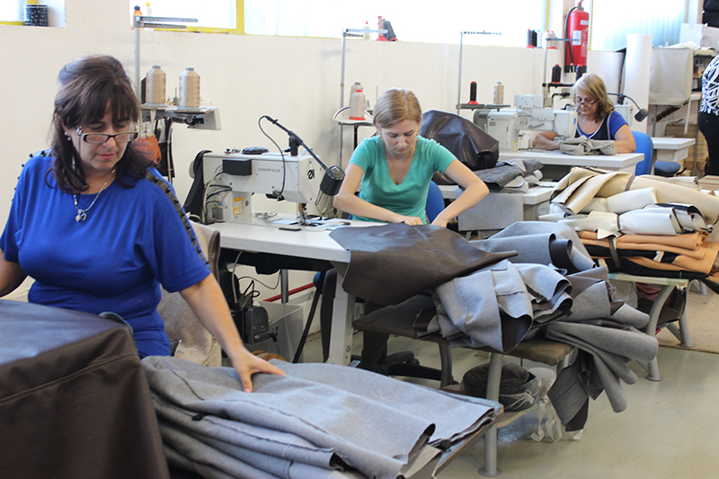
Reasons for existing subcontracting business in the T&C industry. Suppliers needs:
Lack of capacity.
Poor production planning.
Late arrival of inputs.
Money speaks.
Worker actions.

Slide 11
Subcontracting characteristics
  In the T&C industry, large, high wage firms tend to play the role of the parent firm, and small, low wage firms the role of subcontractor.
  The subcontracting relations in the T&C industry seem to be short-term relationships. Long-term, specialization (and supplier) subcontracting seems to be quite important in the engineering industry.
  Subcontract offering firms tend to produce final products and spend more on advertisement activities than other firms.
  Foreign firms do not help in establishing a network of small subcontractors. Subcontracting flourishes where many firms are located in the same region.
  The subcontracted factories and workplaces are not formally part of the buyer’s supply chain and thus corporate social compliance audits do not take place there.

Slide 12
Workflow of subcontracting business in T&C industry
A subcontractor sets up a factory with sewing machines and contact with exporters for work. They show their expertise in products and facility they have to exporters and possible clients.
Garment exporters contact with subcontractors in their location, show their samples to subcontractors and fix price per piece for making garment (in most cases – stitching only).
Subcontractor gets cutting from exporters instead of fabrics.
All trims and accessories are normally provided by exporters. If required, trims can be purchased by subcontractors. And expenses are billed to the exporters.

Slide 13
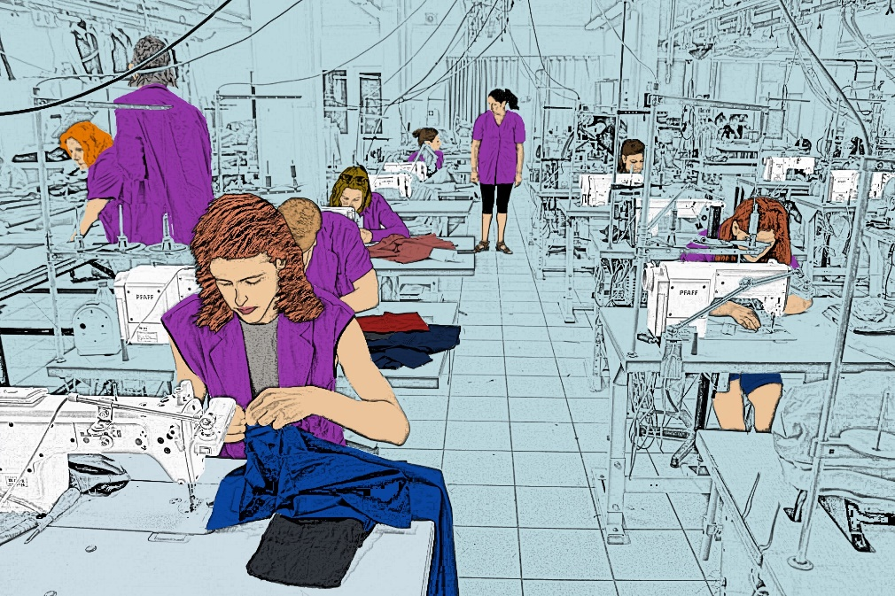
Workflow of subcontracting business in T&C industry
Subcontractor stitches garments. A partial garment stitch or complete garment stitching is done. Subcontractors employ pieces rate operators for sewing. Stitching quality is checked by quality assurance team from the export house.
Stitched garments are sent back to the exporter after inspection.
Exporters check quantity received and product quality.
Subcontractor generate invoice for each order.
Subcontractors receive payment for their work.

Slide 14
Subcontracting types
Product subcontracting: Principal firm contracts out complete products to subcontractor but performs marketing and sales functions. Complete apparel subcontracting by retailers/brands/buying houses is one of the common examples in the textile industry.
In selecting ‘subcontractor’, the most principal firms place greater emphasis on that subcontractor produces high quality products, cheaply in a given time. Other criteria are soundness of management, ability to chase delivery times, ability to offer quality assurance, ability to develop technology and planning and proposal capability.
In apparel supply chain garment exporters receive original contract from apparel brands, international buyers or retailers. These export houses get their excess production done from subcontractors.

Slide 15
Subcontracting types
Export garment manufacturers: In pick seasons garment exporters book orders more than their own production capacity. In such situation, they look for subcontractors to get production done. In this business process, many times exporters get production done at lower cost than it would cost then by producing in-house.
Brands: Domestic brands those don't have their own manufacturing facility, give cut-make-pack orders to subcontractors. Fabric and trims are sourced by brands and given to subcontractors.
Designers: Designers need small quantity of garments in particular designs. They prefer sourcing fabrics and accessories by their own. They just need to stitching work by others. So they reach to subcontractors.

Slide 16
Subcontracting types
Subcontractors or manufacturers: producers able to fulfill the orders on time according to the wishes and needs of the customer in the requested quality.
In the T&C industry, a subcontracting unit is a factory that mainly does garment stitching work. They do not need to set-up other facilities and staffs for layer cutting, garment finishing, and packing activities.
An export house can also work as a subcontractor. When an export house doesn't get enough direct business they take work from other export houses. So there is no fix definition that sub-contractors only sew garments. They can take subcontracting work from cutting to packing, provided they have in-house facilities for these.

Slide 17
Subcontracting types
Specialist subcontracting: This type of subcontractor usually has specialized machinery or equipment and skilled labors to undertake complex and precision tasks.
Some specialist activities in the apparels like printing, embroidery, stone effects, brushing, normal wash, enzyme wash, hand stitch, and special stitches etc., are subcontracted to small firms/subcontractor.
CAD CAM Services offer solutions to some common problems such as:
Problem with opening a pattern because of incompatibility of the software.
Problem with graduation.
If you just need to line or multiply markers and do not have the proper technique (for example plotters).

Slide 18
Subcontracting types
Suppliers of machinery and equipment: Manufacturers can obtain the specific machinery or equipment. As manufacturer you can buy or rent (if necessary to execute a specific order, for example) a particular machine or equipment.
Supplier of basic (fabrics, lining) or auxiliary materials (buttons, threads, accessories etc.): The producers need to purchase materials for their production from different type of suppliers - large and established manufacturers, as well as from smaller or retailers, according to the needs.

Slide 19
Subcontracting types
Bloggers, Influencers, Models through which companies can present their collections of various fashion shows and events, promote their brand on social networks, as well as present their products the best way when advertising them.
Designers, Modelers Or Studios with whose help companies can realize their new collections.
Logistics: Services of courier and transport companies offered nationally and internationally.
Outsourcing (external services): They offer various administrative, legal, consulting or marketing services in the field of fashion like Lawyers, Notaries, Fashion Consultants and Studios, Marketing Agencies, Catering, Printers and more.

Slide 20
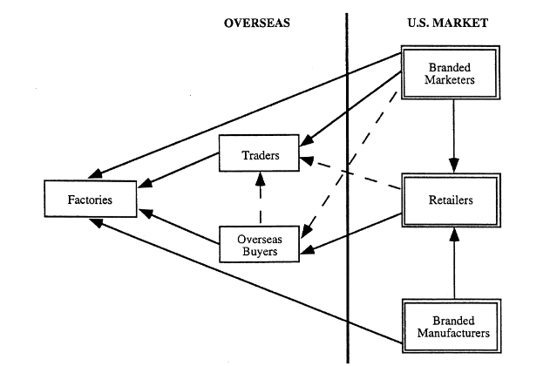

Assignment 1
Is subcontracting good enough? See the given examples of textile or garment subcontracting: International trade and industrial upgrading in theapparel commodity chain. Think about the positive and negative sides of each flow (arrow) of them.
Something positive
Something negative

Slide 21
Upgrading in global value in textile and apparel sector:
  Leverage the subcontracting system based on building FOB capacities of large and medium enterprises and developing direct buyer relationships on CMT basis where possible for small enterprises.
  Invest in design and branding capacities.
  Invest in sourcing and supply chain management capacities with a focus on regional sourcing.
  Boost efforts for market diversification and remove the weak coordination of these efforts.
  Support product diversification.
  Boost efforts to promote regional value chains as a higher ability to export regionally could also help firms to expand into new markets.
  Promote social upgrading and environmental sustainability.

Slide 22
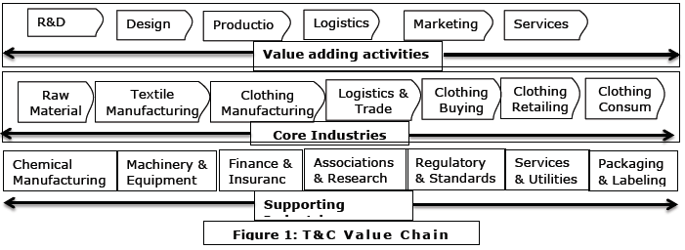
Supply chain
Source: https://www.textiletoday.com.bd/subcontracting-in-textile-and-clothing-sector-in-bangladesh/
Notes:
T&C sector is substantially buyer-driven (i.e. retailing sector) while few parts of the complex supply chain are producer driven (yarn, fabrics, traditional handloom products). T&C manufacturing industry uses higher number of subcontracting activities among all manufacturing and engineering industries.

Slide 23
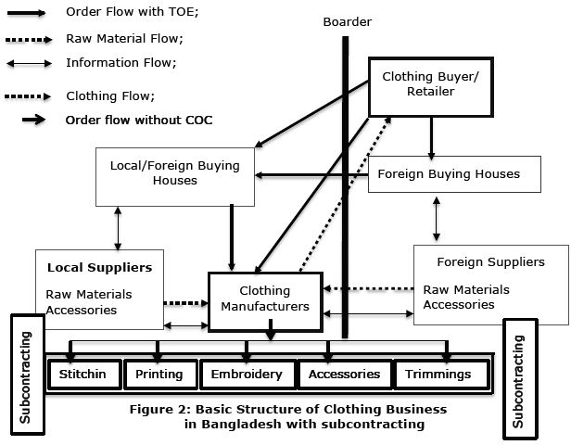
Supply chain
Source: https://www.textiletoday.com.bd/subcontracting-in-textile-and-clothing-sector-in-bangladesh/

Slide 24
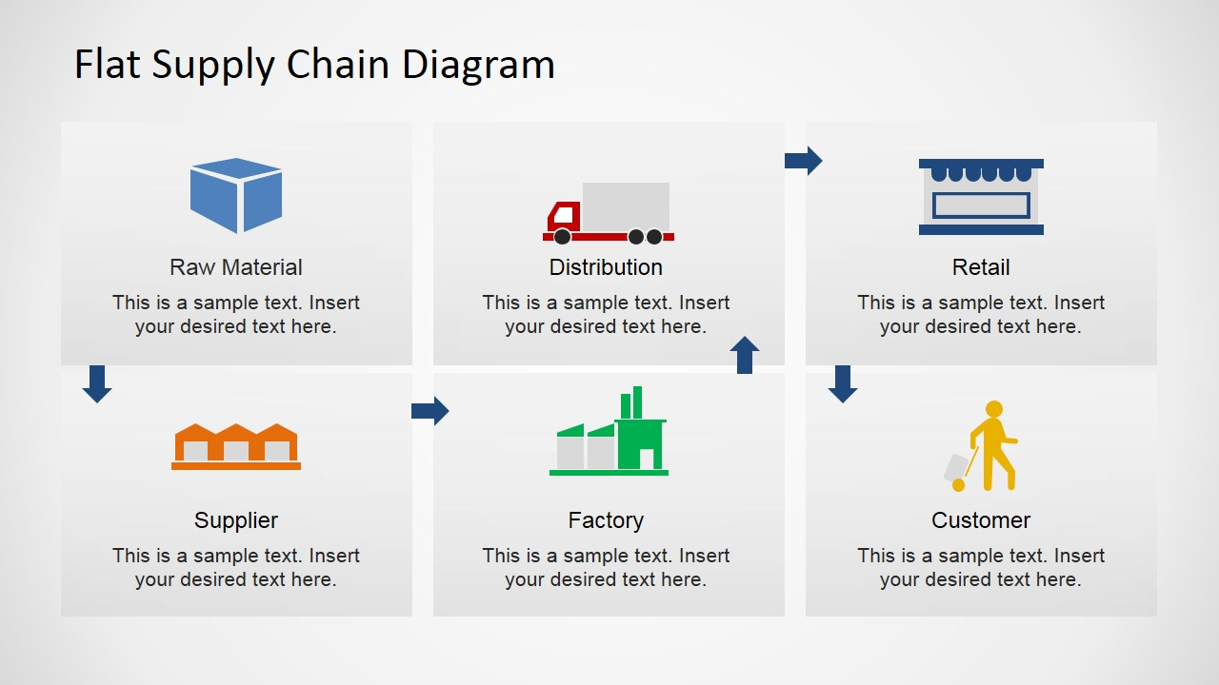
Flat supply chain diagram

Slide 25
Supply chain management
Source: i1.wp.com

Slide 26
Entrepreneurial networks and short supply chains
A supply network is defined as a set of inter-connected supply chains, embodying the flow of goods and services from original sources to end customers.
Source: Operations network of the focal firm (modified from Zheng et al. 1999).

Slide 27
Typical short supply chains

Slide 28
Why short supply chain
  Lack of significant impact or outreach in initiatives focused on women’s participation as work force (80 – 90 % in most garment factories are women).
  Workers’ rights remains a concern despite many initiatives (mainly led by or in collaboration with ILO) in the past two decades.
  Too many audits, often with confusing requirements from different buyers, resulting in high costs for producers.
  Lack of transparency across the chain is a major issue.
  Environmental issues (water use, waste, energy) are overshadowed.
  Lack of clarity as to which initiative the factory should sign up to and what the added benefit could be compared to others.
  Price is still the determining factory for most buyers.

Slide 29
Easy steps for establishment short supply chain in textile
  Step 1: Planting and Harvesting the Raw Materials.
  Step 2: Weaving the Fiber Into Cloth.
  Step 3: Finishing and Shipping the Cloth to Distributors Purification and Pre-Finishing:
    Raising: A machine with thousands of tiny, sharp teeth runs over the cloth to pluck surface fibers, adding fuzziness and warmth to the final product.
    Calendaring: The fabric travels between different types of heated rollers to produce the desired textural effects.
    Chemical Finishing: Chemical treatments can add wrinkle-resistant, flame-retardant, and anti-microbial properties.
    Sanforization: pre-shrinking cotton, ensuring that garments won’t come out of the dryer half their original size.
  Step 4: Producing the Garments.
  Step 5: Shipping Finished Products to The Warehouse.
  Step 6: Distribution From Warehouse to Storefront.

Slide 30

Assignment 2
Look at the positioning of the new trends of textile solution for supply chain: Lean or agile a solution for supply chain management in the textiles and clothing industry?. Discuss on risks and benefits of such networking?
Agile supply chain - It is market sensitive with the ability to respond to actual real time changes in demand.
Lean supply chain - The focus of lean supply management is the elimination of all waste, including time, to enable a level schedule to be established.
benefits
risk

Slide 31
Assignment 3
Look at the cases and discuss on risks and benefits of the solution for supply chain networking?
Company 1 is a UK-based SME supplying womenswear and has been operating since 1968 with 16 employees. The business started primarily as a wholesale and cash and carry business, but over the last four to five years has increasingly developed its own garment ranges. The product ranges consist of womenswear for the fashion mass market. With the shift to own manufacture the company has had to invest in design skills, and currently has four full time design employees.

Slide 32
Assignment 3
Company 2 is fibre producer that has production facilities in Germany, The Netherlands, the UK, the USA, Brazil, Italy and Poland. It produces fibres and has a number of well-known brands in the marketplace. Company 2 has found that competition has intensified in the sector in recent years, and trading conditions are more difficult. It has had to focus on added value products, as it was unable to remain competitive by supplying commodity products, as other countries, such as Turkey and China, are able to produce these much more cheaply. However, it recognizes that now these countries are also able to produce technically complex products, so again competition is getting tougher.
Read the whole information for the two companies on pages 158 and 160 of the article: Lean or agile a solution for supply chain management in the textiles and clothing industry?.

Slide 33
The textile industry hotspots

Slide 34
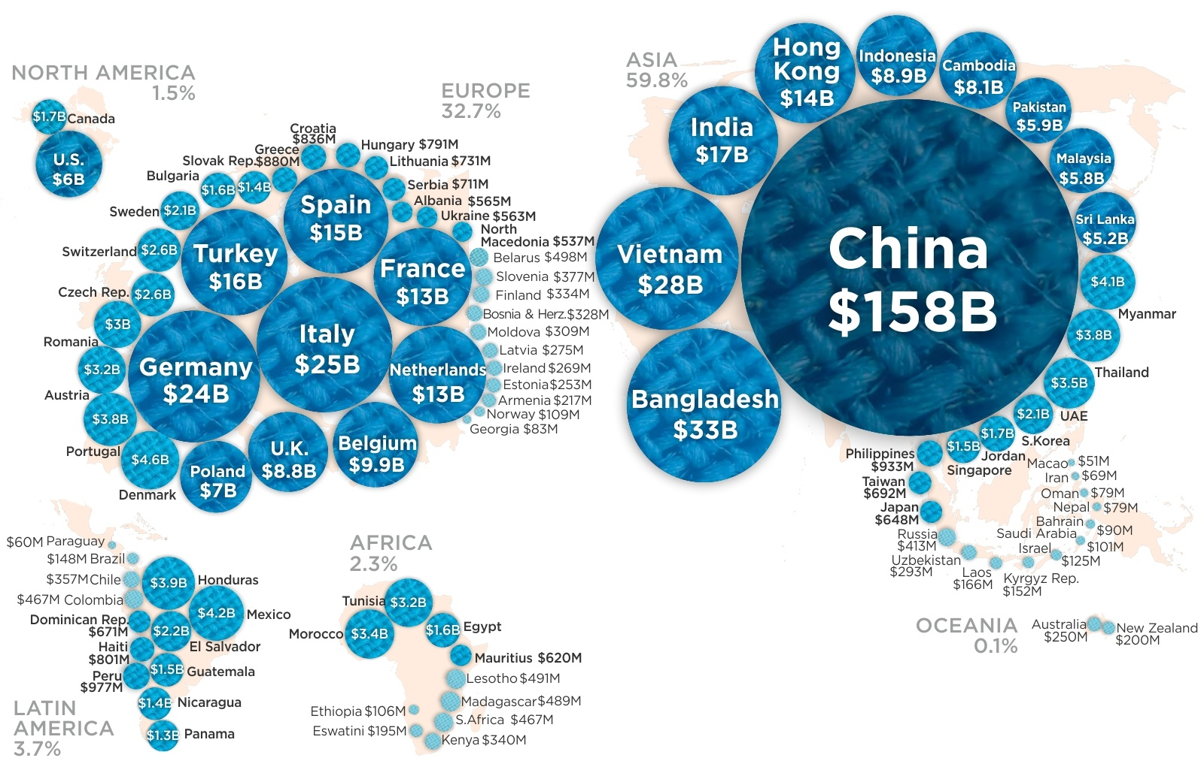
Assignment 4
Where is European T&C subcontracting in compresence with the other world?
See the given examples of textile or garment subcontracting. Explain the positive and negative trends of all over the world subcontracting.
Source: www.howmuch.netarticles/articles/world-map-clothing-exports

Slide 35
Assignment 5
Look at the positioning of the main textile regions in Europe IN-DEPTH ASSESSMENT OF THE SITUATION OF THE T&C SECTOR IN THE EU AND PROSPECTS. Discuss on risks and benefits of such networking?
.
 | Northern Europe | Southern Europe | Eastern Europe
Research and Development | Nordrhein-Westfalen, Germany Nord Pas de Calais, France North West England, UK | Lombardi a and Biella, Italy | Lodzkie, Poland
Education | London, UK West France Nordrhein-Westfalen, Germany
Innovation | Baden-Württemberg, Germany | Lombardia and Piemonte, Italy North Portugal and Galicia, Spain | Romania Slovenia
benefits
risk

Slide 36
The textile industry supply chains, trade logistics and developing countries
  The COVID-19 outbreak led to production stops in China first, followed by closures of shops elsewhere around the world.
  Network, the body, which brings together representatives of the producing associations from Bangladesh, Cambodia, China, Myanmar, Pakistan and Vietnam, released a joint statement on the issue. It urged brands and retailers to consider the impact that their purchasing decisions during the coronavirus pandemic could have on workers and small businesses in the supply chain and, therefore, to honour their contracts with their suppliers.
  One of the concerns in this respect is that production of fashion goods could be moved away to other sourcing countries that are resuming activities faster in the Asian region or that are closer to retailers to diversify their supply chain risk. Governments in developed countries around the world are implementing unprecedented actions to ease the effect on their economies from measures put in place to limit the spread of the pandemic.

Slide 37

Assignment 6
See the given examples of textile or garment subcontracting Hidden-subcontracting.pdf (somo.nl). Think about the positive and negative sides of subcontracting.
Something positive
Something negative

Slide 38
Assignment 7
  Look at the P&G and Wal-Mart supply chain model in the article - Textile and Apparel Supply Chains for the 21st Century (ncsu.edu).
  Discuss on risks and benefits of such networking?
benefits
risk

Slide 39
Questions for discussion
What is a value chain for TCI?
What is subcontracting?
What are the main reasons for existence of subcontracting?
What types of subcontracting do you know?
Looking at the different players in the subcontracting chain there will you place your T&C business idea?
Make a list of apparel manufacturers you know and another list of apparel retailers that you know. Which brands and trademarks do these firms use? Do they make primarily fashion or basic products? How do the products differ?
Which countries are the main source for subcontracting in the T&C industry?
What are the advantages of the short supply chain?

