Slide 1
TOPIC 8. REGULATION, REGISTRATION AND SUPPORT OF THE ENTREPRENEURIAL ACTIVITY IN THE TEXTILE AND CLOTHING INDUSTRY

Slide 2
AGENDA
Legislation
Business Structures
Organisational Structure
Registration
Institutional Support and Programmes for Entrepreneurship

Slide 3
Entrepreneurial regulation. Basics of contemporary business:
How to establish entrepreneurial business?
How to find out the Institutional support for establishing entrepreneurial business?
How to choose supporting programmes by regions and production?

Slide 4
Legal requirements
For the success or failure of a business idea, the choice of legal form is not the most crucial, but in some cases it can lead to a small difference that tilts the scales in one direction or another.
For better professional judgment, entrepreneurs usually use qualified professionals

Slide 5
Legal requirements
The choice of legal form is the first step in conducting a specific business.
Entrepreneurs carry out their activities primarily legally and in compliance with certain legal norms.
03
Based on a comparative analysis of the various legal forms, the entrepreneurs chooses the most suitable for them.
01
02
04
The main law that legalizes entrepreneurship and determines the legal form of business is the Commercial Law.

Slide 6
Types of business structures
Sole trader
General partnership
Limited partnership
Limited Liability Company - Ltd.
Joint-stock company
Limited partnership with shares

Slide 7
Types of business structures
Sole proprietorship is the simplest and most common structure chosen to start a business. It is an unincorporated business owned and run by one individual with no legal distinction between the business and the owner. You are entitled to all profits and are responsible for all your business’ debts, losses and liabilities. The business itself is not taxed separately-the sole proprietorship income is the owner’s income. As long as you are the only owner, this status automatically comes from your business activities. Like all businesses, you will still need to register your business with the authorities, and obtain the right licenses and permits.

Slide 8
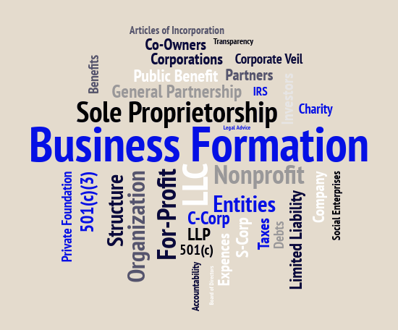
Types of business structures
Sole proprietorship
minimum registration costs;
minimum period for;
lack of capital requirements and start with minimum funds;
no requirement for a way of management;
possibility for simplified accounting.

Slide 9
Types of business structures
Partnership is a business where two or more people share ownership. In general, each partner contributes to all aspects of the business including money, property, and labor or skill. In return, each partner shares in the profits and losses of the business. Because partnerships entail more than one person in the decision-making process, it’s important to discuss a wide variety of issues up front and develop a legal partnership agreement. This agreement should document how future business decisions will be made, including how the partners will divide profits, resolve disputes, change ownership (bring in new partners or buy out current partners) and how to dissolve the partnership.

Slide 10
Types of business structures
Partnership
the partners are jointly and severally liable;
no restriction on the type of founding persons;
is not solely responsible for its obligations;
the responsibility belongs to the partners;
no relationship between the size and value of the
company and the size of its liability;
the personal property of each partner is a variable that affects liability without being able to monitor it.

Slide 11
Types of business structures
Limited liability company (Ltd.) is a flexible form of enterprise that blends elements of partnership and corporate structures. It is a legal form of company that provides limited liability to its owners in the vast majority of jurisdictions. The "owners" of a Ltd. are referred to as "members." The members can consist of a single individual (one owner), two or more individuals, corporations, other Ltd., and even other entities. Unlike shareholders in a corporation, Ltd. is not taxed as a separate business entity. Instead, all profits and losses are "passed through" the business to each member. Ltd. members report profits and losses on their personal tax returns, just like the owners of a partnership would.

Slide 12
Types of business structures
Limited liability company
the management is performed by the general meeting (GM);
each partner has as many votes as the number of shares in the capital;
the management is carried out by a manager, appointed by GM;
relatively fast registration;
not very high set-up costs;
the rights of the partners are defined in the company’s agreement;
precisely determines the rights, obligations and responsibilities of the partners.

Slide 13
Types of business structures
Joint-stock company
established by a statute;
capital is divided into equal parts called shares;
the shareholders are not required personally to
participate in the activities;
presupposes the accumulation of huge capital.
Other legal business entities include corporations, non-profits, and cooperatives. If you are unsure which business structure is best for your business, seek advice from a lawyer who specializes in business structures.

Slide 14
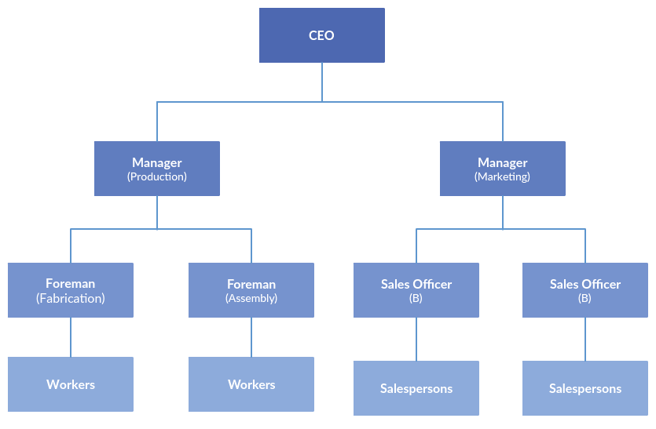
Organisational structure

Slide 15
Registration

Slide 16
Registration process

Slide 17
Registration
Register the name of your company. Company name and brand name can be the same or different.
Open a company’s bank account.
Register the company’s address.
Tax registration.
Register for permits and licenses with the local authorities.
Register a domain and get a website.
Notes:
The entrepreneur will face a variety of legal risks with the operation of the business, both internal and external. While it is not possible to be prepared for all issues that could come up, the entrepreneur should analyze the business operation and take steps to minimize potential risks.
Direct customer legal action:
Avoid conflicts of interest;
Be careful of what you say and do;
Have a good lawyer available to help with decisions before they cause problems;
Separate your personal assets from the business;
Make sure you have adequate liability insurance;
Make sure your critical data is protected and backed up.
Disputes with partners, employees, and suppliers:
Document all agreements;
Be alert for signs of trouble.

Slide 18
Institutional support for entrepreneurship
Coordination;
Industrial development;
Technical support;
Educational support;
Financial support.

Slide 19
European Commission programmes for entrepreneurship
The European Commission supports entrepreneurs by strengthening entrepreneurship education, mentoring, guidance and other support services. Actions support specific groups who may find it difficult to reach their full potential, such as young people, women and senior entrepreneurs. The programs also aim to help businesses access opportunities offered by digital technologies.

Slide 20
European Commission programmes for entrepreneurship
The European Commission sees entrepreneurship as acting upon opportunities and ideas and transforming them into value for others, which can be financial, cultural, or social. The EU entrepreneurship policy aims to support companies, in particular SMEs, throughout their life cycle, promoting entrepreneurial education at all levels, as well as reaching out and encouraging specific groups with entrepreneurial potential.
EISMEA - The Agency implements the European Innovation Council and manages other EU programmes, focusing on SME support, innovation and the single market

Slide 21
EU supporting entrepreneurs in general
EU create an environment where entrepreneurs can flourish and grow:
Supporting start-ups
Transfers of business
Insolvency and second chance

Slide 22
European programmes for entrepreneurship support
COSME programme
Horizon 2020
EEN network
Digital agenda for Europe – startup Europe
Start-up Europe road show
Structural funds
European Investment Fund
European Investment Bank
SME week

Slide 23
COSME programme
COSME supports entrepreneurs by strengthening entrepreneurship education, mentoring, guidance and other support services. Actions support specific groups who may find it difficult to reach their full potential, such as young people, women and senior entrepreneurs. The programme also aims to help businesses access opportunities offered by digital technologies.
Download the poster
Improving business conditions
COSME aims to reduce the administrative and regulatory burden on SMEs by creating a business-friendly environment. COSME also supports businesses to be competitive by encouraging them to adopt new business models and innovative practices. This complements actions in areas with high growth potential such as the tourism sector.

Slide 24
ERASMUS or YONG ENTREPRENEURS PROGRAM
Erasmus for Young Entrepreneurs aims to boost Europe's entrepreneurial culture. The programme:
reinforces entrepreneurial attitudes by offering skills, knowledge and experience.
increases the number of start-ups and boosts their resilience.
fosters the cross-border transfer of ideas, knowledge and cooperation between small firms.
helps small firms to network, innovate, and go international.
helps to create jobs.

Slide 25
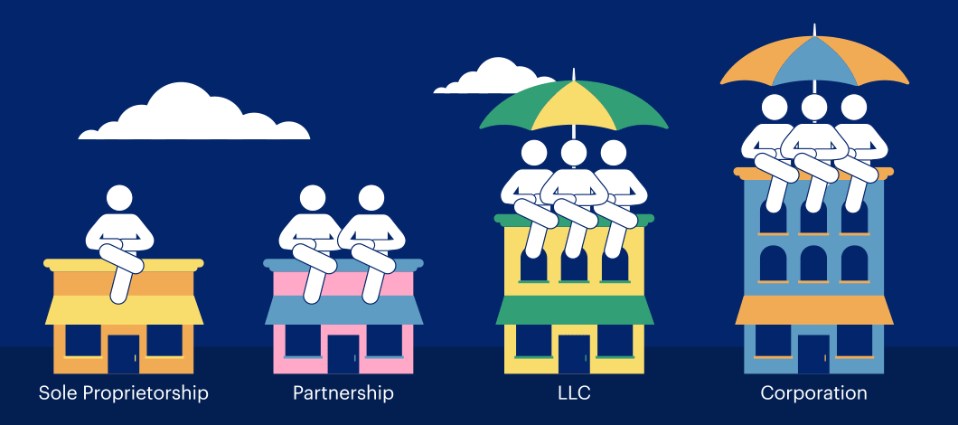
Assignment 1
As a start-up you have to decide which legal form of company you will have. In this case you will start describing the forms of business ownership in the private sector, learning about their specific advantages and disadvantages. Finally you can do an exercise where you have to work out the legal forms of business ownership in your country. You also have to pay attention to the Societas Europaea, the European form of business ownership. Which form you will select depends on several reasons like how much starting capital you need and how much a private person or persons can invest.

Slide 26
Assignment 2
Write a partnership agreement as if you were going into T&C business with partners. Assume that some partners can work 40 hours per week and others can only work 20 hours. Also assume that some partners can contribute 5,000 euro each to setting up the business and others can contribute 1,000 euro. Be certain to specify in the agreement how the profits will be divided among the partners.

Slide 27
Questions for discussion
What are the legal consequences of each form of business organisation?
Name one advantage and one disadvantage of a sole trader over a partnership.
Who owns a cooperative?
Determining the country or local requirements for starting a business.
What aspects of a proposed business should an entrepreneur consider before choosing a type of business ownership?
Identifying tax collection and reporting requirements.
Described environmental regulations that may impact your business.
Examine ways small business owners can manage legal risks.
Where can you find detailed information abut legal requirements and registration of your business?

Slide 28
Questions for discussion and task
What are the legal consequences of each legal form, how many persons will start up a company?
You want to start a sole proprietorship T&C retail business that employs several people. Research the steps necessary to comply with government requirements for setting up your business. Summarize your research.

