Slide 1

TOPIC 12. THE ENTREPREPRENEURIAL ROADMAP IN THE TEXTILE AND CLOTHING INDUSTRY

Slide 2
AGENDA
Entrepreneurial Mapping
Entrepreneurial Clustering

Slide 3
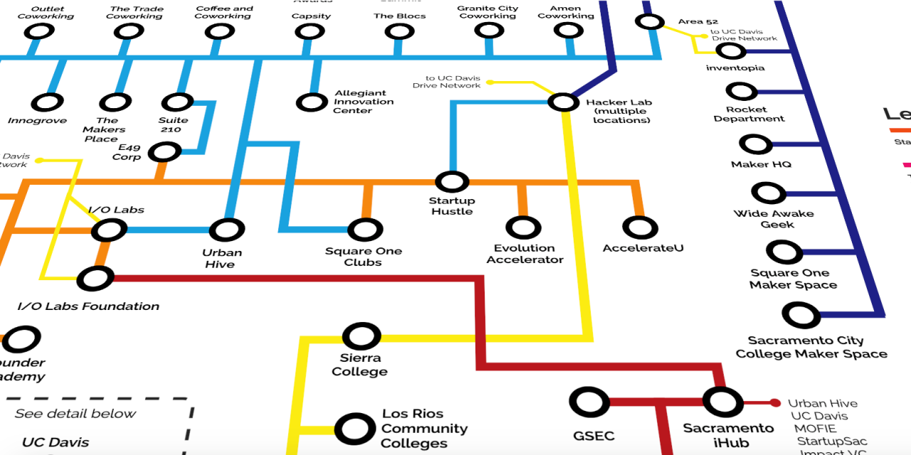
Entrepreneurial mapping
  Entrepreneurial mapping - proposing a map of different entrepreneurial decisions of the existing textile and clothing business based on the main reasons for those businesses’ establishment, for example:
      New textile and/or clothing design;
      New textile fibers or materials;
      New textile and/or clothing
      production instruments, techniques
      or technologies.

Slide 4

Entrepreneurial mapping
      The entrepreneurial mapping will allow to recognize the entrepreneurial premises. Our assumption is that in different sectors of TCI there are quite different precondition for entrepreneurship. The entrepreneurial knowledge, especially for internal entrepreneurial needs, will be enforced differently. The map will be developing the source of the entrepreneurial ideas: workers, managers, special innovation / research teams, competitors or customers. As the entrepreneurial business is close to the new idea rise-up in practice, some examples of mapping could be very useful.

Slide 5
Entrepreneurial mapping stages
  Idea generation: every new venture begins with an idea. In our context, we take an idea to be a description of a need or problem of some constituency coupled with a concept of a possible solution. (A characterization of this phase is still work in process on this site.)
  Opportunity evaluation: this is the step where you ask the question of whether there is an opportunity worth investing in. Investment is principally capital, whether from individuals in the company or from outside investors, and the time and energy of a set of people. But you should also consider other assets such as intellectual property, personal relationships, physical property, etc.

Slide 6
Entrepreneurial mapping stages
  Planning: Once you have decided that an opportunity, you need a plan for how to capitalize on that opportunity. A plan begins as a fairly simple set of ideas, and then becomes more complex as the business takes shape. In the planning phase you will need to create two things: strategy and operating plan.
  Company formation/launch: Once there is a sufficiently compelling opportunity and a plan, the entrepreneurial team will go through the process of choosing the right form of corporate entity and actually creating the venture as a legal entity.
  Growth: After launch, the company works toward creating its product or service, generating revenue and moving toward sustainable performance. The emphasis shifts from planning to execution. At this point, you continue to ask questions but spend more of your time carrying out your plans.

Slide 7
Entrepreneurial mapping stages

Slide 8

Assignment 1
Use the Case study of MAK. Evaluate their innovative idea according to the assessment card.
Creativeness | 1 Missing | 3 Basic | 5 Moderate | 7 Excellent
Novelty
Quality
Originality
Workability
Specificity
Applicability
Effectiveness

Slide 9

Entrepreneurial clustering
  Entrepreneurial clustering - proposing a roadmap to enforce entrepreneurship in different TCI sectors. The roadmap sets the needed support for development and growth of new start-up business in textile and clothing industry. The roadmap reveals the “stops” of the entrepreneurial idea from the very beginning to the growth of the TCI business. For example, the TCI entrepreneurial Academy/ education could be the common stop/ crossroad for each different textile cluster.

Slide 10
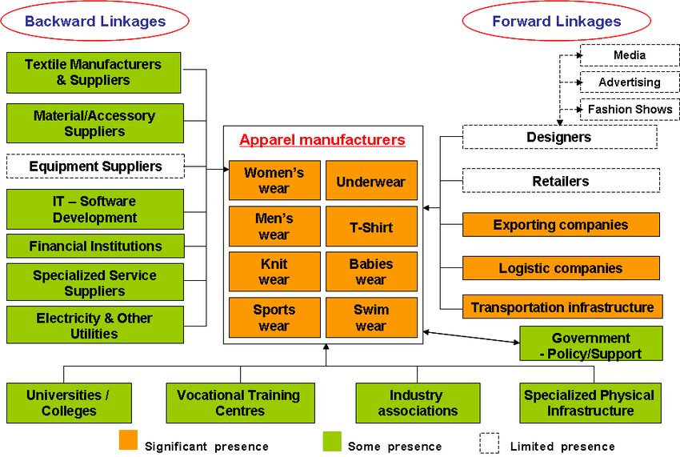
Entrepreneurial clustering roadmap example
(PDF) Creating Shared Value on a Larger Scale (researchgate.net)

Slide 11
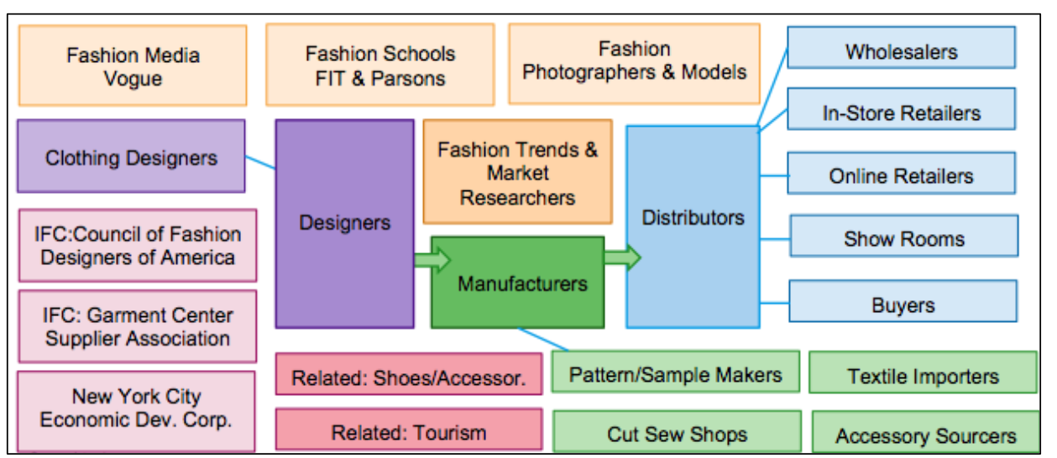
Entrepreneurial clustering roadmap example
NYC Apparel Cluster FINAL.docx (hbs.edu)

Slide 12

Entrepreneurial clustering partners
  Textile research institutes: basic and application-oriented research in the field of special textiles, especially smart textiles. Based on the conventional textile technology as well as on flexible materials, the institute is continuously developing high-tech textiles in order to create new materials.
  For example: Hohenstein Institute - Textile Expertise

Slide 13
Entrepreneurial clustering partners
    Universities textile research centres: independent research institutes working in the field of textiles and dress. For example: https://ctr.hum.ku.dk/.
    Journals of the textile industry: the journal publishes impactful scholarship that shapes the discipline, publication studies on clothing, textiles, and related topics across the discipline. For example: https://www.wtin.com/.
    Textile and apparel associations: they focus on effective textile and apparel research, innovation and skills development, sustainable textile and apparel supply chains. For example: https://euratex.eu/.
    Laboratories for testing of textile materials, textile fabrics and ready garments. For example: https://www.labtexcontrol.com.

Slide 14
Entrepreneurial clustering partners
  Entrepreneurial learning in apparel and textile
    Textile universities: graduating Bachelor, Master and PhD students, prepared to manage textile and apparel processes. For example: https://www.ttf.unizg.hr/.
    Association of universities for textiles - https://www.autex.org/.
    Fashion colleges: graduating Bachelor and Master students, prepared to innovate in textile and apparel industry. For example: https://www.ied.edu.
    Vocational schools for apparel and textile. Dual education. For example: https://www.vhs-aschaffenburg.de/.
    Professional education of workers: graduating professional workers to work on the fashion production lines.

Slide 15
Entrepreneurial clustering partners
    European cluster collaboration platform for T&C - https://clustercollaboration.eu/.
    European technology platform for the future of textiles and clothing - https://www.textile-platform.eu/.
    Fashion incubators. For example: https://www.united-fashion.eu/.
    Textile and fashion start-ups platforms. For example: https://fashionforgood.com.
    Start-up textile challenges and contests. For example: https://www.talentsdemode.com/.

Slide 16
Roadmap players in T&C in Europe
Source: Euratex

