Slide 1
QMS/EMS Implementation and Control

Slide 2
TRAINING COURSE
INDUSTRIAL ENGINEERING, QUALITY CONTROL AND MANAGEMENT
Course: QMS/EMS Implementation and Control
Partner: P4 – University of Zagreb Faculty of Textile Technology
Assoc. Prof. Sanja Ercegović Ražić, Ph.D.

Slide 3
Quality control in yarn production mill
Example of quality control

Slide 4
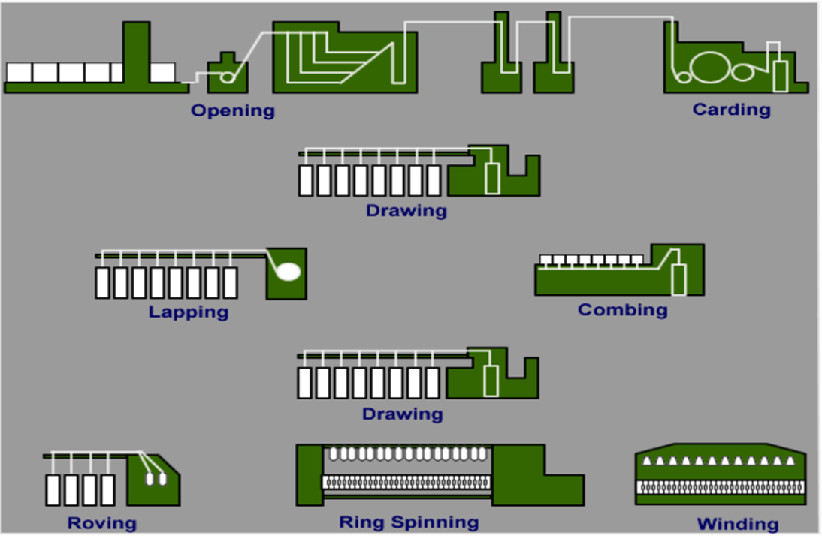
Spinning preparation and spinning process

Slide 5
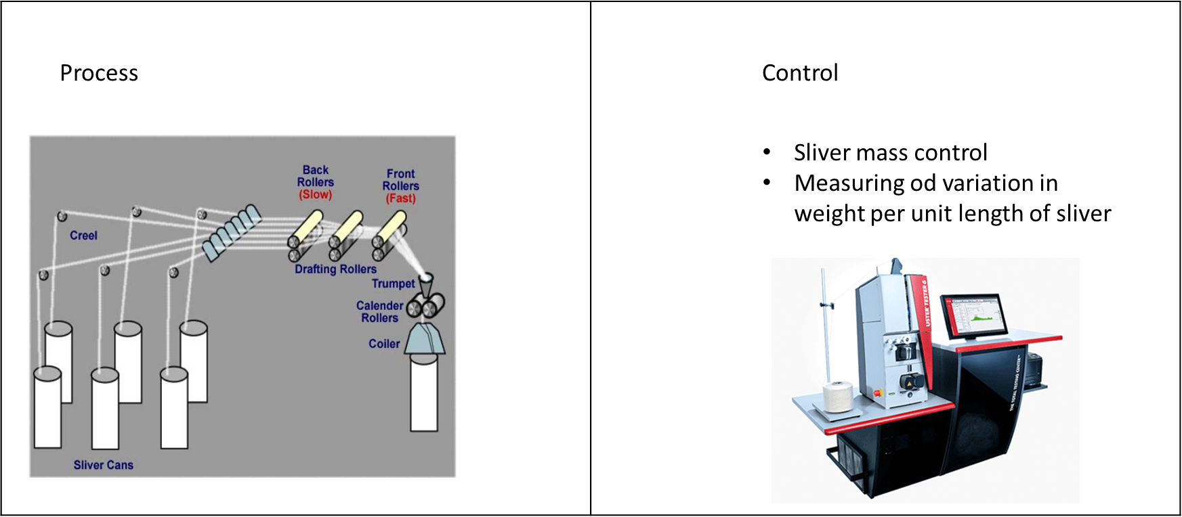
Drawing and blending

Slide 6
Combing

Slide 7
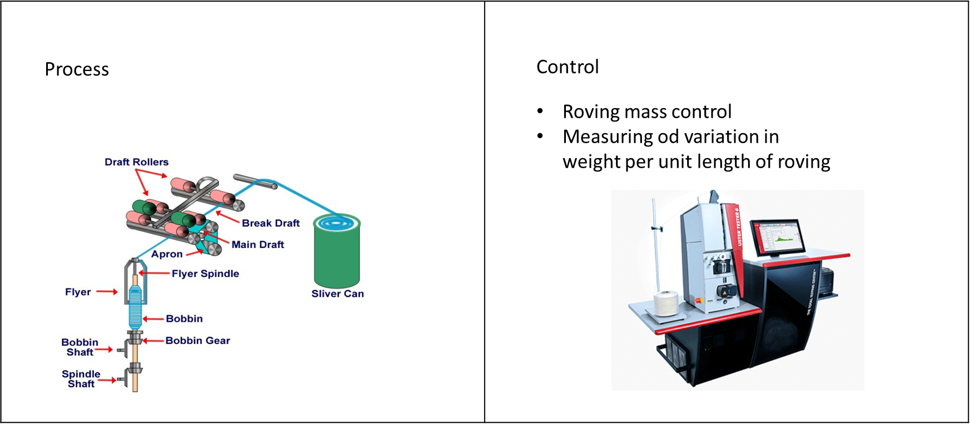
Roving process

Slide 8
Spinning

Slide 9
CONTACTS
Coordinator of project:
Technical University of Sofia
Department of Textile Engineering
Project Manager of ICT-TEX:
Prof. Dr. Angel Terziev
е-mail: aterziev@tu-sofia.bg
Web-site: ICT-TEX.eu
The information and views set out in this publication are those of the authors and do not necessarily reflect the official opinion of the European Union. Neither the European Union institutions and bodies nor any person acting on their behalf may be held responsible for the use which may be made of the information contained therein.

