Slide 1
Course draft: Novel Trends in Textile Functionalisation

Slide 2


Proposed as elective e-course
Novel Trends in Textile Functionalisation
of Module
Finishing, Printing and Functionalization (WP12)
Responsible Partner (P4):
University of Zagreb Faculty of Textile Technology
Assoc. prof. Sanja Ercegović Ražić, PhD

Slide 3
aims and structure of the curriculum
The curriculum will be developed under the project ICT-TEX will be structured into modules, with selectable programs, in this way each user will be able to choose only those programs that are useful for his/her own pathway.
For each course different study materials are developed, addressed to three main target groups:
Trainees (students)
Practitioners (staff)
Trainers (university teachers/researchers)
The courses will be designed to be interactive, and through the access to an open platform, learners are able to select and to follow the interested programs, promoting distance learning. The proposed curriculum and programmes are not linked to the academic credit system, leaving to the specialists the freedom to select the courses of the programme to be studied.

Slide 4
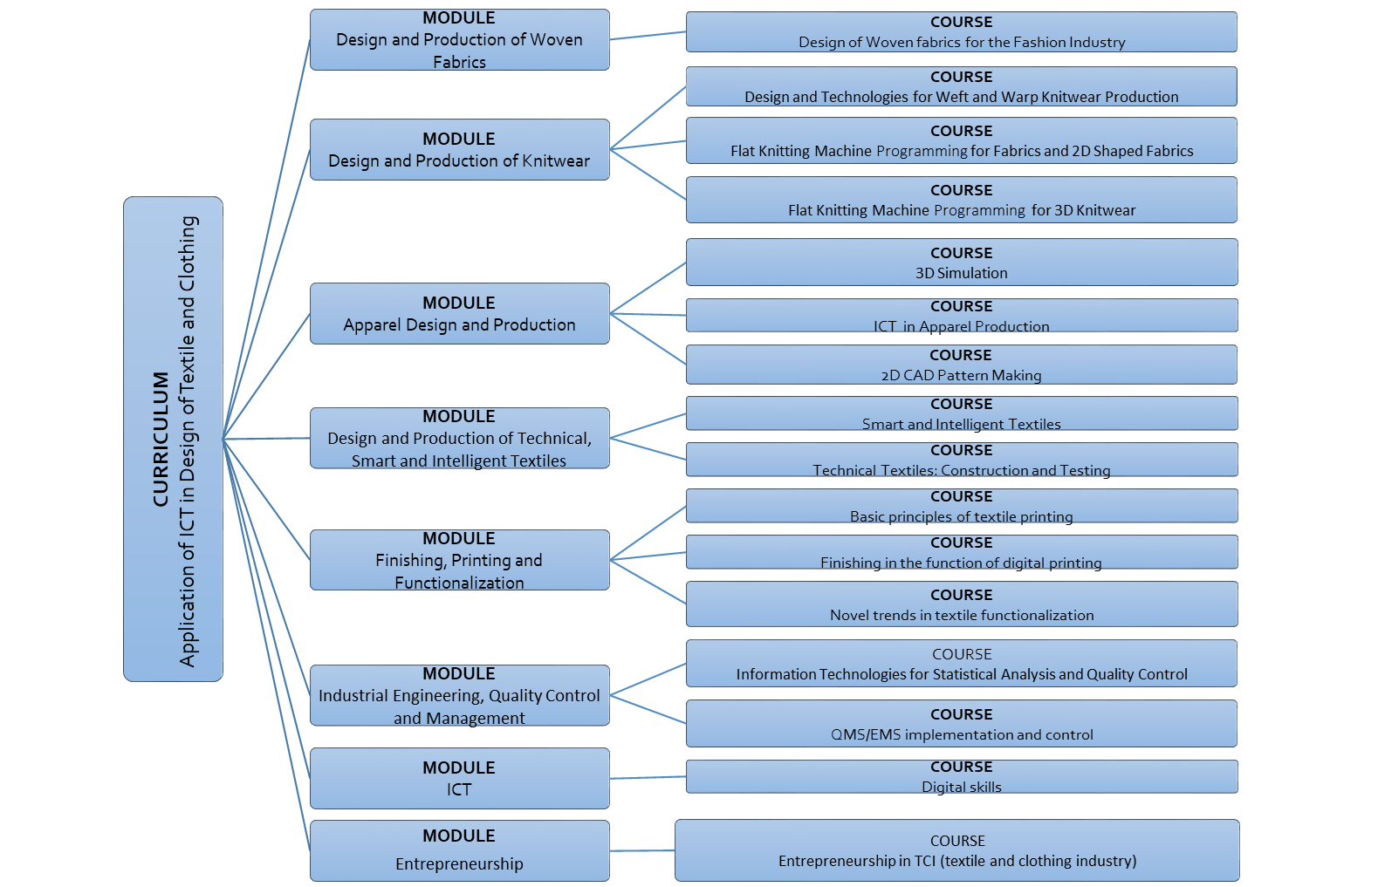

Slide 5
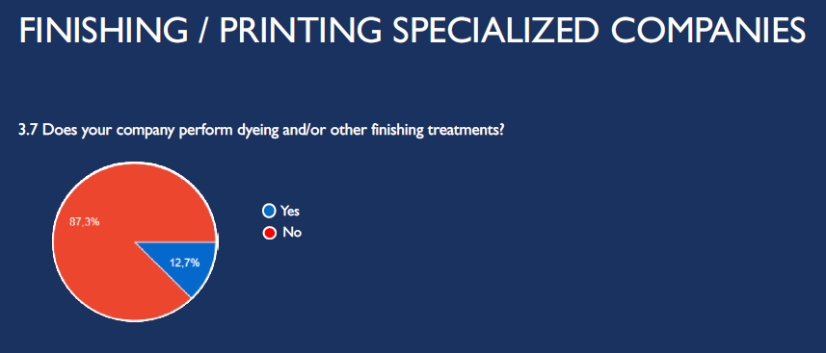

Slide 6
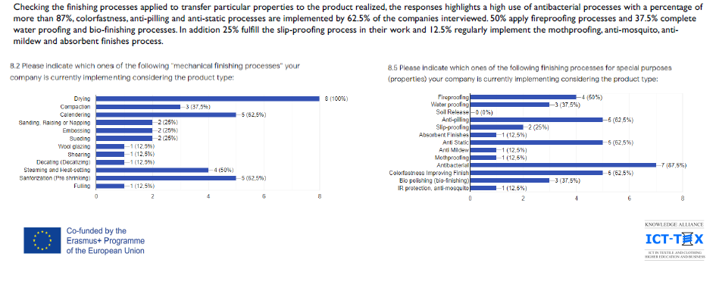

Slide 7
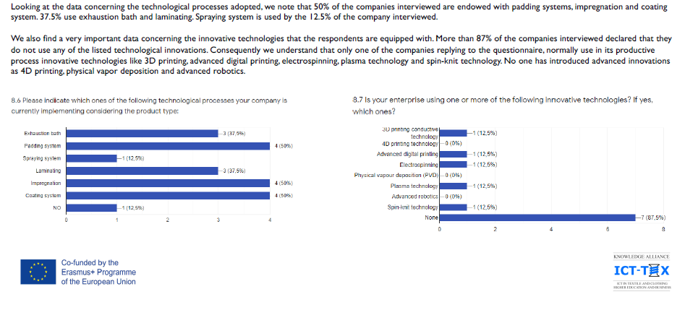

Slide 8
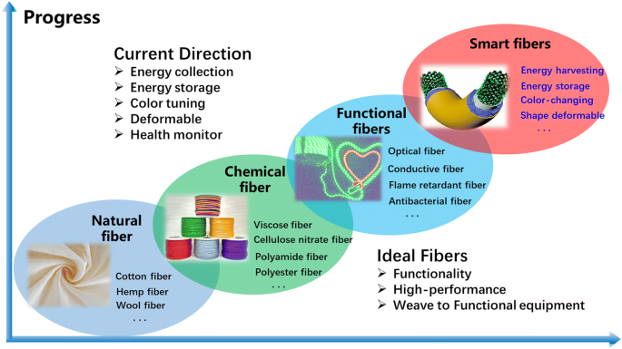
Syllabus: Finishing, Printing and Functionalization
Course draft: Novel Trends in Textile Functionalisation
Total: 30 hours
Requirements for textile materials require continuous improvement of the production process of polymers, fibers, materials, clothing, footwear and equipment, which take on new properties and thus provide the necessary protective/functional properties.
Functional materials - a special category of materials in which the application of targeted chemical, mechanical treatments/ finishing has achieved some new properties in the function of protection.

Slide 9
Lecture plan:
Introduction - Learners will learn about
new technologies,
methods,
processes and
functional properties of such treated textiles.
Such properties would be based on novel technology and biomimetic approach from nature which will be by using appropriate techniqes transfered onto the textiles surface and structure.
Learners will be informed how complex textile structure influenced on the treatment effectiveness and desired properties.
Through the course the processing equipments will be described, the physical-chemical nature of the polymer materials, as well as the most important functionalities provided by these techniques.
The course will be focused on the use of innovative ICT technologies, eco-friendly processes in order to equip learners with relevant skills and knowledge, as well as with responsibilities for developing a novel material functionalities and environmentally friendly.
Literature for e-course and all necessarry materials (statistical analysis, market demand, etc.) will be a part of elective e-course.

Slide 10
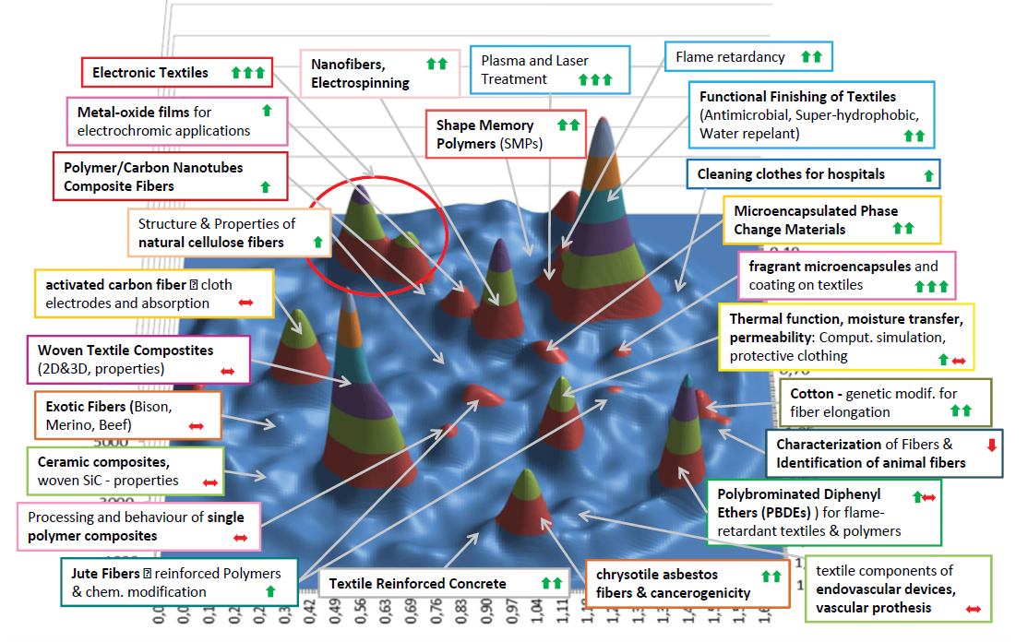
Direction of development of functional textiles
Analysis of Research Fronts in Scientific Publications on “Functional Textiles” 1989–2012 (Depicted are 8931 recorded articles).
Arrows indicate the dynamic of research activity over the last years: green arrows indicate that a topic is increasing, red arrows that a topic is decreasing or stable.
The graph was drawn up by AIT using BibTechMon™
AUTEX Research Journal, Vol. 14, No 4, December 2014, DOI: 10.2478/aut-2014-0031 © AUTEX

Slide 11
The aim of this course is introducing learners with specific functional properties of textiles as self-cleaning, super-hydrophobic, antimicrobial, flame retardant, etc. which are results of functionalization of textiles as an emerging tool for improving textile performance and increase its added value.
Some of established techniques which could be used to impart new functionalities and properties to textile materials including
plasma processing,
electrospinning,
sol-gel process,
foams,
enzymatic treatments,
nanotechnology,
wet processes,
spraying,
polymer coating.
A new generation of new high-value textiles developed by surface treatment, chemical grafting, 3D structure, and nanotechnologies to introduce and develop textiles with new functionalities will be also described. The course will be focused on the use of innovative processes which is supported with ICT technologies, eco-friendly processes in order to equip learners with relevant skills and knowledge, as well as with responsibilities for developing a novel material functionalities and environmentally friendly.

Slide 12
The requirements for textile materials (and thus protective clothing and footwear) require continuous improvement of the production process of polymers, fibers, materials, clothing, footwear and equipment, which take on new properties and thus provide the necessary protective properties, such as:
heat protection,
flame protection,
Chemical protection,
UV radiation,
various radiation sources (ionized),
reduction of tendency to static electricity (antistatic properties),
anti-ballistic properties,
mechanical hazards,
resistance to microorganisms (bacteria, viruses),
water repellent properties,
waterproofing, and other protective properties.

Slide 13
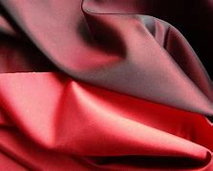
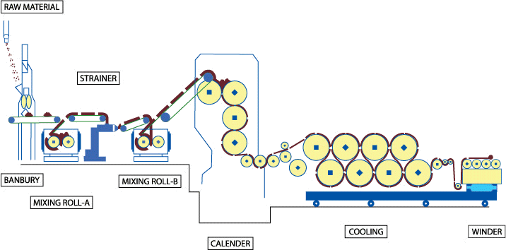
Functional treatments are divided in several groups:
1. Mechanical processing - textile materials undergo mechanical processing by calendering under controlled conditions of heat and pressure, with the purpose of achieving different textures or effects in the fabric - the result: a more compact and flat fabric with a smoothing effect (smoothness).

Slide 14
2. Chemical treatments - by applying chemical agents they change the appearance and improve functional properties and comfort. Materials obtained new properties that cannot be achieved by mechanical processing - multifunctional textiles.
Application procedures: by padding, bath exhaustion, coating, spraying and foam application.
New generation of treatments using nanotechnology - enables new functional properties such as the self-cleaning effect that cannot be achieved by conventional treatments. By coating at the nanostructure level - does not adversely affect the "handle" and feel of the finished material.
Application of sol-gel process - provides new possibilities in textile chemical finishing.
Plasma application - application of PECVD procedure
Layer by layer processing - ultra fine polymer film on the surface; involves layer-to-layer adsorption of polycation and polyanion in the formation of a multilayer ultra-thin layer of polyelectrolyte on the textile surface.

Slide 15
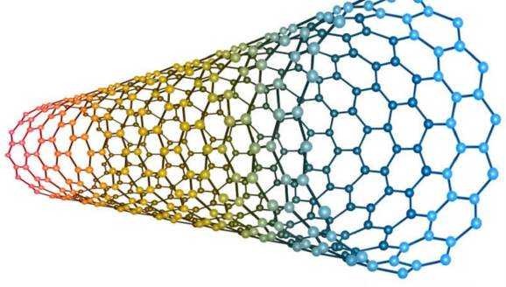
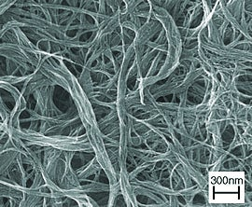
Carbon nano-tubes in textiles
Coating of CNTs on flat textiles using different methods and techniques.
The multifunctionality of textiles is achieved, which include electrical conductivity, specific electromagnetic properties, but also antibacterial effects.
Shim et al. using CNTs, they have produced intelligent e-textiles for bio-monitoring the functioning of the human body

Slide 16
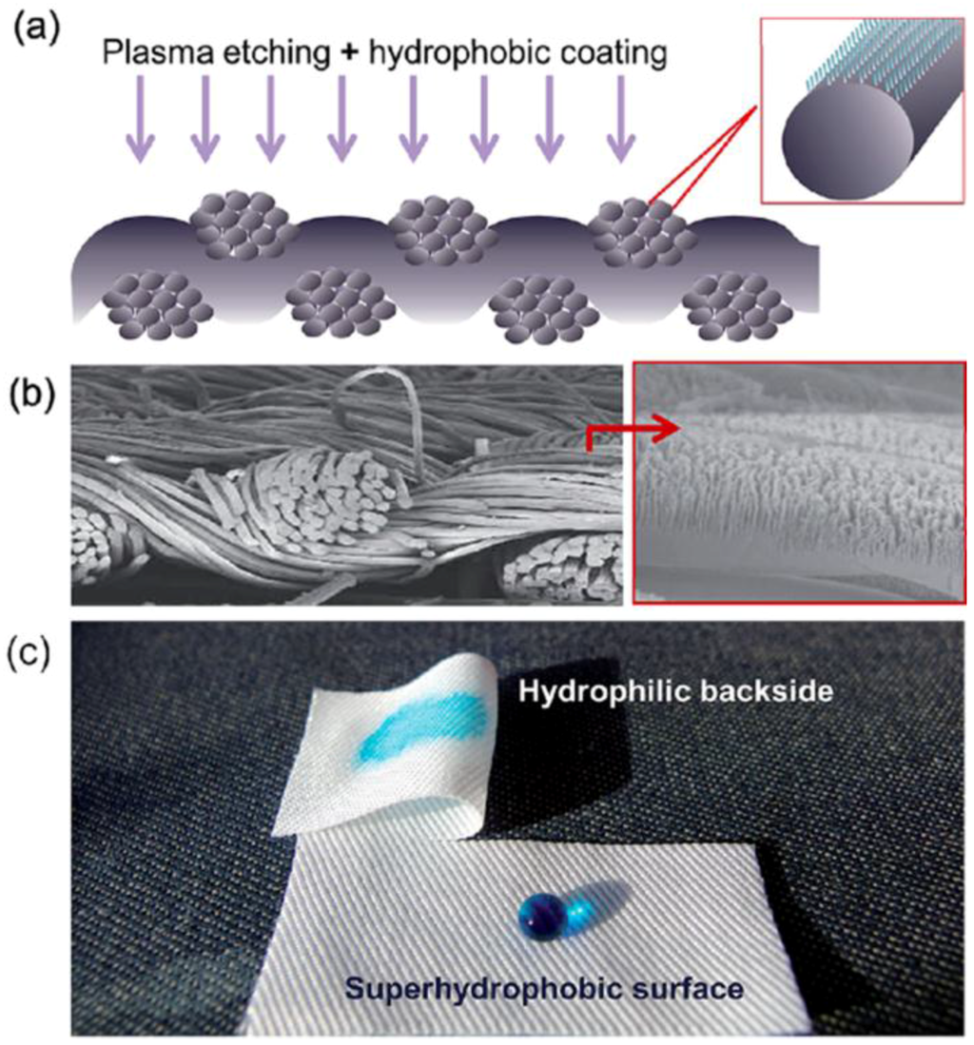
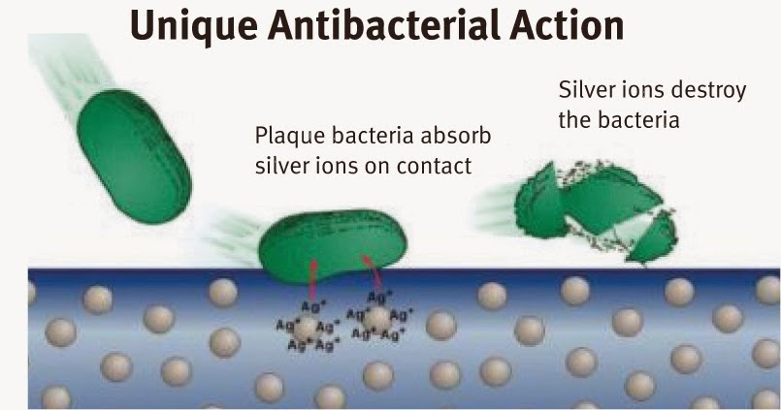
Hydrophobic textiles using plasma technology
Antibacterial textiles

Slide 17
Biotechnological treatments - application of biological agents in the textile industry - enzymes - by enzymatic biopolishing
cellulase - removal of protruding and tangled fibers from the surface - result: cleaning, softness and shine of the material.
The procedure is especially important for lyocell fibers - due to the occurrence of fibrillation!
Transglutaminase - in wool - shrinkage resistance, increased strength, feel, softness, wettability, dyeing, reduction of release tendency and protection against damage due to the use of commercial detergents
Lipases and esterases - polyester fibers - increasing hydrophilicity and absorption properties.
Advantages of enzymes: processing at a lower temperature, avoidance of the use of harmful chemicals. Disadvantages of enzymes: poor stability, poor compatibility with other chemical agents, longer processing time, relatively high cost.

Slide 18
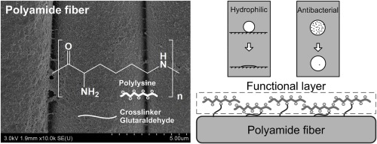
Using Polylysine (PLL ) biomolecule - can be used as a surface coating agent for simultaneously imparting hydrophilic and antibacterial functions to PA fiber.
The effects of the dip coating conditions of PLL on the PA fabric.
The PLL coated fabric exhibited excellent hydrophilic and antibacterial properties with good washing durability.
https://doi.org/10.1016/j.porgcoat.2020.105571

Slide 19
Comfort-enhancing treatments
Thermoregulation - eg application of PCM
Enzymatic bioprocessing - enzymes,
Shrinkage resistance - enzymes, plasma, polymers with self-crosslinking ability,
Easycare - carboxylic crosslinking acids - formaldehyde-free but with mechanical properties,
Self-cleaning - superhydrophobic surfaces,
Superabsorption - "super sponges" - water absorption significantly more than their mass - by gel formation.
Medical, cosmetic and odor resistant treatments - vitamins, cyclodextrins,…

Slide 20
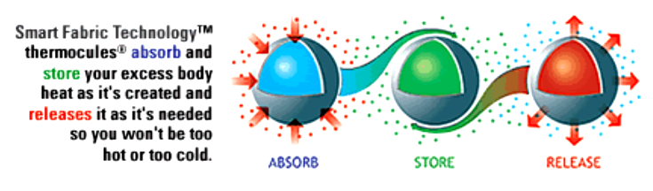
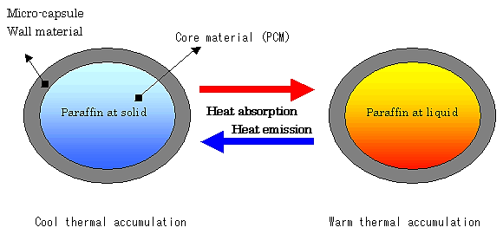
Termegulating Fibres with PCM
Methods:
During fiber spinning - wet and dry process from solution, melt, electrospinning.
Layering on fibers and flat product - finishing with binder and coagulant - method of impregnation and layering.
During the formation of foam and lamination - for the production of nonwovens; incorporation of microcapsules into the foam and incorporation into the textile structure by lamination or microcapsules into a thin polymer film and lamination on the inner part of the material.

Slide 21
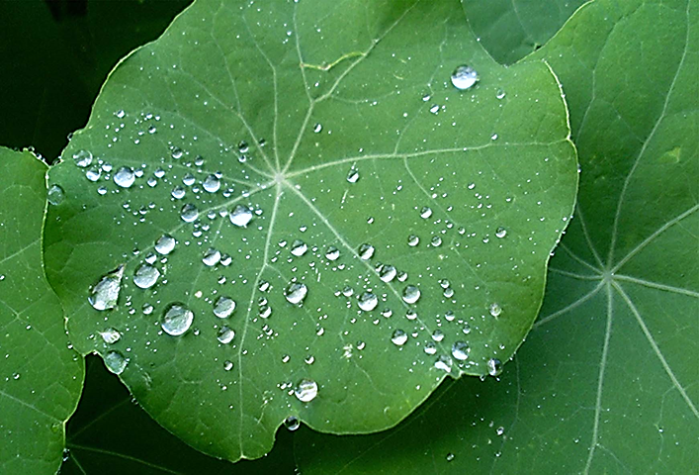
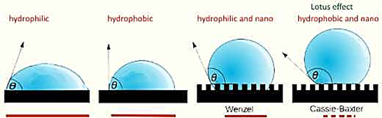
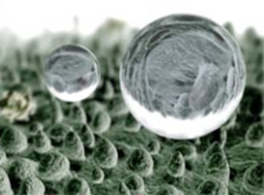
Superhydrophobic properties – effect of the surface self-cleaning
Microscopic structure - Nano structure – Hydrophobic properties (contact angle higher than 150-160°
R. Paul: Functional Finishes for Textiles; Improving Comfort, Performance and Protection, Woodhead Publishing Series, in Textiles, 2015.

Slide 22
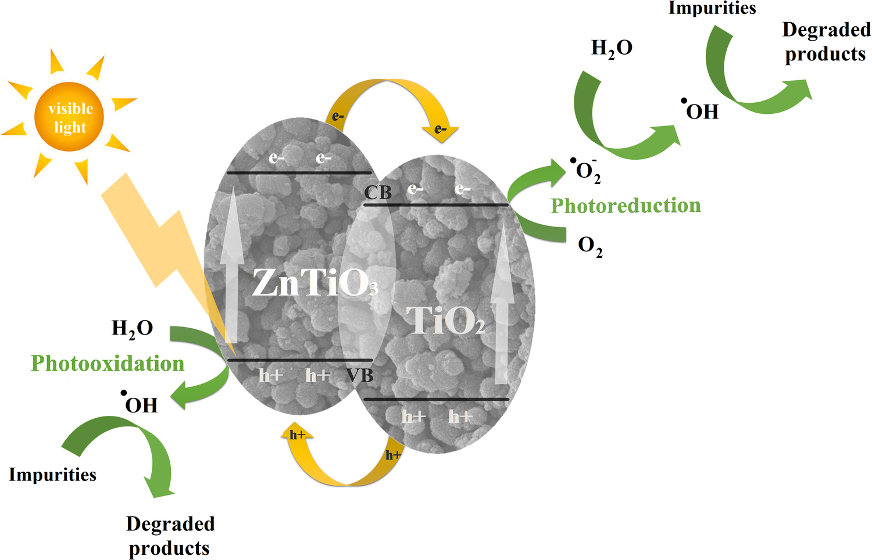
Photocatalytic self-cleaning fabrics
Photocatalytic process is the acceleration of photoreaction in the presence of catalyst. This process will decompose the dirt molecules by utilize the sunlight.
The semiconductor photocatalytic process has shown a great potential as a low-cost, environmental friendly and sustainable treatment technology. Those semiconductor materials also have been used to functionalize onto the different textiles for self-cleaning properties.
Another semiconductor material, which appears to be an alternative to TiO² is zinc oxide (ZnO).
Photocatalytic self-cleaning fabrics are able to clean themselves when exposed to light, but they also possess antibacterial and UV blocking functions
doi:10.1088/1757-899X/133/1/012028

Slide 23
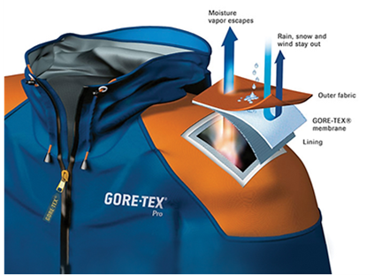
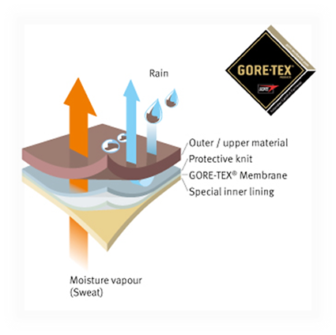
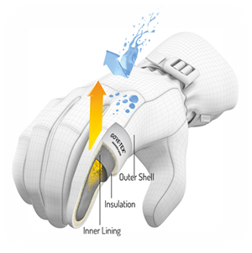
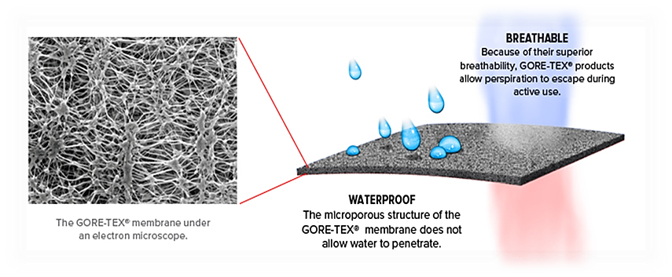
Functional membranes of protective properties
Thermophysiological comfort while wearing such clothing is achieved by using a special membrane, eg Gore Tex®, Pro-line®, Sympatex® and others.
Micropore diameter - 0.2 μm (bacteria are about 4 times larger)
They are resistant to chemicals and UV radiation, non-combustible, thermally stable between -250 ° C to + 280 ° C, biocompatible and degradable.
https://www.bing.com/images/search?q=gore-tex+membrane+for+protective+clothing&qpvt=gore-tex+membrane+for+protective+clothing+&FORM=IGRE

Slide 24
Treatments of textiles for protect users
Antimicrobial,
Insect resistance – repellents
Hydrophobic and oleophobic,
Fireproof,
UV protective,
Treatments from harmful thermal radiation,
Antistatic and electrically conductive,
Biological and chemical,
Anti-ballistic treatments.

Slide 25
The manufacturing of functional textiles can be classified into two groups:
One is to functionalize the fibre by adding dope additives, modifying the fibre forming polymer, and then converting it to clothing. The fibre surface is also functionalised by adding some resins on the fibre surface.
2. The other is to modify the textile surfaces by functional biomaterials, resins, finishes.

Slide 26
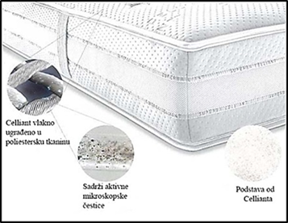
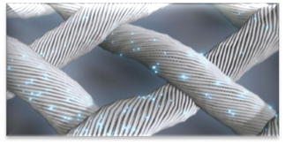
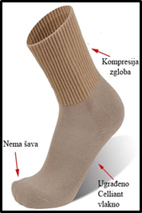
Example: CelliantTM fiber
Fiber protected technology tt. Fiber Innovation Technology (USA) Bistructural morphology (C/C), with disperse system → in the core mineral particles in PET masterbatch (Celliant particles) → basic polymer PET.
The dimensions of the mineral particles are less than 1 μm
Function: Thanks to the mineral particles in the fiber, from Celliant fiber supply the body with additional energy that promotes blood circulation and tissue oxygenation.

Slide 27
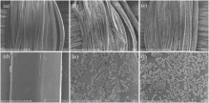
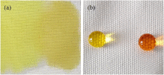
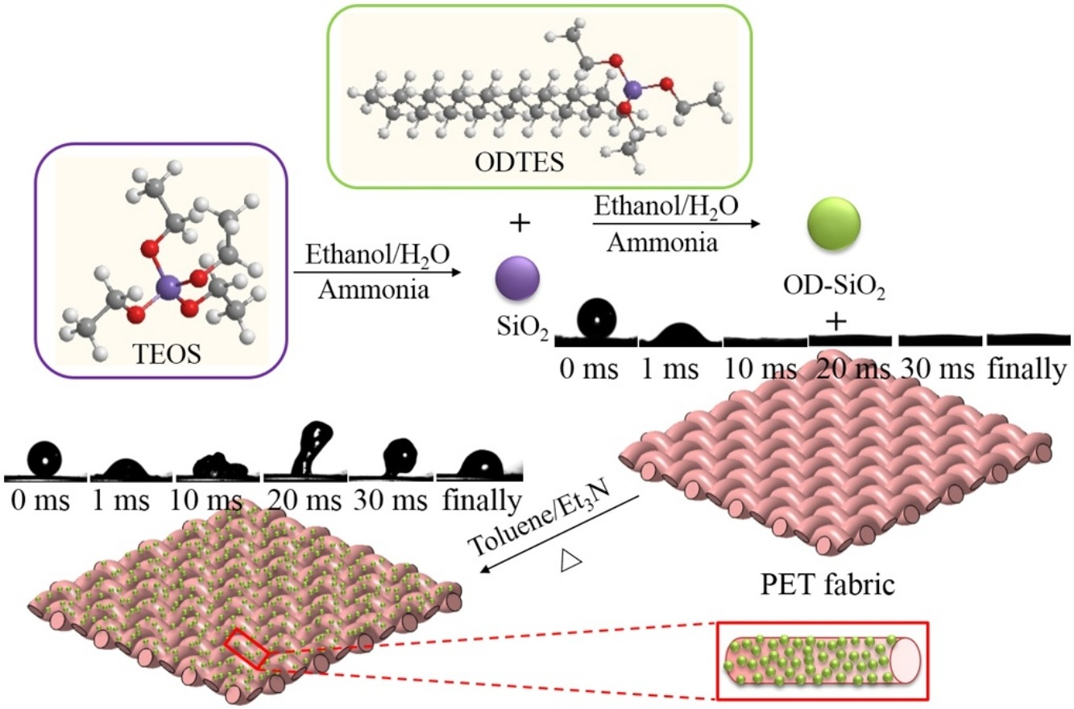
Example:
Treatments organic–inorganic hybrid micro-nanoparticles
Silica dioxide nanoparticles (SiO₂) were synthesized and functionalized with n-octadecyltriethoxysilane (OD) through a modified Stöber method for the preparation of organic–inorganic hybrid micro-nanoparticles - applied onto the polyester (PET) fabric via a conventional “dipping–drying” process for the fluoro-free water-repellent textile materials.
The coated PET fabric surface showed micro/nano-structures and exhibited hydrophobic behavior with water contact angle of 141°. PET hydrophobic fabrics exhibited excellent self-cleaning properties with dyes on the fabric surface.
https://doi.org/10.1016/j.jiec.2019.12.016

Slide 28
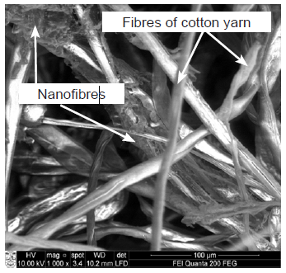
Electrospun nanofibres
An electrospun web in a knit made from yarns covered by nanofibres is more resistant against mechanical damage than an nanofibrous web on the knit, which can be more suitable for healthcare wearable textiles.
SEM image of a knit from yarns covered by a nanofibrous web
After the electrospinning process, cotton yarns coated by an electrospun nanofibrous web were used for knitting using a flat double bed weft knitting machine.
Electrospinning process of “NanospiderTM” equipment
Ragaišienė A, Rukuižienė Ž, Mikučionienė D, Milašius R. Insertion of Electrospun Nanofibres into the Inner Structure of Textiles. FIBRES & TEXTILES in Eastern Europe 2014; 22, 6(108): 59-62.

Slide 29
New technology in Textile industry environmentally friendly
Environmental pollution in textile wet processes can be reduced by four main ways:
process optimization (reducing in water, chemical energy consumption, and time loss),
use of ecofriendly chemicals,
reuse of water, and
new technologies like ozone and plasma technologies, transfer printing, enzymatic processes etc.

Slide 30
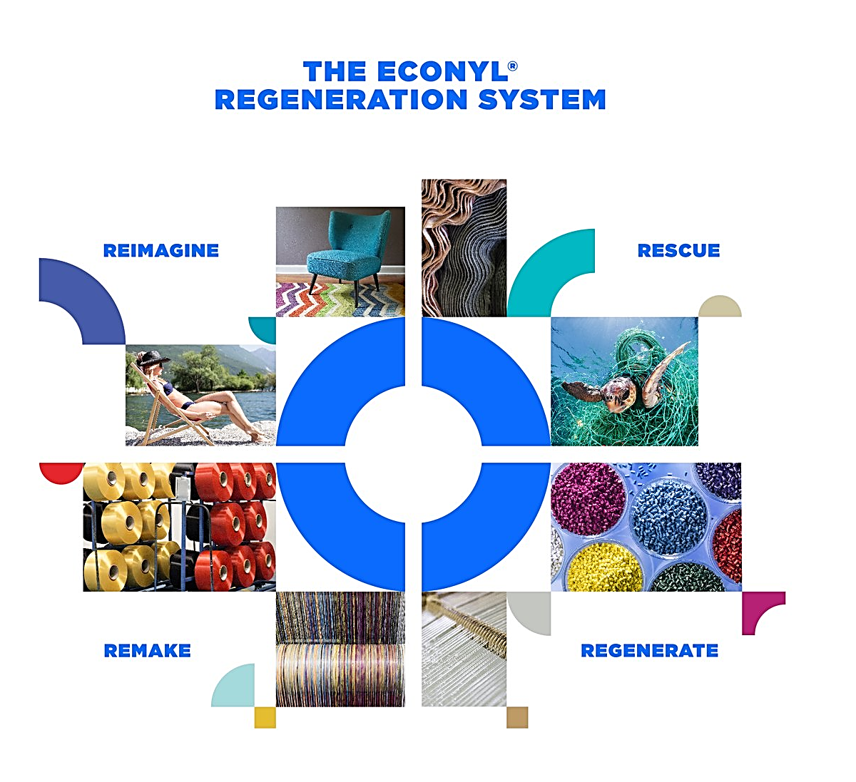
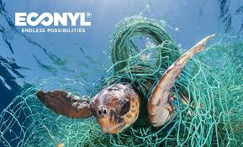

Example: ECONYL® – 100% recycled PA, tt. Aquafil
ECONYL® as material is made from rescued waste such as fishing nets and industrial plastic from oceans and landfills and converted into textile and carpet yarns for the fashion and interior industries
ECONYL® have potential in architecture, design, automotive industry and carpet industry.
https://syvendeswimwear.com/pages/econyl
https://arctic-flamingo.com/econyl-yoga-leggings/
https://www.econyl.com/interiors/

Slide 31

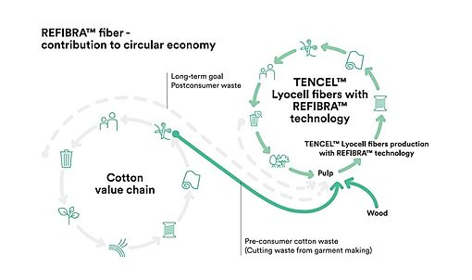

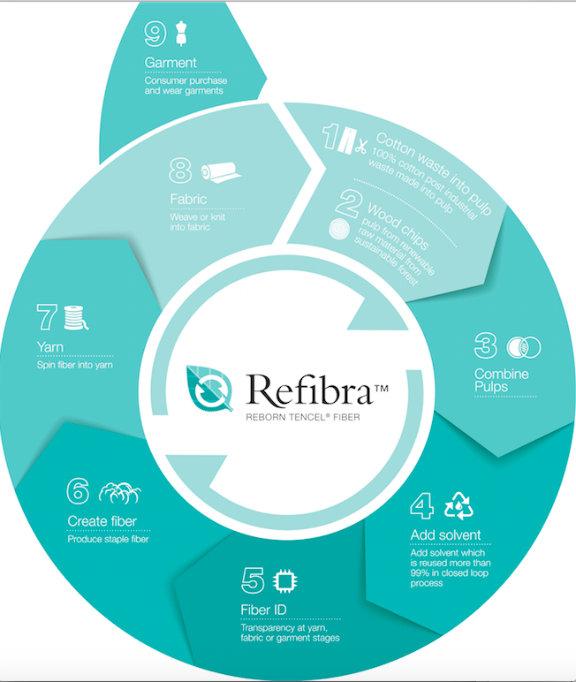
Example: Lenzing™ Refibra™ fibre from cotton as waste raw materials
Based on the application of the concept of closed loop production and the production of standard lyocell fiber under the trade name TENCEL™ (Lyocell fibre),
REFIBRA™ technology represents a contribution to the application of the circular economy model in the textile industry. ​
https://www.sustainabletextiles.club/lenzing-refibra

Slide 32
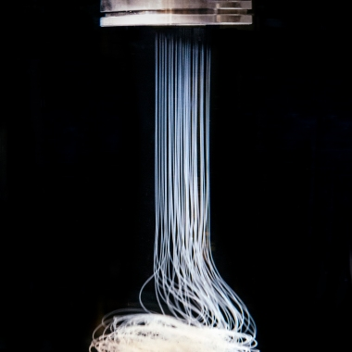
Protein spun Into fiber strands
Microsilk
Northern California-based Bolt Threads created Microsilk, a material made by way of its proprietary technology that replicates the process of spiders producing silk fibers sustainably and at large scale.
The company said spider silk exhibits “remarkable” properties, including elasticity, durability, strength and softness.

Slide 33
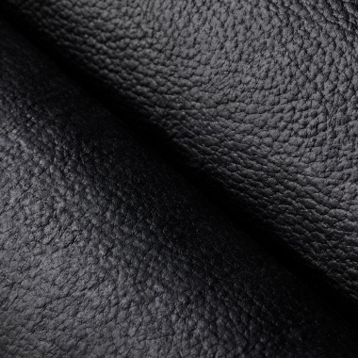
Synthetic leather fabric also from Bolt Threads
Mylo
Mylo, a synthetic leather fabric also from Bolt Threads, made of mycelium - or mushroom roots.
The company’s mission in creating eco-friendly, vegan products is rooted in its “process [that] moves away from petroleum-based polymers and materials, toward a more sustainable and biodegradable solution.

Slide 34
Ozone in the Textile Industry
A new patterning method for
optical bleached fabrics
It provides fashionable products like batik or tie-dyed cloths
Ozonation process has ecological advantage.
The results show that ozonation can be used for
decolorizing the optical bleached samples.
Effect: Increasing ozonation time increases the efficiency. However, bursting strength loss of fabric should be taken into consideration due to the oxidation of cellulose.
I: optical bleached fabric is tied in knots, tightly bound with thread;
II: a = optical bleached fabric before ozonation;
II: b/c = optical bleached fabric after ozonation in accordance with developed method
Source: Use of Ozone in the Textile Industry, DOI: http://dx.doi.org/10.5772/intechopen.81774

Slide 35
Green process line
Cotton fabrics are pretreated by ozone gas and ultrasound before natural dyeing without mordant.
Natural dyes - nutshell, orange tree leaves, and
alkanet roots.
Effect: Fastness of all the dyed samples are generally sufficient, except light fastness.
But light fastness of dyed samples with pomegranate peels is only sufficient.
Source: Benli H, Bahtiyari Mİ. Combination of ozone and ultrasound in pretreatment of cotton fabrics prior
to natural dyeing. Journal of Cleaner Production. 2015;89:116-124. DOI: 10.1016/j.jclepro.2014.11.007

Slide 36

CONTACTS
Coordinator:
Technical University of Sofia
Department of Textile Engineering
Project Manager of ICT-TEX:
Prof. Dr. Angel Terziev
е-mail: aterziev@tu-sofia.bg
Web-site: ICT-TEX.eu
Thank you for your attention
The information and views set out in this publication are those of the authors and do not necessarily reflect the official opinion of the European Union. Neither the European Union institutions and bodies nor any person acting on their behalf may be held responsible for the use which may be made of the information contained therein.

