Slide 1
Instrumental colour assessment
(surface colour measurement and colour fastness)
Color quality control (CQC) is a process used to ensure the consistency, repeatability, and reliability of color in industrial application. It means verifying the color specified as the same as the one manufactured throughout the production.
Five Important Components of a Colour Quality Control
Quantify Color using a Spectrophotometer
Choose an Acceptable Color Tolerance
Analyze Color using QC Software
Visually Evaluate Color by Eye
Evaluate Color Under Controlled Lighting

Slide 2
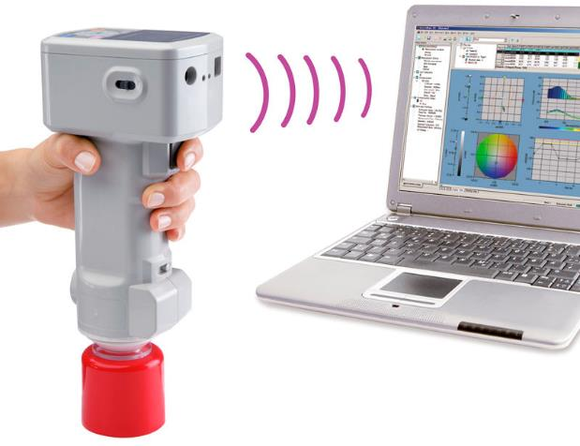
Spectrophotometric measurement
Color metrics imply objective color measurement, based on the simulation of the visual experience of color, but in a much more precise system, which is performed by a spectrophotometer device. Color metrics involve objective, numerical evaluation of color, accurate color reproduction, and precise color differences.
The latest color measurement technologies enable communication with digital standards, meaning that the precision of these measuring instruments is so high that virtually no relevant deviation can be detected from one device to another.

Slide 3
General principles and mathematical system for numerical colour evaluation - CIE
General principles of spectrophotometric colour measurement are standardized in ISO -105 standard
ISO 105 standard is designed as a reference document to support the proper measurement of the colour of specimens by instrumental means. The document describes general concepts and problems associated with reflectance colour measurement.
Following aspects of instrumental colour measurement are defined by the ISO 105 standard:
definitions of a colour measurement and measuring instrument,
principle of measurement,
procedure of measurement,
standardization,
sampling,
specimen preparation,
method of calculation,
test report.

Slide 4
ISO 105 standard for colour measurement lies on CIE Publication No. 15.2. Colorimetry (1986)
CIE - Internationl body for science and art of light and lighting, colour and vision, photobiology and image technology
professional organization accepted as representing the best authority on the subject matter of light and lighting. The CIE is accepted by the International Commission for Weights and Measures (CIPM), the International Standardization Organization (ISO) and the International Electrotechnical Commission (IEC) as an international standardization body.
CIE colour evaluation involves three basic aspects - colour numerical evaluation, color difference assessment and graphic presentation in color space. Color measurement and the evaluation of color differences help the manufacturer greatly in adhering to the specifications agreed between customer and supplier. In order to determine the difference between the colors of two samples, the color coordinates of the standard and of the reconstruction are entered in a color space; the distance of these two color points from each other shows the color difference between the samples. The distance between two points is calculated with a relationship based on its spatial projection onto each of the three main variables of the color system. This is the main application of the CIELab color system and the color differences determined in this system.

Slide 5
CIELab system – most commonly used in colour measurement applications and data interpretations in today's most widely used color QC systems
The CIELab colour space, with some conditions, is a uniform scale and device-independent. Each perceivable colour in colour space is defined with the colour point that has coordinates {L*, a*, b*}.
Total distance between two samples in the CIELab colour space
The CIELab colour space: the detrerminaton method

Slide 6
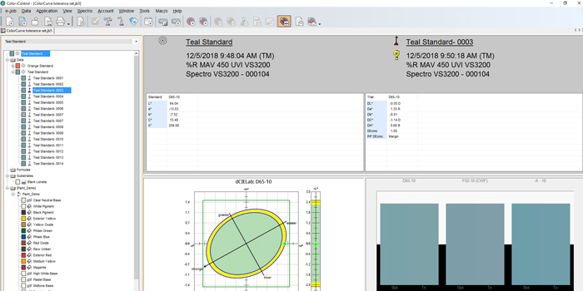
QC applications for CIE colour parameters and differences interpretation
Colour iQC – Quality control and Quality Assurance
Color iQC is a quality control software designed to meet the color measurement and management requirements in industrial market segments. Color iQC as an integral part of quality control processes.
Color iQC analyzes why color errors occur, identifies leading indicators to enable adjustments to the process and ensure final products meet color expectations. It also maintains a complete audit trail to improve communication across the supply chain so quality control professionals can focus less on controlling color quality and more on production speed and efficiency.
X-Rite colour education and training: https://www.xrite.com/learning-color-education/training?segmentid=6&eventid=987

Slide 7
Colour TOOLS – Smart colour analysis and visualization for quality control
Colour quality control application for industries where colour accuracy is a critical component of overall product quality. It enables objective analysis, reporting, communication and visualization of accurate color results. By setting pass/fail tolerances, consistent color quality is assured, removing subjectivity in colour evaluation process.
Product quality assurance - Objective color assessment with sample temperature, accurate colorimetric data, and a clear visual quality representation, standard QTX protocol enables full color approval tracking and communication, confident evaluation with a comprehensive list of illuminants, including latest CIE LED standards, support more customers with the ability to add encrypted color libraries.
Datacolor education: https://www.datacolor.com/business-solutions/academy/events/

Slide 8
Colibri is a color management and matching modular software platform for color control, scalable from one site to a global supply chain whilst maintaining strict control and data ownership. The solution allows streamlining of the entire supply process from specification to color matching to QC.
For the specification of brand colours and standards, for colour matching and prediction of colour and opacity in different applications and on a variety of substrates, for monitoring, certification and final approval of coloured products, for both manual and automatic dispensing of colour recipes in lab and production.
Konika Minolta learning center: https://www5.konicaminolta.eu/en/measuring-instruments/learning-centre/colour-measurement/precise-colour-communication.html

Slide 9
Soft Computing Methods in textile tecnology and QC
In the last 70 years, exceptional efforts have been made to develop the textile field as a scientific research platform within which scientific models for testing the properties of textile materials and clothing, based on geometric principles, principles of balance of forces, or energy minimization principles.
However, these models are problem-specific (related to a specific problem and situation) and therefore the domain of their applicability is limited. During the last decades of the 20th century, the development of sophisticated instruments for testing the properties of textile materials, such as KES (Kawabata Evaluation System) or FAST (Fabric Assurance by Simple Testing), revolutionized the concept of assessing the quality of textile materials. Objective measurements performed on such instruments are the basis for optimizing the parameters of the production process, assessing the behavior of materials during production and use, and assessing the quality of the finished textile product.
The development of such sophisticated testing instruments was accompanied by a growing interest in the application of the so-called. soft computing methods, both in all and in textile technology and production. The results of scientific research, in the field of application of computer thinking techniques in technologies, very quickly had their echo in the real, manufacturing sector.
The main components of soft computing techniques are Artificial Neural Network (ANN), Fuzzy Logic (FL) and evolutionary algorithms (Genetic Algorithm) and have different areas of application in different engineering fields, and their they also find a significant place of application in textile engineering

Slide 10
CONTACTS
Coordinator of project:
Technical University of Sofia
Department of Textile Engineering
Project Manager of ICT-TEX:
Prof. Dr. Angel Terziev
е-mail: aterziev@tu-sofia.bg
Web-site: ICT-TEX.eu
The information and views set out in this publication are those of the authors and do not necessarily reflect the official opinion of the European Union. Neither the European Union institutions and bodies nor any person acting on their behalf may be held responsible for the use which may be made of the information contained therein.

