Slide 1
Quality control in yarn production mill

Slide 2
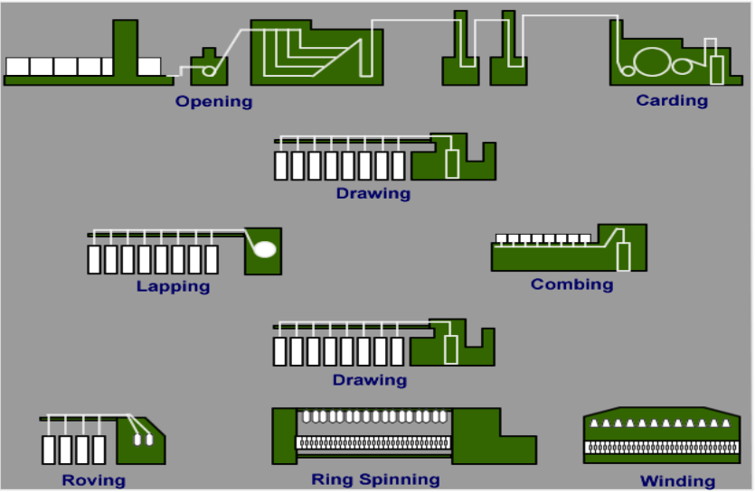
Spinning preparation and spinning process

Slide 3
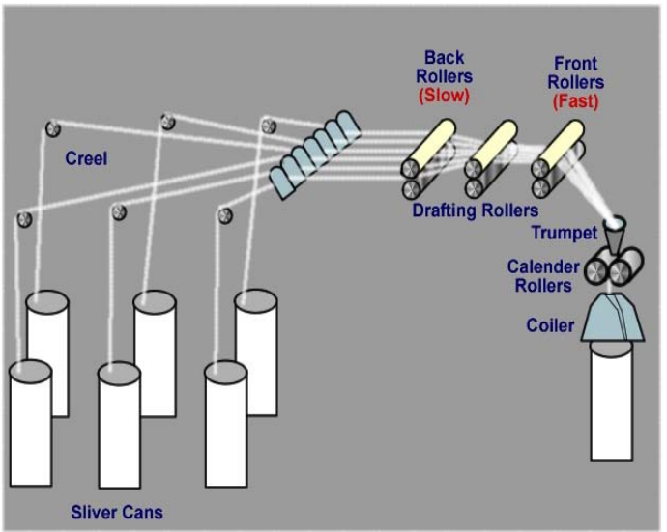
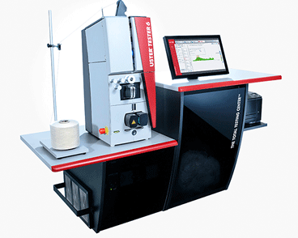
Drawing and blending
Process
Control
Sliver mass control
Measuring od variation in weight per unit length of sliver

Slide 4
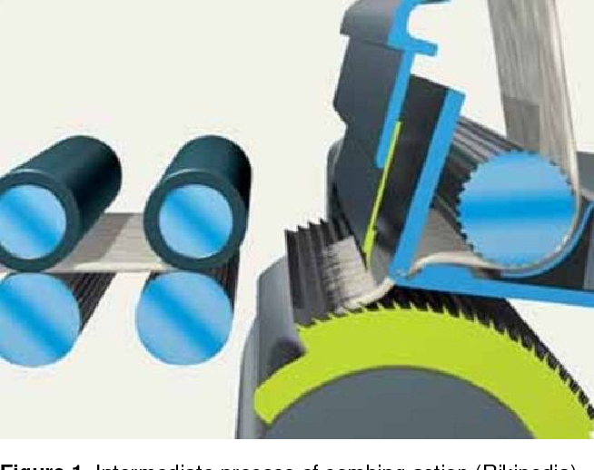
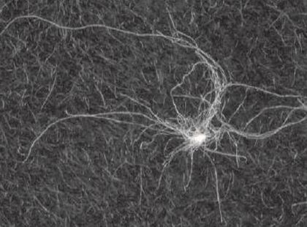
Combing
Process
Control
Sliver mass control
Nep number control

Slide 5
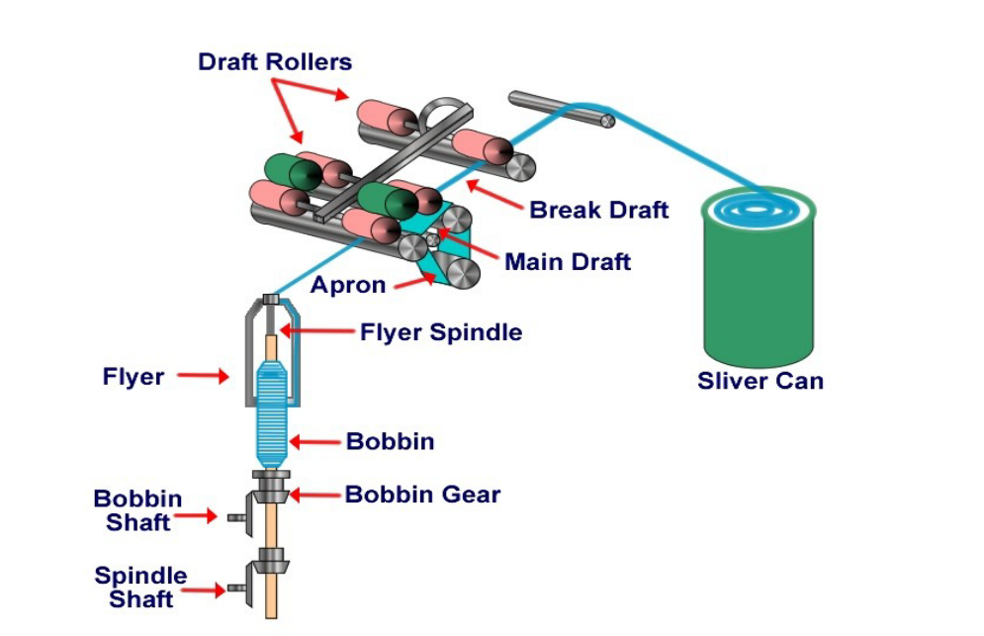
Roving process
Process
Control
Roving mass control
Measuring od variation in weight per unit length of roving

Slide 6
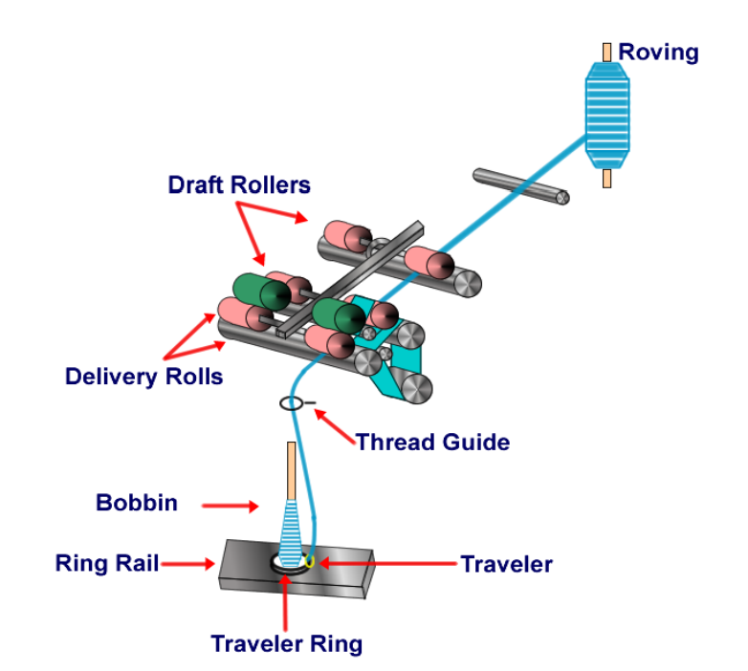
Spinning
Process
Control
Yarn mass control
Measuring od variation in weight per unit length of yarn

